Slide 1
Medical Image Segmentation: Beyond Level Sets (Ismail’s part)

Slide 2
Basics of Level Sets (Ismail)
Notes:
Add another bound here

Slide 3
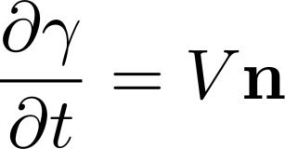
Active Curves
Notes:
Just convex relaxation here

Slide 4
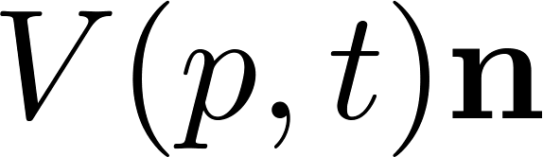
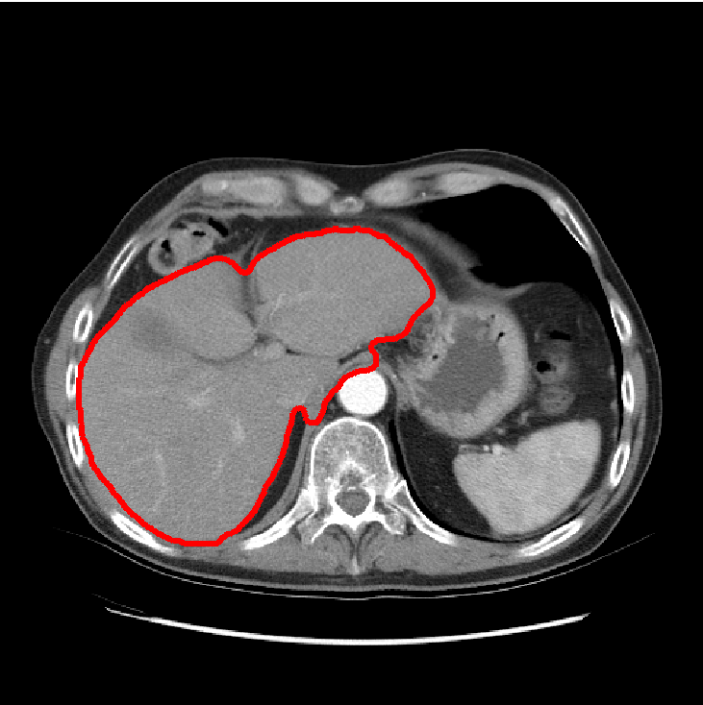
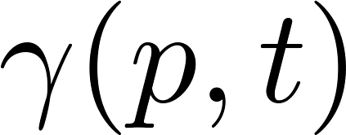

Active Curves
S
S
Notes:
Just convex relaxation here

Slide 5
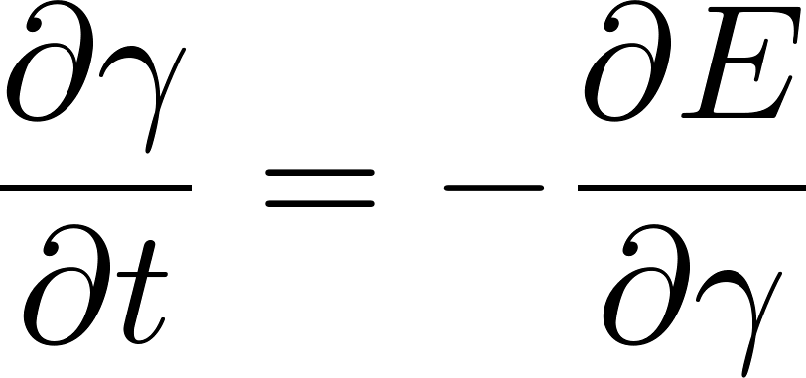
Gradient Descent (1)
Functional
derivative
Regional terms of the form <S,f>
Notes:
Just convex relaxation here

Slide 6
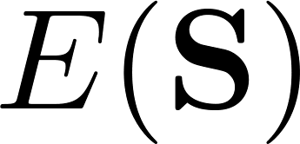



Gradient Descent (2)
∂ E
∂ S
-
∂ E
∂ S
∂S =
∂t
Notes:
Add another bound here

Slide 7
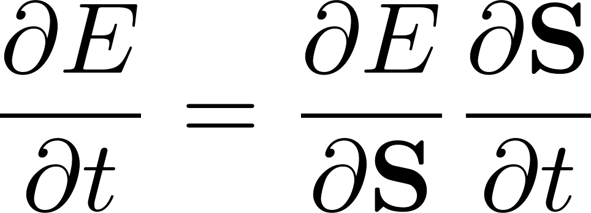
Gradient Descent (2)
∂ E
∂ S
-
∂ E
∂ S
-
∂ E
∂ S
∂S =
∂t
Notes:
Add another bound here

Slide 8
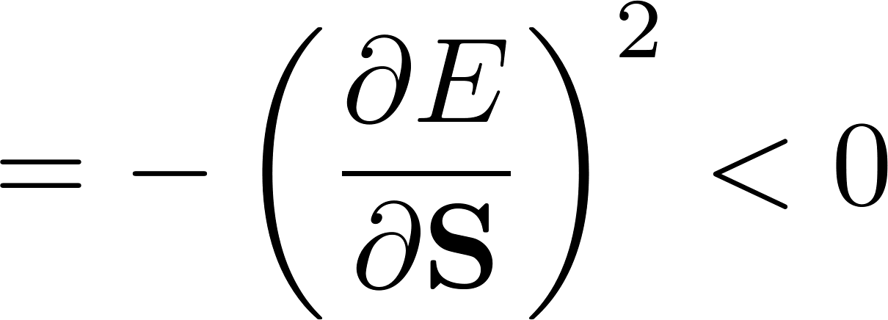
Gradient Descent (2)
∂ E
∂ S
-
∂ E
∂ S
-
∂ E
∂ S
∂S =
∂t
Notes:
Add another bound here

Slide 9
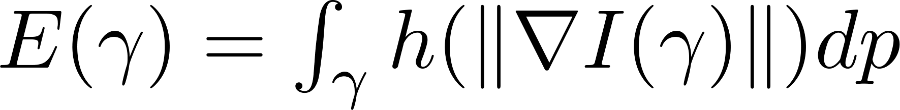
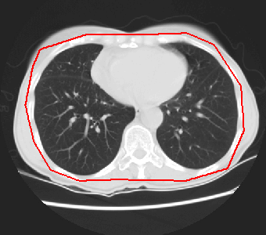

Standard boundary terms:
Geodesic Active Contours
e.g., Caselles et al., 97
Notes:
Add another bound here

Slide 10
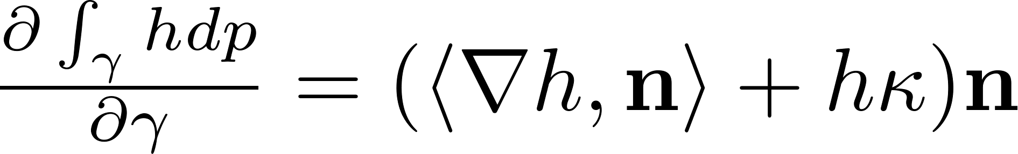
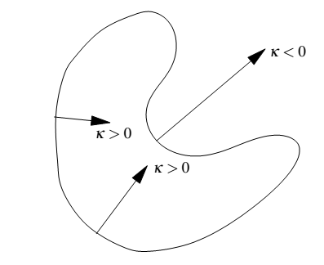
Standard boundary terms:
General derivative with E-L equations
Notes:
Add another bound here

Slide 11
Standard boundary terms:
General derivative with E-L equations
1
Boundary length
Notes:
Add another bound here

Slide 12
Standard boundary terms:
General derivative with E-L equations
Depends on image gradient
Attracts curve to strong edges
Notes:
Add another bound here

Slide 13
Standard boundary terms:
General derivative with E-L equations
Depends on image gradient
Attracts curve to strong edges
Notes:
Add another bound here

Slide 14


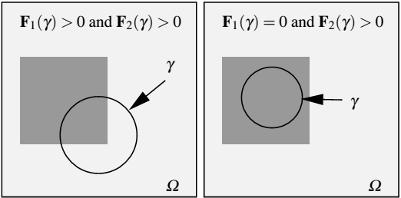
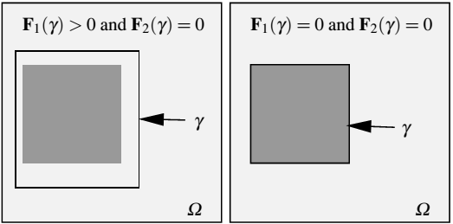
Standard region terms:
Piecewise constant case
e.g., Chan and et Vese, 01
Notes:
Add another bound here

Slide 15
Standard region terms:
Piecewise constant case
e.g., Chan and et Vese, 01
Alternate minimization
(1) Fix parameters and evolve the curve
(2) Fix curve, optimize w.r.t parameters
Notes:
Add another bound here

Slide 16
Standard region terms:
Log-Likelihood
Notes:
Add another bound here

Slide 17
Standard region terms:
Log-Likelihood
Distributions fixed by prior learning
e.g., Paragios and Dercihe, 02
Notes:
Add another bound here

Slide 18
Standard region terms:
Log-Likelihood
Distributions updated iteratively
e.g., Gaussian: Rousson and Deriche 02
Gamma: Ben Ayed et al., 05
Notes:
Add another bound here

Slide 19
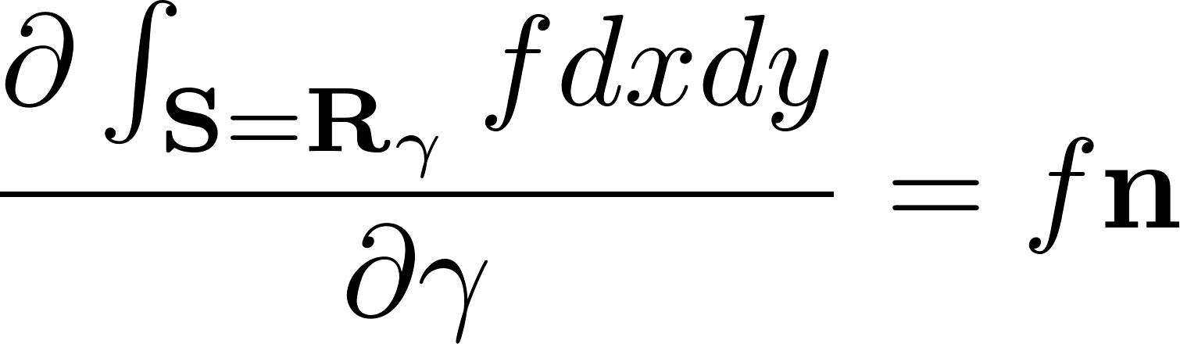
Functional derivatives for region terms
(E-L equations and Green’s theorem)
See Zhu and Yuille, 96
Mitiche and Ben Ayed, 11
Notes:
Just convex relaxation here

Slide 20


Functional derivatives for region terms
(E-L equations and Green’s theorem)
See Zhu and Yuille, 96
Mitiche and Ben Ayed, 11
Curve flow in the log-likelihood case
S
Notes:
Just convex relaxation here

Slide 21
Functional derivatives for region terms
(E-L equations and Green’s theorem)
Curve flow in the log-likelihood case
S
>0
Notes:
Just convex relaxation here

Slide 22
Functional derivatives for region terms
(E-L equations and Green’s theorem)
Curve flow in the log-likelihood case
S
<0
Notes:
Just convex relaxation here

Slide 23
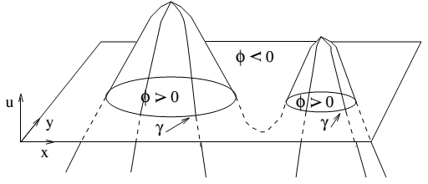
Level set representation of the curve
Notes:
Add another bound here

Slide 24
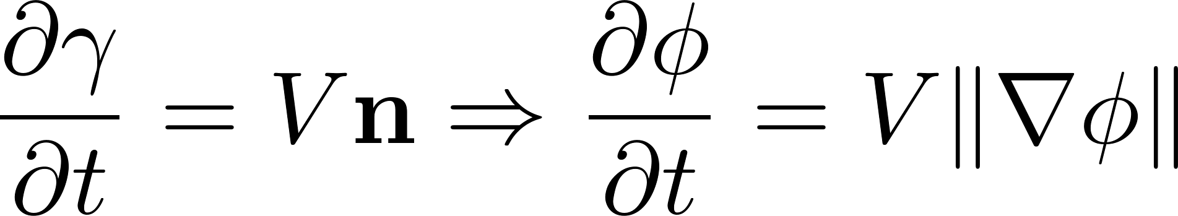
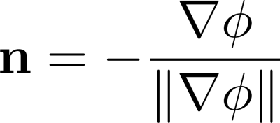
Level set representation of the curve
We can replace everything
Notes:
Add another bound here

Slide 25
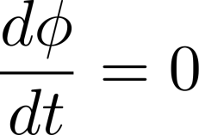
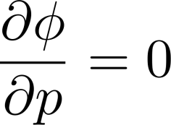
Level set representation of the curve
Easy to show from
the facts that on the curve:
See Mitiche and Ben Ayed, 11
Notes:
Add another bound here

Slide 26
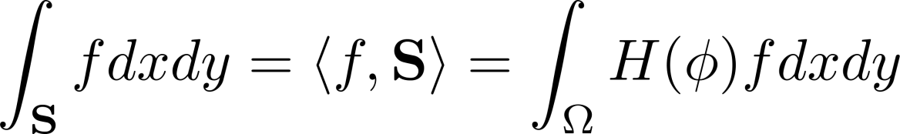


Alternatively, we can embed the level set function in the energy directly
e.g., Chan and Vese, 01
Li et al., 2005
Region terms:
Notes:
Add another bound here

Slide 27
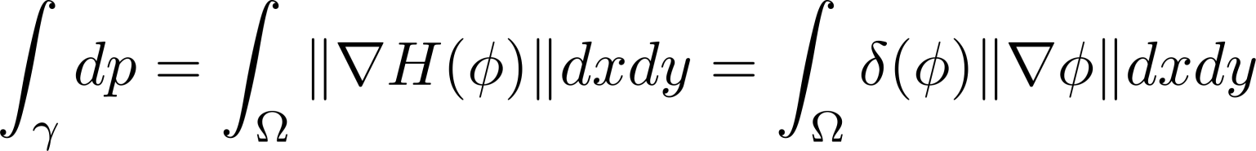

Alternatively, we can embed the level set function in the energy directly
e.g., Chan and Vese, 01
Li et al., 2005
Length term:
Notes:
Add another bound here

Slide 28
Alternatively, we can embed the level set function in the energy directly
e.g., Chan and Vese, 01
Li et al., 2005
Region terms:
Length term:
Compute E-L equations directly w.r.t the level set function
Notes:
Add another bound here

Slide 29
Pros of level sets (1)
Applicable to any differentiable functional:
Notes:
Add another bound here

Slide 30
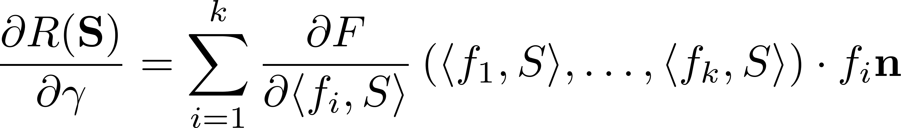
Pros of level sets (1)
Applicable to any differentiable functional:
Notes:
Add another bound here

Slide 31
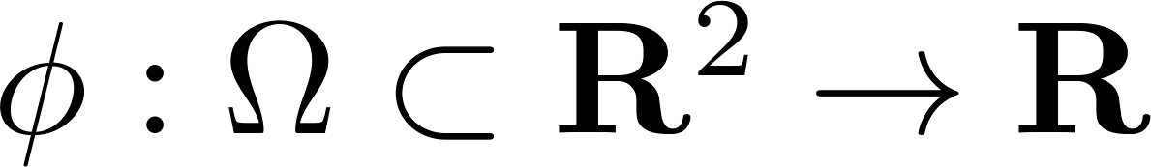
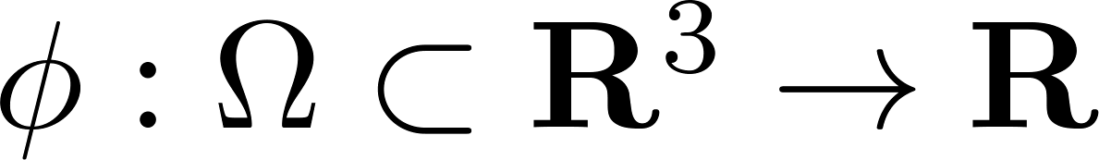
Pros of level sets (2)
Direct extension to higher dimensions
Notes:
Add another bound here

Slide 32

Small moves + Fixed and small time step
+ Can be slow in practice:
Cons of level sets (1)
Courant-Friedrichs-Lewy (CFL) conditions for evolution stability
∂t < cst
See, for example, Estellers et al.,
IEEE TIP 12
∂ E
∂ S
∂S =
∂t
Notes:
Add another bound here

Slide 33
Sometimes very weak local optima
Cons of level sets (2)
∂ E
∂ S
= 0
Notes:
Add another bound here

Slide 34
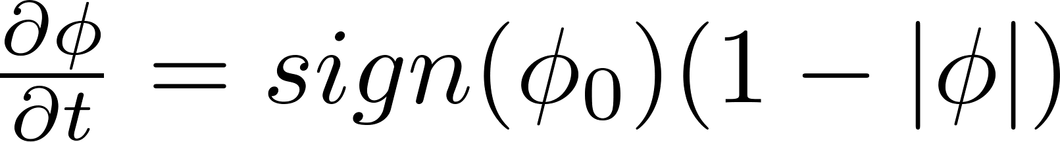
Dependence on the choice of an
approximate numerical scheme (for stable evolution)
Cons of level sets (3)
e.g., Complex upwind schemes for PDE discretization
See, for example, Sethian 99
Keep a distance function by ad hoc
re-initialization procedures
See, for example, S. Osher and R. Fedkiw 2002
Notes:
Add another bound here

