Slide 1
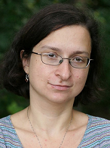
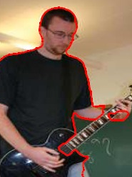
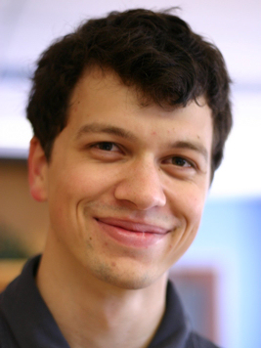
Higher-order Segmentation Functionals: Entropy, Color Consistency, Curvature, etc.
Institute Henri Poincare
January 2014
Western University
Canada
Yuri Boykov jointly with
Andrew
Delong
M. Tang
I. Ben Ayed
O. Veksler
H. Isack
L. Gorelick
C. Nieuwenhuis
E. Toppe
C. Olsson
A. Osokin
A. Delong

Slide 2
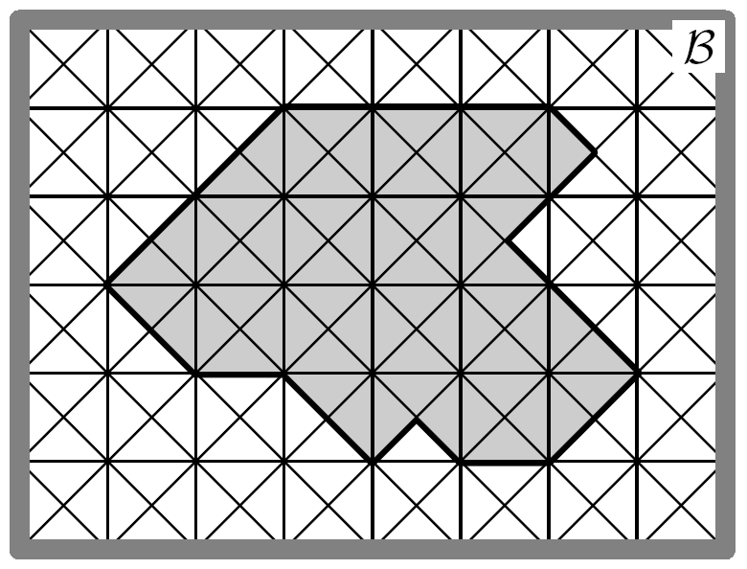
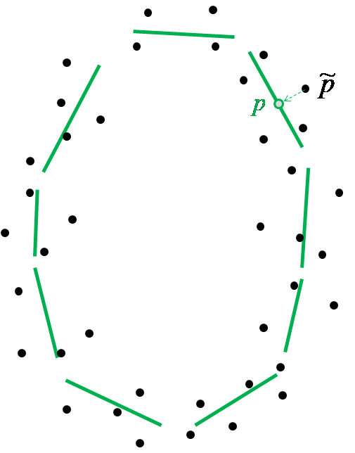
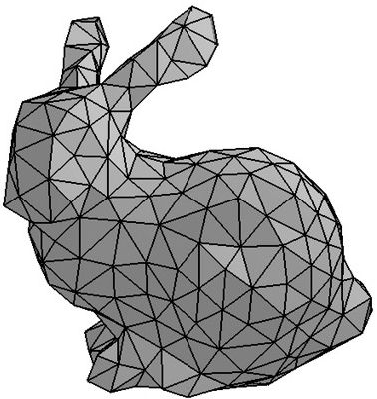
Different surface representations
continuous
optimization
combinatorial
optimization
mixed
optimization
point cloud
labeling
mesh
level-sets
graph labeling
on complex
on grid

Slide 3
this talk
combinatorial
optimization
graph labeling
on grid
Implicit surfaces/bondary

Slide 4
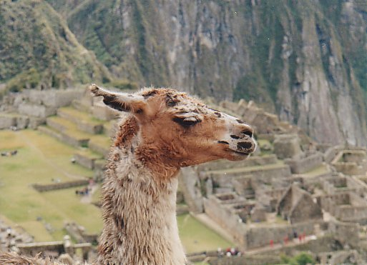
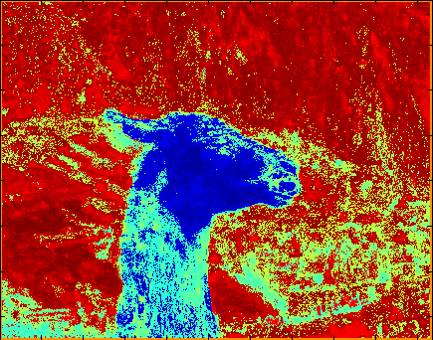
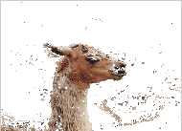
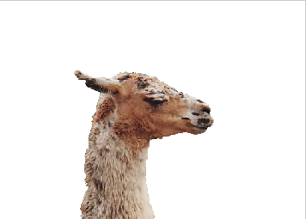
Image segmentation Basics
S

Slide 5
Linear (modular) appearance of region S
Examples of potential functions f
Log-likelihoods
Chan-Vese
Ballooning

Slide 6
Basic boundary regularization for S
pair-wise discontinuities

Slide 7
Basic boundary regularization for S
second-order terms
quadratic

Slide 8
Basic boundary regularization for S
second-order terms
Examples of discontinuity penalties w
Boundary length
Image-weighted
boundary length

Slide 9
Basic boundary regularization for S
second-order terms
corresponds to boundary length |∂S|
grids [B&K, 2003], via integral geometry
complexes [Sullivan 1994]
submodular second-order energy
can be minimized exactly via graph cuts
[Greig et al.’91, Sullivan’94, Boykov-Jolly’01]
a cut
t
n-links
t-link
t-link
s

Slide 10
Submodular set functions
any (binary) segmentation energy E(S)
is a set function E:
Ω
S

Slide 11
Submodular set functions
Set function is submodular if for any
Ω
S
T
Significance: any submodular set function can be
globally optimized in polynomial time
[Grotschel et al.1981,88, Schrijver 2000]

Slide 12
Submodular set functions
an alternative equivalent definition providing intuitive interpretation: “diminishing returns”
Set function is submodular if for any
Ω
S
T
v
Easily follows from the previous definition:
Significance: any submodular set function can be
globally optimized in polynomial time
[Grotschel et al.1981,88, Schrijver 2000]

Slide 13
Graph cuts for minimization of submodular set functions
Assume set Ω and 2nd-order (quadratic) function
Indicator variables
Function E(S) is submodular if for any
Significance: submodular 2nd-order boolean (set) function
can be globally optimized in polynomial time by graph cuts
[Hammer 1968, Pickard&Ratliff 1973]
[Boros&Hammer 2000, Kolmogorov&Zabih2003]

Slide 14
Global Optimization
Combinatorial
optimization
Continuous
optimization
?
submodularity
convexity

Slide 15
Graph cuts for minimization of posterior energy (MRF)
Assume Gibbs distribution over binary random variables
for
Theorem [Boykov, Delong, Kolmogorov, Veksler in unpublished book 2014?]
All random variables s_{p} are positively correlated iff set function E(S) is submodular
That is, submodularity implies MRF with “smoothness” prior

Slide 16
Basic segmentation energy
segment region/appearance
boundary smoothness

Slide 17
Higher-order binary segmentation
segment region/appearance
boundary smoothness
this talk
Appearance Entropy (N-th order)
Curvature (3-rd order)
Color consistency (N-th order)
Convexity (3-rd order)
Cardinality potentials (N-th order)
Distribution consistency (N-th order)
Connectivity (N-th order)
Shape priors (N-th order)

Slide 18
Overview of this talk
high-order functionals
optimization
From likelihoods to entropy
From entropy to color consistency
Convex cardinality potentials
Distribution consistency
From length to curvature
block-coordinate descent
[Zhu&Yuille 96, GrabCut 04]
global minimum
[our work: One Cut 2014]
submodular approximations
[our work: Trust Region 13, Auxiliary Cuts 13]
other extensions [arXiv13]

Slide 19
Given likelihood models
unary (linear) term
pair-wise (quadratic) term
assuming known
guaranteed globally optimal S
parametric models – e.g. Gaussian or GMM
non-parametric models - histograms
image segmentation, graph cut
[Boykov&Jolly, ICCV2001]

Slide 20
Beyond fixed likelihood models
mixed optimization term
pair-wise (quadratic) term
extra variables
NP hard mixed optimization!
[Vesente et al., ICCV’09]
parametric models – e.g. Gaussian or GMM
non-parametric models - histograms
Models θ₀ , θ₁
are iteratively
re-estimated
(from initial box)
iterative image segmentation, Grabcut
(block coordinate descent )
[Rother, et al. SIGGRAPH’2004]

Slide 21
Block-coordinate descent for
Minimize over segmentation S for fixed θ₀ , θ₁
Minimize over θ₀ , θ₁ for fixed labeling S
optimal S is computed using graph cuts, as in [BJ 2001]
fixed for S=const
distribution of intensities in
current bkg. segment ={p:S_{p}=0}
distribution of intensities in
current obj. segment S={p:S_{p}=1}

Slide 22
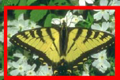
Iterative learning of color models (binary case )
GrabCut: iterated graph cuts [Rother et al., SIGGRAPH 04]
start from models θ₀ , θ₁
inside and outside some given box
iterate graph cuts and model re-estimation
until convergence to a local minimum
solution is sensitive to initial box

Slide 23
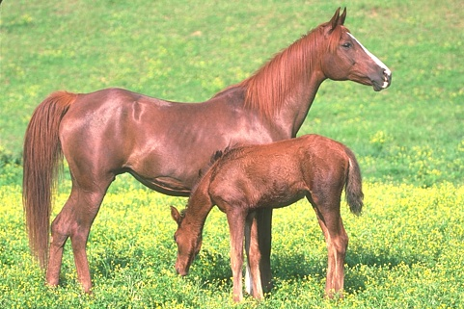
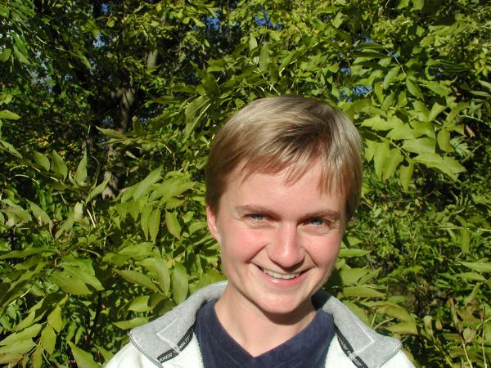
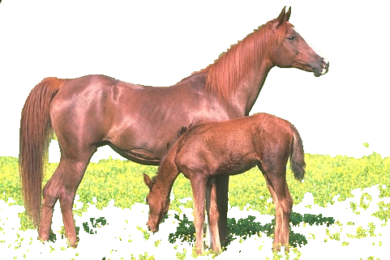
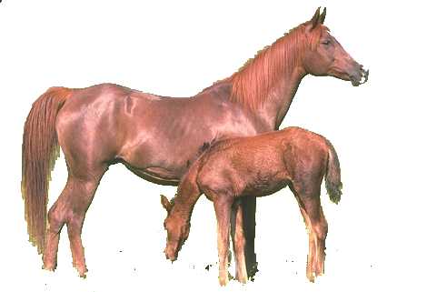
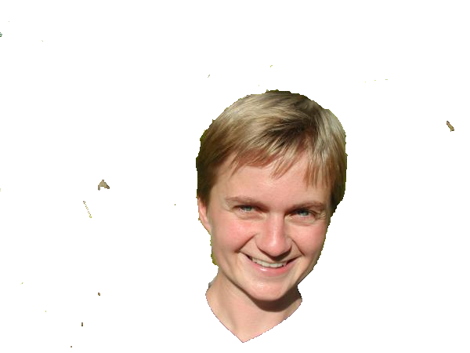
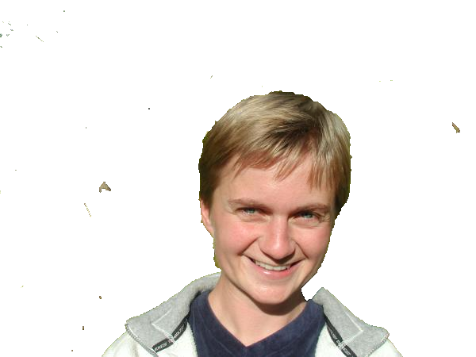
Iterative learning of color models (binary case )
E=1.410×10⁶
E=1.39×10⁶
E=2.41×10⁶
E=2.37×10⁶
BCD minimization of converges to a local minimum
(interactivity a la “snakes”)

Slide 24
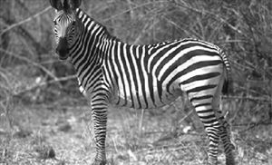
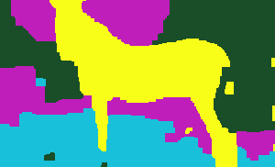
Iterative learning of color models (could be used for more than 2 labels )
Unsupervised segmentation [Zhu&Yuille, 1996]
using level sets + merging heuristic
iterate segmentation
and model re-estimation
until convergence
initialize models θ₀ , θ₁ , θ₂ , ...
from many randomly sampled boxes
models compete, stable result if sufficiently many

Slide 25
Iterative learning of color models (could be used for more than 2 labels )
Unsupervised segmentation [Delong et al., 2012]
using a-expansion (graph-cuts)
iterate segmentation
and model re-estimation
until convergence
initialize models θ₀ , θ₁ , θ₂ , ...
from many randomly sampled boxes
models compete, stable result if sufficiently many

Slide 26
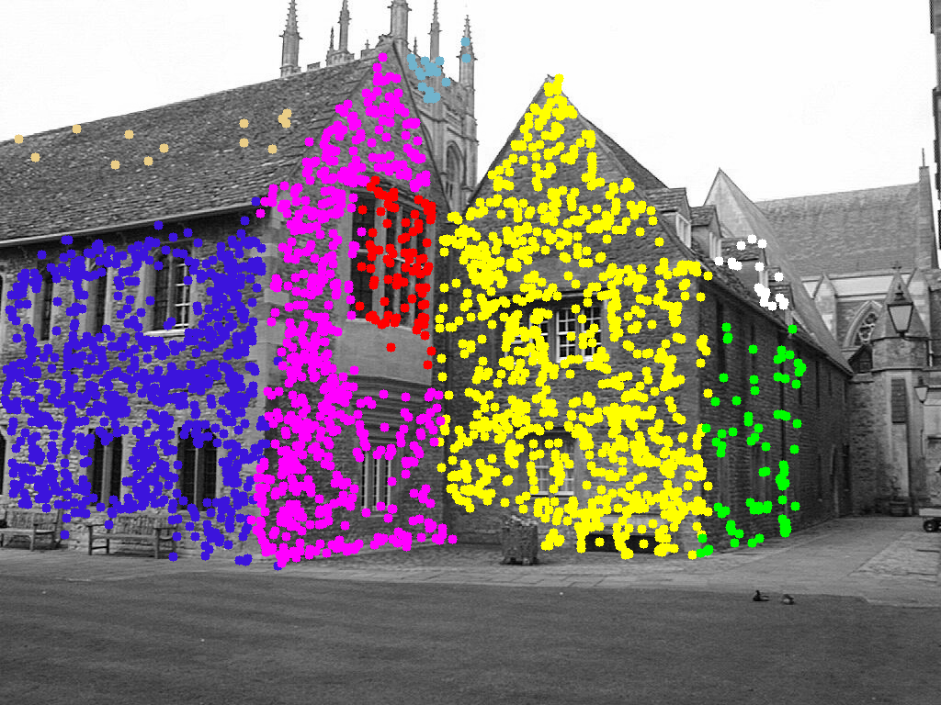
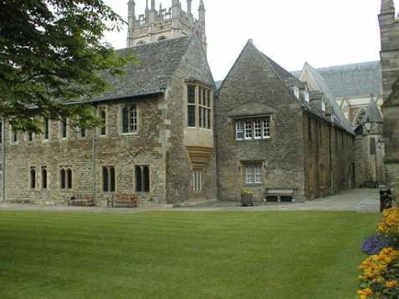
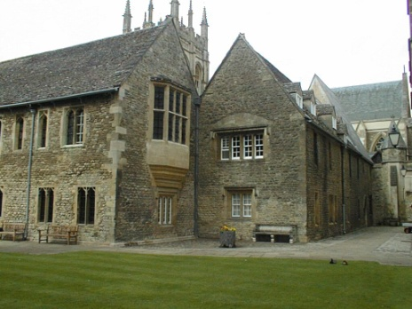
Iterative learning of other models (could be used for more than 2 labels )
Geometric multi-model fitting [Isack et al., 2012]
using a-expansion (graph-cuts)
initialize plane models θ₀ , θ₁ , θ₂ , ...
from many randomly sampled SIFT matches
in 2 images of the same scene
iterate segmentation
and model re-estimation
until convergence
models compete, stable result if sufficiently many

Slide 27
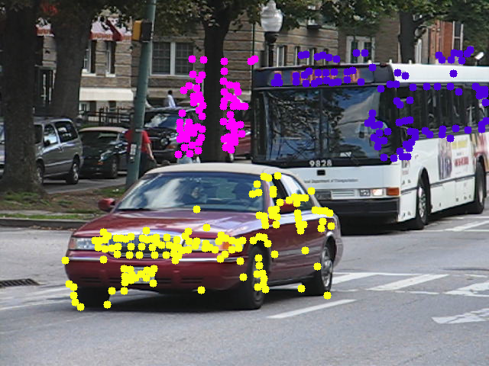
Iterative learning of other models (could be used for more than 2 labels )
Geometric multi-model fitting [Isack et al., 2012]
using a-expansion (graph-cuts)
VIDEO
initialize Fundamental matrices θ₀ , θ₁ , θ₂ , ...
from many randomly sampled SIFT matches
in 2 consecutive frames in video
iterate segmentation
and model re-estimation
until convergence
models compete, stable result if sufficiently many

Slide 28
From color model estimation to entropy and color consistency
global optimization in One Cut
[Tang et al. ICCV 2013]

Slide 29
Interpretation of log-likelihoods: entropy of segment intensities
where θ = {p₁ , p₂ , ... , p_{n} }
given distribution
of intensities
pixels of color i in S
=
S₁
S₂
S
=
S₃
S_{i}
S₅
S₄
H(S|θ )
cross entropy
of distribution p^{S} w.r.t. θ
distribution of intensities
observed at S
probability of
intensity i in S

Slide 30
Interpretation of log-likelihoods: entropy of segment intensities
joint estimation of S and color models
[Rother et al., SIGGRAPH’04, ICCV’09]
cross-entropy
entropy
Note: H(P|Q) ≥ H(P) for any two distributions (equality when Q=P)
entropy of
intensities in
entropy of
intensities in
minimization of segments entropy
[Tang et al, ICCV 2013]

Slide 31
Interpretation of log-likelihoods: entropy of segment intensities
mixed optimization
[Rother et al., SIGGRAPH’04, ICCV’09]
cross-entropy
entropy
Note: H(P|Q) ≥ H(P) for any two distributions (equality when Q=P)
entropy of
intensities in
entropy of
intensities in
binary optimization
[Tang et al, ICCV 2013]

Slide 32
Interpretation of log-likelihoods: entropy of segment intensities
cross-entropy
entropy
Note: H(P|Q) ≥ H(P) for any two distributions (equality when Q=P)
entropy of
intensities in
entropy of
intensities in
common energy for categorical clustering, e.g. [Li et al. ICML’04]

Slide 33
Minimizing entropy of segments intensities (intuitive motivation)
break image into two coherent segments
with low entropy of intensities
high entropy segmentation
low entropy segmentation
S
S
S
S
S
S
S
S
unsupervised image segmentation (like in Chan-Vese)

Slide 34
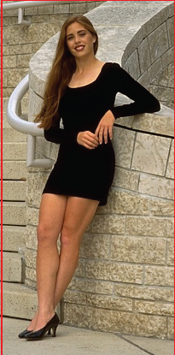
Minimizing entropy of segments intensities (intuitive motivation)
break image into two coherent segments
with low entropy of intensities
S
S
S
S
more general than Chan-Vese (colors can vary within each segment)

Slide 35
From entropy to color consistency
all pixels Ω = ∪Ω_{i}
Ω₂
Ω₁
Ω_{i}
Ω₅
Ω₄
Ω₃
Minimization of entropy encourages
pixels Ω_{i} of the same color bin i
to be segmented together
(proof: see next page)
Notes:
Grabcut energy is NP-hard and is therefore optimized iteratively, resulting in local minimum.
Analysis of the energy shows that it can be decomposed into three terms:
Volume Balancing – which is supermodular and therefore NP-hard
Color separation – which is submodular and easy to optimize
Boundary length – easy to optimize as well.
We propose to replace the NP-hard term with application dependent unary terms
And advocate an even simpler color separation term.
The resulting energy is submodular and global minimum is guaranteed in one graph-cut.
We show state-of-the art results in several applications.

Slide 36
From entropy to color consistency
S_{i} = S∩Ω_{i}
S_{i}
S_{i}
S
S
|S|
|S|
volume
balancing
color consistency
pixels in each color bin i
prefer to be together
(either inside object
or background)
|S|
|S_{i}|
0
|Ω|/2
|Ω|
0
|Ω_{i}|/2
|Ω_{i}|
Notes:
Grabcut energy is NP-hard and is therefore optimized iteratively, resulting in local minimum.
Analysis of the energy shows that it can be decomposed into three terms:
Volume Balancing – which is supermodular and therefore NP-hard
Color separation – which is submodular and easy to optimize
Boundary length – easy to optimize as well.
We propose to replace the NP-hard term with application dependent unary terms
And advocate an even simpler color separation term.
The resulting energy is submodular and global minimum is guaranteed in one graph-cut.
We show state-of-the art results in several applications.

Slide 37
From entropy to color consistency
S_{i} = S∩Ω_{i}
segmentation S
with better
color consistency
S
S
volume
balancing
color consistency
pixels in each color bin i
prefer to be together
(either inside object
or background)
|S|
|S_{i}|
0
|Ω|/2
|Ω|
0
|Ω_{i}|/2
|Ω_{i}|
Notes:
Grabcut energy is NP-hard and is therefore optimized iteratively, resulting in local minimum.
Analysis of the energy shows that it can be decomposed into three terms:
Volume Balancing – which is supermodular and therefore NP-hard
Color separation – which is submodular and easy to optimize
Boundary length – easy to optimize as well.
We propose to replace the NP-hard term with application dependent unary terms
And advocate an even simpler color separation term.
The resulting energy is submodular and global minimum is guaranteed in one graph-cut.
We show state-of-the art results in several applications.

Slide 38
From entropy to color consistency
S_{i} = S∩Ω_{i}
In many applications, this term
can be either dropped or replaced with simple unary ballooning
[Tang et al. ICCV 2013]
Graph-cut constructions
for similar cardinality terms
(for superpixel consistency)
[Kohli et al. IJCV’09]
S
convex function of
cardinality |S|
(non-submodular)
concave function of
cardinality |S_{i}|
(submodular)
S
volume
balancing
color consistency
pixels in each color bin i
prefer to be together
(either inside object
or background)
|S|
|S_{i}|
0
|Ω|/2
|Ω|
0
|Ω_{i}|/2
|Ω_{i}|
Notes:
Grabcut energy is NP-hard and is therefore optimized iteratively, resulting in local minimum.
Analysis of the energy shows that it can be decomposed into three terms:
Volume Balancing – which is supermodular and therefore NP-hard
Color separation – which is submodular and easy to optimize
Boundary length – easy to optimize as well.
We propose to replace the NP-hard term with application dependent unary terms
And advocate an even simpler color separation term.
The resulting energy is submodular and global minimum is guaranteed in one graph-cut.
We show state-of-the art results in several applications.

Slide 39
From entropy to color consistency
L₁ color separation
works better in practice
[Tang et al. ICCV 2013]
In many applications, this term
can be either dropped or replaced with simple unary ballooning
[Tang et al. ICCV 2013]
(also, simpler construction)
convex function of
cardinality |S|
(non-submodular)
connect pixels in each color bin
to corresponding auxiliary nodes
|S_{i}|
volume
balancing
color consistency
boundary smoothness
|S|
|S_{i}|
0
|Ω|/2
|Ω|
0
|Ω_{i}|/2
|Ω_{i}|
Notes:
Grabcut energy is NP-hard and is therefore optimized iteratively, resulting in local minimum.
Analysis of the energy shows that it can be decomposed into three terms:
Volume Balancing – which is supermodular and therefore NP-hard
Color separation – which is submodular and easy to optimize
Boundary length – easy to optimize as well.
We propose to replace the NP-hard term with application dependent unary terms
And advocate an even simpler color separation term.
The resulting energy is submodular and global minimum is guaranteed in one graph-cut.
We show state-of-the art results in several applications.

Slide 40
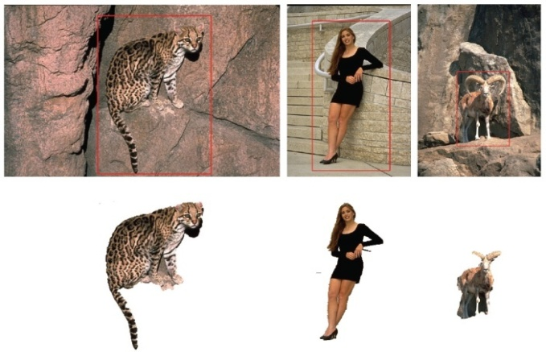
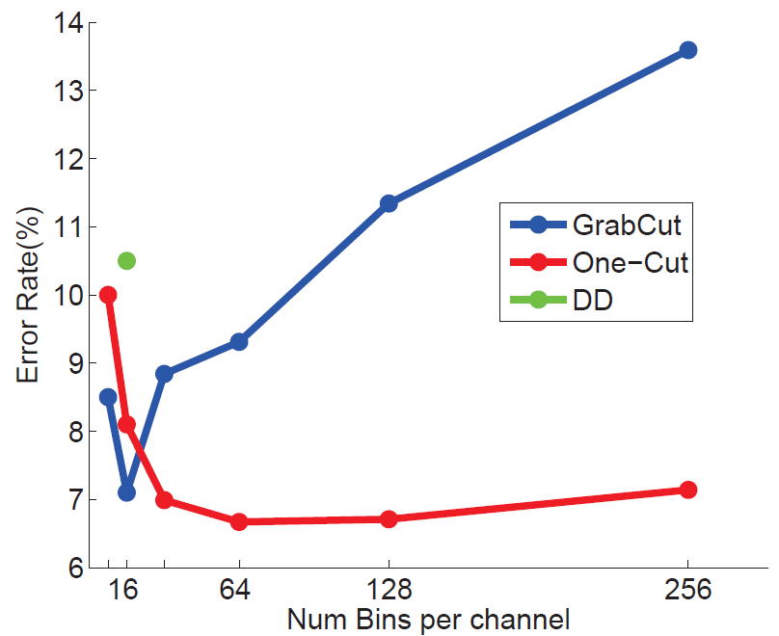
smoothness + color consistency
One Cut
[Tang, et al., ICCV’13]
box segmentation
guaranteed global minimum
linear
ballooning
inside the box
connect pixels in each color bin
to corresponding auxiliary nodes
Grabcut is
sensitive to bin size

Slide 41
smoothness + color consistency
One Cut
[Tang, et al., ICCV’13]
box segmentation
guaranteed global minimum
linear
ballooning
inside the box
from seeds
ballooning from
hard constraints
saliency-based segmentation
connect pixels in each color bin
to corresponding auxiliary nodes
linear
ballooning from
saliency measure

Slide 42
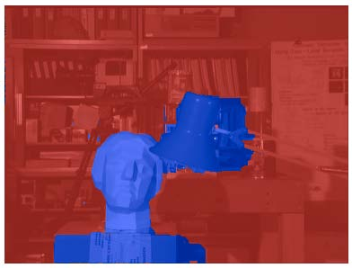
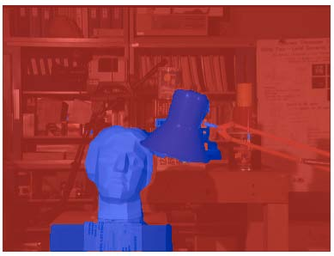
photo-consistency + smoothness + color consistency
Color consistency can be integrated into
binary stereo
photo-consistency+smoothness
+ color consistency
connect pixels in each color bin
to corresponding auxiliary nodes

Slide 43
Approximating: - Convex cardinality potentials - Distribution consistency - Other high-order region terms

Slide 44
General Trust Region Approach (overview)
hard
submodular
(easy)
Trust region
1st-order approximation for H(S)
Notes:
Iterative optimization algorithm
Approximation model is constructed near current solution
The model is only “trusted” locally within a small radius around the current solution – trust region
The approximate model is globally optimized within the current trust region – trust region sub-problem.
The size of the trust region is adjusted

Slide 45
General Trust Region Approach (overview)
Constrained optimization
minimize
Unconstrained Lagrangian Formulation
minimize
can be approximated with unary terms
[Boykov,Kolmogorov,Cremers,Delong, ECCV’06]

Slide 46
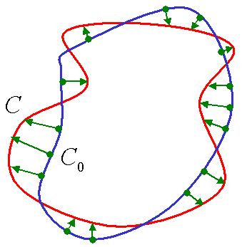
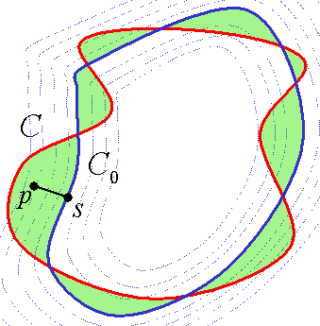
Approximating L₂ distance
d_{p} - signed distance map from C₀
unary potentials [Boykov et al. ECCV 2006]

Slide 47
Trust Region Approximation
Linear approx.
at S₀
non-submodular term
submodular terms
|S|
0
S₀
appearance log-likelihoods
boundary length
volume constraint
trust
region
S₀
L₂ distance to S₀
submodular
approx.

Slide 48
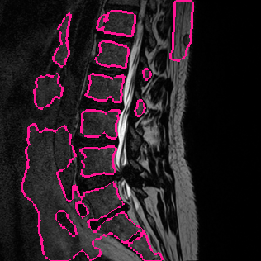
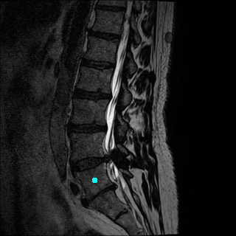
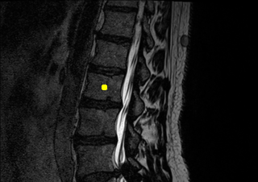
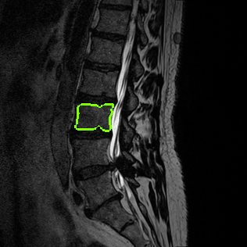
Volume Constraint for Vertebrae segmentation
Log-Lik. + length

Slide 49
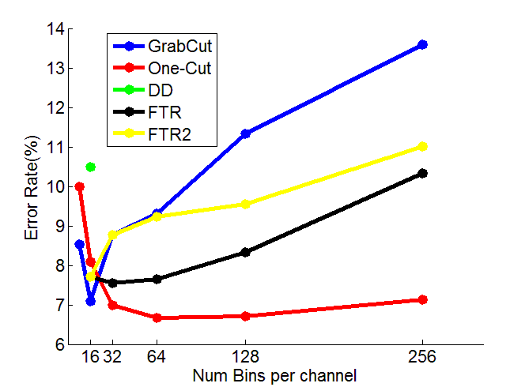
Back to entropy-based segmentation
Approximations
(local minima near the box)
Interactive segmentation with box
global minimum
non-submodular term
submodular terms
volume
balancing
color consistency
boundary smoothness
+
+
|S|
|S_{i}|
0
|Ω|/2
|Ω|
0
|Ω_{i}|/2
|Ω_{i}|

Slide 50
Trust Region Approximation
Surprisingly, TR outperforms QPBO, DD, TRWS, BP, etc.
on many high-order [CVPR’13] and/or
non-submodular problems [arXiv13]

Slide 51
Curvature

Slide 52
Pair-wise smoothness: limitations
discrete metrication errors
resolved by higher connectivity
continuous convex formulations
4-neighborhood
8-neighborhood

Slide 53
Pair-wise smoothness: limitations
boundary over-smoothing (a.k.a. shrinking bias)
S

Slide 54
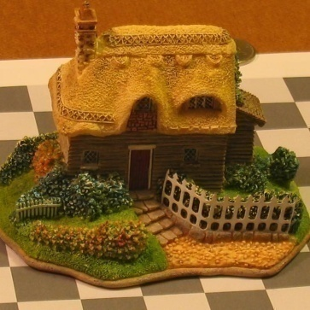
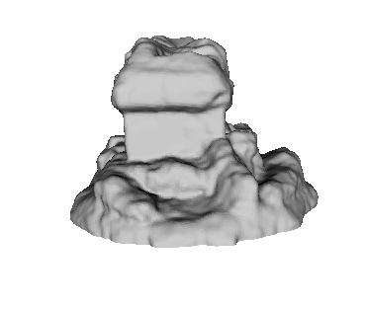
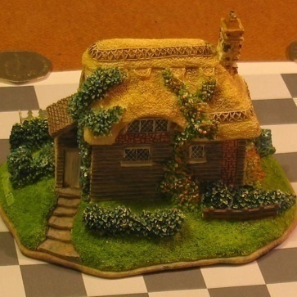
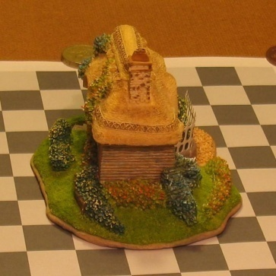
Pair-wise smoothness: limitations
boundary over-smoothing (a.k.a. shrinking bias)
needs higher-order smoothness
curvature
multi-view reconstruction
[Vogiatzis et al. 2005]

Slide 55
Higher-order smoothness & curvature for discrete regularization
Geman and Geman 1983 (line process, simulated annealing)
Second-order stereo and surface reconstruction
Li & Zuker 2010 (loopy belief propagation)
Woodford et al. 2009 (fusion of proposals, QPBO)
Olsson et al. 2012-13 (fusion of planes, nearly submodular)
Curvature in segmentation:
Schoenemann et al. 2009 (complex, LP relaxation, many extra variables)
Strandmark & Kahl 2011 (complex, LP relaxation,…)
El-Zehiry & Grady 2010 (grid, 3-clique, only 90 degree accurate, QPBO)
Shekhovtsov et al. 2012 (grid patches, approximately learned, QPBO)
Olsson et al. 2013 (grid patches, integral geometry, partial enumeration)
Nieuwenhuis et al 2014? (grid, 3-cliques, integral geometry, trust region)
this talk
good approximation of curvature, better and faster optimization
practical !

Slide 56
the rest of the talk:
Absolute curvature regularization on a grid
[Olsson, Ulen, Boykov, Kolmogorov - ICCV 2013]
Squared curvature regularization on a grid
[Nieuwenhuis, Toppe, Gorelick, Veksler, Boykov - arXiv 2013]

Slide 57
Absolute Curvature
Motivating example: for any convex shape
S
S
no shrinking bias
thin structures

Slide 58
Absolute Curvature
easy to estimate
via approximating
polygons
θ
polygons also work for |κ|^{p}
[Bruckstein et al. 2001]

Slide 59
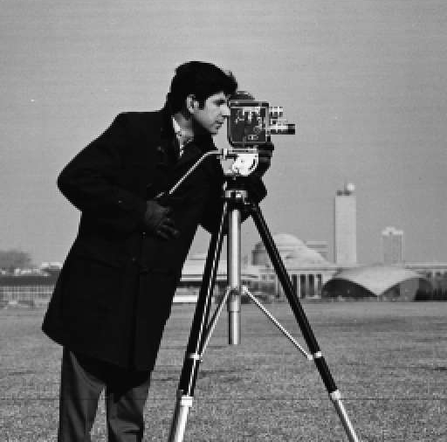
curvature on a cell complex
(standard geometry)
π/2
3π/4
4- or 3-cliques on a cell complex
Schoenemann et al. 2009
Strandmark & Kahl 2011
π/4
π/2
solved via LP relaxations

Slide 60
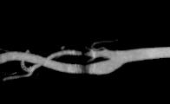
curvature on a cell complex
(standard geometry)
π/2
3π/4
3 cliques are enough for 90 degree accuracy
π/4
El-Zehiry & Grady 2010
π/2
solved via QPBO
QPBO
QPBO-I

Slide 61
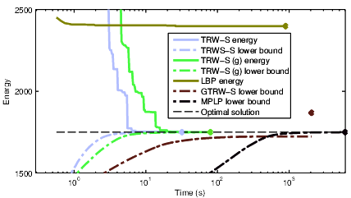
curvature on a cell complex
(standard geometry)
π/2
0
3π/4
zero gap
cell-patch cliques on a complex
π/4
0
Olsson et al., ICCV 2013
partial enumeration + TRWS
0
π/2
- new graph: patches are nodes
curvature is a unary potential
P₁
P₂
P₃
patches overlap, need consistency
P₄
P₅
P₆
tighter LP relaxation
reduction to pair-wise
Constrain Satisfaction Problem

Slide 62
curvature on a cell complex
(standard geometry)
curvature on a pixel grid
(integral geometry)
π/2
0
3π/4
2A+B= π/2
A+F+G+H = 3π/4
A
0
A
A
H
F
π/4
B
0
G
0
A
C
0
D
0
0
A+C= π/4
E
π/2
D+E+F = π/2
F
representative cell-patches
representative pixel-patches
3π/4
π/2
π/2
π/4
π/2
A
B
C
D
E
F
G
H
0
0
0
0
0
0
0
0
0
0
0

Slide 63
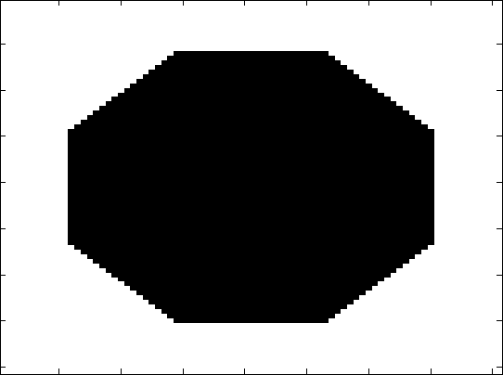
integral approach to absolute curvature on a grid
2x2 patches
3x3 patches
5x5 patches
zero gap

Slide 64
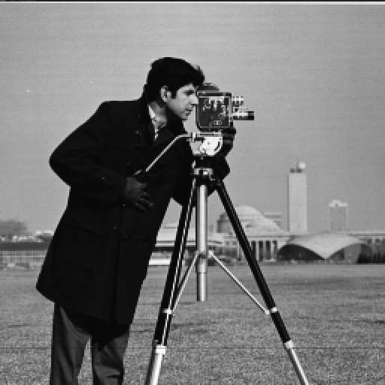
integral approach to absolute curvature on a grid
2x2 patches
3x3 patches
5x5 patches
zero gap

Slide 65
Squared Curvature with 3-cliques

Slide 66
Nieuwenhuis et al., arXiv 2013
general intuition example
3-cliques
with configurations
(0,1,0) and (1,0,1)
S
p-Δ
p
p+Δ
S
more responses where curvature is higher

Slide 67
Δs_{n}
n-1
…
…
n
3
r_{n}
2
Δθ_{i}
n+1
1
n+2
N
5x5 neighborhood
…
N-1
d_{i}
Δθ_{i}
C
θ_{i}
Δθ_{i}
c_{i}

Slide 68
n
zoom-in
r_{n}
d
r =1/κ
Thus, appropriately weighted 3-cliques estimate squared curvature integral

Slide 69
Experimental evaluation
r

Slide 70
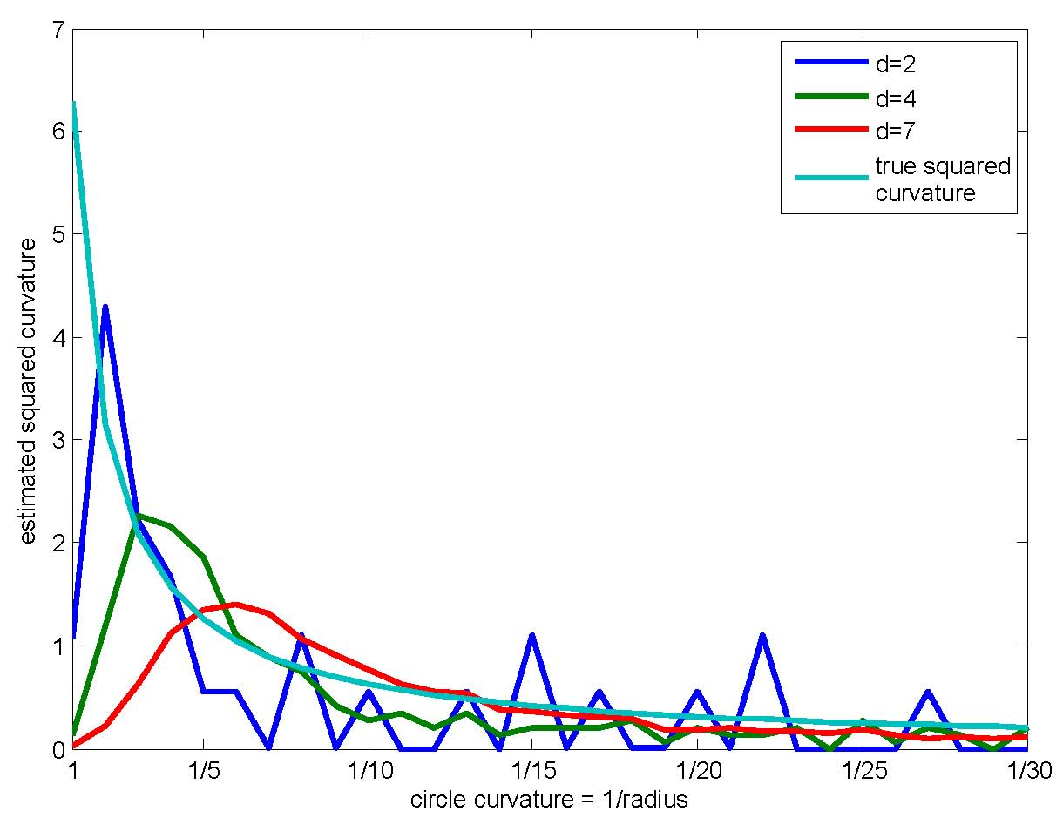
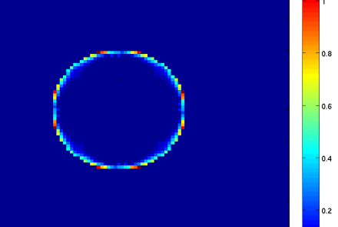
Experimental evaluation
r

Slide 71
Model is OK on given segments. But, how do we optimize non-submodular 3-cliques (010) and (101)?
Standard trick: convert to non-submodular
pair-wise binary optimization
2. Our observation: QPBO does not work
(unless non-submodular regularization is very weak)
Fast Trust Region [CVPR13, arXiv]
uses local submodular approximations

Slide 72
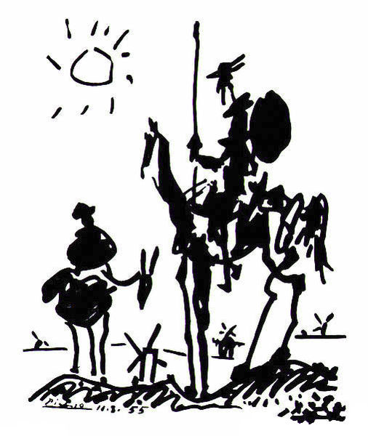
Segmentation Examples
length-based regularization

Slide 73
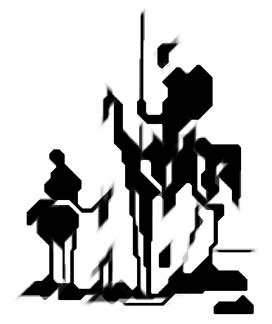
Segmentation Examples
elastica [Heber,Ranftl,Pock, 2012]

Slide 74
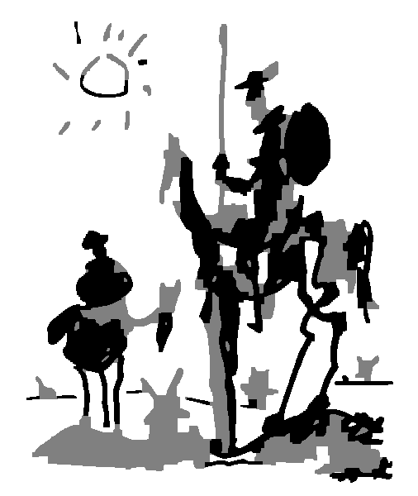
Segmentation Examples
90-degree curvature [El-Zehiry&Grady, 2010]

Slide 75
Segmentation Examples
7x7 neighborhood
our squared curvature

Slide 76
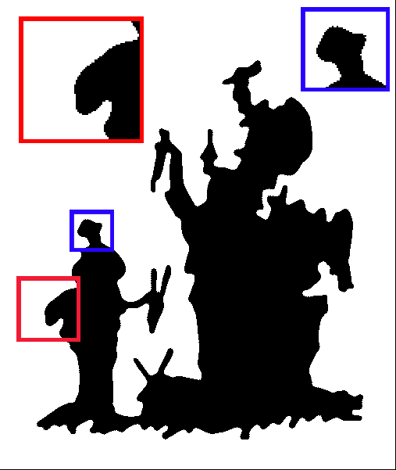
Segmentation Examples
7x7 neighborhood
our squared curvature (stronger)

Slide 77
Segmentation Examples
2x2 neighborhood
our squared curvature (stronger)

Slide 78
Binary inpainting
length
squared curvature

Slide 79
Conclusions
Optimization of Entropy is a useful information- theoretic interpretation of color model estimation
L₁ color separation is an easy-to-optimize objective useful in its own right [ICCV 2013]
Global optimization matters: one cut [ICCV13]
Trust region, auxiliary cuts, partial enumeration
General approximation techniques
- for high-order energies [CVPR13]
- for non-submodular energies [arXiv’13]
outperforming state-of-the-art combinatorial optimization methods

