Slide 1
Warm up Question:
Question: 8-bit indexed colour uses 256 colours.
True
False
Question: Vector images look good even if you resize them to make them bigger.
True
False
Question: How many different colours will 6 bits allow for (a 6 bit colour depth)?
Notes:
True
True
64

Slide 2
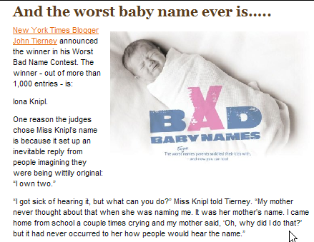
The Internet and The World Wide Web
Computer Science 1033 – Week 5
“Give a person a fish and you feed them for a day; teach that person to use the Internet and they won't bother you for weeks”.→ Anonymous

Slide 3
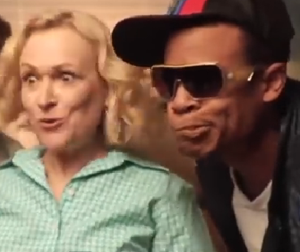
Graphics Continued
Computer Science 1033 – Week 5
“Give a person a fish and you feed them for a day; teach that person to use the Internet and they won't bother you for weeks”.→ Anonymous

Slide 4
Overview of Today’s Topics
Announcements
How to hand in Assignment 1
Compression
File types: GIF, JPG and PNG
Review

Slide 5
Reading for this week from our online textbook:
Graphics → Image Formats and Compression Techniques

Slide 6
Scan to nominate!

Slide 8
Announcements
Poster Assignment
Due THIS Friday!!! Get it handed in by Thursday, make your life less stressful ☺
Remember that the t.a.s have till Feb 18th to mark the assignments, don’t email me till then if yours is not marked.
TA have consulting this week in MC16a, schedule is in OWL.
You will lose 15% if you did not submit correctly in OWL. MAKE SURE YOU SAVE THE EMAIL TO PROVE YOU SUBMITTED, we will NOT give you this mark back without the email even if your assignment was up on Panther BEFORE the due date.

Slide 9
Announcements
Handing in Assignment is 2-part:
Part 1: Uploading to panther.uwo.ca via WinSCP
Part 2: Submitting the links and references via Owl
Video of how to hand it in:
http://www.csd.uwo.ca/~lreid/cs1033/howtohandinassignment1/SubmissionVideos.html

Slide 10
Transferring Files to the World Wide Web
This info is a refresher of Lab 1 and help on what you will need to do for all 3 assignments!

Slide 11
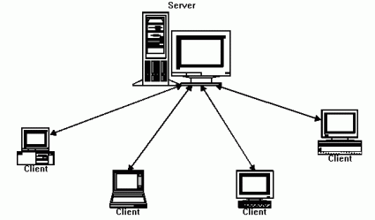
Servers vs. Clients
Web Server → a computer that delivers (serves up) web pages
Client → the computer that is requesting to see/visit the web page.
Many clients will visit one web server, for example 20,000 students might visit Western’s web server to see the page: http://www.uwo.ca
We will put/post our web pages on the Western web server so clients can see our pages.

Slide 12
Advantages of a Web Server
Connected: Computer is on all the time and connected to the Internet
Always Available: Since it never gets turned off, your website will always be available
Well Maintained: The people running the servers will take care of security and computer maintenance issues

Slide 13
Web Server at Western
We will use 2 different Western Web Servers
panther.uwo.ca (poster assignment)
cs1033.gaul.csd.uwo.ca (web & major assign)
Panther will be hosting (holding) our jpg image and our .afphoto file.
We will create/edit/work with the web pages on our local machine and then upload them to panther to see them on the internet
Upload
Download
Your local machine
Panther
(panther.uwo.ca)

Slide 14
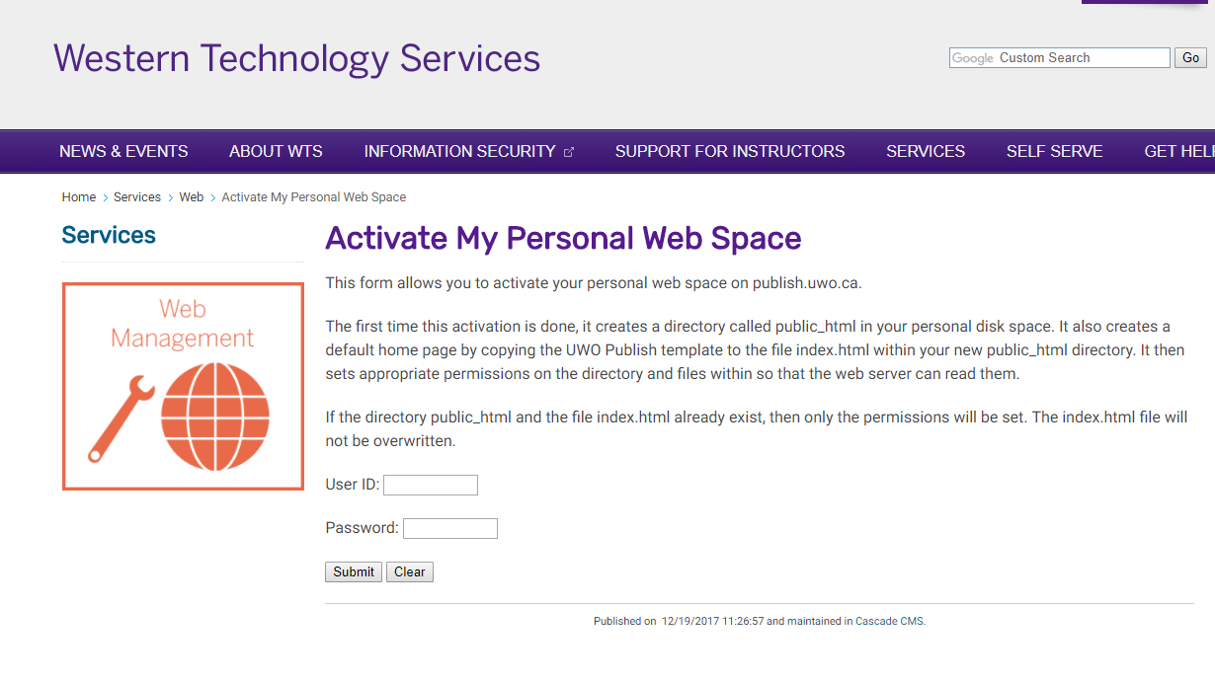
Creating an area for our web pages
Each student needs to initiate a folder called public_html to hold his/her web pages and images. This folder is created automatically at Western by visiting the site: (YOU ALL SHOULD HAVE DONE THIS IN LAB 1) https://wts.uwo.ca/services/web/activate_my_personal_web_space.html

Slide 15
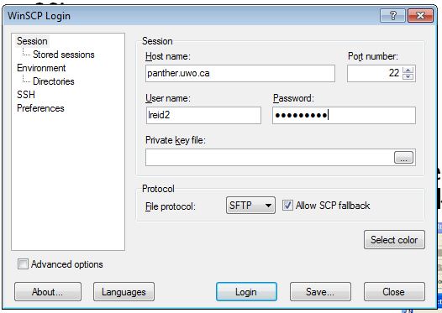
Uploading our Web Pages to Panther
Upload by using a File Transfer Protocol program such as:
WinSCP
FileZilla
WS-FTP
Fugu (for Mac)
Log on to the Web Server, Panther, by select Secure File Transfer Client, click on the Quick Connect button and entering the following
panther.uwo.ca
Your userid
Your password
Port 22 (should be default)

Slide 16
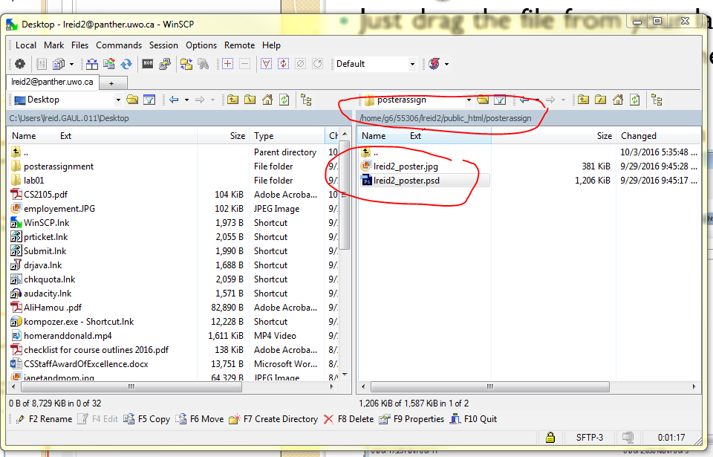
Using WinSCP
Create a folder inside the folder public_html called posterassign
Then drag the files from your laptop/lab machine to your posterassign folder inside of public_html folder on the machine: panther.uwo.ca
Then you might have to set the permissions on your files and folders (although permissions will likely be set already)

Slide 17
Double check that it worked:
Open a browser like Chrome
Type in the web address: http://publish.uwo.ca/~youruserid/foldername
For example:
http://publish.uwo.ca/~lreid2
usually when things don’t work it is because your permissions are wrong or you didn’t use all lowercase!

Slide 18
Handing in Poster Assignment
Step 1: Create your assignment in Affinity Photo
Step 2: Save your file as a afphoto and jpg with the correct file name
Step 3: FTP to panther.uwo.ca
Step 4: create a folder called posterassign
Step 5: move the .afphoto and .jpg files into posterassign folder
Step 6: using IE (Chrome, Safari or Firefox) double check that you can see your jpg

Slide 19
Handing in Poster Assignment
Step 7: Create a file in a simple text editor such as Notepad (.txt)
Step 8: Put the necessary info in the .txt file
Step 9: Log onto Owl and go to Poster Assignment
Step 10: Copy the information in the .txt file into the Assignment Text box in Owl for Poster Assignment
Step 11: Press the Submit button
Step 12: SAVE the email that Owl sends you to prove you handed in the assignment.
YOU’RE DONE!
NEED A REMINDER, GO TO → http://www.csd.uwo.ca/~lreid/cs1033/howtohandinassignment1/SubmissionVideos.html

Slide 20
Announcements
Hints for Assignment 1 (Poster Assignment)
Hints for marking:
Have all required items
Have something clever/eye catching
Don’t touch the edge of the posters/shape with text
Have white space (don’t be too verbose)
Make sure text is easy to read
Make sure images aren’t skewed and make sense
Pick good colours and have it looking “professional” (remember CRAP!)
Make sure you have that EMAIL from OWL!!!!

Slide 21
Hints on the marking of assignment
Follow the instructions carefully, for example:
you get 2 marks if you named your files as stated in the instructions!
If you get a mark for every requirement we ask for.
DON’T Collapse your layers
Name your layers with good names
Check for spelling
Text:
Contrast
Edges
Images
Crisp
Appropriate
Colours
Professional looking – remember CRAP

Slide 22
Poster Assignment Tips
Follow the instructions carefully. Just by following the instructions, you can get a good mark for this assignment!
Check that you have all the required criteria such as a shape from the shape tool.
Check that you named all your files EXACTLY as we indicated.
Make sure you picked good layer names
Remember to follow the CRAP rules!
Other tips
Colour Choices → https://kuler.adobe.com/ and http://design-seeds.com/
Notes:
http://www.csd.uwo.ca/~lreid/cs1033/ExamplesForColourMarking.pdf

Slide 23
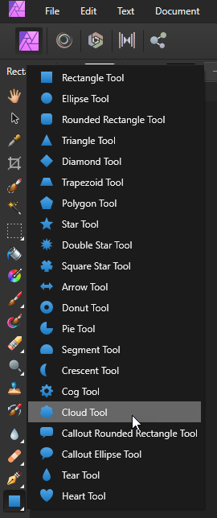
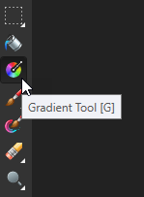
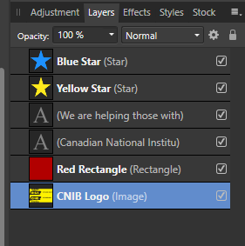
Hints on Assignment
Use the shape tool to create:
A shape, you can use the custom shape tool
Give the shape a good name, don’t collapse the layers

Slide 24
Big Ideas For This Week
Big Idea 1: Size Matters → Squishing is important in computer science!
Big Idea 2: Gif vs Jpg vs Png → Make the right choice!

Slide 25
How Does Compression Work?
Several different ways to do compression depend on the type of image
Are you willing to do a lossy compression and lose some of the original information?
For example: When packing a suitcase, what are you two options for filling the suitcase?
A. Folding carefully and sitting on the case!
B. Leaving some unimportant stuff at home and using a smaller case!
QUESTION: Which is lossy and which is lossless?

Slide 26
Compression for images with large blocks of the same colour
Assume this is an image (boring though it may be!) we want to compress.
Say the image is 100 pixels high and 200 pixels wide, so we would have to store info about 20,000 pixels.
We need to store the color of every pixel
NOTE:
the yellow is: #FFFF00
the green is: #00CC99
100 pixels high
200 pixels wide

Slide 27
Compression Concepts
RAW has no compression –large file
A RAW stores the information about each pixel, one at a time, so the RAW file would look something like this: (Starting at the top, left corner, going left to right, ending at the bottom right)
Each color is 3 byte, so that is 60,000 bytes of information we are storing
100 pixels high
200 pixels wide
#FFFF00 #FFFF00 #FFFF00 #FFFF00 #FFFF00 … #FFFF00 #00CC99 #00CC99 … #FFFF00
YellowWithGreen.raw

Slide 28
Compression Concepts
Can anyone think of a way to store the data about the color of each pixel, without losing any information (lossless compression) and do it in less than 60,000 bytes
(0,100)
(200,100)
100 pixels high
← HINT
200 pixels wide
(0,0)
(200,0)

Slide 29
Compression Concepts
Record (store) this info: startx,starty,endx,endy,color
0,50,200,100, #FFFF00
0,0,80,50, #FFFF00
80,0,130,20, #FFFF00
130,0,200,50, #FFFF00
80,20,130,50, #00CC99
(200,100)
(80,50)
(130,50)
(200,50)
(80,20)
(130,20)
Store:
startx= 1 byte
starty = 1 byte
endx = 1 byte
endy = 1 byte
color = 3 byte
Each shape: record 7 bytes
Multiply by 5 shapes = 35 bytes!
(0,0)
(200,0)
(80,0)
(130,0)

Slide 30
AMAZING:
35 bytes vs 60,000 bytes!
NOTE:
This idea works great with rectangular shapes but gets a lot more complicated when curves are involved!
GIF compressions are, in reality, a bit, a lot more complicated
Thus compression aids with making smaller file size…downloads faster images

Slide 31
Other Compression Ideas
Looks for patterns, for example: 143451434514345
If “1” represents pattern 14345, compresses it to “111”
Build a decoding hash table
0 13245
1 14345
2 23423
3 11223
Pattern:
1324523423143451122323423
Based on table will map to
02132

Slide 32
Compression Tricks – Compressing Words (for example text in a dictionary)
ASCII Code – each letter is represented by 8 bits (1 byte)
Question: Which letter is the most common in the English language?
Huffman Coding - rather than ASCII (each letter is 8bits or 1 byte) use the least number of bits for common letters and more bits for less common letters → Sample Huffman code
QUESTIONS
How many bytes will the word “see” be in ASCII? in Huffman?
How many bytes will the word “zoo” be in ASCII, in Huffman?

Slide 33
ASCII code
Huffman code
see
zoo
s=8 bits
e=8 bits
e=8 bits
----------
see = 24 bits (in ASCII code)
s=4 bits
e=3 bits
e=3 bits
-----------
see = 10 bits (in Huffman coding)
z=8 bits
o=8 bits
o=8 bits
----------
zoo= 24 bits (in ASCII code)
z=11 bits
o=4 bits
o=4 bits
-----------
zoo = 19 bits (in Huffman coding)

Slide 34
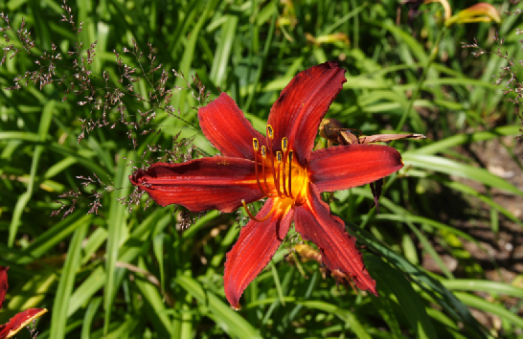
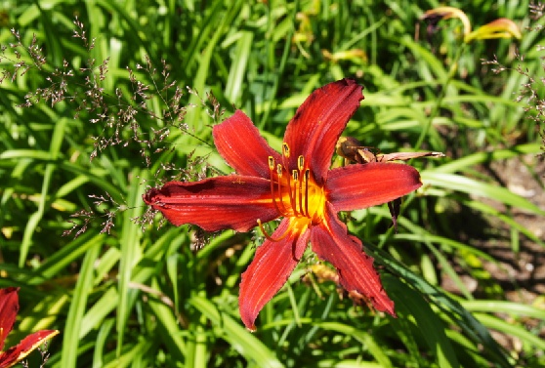
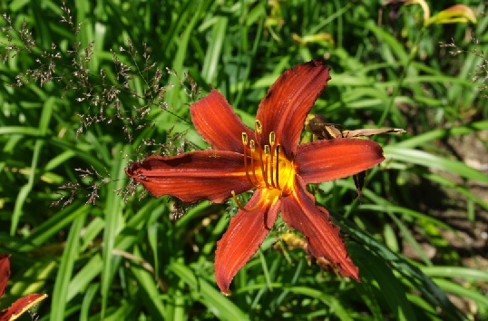
Other Compression Ideas
How do our eyes see images?
QUESTION: which one looks more different from the original image?
Original Image
A. Brightness Adjusted Slightly
B. Colour Adjusted Slightly

Slide 35
Brightness vs. Colour
The designers of the JPEG compression algorithm realized that the human eye is more sensitive to brightness details than to fine color details. (This is an example of how Biology and Computer Science and Physics overlap ☺ !)
If it finds two adjacent pixels with very similar colors, it will store both those pixels with the same color and discard the other color.
https://www.youtube.com/watch?v=Jcgg7jq1W3o&list=PLQMVnqe4XbictUtFZK1-gBYvyUzTWJnOk

Slide 36
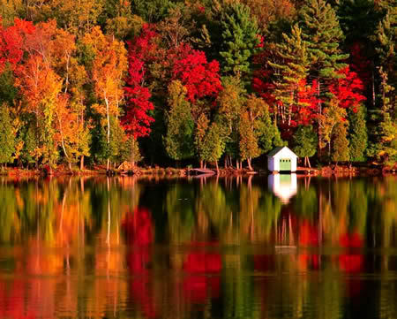
How do we pick the most appropriate file format?
Depends on what type of image we are representing
QUESTIONS:
How many colours are needed for the first image?
How many for the second image?

Slide 37
Depends on type of image!
The type of image we are trying to compress will determine the best file format to choose!
3 file formats we will look at:
GIF
JPG
PNG

Slide 38
GIF (Graphic Interchange Format)
Widely used on the World Wide Web
Cross Platform (works on Macs, Windows)
ONLY supports 8 bit colour!
QUESTION: How many colours can you have in a GIF file if it allows for 8 bit colour?
Not great for photographs but good for clipart, logos, animation
Looks for large blocks of area that all have the same colour
Saving an image with 24 bit colour as a gif will lower the quality the first time you convert it to a gif

Slide 39
GIF
Produces smaller file sizes than jpgs
Does a lossless compression:
Assume we have an image that is
200 by 200 pixels
If the original image had 256 colours or less
With no compression the file size would be: 200*200*3/1024 = 117 KB
Same image, save as a gif:
With 256 Colours → 8.4 KB
With 16 Colours → 5 KB
NOTICE: NO CHANGE IN QUALITY, LOSSLESS COMPRESSION!

Slide 40
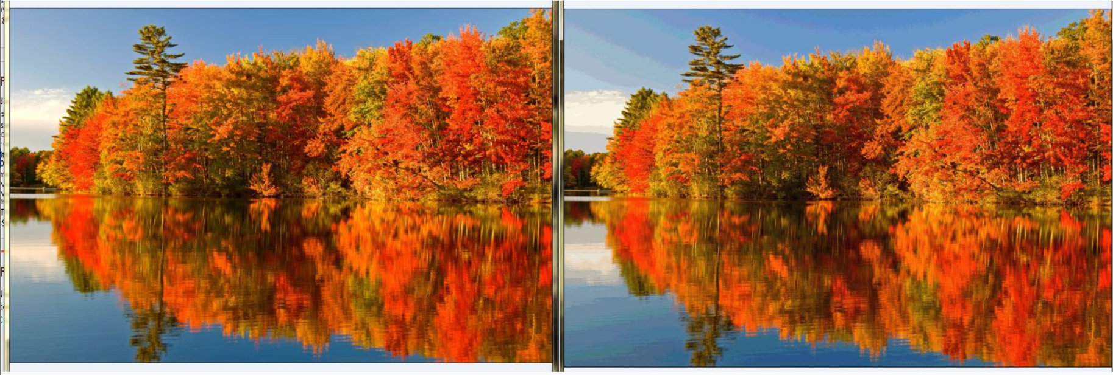
GIF
Not great for photography because can only store 256 colours.
QUESTION: Can you tell which image has fewer colours?

Slide 41
GIF → Transparency
One Colour Transparency
Allows for transparency of ONE colour
Background will show through:
Question: Can you see the problem with this type of transparency?

Slide 42
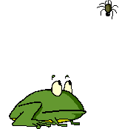
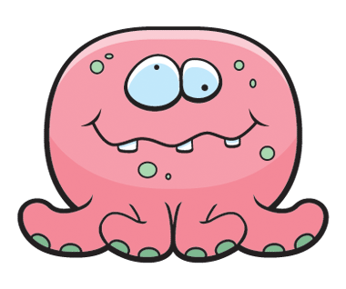
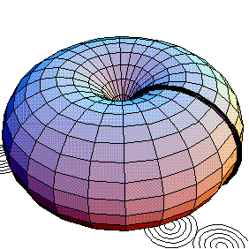
GIF → Animation
Allows for animation
Don’t need a plug in for gif animation!
Works in all browsers, universal format!

Slide 43
GIF → Dithering
Allows for dithering:
Question: What do you think a program, that converts images into gifs does, if the image has more than 256 colors?
Solution 1: Substitute one of the colors you have for one of the colors you are missing
Solution 2: Any guesses?
HINT: What did you do when you were a kid and your parent gave you red and blue and yellow and black play-doh?
you didn’t realize it but you were using a 2-bit color depth play-doh palette = 2² = 4 colors

Slide 44
GIF → Dithering
Juxtaposing (place side by side) pixels of two colors to create the illusion that a third color is present (grainy look)
Example:
Assume our image uses 257 colours
The 257th colour that is not in our palette is:
Assume we do have these 2 colours: and
Thus dithering will change this →
To this →

Slide 45
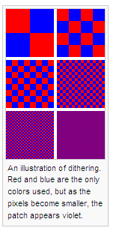
Another Example of Dithering

Slide 46
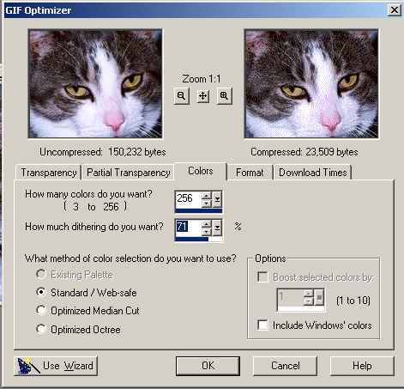
GIF → Dithering
You can reduce the number of colors in a GIF and choose options to control the way colors dither in the application or in a browser.
Different ways to dither produce different results

Slide 47
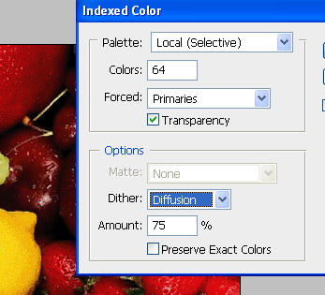
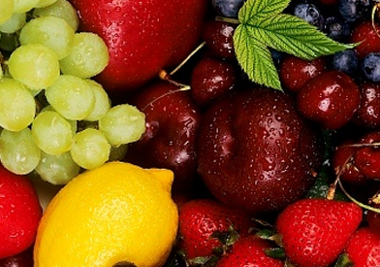
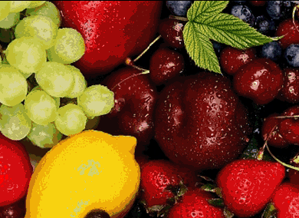
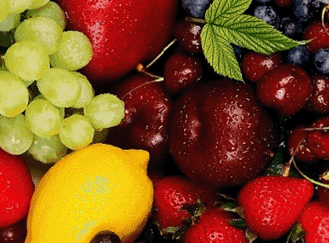
GIF → Dithering
← Original Image
Dithering, used 64 colours to make the differences show up more to the naked eye!
Saved as 6 bit gif with no dithering
Saved as 6 bit gif with dithering
Notes:
Saved with 64 colours to show differences better

Slide 48
GIF → Interlacing
How images are downloaded to your screen
Interlacing lets you have a feel for the whole picture, you don’t have to wait around to see it download (good for dial up connections)
a process by which the image is drawn in a series of passes rather than all at the same time (file size bigger)

Slide 49
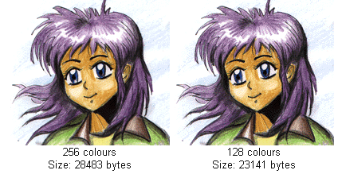
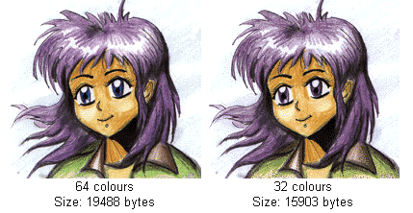
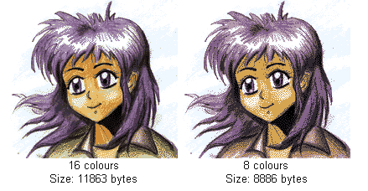
GIF → Compression
Can compress more by reducing the number of colours in the image:
Colour Resolution | Size (KB) | % Decreased
256 | 28,483
128 | 23,141 | 19
64 | 19,488 | 32
32 | 15,903 | 44
16 | 11,863 | 58
8 | 8,886 | 69

Slide 50
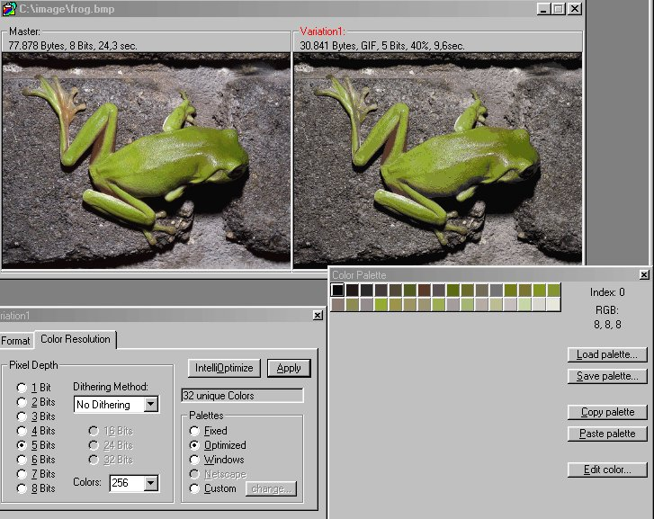
GIF

Slide 51
Break
A cute commercial from a Superbowl (A Canadian one!)
https://www.youtube.com/watch?v=yXFKPcEfigk
A freaky painting → http://www.youtube.com/watch?v=d6egUsZvWu4
Do your review sheet!

Slide 52
Review Sheet
http://www.csd.uwo.ca/~lreid/cs1033

Slide 53
JPG (JPEG) – Joint Photographic Experts Group
Widely used on the World Wide Web
Cross Platform (works on Macs, Windows)
Supports 24 bit colour
Question: How many colours can you have in a JPG file if it allows for 24 bit colour?
Great for photographs
Larger file sizes than GIFs BUT allows for a full colour scheme!

Slide 54
JPG
Good for photographs, computer games, screenshots, stills from a movie, etc
Best for blends of color, softer shadow effects, subtle changes in color
Not good for well-defined lines or sharp contrasts between colours
Question: Guess which one is the GIF and which one is the JPG:

Slide 55
JPG
Notice what happened to Homer when his original GIF was resaved as a JPG:

Slide 56
JPG
JPG does a lossy compression
Discards more data about colours than about brightness
Not all of the information in the original image is preserved – not the same as the original
Degrades the image quality
Compression is achieved by ‘forgetting’ certain details about the image, which the JPG will then try to fill in later when it is being displayed
Degree of amount of information LOST (lossyness) can be varied by adjusting compression parameters. (controlled by you)
Because image data is lost with each compression, work with the image in native format, and when ready with final product, save it as a .jpg file

Slide 57
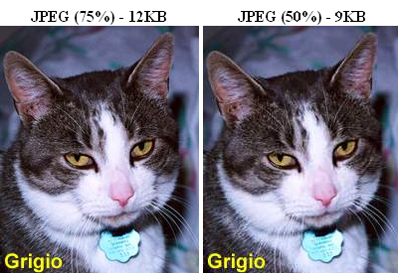
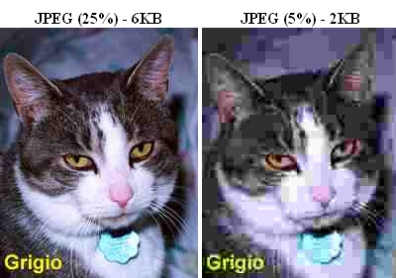
JPG
Original → 0% Compression = 100% Quality
Quality of image is inversely proportional to amount of compression
A higher image quality setting (has a lower compression value) results in less data being discarded.

Slide 58
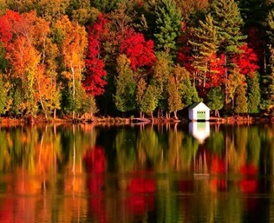
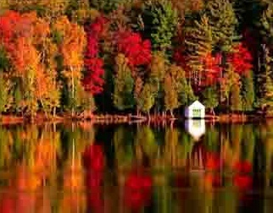
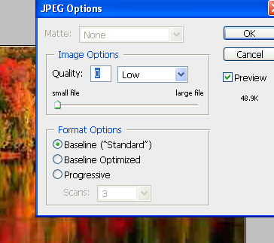
JPG
Can you tell which image was saved with low quality, high compression in Photoshop?

Slide 59
JPG
No Transparency
No Animation
No Interlacing
No dithering (Question: why no dithering?)

Slide 60
PNG
Pronounced PING
Created specifically because of licensing issues with GIFs in the 90s
Does LOSSLESS compression
Three versions of PNG
PNG-8
PNG-24
PNG-32

Slide 61
PNG-8
Similar to GIF
Only allows for 256 colours
Allows for 1 transparent colour
Storing of colours is more efficient in PNG files than GIFS thus PNG-8 files might be SMALLER than their GIF counterparts (this is software dependent)

Slide 62
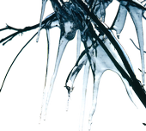
PNG-24 (and PNG 32)
Allows for 24 bit colour
It is LOSSLESS
QUESTION: If I take the same image and save it (same quality level) as JPG file, then as a PNG-24 file, which file size will be smaller? (keep in mind that jpgs are lossy and pngs are lossless).
Allows for transparency on each pixel, with different levels of opacity:
PNG 32 allows for a full palette with full transparency but with PNG 24 if you want varying levels transparency, you will lose some colours

Slide 63
Comparison of GIF, JPG, PNG
 | GIF | JPG | PNG-8 | PNG-24/PNG-32
Best For | Logos, Cartoons, Drawings | Photographs | Logos, Cartoons, Drawings | Photograph Images with a need for transparency
Type of Compression | Lossless | Lossy | Lossless | Lossless
Well Supported in Browsers | All | All | All | Not on IE6
Transparency | One COLOUR only | NO | One COLOUR only | Varying levels of opacity and transparency
Animation | Yes | No | No | No
Dithering | Yes | No | Yes | No
Interlacing | Yes | No | Yes | Yes
Shape of image |  | Must be rectangular

Slide 64
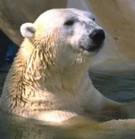
File Size Comparison

Slide 65
Things to think about when working with images:
How big do I need it to be within my page (determines the Width Pixels by Height Pixels)
Will I ever need to print the image (determines the DPI)
What type of picture is it: cartoony or photograph , how many colours (determines GIF vs. JPG)
Will I need 1 colour to be transparent (determines GIF/PNG vs JPG)
Will I need varying levels of transparency in my photograph (JPG vs PNG24)

Slide 66
Nice Review
https://www.youtube.com/watch?v=15aqFQQVBWU

Slide 67
Review
Question: How big will an image be in terms of bytes if it is uncompressed, true colour and 200 by 400 pixels?
Question: What type of compression doesn’t lose any of the original information about the image?
Question: Which type(s) of file formats perform a lossless compression?
Question JPGs will produce a smaller file size than PNG 24 for a photograph: TRUE OR FALSE

