Slide 1
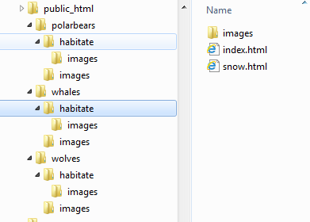
Warm up Questions:
Question: Assuming I have this → directory structure for my website on the domain arcticanimals.org
What is the shortest URL I have to type to see the habitat home page for whales?
What URL would I type to see the wolves home page?
1. http://www.arcticanimals.org/whales/habitate
2. http://www.arcticanimals.org/wolves

Slide 2
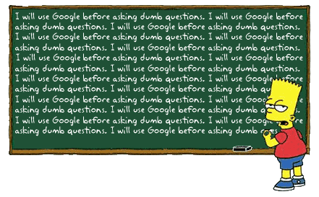
WeB SITE Design & SearchING
Computer Science 1033 – Week 8
https://trends.google.ca/trends/yis/2019/CA/
Click on Bart’s blackboard to see the Google ad that was on during the 2010 Super Bowl
“There is no Ctrl button on Chuck Norris's computer. Chuck Norris is always in control.”
“Apple pays Chuck Norris 99 cents every time he listens to a song.”

Slide 3
Fun with Google
Type in the following terms to http://www.google.com and then for each term, hit the “I’m feeling lucky” button:
elgoog
Google gravity – underwater sphere
Chuck Norris google easter egg
http://lmgtfy.com/
Something else cool

Slide 4
Overview of Today’s Topics
Announcements
Using a table for simple layout
Publishing your webpage
Page Rank Algorithm
Searching
Review

Slide 5
Textbook Readings for this Week
Websites
Online Visibility

Slide 6
Announcements
Web Assignment due Friday (March 13th)
Final Exam
Thursday, April 23rd at 2:00 pm
All multiple choice – 2 hour time period
Bring:
Pencil (soft) and eraser
Student card
Do NOT bring: calculator, iPod, hat, etc..

Slide 7
Announcements
Poster Assignment should be marked now.
You can ask for a remark but I remark the whole assignment and your mark could go lower.

Slide 8
Hints for Web Assignment
Remember:
Titles
Headers
File names, spaces, lowercase
Images
Alt, Title
Size within page
On each page
Banner
No Scrolling horizontal/vertically to see buttons
Consistency
Buttons → look, ease of use
Back to top
References page layout
Text colours, contrast
Broken links
Check from a different computer!
Underlining
Colours
Link Colours
Paragraphs
Padding
Followed the instructions (make the anchor links, etc..)

Slide 9
How to do Web Assignment
Colours → look at: http://kuler.adobe.com/
https://www.design-seeds.com/
Marks for:
Nice Banner
Good Colour Scheme
Alt/title tag on banner/images
No scrolling horizontally EVER at 1000 pixels
Consistency in the layout of the pages and the buttons/NICE LAYOUT ON EVERY PAGE
NO Underlining

Slide 10
Roll over buttons get 1 or 2 marks more
PROPERTY TITLES! Website – Web Page
Antonio’s Restaurant – Home
Antonio’s Restaurant – References
Must use table to lay things out
Headings on pages
Use an image for each page/good size
Layout paragraphs well (don’t squish on edge)
Bold/highlight headings

Slide 11
Announcements
Web Assignment
IT will take you longer than you think, give yourself LOTS of time to finish it and to hand it in (Hand it in on before Wednesday, the labs will be VERY busy on Thursday and Friday).
Hints:
Remember your titles
Think about layout, consistency, ease of use!
Follow the specs
Use a table for a clean layout (put the banner in the top row and content in the bottom row)
Common Mistakes → http://www.csd.uwo.ca/~lreid/cs1033/assignment3/SamplesOfCommonMistakes/

Slide 12
Announcements
Web Assignment Hints
THINGS THAT CAN GO HORRIBLY WRONG ☹
http://cs1033.gaul.csd.uwo.ca/~lreid2/other/student1/
http://cs1033.gaul.csd.uwo.ca/~lreid2/other/student2
http://cs1033.gaul.csd.uwo.ca/~lreid2/other/student3/assign3/howtohelp.html (need to scroll for buttons, bullets, banner)
http://cs1033.gaul.csd.uwo.ca/~lreid2/other/student9/major/ (consistency)
http://cs1033.gaul.csd.uwo.ca/~lreid2/other/student19/
http://cs1033.gaul.csd.uwo.ca/~lreid2/other/student20 (edges)
http://cs1033.gaul.csd.uwo.ca/~lreid2/other/student14 (scrolling and banner on next page)
http://cs1033.gaul.csd.uwo.ca/~lreid2/other/student22
http://cs1033.gaul.csd.uwo.ca/~lreid2/other/student18/Contact%20Us.html (file names and button movement)
THINGS THAT CAN GO RIGHT ☺
http://cs1033.gaul.csd.uwo.ca/~lreid2/other/student8/assign3/registration.html
http://cs1033.gaul.csd.uwo.ca/~lreid2/other/student22/assign3/
http://cs1033.gaul.csd.uwo.ca/~lreid2/other/student15/index.html

Slide 13
Paragraphs → Centering → DON’T
Hyphens on lists
Emails links
Back to top, anchors
Think about link colours
Link lengths
http://www.csd.uwo.ca/images/CSD_long_photo_16.jpg vs.
Middlesex
Common Mistake: renaming files/folder…this will TOTALLY SCREW up your website if you do not do it correctly!

Slide 14
Let’s try it out
Watch me start Web Assignment!

Slide 15
HTML Tables and BlueGriffon
Tables are made up of rows and columns
Place where a row meets a column is called a cell. A cell can hold any kind of data: links, text, images, etc…
Can have a table inside another table (called a nested table)
For CS1033, we will use tables to make a simple clean layout for each of our pages!
Tables can be expressed in terms of one of:
Percentage %
Pixels

Slide 16
Tables expressed in terms of Percentage
Here is an example: http://www.csd.uwo.ca/~lreid/outreach/iveysurveyTables.htm
% of the browser, not the entire screen
Another example: http://www.csd.uwo.ca/~lreid/cs1033/ExamplesForLectures/tablesexamples.html

Slide 17
Table expressed in terms of Pixels
Resolution affects the way a page is displayed.
In general, most people do NOT have their resolution below 1024 by 768. Thus if we make our page 1000 pixels wide EVERYONE should be able to view it. If we make our page 1200 pixels wide, some people (the ones whose resolution is still 1024 by 768) will have to scroll horizontally.

Slide 18
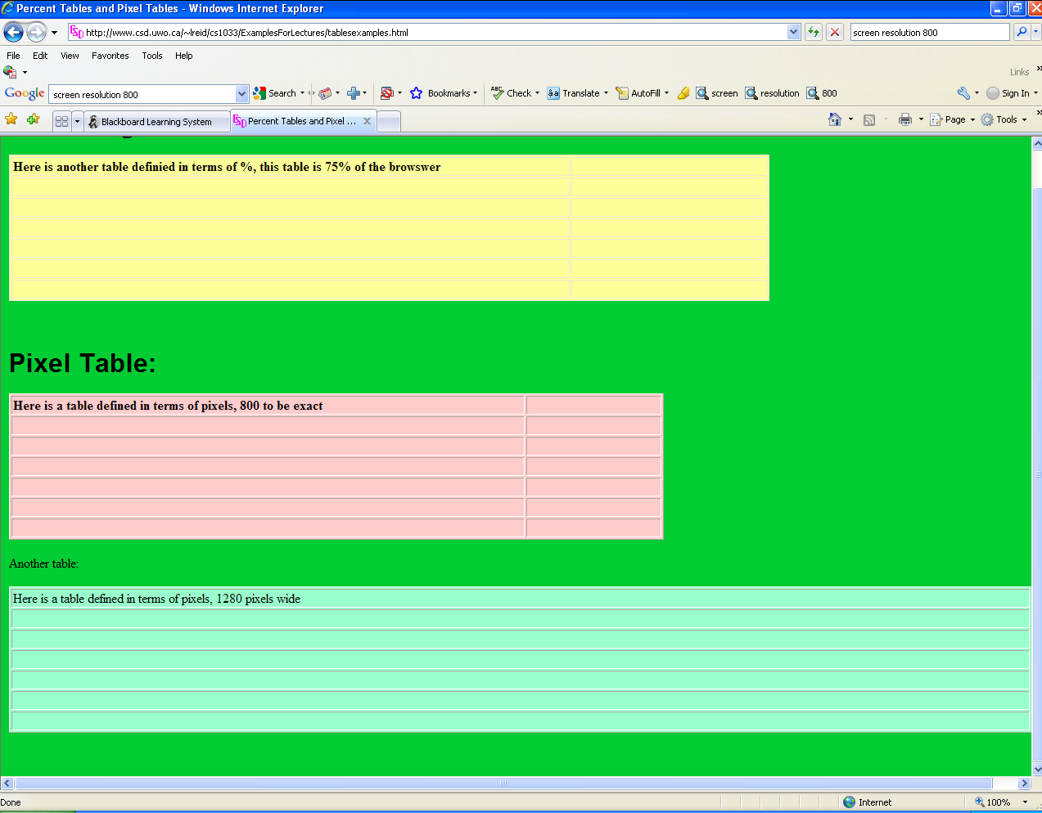
Resolution 1280 by 1024:

Slide 19
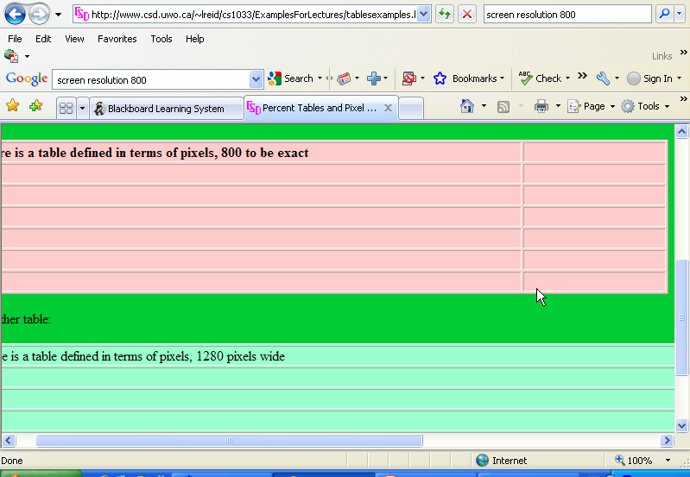
Resolution 800 by 600:

Slide 20
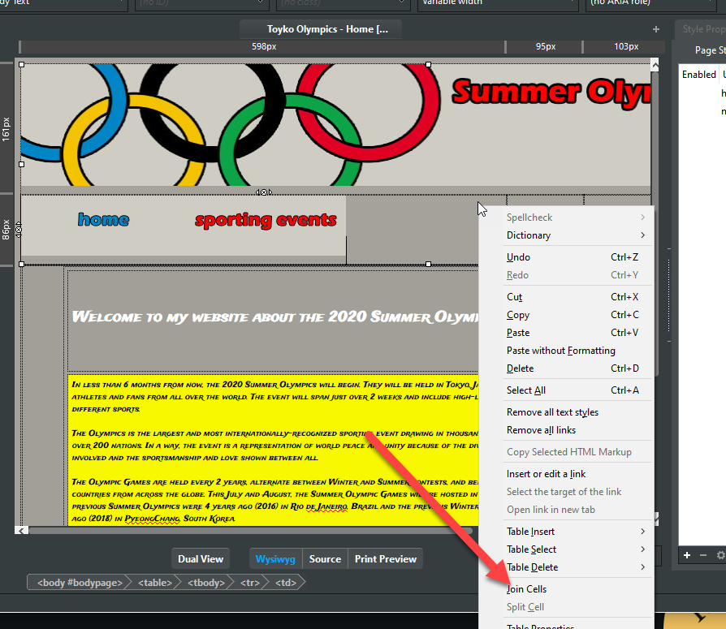
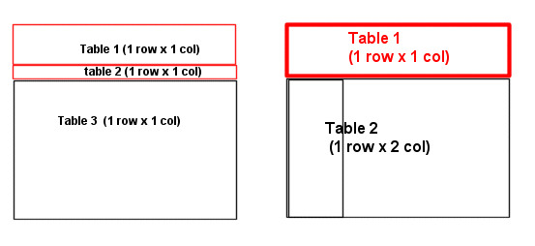
Some hints for using tables to organize your overall appearance:
Have the border set to 0
Make sure you give some cell padding, so the text doesn’t go flush to the end of the cell
Use the alignment buttons to make everything look clean. Do NOT centre paragraphs of text.
Use pixels to set up your table initially, don’t go wider than 1000 pixels
Merge/join and split cells to help you define your areas

Slide 21
Publishing your Website
Move your website from the machine you built the site on to the web server
Question: What program do we use to perform the move?
NOTE: Not all web servers allow certain FTP software to connect to them because of security reasons.

Slide 22
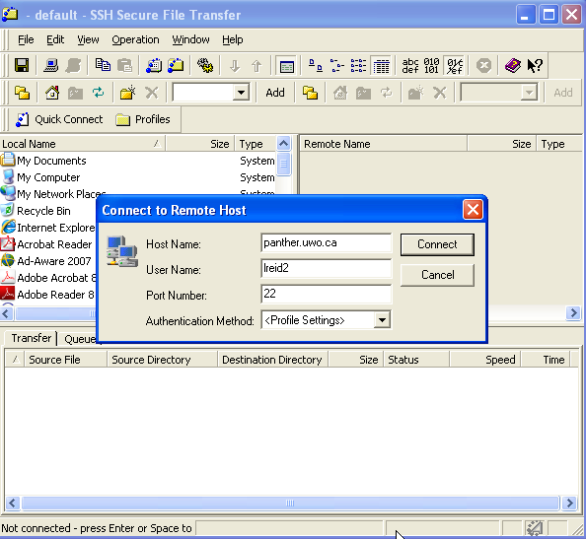
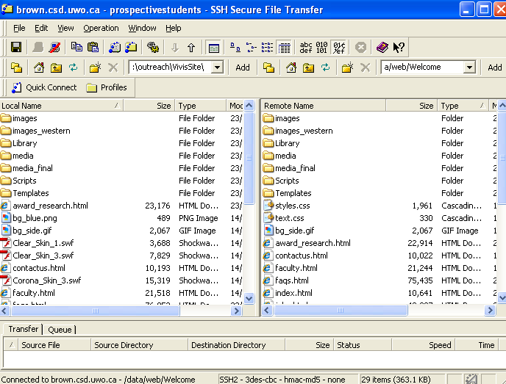
Publishing your Website
Question: There are 4 pieces of information you need to in order to move your web site onto your web server, what are they?
Question: There is 1 more piece of information you need to CHECK that the web site was moved correctly, what is it?
Need to:
Connect to internet if not already connected
Start FTP program
Enter the name of the webserver (host name)
Enter your username
Enter your password
Find the appropriate folder on the local machine (from folder) and the appropriate folder on the web server (to folder)
Move the files from the local machine to the web server
Start IE or Firefox and check that the transfer worked correctly. ALWAYS CHECK!!

Slide 23
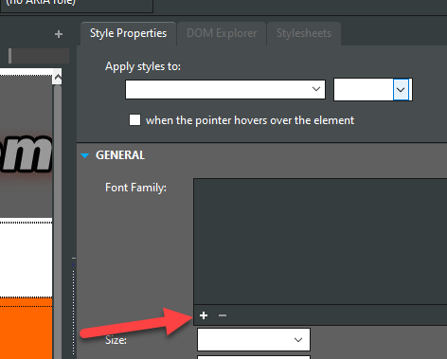
Hint: Use Google Fonts if you want cool fonts in your web page!
http://www.google.com/fonts
Click on red + button and then the black bar at the bottom that says Families Selected and copy and paste the code you get at the google site into your code below the <head> tag. (the code will look like this → <link href='http://fonts.googleapis.com/css?family=Eater' rel='stylesheet' type='text/css'>
In BlueGriffon, view the source and paste the link below the <head> tag near the top:
Save your file
Highlight text
Go to (no class) near the top and type in a name
Go to style properties and pick Apply styles to: and pick your name
Click on GENERAL and press + and pick new font
Notes:
HOW TO VIDEO in dreamweaver

Slide 24
Marketing your Website
Include the web address for your new site:
As part of your signature on outgoing email
On all printed material → letterhead, business cards, labels, catalogues, posters, media advertisements
Try to make your website be in the “first ten listed” when your customers search using search engines for your site.
How can you do that, we will give you some tips ☺

Slide 25
Break
Check out some Poster Assignment:

Slide 26
Search Engines
Question: What is the most popular search engine?
Question: What search engine is coming in second? Hint: The Colbert Report
QUESTION → What % of the market does the most popular search engine have?
Real Time Info

Slide 27
How does a Search Engine work?
2 Parts:
Part 1: Finding all the data on the Web and building a database. Similar to Librarians getting new books, cataloguing them and putting them in the library!
Part 2: Given keywords from a searcher (person looking for a topic), returning the “BEST/MOST APPROPRIATE” pages. Similar to a patron walking into a library, going to the card catalogue and looking for a book.

Slide 28
Part 1: Building the Search Database
Web Crawlers or Web Spiders crawl the internet constantly, going from web page to web page via links, looking at all the words on the page, building an index (database):
Index contains list of alphabetical list of words it finds, where within the page the word was and the links (URL to the page) where it found the words.
Words are called keywords

Slide 29
Part 1: Index/Database
Index is stored in a really big database
Looks sort of like this:
keyword | Index: Page and position within page
aardvark | 3 (body, 2nd word, 8th word) | 5(body, 12th word) | 20
africa | 2 (title) | 7 (… | 19 | 27 | 30
anteater | 2 (title, body 1st word) | 3 (… | 5 | 7
Index Number | Website found on
1 | http://www.antartic.org/index.html
2 | http://www.worldaidforafrica.org/info.html
3 | http://www.worldwiderefuge.org/animals.html
4 | http://www.csd.uwo.ca/~lreid/resume.html
5 | http://www.AnimalsRUs.com

Slide 30
Part 2: How does the search engine decide which pages to return to the searcher?
Uses index to decide which pages have the given keywords
Every engine uses slightly different algorithms to decide the order of displaying the returned pages
Google uses the “PageRank” algorithm as ONE of the factors to decide what order to present the pages it found to you.

Slide 31
BG (Before Google…)
Around 1990, there was no index, so you had to search EVERYTHING (like looking for a needle in a haystack or looking through a book page by page for one word)
Sample Search from early 1990s BEFORE World Wide Web
http://www.youtube.com/watch?v=-PshzRzxEOE&t=5m45s

Slide 32
BG (Before Google…)
Around 1990 webpages were returned just by the file names of the sites and titles stored in the index but NOT the content, e.g. if you searched for “Dog”, you would get things like:
www.uwo.ca/dogs.html
www.uoft.ca/mydogisgreat.html OR
You might find a URL with a file that had was titled: “The Black Dog” BUT some sites only matched titles if the match was exact (e.g. would only find paper above if user had search for “The Black Dog”)
Also, wouldn’t find your page if it wasn’t in the index

Slide 33
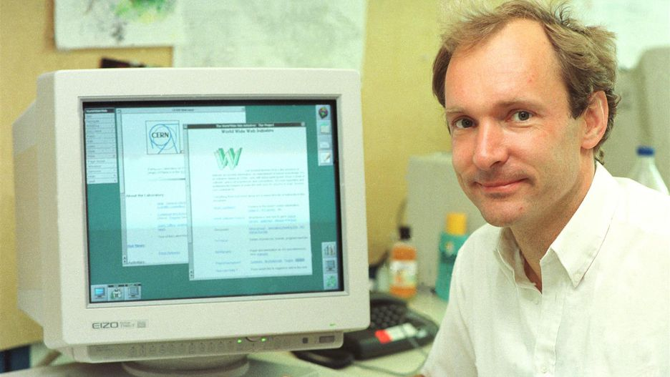
BG (Before Google..)
Then came the World Wide Web, ~1991
Developed by Tim Berners Lee in Geneva Switzerland
Problem: data was difficult to access and exchange for research
He worked from several criteria:
System must be flexible, work in multiple operating systems
System must be capable of recording links between objects
System must make it easy to enter and correct information.
All papers/files were now all stored in the same standardized manner → html files
Key feature of his initial design → MUST HAVE HYPERLINKS!
User is in control and can jump from one paper to another paper.

Slide 34
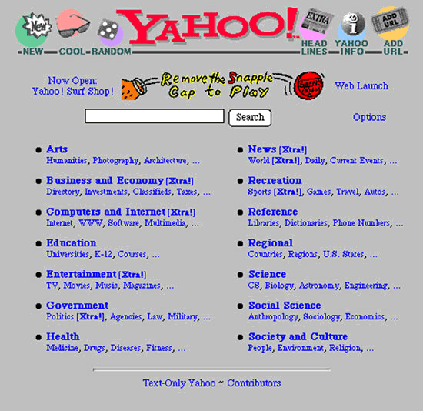
BG (Before Google)
Around 1994 some software allowed the user to submit pages they wanted included in the index
1994 Yahoo began as a collection of good webpages that included man-made descriptions with each URL.
Had a searchable man-made directory.
Commercial sites could pay to be included.
Also in 1994 the indexes that were built began to include ALL the data on the webpage (not just the title or URL)

Slide 35
BG (Before Google)
Around 1995
Unlimited bandwidth for the first time
First natural language queries, E.g “dog, 1992” rather than “Select * from index where year=1992 and pet=‘dog’”
Advanced searching techniques such as:
Ca* would webpages with return Canada, Cats, Calico
Add your URL to the index and it gets added within 24 hours
Results are still just returned mostly randomly or with basic techniques (e.g. the page that contains the word “dogs” the most would be returned as the first result)

Slide 36
Then in 1996 Larry Page and Sergey Brin start working on the “BackRub” algorithm. The beginnings of:
Da… da … da
Based on the idea that “analyzed the relationships between websites would produce better ranking of results than existing techniques, which ranked results according to the number of times the search term appeared on a page” (www.wikipedia.org)

Slide 37
What is Google’s PageRank Algorithm?
Algorithm gives each webpage returned from the keyword search a weight between 0 and 1.
The higher the weight given to the page, the more likely it is that this page will be displayed first to you.
Question: How is the weighting done?

Slide 38
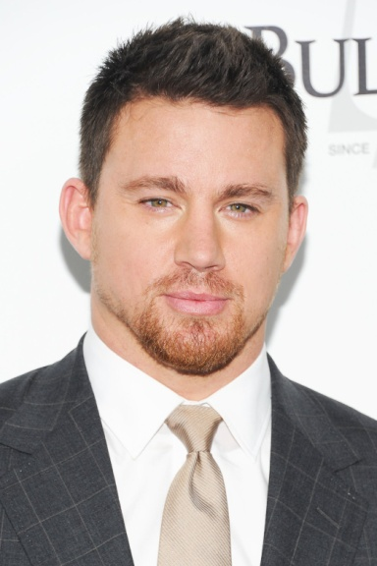
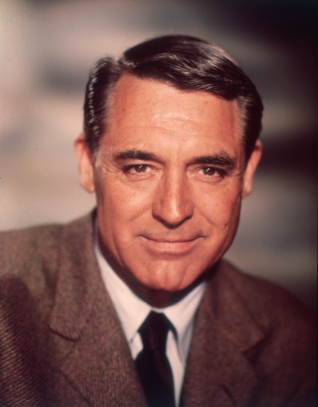
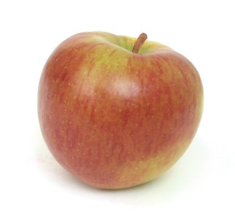
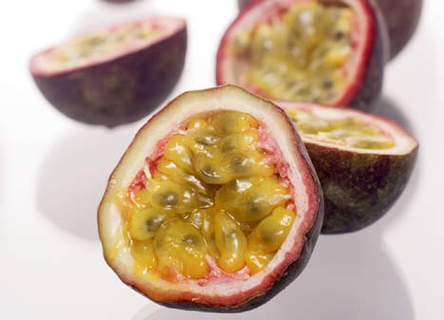
How do we, as humans, decide who or what is “important” ? CLICKER QUESTION
Guy A or Guy B ?
Does the guy get to tell us he is important or do we decide?
Q1. Do you know Guy A
Q2. Do you know Guy B
Activity: Google this: who are some handsome actors in Hollywood
A1 B1
A2 B2
What is the name of A?
What is the name of B?

Slide 39
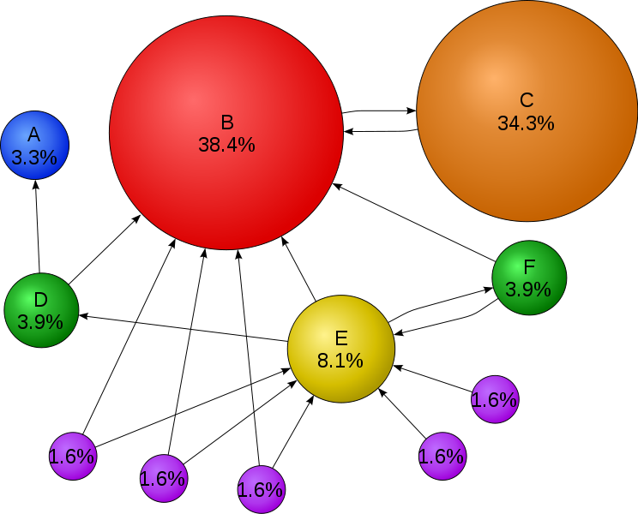
QUESTIONS:
Which site has the highest ranking? Why do you think it has the highest ranking?
Which site has the second highest ranking? Why do you think it is second highest?

Slide 40
How PageRank Works – A simple world with only FOUR pages on the entire Internet!
First, assume we only have 4 pages, Page A, Page B, Page C and Page D on the Internet to simplify this.
Each page is given a weight of 0.25 (1 divided by 4)
Scenario 1:
Pages B, C, and D all have a link to Page A. (Thus page A must be very useful because everyone is pointing at it).
Then pages B, C and D are each giving their 0.25 rank to A, so A gets a ranking of 0.75
Scenario 2:
Page B links to A and C (0.25 divided between 2 pages)
Page C just links to A (all of 0.25 goes to A)
Page D links to A, B and C (0.25 divide between 3 pages)
The Weight of A is now:
0.25/2 (Bs ranking ) + 0.25 (Cs ranking) + 0.25/3 (Ds ranking)
0.125 +0.25 + 0.083 = 0.458
THUS, pages with lots of links pointing at them, must be important so they get the highest weight/ranking
Page B
Page A
Page D
Page C
Page B
Page A
Page D
Page C

Slide 41
Let’s Try It Out
Page B
Page A (0.458)
Page C
Scenario 2:
Page B links to A and C (0.25 divided between 2 pages)
Page C just links to A (all of 0.25 goes to A)
Page D links to A, B and C (0.25 divide between 3 pages)
The Weight of A is now:
0.25/2 (Bs ranking ) + 0.25 (Cs ranking) + 0.25/3 (Ds ranking)
0.125 +0.25 + 0.083 = 0.458
Question: What ranking will pages B,C and D have?
B’s ranking: B has only one link to it, D links to B (D has links to all 3 pages) = 0.083
C’s ranking: C has two links to it, B and D = 0.125 + 0.83 = 0.208
D has no links to ☹ so it gets a weight of 0
Page D

Slide 42
A
Weight = 0.458
C
Weight=0.208
D
Weight=0
B
Weight=0.083

Slide 43
Summary of Page Rank
Page Rank evaluates 2 key factors:
How many links are there to a web page
What is the quality of the linking sites (although a high ranked page with LOTS of links on it may pass you less because it is spread too thinly)
Page Rank does not take into account the content of the page (thus frequent content updates don’t improve Page Rank necessarily)
Page Rank ranks web pages NOT web sites
Each inbound link is important in the overall total except for banned site, they don’t count.
Each Page Rank level is progressively harder to reach, it is thought to be calculated on a logarithmic scale.

Slide 44
How to tick off Google ☺
Because pages with lots of other pages that point at them get the highest weight, “CLEVER” people have tried making up lots of fake websites that all point to their website, thus boosting their ranking
If Google catches you doing this, they take you OUT OF THE INDEX/DATABASE!

Slide 45
How do I get my page higher up on the results page that Google returns?
Called Search Engine Optimization (SEO)
3 Components you should look at when you are trying to make your site more visible are:
Text
Links
Popularity (we just talked about it →pagerank)

Slide 46
Number 1: Text Component
Users will type a set of words or phrases into the a search engine box to find what they want.
It is crucial you know what sets of words or phrases, also called keywords, that users will type to find your products or services.
STEP 1: IDENTIFY THE CRUCIAL KEYWORDS
Once you know the words, make sure they are in the areas that a search engine will consider to be the most important places.
STEP 2: PUT THE KEYWORDS IN THE BEST LOCATIONS
Search Engines ALSO use the placement of keywords to weight the webpage when deciding which pages to return in the top positions (as well as PageRank algorithm weighting)

Slide 47
Identify Crucial Keywords
Five-Second Usability Test:
Show people your site for 5 second, then have them write down everything they remember about the webpage. If they did not write down any of your keywords, then you need to redo your site!
QUESTION – What do you think the site is about?
Brainstorm to find keywords, use your marketing material and see what pops out.
Think about how people might combine your keywords
HINT: keep updating your keywords:
Question: When do users commonly search for the word allergies?
Notes:
In the summer

Slide 48
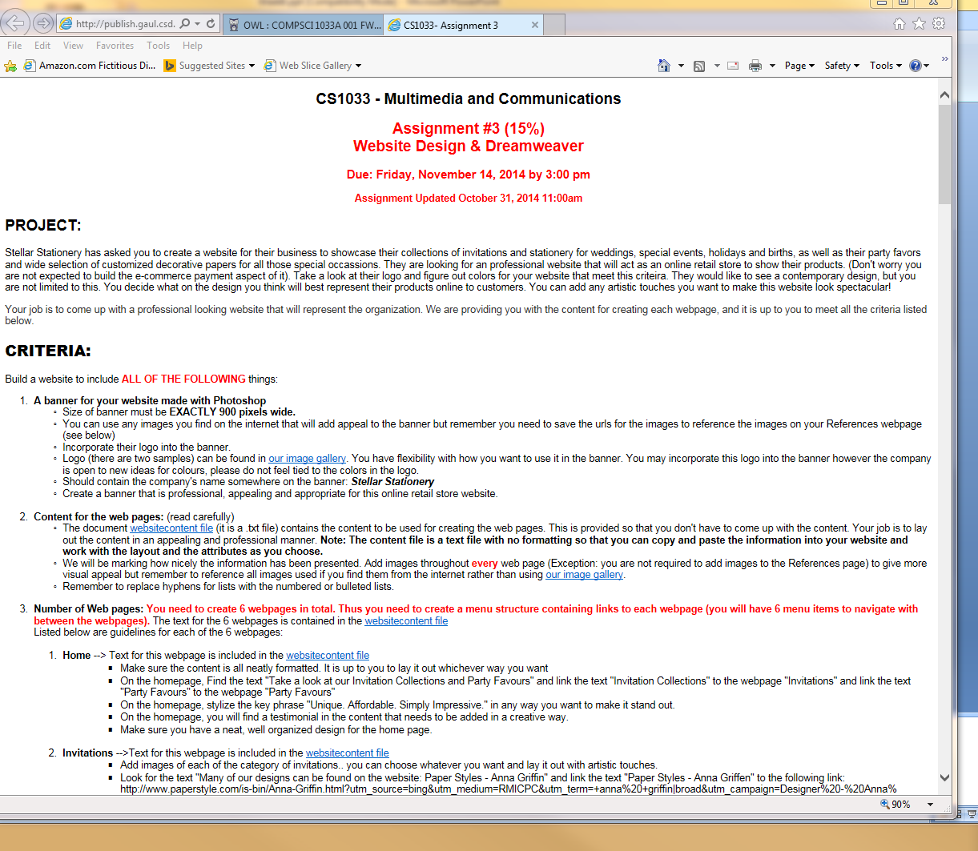
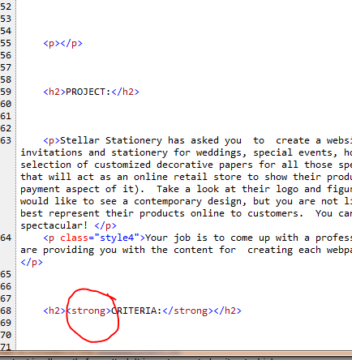
Put Keywords in the Best Locations!
Most important place to put keywords:
Title
Visible Body (the text you can cut from a page and paste into Notepad)
Text around and in links
Text that is above the fold
Some locations that are not quite as important to search engines (but sometimes still considered) are:
Alternative text
Text in the domain name and file names
Meta tag (considered by far the least important)

Slide 49
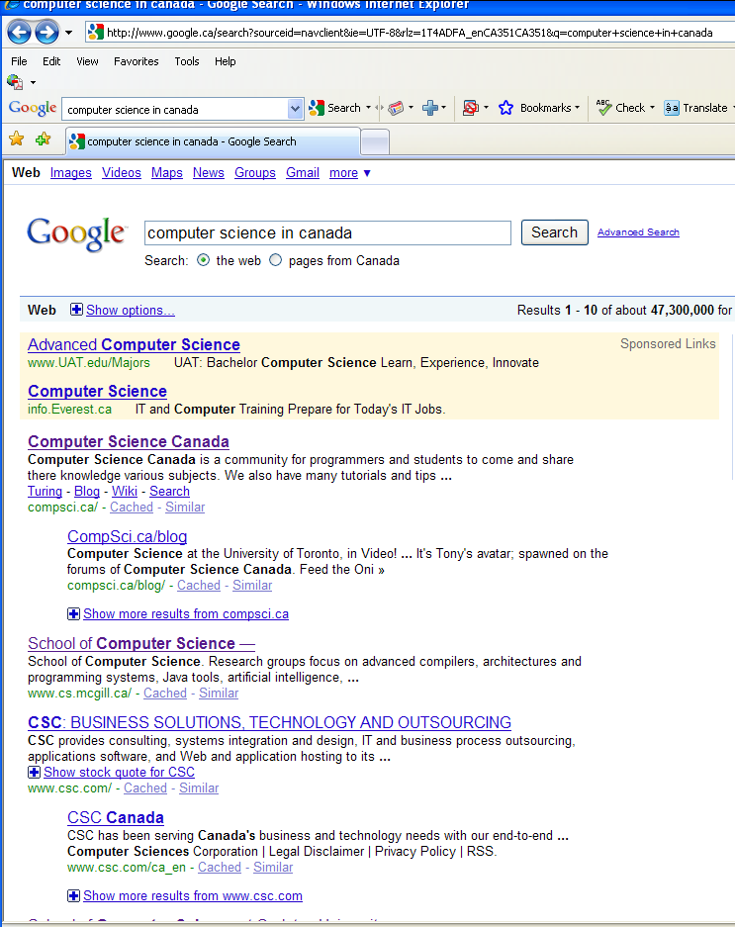
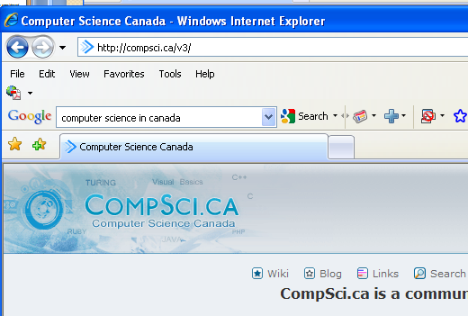
Title-Tag is considered the MOST important text by all search engines
Title tag is what is shown as the link for all returned results
Title tag is text shown when people bookmark your site
Can be 100 characters but keep most important stuff in the first 63 characters

Slide 50
Body of the Webpage
Search engines think keywords found near the top of the page make the page more relevant and thus give those pages a higher ranking (Keyword Prominence)
Question: If you are searching for 2 or more keywords, like “civil” and “war”, how do you think search engines ranks pages?
Keyword Density also gives a higher ranking
Question: What do you think keyword density is?
Notes:
2 words that are closer together get a higher ranking than 2 words that are separated.

Slide 51
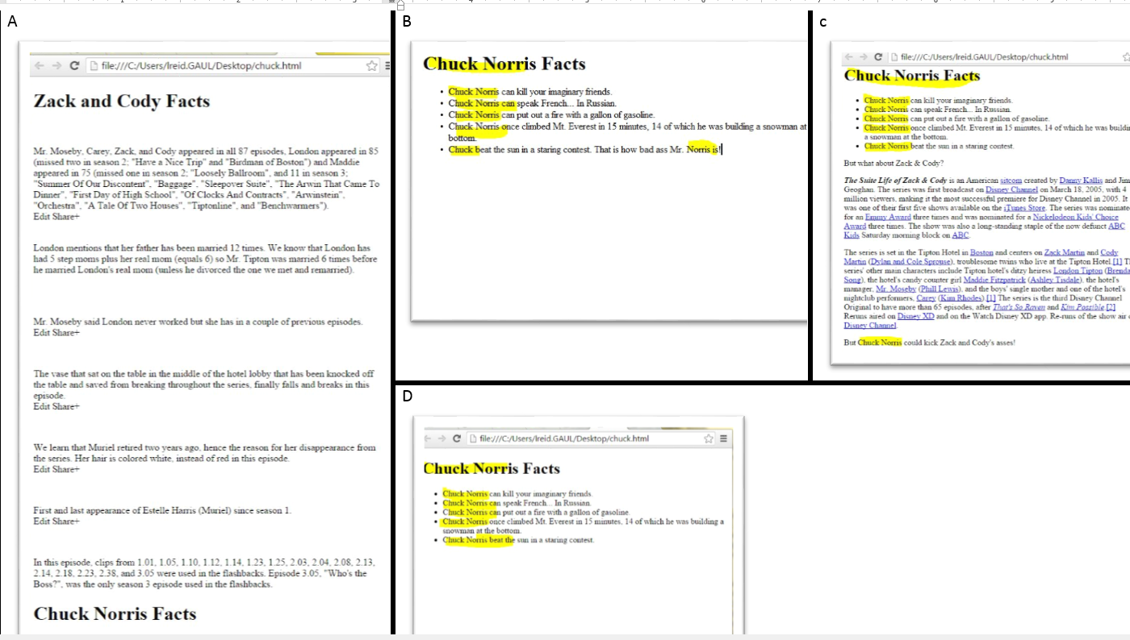
Assume we are search for: Chuck, Norris

Slide 52
Another clever trick that people try to beat Google – Keyword Stuffing
A simple site about cats: http://www.csd.uwo.ca/~lreid/cs1033/keywordstuffing.html
Question: How did I do keyword stuffing with the above page? (I did 2 things, can you find them?)
Another example –how is this stuffed? → YouTube video (view source)
Moral of the story: you USUALLY can’t outwit Google, just use good content to win over your visitors!

Slide 53
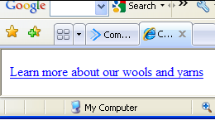
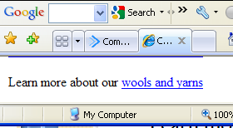
Body of the Webpage
Text in and around links is used by search engines, for example:
Instead of this <a href=http://www.yarnsandwools.com>Learn more</a> about our wools and yarns
Do this: <a href=http://www.yarnsandwools.com>Learn more about our wools and yarns</a>
Or this: Learn more about our <a href=http://www.yarnsandwools.com>wools and yarns</a>

Slide 54
Number 2: Link Component
Make sure that your links are easy to navigate so that web spiders can search through your content easily and index ALL your content.
NOTE: It is hard for spiders to crawl through:
Image maps
JavaScript
Database Driven Web Pages (ones with ?, &, etc in the URL that are created, CGI pages can be problematic)
Links in Flash documents
Poorly written html (don’t use MS Word, etc to write the html tags!)

Slide 55
Number 3: Popularity Component
Popularity is broken into two parts:
Link Popularity
Not just getting many links to your site, the links to your site must be high quality links! REMEMBER PAGERANK!
Click-through popularity
Measures how many times your site is clicked on
Measures how often a user returns to your site
Measures how long a user stays at your site
Question: Click-through popularity is not used by some search engines to give a weight to a page, WHY?
Review

Slide 56
Some tips to increase your popularity weighting
Check your competitors web pages, try to figure out why their site is ranked higher than yours.
For example:
Go to http://www.google.ca
Search for Horseback Riding London Ontario
Suppose I work for Circle R Ranch, why did my site not show up first?

Slide 57
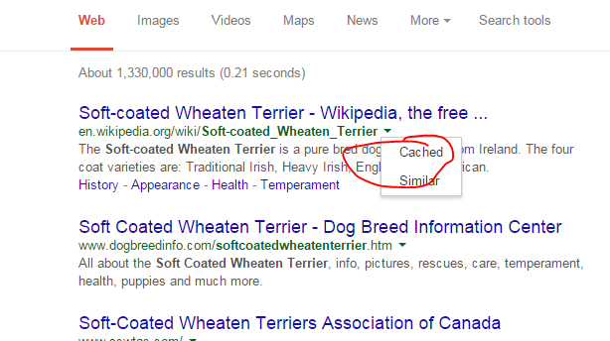
How can you get Google to find you faster?
Submit your site to here: http://www.google.com/submityourcontent/#
Question: When you do a search in google, what happens if you click on cached? For example, search for Soft Coated Wheaten Terriers Dogs, then click on the cache link → http://www.google.ca
Hover over the green arrow next to the link:

Slide 58
Google Quiz – Can you find which one will rank higher?
This Page or…
That Page?
https://we.love.cats.ca
ThisPage
ThisPage
ThisPage
ThisPage
ThisPage
ThisPage
ThisPage
ThisPage
http://we.love.cats.ca
OrThisPage (view the source)
OrThisPage? (check the title)
OrThisPage? (view source&check images folder)
OrThisPage? (view source, h1 and h2)
OrThisPage? (location, location, location)
OrThisPage? (alt)
OrThisPage? (links)
OrThisPage? (name)
Notes:
First 63 characters of title are important, doesn’t look past 100
Okay:<img src="pancakes.png" alt="pancakes">
This alt text is only "okay" because it's not very descriptive. Yes, this is an image of a stack of pancakes. But, there's more to be said about this image.
Good:
<img src="pancakes.png" alt="Stack of blueberry pancakes with powdered sugar">
This alt text is a better alternative because it is far more descriptive of what's in the image. This isn't just a stack of "pancakes" (as the first alt text example demonstrated); it's a stack of blueberry pancakes with a dusting of powdered sugar!
Not recommended:
<img src="pancakes.png" alt="">
or
<img src="pancakes.png" alt="pancake pancakes pan cake hotcakes hotcake breakfast food best breakfast top breakfasts breakfast recipes pancake recipe">
For img tag, use keywords but don’t keyword stuff – google wont dock you for poorly written alt text BUT you will be in trouble if it figures out that you are using the alt text as an opportunity to stuff as many keywords as you can think of. Also, don’t use “Picture of” or “image of”, google knows it is an image. TITLE/HOVER TAG is NOT used in ranking.
Okay alt text: <img src="bird.png" alt="Rooster"> Better alt text: <img src="bird.png" alt="Rooster crowing">
Best alt text: <img src="bird.png" alt="Red-crested rooster crowing">
Google cant see images yet so ifyou can describe what the image is showing, that will help google decide if your page is appropriate to return.

Slide 59
A few more tips…
Improve your page speed (Google checks how fast a page loads – check your code/files)
Optimize for voice search (that is how people search now)
Optimize for mobile searches (over 60% of searches are now mobile)
Have a great user experience – Google checks:
How long did the user stay on your page
How many times do they visit your site
How many pages on your site do they visit
What is your bounce rate (% of users who leave your site after viewing only 1 page)

Slide 60
Search Insights
https://www.google.ca/trends/
Search for “Costumes”, “Flowers”, “Chocolates”
How it works → https://www.youtube.com/watch?v=EOdN0CF1N68
Last year’s trends: https://trends.google.ca/trends/yis/2019/CA/
Question: How about the top keywords for today? http://www.google.ca/trends/hottrends

Slide 61
Usage Statistic: What are they?
It is important to know what your visitors like and dislike about your website so you can improve it!
Analyze your stats from your IPS provider or from companies on line
Question: What kind of stats do you think you could get about a website?

Slide 62
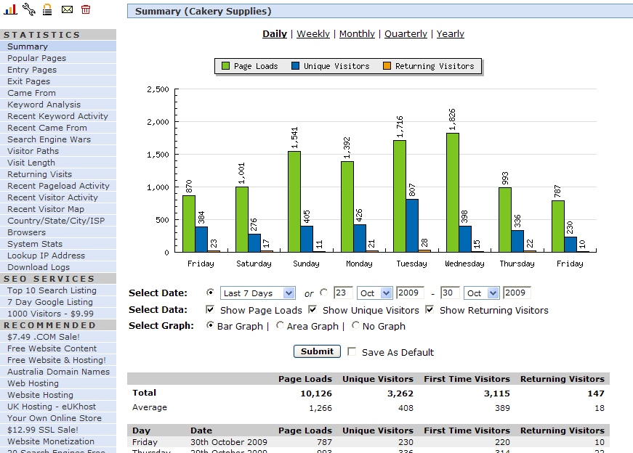
Usage Statistics: An Example
Entry page
Exit page
Here is a real report:
Total Hits: 3,357
Total Files: 1,441
Total Pages: 413
Total Visits: 337
Hits: Each file (a html file, a graphic file, ) sent to a client
Pages: A webpage
Question: Which will always be bigger: hits or pages?
Notes:
http://my7.statcounter.com/project/standard/stats.php?project_id=2368090

Slide 63
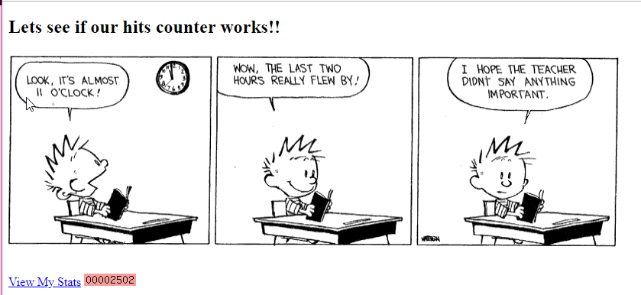
Hit Counters
I installed a hit counter from http://statcounter.com into this page: http://www.csd.uwo.ca/~lreid/cs033/TestCounter.html
Right before class

Slide 64
What if you do NOT want people to find your website?
https://support.google.com/webmasters/answer/93710?visit_id=1-636564907849131550-2586980481&rd=1
<meta> tag
To prevent most search engine web crawlers from indexing a page on your site, place the following meta tag into the <head> section of your page:
<meta name="robots" content="noindex">
To prevent only Google web crawlers from indexing a page:
<meta name="googlebot" content="noindex">

Slide 65
Google
Some more facts from www.wikipedia.org
Their search engine was originally nicknamed "BackRub" because the system checked backlinks to estimate the importance of a site.
Both Brin and Page were against using advertising pop-ups in a search engine, or an "advertising funded search engines" model, and they wrote a research paper in 1998 on the topic while still students. However, they soon changed their minds and early on allowed simple text ads.
99% of Google's revenue is derived from its advertising programs.
2006 earnings from ads → 10.5 Billion, from other revenue 112 million
2017 earnings → 110 Billion (86% from ads)
Google usually near the top of lists of the best places to work

Slide 66
Let’s Review
http://www.youtube.com/watch?v=NW1h_yh5_v0
https://www.youtube.com/watch?v=0eKVizvYSUQ

Slide 67
Review
Question: What is the PageRank algorithm?
Question: Name the most popular search directory web site?
Question: Name the most popular search engine website? What % of the market does it currently have?
Question: What are the 3 components you must address to get your page a higher ranking?
Question: Who started Google?
Question: Who invented URLs, the World Wide Web and HTML?

