Slide 1




Society of Graduate Students
Middlesex College, Room 8
sogs@uwo.ca | sogs.ca | stickwithsogs.ca
@WesternSOGS
@Western.SOGS
@WesternSOGS

Slide 2

The Society of Graduate Students was incorporated in 1964.
It originally served as a liaison between graduate students and the administration.
Its first noteworthy act of advocacy was creating and temporarily operating the Western Daycare between 1967-1972.
50+ years later, SOGS is so much more…

Slide 3
SOGS IS:
AN ADVOCATE. SOGS works with university stakeholders and administration, as well as municipal and government officials to fight for the rights of its members.
A STUDENT UNION. SOGS is a local of the Canadian Federation of Students (Local 47) and works with the TA Union (PSAC 610) to ensure student voices are heard.
A STUDENT GOVERNMENT. SOGS democratically elects councilors, Executive officials, committee chairs and members, Commissioners, Speaker, and Ombudsperson.
COMMITTED TO ENHANCING GRADUATE STUDENT EXPERIENCE. SOGS offers social & family events programming, plans orientation weeks, offers financial assistance programs and academic awards.
A CHAMPION OF GRADUATE STUDENT WELLNESS. SOGS works with Student Experience and SGPS to host Wellness Week and offers support programs.
AN EMPLOYER OF GRADUATE STUDENTS and an OWNER OF A SMALL BUSINESS, the Grad Club.
Notes:
Your SOGS dues pay for:
Academic awards and scholarships
Advocacy initiatives
Commissioners (Accessibility, Indigenous, Pride, Women’s Concerns)
Committees
Council and grant funds
Financial Aid Programs
Graduate student jobs
GradCast: The Official (research-focused) Radio Show of SOGS
Social and orientation events
Ombudsperson for graduate students
Peer and Academic Support programs
Operation of the Grad Club
Operation of the SOGS office and staff
Wellness Week
Western Research Forum
and more...

Slide 4
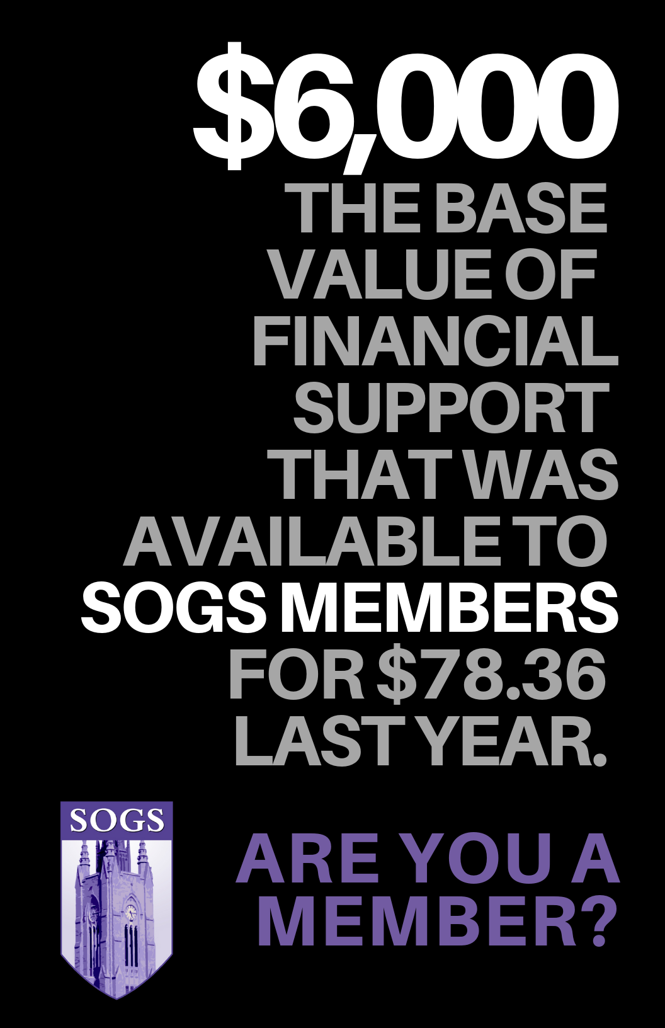


Slide 5


Slide 6


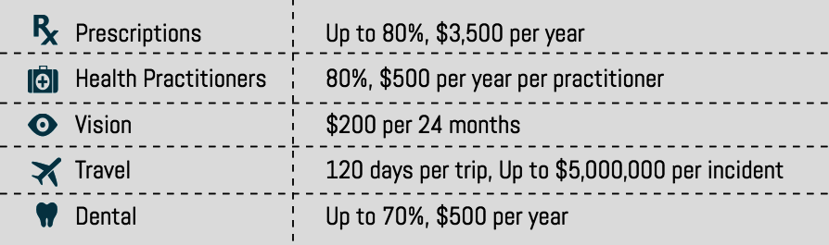
EXTENDED HEALTH &
DENTAL INSURANCE
DOWNLOAD THE Studentcare APP!
Top up with PSAC 610
Includes Psychology Network!
*For new students who start in September*
Don’t want all the coverage of the full plan? Downgrade to the basic plan
DOWNGRADE ONLINE September 1-31 via studentcare.ca
Do you have dependents?
OPT-IN ONLINE September 1-31 via studentcare.ca
Have equivalent coverage?
OPT-OUT ONLINE September via studentcare.ca
(*refunds are issued back to your student account in October)

Slide 7


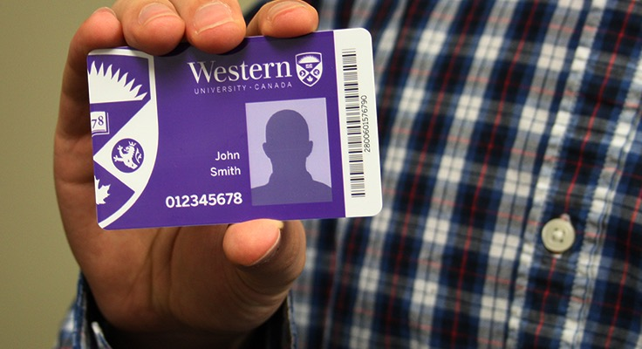
LONDON TRANSIT (LTC)
BUS PASS
Your Western ONECard is a “tap” bus pass
Replacements student cards can be purchased in the Registrar’s Office (WSSB 1120 - Foyer)
Students with old Western ID cards (made prior to the fall of 2016) will need to go to the SOGS office to pick-up a paper pass.

Slide 8



FINANCIAL ASSISTANCE &
STUDENT SUPPORT
SOGS BURSARIES
$1500 each
TRAVEL SUBSIDY
up to $500 per term
CHILD CARE SUBSIDY
up to $500 per term
EMERGENCY LOAN
up to $1000
PROFESSIONAL PLACEMENT SUBSIDY
up to $500 per term
sogs.ca/food-bank-program
Wellness Joint Fund
For more information please visit:
sogs.ca/financial-support

Slide 9
FINANCIAL AWARDS
  125TH ANNIVERSARY SCHOLARSHIP
  4 Scholarships of $1250 each awarded once per year.
PEGGY COLLINS MEMORIAL AWARD
2 awards of $1000 to part-time students.
ACADEMIC JOINT FUND
Co-sponsored by SGPS and Western Research, this fund supports conference & scholastic events showcasing graduate student research.
For more information please visit:
sogs.ca/financial-support/

Slide 10



GRADUATE STUDENT COMMUNITY:
Academics
Gradcast is the official radio show of SOGS. It airs on CHRW 94.9 every Tuesday at 6pm. Listen to your peers talk about their research and experiences as a grad student at Western. Download the episodes on Podbean.com

Slide 11


Canadian Federation of Students
International Student Identity Card:
If you pay your CFS membership due, you get a free card.
Get the virtual card today to access discounts!
Free Tax Filing via UFile:
Free tax Filing! Your CFS membership gets you free income tax filing online via Ufile.ca!
www.cfs.ca/services for more information.

Slide 12



GRADUATE STUDENT COMMUNITY: The Grad Club
The Goblet of Knowledge
*Book this cup and receive a complementary drink post-defense

Slide 13



Graduate Student
Community: Wellness

Slide 14

GET INVOLVED
  Executive
  President, Vice-Presidents (Academic, Advocacy, Finance, Student Services)
  Elected position / paid position
  Committees
  SOGS has numerous committees under each executive portfolio
  Commissioners
  Accessibility, Indigenous, Pride, Racialized, Women’s Concerns
  Elected position
  Report to VP Advocacy
  Committee Chairs
  Elected by committee
  Reports to corresponding VP
  Receives an annual honorarium
  Councillors
  Departmental reps that participate as voting members of grad. student govt.
  Elected position / Dept. grants paid to each grad student association based on
  attendance at council
  Committee members
  Each committee member receives a
  $5 voucher for the Grad Club!
  Volunteer to be a member
  Reports to committee chair

Slide 15

Buy your tickets to the Family BBQ (kids eat free!!) and the Bon Fire Night at the SOGS office. Tickets are $5 per person. *Bon Fire Night is adults-only.

Slide 16


