Slide 1

Western University
Ryan Kahue – Educator Partnership Coordinator
Danielle McRae – Administrative Coordinator
Geetika Gupta – Special Events Coordinator
Chris Zhang – Community Events Coordinator
Email: letstalkscienceuwo@gmail.com
Website: outreach.letstalkscience.ca/uwo

Slide 2
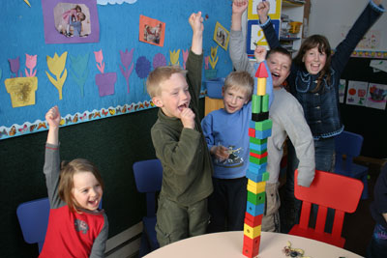
Program Overview
At campuses across Canada, science students are volunteering in their communities to ignite science excitement.
Began in 1991 at UWO
46 active sites at
Universities and some
Colleges across Canada
Notes:
Let’s talk science is a national not-for-profit organization which aims to get children and youth across Canada, interested, excited, and engages in science, technology, engineering and math. In our science outreach program graduate and undergraduate student volunteers go out into the community to deliver hands on science activities.

Slide 3
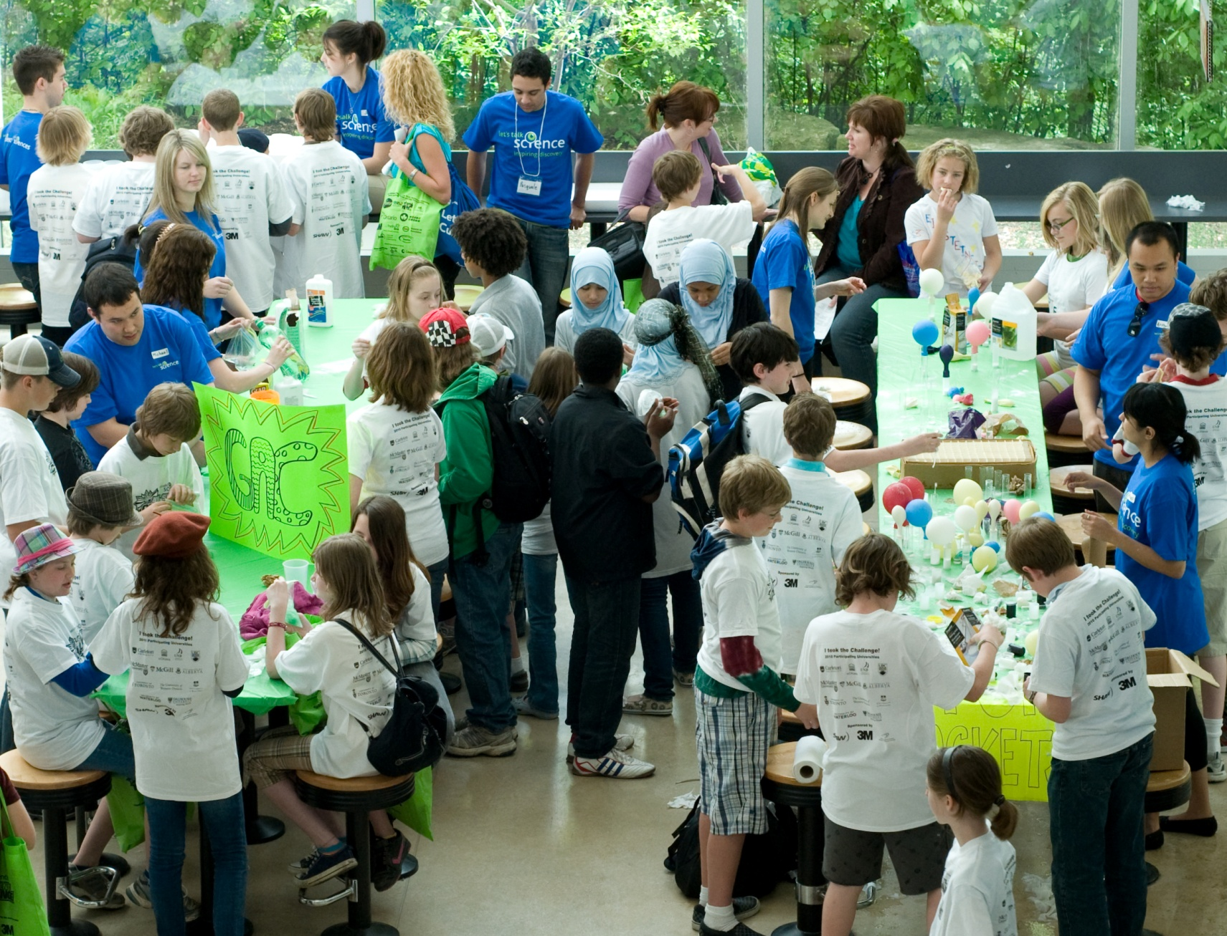
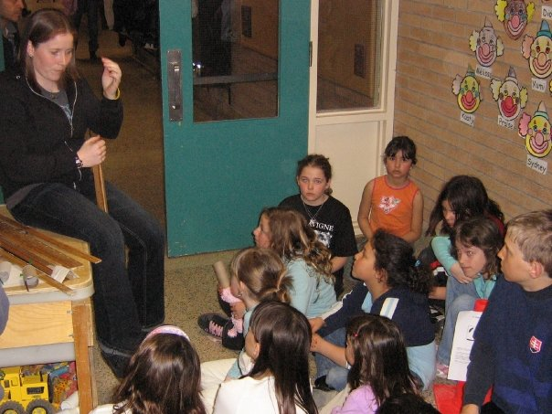
Let’s Talk Science at Western
Teacher Partnerships
- Teachers available at all
levels (K-8)
- Variety of subject areas
- Team or solo visits
Community Events
- One-time events
- Working in teams
- Let’s Talk Science Challenge & Symposia
Notes:
*Also mention workshop development, if you’re passionate about a certain STEM topic or have a fun hands-on way to illustrate it, and you want support, resources, materials, and an audience to test it with!

Slide 4
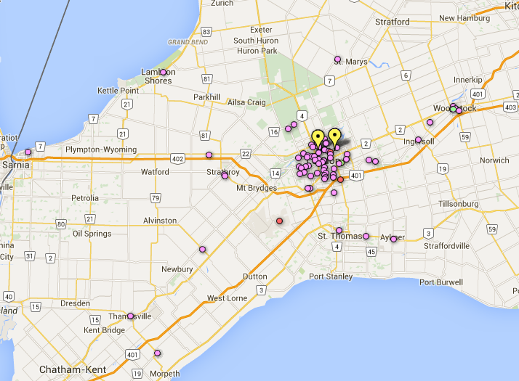
Activities in 2018-19
257 activities
135 volunteers
51 teacher partnerships
9850 youth reached
Notes:
Mention volunteers from all disciplines (Schulich, biology, chemistry, physics, engineering, geography, computer science, math)
Mention we do all sorts of activities (biology, chemistry, health, engineering, physics, earth science, computer science)
Activities

Slide 5
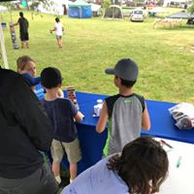
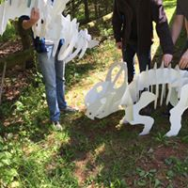
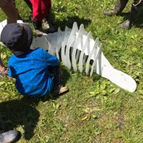
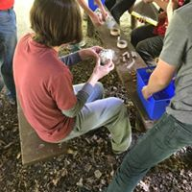
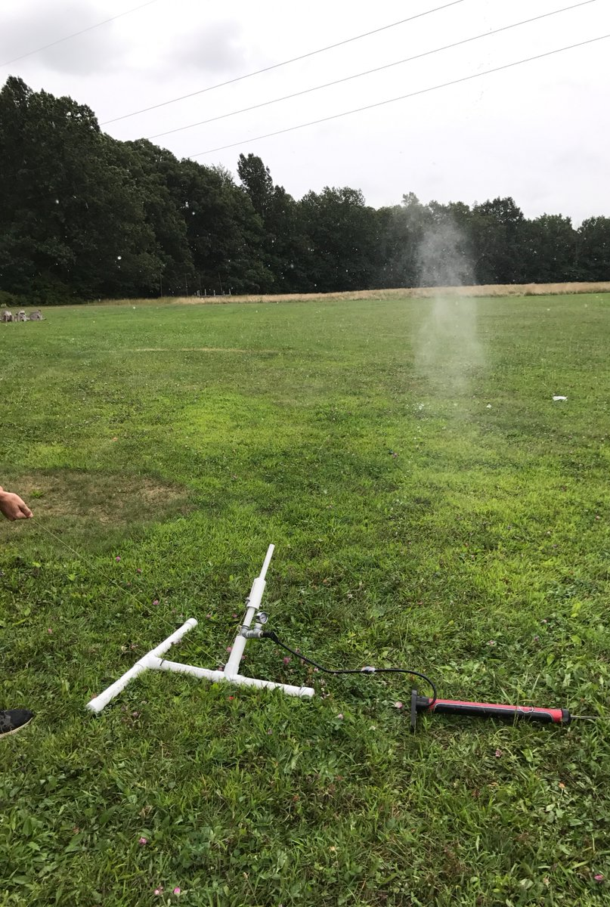
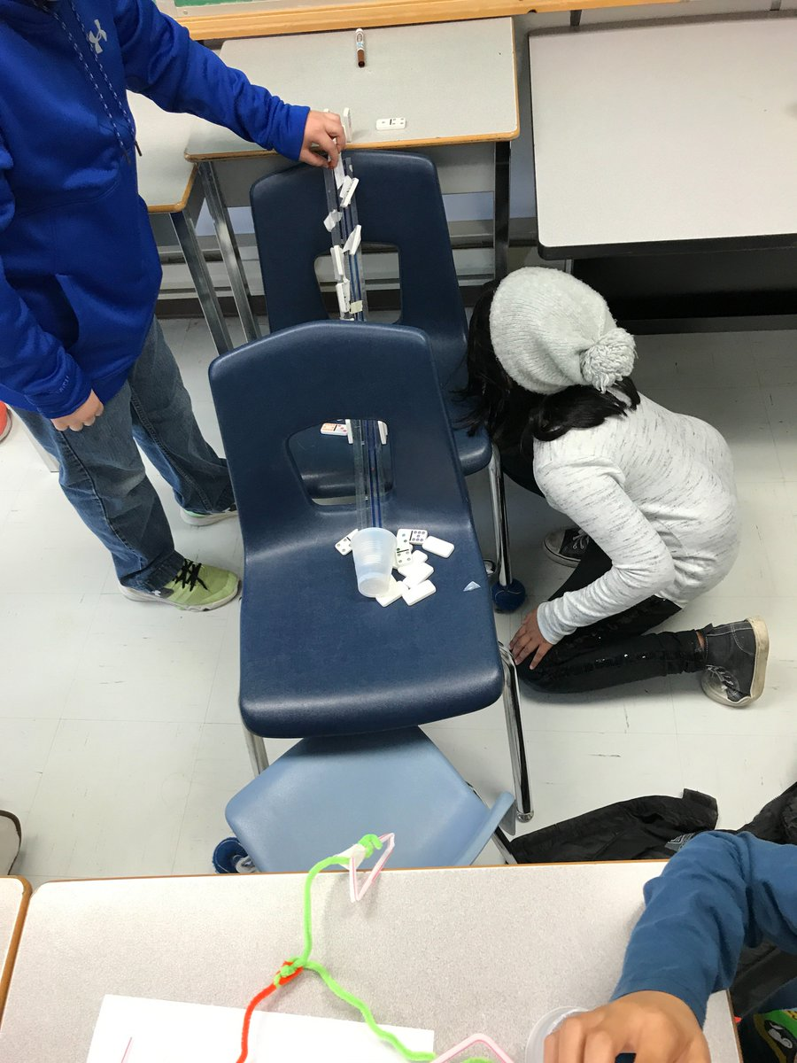
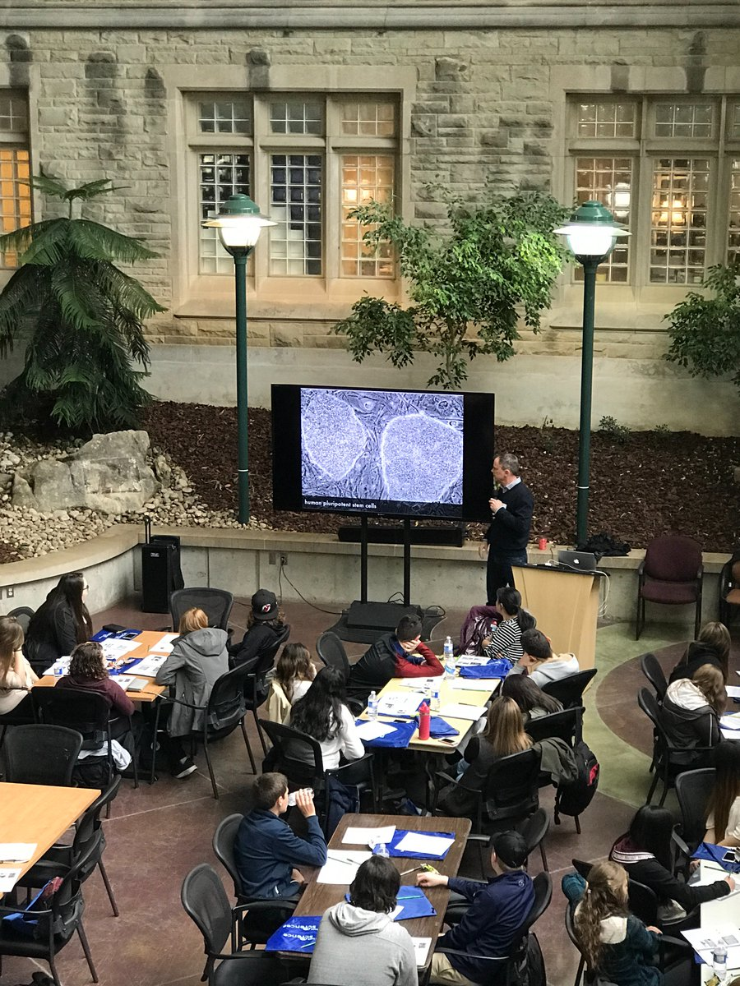
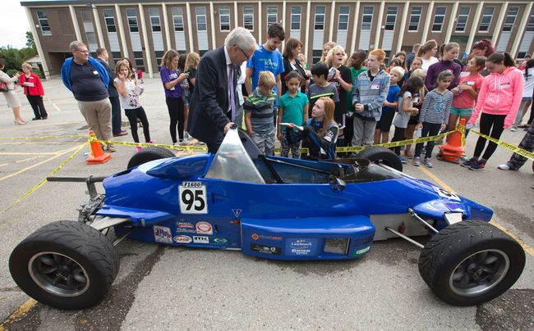
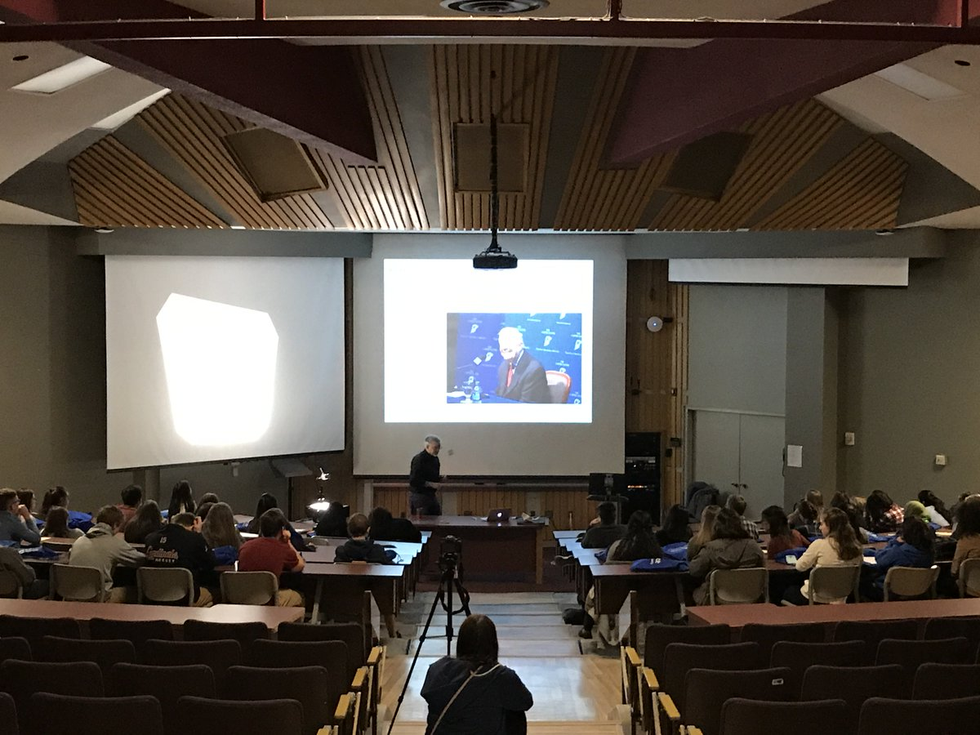
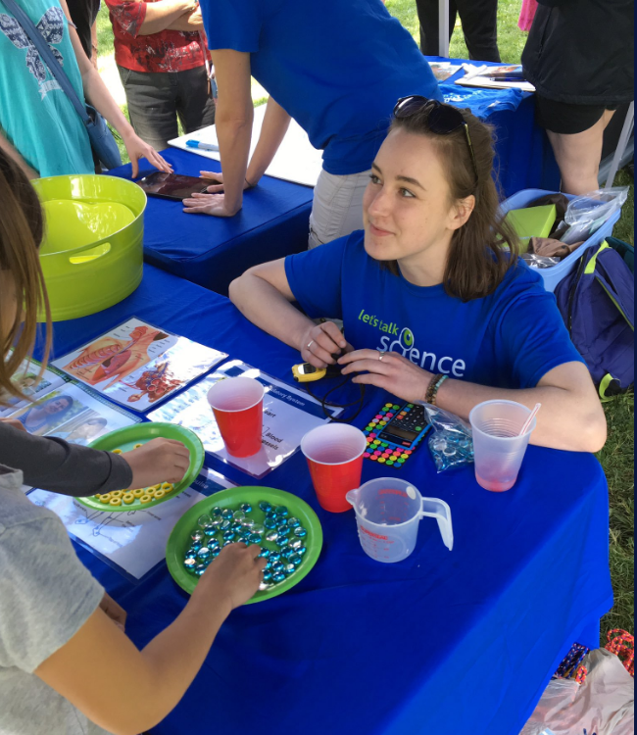
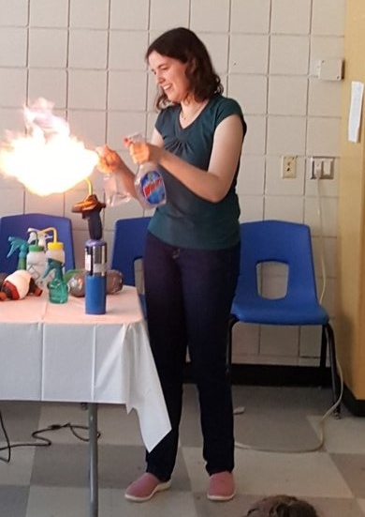
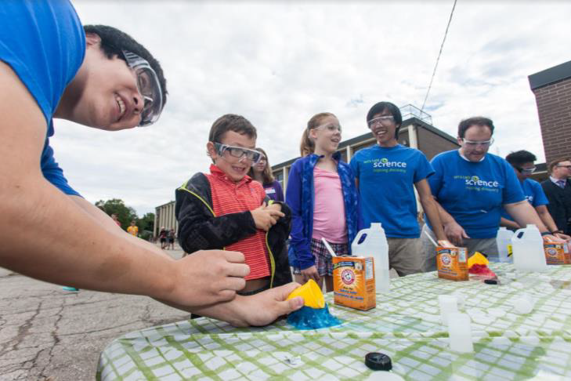
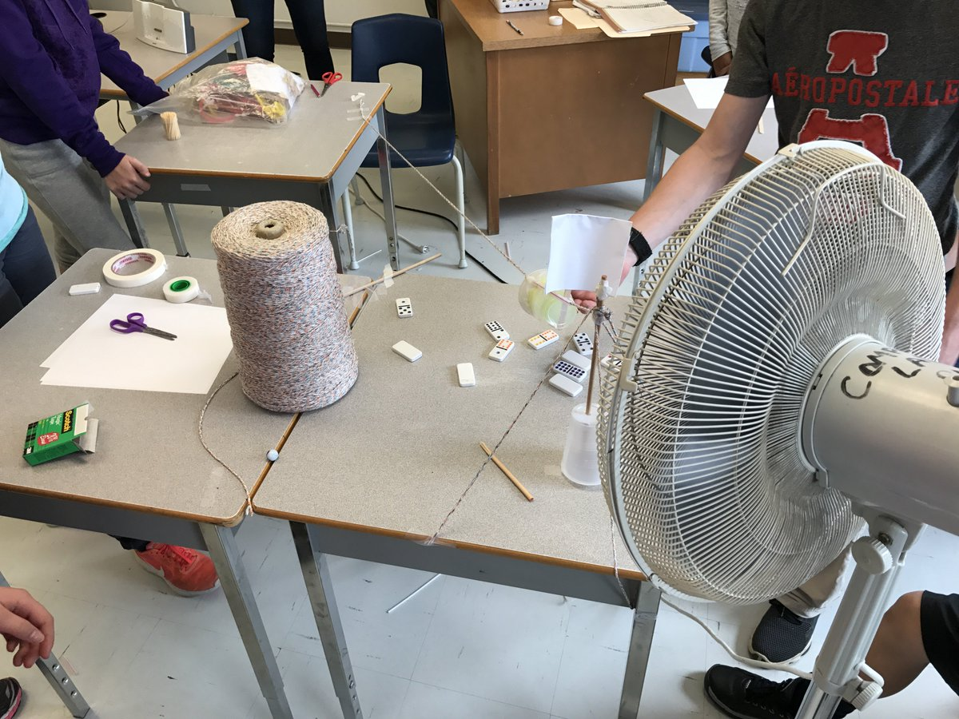
Let’s Talk Science Outreach

Slide 6
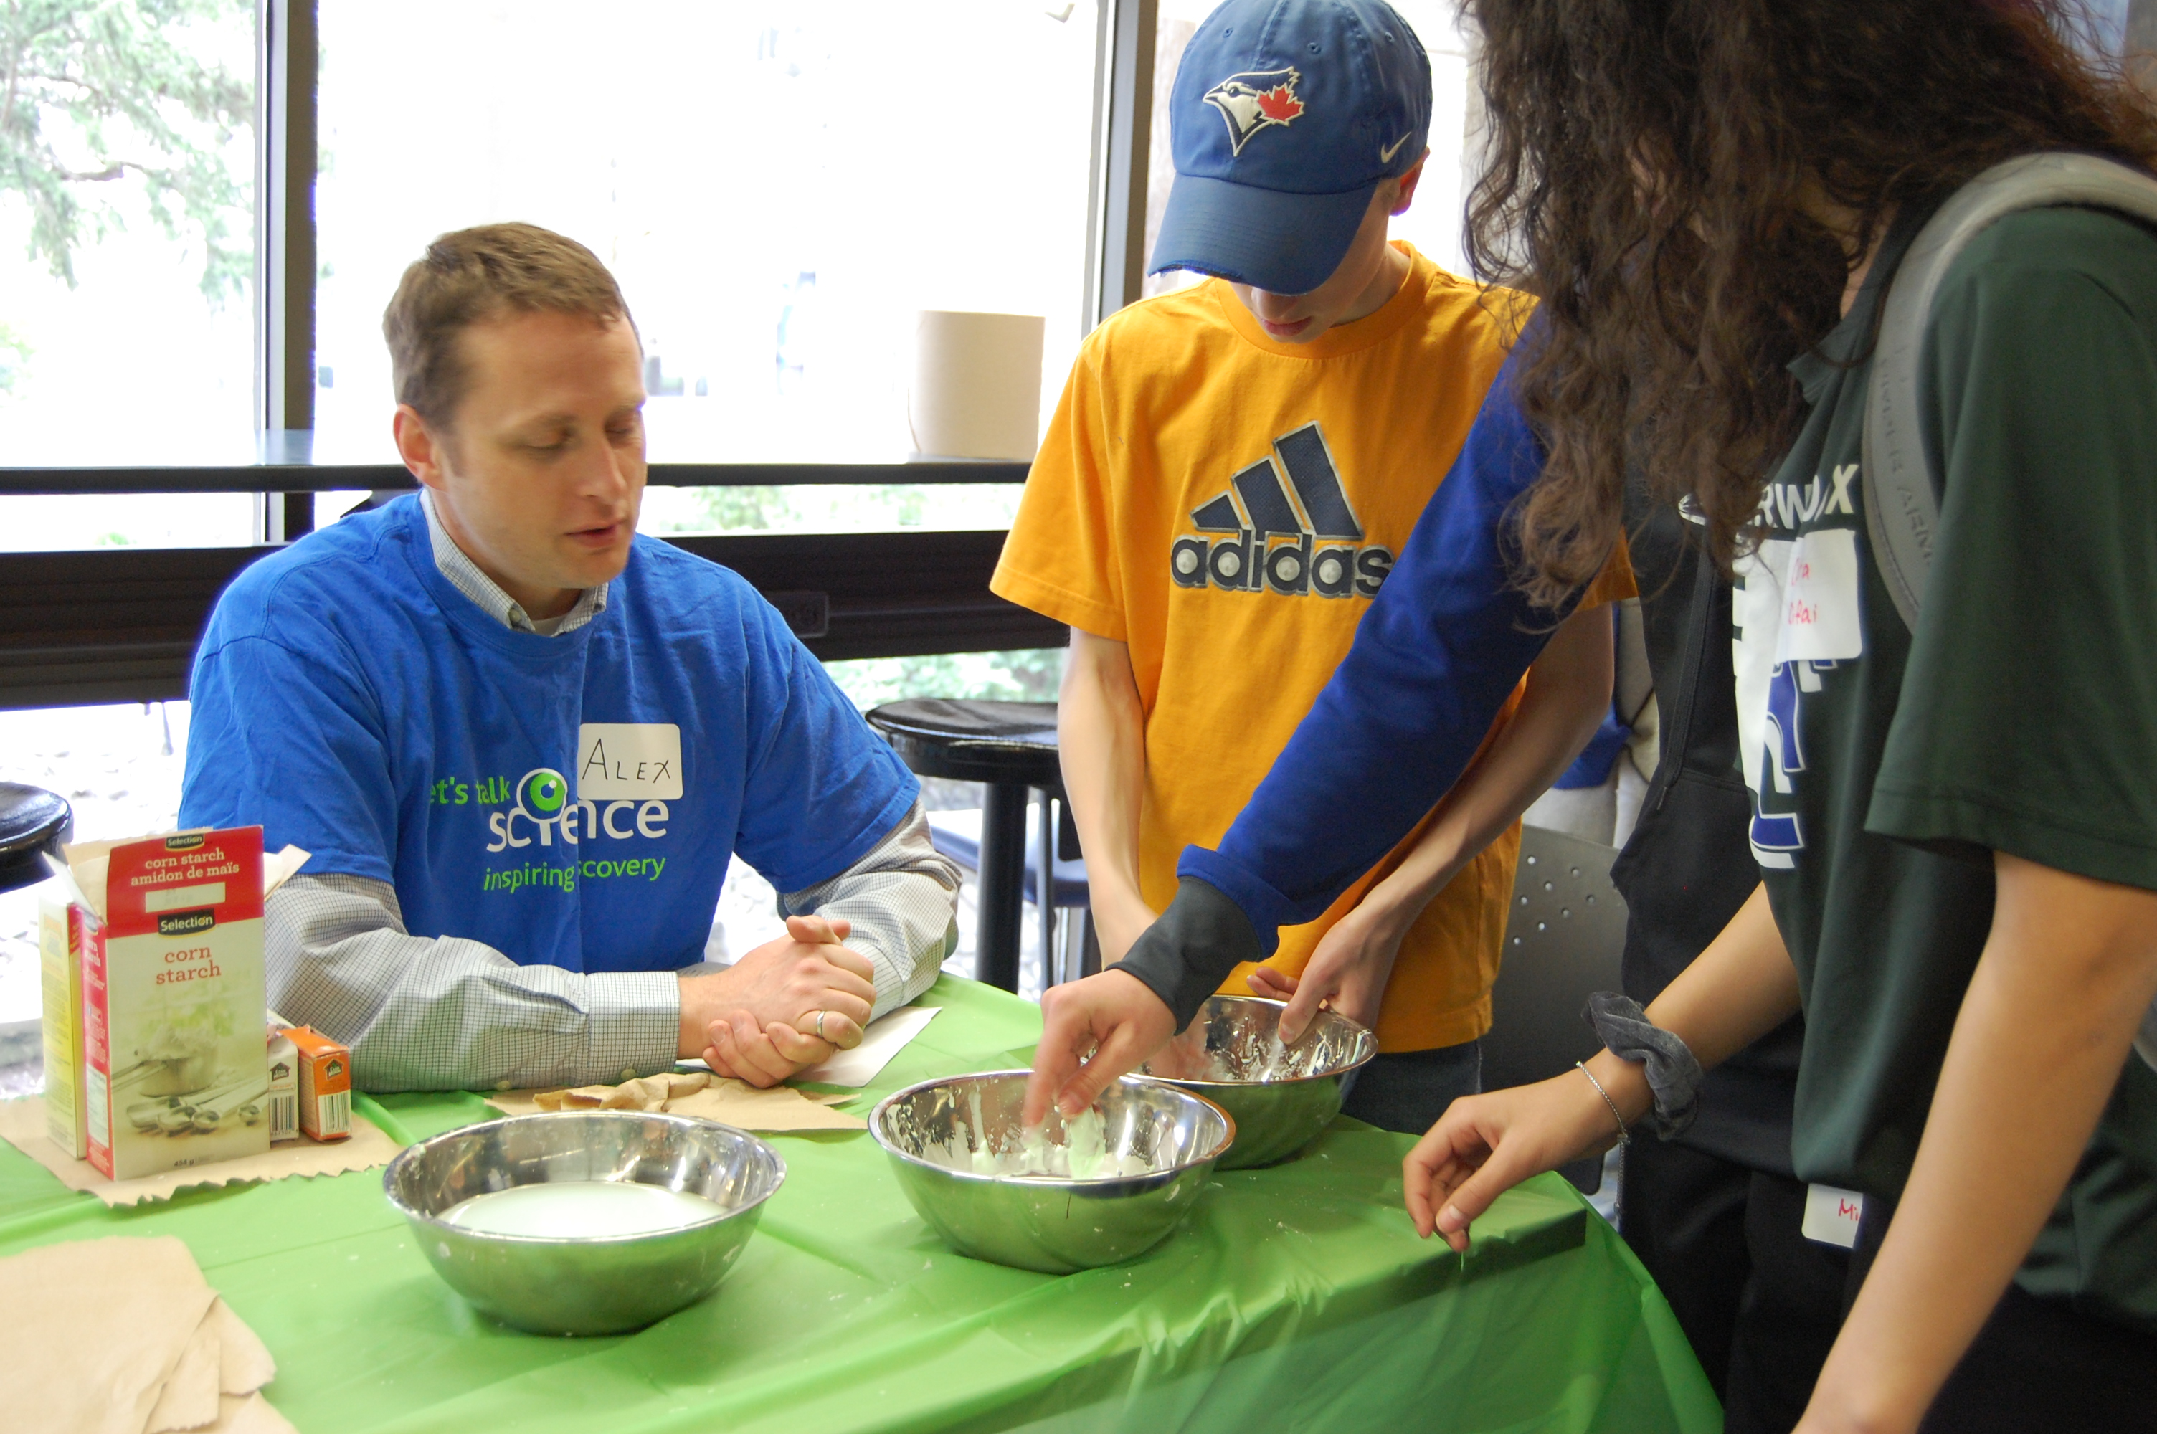
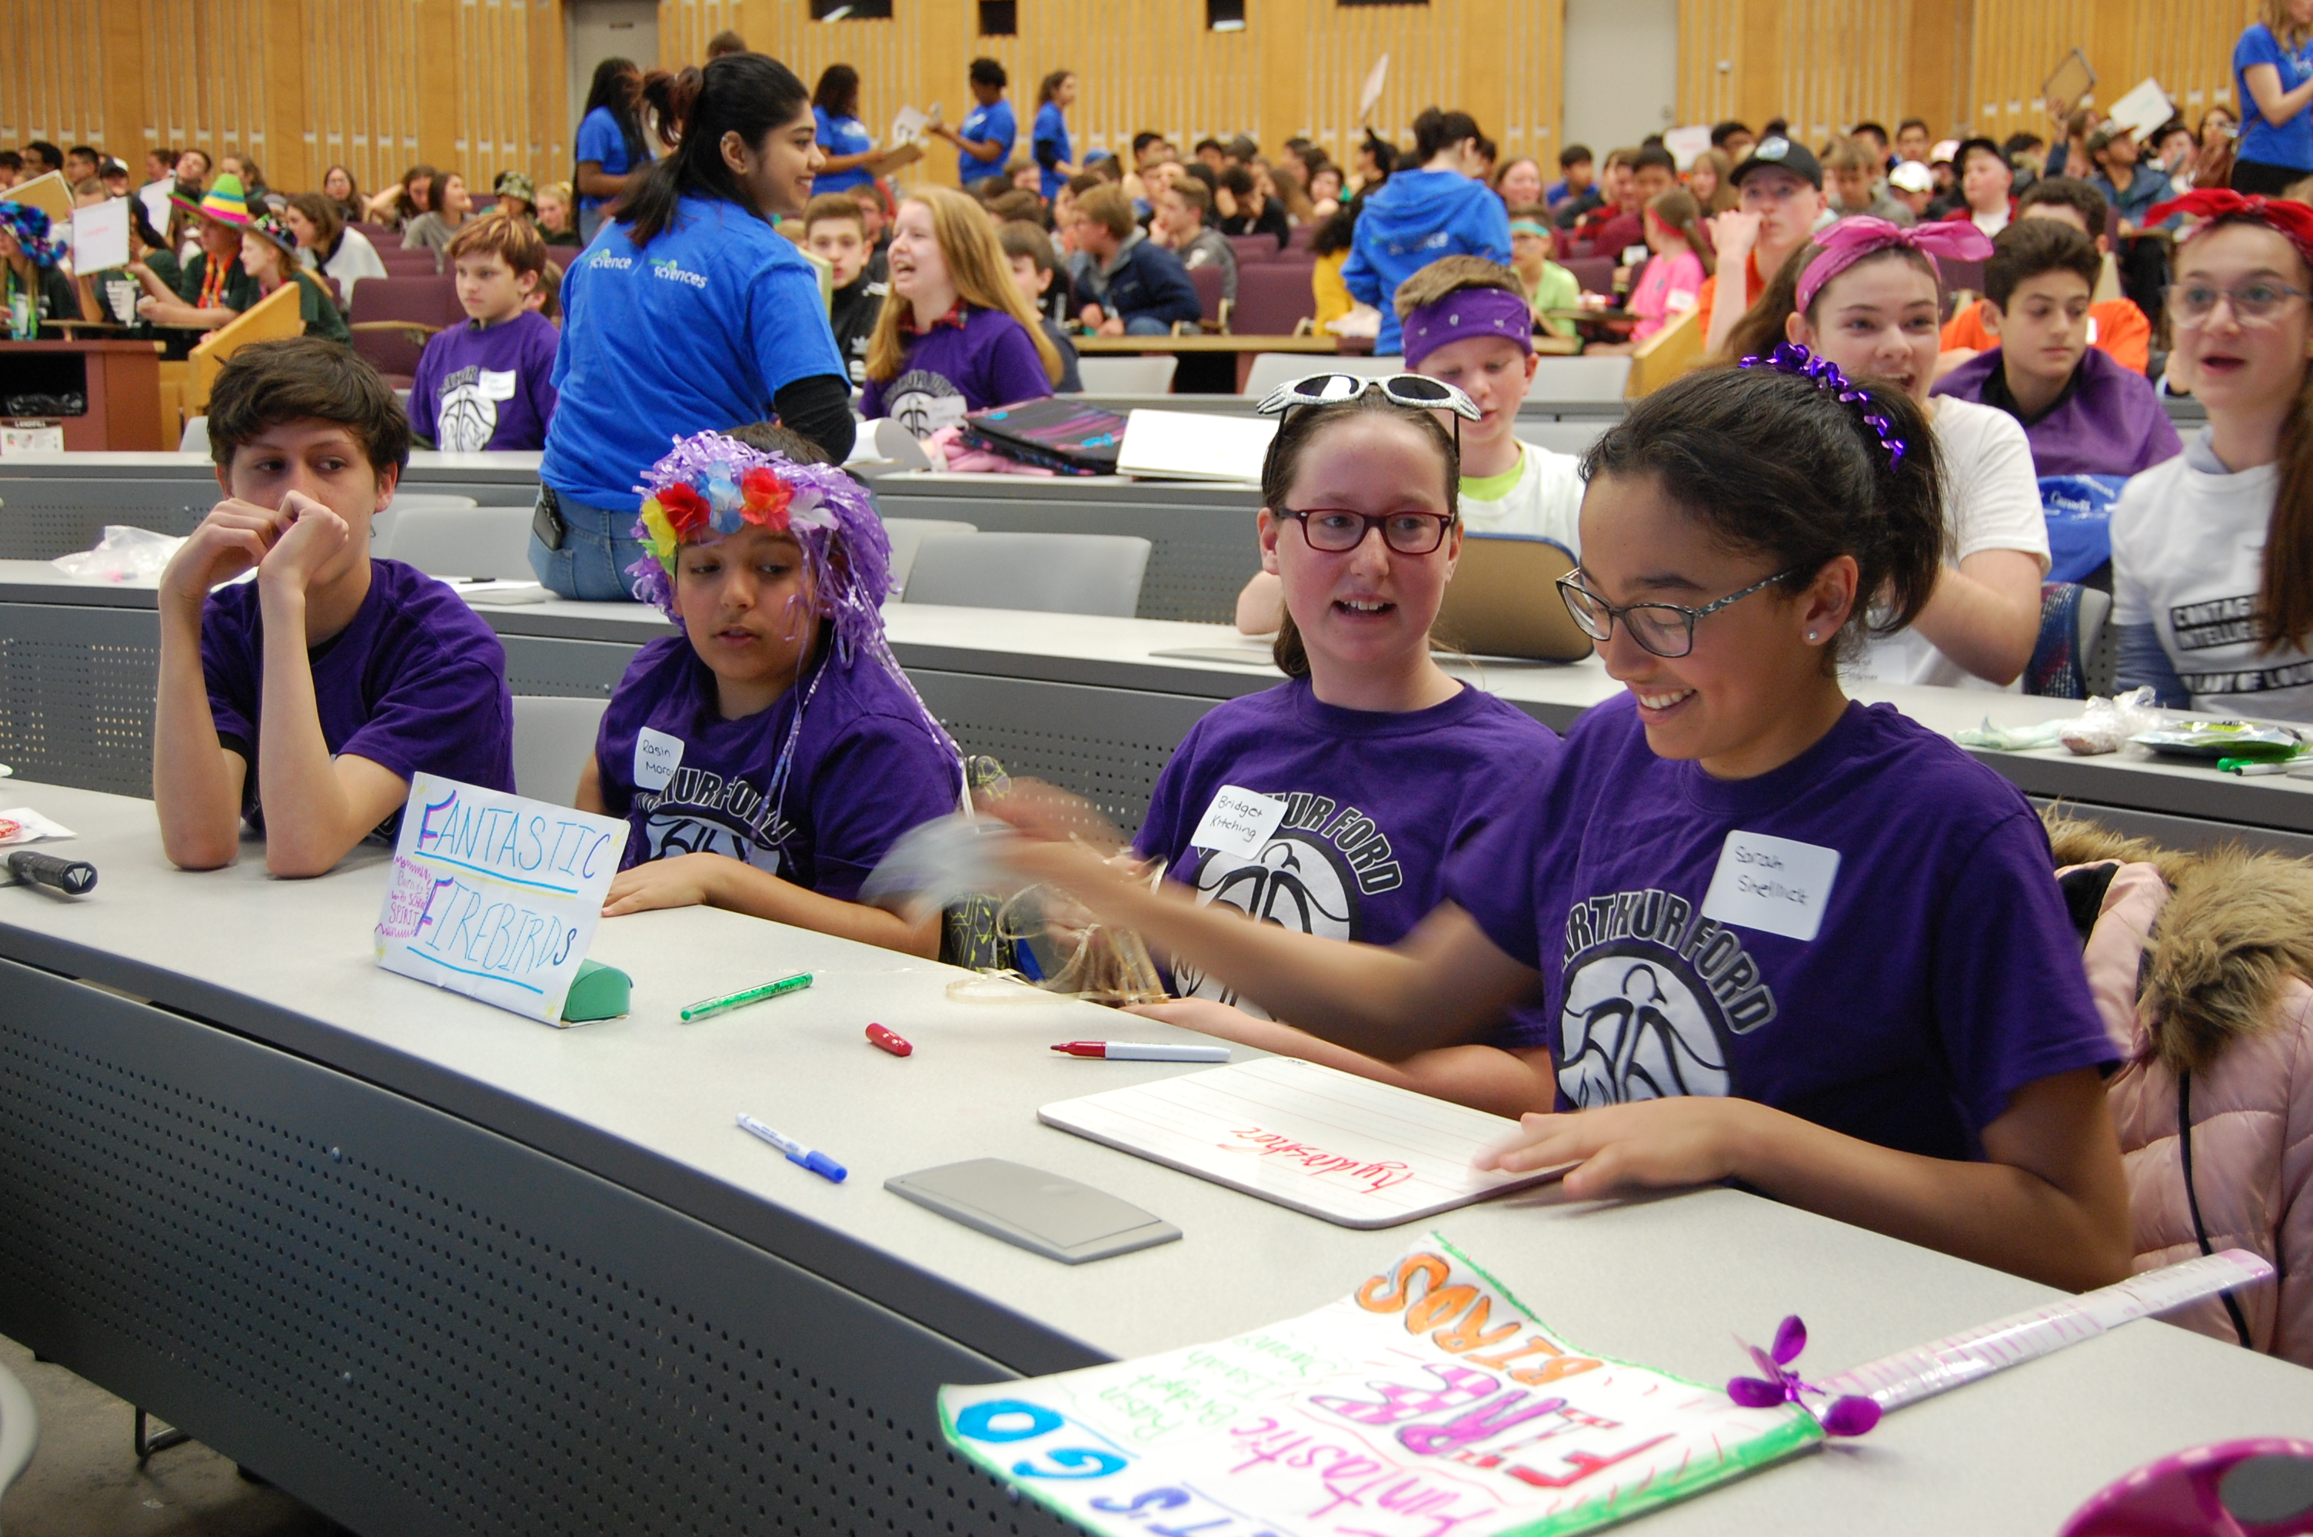
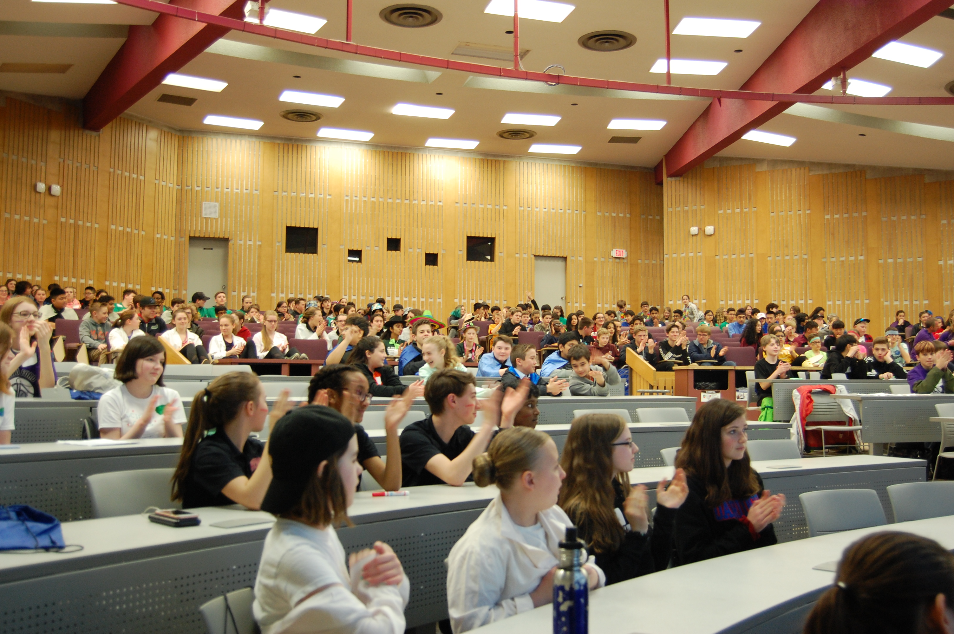
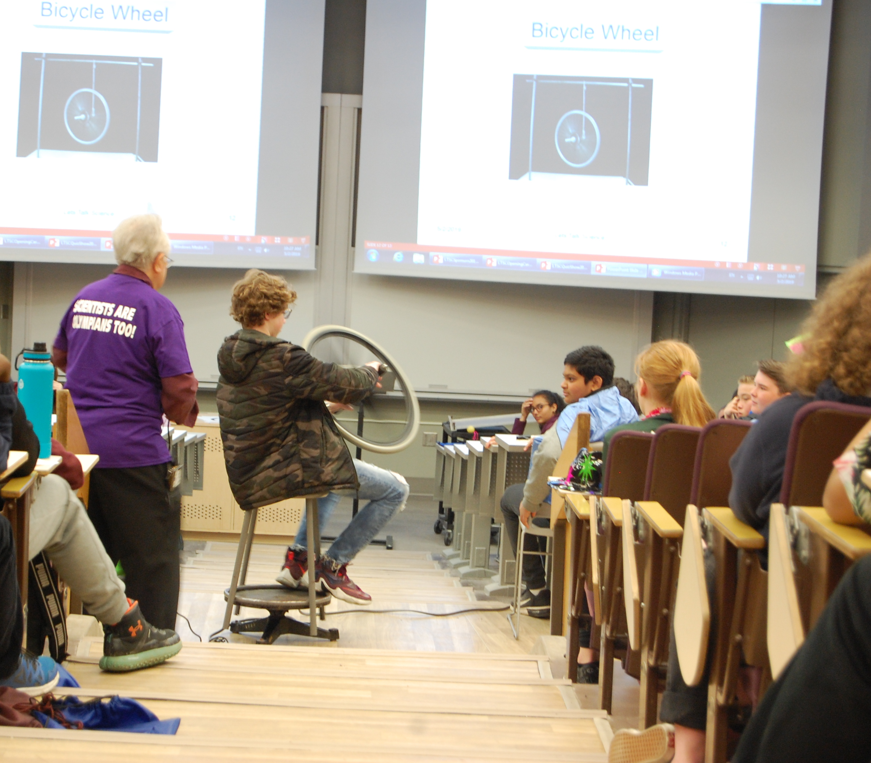
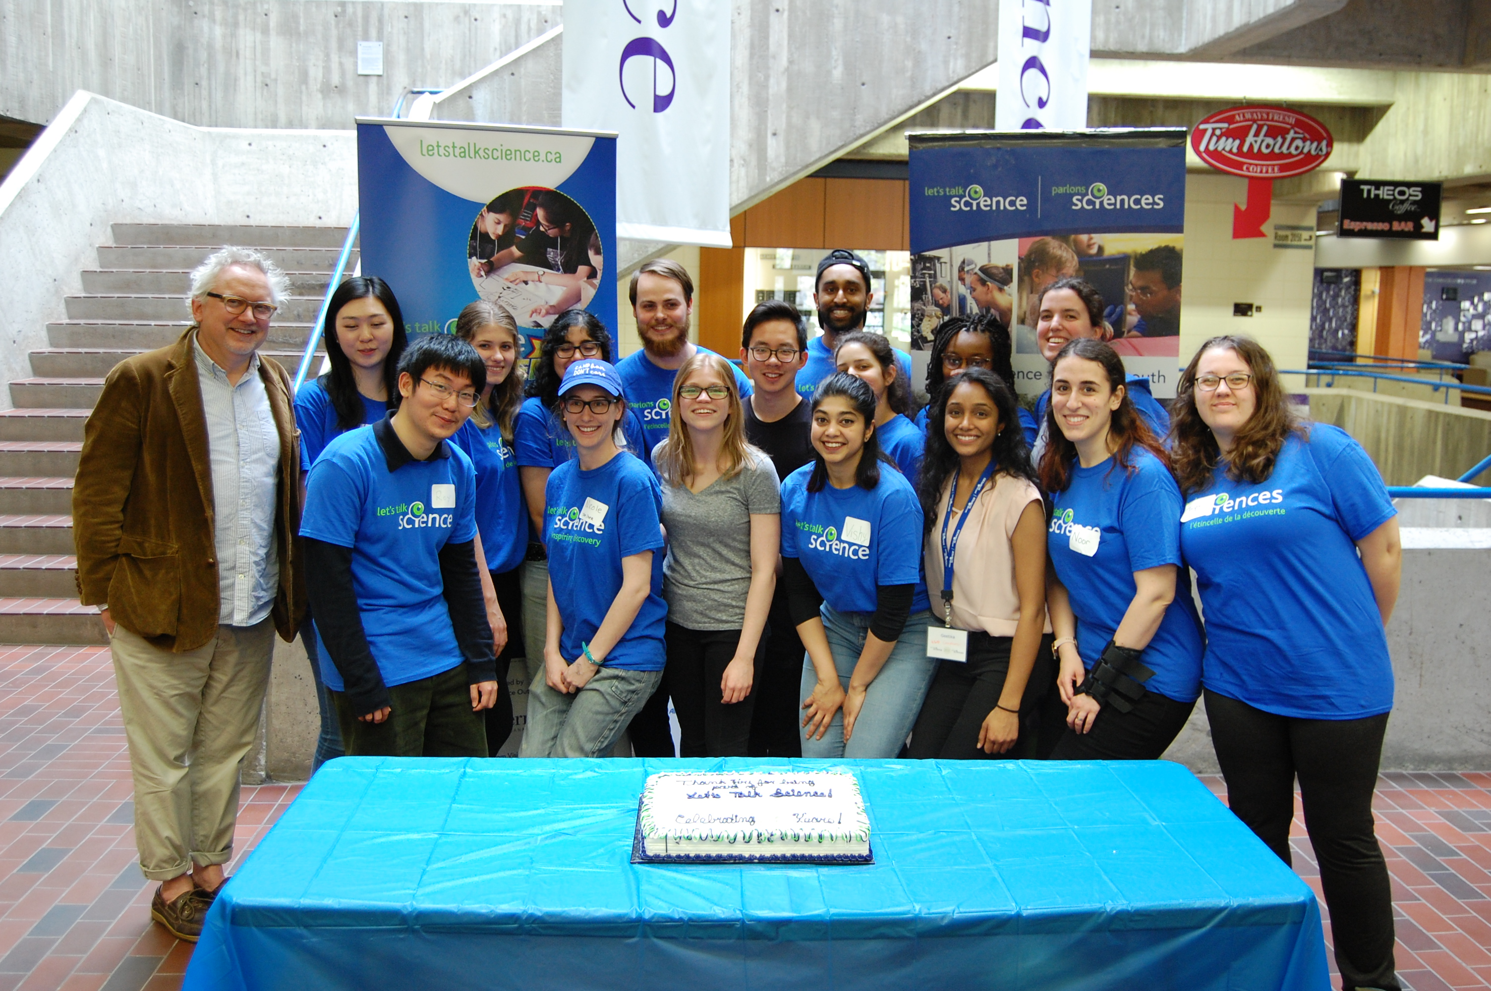
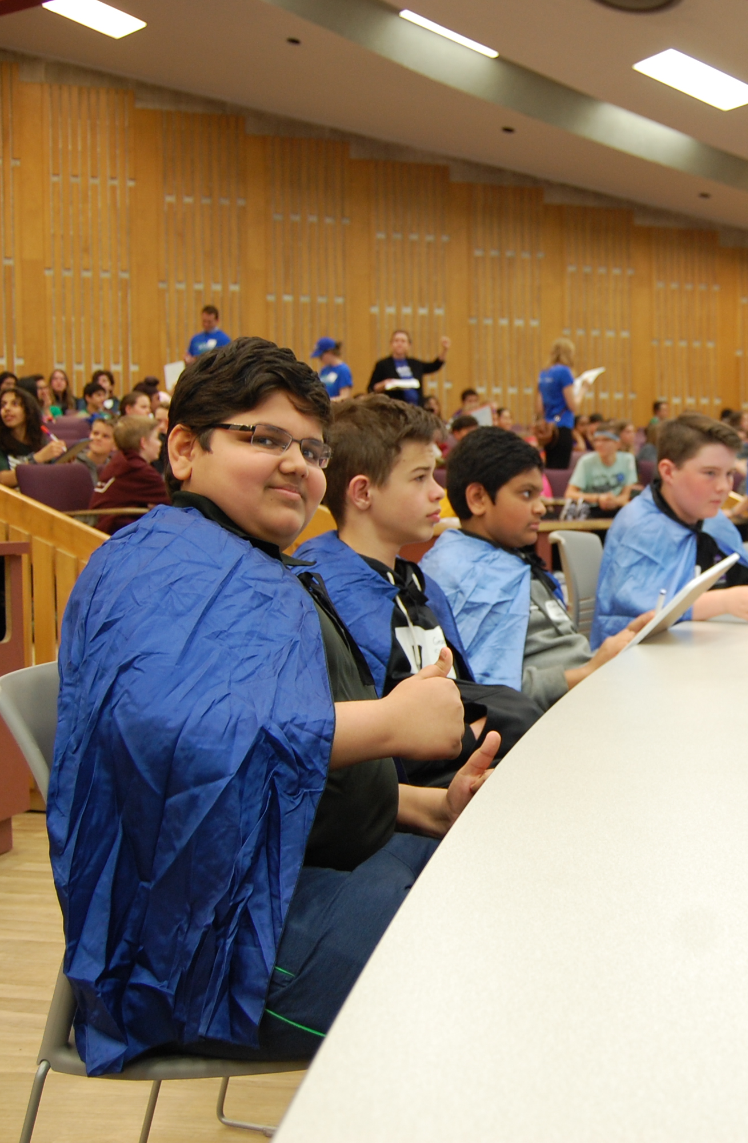
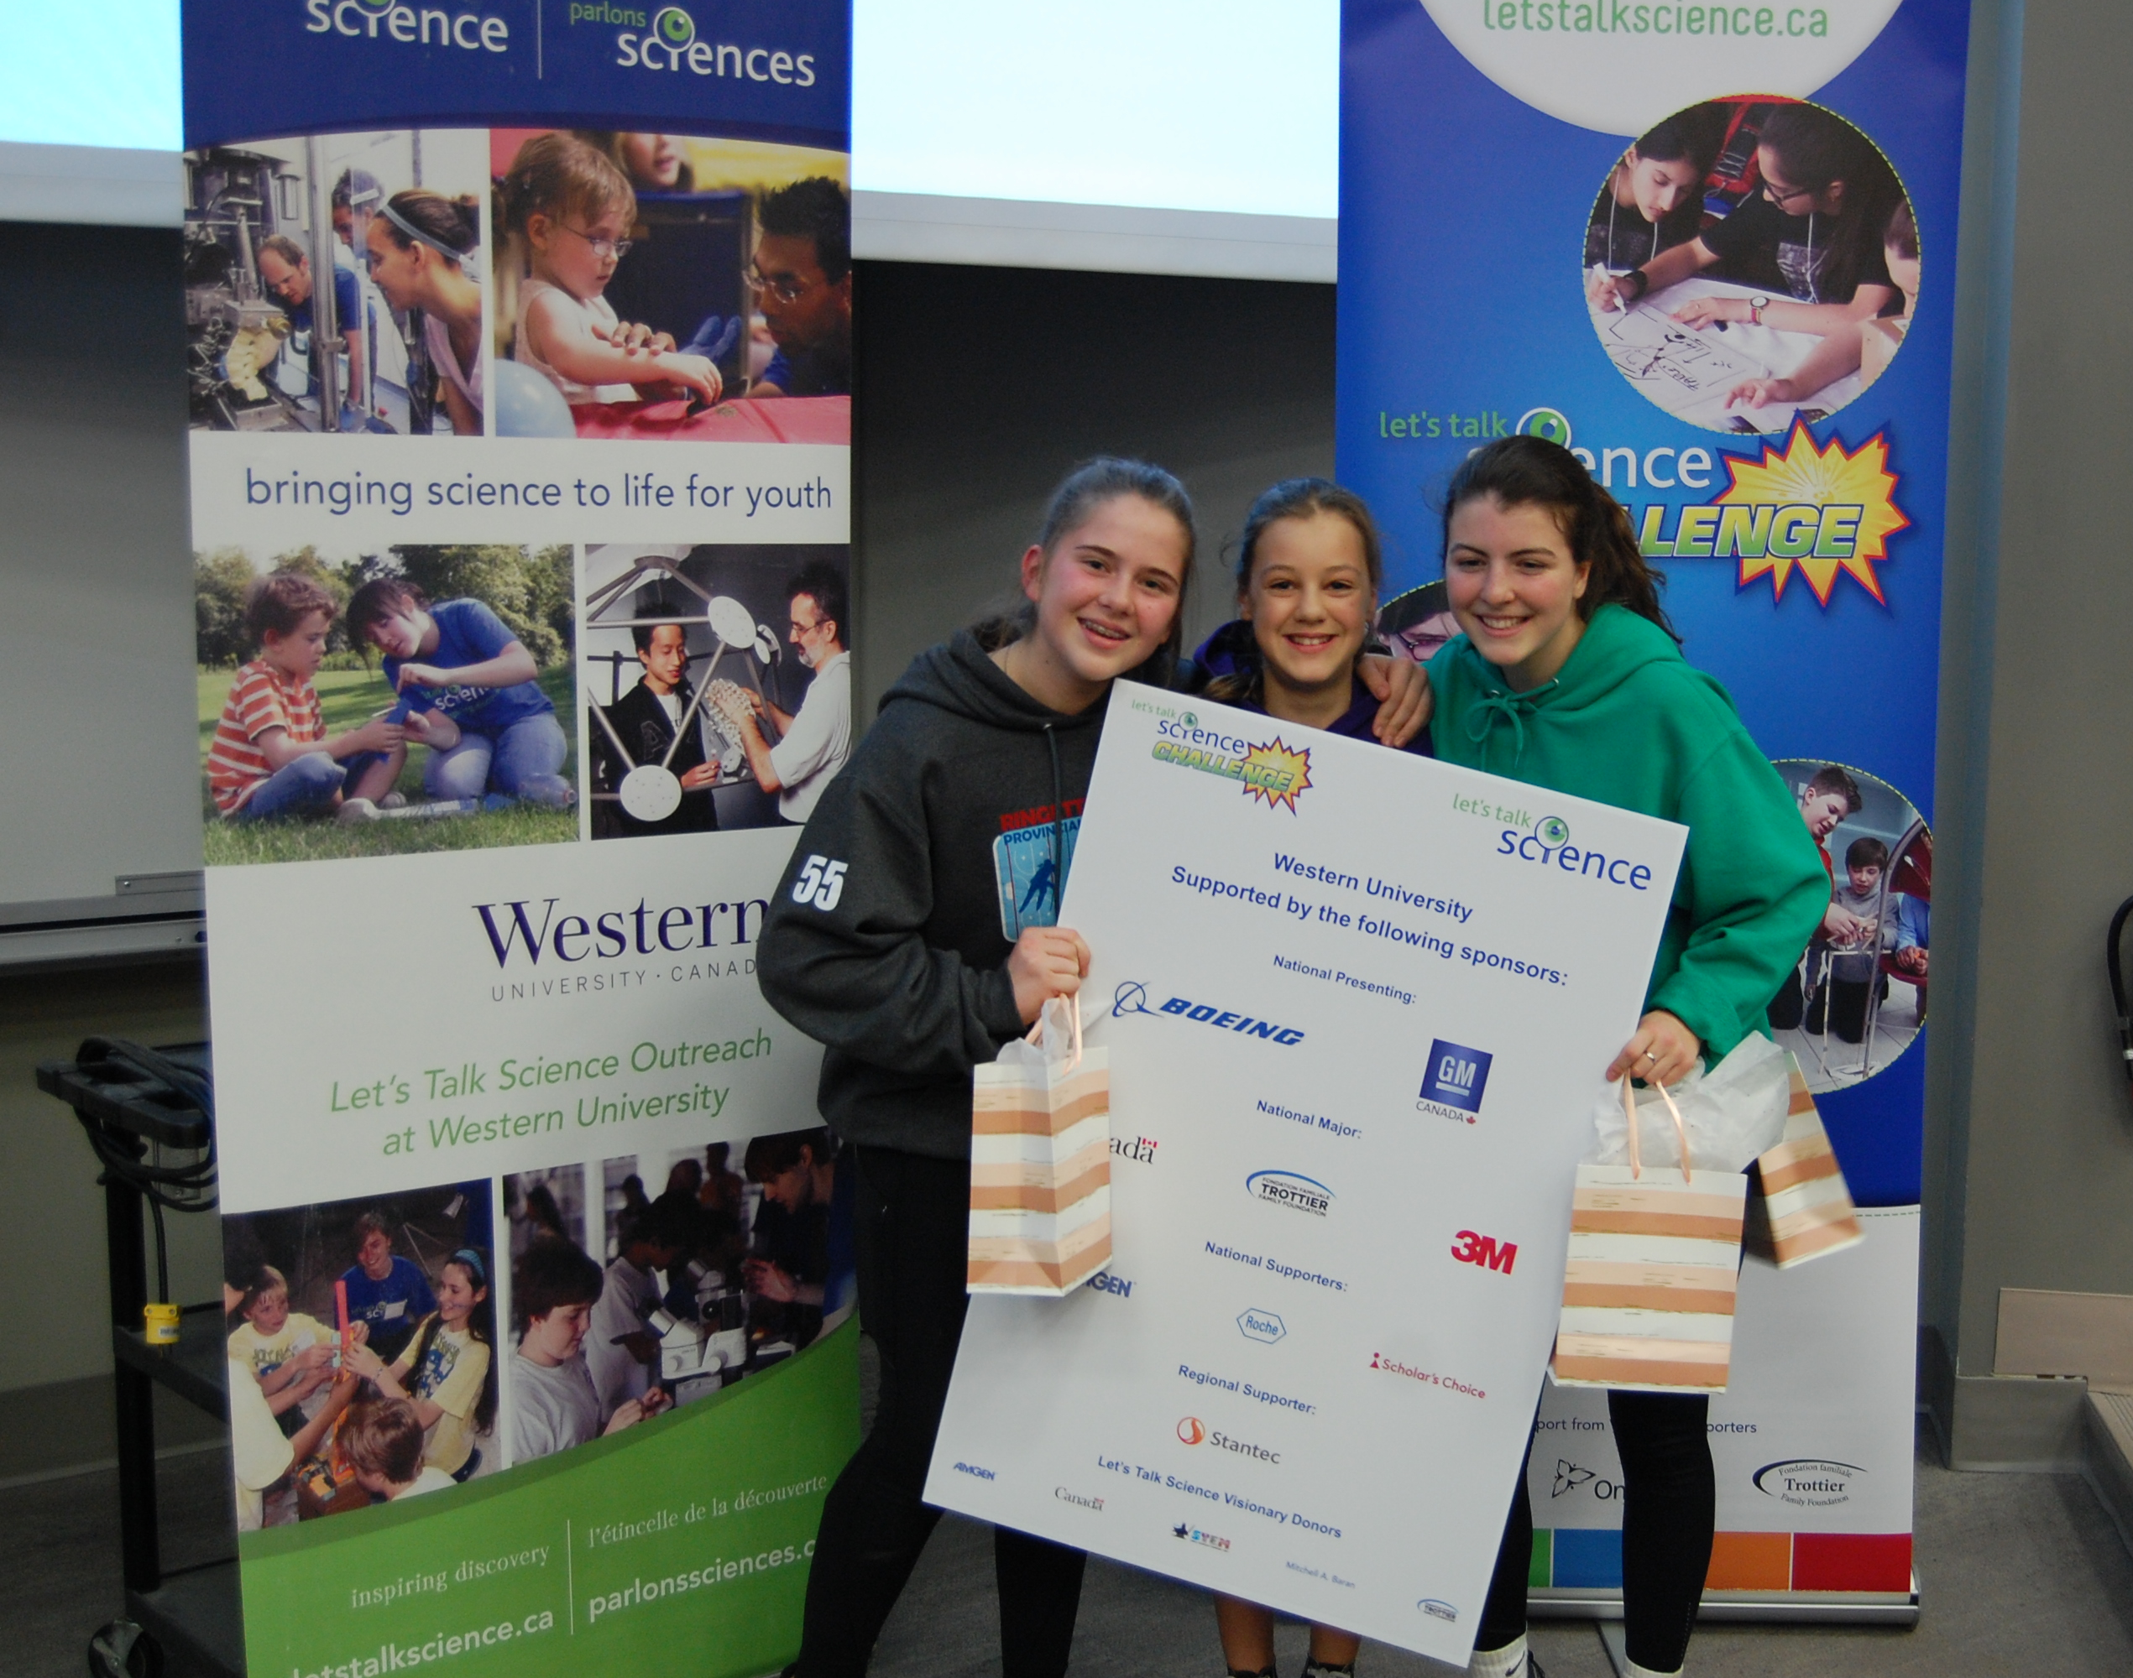
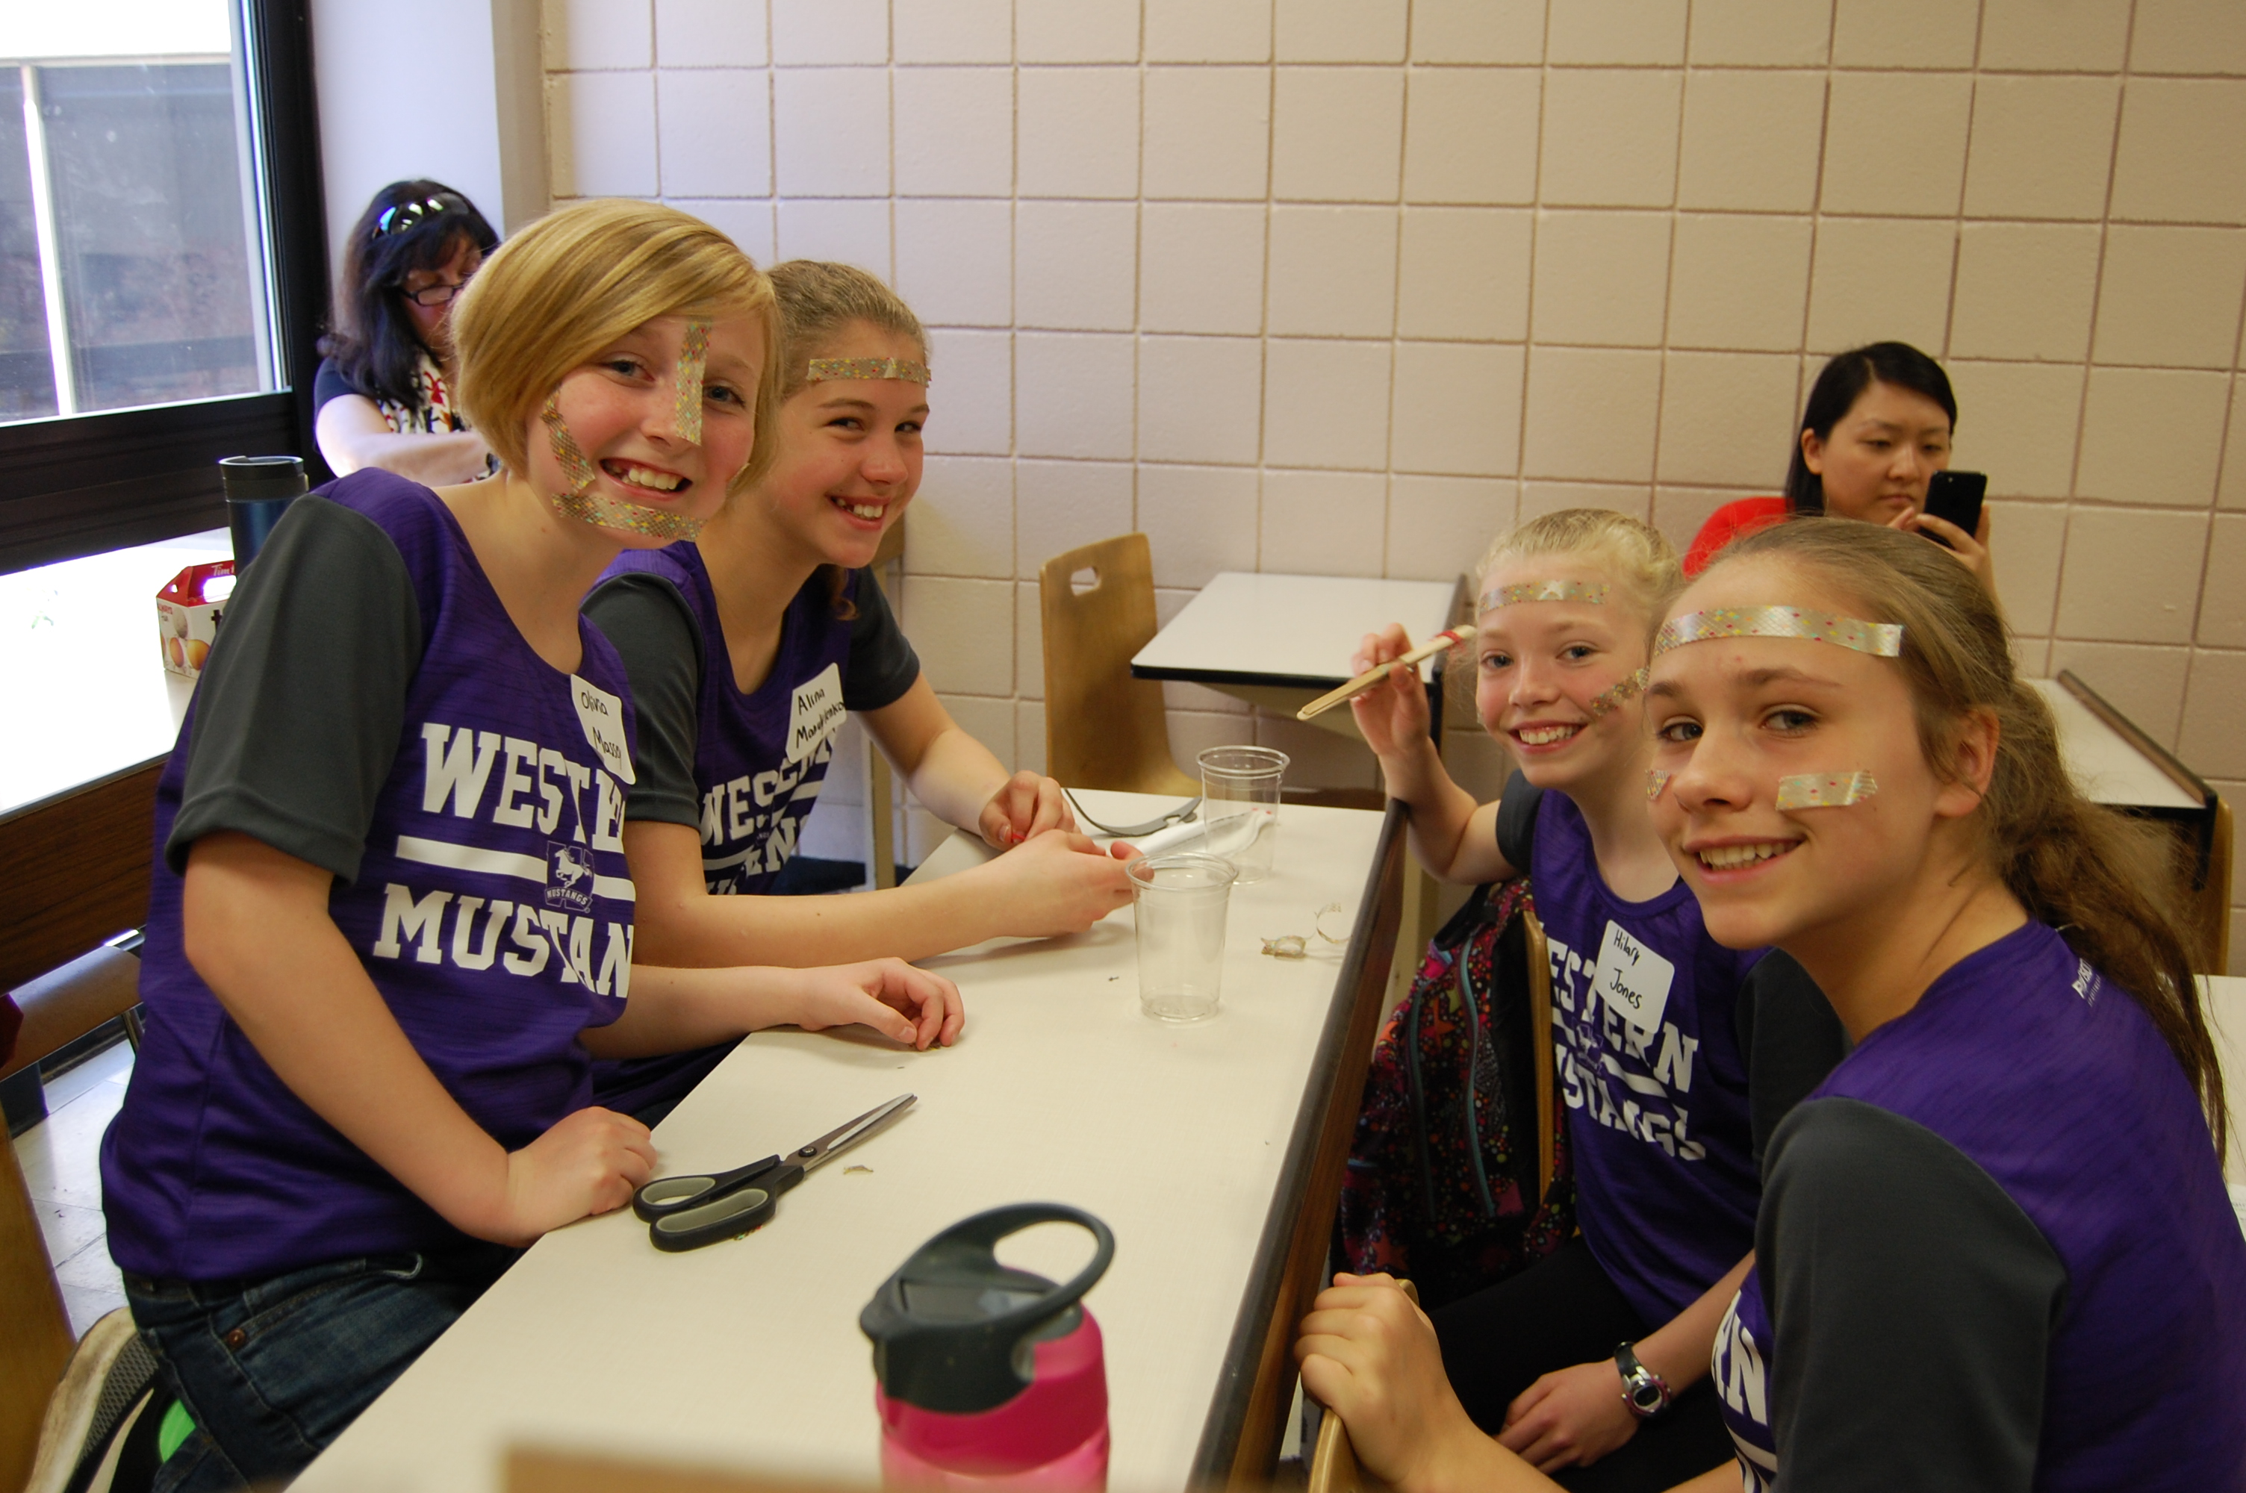
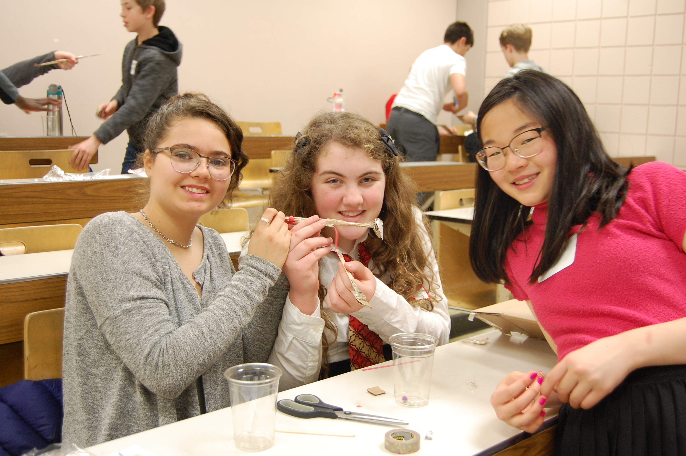
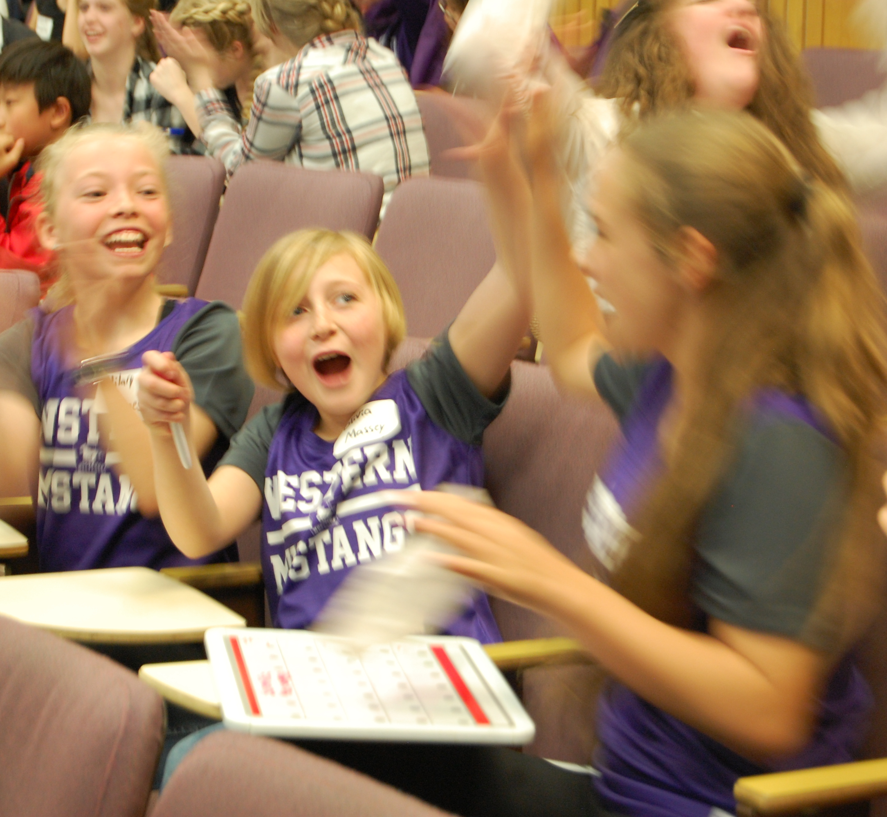
Let’s Talk Science Challenge
Notes:
The Let’s Talk Science Challenge is run at over 20 locations by volunteers, it’s a day of science trivia and hands-on challenges for grades 6-8. Last year we hosted over 250 grade 6-8 students from across London and surrounding areas.

Slide 7
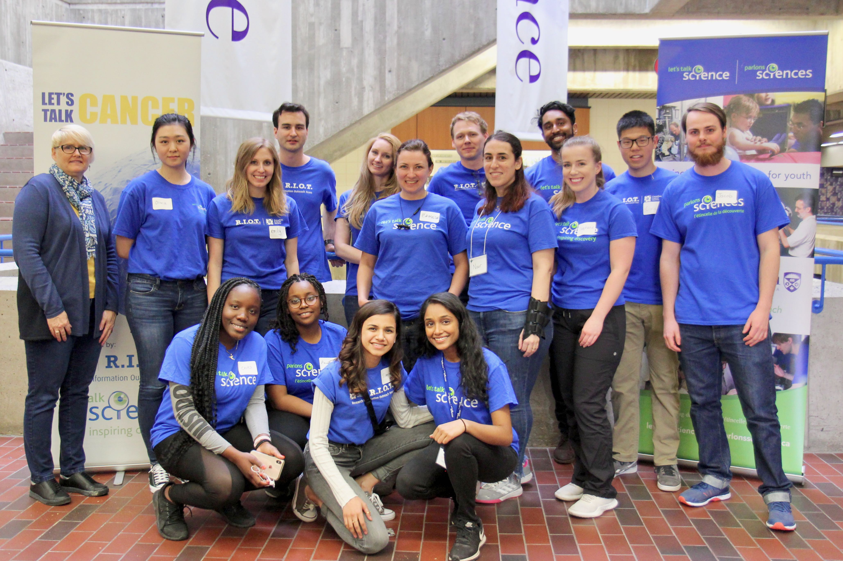
Why Volunteer?
Develop leadership skills!
Be a role model – make a difference!
Personal satisfaction – it's fun!
Develop teaching
and communication skills!
Sharing passion for science!
Looks great on CV!

Slide 8
Contact Us
Recruiting volunteers year-round!
Outreach.LetsTalkScience.ca/UWO
LetsTalkScienceUWO@gmail.com
Volunteer requirements:
  Police Vulnerable Sector Check (PVSC)
  Science with Impact Training Session (~2 hours)
  4 volunteer events/year

