Slide 1
CS3350B Computer Architecture Winter 2015 Lecture 6.1: Fundamentals of Instructional Level Parallelism
Marc Moreno Maza
www.csd.uwo.ca/Courses/CS3350b
[Adapted from lectures on Computer Organization and Design,
Patterson & Hennessy, 5th edition, 2011]

Slide 2
Analogy: Gotta Do Laundry
Ann, Brian, Cathy, Dave each have one load of clothes to wash, dry, fold, and put away
Washer takes 30 minutes
Dryer takes 30 minutes
“Folder” takes 30 minutes
“Stasher” takes 30 minutes to put clothes into drawers
A
B
C
D

Slide 3
Sequential Laundry
6 PM
7
8
9
10
11
12
1
2 AM
Sequential laundry takes 8 hours for 4 loads
T
a
s
k
O
r
d
e
r
30
30
30
30
30
30
30
30
30
30
30
30
30
30
30
30
Time
A
B
C
D
Notes:
Q1: if you have 20 loads, how long will it take?
20 times as long as 1 load: 40 hours

Slide 4
Pipelined Laundry
6 PM
7
8
9
10
11
12
1
2 AM
Pipelined laundry takes 3.5 hours for 4 loads!
30
30
30
30
30
30
30
Time
T
a
s
k
O
r
d
e
r
A
B
C
D

Slide 5
Pipelining Lessons (1/2)
6 PM
7
8
9
Pipelining doesn’t help latency of single task, it helps throughput of entire workload
Multiple tasks operating simultaneously using different resources
Potential speedup = Number of pipe stages
Time to “fill” pipeline and time to “drain” it reduces speedup: 2.3x vs. 4x in this example
T
a
s
k
O
r
d
e
r
Time
30
30
30
30
30
30
30
A
B
C
D
Notes:
Q1: if you have only one load of dirty clothes to wash, will pipelining help?
Q2: if you have 20 loads to be washed using this pipeline, how long will it take?
5 times as long as 1 load.

Slide 6
Pipelining Lessons (2/2)
6 PM
7
8
9
Suppose new Washer takes 20 minutes, new Stasher takes 20 minutes. How much faster is pipeline?
Pipeline rate limited by slowest pipeline stage
Unbalanced lengths of pipe stages reduces speedup
T
a
s
k
O
r
d
e
r
Time
30
30
30
30
30
30
30
A
B
C
D

Slide 7
Recap: MIPS Three Instruction Formats
31
25
20
15
10
5
0
R-format:
op
rs
rt
rd
shamt
funct
31
25
20
15
0
I-format:
op
rs
rt
address offset
31
25
0
J-format:
op
target address
Examples:
R-format: add, sub, jr
I-format: lw, sw, beq, bne
J-format: j, jal

Slide 8
Recap: Five Stages in Executing MIPS
(1) Instruction Fetch (IFetch)
Fetch an instruction; increment PC
(2) Instruction Decode (Dec)
Decode instruction; read registers; sign extend offset
(3) ALU (Arithmetic-Logic Unit) (Exec)
Execute R-format operations; calculate memory address; branch comparison; branch and jump completion
(4) Memory Access (Mem)
Read data from memory for load or write data to memory for store
(5) Register Write (WB)
Write data back to register

Slide 9
Graphical Representation
rd
PC
instruction
memory
registers
rs
Data
memory
rt
ALU
+4
imm
2. Decode/
Register
Read
1. Instruction
Fetch
3. Execute
4. Memory
5. Register
Write
Short name:
IFetch
Dec
Exec
Mem
WB
Graphical
Representation:
I$
Reg
ALU
D$
Reg
Notes:
missing: multiplexors or “data selectors” – where should they be in this picture and why?
also missing – opcode for control of what operations to perform
state elements vs combinational ones – combinational given the same input will always produce the same output – out depends only on the current input

Slide 10
Single Cycle CPU Clocking
All stages of an instruction completed within one long clock cycle
Clock cycle sufficiently long to allow each instruction to complete all stages without interruption within one cycle
2. Decode/
Register
Read
1. Instruction
Fetch
5. Reg.
Write
3. Execute
4. Memory

Slide 11
Single Cycle Performance
Assume time for actions are
100ps for register read or write
200ps for other events
Clock rate of the single cycle datapath is?
Instr | Instr fetch | Register read | ALU op | Memory access | Register write | Total time
lw | 200ps | 100 ps | 200ps | 200ps | 100 ps | 800ps
sw | 200ps | 100 ps | 200ps | 200ps |  | 700ps
R-format | 200ps | 100 ps | 200ps |  | 100 ps | 600ps
beq | 200ps | 100 ps | 200ps |  |  | 500ps
What can we do to improve clock rate?
Will this improve performance as well?
Want increased clock rate to mean faster programs
Notes:
1.25 GHz

Slide 12
Multiple-cycle CPU Clocking
Only one stage of instruction per clock cycle
Clock is made as long as the slowest stage
Advantages over single cycle execution: Unused stages in a particular instruction can be skipped OR instructions can be pipelined (overlapped)
2. Decode/
Register
Read
1. Instruction
Fetch
3. Execute
4. Memory
5. Register
Write

Slide 13
How Can We Make It Faster?
Split the multiple instruction cycle into smaller and smaller steps
There is a point of diminishing returns where as much time is spent loading the state registers as doing the work
Start fetching and executing the next instruction before the current one has completed
Pipelining – (all?) modern processors are pipelined for performance
Remember the performance equation: CPU time = CPI * CC * IC
Fetch (and execute) more than one instruction at a time
Superscalar processing – stay tuned

Slide 14
A Pipelined MIPS Processor
Start the next instruction before the current one has completed
improves throughput - total amount of work done in a given time
instruction latency (execution time, delay time, response time - time from the start of an instruction to its completion) is not reduced
Cycle 1
Cycle 2
Cycle 3
Cycle 4
Cycle 5
Cycle 6
Cycle 7
Cycle 8
lw
IFetch
Dec
Exec
Mem
WB
sw
IFetch
Dec
Exec
Mem
WB
R-type
IFetch
Dec
Exec
Mem
WB
clock cycle (pipeline stage time) is limited by the slowest stage
for some instructions, some stages are wasted cycles
Notes:
Latency = execution time (delay or response time) – the total time from start to finish of ONE instruction
For processors one important measure is THROUGHPUT (or the execution bandwidth) – the total amount of work done in a given amount of time
For memories one important measure is BANDWIDTH – the amount of information communicated across an interconnect (e.g., bus) per unit time; the number of operations performed per second (the WIDTH of the operation and the RATE of the operation)

Slide 15
Why Pipeline? For Performance!
Under ideal conditions and with a large number of instructions, the speed-up from pipelining is approximately equal to the number of pipe stages.
A five-stage pipeline is nearly five times faster.
Time (clock cycles)
Once the pipeline is full, one instruction is completed every cycle, so CPI = 1
I
n
s
t
r.
O
r
d
e
r
Inst 0
I$
Reg
ALU
D$
Reg
Inst 1
I$
Reg
ALU
D$
Reg
Inst 2
I$
Reg
ALU
D$
Reg
Inst 3
I$
Reg
ALU
D$
Reg
Inst 4
I$
Reg
ALU
D$
Reg
Time to fill the pipeline

Slide 16
Pipeline Performance
Assume time for stages is
100ps for register read or write
200ps for other stages
What is pipelined clock rate?
Compare pipelined datapath with single-cycle datapath
Instr | Instr fetch | Register read | ALU op | Memory access | Register write | Total time
lw | 200ps | 100 ps | 200ps | 200ps | 100 ps | 800ps
sw | 200ps | 100 ps | 200ps | 200ps |  | 700ps
R-format | 200ps | 100 ps | 200ps |  | 100 ps | 600ps
beq | 200ps | 100 ps | 200ps |  |  | 500ps

Slide 17
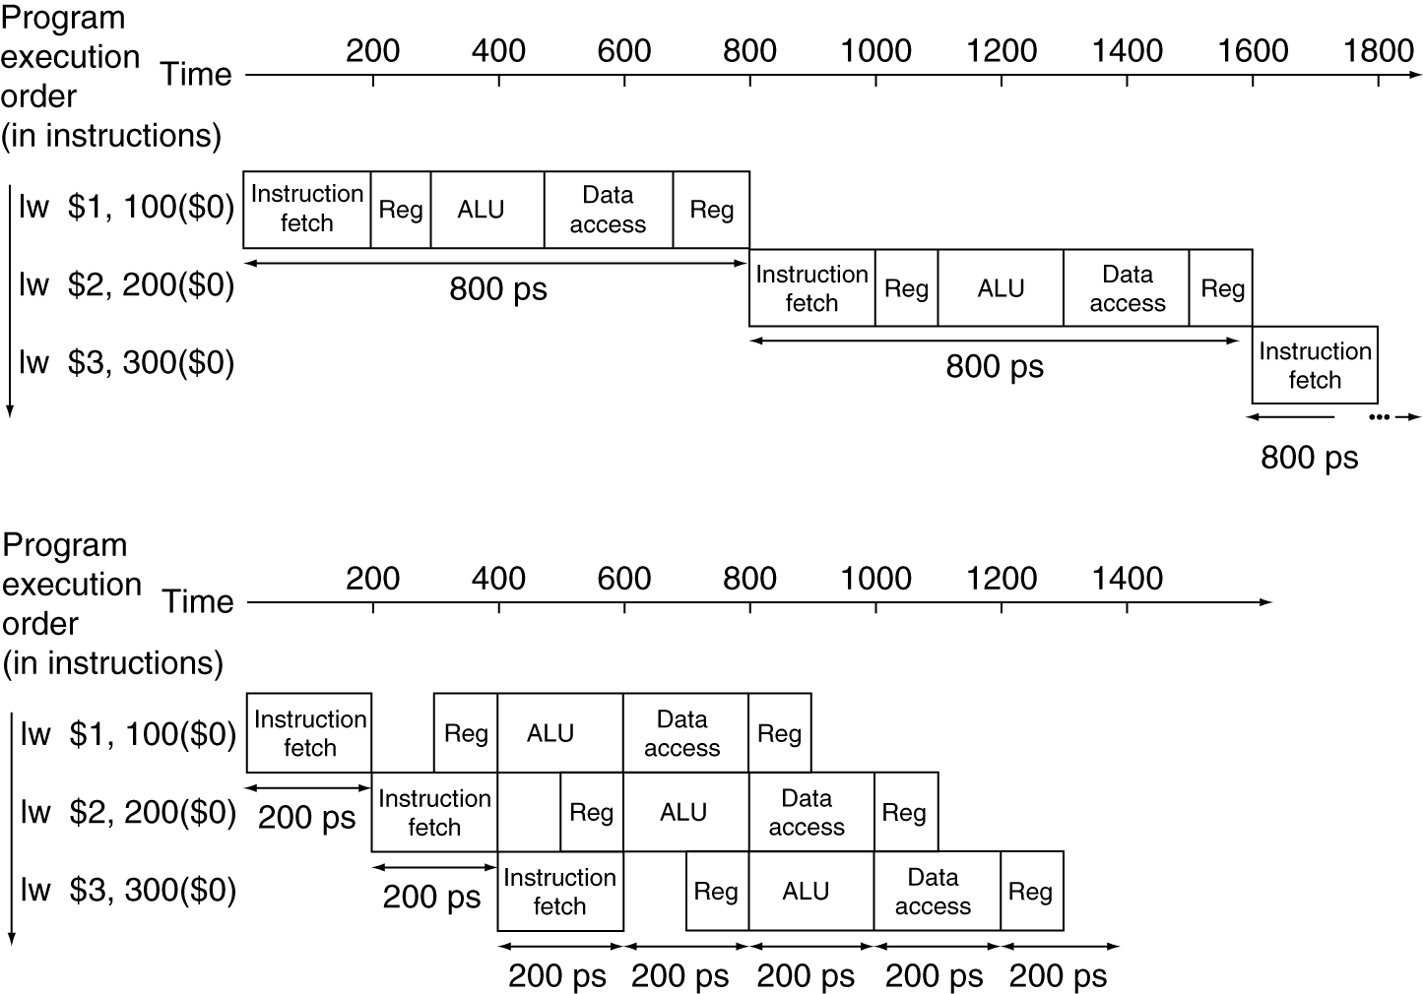
Pipeline Performance
Single-cycle (T_{c}= 800ps)
Pipelined (T_{c}= 200ps)
Notes:
three lw
Q1: nonpipeline timing: 2400ps
Q2: pipelining timing: 1400ps
Q3: speedup 2400/1400 =
Add 1000,000 instructions
Timing and speedup?

Slide 18
Pipeline Speedup
If all stages are balanced (i.e. all take the same time) and there are no dependencies between the instructions,
CPI = 1 (each instruction takes 5 cycles, but 1 completes each cycle)
Ideal speedup is: Time between instructions_{nonpipelined} Number of stages = Time between instructions_{pipelined}
Speedup due to increased throughput; Latency (time for each instruction) does not decrease
If not balanced, speedup is less
Pipelining the three lw, speedup: 2400ps/1400ps = 1.7
Add 1000,000 more instructions, the speedup:
(10^6*200+1400)/(10^6*800+2400) ~ 800/200 = 4
Notes:
Q: if you have only one instruction, will pipelining help?

Slide 19
MIPS Pipeline Datapath Modifications
What do we need to add/modify in our MIPS datapath?
Add State registers between each pipeline stage to isolate them
IF:IFetch
ID:Dec
EX:Execute
MEM:
MemAccess
WB:
WriteBack
Add
4
Shift
left 2
Add
Instruction
Memory
Read Addr 1
Data
Memory
Register
File
Read
Data 1
IFetch/Dec
Read Addr 2
PC
Read
Address
Dec/Exec
Read
Data
Write Addr
Exec/Mem
Address
Read
Data 2
ALU
Mem/WB
Write Data
Write Data
Sign
Extend
16
32
System Clock
Notes:
Note two exceptions to right-to-left flow
WB that writes the result back into the register file in the middle of the datapath
Selection of the next value of the PC, one input comes from the calculated branch address from the MEM stage
Only later instructions in the pipeline can be influenced by these two REVERSE data movements.
The first one (WB to ID) leads to data hazards.
The second one (MEM to IF) leads to control hazards.
All instructions must update some state in the processor – the register file, the memory, or the PC – so separate pipeline registers are redundant to the state that is updated (not needed).
PC can be thought of as a pipeline register: the one that feeds the IF stage of the pipeline. Unlike all of the other pipeline registers, the PC is part of the visible architecture state – its content must be saved when an exception occurs (the contents of the other pipe registers are discarded).

Slide 20
Pipelining the MIPS ISA
MIPS Instruction Set designed for pipelining
All instructions are 32-bits
Easier to fetch and decode in one cycle
x86: 1- to 17-byte instructions
(x86 HW actually translates to internal RISC instructions!)
Few and regular instruction formats, 2 source register fields always in same place
Can decode and read registers in one step
Memory operands only in Loads and Stores
Can calculate address at 3rd stage, access memory at 4th stage
Alignment of memory operands
Memory access takes only one cycle

Slide 21
Other Sample Pipeline Alternatives
ARM7
Intel XScale
IM
Reg
EX
PC update
IM access
decode
reg
access
ALU op
DM access
shift/rotate
commit result
(write back)
IM1
IM2
Reg
ALU
DM1
Reg
DM2
SHFT
PC update
BTB access
start IM access
decode
reg 1 access
DM write
reg write
ALU op
shift/rotate
reg 2 access
start DM access
exception
IM access

Slide 22
Can Pipelining Get us Into Trouble?
Yes: Pipeline Hazards
structural hazards: attempt to use the same resource by two different instructions at the same time
data hazards: attempt to use data before it is ready
An instruction’s source operand(s) are produced by a prior instruction still in the pipeline
control hazards: attempt to make a decision about program control flow before the condition has been evaluated and the new PC target address calculated
branch instructions
Can always resolve hazards by waiting
pipeline control must detect the hazard
and take action to resolve hazards
Notes:
Note that data hazards can come from R-type instructions or lw instructions

Slide 23
Takeaway
All modern day processors use pipelining
Pipelining doesn’t help latency of single task, it helps throughput of entire workload
Potential speedup: a CPI of 1 and a faster CC
Recall CPU time = CPI * CC * IC
Pipeline rate limited by slowest pipeline stage
Unbalanced pipe stages make for inefficiencies
The time to “fill” pipeline and time to “drain” it can impact speedup for deep pipelines and short code runs
Must detect and resolve hazards
Stalling negatively affects CPI (makes CPI more than the ideal of 1)
Compiler can arrange code to avoid hazards and stalls: Requires knowledge of the pipeline structure

