Slide 1
CS3350B
Computer Architecture
Winter 2015
Lecture 7.1: Multicore: Basics and Key Issues
Marc Moreno Maza
www.csd.uwo.ca/Courses/CS3350b
[Adapted from lectures on
Computer Organization and Design,
Patterson & Hennessy, 4th or 5th edition, 2011]

Slide 2
Why We need Multiprocessors?
Uniprocessor performance
  25% annual improvement rate from 1978 to 1986
  52% annual improvement rate from 1986 to 2002
    Profound impact of RISC, x86
  20% annual improvement rate from 2002 to present
    Power wall: solutions for higher ILP are power-inefficient
    ILP wall: hard to exploit more ILP
    Memory wall: ever-increasing memory latency relative to processor speed

Slide 3
Beyond Implicit Parallelism
Consider “atxpy”:
  double a, x[SIZE], y[SIZE], z[SIZE];
  void atxpy(){
  for (i = 0; i < SIZE; i++)
  z[i] = a*x[i] + y[i];
  }
Lots of instruction-level parallelism (ILP)
  Great!
  But how much can we really exploit? 4-issue? 8-issue?
    Limits to (efficient) super-scalar execution
But, if SIZE is 10,000 the loop has 10,000-way parallelism!
  How do we exploit it?

Slide 4
Where are We Now?
Multiprocessor – a computer system with at least two processors
  Can deliver high throughput for independent jobs via job-level parallelism or process-level parallelism
  And improve the run time of a single program that has been specially crafted to run on a multiprocessor - a parallel processing program
Processor
Processor
Processor
Cache
Cache
Cache
Interconnection Network
Memory
I/O
Notes:
Power has become the overriding issue for both data centers and microprocessors. Power efficiency has joined scalable performance making the case for multiprocessors. Multiprocessors also improve availability.

Slide 5
Multicores Now Common
The power challenge has forced a change in the design of microprocessors
  Since 2002 the rate of improvement in the response time of programs has slowed from a factor of 1.5 per year to less than a factor of 1.2 per year
Today’s microprocessors typically contain more than one core – Chip Multicore microProcessors (CMPs) – in a single IC
  The number of cores is expected to double every two years
Product | AMD Barcelona | Intel Nehalem | IBM Power 6 | Sun Niagara 2
Cores per chip | 4 | 4 | 2 | 8
Clock rate | 2.5 GHz | ~2.5 GHz? | 4.7 GHz | 1.4 GHz
Power | 120 W | ~100 W? | ~100 W? | 94 W
Notes:
Multicore issues
Hard for programmers to write explicitly parallel programs - task scheduling with load balancing and minimal communication and synchronization overhead.

Slide 6
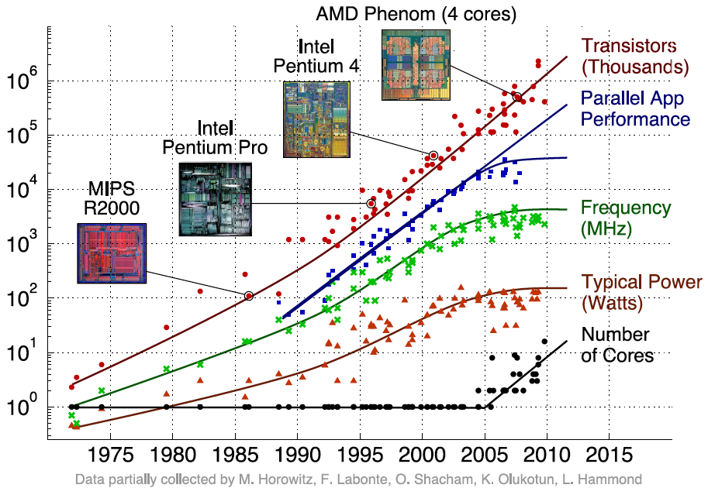
Transition to Multicore
Sequential App Performance

Slide 7
Other Multiprocessor Basics
Some of the problems that need higher performance can be handled simply by using a cluster – a set of independent servers (or PCs) connected over a local area network (LAN) functioning as a single large multiprocessor
  Search engines, Web servers, email servers, databases, …
A key challenge is to craft parallel (concurrent) programs that have high performance on multiprocessors as the number of processors increase – i.e., that scale
  Scheduling, load balancing, time for synchronization, overhead for communication

Slide 8
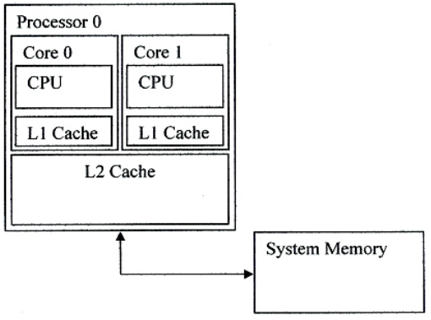
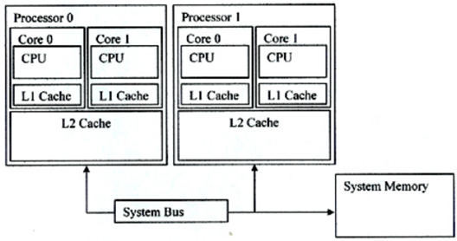
Multicore vs Multi-processor
Multicore Processor with Shared L2 Cache
Multi-Processor System with Cores that share L2 Cache
Notes:
Before starting to talk about multiprocessors, it may be helpful to underline the difference between a multi-core processor and a multi-processor system. So as we can see here, a Multi-Core Processor has two cores. These cores have their own Central Processing Units and Level-1 Caches and share a Level-2 Cache.
On the other hand, in a multiprocessor system there are two multiprocessors containing (in this example) 2 cores each. And these processors communicate over a System Bus. Sometimes this bus is also called an Interconnect.

Slide 9
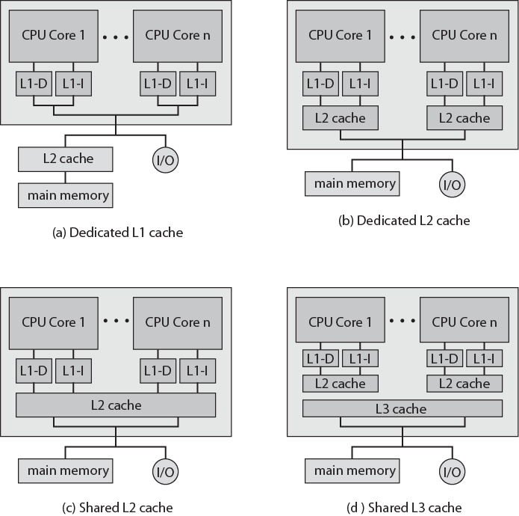
Multicore Organization Alternatives
(a) ARM11 MPCore
(b) AMD Opteron
(c) Intel Core Duo
(d) Intel Core i7

Slide 10
Itanium 2 Dual Core
Notes:
The advanced load address table (ALAT) is a functional unit in the Intel Itanium processor architecture. It is implemented with an associative memory. The ALAT is used to store information related to advance load instructions, as part of the speculative execution process.
Arbiter grants the request and connects output port with input port by MUX.

Slide 11
High Level Multicore Architectural view
Intel® Core™ Microarchitecture – Memory Sub-system
Intel Core 2
Duo Processor
Intel Core 2
Quad Processor
A | A | A | A
E | E | E | E
C1 |  | C2
B |  | B
A | A
E | E
C
B
64B Cache Line
Memory
64B Cache Line
Memory
Dual Core has shared cache, Quad core
has both shared And separated cache
A = Architectural State E = Execution Engine & Interrupt
C = 2nd Level Cache B = Bus Interface connects to main memory & I/O
Notes:
Main point to cover here is that False sharing is issue for platforms with separated cores – we can alleviate false sharing by restructuring the data layout/data access patterns
A = Architectural states refers to contents or state of FPU, MMX registers and others
E = Execution Engine refers to functions units such as FP, ALU, SIMD etc
C = 2nd Level Cache – memory w ~1 or 2 cycle latency compared to 100’s of clocks for main memory
B = system bus interface that connects to main memory & I/O.
Cache Line is the smallest unit of data that can be transferred to or from memory.
When a single data elements is requested by a program – say your need to read one variable of type float form memory – then that float and its 7 nearest neighbors (8 floats in total = 64 Bytes) in memory (in the same cache line) are brought into the faster cache memory for use by the processor

Slide 12
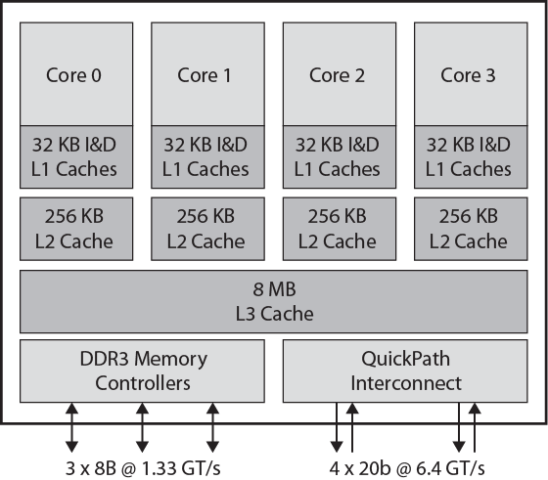
Intel Core i7 Block Diagram
November 2008
Four x86 SMT processors
Dedicated L2, shared L3 cache
Speculative pre-fetch for caches
On chip DDR3 memory controller
  Three 8 byte channels (192 bits) giving 32GB/s
  No front side bus
QuickPath Interconnection
  Cache coherent point-to-point link
  High speed communications between processor chips
  6.4G transfers per second, 16 bits per transfer
  Dedicated bi-directional pairs
  Total bandwidth 25.6GB/s
Notes:
double data rate type three synchronous dynamic random access memory, is a modern type of dynamic random access memory (DRAM) with a high bandwidth ("double data rate") interface, and has been in use since 2007
gigatransfers per second

Slide 13
Simultaneous Multithreading (SMT)
A variation on multithreading that uses the resources of a multiple-issue, dynamically scheduled processor (superscalar) to exploit both program ILP and thread-level parallelism (TLP)
  Most SS processors have more machine level parallelism than most programs can effectively use (i.e., than have ILP)
  With register renaming and dynamic scheduling, multiple instructions from independent threads can be issued without regard to dependencies among them
    Need separate rename tables for each thread or need to be able to indicate which thread the entry belongs to
    Need the capability to commit from multiple threads in one cycle
Intel’s Pentium 4 SMT is called hyperthreading
  Supports just two threads (doubles the architecture state)

Slide 14
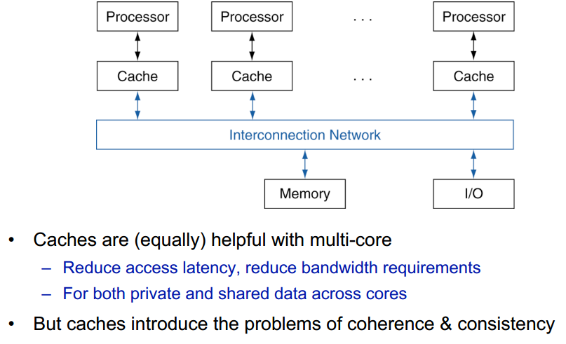
SMT
Notes:
Caches are (equally) helpful with multicore
Reduce access latency, reduce bandwidth requirements
For both private and shared data across cores
But caches introduce the problems of coherence and consistency

Slide 15
Cache Coherence
What is the coherence problem?
  Core writes to a location in its L1 cache
  Other L1 caches may hold shared copies - these will be immediately out of date
The core may either
  Write through to L2 cache and/or memory
  Copy back only when cache line is rejected
In either case because each core may have its own copy, it is not sufficient just to update L2 and/or memory

Slide 16
Cache Coherence in Multicores
In multicore processors its likely that the cores will share a common physical address space, causing a cache coherence problem
Core 1
Core 2
L1 I$
L1 D$
L1 I$
L1 D$
Unified (shared) L2
Notes:
For class handout

Slide 17
Cache Coherence in Multicores
In multicore processors its likely that the cores will share a common physical address space, causing a cache coherence problem
Read X
Read X
Core 1
Core 2
read again
Write 1 to X
X = ?
L1 I$
L1 D$
L1 I$
L1 D$
X = 0
X = 0
X = 1
X = 1
X = 0
Unified (shared) L2
Notes:
For lecture
Assumes a write through L1 cache

Slide 18
A Coherent Memory System
Any read of a data item should return the most recently written value of the data item
  Coherence – defines what values can be returned by a read
    Writes to the same location are serialized (two writes to the same location must be seen in the same order by all cores)
  Consistency – determines when a written value will be returned by a read
To enforce coherence, caches (hardware) must provide
  Replication of shared data items in multiple cores’ caches
    Replication reduces both latency and contention for a read shared data item
  Migration of shared data items to a core’s local cache
    Migration reduced the latency of the access the data and the bandwidth demand on the shared memory (L2 in our example)
Notes:
Supporting migration and replication is critical to performance in accessing shared data.

Slide 19
Snooping Protocols
Schemes where every core knows which other core has a copy of its cached data are far too complex.
So each core (cache system) ‘snoops’ (i.e. watches continually) for activity concerned with data addresses which it has cached.
This has normally been implemented with a bus structure which is ‘global’, i.e. all communication can be seen by all
Snooping Protocols can be implemented without a bus, but for simplicity the next slides assume a shared bus.
There are ‘directory based’ coherence schemes but we will not consider them this year.

Slide 20
Snooping Protocols
Write Invalidate
  A core wanting to write to an address, grabs a bus cycle and sends a ‘write invalidate’ message which contains the address
  All snooping caches invalidate their copy of appropriate cache line
  The core writes to its cached copy (assume for now that it also writes through to memory)
  Any shared read in other cores will now miss in cache and re-fetch the new data.

Slide 21
Snooping Protocols
Write Update
  A core wanting to write grabs bus cycle and broadcasts address & new data as it updates its own copy
  All snooping caches update their copy
Note that in both schemes, the problem of simultaneous writes is taken care of by bus arbitration - only one core can use the bus at any one time.

Slide 22
Update or Invalidate?
Update looks the simplest, most obvious and fastest, but:
  Multiple writes to the same word (no intervening read) need only one invalidate message but would require an update for each
  Writes to same block in (usual) multi-word cache block require only one invalidate but would require multiple updates.

Slide 23
Update or Invalidate?
Due to both spatial and temporal locality, the previous cases occur often.
Bus bandwidth is a precious commodity in shared memory multi-cores chips
Experience has shown that invalidate protocols use significantly less bandwidth.
We will only consider implementation details only of the invalidate protocols.
All commercial machines use write-invalidate as their standard coherence protocol

Slide 24
Implementation Issues
In both schemes, knowing if a cached value is not shared (no copies in another cache) can avoid sending any messages.
Invalidate description assumed that a cache value update was written through to memory. If we used a ‘copy back’ scheme (usual for high performance) other cores could re-fetch incorrect old value on a cache miss.
We need a protocol to handle all this.

Slide 25
MESI Protocol (1)
A practical multi-core invalidate protocol which attempts to minimize bus usage.
Allows usage of a ‘copy back’ scheme - i.e. L2/main memory is not updated until a ‘dirty’ cache line is displaced
Extension of the usual cache tags, i.e. invalid tag and ‘dirty’ tag in normal copy back cache.
To make the description simpler, we will ignore L2 cache and treat L2/main memory as a single main memory unit

Slide 26
MESI Protocol (2)
Any cache line can be in one of 4 states (2 bits)
Modified – The cache line has been modified and is different from main memory – This is the only cached copy. (cf. ‘dirty’)
Exclusive – The cache line is the same as main memory and is the only cached copy
Shared - Same value as main memory but copies may exist in other caches.
Invalid - Line data is not valid (as in simple cache)

Slide 27
MESI Protocol (3)
Cache line state changes are a function of memory access events.
Events may be either
  Due to local core activity (i.e. cache access)
  Due to bus activity - as a result of snooping
Each cache line has its own state affected only if the address matches

Slide 28
MESI Protocol (4)
Operation can be described informally by looking at actions in a local core
  Read Hit
  Read Miss
  Write Hit
  Write Miss
More formally by a state transition diagram

Slide 29
MESI Local Read Hit
The line must be in one of MES
This must be the correct local value (if M it must have been modified locally)
Simply return value
No state change

Slide 30
MESI Local Read Miss
A core makes read request to main memory upon a read miss: detailed action depends on copies in other cores
Case 1: One cache has an E copy
  The snooping cache puts the copy value on the bus
  The memory access is abandoned
  The local core caches the value
  Both lines are set to S
Case 2: No other copy in caches
  The core waits for a memory response
  The value is stored in the cache and marked E

Slide 31
MESI Local Read Miss
Case 3: Several caches have a copy (S)
  One snooping cache puts the copy value on the bus (arbitrated)
  The memory access is abandoned
  The local core caches the value and sets the tag to S
  Other copies remain S

Slide 32
MESI Local Read Miss
Case 4: One cache has M (modified) copy
  The snooping cache puts its copy of the value on the bus
  The memory access is abandoned
  The local core caches the value and sets the tag to S
  The source (M) value is copied back to memory
  The source value changes its tag from M to S

Slide 33
MESI Local Write Hit
Line must be one of MES
M
  line is exclusive and already ‘dirty’
  Update local cache value
  no state change
E
  Update local cache value
  Change E to M
S
  Core broadcasts an invalidate on bus
  Snooping cores with an S copy change S to I
  The local cache value is updated
  The local state changes from S to M

Slide 34
MESI Local Write Miss
Detailed action depends on copies in other cores
Case 1: No other copies
  Local copy state set to M
Case 2: Other copies, either one in state E or more in state S
  Value read from memory to local cache - bus transaction marked RWITM (read with intent to modify)
  The snooping cores see this and set their tags to I
  The local copy is updated and sets the tag to M

Slide 35
MESI Local Write Miss
Case 3: Another copy in state M
  Core issues bus transaction marked RWITM
  The snooping core sees this
    Blocks the RWITM request
    Takes control of the bus
    Writes back its copy to memory
    Sets its copy state to I
  The original local core re-issues RWITM request
  This is now simply a no-copy case
    Value read from memory to local cache
    Local copy value updated
    Local copy state set to M

Slide 36
Comments on MESI Protocol
Relies on global view of all memory activity – usually implies a global bus
Bus is a limited shared resource
As number of cores increases
  Demands on bus bandwidth increase – more total memory activity
  The bus gets slower due to increased capacitive load
General consensus is that bus-based systems cannot be extended beyond a small number (8 or 16?) cores

Slide 37
Example of Snooping Invalidation
Core 1
Core 2
L1 I$
L1 D$
L1 I$
L1 D$
Unified (shared) L2
Notes:
For class handout

Slide 38
Example of Snooping Invalidation
Read X
Read X
Core 1
Core 2
Write 1 to X
Read X
L1 I$
L1 D$
L1 I$
L1 D$
X = 0
X = 0
X = 1
X = I
X = 1
X = I
X = 1
X = 0
Unified (shared) L2
When the second miss by Core 2 occurs, Core 1 responds with the value canceling the response from the L2 cache (and also updating the L2 copy)
Notes:
For lecture
Snooping bus with write-back L1 cache. Requires an additional state – called owner – which indicates that a block may be shared, but the owning core is responsible for updating any other processors and memory when it changes the block or replaces it

Slide 39
Another Example for Write Invalidate Snooping
P
P
P
1
2
3
u
= ?
u
= ?
3
$
4
$
5
$
u
:5
u
:5
u
= 7
1
I/O devices
u
:5
2
u = 7
Memory
Must invalidate before step 3
All recent MPUs use write invalidate
(invalidate protocols use significantly less bandwidth)

Slide 40
Block Size Effects on Multicores
Writes to one word in a multi-word block mean that the full block is invalidated
Multi-word blocks can also result in false sharing: when two cores are writing to two different variables that happen to fall in the same cache block
  With write-invalidate, false sharing increases cache miss rates
Core1
Core2
A
B
4 word cache block
Notes:
Cache Line is the smallest unit of data that can be transferred to or from memory.
When a single data elements is requested by a program – say your need to read one variable of type float form memory – then that float and its 7 nearest neighbors (8 floats in total = 64 Bytes) in memory (in the same cache line) are brought into the faster cache memory for use by the processor

Slide 41
False Sharing
Performance issue in programs where cores may write to different memory addresses BUT in the same cache lines
Known as Ping-Ponging – Cache line is shipped between cores
Core 0
Core 1
X[0] =
0
X[1] =
0
Time
X[0] =
1
X[1] =
1
X[0] =
2
1
1
1
0
1
1
0
2
False Sharing is not an issue in shared cache.
It is an issue in separated cache
Notes:
Intel book – Multi-core Programming – Increasing Performance Through Software Multi-threading by Shameem Akhter and Jason Roberts
False Sharing
The smallest unit of memory that two processors interchange is a cache line or cache sector. Two separate caches can share a cache line when they both need to read it, but if the line is written in one cache, and read in another, it must be shipped between caches, even if the locations of interest are disjoint.
Like two people writing in different parts of a log book, the writes are independent, but unless the book can be ripped apart, the writers must pass the book back and forth. In the same way, two hardware threads writing to different locations contend for a cache sector to the point where it becomes a ping-pong game.
In this ping pong game, there are two threads, each running on a different core. Each thread increments a different location belonging to the same cache line. But because the locations belong to the same cache line, the cores must pass the sector back and forth across the memory bus.
In order to avoid false sharing – we need to alter either the algorithm or the data structure. We can add some “padding” to a data structure or arrays ( just enough padding generally less than cache line size) so that threads access data from different cache lines. Or we can adjust the implementation of the algorithm (the loop stride) to access data in different cache line for each thread

Slide 42
Coherency Misses
True sharing misses arise from the communication of data through the cache coherence mechanism
  Invalidates due to 1st write to shared block
  Reads by another CPU of modified block in different cache
  Miss would still occur if block size were 1 word
False sharing misses when a block is invalidated because some word in the block, other than the one being read, is written into
  Invalidation does not cause a new value to be communicated, but only causes an extra cache miss
  Block is shared, but no word in block is actually shared
  ⇒ miss would not occur if block size were 1 word

Slide 43
MP Performance for Processor Commercial Workload: OLTP, Decision Support (Database), Search Engine
Uniprocessor cache misses
improve with
cache size increase (Instruction, Capacity/Conflict,
Compulsory)
True sharing and false sharing unchanged going from 1 MB to 8 MB (L3 cache)
(Memory) Cycles per Instruction

Slide 44
MP Performance 2MB Cache Commercial Workload: OLTP, Decision Support (Database), Search Engine
True sharing,
false sharing increase going from 1 to 8 CPUs
(Memory) Cycles per Instruction
Notes:
Online transaction processing

Slide 45
Avoiding False Sharing
Change either
Algorithm
  adjust the implementation of the algorithm (the loop stride) to access data in different cache line for each thread
Or
Data Structure:
  add some “padding” to a data structure or arrays ( just enough padding generally less than cache line size) so that threads access data from different cache lines.

Slide 46
Summary
Multicores are common multiprocessors nowadays
Offer computing resources to improve throughput by process and thread level parallelism in addition to ILP
Dedicated on-chip caches and shared lower level caches
Key issues
  Cache coherence
    Popular protocol: snooping invalidation
  False-sharing

Slide 47
Example: True v. False Sharing v. Hit?
Assume x1 and x2 in same cache block.
P1 and P2 both read x1 and x2 before.
Time | P1 | P2 | True, False, Hit? Why?
1 | Write x1
2 |  | Read x2
3 | Write x1
4 |  | Write x2
5 | Read x2
True miss; invalidate x1 in P2
False miss; x1 irrelevant to P2
False miss; x1 irrelevant to P2
False miss; x1 irrelevant to P2
True miss; invalidate x2 in P1

Slide 48


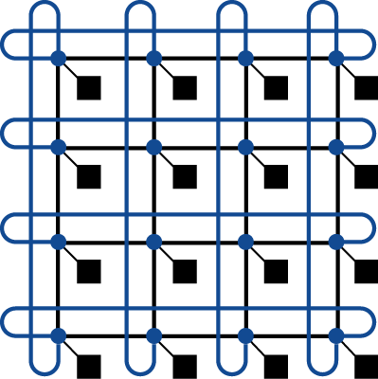

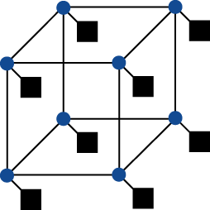
Aside: Interconnection Networks
Network topologies
  Arrangements of processors, switches, and links
Bus
Ring
N-cube (N = 3)
2D Mesh
Fully connected

Slide 49
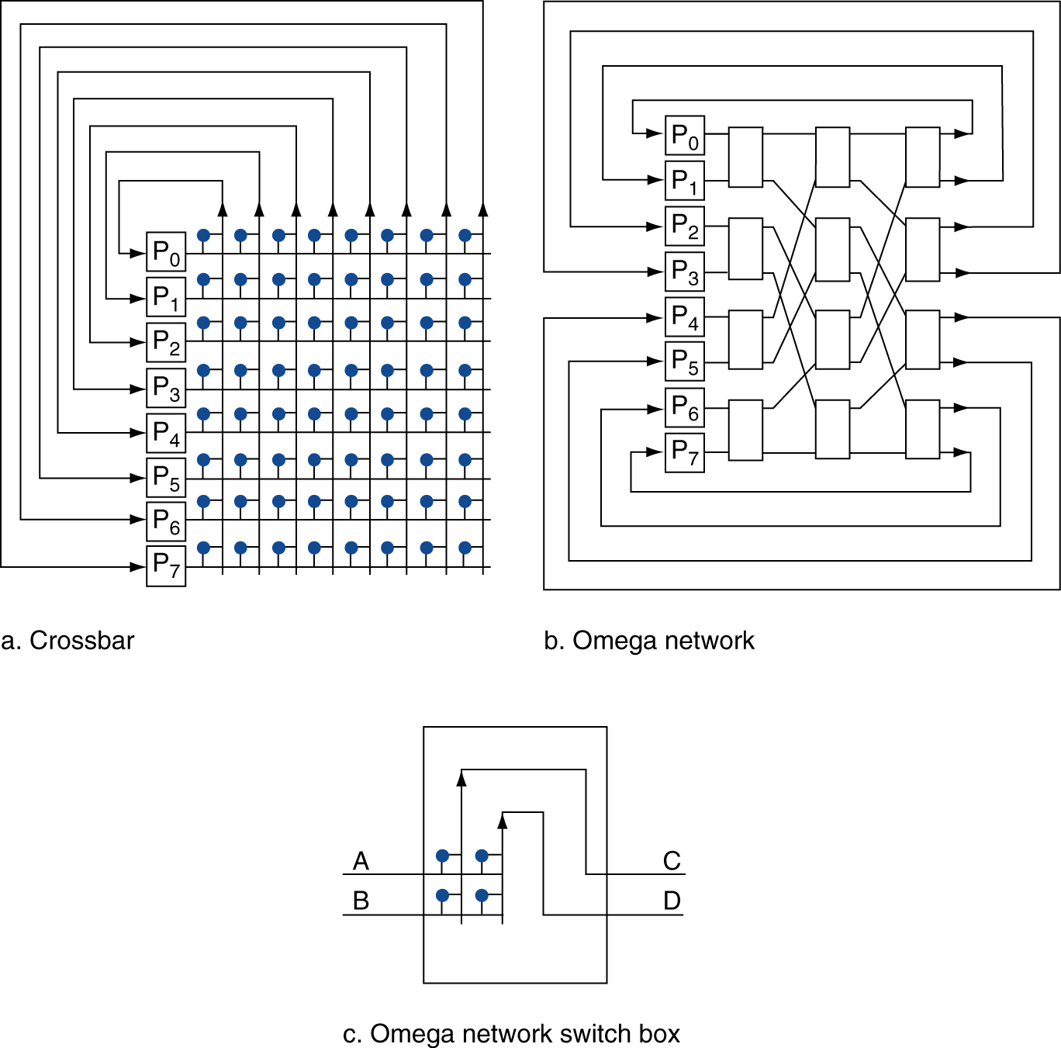
Aside: Multistage Networks

Slide 50
Aside: Network Characteristics
Performance
  Latency per message (unloaded network)
  Throughput
    Link bandwidth
    Total network bandwidth
    Bisection bandwidth
  Congestion delays (depending on traffic)
Cost
Power
Routability in silicon

Slide 51
Next: Exploit TLP on Multicores
Basic idea: Processor resources are expensive and should not be left idle
Long memory latency to memory on cache miss?
Hardware switches threads to bring in other useful work while waiting for cache miss
Cost of thread context switch must be much less than cache miss latency
Put in redundant hardware so don’t have to save context on every thread switch:
  PC, Registers, L1 caches?
Attractive for apps with abundant TLP
  Commercial multi-user workloads

Slide 52
struct foo {
int x;
int y;
};
static struct foo f;
/* The two following functions are running concurrentlyby two threads: */
int sum_a(void) {
int s = 0;
int i;
for (i = 0; i < 1000000; ++i)
s += f.x;
return s;
}
void inc_b(void) {
int i;
for (i = 0; i < 1000000; ++i)
++f.y;
}
Notes:
False sharing example

