Slide 1
CS 2033 Multimedia & Communications II
Lecture 2 – Advanced Photo EDITING

Slide 2
Announcements
Office hours will be cancelled today. If you have questions, come by my office Wednesday 1:30-3:30pm instead.
Labs begin this week. Remember you must go to the section you are enrolled in.
Sign the attendance sheet and show your finished work to the TA before leaving the lab.

Slide 3
Photo Editing
In CS1033, you learned how to create posters and banners.
This is part of what photo editing software is used for, but there's so much more!

Slide 4
Photo Editing
When you hear "that looks Photoshopped," does it refer to a poster created in Photoshop?
Probably not.
Does it mean the work was done in Adobe Photoshop?
Not necessarily.

Slide 5
Photo Editing
"Photoshop" is not just a program, but it is a word in dictionaries now.
"to digitally alter (a photograph or other graphic) using image-editing software such as Photoshop" (dictionary.com)
2 key points in this definition:
digitally alter graphics
using image-editing software

Slide 6
Photo Editing
Adobe Photoshop is the most popular image editing software, but there are other great ones.
We are using Affinity Photo which is similar to Adobe Photoshop.
Another popular example is GIMP.
We can "photoshop" graphics using Affinity Photo!

Slide 7
Photo Editing
Note that the term "photoshop" is used in our lectures/labs for this course in the general context.
When you see this term here, know that it just means digitally altering photos; but NOT specifically with Adobe Photoshop.

Slide 8
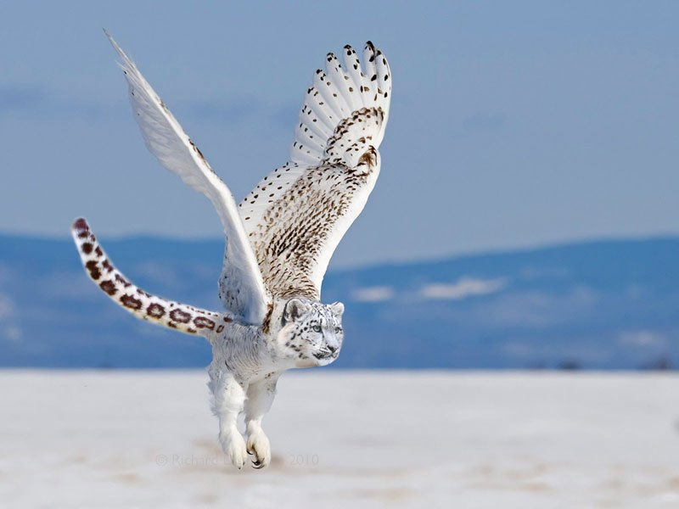
Examples
https://twistedsifter.com/2015/11/photoshopped-animal-hybrids-gallery/

Slide 9
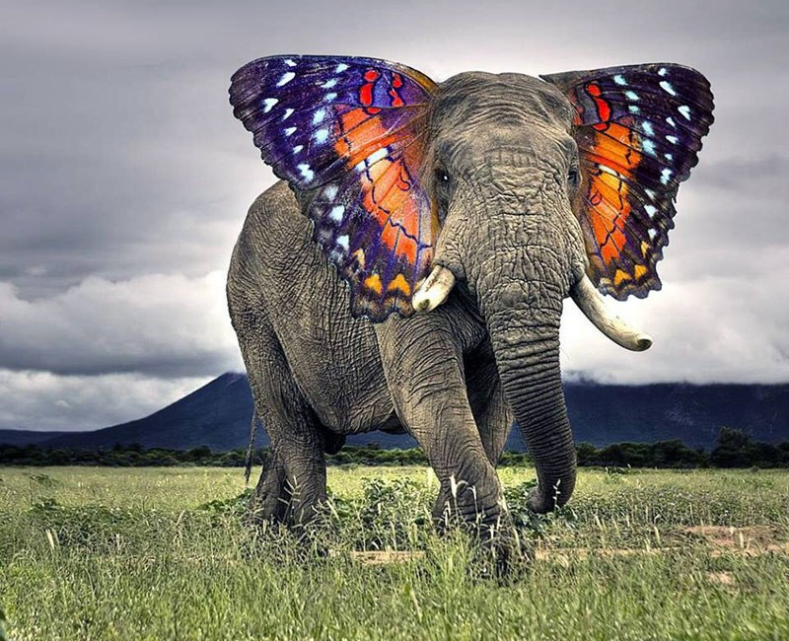
Examples
https://twistedsifter.com/2015/11/photoshopped-animal-hybrids-gallery/

Slide 10
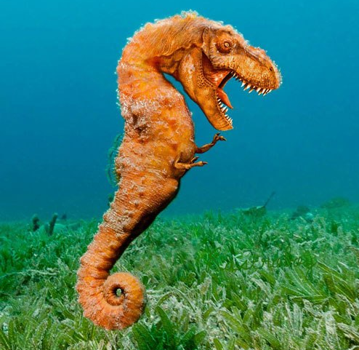
Examples
https://twistedsifter.com/2015/11/photoshopped-animal-hybrids-gallery/

Slide 11
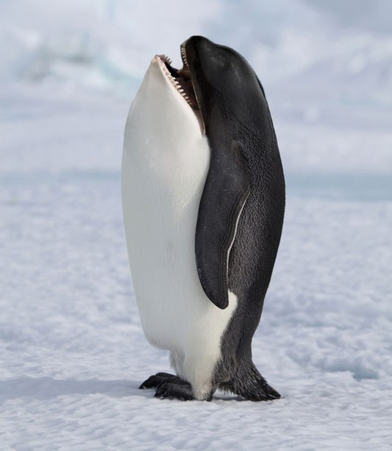
Examples
https://twistedsifter.com/2015/11/photoshopped-animal-hybrids-gallery/

Slide 12
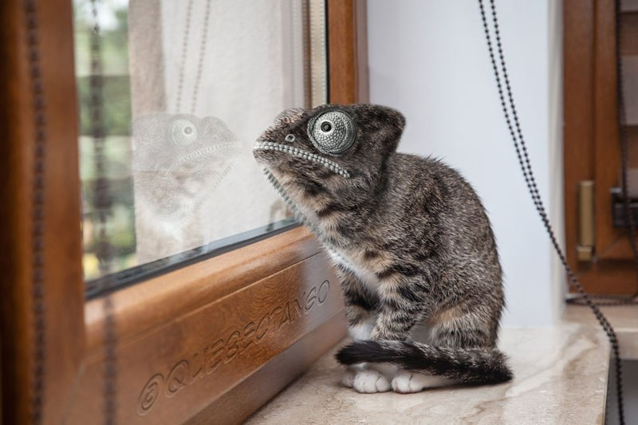
Examples
https://twistedsifter.com/2015/11/photoshopped-animal-hybrids-gallery/

Slide 13
Photoshop
It's not only for creating amazing animal hybrids!
It is often used in ads, tabloids, and magazines to make people look different (better or worse).
i.e. removing acne and wrinkles, changing body size (muscles, waist, stomach, legs, etc.)

Slide 14
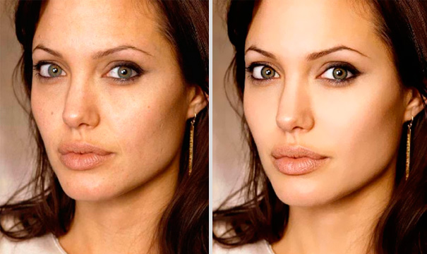
Examples
https://www.boredpanda.com/photoshopped-celebrities-before-after/

Slide 15
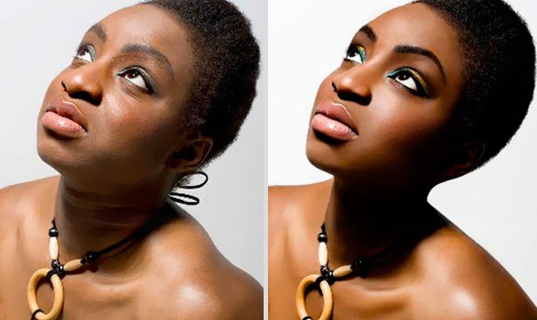
Examples
https://www.boredpanda.com/photoshopped-celebrities-before-after/

Slide 16
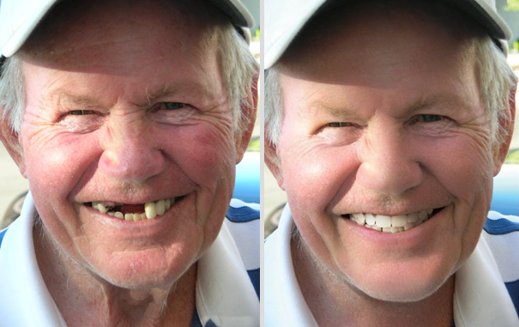
Examples
https://www.boredpanda.com/photoshopped-celebrities-before-after/

Slide 17
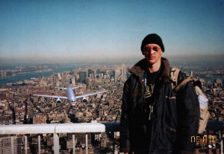
Be responsible
https://en.wikipedia.org/wiki/Tourist_guy

Slide 18
Photoshop
These programs are used for a lot more than creating posters.
In this course, you will learn about many of the tools for retouching pictures, merging multiple pictures, modifying the colours in an image, and more!
First we need a refresher on colours, pixels, sampling, and resolution.

Slide 19
Colours
Colours are often represented with RGB and hexadecimal codes.
Both formats are based on red, green, and blue components.
RGB are triplets of numbers 0-255.
Hexadecimal are 6-digit strings of numbers 0-F (F=15).

Slide 20
Bitmapped graphics
Bitmapped graphics are composed of grids of pixel cells. Each pixel has exactly one colour.
Cameras convert analog scenes into digital pictures by performing sampling and quantizing.
Resolution denotes how big the pixels are, usually measured in PPI.

Slide 21
Resampling and resizing
A common function in photo programs is to change the image/graphic size.
The term "resizing" an image is often used incorrectly.
What's the difference between resampling and resizing images?
Both are easy to do but what do they each do?

Slide 22
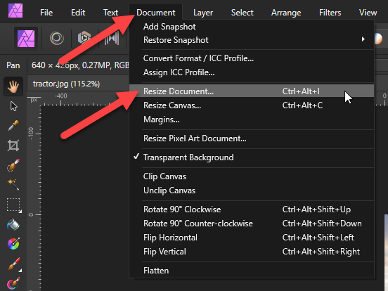
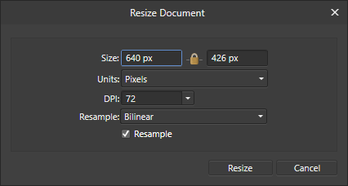
Resampling and resizing

Slide 23
Resampling
Remember pixels = samples.
So resampling means breaking the picture into pixels again.
This process changes how many pixels are in the image, not how big the pixels are.
Used for pictures online and on computers, not so much for print.

Slide 24
Resampling
Usually results in decreased quality.
Downsampling = making it smaller.
Pixels are removed via decimation.
Upsampling = making it larger.
Pixels must be added via interpolation.
More on this in a bit…

Slide 25
Resizing
The other method of changing an image's size is called resizing.
This does not involve changing the pixels (samples).
It simply changes the resolution.
Mainly used for printing, as this only affects the size it will print.
No change in quality or filesize.

Slide 26
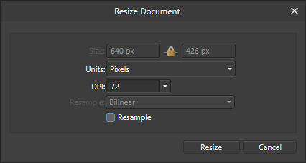
Resampling and resizing
Resampling
Resizing

Slide 27
Resampling and resizing
What does the lock icon mean?
The width and height will change proportionally together.
Why are the Size boxes and Resample menu grayed out when "Resample" is unchecked?
Because with resizing, only the DPI is being changed. The number of pixels does not change.

Slide 28
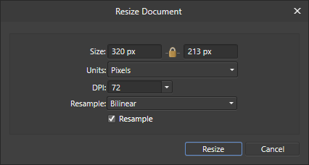
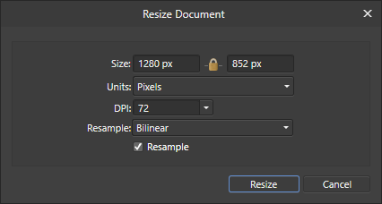
Resampling and resizing
With resampling, enter a new width or height and click into another box. The other dimension will be updated automatically.

Slide 29
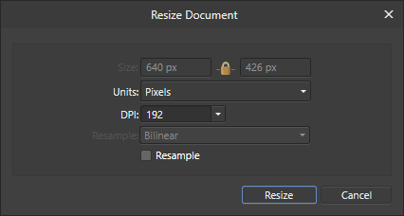
Resampling and resizing
With resizing, enter a new resolution and nothing else changes. You won't notice any difference in the image unless you print it out.

Slide 30
Resampling techniques
How is resampling actually done?
Pixels must be removed or added, but how is this accomplished?
How do they affect the image quality?

Slide 31
Resampling techniques
Downsampling involves removing pixels from the original image.
This can cause distortions, or artifacts, due to the missing pixels.
There are algorithms that help with this by blending the nearby pixels to smooth over the transition.

Slide 32
Resampling techniques
With downsampling, data is being removed. Suppose we start with this simple example graphic:
Downsampling removes about half the pixels on each dimension. We are left with something like this:

Slide 33
Resampling techniques
Upsampling involves adding pixels to fill in the gaps between the original pixels.
This generally causes blurring and artifacts because the new pixel colours may not transition smoothly.
The selection of the new pixel colours is based on interpolation.

Slide 34
Resampling techniques
In simple terms, interpolation means averaging the colours of the neighbouring pixels.
This may work well if there is a consistent gradient between the colours but this isn't often the case.
There are several algorithms for interpolating colours.

Slide 35
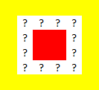
Resampling techniques
With upsampling, new pixels are added and their colours are unknown. Suppose we have this initial simple graphic:
We want to resample it larger. The red and yellow pixels can remain mostly as they are. What goes in between? Yellow? Red? Orange?

Slide 36
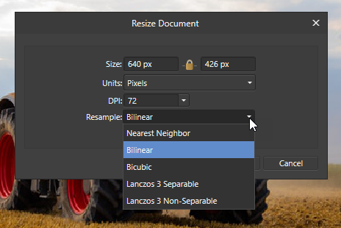
Resampling techniques
Affinity Photo has 5 options for decimation / interpolation.
Some options are better suited for certain situations.

Slide 37
Selections
A large part of "photoshopping" is to apply effects to images.
Effects don't have to be applied to the entire canvas/graphic. They can be applied to a smaller region.
The regions, which can be any size and shape (including complex polygons), are often called selections.

Slide 38
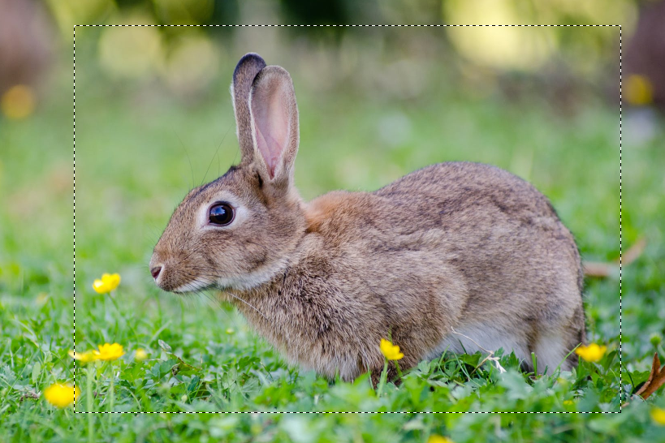
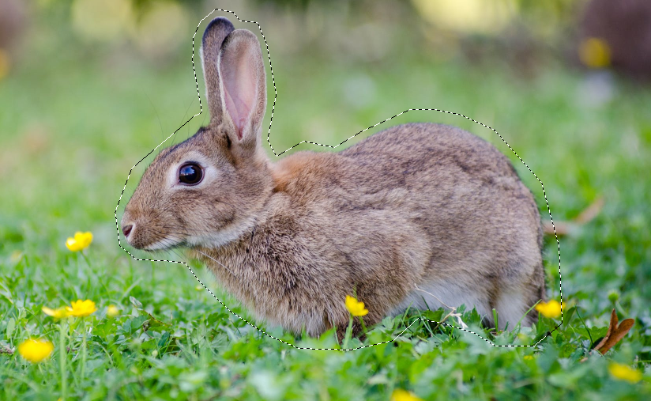
Selections
Selections are usually indicated with "marching ants", or rotating dashed lines around the perimeter.

Slide 39
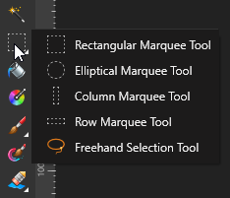
Selections
There are several tools to make selections in Affinity Photo.
Marquee Tools
Freehand Selection Tool
Selection Brush Tool
Flood Select Tool

Slide 40
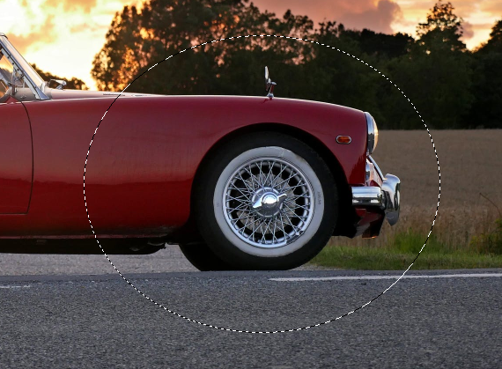
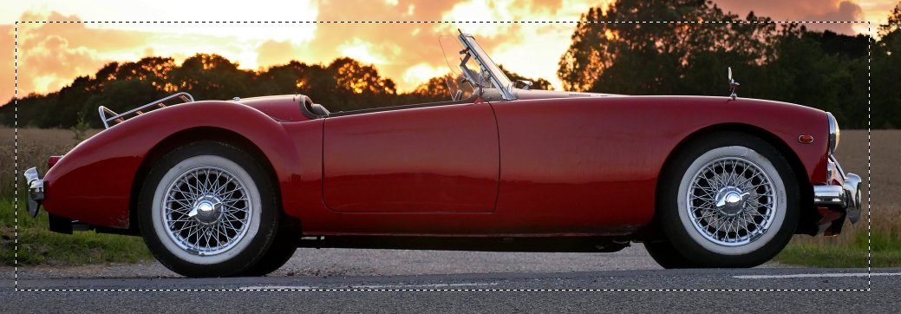
Selections
Marquee Tools
Simple to use, just drag your cursor.
Rectangular and Elliptical are commonly used marquees.
Single row / column marquees are not as important.

Slide 41
Selections
Freehand Selection Tool (also known as Lasso Tool)
There are 3 modes:
Freehand – draw selection freely
Polygonal – draw one line at a time
Magnetic – automatically snaps to edges of high contrast

Slide 42
Selections
Freehand Selection Tool - Freehand
Allows you to make selections from drawing segments in freeform.

Slide 43
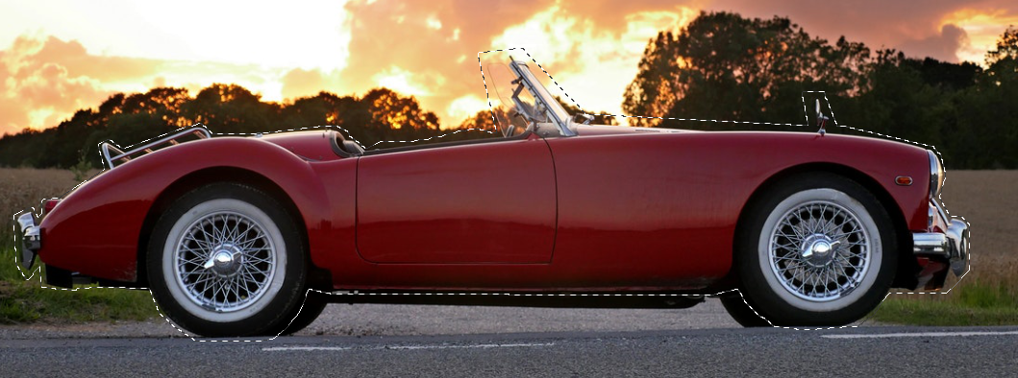
Selections
Freehand Selection Tool - Polygonal
Every time you click, a line segment is added. It's easier to create a large, complex selection using this mode.

Slide 44
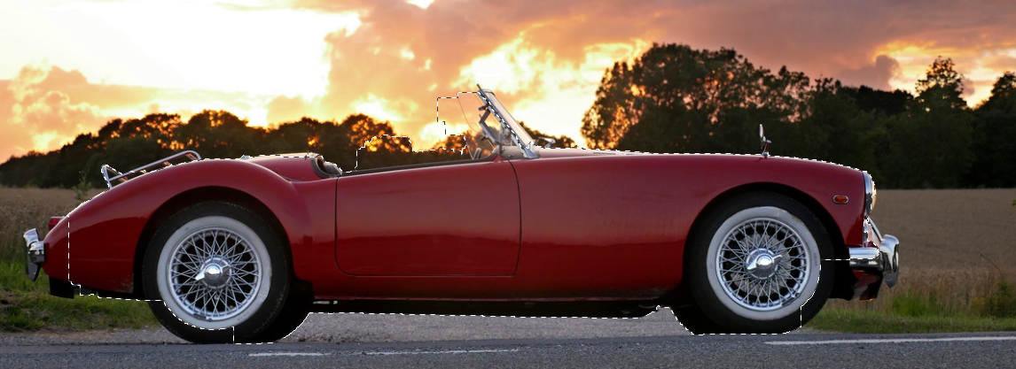
Selections
Freehand Selection Tool - Magnetic
The program attempts to snap the selection to the closest edge as you move the cursor.

Slide 45
Selections
Freehand Selection Tool - Magnetic
The snapping is done using edge detection algorithms: it looks for lines of high contrast between two nearby colours and assumes that's an edge
This mode is not recommended because it's very unpredictable and inaccurate in most cases.
Only works well with well-defined, high-contrast shapes.

Slide 46
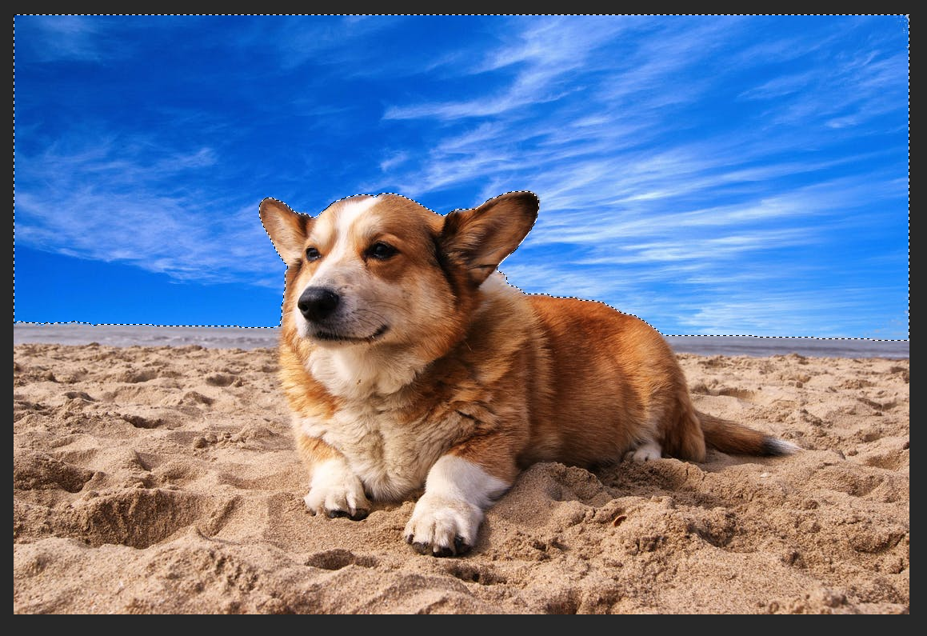
Selections
Selection Brush Tool
Similar to magnetic Freehand Selection Tool - as you drag, it looks for colours similar to the current selection and grows the selection.
Not effective if there are similar colours in the background and foreground.

Slide 47
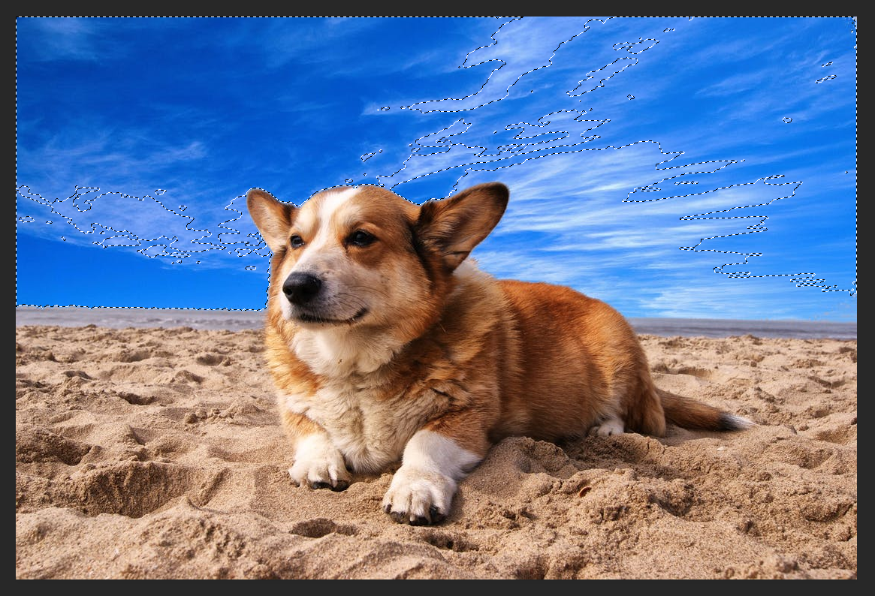
Selections
Flood Select Tool
Creates a selection at once based on a selected pixel colour that you clicked on.
The tolerance affects how much the selection will include pixels of similar colour or brightness.

Slide 48
Selections
Are selections always perfect? No!
Whether you make a selection by hand or use one of the automatic selection tools, it's likely imperfect.
A high contrast between background and foreground colours yields a much higher chance at being correct.

Slide 49
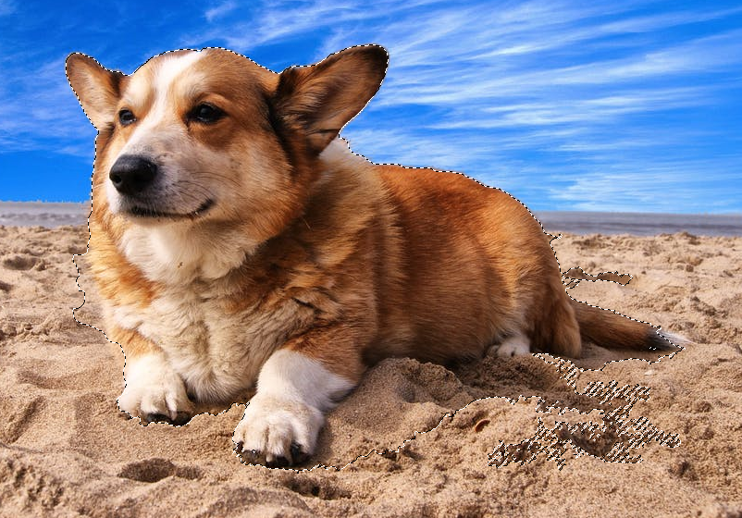
Selections
Which areas of this selection are good? Which are not good? Why?

Slide 50
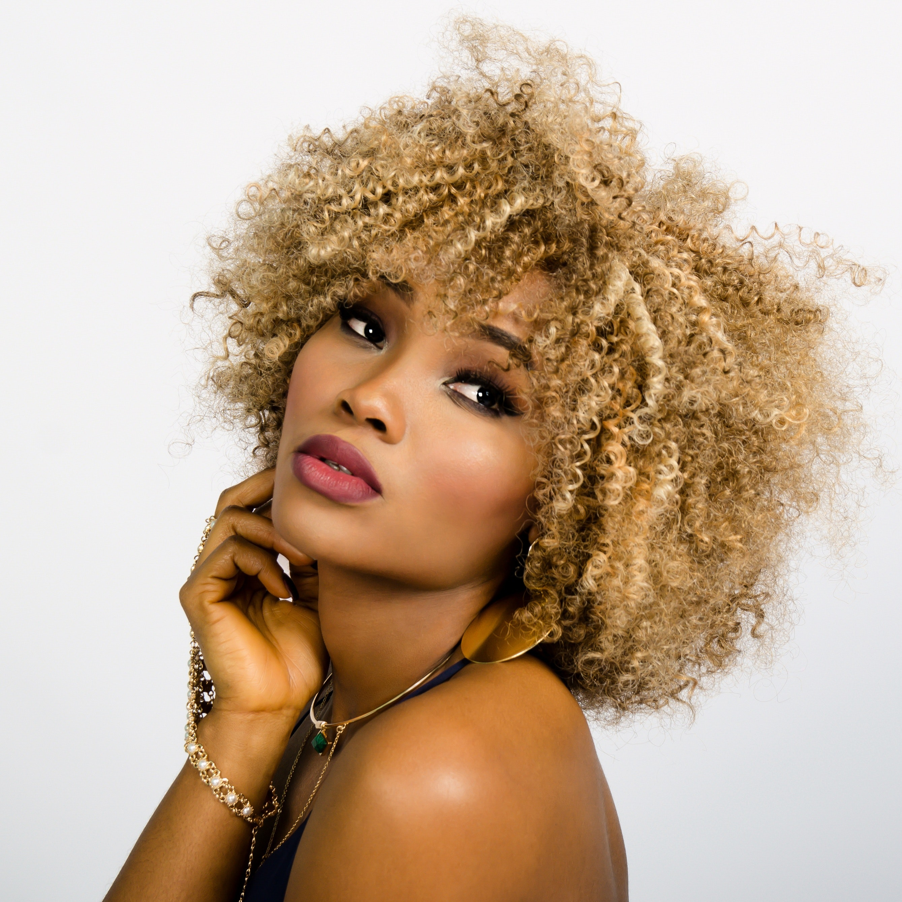
Selections
Will it be easier to remove the background in this picture?

Slide 51
Selections
The white background should help.
However, hair is difficult to properly select.
Hair generally does not have well-defined edges and can loop and flow in all different directions.
Very difficult to work with!

Slide 52
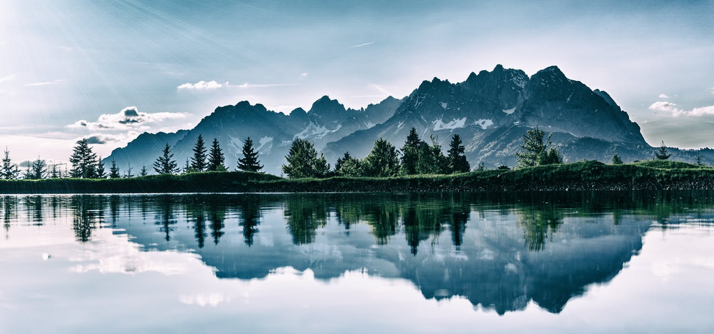
Selections
Selections can be altered after they are made.
i.e. we want to select just the trees.

Slide 53
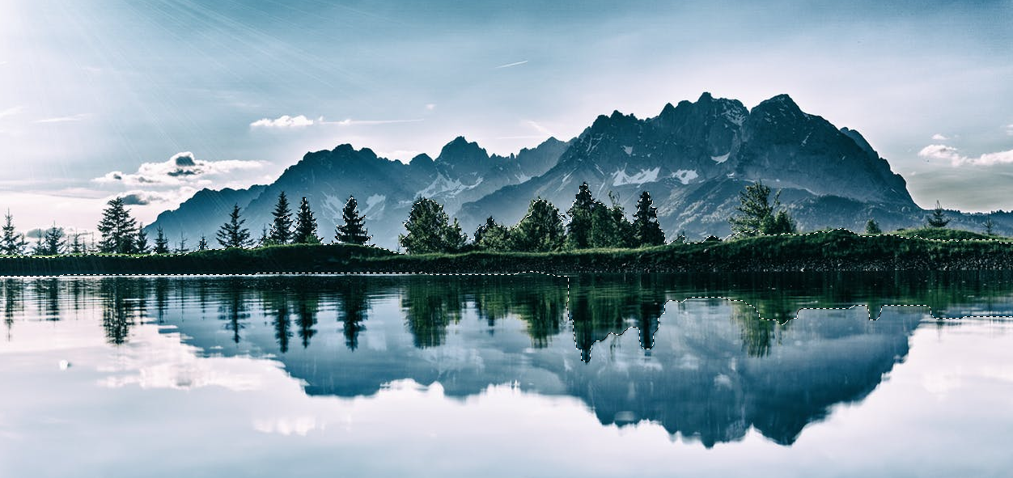
Selections
Some are missing and part of the reflection got mistakenly selected.

Slide 54
Selections
Rather than starting the selection over, you can alter a selection to refine it or fix any mistakes.
You may:
Create a new selection
Add to selection
Remove from selection
Intersect with selection

Slide 55
Selections
I performed an intersection with the previous selection and a rectangle selection along the water. This excludes the tree reflections.

Slide 56
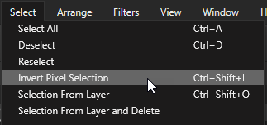
Selections
In some cases, it is easier to select the opposite of what you want to select and then invert it.
This might occur if the object you want to select has a lot of colours and the background is a solid colour.

Slide 57
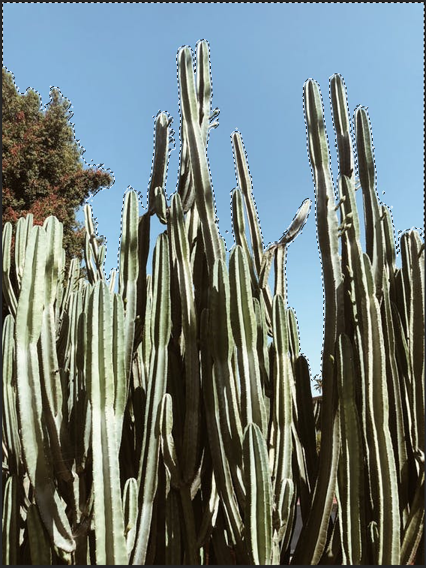
Selections

Slide 58
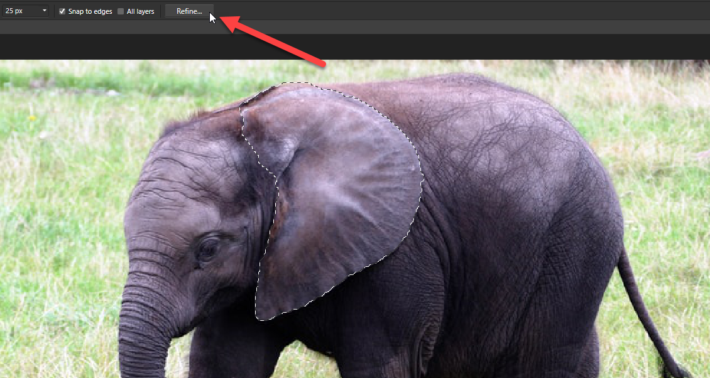
Selections
Selections can also be modified by clicking the "Refine" button.

Slide 59
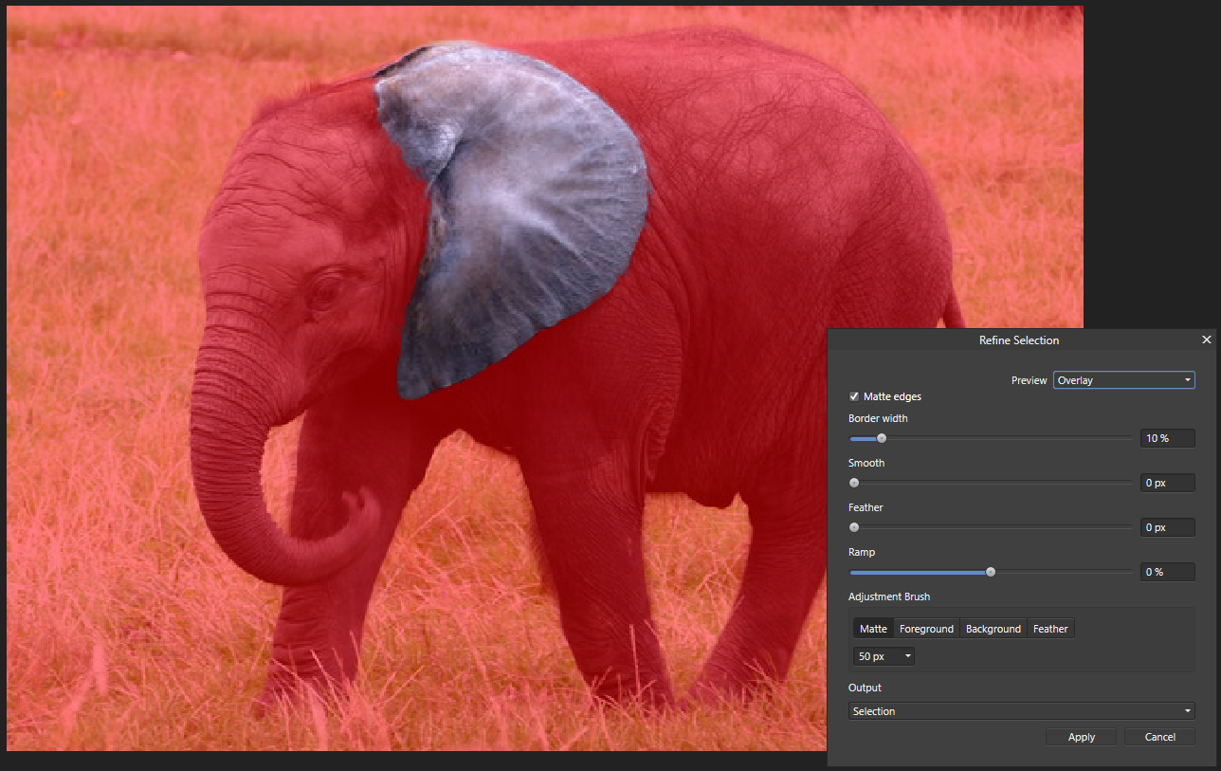
Selections

Slide 60
Selections
The 4 main parameters for refinement are:
Border width
Smooth
Feather
Ramp
Play with these sliders to see how they affect the selection.

Slide 61
Selections
It can still be difficult to make a perfect selection even with these add/remove/intersect modifiers and refinement settings.
Masks can help with this!
We'll just learn about clipping masks for now and cover more about masks next week.

Slide 62
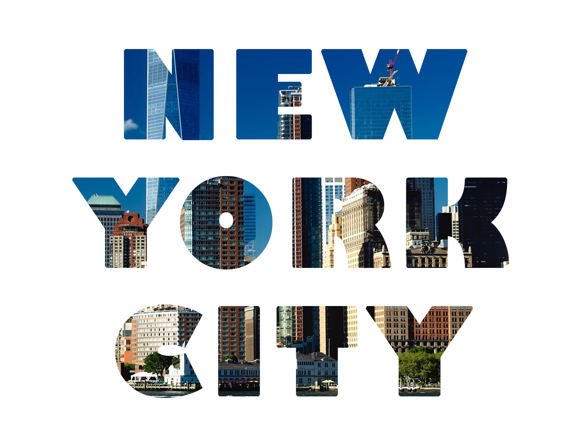
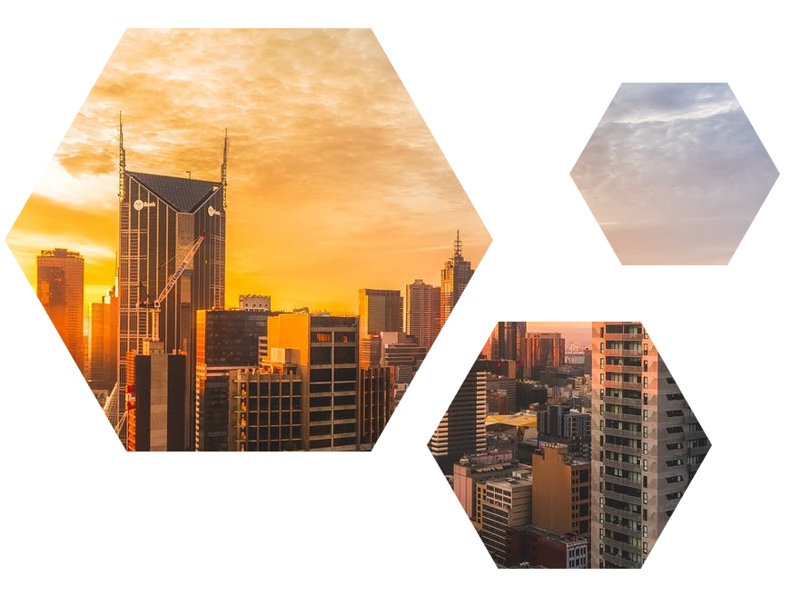
Clipping masks
What is a clipping mask?

Slide 63
Clipping masks
We want an image to show through onto text or a shape.
Affinity Photo makes this very easy!
Clipping masks link a background layer to foreground layers, such that the background is shown only in the regions defined by the foreground.

Slide 64
Clipping masks
A clipping mask requires 2+ layers:
One mask background layer.
The texture to show through.
One or more foreground layers.
The visible shape outlines on which the texture will appear.

Slide 65
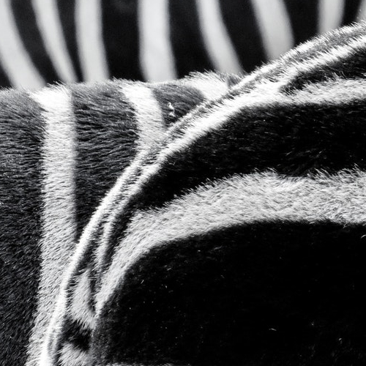
Clipping masks
Background texture layer
Foreground outline layer
Clipping mask

Slide 66
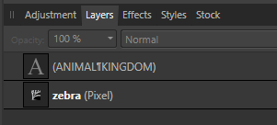
Clipping masks
In this example, zebra is the background layer and ANIMAL KINGDOM is the text we want shown.
Notice the background layer is below the text layer.
They MUST be in this order!

Slide 67
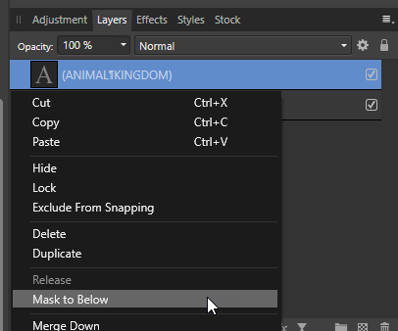
Clipping masks
Right-click on the foreground (text) layer and click "Mask to Below".
They are shown as one merged layer.
An arrow appears beside the layer to indicate the clipping mask.

Slide 68
Clipping masks
What if you want multiple texts or shapes as the foreground?
Select all the layers you want to be in the foreground. Hold Ctrl while clicking on additional layers to select multiple.
Click the folder icon to create a new group of these selected layers, or push Ctrl+G.

Slide 69
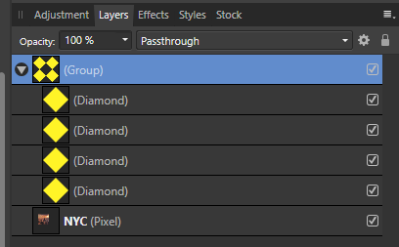
Clipping masks
Just like with single layer clipping masks, the background layer MUST be immediately below the group of foreground layers.
Create a clipping mask the same way and it will be applied to all the grouped layers.

Slide 70
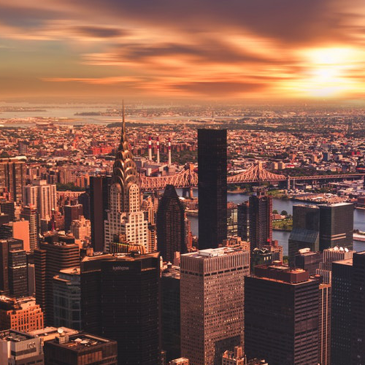
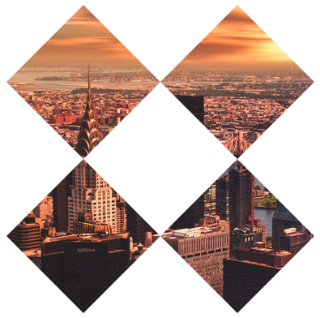
Clipping masks
Background texture layer
Group of foreground layers
Clipping mask

Slide 71
Retouching pictures
There are several tools that make it easy to remove red eye, acne, dirt, moles, scars, or other blemishes.

Slide 72
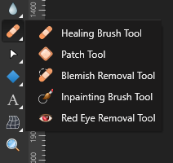
Retouching pictures
The main re-touching tools are grouped together:
Healing Brush Tool
Patch Tool
Blemish Removal Tool
Inpainting Brush Tool
Red Eye Removal Tool

Slide 73
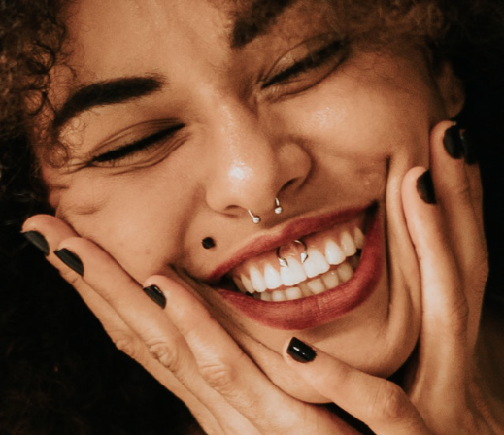
Retouching pictures

Slide 74
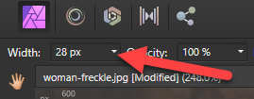
Retouching pictures
Healing Brush Tool requires you to choose a good sample with which the blemish will be covered.
Choose a Width appropriate for the blemish you are removing.
Find an area without a blemish that can be used to cover the blemish. Hold Alt and click.
Click over the blemish to remove it.

Slide 75
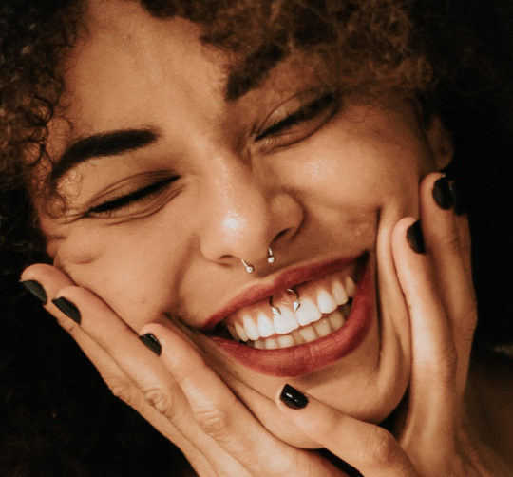
Retouching pictures

Slide 76
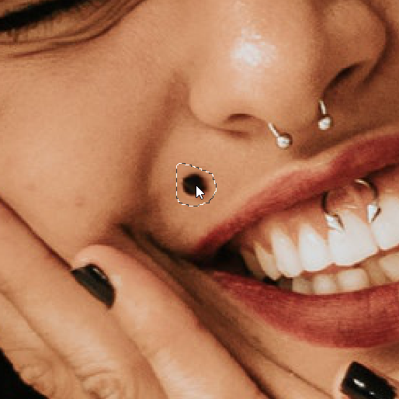
Retouching pictures
Patch Tool is similar to Healing Brush Tool, also used to remove something like a blemish or scar from a picture.
With Patch Tool, draw a selection around the item to remove.

Slide 77
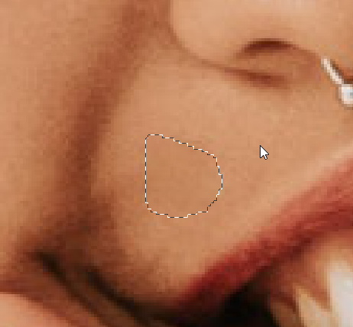
Retouching pictures
Move your cursor around to see a preview of the selection covered with the area where your cursor is pointing, i.e. without the blemish.
When the cursor is on an unblemished area, click to make the replacement.

Slide 78
Retouching pictures
Blemish Removal Tool is also similar to the Healing Brush Tool.
It also uses a brush/circle selector.
Choose an appropriate Width for the brush.
Click on the blemish and it will be automatically covered with surrounding pixel colours.

Slide 79
Retouching pictures
If the automatic removal doesn't look great, you can instead click and drag the brush to an unblemished area.
You also get a live preview just like with the Patch Tool.

Slide 80
Retouching pictures
The Inpainting Brush Tool is better suited for removing large items.
Click down and drag the cursor all over the item you want removed.
A translucent red layer will show where you have drawn.
Release the mouse when finished to remove the painted area.

Slide 81
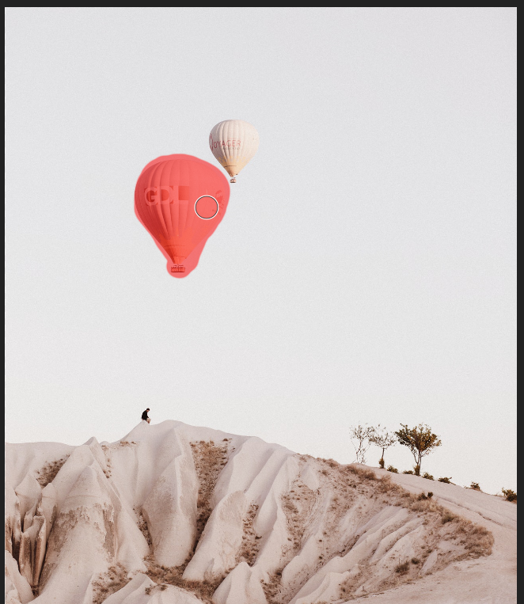
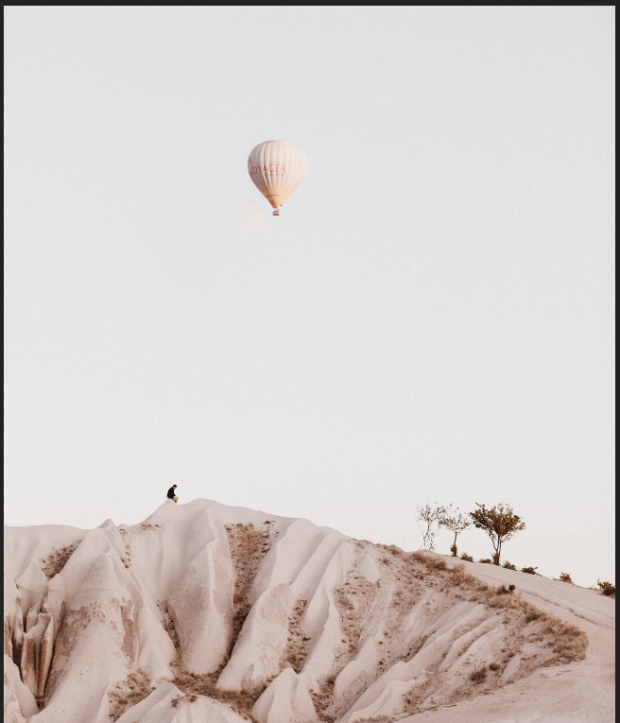
Retouching pictures

Slide 82
Retouching pictures
Red Eye Removal Tool removes red eye caused by camera glare.
Click on the red area of each eye and they will be turned dark automatically.

Slide 83
Retouching pictures
Cloning is also possible in Affinity Photo! Use the Clone Brush Tool (stamp-like icon).
Select a source point of an object by holding Alt and clicking on the spot you want to be the source.
Then you start drawing somewhere else on the canvas and it will paint in the object from the source point.

Slide 84
Retouching pictures
Select a source point.
The painting will come from the original object, relative to this source point.
Click and drag to draw the clone. Notice the crosshairs on the original as you draw out the clone.

Slide 85
Retouching pictures
Clone

