Slide 1
CS 2033 Multimedia & Communications II
Lecture 3 – Advanced Photoshop

Slide 2
Announcements
Assignment 1 is posted on OWL and it is due Jan. 31.
There's a lot to do so it's best to start on it now and do what you can.
There are a couple small parts that are in Lab 3. They are shown in lecture, so you can still do them even before Lab 3 next week.
Follow the instructions carefully!

Slide 3
Announcements
Quiz 1 will be open Feb. 5-6th.
You can refer to the lecture notes and your notes during the quiz.
You can even use Google if you want.
The questions will involve thinking outside the box.

Slide 4
Colour channels
Recall that graphics on computers use the RGB colour model.
In printing, the CMYK model is used.
Colour models are made up of channels or bands.
RGB: 3 bands x 8 bits = 24 bits/pixel.
CMYK: 4 bands x 8 bits = 32 bits/pixel.

Slide 5
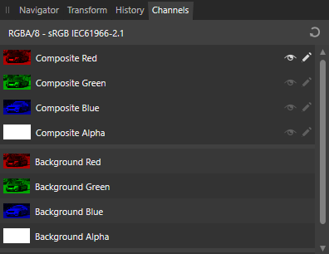
Colour channels
Each individual band is an 8-bit grayscale image.
A colour image is a composite, made of several grayscale bands.
In Affinity Photo, you can see the individual channels by clicking on the Channels tab.

Slide 6
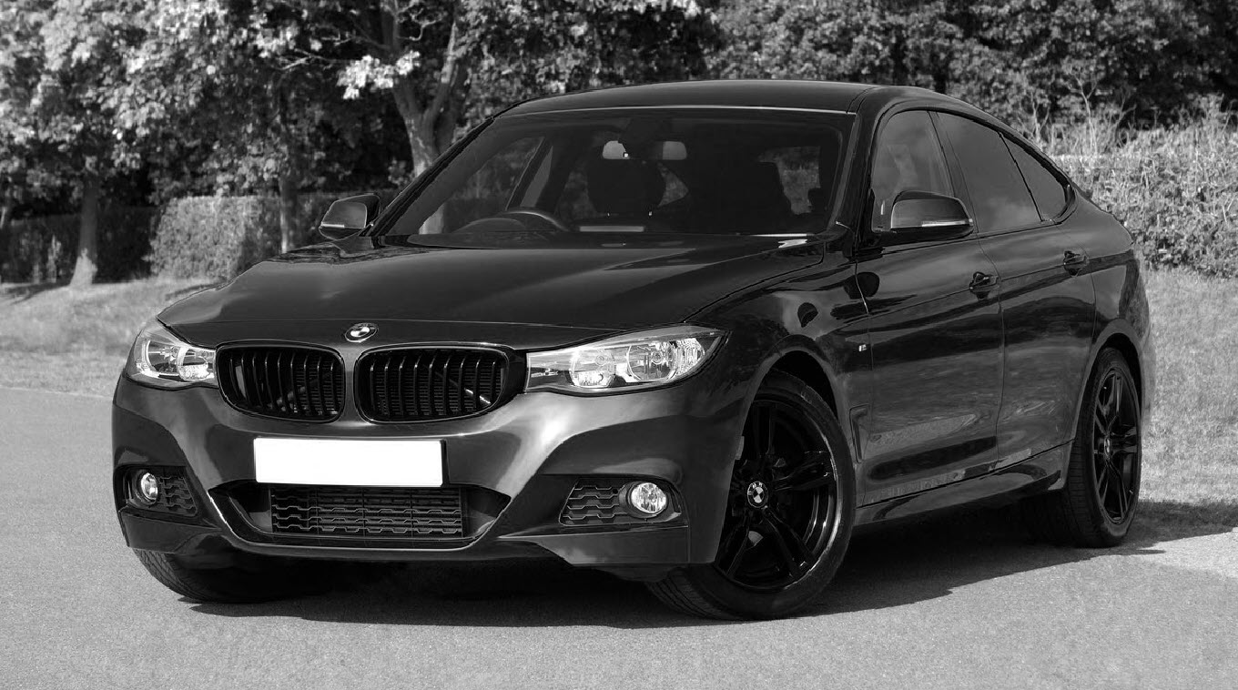
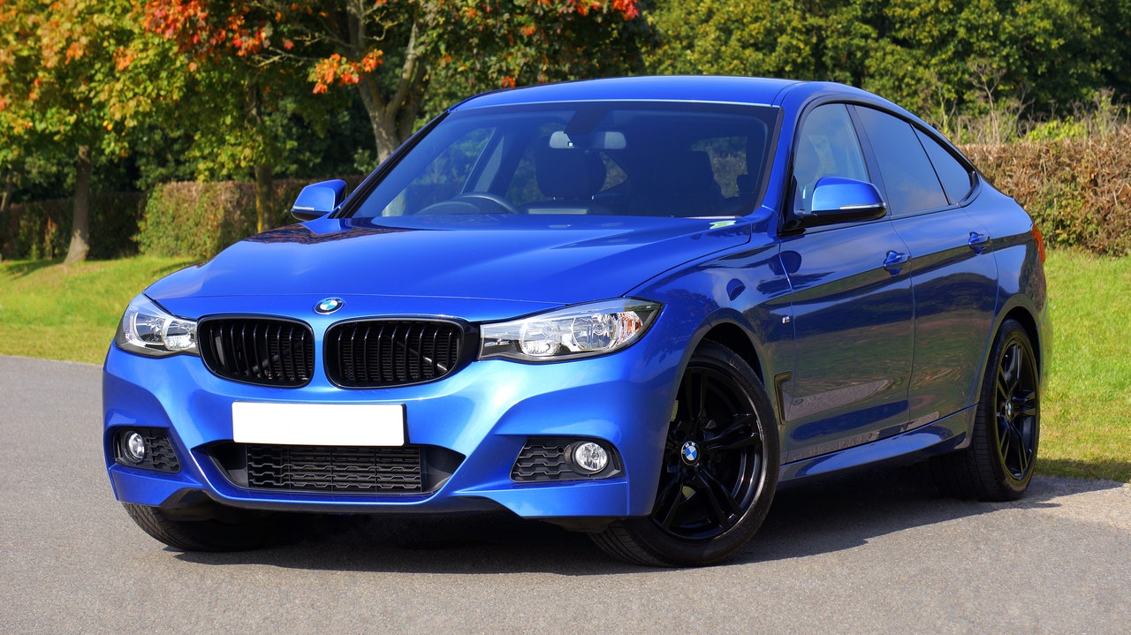
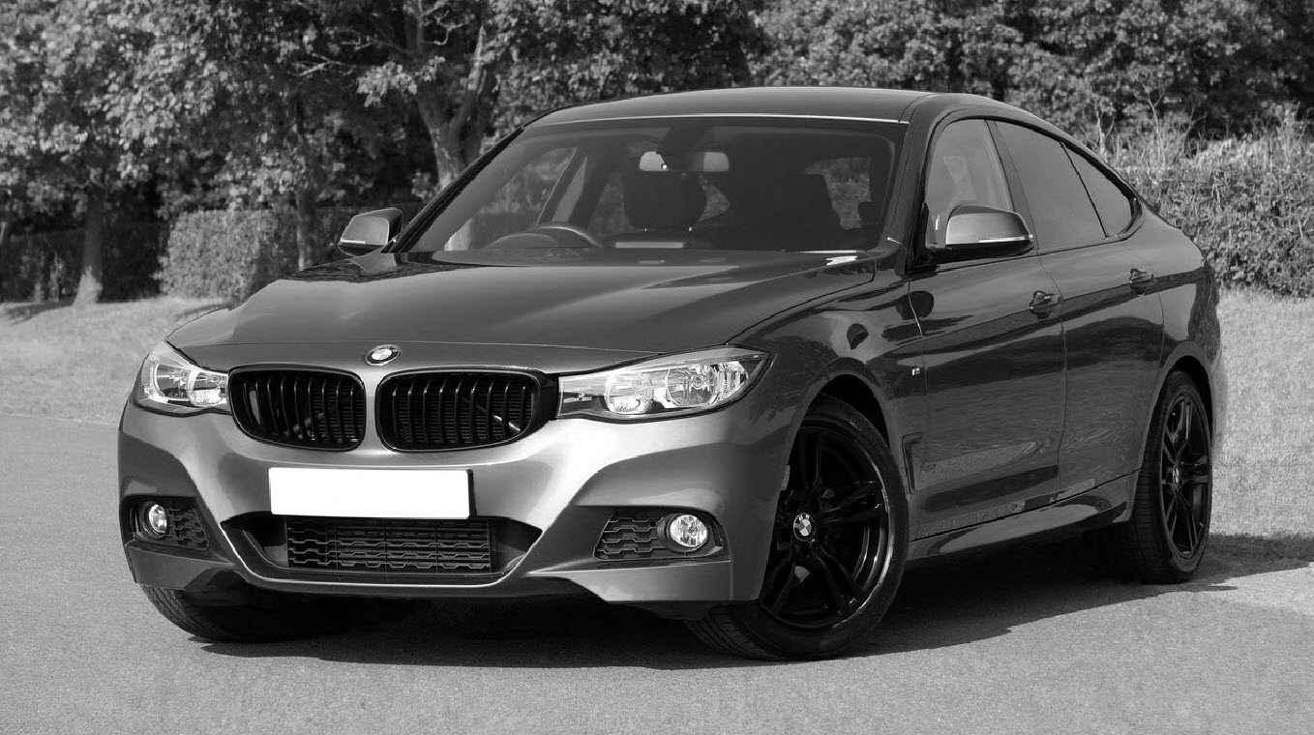
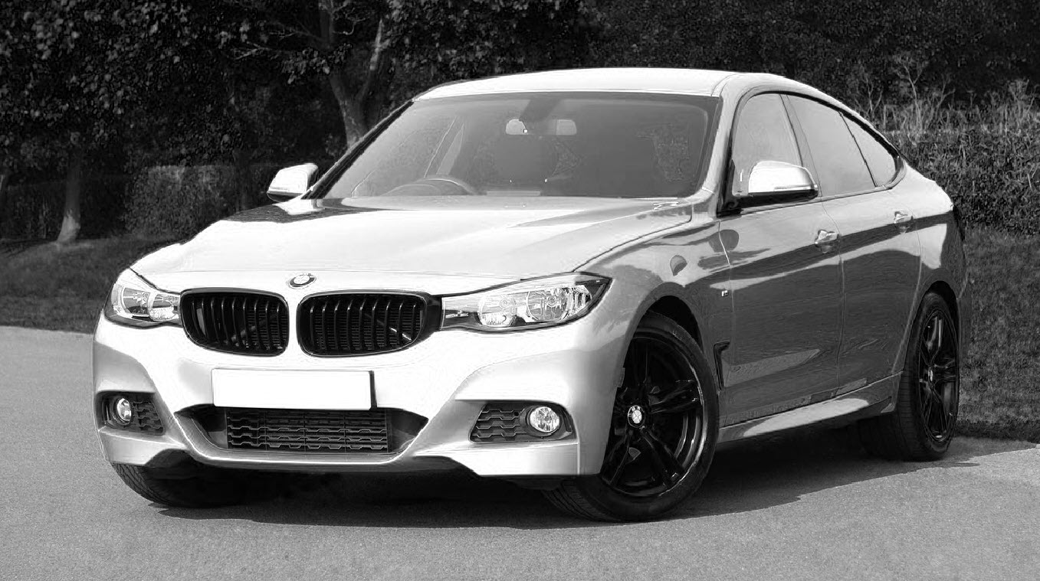
Colour channels

Slide 7
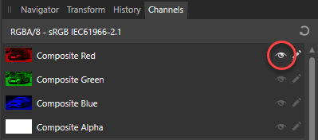
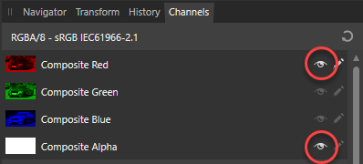
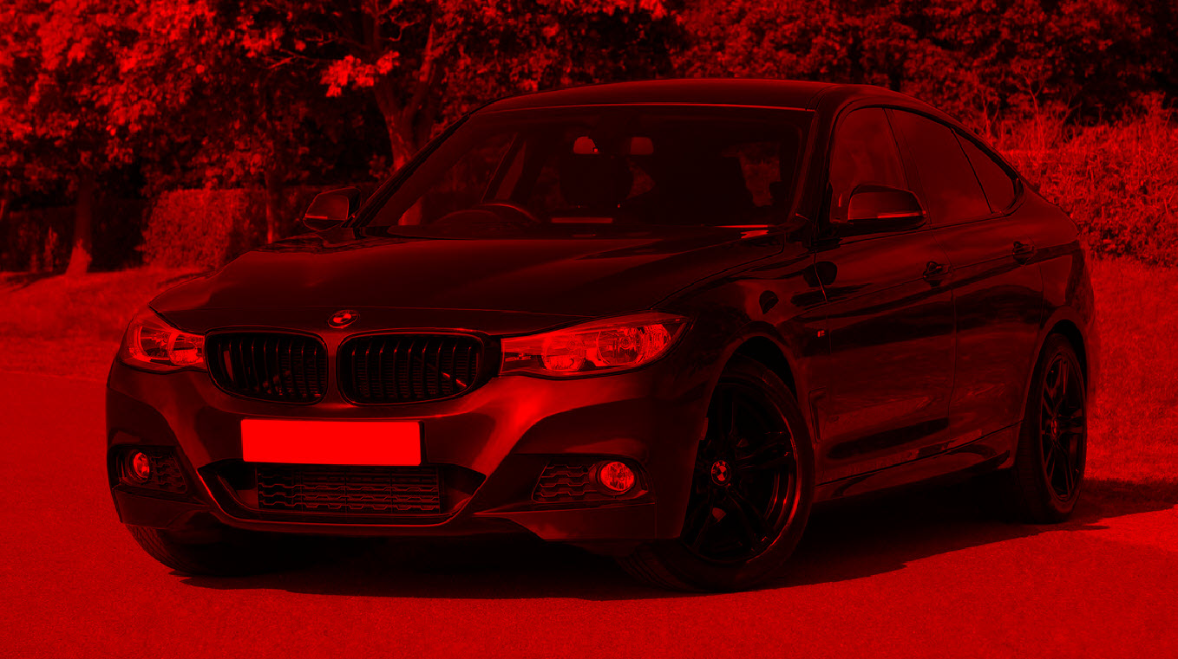
Colour channels
You can also see these channels in colour by clicking the eye icon beside the Alpha channel.

Slide 8
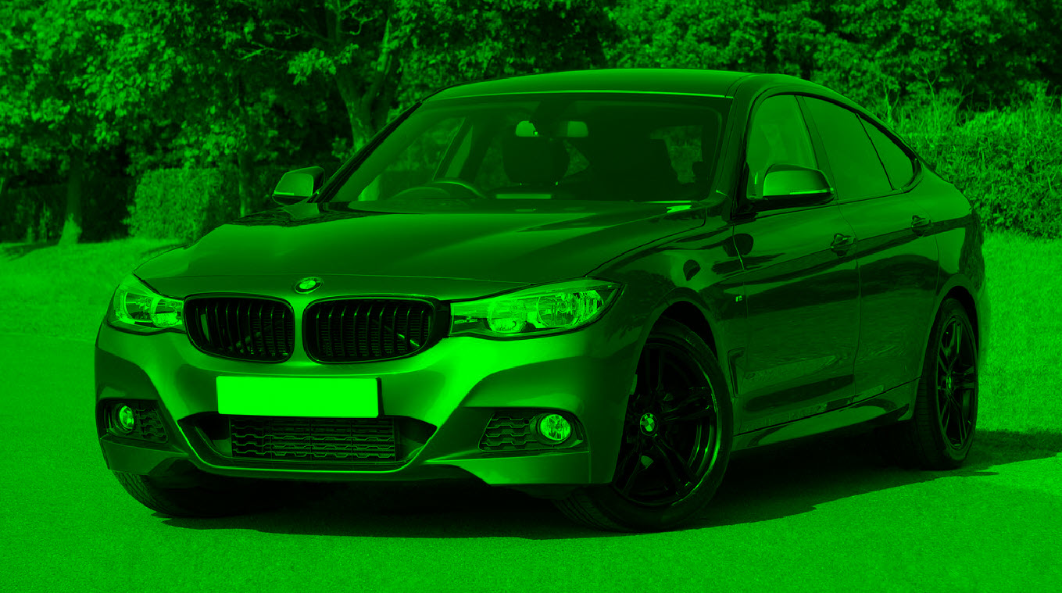
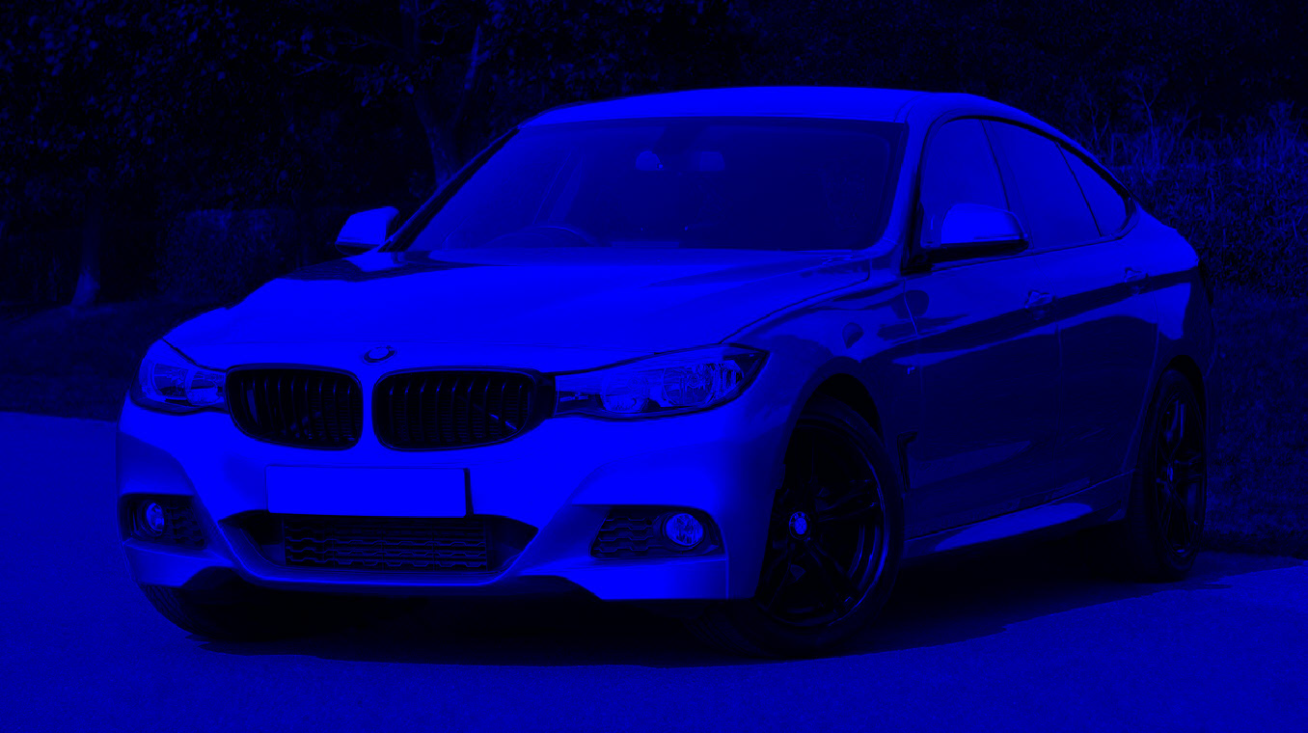
Colour channels

Slide 9
Colour channels
Affinity Photo sees images in terms of the grayscale channels. They cannot see colour the way we can.
What do the gray values represent, and how does that translate to a colour composite for us to see?

Slide 10
Colour channels
Think of it as a measurement of how much of the colour (R, G, or B) is present in that region of the fully coloured picture.
White: full colour from channel
Black: no colour from channel
Gray: some colour from channel

Slide 11
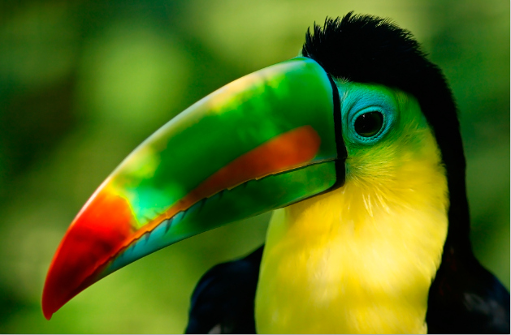
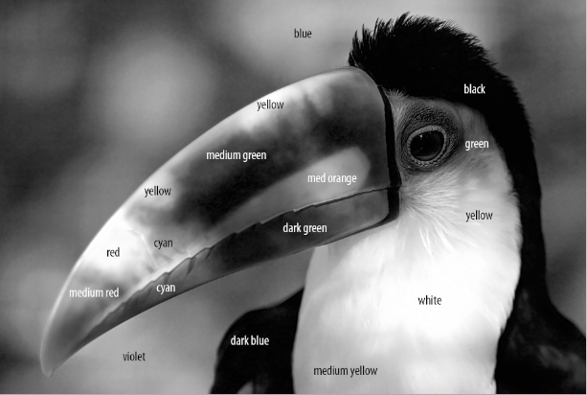
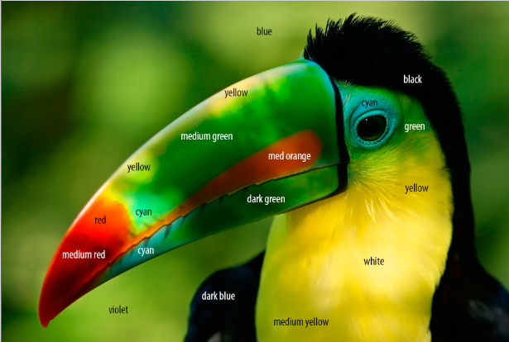
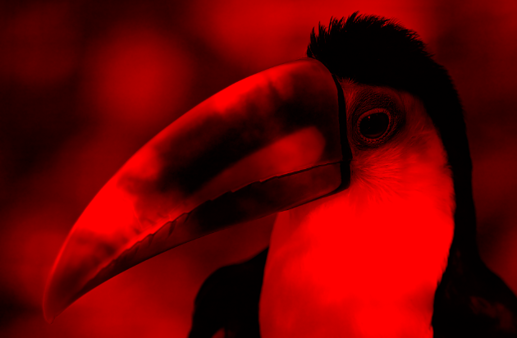
Colour channels

Slide 12
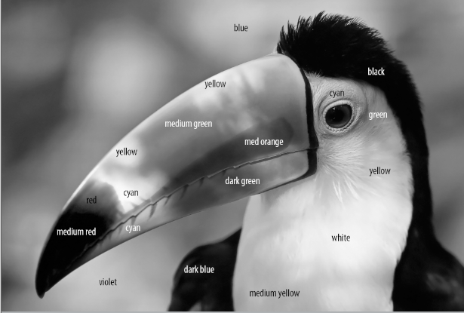
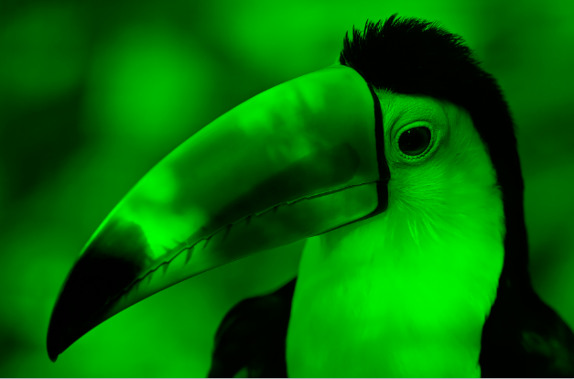
Colour channels

Slide 13
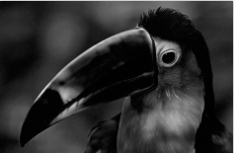
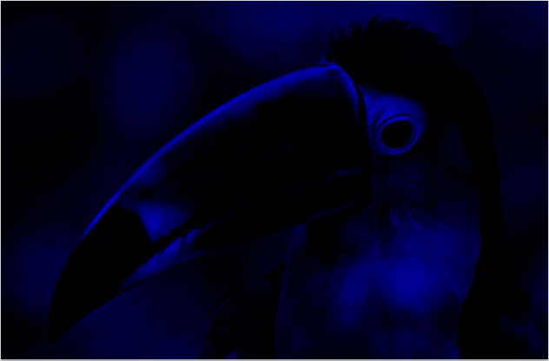
Colour channels

Slide 14
Colour channels
Why is the blue channel so dark?
Look at the original picture. Are there many blues (including purples and cyans) in there?
Remember dark means very little of the channel's colour is present, so lack of blues in the picture results in the blue channel being dark.

Slide 15
Colour channels
Similar to the way RGB and hex colours are represented.
Therefore it's logical for Affinity to view image colours this way.
The colour image we see is the sum of these grayscale images.
How many channels do you think a grayscale image contains?

Slide 16
Masks
We discussed selections last week.
Difficult to make perfect selections.
Especially difficult when picture contains hair, fur, or other unstructured elements.
Even tough with several selection tools, add/remove/intersect, and other refinement tools.

Slide 17
Masks
Masks can help a little…
What is a mask?
It's a special layer linked to a regular pixel layer that controls the transparency of that linked layer.
You can select which regions in the image represent transparency and which represent opaque colours.

Slide 18
Masks
Selections are often converted directly to masks.
Masks are like saved selections.
They are also non-destructive – more on this shortly.

Slide 19
Masks
Some selections are very complex and tedious to make.
Imagine you make one little mistake and have to start all over after 10 minutes of carefully making a complex selection! ☹
A mask preserves the selection so you can experiment with effects without losing the selection.

Slide 20
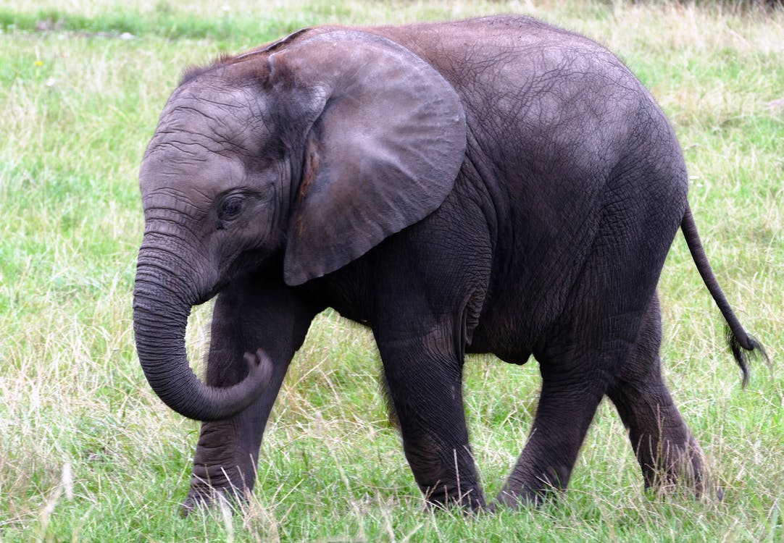
Masks
Suppose we want to add funky colours to this elephant's ear. This picture is in a layer. For later use, duplicate this layer.

Slide 21
Masks
Use any selection tool to select just the ear.

Slide 22
Masks
With that selection active, look under the Layers panel and click the "Mask Layer" button.
There is now a thumbnail of the mask in colour and another in black and white.

Slide 23
Masks
What does the mask look like?
Hold Alt and click on the mask thumbnail to see it.

Slide 24
Masks
Masks are shown in black and white (and sometimes gray).
Black = hidden regions
White = visible regions
Gray = controls opacity (partially visible regions)

Slide 25
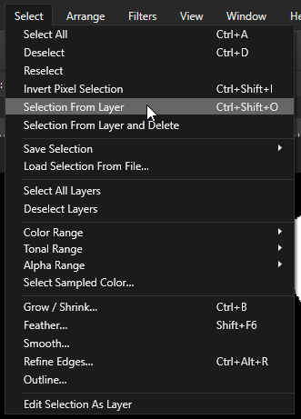
Masks
If you ever need to re-select a mask region, it is easy to do.
Enter the mask view (Hold Alt and click on the mask thumbnail).
Click Select > Selection From Layer.

Slide 26
Masks
Effects can be applied directly to mask selections.
Effects can be applied to whole images.
Masks can block specific regions from being affected.
Examples of both cases shown on next slide.

Slide 27
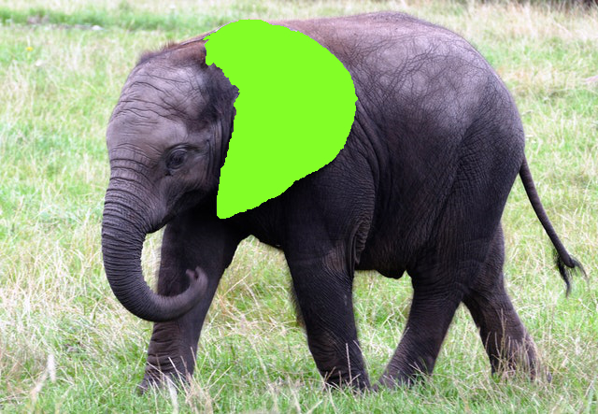
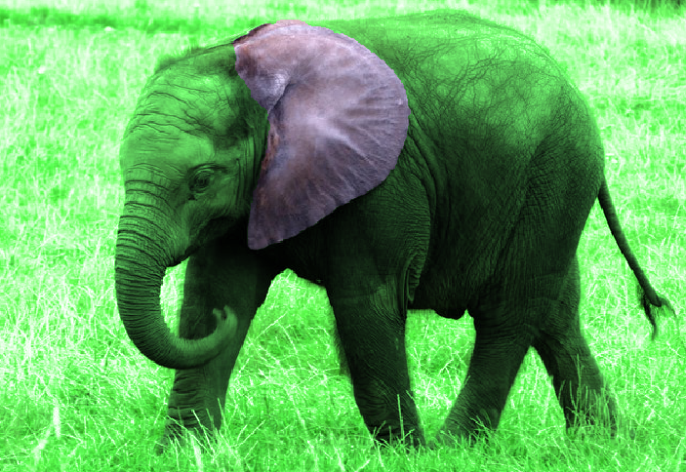
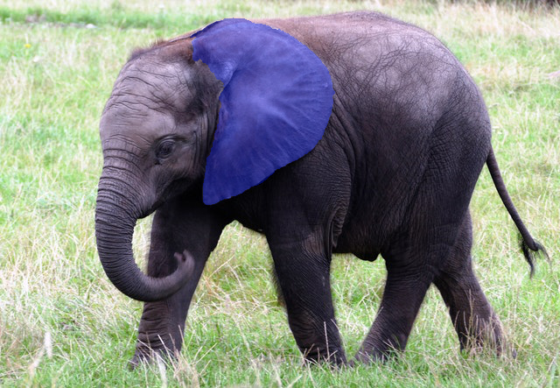
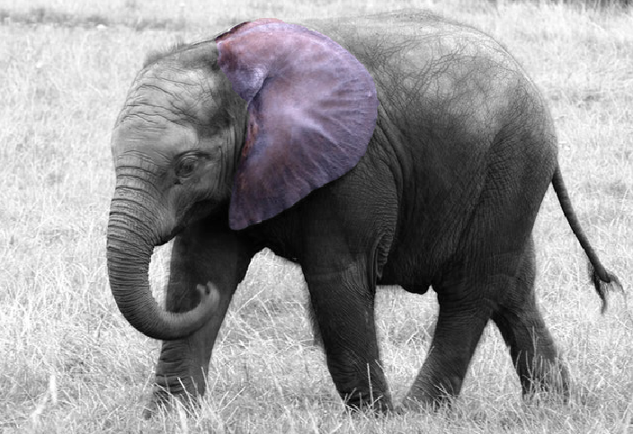
Masks

Slide 28
Masks
Another way to modify masks is to go into this black and white mask view and select the Brush Tool.
Paint with white or black paint to add or remove areas respectively.
Other colours show up as grays to create translucent regions.

Slide 29
Masks
Painting masks this way allows us to modify its shape and outline easily.
Changing a selection is sometimes difficult while maintaining the rest of the selection.
Changing a mask doesn't rely on keeping it selected.

Slide 30
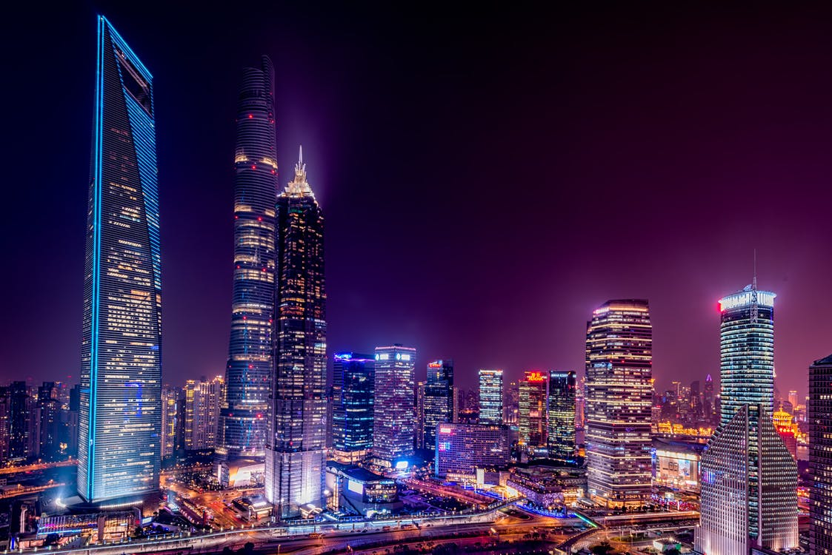
Masks
Suppose we have these two layers and want to place the moon onto the picture of the city skyline.

Slide 31
Masks
Select the moon and create a mask.
Which selection tool? Up to you! The best options are:
Selection Brush Tool
Flood Select Tool
Elliptical Marquee

Slide 32
Masks
With the moon selected, click the little icon "Mask Layer"
Now just the moon should show up from that layer.
Move that moon around to be positioned in the upper right region of the background image.

Slide 33
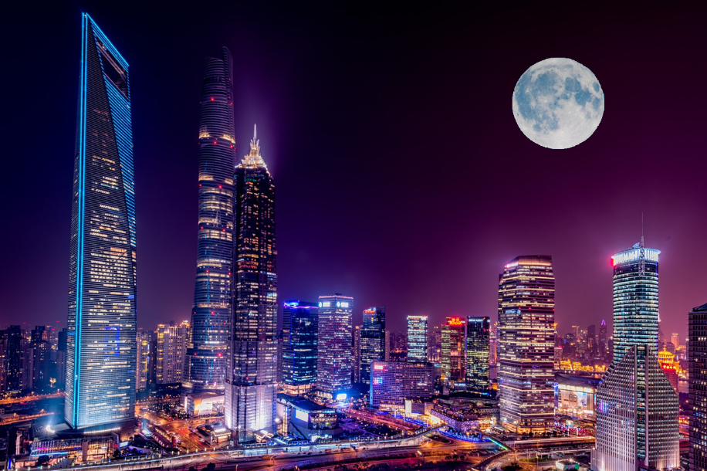
Masks

Slide 34
Masks
Why didn't we just use the eraser tool to remove the background around the moon?
This is an option but erasing or modifying the actual layer is usually not recommended.
Masks are the better method.
But why?

Slide 35
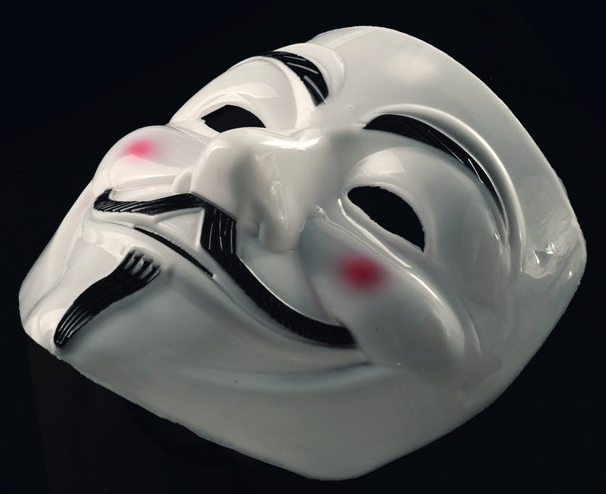
Masks vs. Erasers
MASKS | ERASERS
Pixels are visible or invisible, but always there. | Erased pixels are removed permanently.
Easy to change which are visible and which aren't within the mask. | Undo or History State can be used to correct a mistake but limited to one session.
Always a great option. | Usually a bad option.

Slide 36
Quick mask
Quick mask is not really a mask.
It's actually another selection tool.
Allows you to paint out a selection.
White paint adds to selection and black paint removes from selection
Enter/exit Quick Mask mode with:

Slide 37
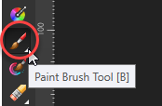
Quick mask
By default, a red translucent layer is shown over the image.
Select the Paint Brush Tool and set the main colour is set to white.
Begin painting where you want to select. If you make a mistake, switch to black paint to cover the mistake.

Slide 38
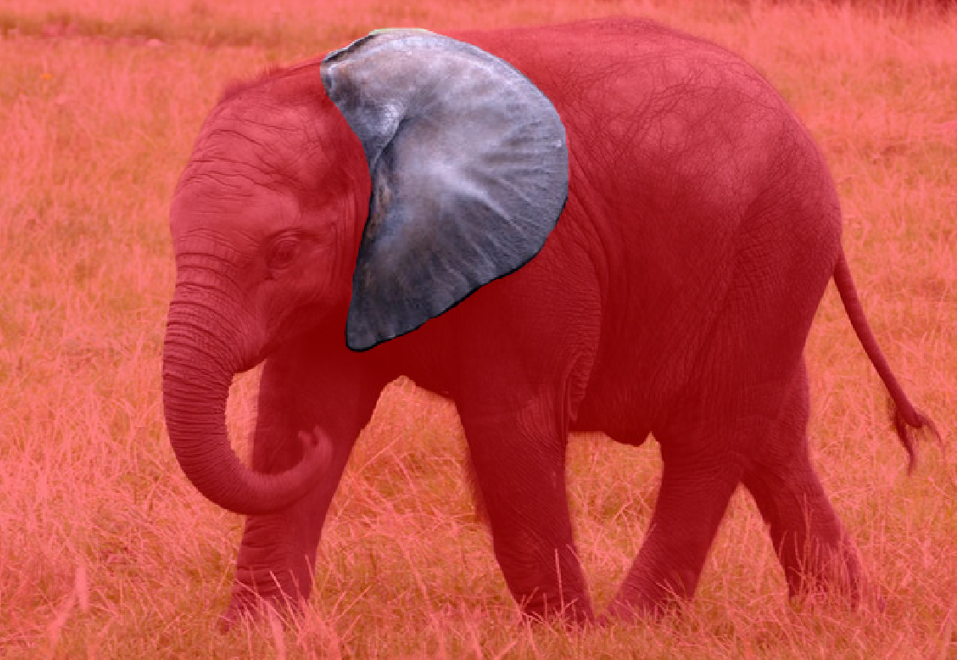
Quick mask

Slide 39
Quick mask
Click the Toggle Quick Mask icon again to leave this mode.
The region(s) that were painted in white in Quick Mask mode are now selected in regular mode.
You can switch back and forth to refine your selection by painting in white or black as needed.

Slide 40
Quick mask

Slide 41
Tilt-shift photography
Tilt-shift is an effect in which the foreground is focused and the background is blurred.
This is usually used to give the illusion of a miniature model.
Works best for pictures from an elevated viewpoint, and that contain cars, houses, boats, etc.

Slide 42
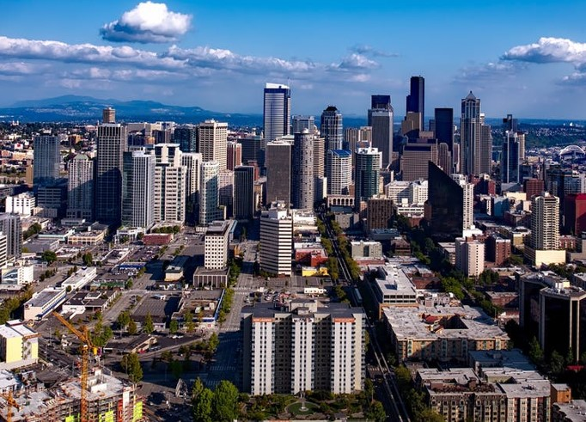
Tilt-shift photography

Slide 43
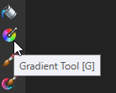
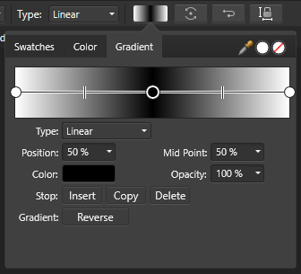
Tilt-shift photography
Simple way to apply this effect is:
Enter Quick Mask mode
Use the Gradient Tool and create a vertical gradient over the image.
Make both gradient stops (endpoints) white and insert a stop in the middle that is black.

Slide 44
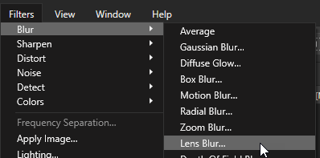
Tilt-shift photography
Exit Quick Mask mode.
There are two rectangle selections: one across the top and one across the bottom.
Click Filter > Blur > Lens Blur to blur the active selection. Try a Radius of 1-3px.
Push Apply.

Slide 45
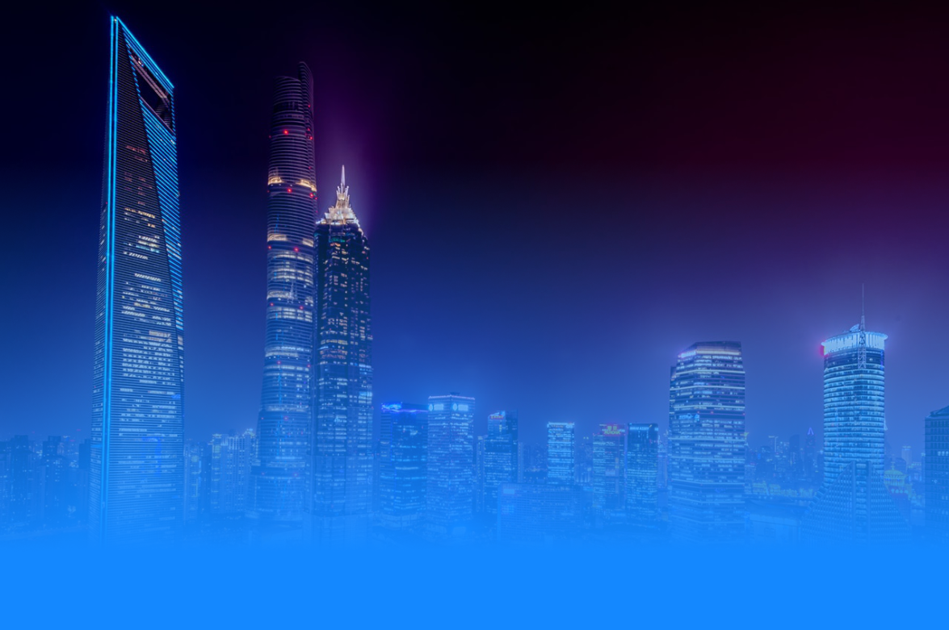
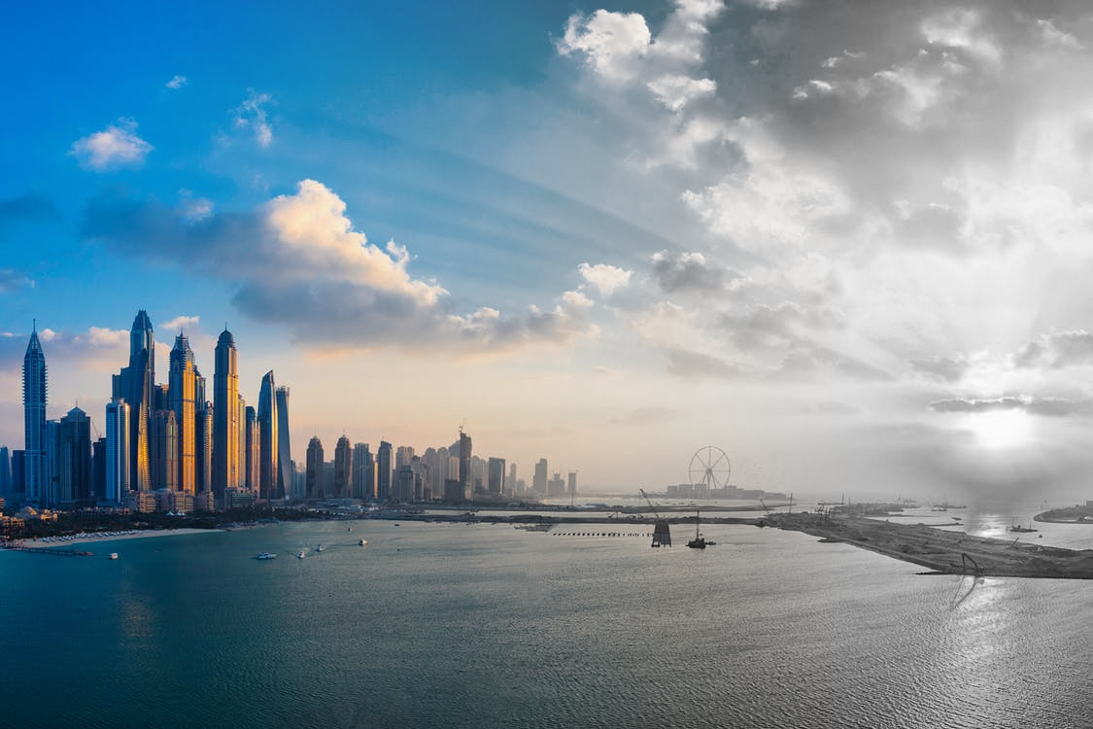
Gradient masks
Gradients are also useful for fades and gradual colour changes.

Slide 46
Gradient masks
Remember in a mask, white = visible and black = hidden.
Gradient masks are black to white so the effect is only visible in part of the image (where the gradient is white).
Let's look at how this fade effect was made.

Slide 47
Gradient masks
Original picture
Gradient mask

Slide 48
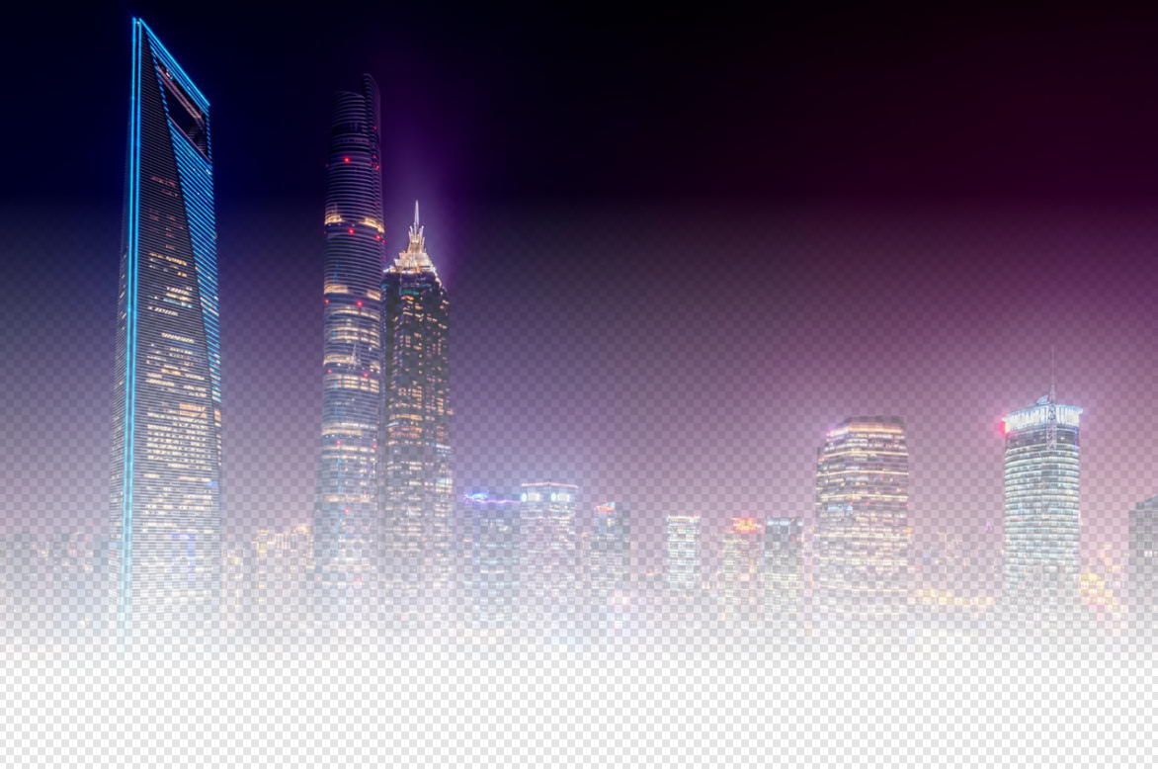
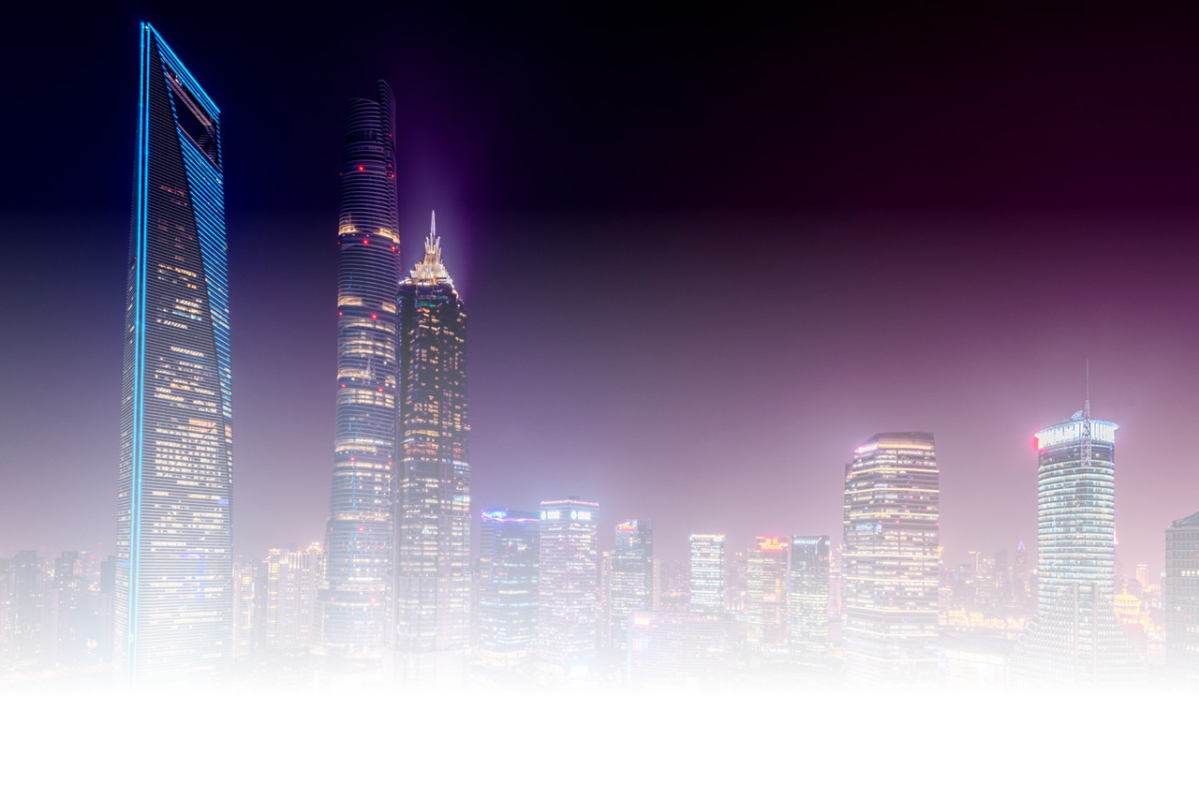
Gradient masks
Mask applied to original picture:
or

Slide 49
Gradient masks
Layer below masked image
Final product

Slide 50
Pixel manipulation
How are most image effects done?
Often by pixel manipulation.
Remember images are just grids of individual coloured cells.
These colours can be analyzed and changed to other colours.
Can be done on the entire image or on a specific region.

Slide 51
Pixel manipulation
For example, say we want to darken an image.
Recall that low colour values are darker (close to 0).
The algorithm looks at each pixel colour individually and decreases its colour value in all 3 channels.

Slide 52
Pixel manipulation
Affinity Photo handles these algorithms so you don't have to know how they all work.
However, it is good to understand these fundamental concepts about pixel manipulation.

Slide 53
Colour manipulation
Recolouring images is often useful.
There are several ways to do this in Affinity Photo. We'll look at a few.
The bottom of the Layers panel has several icons. Click the half-moon looking one.
This will reveal a list of ways to modify the colours.

Slide 54
Colour manipulation
Brightness and Contrast
Brightness is simple: how dark or light the image is.
Contrast is how different the brightness is throughout various parts of the image.
Emphasizes or minimizes the extremes (darks and lights)

Slide 55
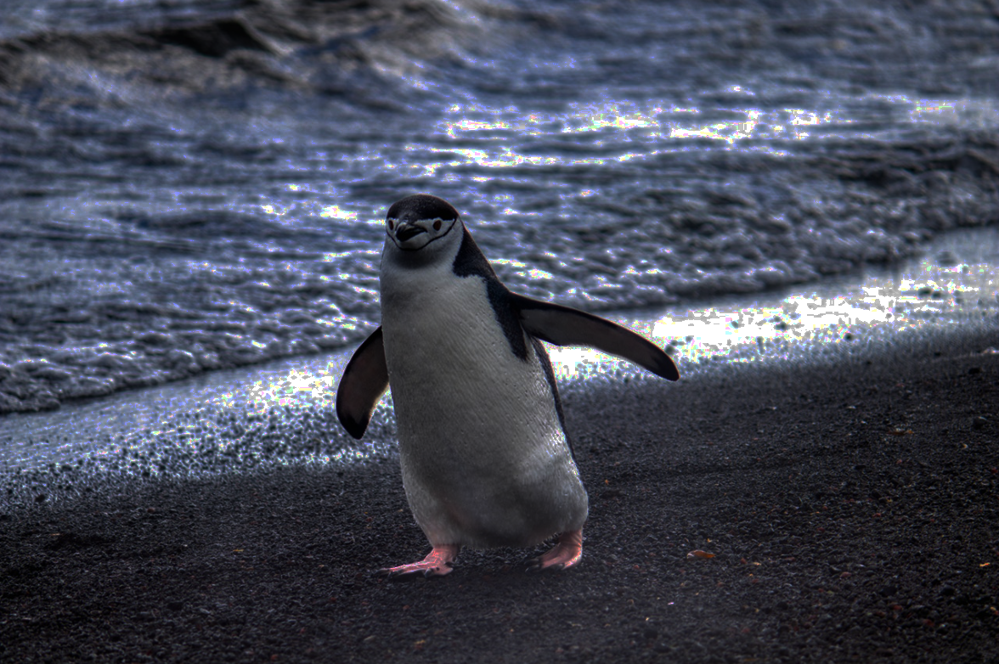
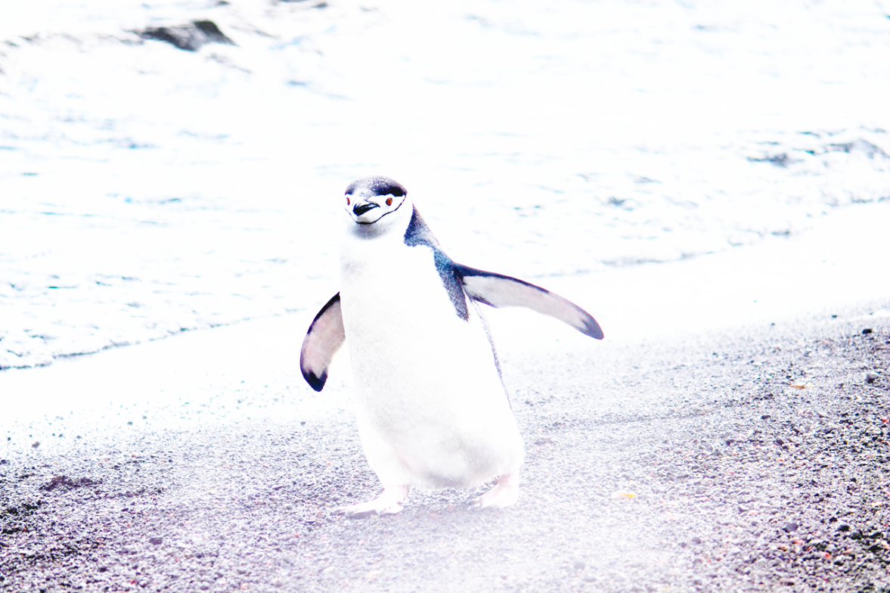
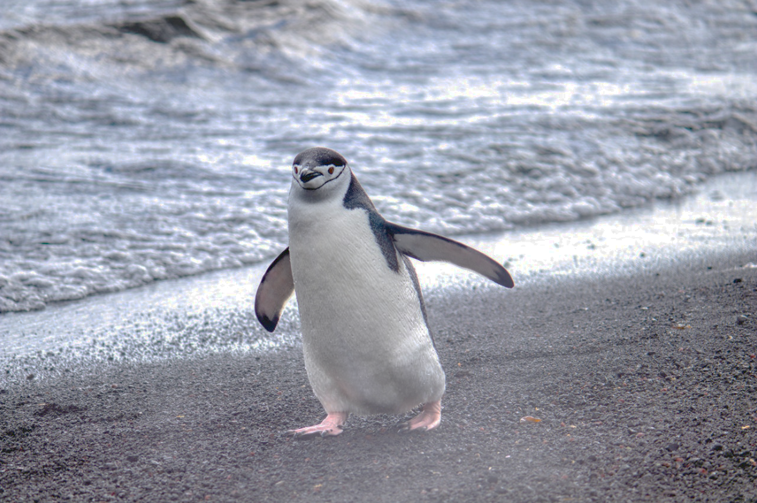
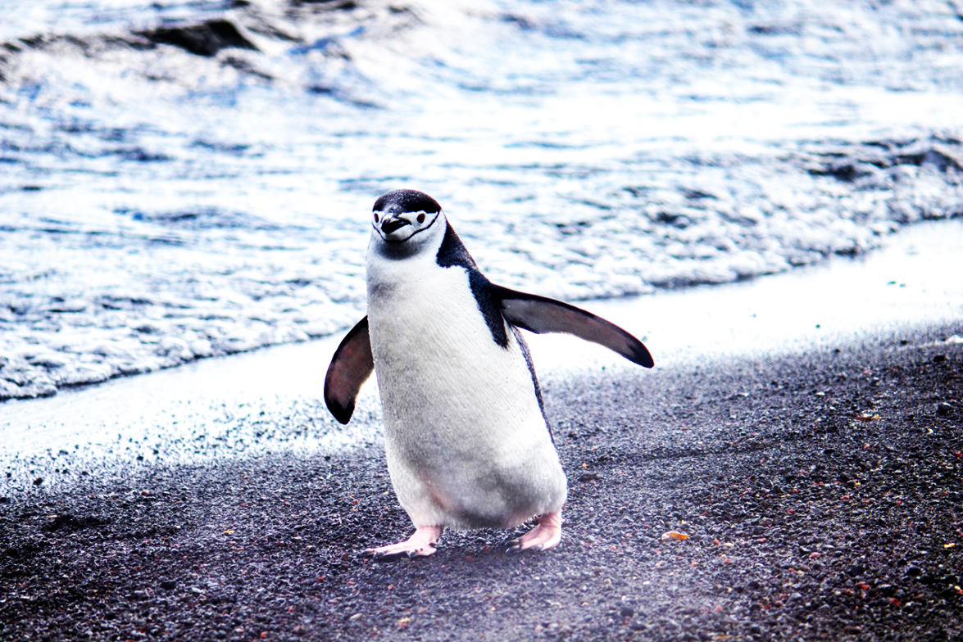
Colour manipulation
-100% Brightness
100% Brightness
-100% Contrast
100% Contrast

Slide 56
Colour manipulation
HSL
Hue – the base colour, without specific information about darkness
Saturation – the intensity of the hue; pure vs. muted or whitewashed
Lightness – the brightness of the colour
HSL is a colour model like RGB and there are algorithms to convert between these different models.

Slide 57
Colour manipulation
Black & White
This is straightforward; it simply converts the image to grayscale.
Lens Filter
Apply a cooling, warming, or other colour filter to the image.
Similar to Instagram filters.

Slide 58
Colour manipulation
Selective Color
This allows you to control specific colours in the image.
Choose which colours you want to affect in the original image.
Use the C, M, Y, and K sliders.
Play with them to see the effects.

Slide 59
Colour manipulation
Selective Color
If the colour you chose isn't in the image, the sliders won't do much.
i.e. if you have an image entirely of green grass and you choose Reds, the sliders won't change anything.
If you choose Greens, then the sliders will make a big difference!

Slide 60
Colour manipulation

Slide 61
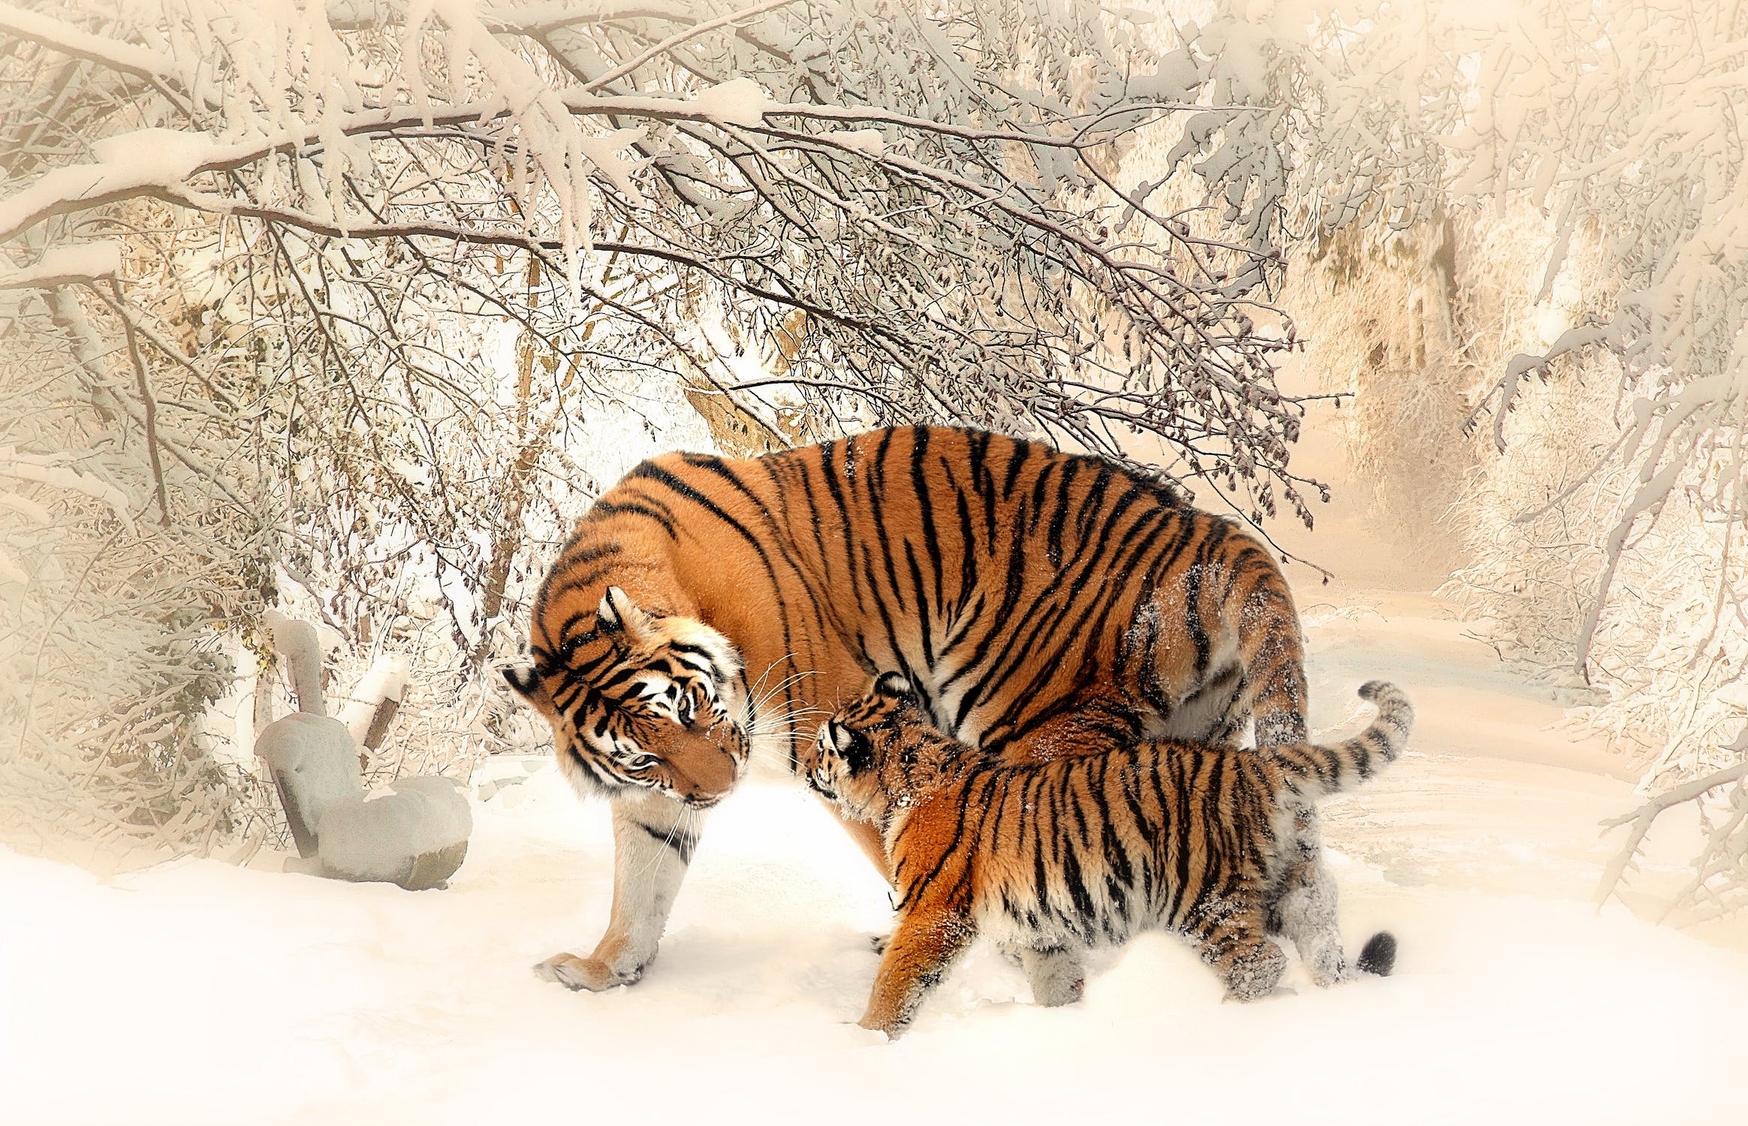
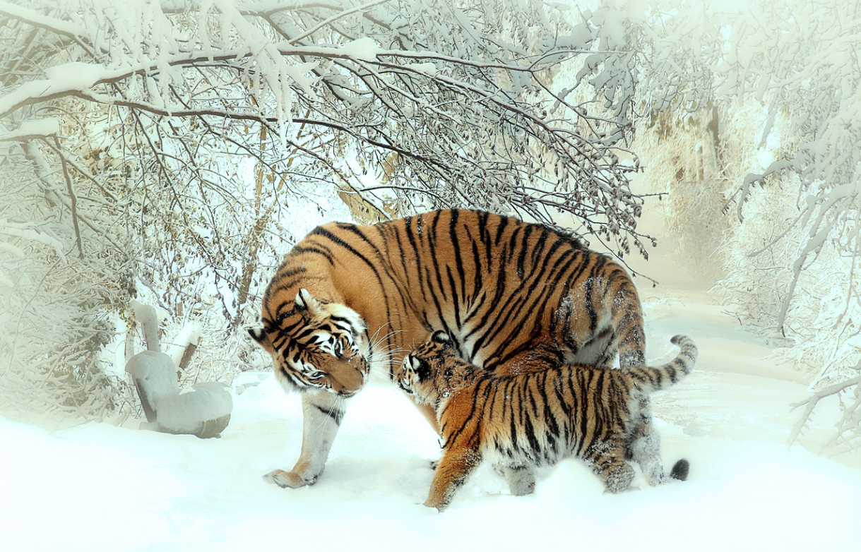
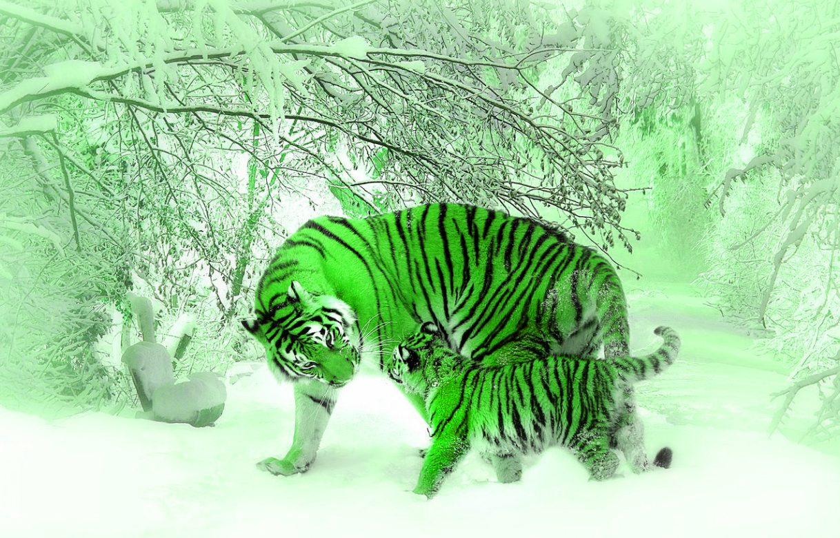
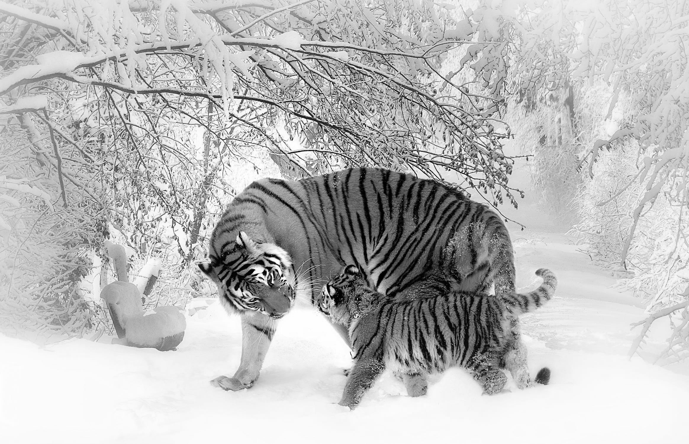
Colour manipulation
Original image
Blue lens filter
HSL adjustment
Black and white

