Slide 1
CS 2033
Multimedia & Communications II
Lecture 6 – ADVANCED CSS

Slide 2
Announcements
Assignment 2 is posted on OWL.
  Create a website using code.
  Do NOT use a program like BlueGriffon or Kompozer.
  Do NOT use online templates.
Next week is reading week – no classes, no labs, no office hours.

Slide 3
CSS
CSS is used for adding colours, borders, and other aesthetics to websites. But there's more to it…
It is also used for creating layouts. There are several styles that control the size, position, or structure of the HTML elements.
They allow us to create a layout without tables.

Slide 4
CSS
Remember that divs and many other HTML elements can be nested within one another.
Important for creating layouts.
This relationship is known as parent-child, where the parent is the container / outer element and the child is the inner element.

Slide 5
CSS Layouts
Divs are the best HTML elements (in my opinion anyway!)Don't be skimpy with them!
Assign classes to each of the divs.
Note that elements can be assigned multiple classes.
  i.e. <div class="bigbox nav"></div>

Slide 6
CSS Layouts
Common layout style properties:
  position
  TRBL
  display
  margin
  float
  width / height

Slide 7
CSS Layouts
There are many ways to create a layout with divs and CSS.
Within a page, some sections may be laid out different than others.
Some of the common strategies will be explained here, but there are endless possibilities by combining these ideas and your creativity!

Slide 8
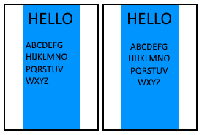
Wrapper
It is usually a good idea to include all or most of the content in a giant div. It is common to call this the wrapper or container.
The wrapper is often centered to keep the content in the middle.
This does NOT mean the
content is centered!

Slide 9
Wrapper
The wrapper may be given a width in pixels or %. Either is fine.
  Pixels keep a rigid structure.
  % is flexible for any window size.
Either way, we should make it look good on different sized screens.
We will talk more about responsive websites later in the term.

Slide 10
Sections
Sections are HTML elements similar to divs but intended for keeping the different areas separated.
It's good practice to use sections to contain each distinct portion of a page, and then use divs within them for more layout control.

Slide 11
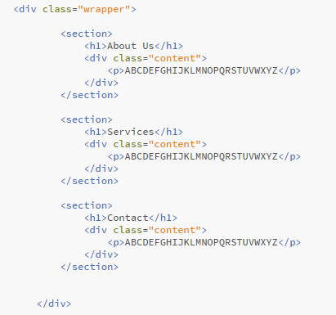
Sections

Slide 12
Columns
Within sections, there are many options for placing text, images, and other multimedia.
The most basic option is to have a single element across the entire width of the section / wrapper.
Many sites have multiple columns of side-by-side content.

Slide 13

Columns

Slide 14

Columns

Slide 15
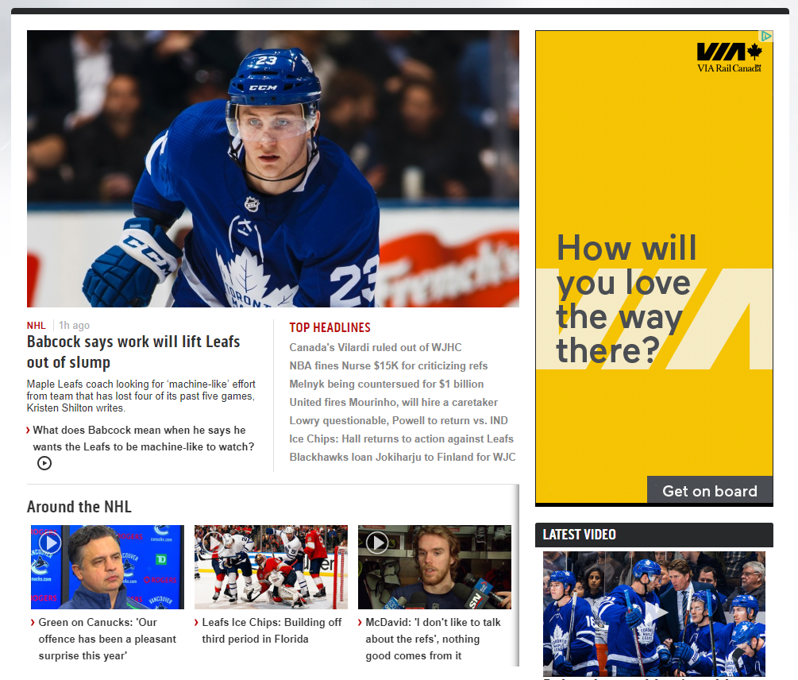
Columns

Slide 16
Columns
How do we place elements side by side?
  Display: block, inline-block, table-cell
  Float: left or right
  Position: absolute
    Within a relative position element
    Usually not the best option

Slide 17
Display
The display style affects how elements are shown sequentially.
There are several display options. The most common ones are:
  Block: takes up the entire row
  Inline-block: placed side by side if fits
  Table-cell: placed side by side and resizes to fit in a row

Slide 18



Display
block
inline-block
table-cell

Slide 19
Display
Inline-block and table-cell are great for creating columns.
Which one is best? It depends…
  Should they be spaced out?
  Should they fall to the next line if the window/screen is small?

Slide 20
Display
Margins work with inline-block. Not so much with table-cell, although you can nest divs within and add margins that way.
Inline-block elements will only stay together if they can fit. Table-cell elements remain together and just squish smaller.

Slide 21
Display
See the difference between table-cell, inline-block, and block.
http://www.csd.uwo.ca/~bsarlo/cs2033b/samples/lec6/display.html

Slide 22
Float
Float is another layout style.
Often used to let text wrap around an image on the left or right.
Can also help with column layouts.
Floating may break the natural flow and cause overlapping.
Not the best option unless you know what you're doing!

Slide 23
Float
See the difference between left float, right float, and no float.
http://www.csd.uwo.ca/~bsarlo/cs2033b/samples/lec6/float.html

Slide 24
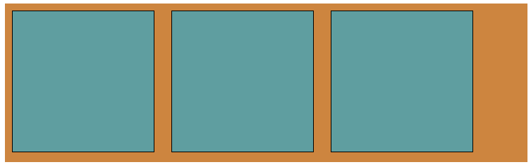
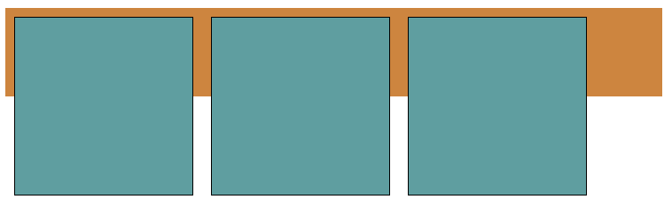
Float
display: inline-block
float: left

Slide 25
Position
The last main layout style is position (often used with TRBL)
Static and relative position follow natural flow of elements (blocks).
Fixed position remains when scrolling.
  Useful for navigation bar, footer, feedback link, etc.

Slide 26
Position
For column-based layouts, absolute positioning can be used.
They must be contained in a relative positioned element first!
Absolute is a precise location, but it is (ironically) relative to its parent.
Never use absolute if it's not inside a relative parent element.

Slide 27
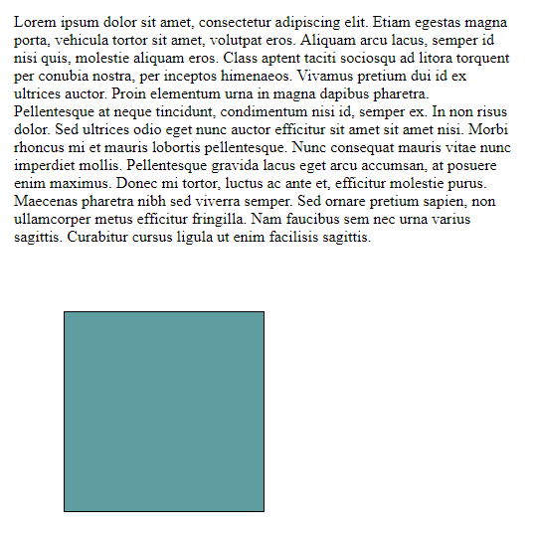
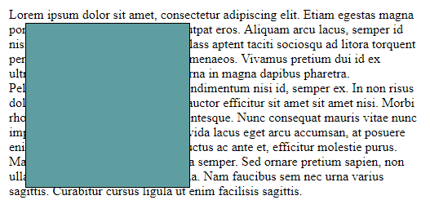
Position
position: relative
position: absolute
Absolute positioning doesn't care what's underneath. It's a precise location.

Slide 28
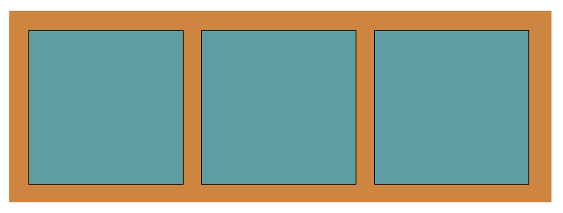
Position
position: relative
position: absolute
See the difference between relative and absolute positions.
http://www.csd.uwo.ca/~bsarlo/cs2033b/samples/lec6/position.html

Slide 29
Position
Absolute within relative position can create side-by-side layouts.
Disadvantages?
  Sticks out of page on small windows.
  Each element's location has to be calculated and specified.
  Behaves like floats if height of parent is not known.

Slide 30
Layouts
Overall, better to avoid absolute positioning unless you know what you're doing.
Floats should generally be avoided for layouts as well.
Verdict: inline-block or table-cell display are usually the best options!

Slide 31
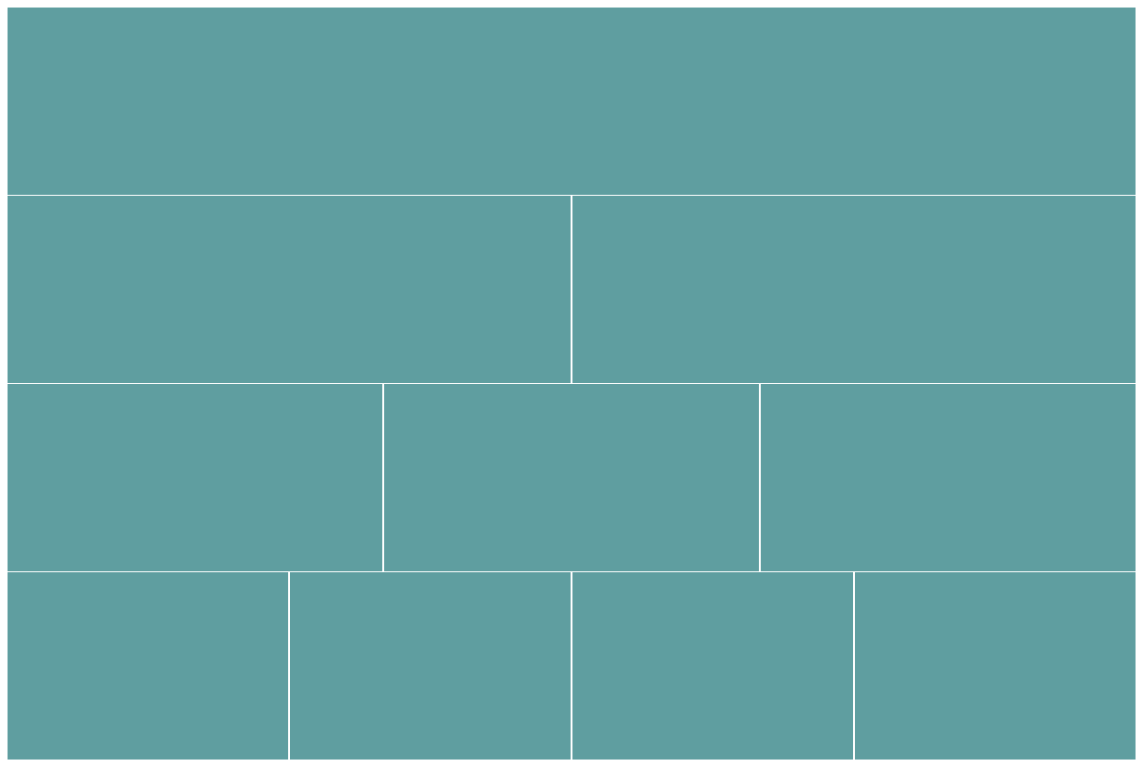
Layouts
This was created with just sections and divs, and CSS styles.. No tables!

Slide 32
Layouts
We can use groups of the different sized elements as we want.
Here's an example of a website structured using these blocks.
http://www.csd.uwo.ca/~bsarlo/cs2033b/samples/lec6/layout-example.html

Slide 33
Child selectors
We have seen several ways to select elements but there are more!
The asterisk * is used to select everything at once.
  i.e. * { margin: 2px; }
Another approach is selecting all the children of parent elements.
  i.e. all paragraphs within divs.

Slide 34
Child selectors
It is easy to select specific children.
Write the parent selector, then a space, and the child selector.
  Selectors can be any combination of types (tag, class, or ID).
#wrapper p { }
div .red { }
ul li.link { }

Slide 35
Child selectors
They can continue with multiple levels of children.
  i.e. #main div ul.nav li p { }
We can also use the comma grouping method combined with these child selectors.
  i.e. ul.nav li, div p, #buttons { }

Slide 36
Pseudo-classes
Pseudo-classes are advanced CSS selectors that apply to certain states or actions on elements.
i.e. hovering the cursor over an element
They are specified with a colon : followed by a pseudo-class type.
  i.e. :hover

Slide 37
Pseudo-classes
Apply pseudo-classes to elements by tag, class, ID, or any combination.
a:hover { }
.link:hover { }
#title:hover { }
ul li:hover { }

Slide 38
Pseudo-classes
Works great for simple link rollovers.
Also used in more complex navigation menus with dropdown menus.
http://www.csd.uwo.ca/~bsarlo/cs2033b/samples/lec6/dropdown.html

Slide 39
Pseudo-classes
The idea is lists within lists.
Main links are visible and sub-links are hidden by default.
Sub-links become visible when the main link is hovered by a cursor.
Primary CSS for this:
  Display style (none ↔ block)
  :hover pseudo-class (to trigger display change)

Slide 40
Pseudo-classes
There are lots of pseudo-classes besides :hover.
  :required
  :focus
  :visited
  :active
  :enabled
  and many more

Slide 41
CSS transitions
By default, style changes like rollovers are instantaneous.
This is fine but it can look too static.
CSS allows us to animate style changes using gradual transitions.
http://www.csd.uwo.ca/~bsarlo/cs2033b/samples/lec6/transitions.html

Slide 42
CSS transitions
Make a style change gradual in a selector with the transition style rule.
Within this rule, we can specify the parameters like duration, speed curve (i.e. ease or linear), and time delay (i.e. start after 5s).
These can be specified for individual style changes or for all styles at once.

Slide 43
CSS transitions
Suppose we have:
div {
background-color:red;
}
div:hover {
background-color:black;
}
Hovering the div will turn it black but by default it will be immediate.

Slide 44
CSS transitions
Add the transition line in the div rule-set. Apply a 2s transition.
div {
background-color:red;
transition: background-color 2s;
}
div:hover {
background-color:black;
}

Slide 45
CSS transitions
You can specify multiple style properties to be animated by separating them with commas.
Suppose you want the width and height to change.
Add the following line:
  transition: width 2s, height 2s;

Slide 46
CSS transitions
To apply the transition to all style properties at once, use the word all in place of a property name.
i.e. transition: all 2s;
This helps simplify the code in cases where many changed styles are intended to have a transition.

Slide 47
CSS animations
Transitions are for style changes, usually triggered by :hover, :focus, or another pseudo-class.
Sometimes we want an animation that is independent of user input.
  i.e. a shape growing and shrinking back and forth continuously.

Slide 48
CSS animations
This is called an animation in CSS.
Note the difference between transitions and animations.
CSS animations use keyframes
  Remember these from CS1033?
  In CSS we can also have intermediate keyframes for multiple segments.

Slide 49
CSS animations
@keyframes growAnim {
from { width:200px; }
to { width:300px; }
}
This animation, named growAnim, has 2 keyframes.
  Start (from): width of 200px
  End (to): width of 300px

Slide 50
CSS animations
If we want it to grow in different segments, we can use a %-based keyframe structure instead.
@keyframes growAnim {
0% { width:200px; }
75% { width:250px; }
100% { width:300px; }
}
This is similar to ease-in.

Slide 51
CSS animations
Once a keyframe structure is created, it can be applied to a rule-set easily.
animation: growAnim 3s infinite;
The main parameters are:
  Animation name
  Duration
  Iteration count (looping)

Slide 52
CSS animations
Two other common animation parameters are:
  Direction: normal (start to finish), reverse (finish to start), alternate, etc.
  Timing function: ease, ease-in, ease-out, linear, etc.
http://www.csd.uwo.ca/~bsarlo/cs2033b/samples/lec6/animations.html

Slide 53
Transitions and animations
Notes on transitions/animations:
  Make looped animations seamless.
    Use the alternate direction parameter.
    Use the % based keyframe structure and set the same styles for 100% as 0%.
  Don't make your page overly flashy with animations.
  Not all properties are animatable.

Slide 54
Conclusion
That's all for today.
Have a great reading week!

