Slide 1
CS 2033 Multimedia & Communications II
Lecture 9 – BOOTSTRAP

Slide 2
Announcements
Office hours are cancelled today.
If you have questions for me, I'll be in my office on Wednesday from 12:30-4:30pm.
Assignment 3 is now posted. It is due March 27. Give yourself lots of time to work through it.

Slide 3
Bootstrap
Bootstrap is a library for website development.
Many pre-made modules that are free to use for anyone making a website.
Saves us time having to write all the code for everything in a website
Why reinvent the wheel?!

Slide 4
Bootstrap
So why did we spend so much time learning HTML, CSS, and JS?
They are still important to know! You'll likely have to combine your own code with Bootstrap modules.
You will have to code certain modules from scratch still, like JS form validation.

Slide 5
How does it work?
They have CSS/JS files with many styles, classes, and useful functions.
Load Bootstrap with link/script tags in your website.
Just like you would link your own external CSS and JS files.
You can download them to your folder or use a hosted set of files.

Slide 6
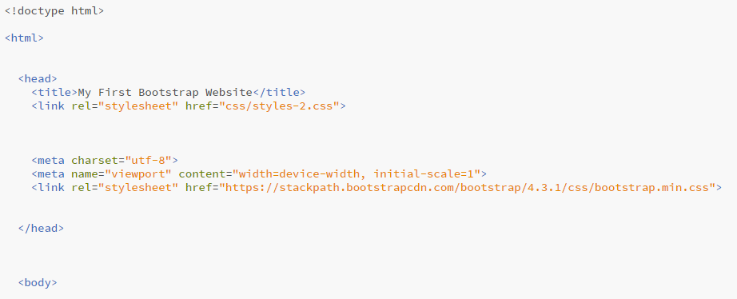
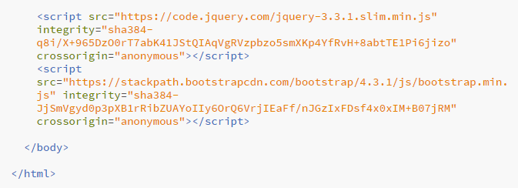
How does it work?

Slide 7
How does it work?
It’s that easy! You now have access to the pre-made styles and modules in the Bootstrap library.
You may find online that there are some more complex components or modules that use additional libraries. Those ones can be linked from your site in the same way.

Slide 8
How does it work?
Let’s begin adding Bootstrap components to our website now.
Start with a div container (like the wrapper) using the class container (fixed width) or container-fluid (full window width).
<div class="container"> </div>

Slide 9
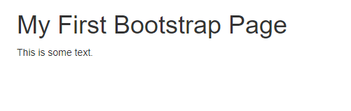
How does it work?
Within the container, add any normal HTML elements like headers (h1-h6), paragraphs (p), etc.
In this example I used a fixed width container and added an h1 and p.
With Bootstrap links.
Without Bootstrap links.

Slide 10
Bootstrap layouts
Remember the layout classes we used before for placing elements side by side in a grid-like formation?
Bootstrap has something similar but much better than mine!
Many more sizes so that you can have up to 12 small columns of elements across a row.

Slide 11
Bootstrap layouts
Create a div with class: row. Within a row, add cells based on the size you desire (1 is small, 12 is large).
Cell classes are: col-lg-1, col-lg-2, col-lg-3, col-lg-4, …, col-lg-12.
Sum of cell sizes in a row must = 12.
https://www.w3schools.com/booTsTrap/bootstrap_grid_basic.asp

Slide 12
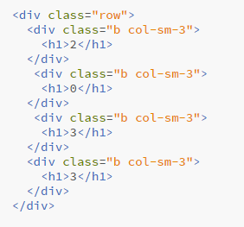
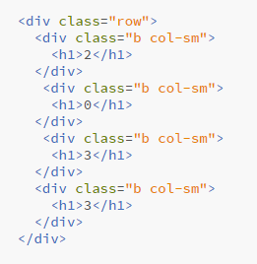
Bootstrap layouts
You can also omit the size value and they will try to auto-size it to fill the available space.
No margins
1px margins

Slide 13
Bootstrap layouts
These numbered classes are made to be the correct size on a normal desktop monitor.
Resize the window smaller to see how they no longer fit across a row.
These blocks were designed to work on all different screen sizes. They are responsive – more on this concept next week!

Slide 14
Bootstrap layouts
For full control over the responsiveness, they provide 4 size classes: xs, sm, md, and lg.
I just showed you lg but you could swap in another size to indicate which screen size it would apply to.
Sample
Try resizing the window and see where each block size wraps down.

Slide 15
Bootstrap modules
Now that you know the Bootstrap layout system, let's look at other useful modules in the library.
There are many components. We'll just look at a few common ones.
Look online for more information on other components.
https://getbootstrap.com/docs/4.3/components/alerts/

Slide 16
Bootstrap modules
Navbar
Navbars (navigation bars) are easy to create in Bootstrap.
This includes dropdown menus.
They are easy to customize using various built-in nav styles.
Sample

Slide 17
Bootstrap modules
Modal windows
Pop up over the main website
Often a translucent tint covers the site and this window appears above it all.
Draws immediate attention to info contained in the window.
Sample

Slide 18
Bootstrap modules
Figures
Images and other media may need captions underneath them.
Bootstrap provides CSS classes for easily creating figures and captions.
Sample

Slide 19
Bootstrap modules
Carousel
Clean image slideshow.
Images slide in and out with smooth transitions.
Often have arrows and/or line indicators to change images manually.
Sample

Slide 20
Bootstrap modules
As mentioned before, some modules are more advanced and require additional libraries to work.
These other libraries are similar to Bootstrap – they provide lots of pre-built functions and features to save time for website developers!
i.e. Carousel requires jQuery

Slide 21
jQuery
jQuery is a JavaScript-based library used to simplify the code.
It's almost like another language but it ties in closely with JS.
Regular JS is now called vanilla JS.
jQuery contains various shortcuts and built-in functions that help us to leave out redundant code.

Slide 22
jQuery
Easy to access elements by tag, class, and ID with jQuery.
$(".theClass")
Similar to getElementsByClassName()
$("#theID")
Similar to getElementById()
$("tag")
Similar to getElementsByTagName()

Slide 23
jQuery
When using grouped selectors, like by tag or class, it's likely you will need to also use the this selector.
i.e. add an event listener to all elements of a certain class but only the triggered one should react.
$(this)

Slide 24
jQuery
Speaking of event listeners, they are also easy to add in jQuery.
Add listener to selected element(s) and its function is contained with it.
element.mouseover(function() { // Do something. });

Slide 25
jQuery
You probably noticed that a common task in JS is changing CSS.
It's easy to do this in jQuery too.
element.css("property", "value");
Examples:
$("#top").css("display", "block");
$(".link").css("margin", "5px");

Slide 26
jQuery
We also changed the content of elements using JS's innerHTML.
In jQuery, use .html()
element.html("content");
Example:
$("#top").html("Welcome");
$(".link").html("<p>Home</p>");

Slide 27
Other JS libraries
Vanilla JS isn't used on its own as much as it used to be.
Web developers nowadays use a lot of jQuery and other frameworks.
Angular
React
node.js
etc.

Slide 28
jQuery
There's a lot more that can be done with jQuery but that's all you need to know for this course.
Since some Bootstrap modules use jQuery, it's important to know how to load it in.
These basics are also helpful to know so that you can save time doing these mundane tasks.

