Slide 1
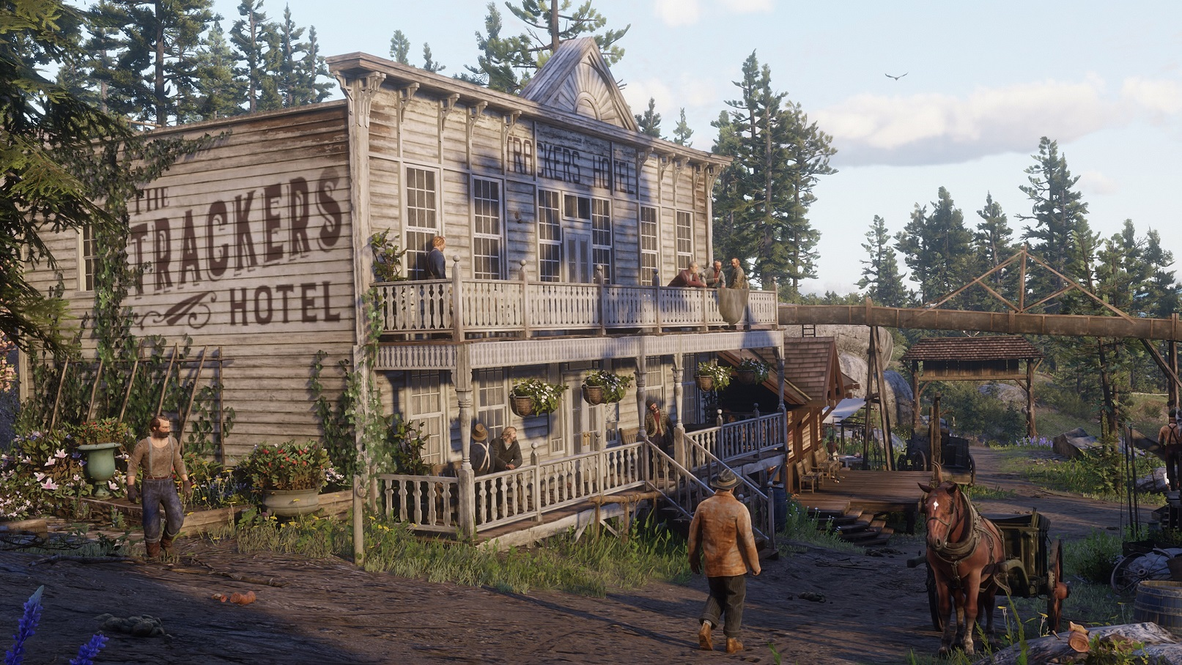
What makes this world feel alive?

Slide 2

A Memory-Driven Action Selection
Framework for Scalable
Ambient NPC Behavior
Eric Buitron Lopez
Supervisor: Dr. Roberto Solis-Oba
MSc Project Presentation – April 24, 2026

Slide 3

Types of Characters in Video Games
1
Player Characters
Controlled by a human player
Main NPCs
Narrative or gameplay importance
Ambient NPCs
Populate the game world
Limited interactions with player characters
Substantial interactions with player characters
Create a sense of realism and immersion
Concepts & Definitions
Problem Statement
Framework Model
Implementation
Results & Demos
5
Conclusions

Slide 4
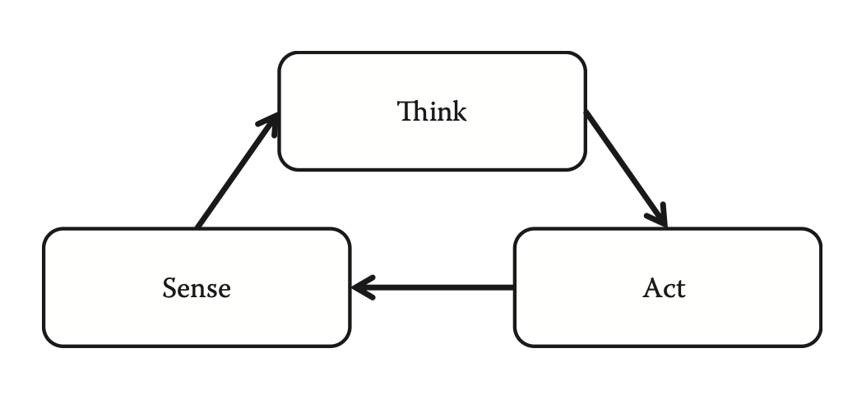
Why Ambient NPCs?
2
Games require hundreds of ambient NPCs
Ambient NPCs receive the fewest computational resources
Concepts & Definitions
Problem Statement
Framework Model
Implementation
Results & Demos
5
Conclusions

Slide 5
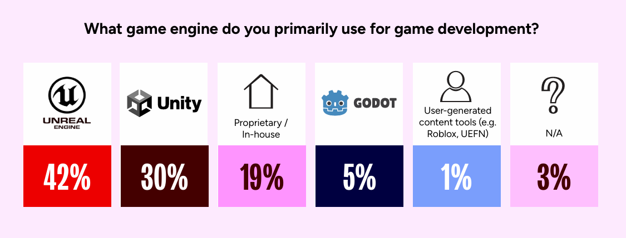
Game Engines
3
Software used to develop video games, providing rendering, physics, audio, input and AI systems.
GDC 2026
Concepts & Definitions
Problem Statement
Framework Model
Implementation
Results & Demos
5
Conclusions

Slide 6
Frame Budgets in Real-Time Games
4
Games aim to run at 30-60 FPS
Commercial games typically allocate 5–10% of the total frame budget to all AI systems.
Concepts & Definitions
Problem Statement
Framework Model
Implementation
Results & Demos
4
Conclusions

Slide 7
What is Game AI?
5
Game AI ≠ Machine Learning or LLMs
Game AI consists of three categories:
Movement
Behavior
Strategy
How characters
navigate the game world
How characters decide
what to do
How characters plan
over time
This research focuses on behavioral algorithms for ambient NPCs
Concepts & Definitions
Problem Statement
Framework Model
Implementation
Results & Demos
3
Conclusions

Slide 8
6
Skyrim
Repetitive Behavior
Grand Theft Auto V
Cyberpunk 2077
Limited Behavioral Continuity
Poor Environmental Awareness
Identical daily schedules
NPCs don't react to dramatic events
Interrupted NPCs don't continue behavior
The Problem
Concepts & Definitions
Problem Statement
Framework Model
Implementation
Results & Demos
6
Conclusions

Slide 9
Existing Approaches: A Trade-Off
7
Behavioral variety
Finite State Machines
- Cheap to run
- Repetitive patterns
CIVIL AI
- Combines multiple algorithms
- Tightly coupled to Unity
Planning (GOAP)
- Varied behavior
- Expensive per decision
Behavior Trees
- Widely adopted
- Deterministic paths
Variety + Scalability for Ambient NPCs?
Utility Systems
- Context-sensitive
- Requires tuning
Computational cost per decision
Our framework fills this gap
Concepts & Definitions
Problem Statement
Framework Model
Implementation
Results & Demos
7
Conclusions

Slide 10
NPC Behavior Research
8
Bulitko et al. target ambient NPC variety
Use offline evolutionary computation and trained neural networks.
Cardon and Jacopin target scalability
Accelerate GOAP with GPU parallelism.
Memory representation research
Our framework produces variety at runtime without offline training.
Our framework avoids planning entirely.
Uses semantic memory for recall and reasoning.
Our framework uses bounded memory as a mechanism for variety.
Concepts & Definitions
Problem Statement
Framework Model
Implementation
Results & Demos
Conclusions

Slide 11
Research Objectives
9
1. Enable behavioral variety without per-character scripting
2. Support context-aware action selection
3. Maintain behavioral continuity through interruptions
4. Provide an engine-agnostic, data-driven design
5. Achieve computational efficiency for large populations
Concepts & Definitions
Problem Statement
Framework Model
Implementation
Results & Demos
21
Conclusions

Slide 12
Our Approach
10
Instead of computing the best action,
NPCs track what they have done recently
and choose something different.
Traditional
Our approach
→
Expensive computation
per decision or lightweight repetitive decisions
Quick memory lookup
per decision
Concepts & Definitions
Problem Statement
Framework Model
Implementation
Results & Demos
8
Conclusions

Slide 13
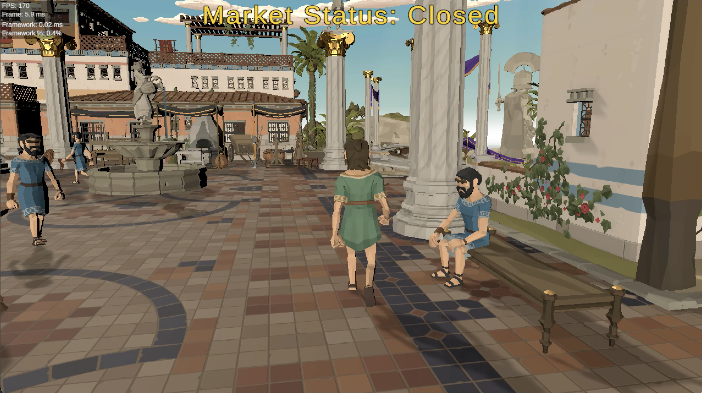
Entities
11
Concepts & Definitions
Problem Statement
Framework Model
Implementation
Results & Demos
9
Conclusions

Slide 14
Framework Entities
12
Bench A
State
Supported Actions
”Occupied seats": 1/2
"Sit on bench"
Concepts & Definitions
Problem Statement
Framework Model
Implementation
Results & Demos
9
Conclusions

Slide 15
Behavioral Entities
13
NPC A
State
Supported Actions
”Mood": ”Happy"
"Socialize"
Decision-making Systems
Concepts & Definitions
Problem Statement
Framework Model
Implementation
Results & Demos
9
Conclusions

Slide 16
Entities
14
Bench A
State
Supported Actions
”Occupied seats": 1/2
"Sit on bench"
NPC A
State
Supported Actions
”Mood": ”Happy"
"Socialize"
Decision-making systems
Concepts & Definitions
Problem Statement
Framework Model
Implementation
Results & Demos
9
Conclusions

Slide 17
Actions: What vs. How
15
Our Framework
Game Engine
Decides WHAT action to perform
and on WHICH entity
→
Decides HOW the action looks and sounds
(animations, movement, audio)
"Sit on Bench C"
Play “sit” animation
Two action categories:
Entity-requiring actions need a target (e.g., "sit on bench" requires a bench).
Independently-performed actions need no target (e.g., walking around).
Concepts & Definitions
Problem Statement
Framework Model
Implementation
Results & Demos
11
Conclusions

Slide 18
Actions and State Operations
16
An action is defined by preconditions and effects, both expressed as state operations
Preconditions check action validity → Effects modify entity state → Same structure, two roles
State Operations Example: "Sit on Bench" action
 | Target | State Property | Operation | Value
Precondition | Bench A | “Occupied seats” | <= | 3
Precondition | Game Environment | “Weather” | != | “Rainy”
Precondition | Visitor NPC | “Energy level” | <= | 70
Effect | Bench A | “Occupied seats” | += | 1
Effect | Visitor NPC | “Set sitting” | = | True
Concepts & Definitions
Problem Statement
Framework Model
Implementation
Results & Demos
12
Conclusions

Slide 19
Action Properties
17
Three types of effects, applied at different moments during execution:
Immediate
Effects
Interruption
Effects
Completion
Effects
When the action begins
If the action is interrupted
When the action finishes
Beyond preconditions and effects, each action defines:
Duration
Maximum Timeout
Resumability Flag
Expected time the action will take before completing.
A time limit after which the framework considers the action to have completed.
Whether the action can be resumed after interruption.
Concepts & Definitions
Problem Statement
Framework Model
Implementation
Results & Demos
Conclusions

Slide 20
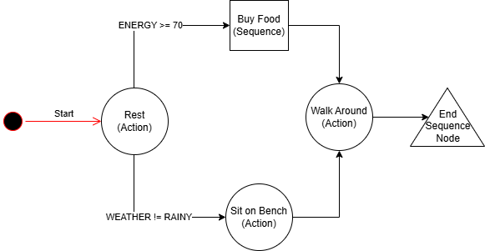
Behavior Sequences
18
Behavioral patterns that connect actions through conditional decisions.
Concepts & Definitions
Problem Statement
Framework Model
Implementation
Results & Demos
13
Conclusions

Slide 21
Action Nodes
19
Reference an action that the NPC will attempt to perform.
Concepts & Definitions
Problem Statement
Framework Model
Implementation
Results & Demos
13
Conclusions

Slide 22
Nested Sequence Nodes
20
References a different behavior sequence that the NPC will follow before continuing.
Concepts & Definitions
Problem Statement
Framework Model
Implementation
Results & Demos
13
Conclusions

Slide 23
End Sequence Nodes
21
Mark the completion of a behavior sequence.
Concepts & Definitions
Problem Statement
Framework Model
Implementation
Results & Demos
13
Conclusions

Slide 24
Behavior Sequences
22
NPCs follow paths through this graph. At decision points, preconditions (defined as state operations) filter which transitions are valid.
Concepts & Definitions
Problem Statement
Framework Model
Implementation
Results & Demos
13
Conclusions

Slide 25
Sequence Stack
23
Each NPC has its own main behavior sequence defining its default behavior in a game and a sequence stack of active sequences.
1
2
3
4
5
Sequence Stack
Sequence Stack
Sequence Stack
Sequence Stack
Sequence Stack
Buy Food Sequence
Main Sequence
Main Sequence
Main Sequence
Main Sequence
Empty
Concepts & Definitions
Problem Statement
Framework Model
Implementation
Results & Demos
Conclusions

Slide 26
Memory System
24
Transition Memories
"Chose ‘sit on bench’ at decision point X, 30s ago"
"Used 'Bench A' for the 'sit on bench' action, 90s ago"
"Was sitting on 'Bench A' doing 'sit on bench' action when the rain event interrupted
Track which transition was chosen at
each decision point in a behavior sequence
Action Memories
Track which entity was selected
for an entity-requiring action
Interruption Memories
Preserve context for resuming
an action that was interrupted
Concepts & Definitions
Problem Statement
Framework Model
Implementation
Results & Demos
14
Conclusions

Slide 27
Memory Management
25
Each memory type has an independent configurable capacity per NPC.
Lower capacity → NPC cycles through options faster.
Higher capacity → more variety before revisiting earlier choices.
1. Deduplication on Insert
2. Oldest-First Removal
When a new memory matches an existing record, the existing record is removed before the new one is added. Only the most recent occurrence is tracked.
When capacity is reached, the oldest memory of that type is discarded to make room for the new one.
Concepts & Definitions
Problem Statement
Framework Model
Implementation
Results & Demos
Conclusions

Slide 28
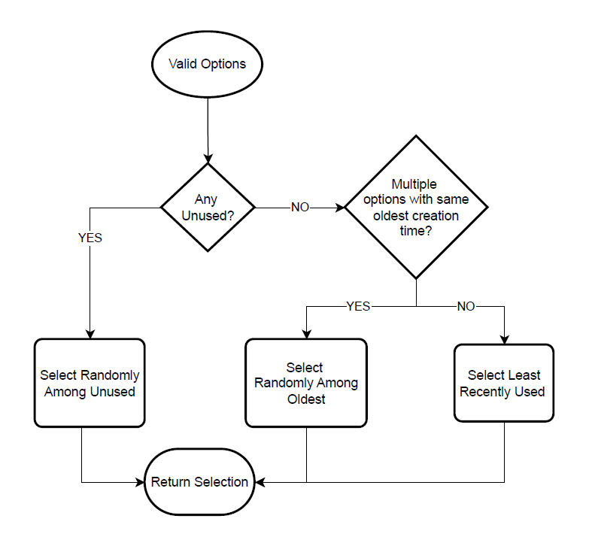
Memory-Driven Selection Algorithm
26
Used at two decision points:
1. Choosing a transition
Which transition to follow
in the behavior sequence
(uses transition memories and valid transitions)
2. Choosing an entity
Which entity to use for
an entity-requiring action
(uses action memories and valid entities)
Same algorithm, different memory type → variety in both what NPCs do and where they do it
Concepts & Definitions
Problem Statement
Framework Model
Implementation
Results & Demos
15
Conclusions

Slide 29
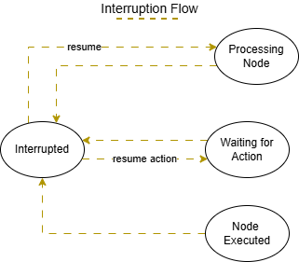
Interruption and Resumption
27
Example
NPC is sitting on a bench
→ Rain event fires
1
Sequence Stack
2
→ Framework creates an interruption memory and sets behavior sequence state
Sequence Stack
Response Sequence
→ Framework triggers a response behavior sequence
Main Sequence
Main Sequence
→ Rain stops: NPC attempts to resume where it left off using interruption memories
Concepts & Definitions
Problem Statement
Framework Model
Implementation
Results & Demos
Conclusions

Slide 30
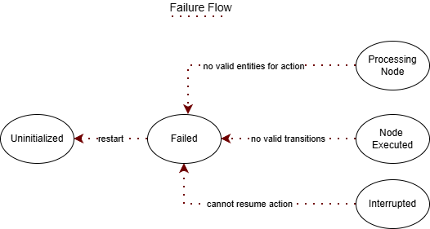
Behavioral Resilience
28
Example
NPC wants to sit on a bench
→ All benches are occupied
→ No valid entity available
1
Sequence Stack
2
3
4
Sequence Stack
Sequence Stack
Sequence Stack
→ Framework activates a fallback
behavior sequence
Main Sequence
Fallback Sequence
Empty
Main Sequence
Concepts & Definitions
Problem Statement
Framework Model
Implementation
Results & Demos
Conclusions

Slide 31
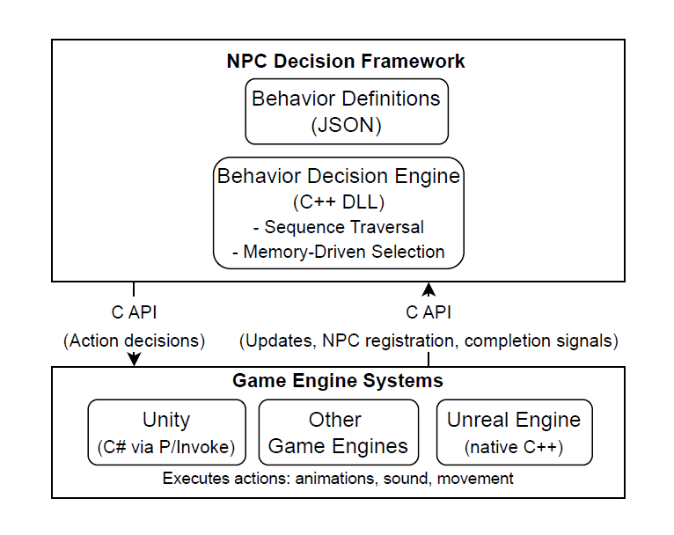
Data-Driven Engine-Agnostic Architecture
29
One compiled library. Same JSON definitions. Different game engines.
Concepts & Definitions
Problem Statement
Framework Model
Implementation
Results & Demos
17
Conclusions

Slide 32
Technology Selection
30
C++ Implementation
Native integration with Unreal Engine. Broadly supported by other engines.
Single compiled binary loadable at runtime by any compatible engine.
Dynamic Link Library (DLL)
Public C API
Stable, widely-supported interface. Avoids C++ issues across compilers.
JSON Configuration Files
Human-readable. Editable without recompiling the framework. Simplicity for parsing over alternatives (XML, YAML).
Alternative considered:
.NET / C# was rejected because Unreal Engine integration required disproportionate engineering effort.
Concepts & Definitions
Problem Statement
Framework Model
Implementation
Results & Demos
Conclusions

Slide 33
Framework Interface
31
The interface between our framework and a game engine has two directions.
Engine → Framework
Framework → Engine
Public C API
Three required callbacks
Lifecycle
Execute action
initialize, update, shutdown
Makes an NPC perform an action
Entity management
Environmental query
register and unregister entities at runtime
current value of this environmental condition
Runtime signals
Position query
action completion, interruption events
current position of this entity
Concepts & Definitions
Problem Statement
Framework Model
Implementation
Results & Demos
Conclusions
Notes:
C API

Slide 34
JSON Configuration Files
32
State Schema
Environmental Conditions
Actions
Behavior Sequences
Entity
Concepts & Definitions
Problem Statement
Framework Model
Implementation
Results & Demos
Conclusions

Slide 35
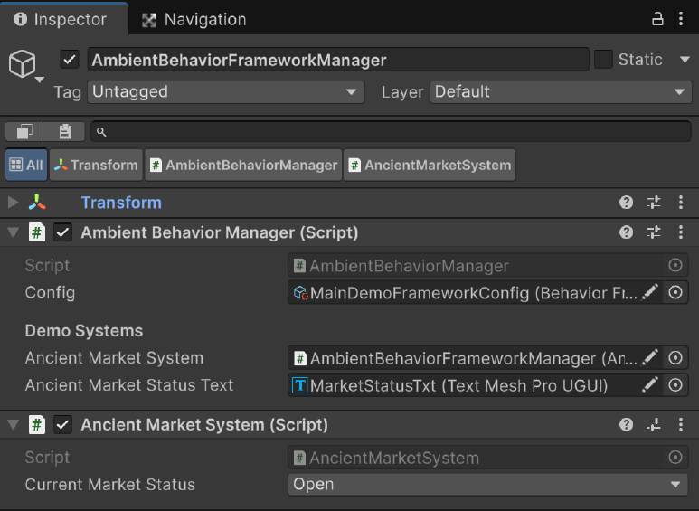
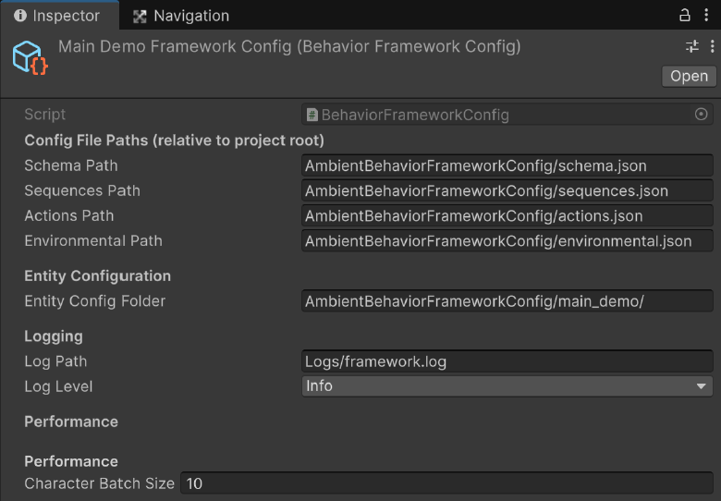
Game Engine Integration
33
Integrating a new engine requires only a small wrapper layer.
The wrapper layer:
Implements the framework interface
Translates framework action requests into animations and movement
Concepts & Definitions
Problem Statement
Framework Model
Implementation
Results & Demos
Conclusions

Slide 36
Data Structures Overview
34
Four decisions that make engine-agnostic performance possible:
Integer Keys for All Identifiers
Hash Tables for Lookups
Runtime checks are integer comparisons.
Average constant-time access during decision-making.
Fixed-Capacity Memory Containers
Adjacency Structures for Sequence Graphs
Each NPC's memory is bounded per type. Capacity drives forgetting behavior.
Behavior sequences store nodes and outgoing transitions directly. Sequences are small, so traversal at decision points is cheap.
Combined effect: 1–4 µs per decision
Concepts & Definitions
Problem Statement
Framework Model
Implementation
Results & Demos
Conclusions

Slide 37
Evaluation Methodology
35
Test Protocol
Populations:
50, 100, 150, 200 NPCs
Profiling
Runs:
5 additional runs at 200 NPCs for per-function cost breakdown.
5 independent per configuration
Hardware:
CPU: Ryzen 9 7900X, GPU: RTX 2070, 32 GB RAM
Concepts & Definitions
Problem Statement
Framework Model
Implementation
Results & Demos
Conclusions

Slide 38
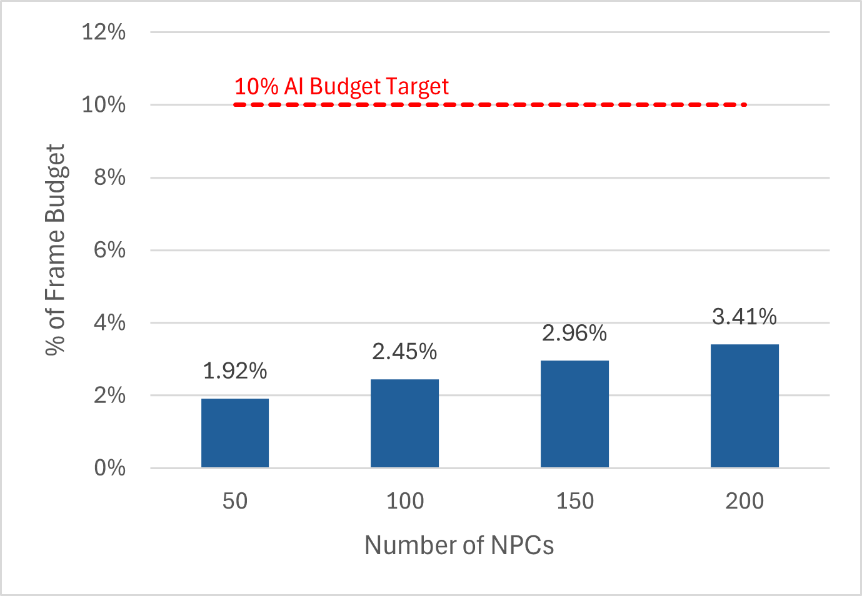
Performance Results
36
1.8×
cost increase with 4x
NPCs, suggesting sub-linear scaling
< 3.5%
of frame budget at 200 NPCs
Recall: commercial games allocate 5–10% of frame budget to all AI systems. The 10% line represents the full AI budget.
Concepts & Definitions
Problem Statement
Framework Model
Implementation
Results & Demos
20
Conclusions

Slide 39
Variable Workload Analysis
37
Action duration in seconds = most NPCs don’t need a decision on most frames
NPCs requiring a behavioral decision per frame
NPCs | Avg/Frame | Max
50 | 0.2 | 3 – 4
100 | 0.4 | 5 – 7
150 | 0.6 | 10 – 20
200 | 0.8 | 19 – 36
Two cost components per frame
Fixed
Iterating over all registered NPCs (cheap)
Variable
Selection algorithm (only when an NPC needs a decision)
Concepts & Definitions
Problem Statement
Framework Model
Implementation
Results & Demos
Conclusions

Slide 40
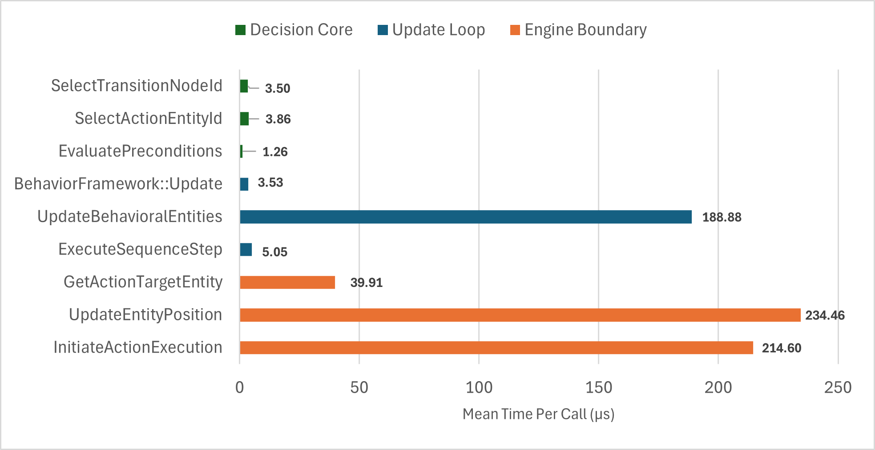
Internal Performance Breakdown
38
Core decision-making
1 – 4 µs
per decision
Engine-boundary overhead
Dominant
The selection algorithm is not the bottleneck. Cost comes from crossing the DLL/engine interface.
per-frame cost
Concepts & Definitions
Problem Statement
Framework Model
Implementation
Results & Demos
Conclusions

Slide 41
Live Demos
39
Unity
Ancient Marketplace
Unreal Engine
Dance Club
Concepts & Definitions
Problem Statement
Framework Model
Implementation
Results & Demos
18
Conclusions

Slide 42
Contributions
40
1. Memory-Driven Action Selection
NPCs with identical definitions produce distinct patterns. 1–4 µs per decision.
2. Unified State Operation Mechanism
Same structure for preconditions and effects. Works identically across any game engine.
3. Behavioral Resilience
Interruption/resumption and recovery keep NPCs active under all conditions.
4. Engine-Agnostic Architecture
Implemented as a C++ DLL validated in Unity and Unreal with identical JSON-defined configuration files.
Concepts & Definitions
Problem Statement
Framework Model
Implementation
Results & Demos
21
Conclusions

Slide 43
Limitations and Future Work
41
Evaluation Scope
Behavioral assessment is qualitative (no quantitative metrics like action distribution entropy).
No formal comparison with other NPC behavior systems.
Performance measured on a single hardware config in the Unity editor.
Configuration Authoring
JSON files must be authored manually.
Manageable for our demos but error-prone at larger scale.
Visual editing tools would make the framework more accessible to game designers.
Concepts & Definitions
Problem Statement
Framework Model
Implementation
Results & Demos
22
Conclusions

Slide 44
Conclusions
42
Lightweight memory-based algorithms provide a practical alternative to more computationally expensive approaches for ambient NPC behavior.
The engine-agnostic design of our framework allows the same compiled library to be used across multiple game engines.
Beyond Video Games
Training Simulations
Architectural Walkthroughs
Virtual Environments for Research

Slide 45
Thank you. Questions?
Eric Buitron Lopez
ebuitron@uwo.ca

