Slide 1
Architecture Models

Slide 2
Readings
Coulouris, Dollimore and Kindberg Distributed Systems: Concepts and Design Edn. 3
Note: All figures from this book

Slide 3
Components of a Distributed System
A process is a running program
Processes interact by sending each other messages or reading/writing shared memory

Slide 4
Client-Server Architectureb
A server process invokes a service based on a request from a client process
The result of the execution of the service is returned to the client process
Examples: Web servers

Slide 5
Client-Server Architecture
Servers may be clients of other servers
Example: A web server is often a client of a file server
Potential problem: A single server may be a scalability bottleneck and a single point of failure
Notes:
Problem: give an example of a system that uses client-server architecture

Slide 6
Peer-to-Peer Architecture
All processes play similar roles – i.e., they interact as peers
No central component – potentially better scalability and resiliency to failures
Use the power of modern desktops to implement a large-scale distributed system
Examples: Skype, Bittorrent

Slide 7
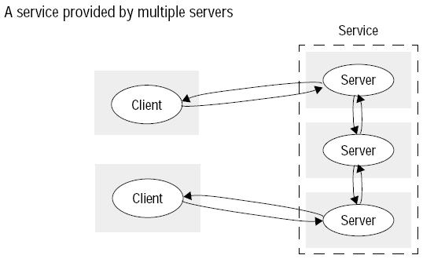
Services by multiple servers
Multiple servers provide services to clients
Servers may partition the service objects or replicate them (e.g., Amazon)

Slide 8
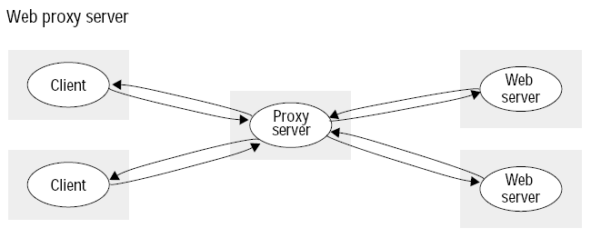
Proxy Servers and Caches
A cache is a store of recently used data that is closer than the main storage
A newly accessed piece of data is placed in the cache
When that data is accessed again, it is fetched from the cache (assuming it is recent enough)
Proxy servers intercept communication with the real server to provide faster service (e.g., deliver cached data), better security (e.g., a proxy configured as a firewall, UWO proxy)
Notes:
What is a cache? Where are caches used?
Problem: design a cache replacement protocol

Slide 9
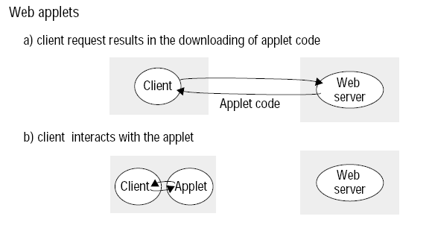
Mobile Code
Code that is downloaded from a remote machine (e.g., a server) and is run in a local machine (e.g., a client)
Reason: provide better interactive experience

Slide 10
Mobile Agents
A running program (both code and data) that travels from one computer to another
Example: a worm
Used to attack computer systems

Slide 11
Summary
In this section we briefly described different models of interaction in distributed systems

