Slide 1
Case Study - GFS

Slide 2
Outline
NFS
Google File System (GFS)

Slide 3
Network File Systems
I’m on a Unix machine in MC 325;
I go to another machine in MC 325
I see the same files
Why?
This is because you are using a networked file system
Let’s take a quick look at NFS

Slide 4
The Sun Network File System (NFS)
An implementation and a specification of a software system for accessing remote files across LANs (or WANs)
The implementation is part of the Solaris and SunOS operating systems running on Sun workstations using an unreliable datagram protocol (UDP/IP protocol) and Ethernet

Slide 5
NFS
You can think of a networked file system as a hierarchical tree structure
The leaf nodes represent directories on actual file systems (local to a machine)
Directories can be mounted which means that they can appear in the tree structure
The directories can be on remote machines
The remote machines may use a different OS then the client machine

Slide 6
NFS
Support access to files on remote servers
Must support concurrency
Make varying guarantees about locking, who “wins” with concurrent writes, etc...
Must gracefully handle dropped connections

Slide 7
NFS
An NFS file server runs on a machine (which may have large disks) that has a local file system.
An NFS client runs on an arbitrary machine and access the files on machines that run NFS servers.

Slide 8
NFS
When an application program calls open to obtain access to a file it is making a call to the NFS client
If the path refers to a local file, the system uses the computer’s standard file system software to access the file
If the path refers to a remote file, the system uses NFS client software to access the remote file through the NFS server

Slide 9
NFS
The NFS server handles incoming client requests
These requests are mapped to local file system operations

Slide 10
NFS Protocol
Primarily stateless
Stateless means that servers do not maintain information about their clients from one access to another
All requests must include a unique file identifier, absolute offset inside the file etc;
Operated over UDP; did not use TCP streams

Slide 11
NFS
Files are assumed to be shared by multiple clients
Synchronization is needed
Problem
There is a performance problem if every time a client wants to access a file it has to go to the server
Thus clients are allowed to keep a local copy of the file while they are reading and writing its contents
This is referred to as caching

Slide 12
NFS
UNIX Semantics
When a read follows a write the read returns the value just written
When two writes happen in quick succession followed by a read, the value read is the value stored by the last write
In a centralized systems this is easy to implement
If there is no caching in NFS then this is also easy to implement

Slide 13
NFS
NFS allows clients to cache for performance reasons
How then is UNIX semantics provided?
Approach 1:
Propagate all changes to cached files back to the server as they happen
Not efficient
Lots of network traffic

Slide 14
NFS
Approach 2: Change the semantics
NFS implements session semantics
Changes to an open file are initially visible only to the process that modified the file
Implementation
When a process closes the file, it sends a copy to the NFS server so that subsequent reads get the new value
What if two clients are caching and modifying the file at the same time?

Slide 15
NFS and Replication
Replication is through caching
Can have multiple caches of a file
The “master” has the copy that was last written to it

Slide 16
Outline
NFS
Google File System (GFS)

Slide 17
Motivation
Google needed a good distributed file system
Redundant storage of massive amounts of data on cheap and unreliable computers
Why not use an existing file system?
Google’s problems are different from anyone else’s
Different workload and design priorities
GFS is designed for Google apps and workloads
Google apps are designed for GFS

Slide 18
Google Workload Characteristics
Most files are mutated by appending new data – large sequential writes
Random writes are very uncommon
Files are written once, then they are only read
Reads are sequential
Large streaming reads and small random reads
High sustained throughput favoured over low latency

Slide 19
Google Workload Characteristics
Google applications:
Data analysis programs that scan through data repositories
Data streaming applications
Archiving
Applications producing (intermediate) search results

Slide 20
Assumptions
High component failure rates
Inexpensive commodity components fail all the time
“Modest” number of HUGE files
Just a few million
Each is 100MB or larger; multi-GB files typical

Slide 21
Files and Chunks
Files are divided into fixed-size chunks
Each chunk has an identifier, chunk handle, assigned by the master at the time of chunk creation
Each chunk is replicated 3 times
Chunk size is of fixed size (64MB)

Slide 22
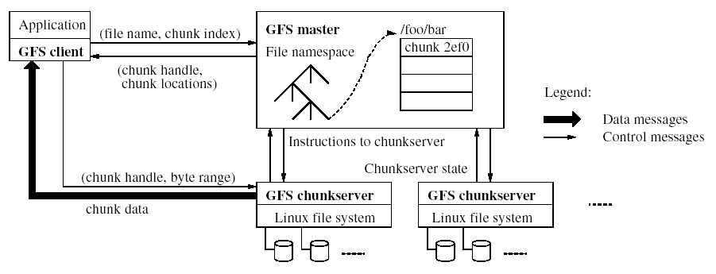
GFS Architecture
Single master for a cluster

Slide 23
Master
Stores metadata for files
Mapping from files to chunks
Locations of each chunk’s replicas (referred to as chunk locations)
Interacts with clients
Creates chunk replicas
Maintains an operational log
Records changes to metadata
Checkpoints log
Log can be used to recover from failures

Slide 24
Chunkservers
Store chunks on local disks as Linux files
Read/write chunk data specified by a chunk handle and byte range

Slide 25
Why Keep Metadata In Memory?
To keep master operations fast
Master can periodically scan its internal state in the background, in order to implement:
Re-replication (in case of chunk server failures)
Chunk migration (for load balancing)

Slide 26
Master/Chunkserver Interaction
Master and chunkserver communicate regularly to obtain state
Is chunkserver down?
Use Heartbeat messages
Is there a disk failure on chunkserver?
Which chunk replicas does chunkserver store?
Useful when a Master goes down
Master sends instructions to chunkserver
Delete existing chunk
Create new chunk

Slide 27
Master/Chunkserver Interaction
Master does not need to keep chunk locations persistent since is periodically polls chunkservers for that information
Master controls initial chunk placement, migration and re-replication

Slide 28
Read Algorithm
Application originates the read request
GFS client translates the request to file name and chunk index and sends to master
Master responds with chunk handle and replica locations (chunkservers where the replicas are stored)
Application
1
2
(file name, byte offset)
file name, chunk index
GFS Client
Master
Chunk handle, replica locations
3

Slide 29
Read Algorithm
Client picks a location and sends the (chunk handle, byte range) request to the location
Chunkserver sends requested data to the client
Client forwards the data to the applicaiton
Chunkserver
Application
4
Chunkserver
6
(data from file)
Chunk handle, byte range
GFS Client
Chunkserver
Data from file
5

Slide 30
Read
The client caches the chunk handle and the replication locations
The master does not have to be consulted for each read.
The client then sends a request to one of the replicas most likely the closest one
Note: Further reads of the same chunk require no more client-master interaction

Slide 31
Chunk Size
Chunk size is 64 MB
Larger than typical file system block sizes
Advantages
Reduces a client’s need to interact with the master
Reduces the size of the metadata stored on the master

Slide 32
Chunk Size
Disadvantages
A small file consists of a small number of chunks
The chunkservers storing these chunks may become hot spots if many clients are accessing the same file
Does not occur very much in practice

Slide 33
Write Algorithm
Application originates the write request
GFS client translates the request to file name and chunk index and sends to master
Master responds with chunk handle and replica locations ( primary and secondary)
Application
1
2
(file name, byte offset)
file name, chunk index
GFS Client
Master
Chunk handle, primary and secondary replica locations
3

Slide 34
Write Algorithm
Client pushes write data to all locations. Data is stored in a chunkserver’s internal buffers
Typically data is sent along a chain of chunk servers in a pipelined fashion
Primary
buffer
Chunkserver
Application
4
Secondary
buffer
Chunkserver
Send Data
Send Data
Secondary
GFS Client
buffer
Chunkserver
Send Data

Slide 35
Write Algorithm
Client sends write command to primary after receiving an acknowledgement from each replica
Primary
5
buffer
Chunkserver
Application
Write command
Secondary
buffer
Chunkserver
Secondary
GFS Client
buffer
Chunkserver

Slide 36
Write Algorithm
Primary determines serial order for data instances (which could come from multiple clients) stored in buffer and writes the instances in that order to the chunk
determine serial order
6
Primary
buffer
Chunkserver
Application
Secondary
buffer
Chunkserver
Secondary
GFS Client
buffer
Chunkserver

Slide 37
Write Algorithm
Primary send the serial order to the secondary replica and tells them to write
send serial order
7
Primary
buffer
Chunkserver
Application
Secondary
buffer
Chunkserver
Secondary
GFS Client
buffer
Chunkserver

Slide 38
Write Algorithm
Secondary replicas respond to the primary
Primary respond back to the client
If write fails at one of the chunkservers, client is informed and retries the write

Slide 39
Failure Handling DuringWrites
If a write fails at the primary:
The primary may report failure to the client – the client will retry
If the primary does not respond, the client retries from Step 1 by contacting the master
If a write succeeds at the primary, but fails at several replicas
The client retries several times

Slide 40
Atomic Record Appends
The client pushes the data (a record) to all replicas of the last chunk of the file
Sends request to primary
Case 1: Record fits within the maximum size of chunk
Primary appends data to its replica
Primary tells the secondaries to write the data at the exact offset

Slide 41
Atomic Record Appends
Case 2: What if appending the record would cause the chunk to exceed the maximum size
Pad the chunk to the maximum size
Tell the primaries to do the same thing
Reply to client indicating that the operation should be retried on the next chunk

Slide 42
Data Consistency in GFS
Loose data consistency – applications are designed for it
Some replicas may have duplicate records (because of failed and retried appends)
Applications may see inconsistent data – data is different on different replicas

Slide 43
Data Consistency in GFS
Clients must deal with it
If clients cannot tolerate duplicates, they must insert version numbers in records
GFS pushes complexity to the client; without this, complex failure recovery scheme would need to be in place

Slide 44
Summary
We have presented two case studies related to file systems

