Slide 1
CS1033 Assignment 2 Slide Show
Lab Leader:
Alex

Slide 2
Notes:
rsharm33
Laura

Slide 3
Notes:
Laura
atomane

Slide 6
Notes:
Bleung46
laura

Slide 9
Notes:
Vramsay
laura

Slide 15
Notes:
Atay17
Laura LOVES this one

Slide 28
Notes:
Mmenecol
laura

Slide 29
Notes:
Jjesson
laura

Slide 33
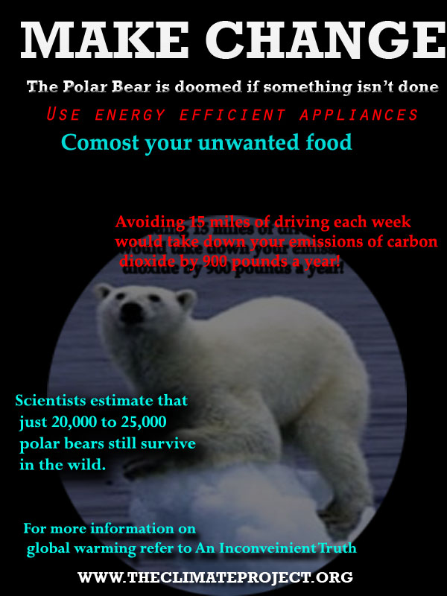

Slide 38
Notes:
Chall53
laura

Slide 40
Notes:
Agolds5
laura

