Slide 1
POSTER SHOW Group 1

Slide 2

Slide 1 of 160
Notes:
https://cs1033.gaul.csd.uwo.ca/~aadata/posterassign/aadata_poster.jpg

Slide 3

Slide 2 of 160
Notes:
https://cs1033.gaul.csd.uwo.ca/~aagost/posterassign/aagost_poster.jpg

Slide 4
Slide 3 of 160
Notes:
https://cs1033.gaul.csd.uwo.ca/~aalderm2/posterassign/aalderm2_poster.jpg

Slide 5

Slide 4 of 160
Notes:
https://cs1033.gaul.csd.uwo.ca/~aalfarr3/posterassign/aalfarr3_poster.jpg

Slide 6

Slide 5 of 160
Notes:
https://cs1033.gaul.csd.uwo.ca/~aandre42/posterassign/aandre42_poster.jpg

Slide 7

Slide 6 of 160
Notes:
https://cs1033.gaul.csd.uwo.ca/~aasher2/posterassign/aasher2_poster.jpg

Slide 8

Slide 7 of 160
Notes:
https://cs1033.gaul.csd.uwo.ca/~abadial/posterassign/abadial_poster.jpg

Slide 9

Slide 8 of 160
Notes:
https://cs1033.gaul.csd.uwo.ca/~abahar2/posterassign/abahar2_poster.jpg

Slide 10
Slide 9 of 160
Notes:
https://cs1033.gaul.csd.uwo.ca/~aban3/posterassign/aban3_poster.jpg

Slide 11

Slide 10 of 160
Notes:
https://cs1033.gaul.csd.uwo.ca/~abarrste/posterassign/abarrste_poster.jpg

Slide 12

Slide 11 of 160
Notes:
https://cs1033.gaul.csd.uwo.ca/~abasque/posterassign/abasque_poster.jpg

Slide 13

Slide 12 of 160
Notes:
https://cs1033.gaul.csd.uwo.ca/~abhati68/posterassign/abhati68_poster.jpg

Slide 14

Slide 13 of 160
Notes:
https://cs1033.gaul.csd.uwo.ca/~acamilus/posterassign/acamilus_poster.jpg

Slide 15
Slide 14 of 160
Notes:
https://cs1033.gaul.csd.uwo.ca/~acarinc2/posterassign/acarinc2_poster.jpg

Slide 16
Slide 15 of 160
Notes:
https://cs1033.gaul.csd.uwo.ca/~acaron8/posterassign/acaron8_poster.jpg

Slide 17

Slide 16 of 160
Notes:
https://cs1033.gaul.csd.uwo.ca/~achhab6/posterassign/achhab6_poster.jpg

Slide 18
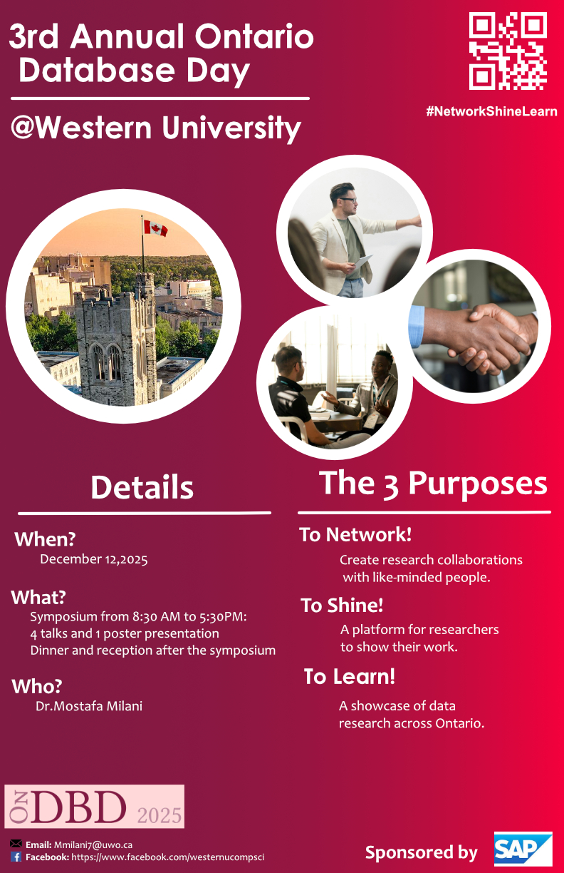
Slide 17 of 160
Notes:
https://cs1033.gaul.csd.uwo.ca/~achong66/posterassign/achong66_poster.jpg

Slide 19
Slide 18 of 160
Notes:
https://cs1033.gaul.csd.uwo.ca/~acochr3/posterassign/acochr3_poster.jpg

Slide 20

Slide 19 of 160
Notes:
https://cs1033.gaul.csd.uwo.ca/~adallal/posterassign/adallal_poster.jpg

Slide 21

Slide 20 of 160
Notes:
https://cs1033.gaul.csd.uwo.ca/~aday57/posterassign/aday57_poster.jpg

Slide 22

Slide 21 of 160
Notes:
https://cs1033.gaul.csd.uwo.ca/~adhil53/posterassign/adhil53_poster.jpg

Slide 23

Slide 22 of 160
Notes:
https://cs1033.gaul.csd.uwo.ca/~aelbann/posterassign/aelbann_poster.jpg

Slide 24

Slide 23 of 160
Notes:
https://cs1033.gaul.csd.uwo.ca/~afu52/posterassign/afu52_poster.jpg

Slide 25

Slide 24 of 160
Notes:
https://cs1033.gaul.csd.uwo.ca/~agaloyan/posterassign/agaloyan_poster.jpg

Slide 26

Slide 25 of 160
Notes:
https://cs1033.gaul.csd.uwo.ca/~aghaff/posterassign/aghaff_poster.jpg

Slide 27

Slide 26 of 160
Notes:
https://cs1033.gaul.csd.uwo.ca/~agliga3/posterassign/agliga3_poster.jpg

Slide 28
Slide 27 of 160
Notes:
https://cs1033.gaul.csd.uwo.ca/~aguerr3/posterassign/aguerr3_poster.jpg

Slide 29

Slide 28 of 160
Notes:
https://cs1033.gaul.csd.uwo.ca/~agupt447/posterassign/agupt447_poster.jpg

Slide 30

Slide 29 of 160
Notes:
https://cs1033.gaul.csd.uwo.ca/~ahari3/posterassign/ahari3_poster.jpg

Slide 31

Slide 30 of 160
Notes:
https://cs1033.gaul.csd.uwo.ca/~aharis4/posterassign/aharis4_poster.jpg

Slide 32

Slide 31 of 160
Notes:
https://cs1033.gaul.csd.uwo.ca/~ahayek2/posterassign/ahayek2_poster.jpg

Slide 33

Slide 32 of 160
Notes:
https://cs1033.gaul.csd.uwo.ca/~ahu228/posterassign/ahu228_poster.jpg

Slide 34

Slide 33 of 160
Notes:
https://cs1033.gaul.csd.uwo.ca/~ahwang24/posterassign/ahwang24_poster.jpg

Slide 35

Slide 34 of 160
Notes:
https://cs1033.gaul.csd.uwo.ca/~aibra54/posterassign/aibra54_poster.jpg

Slide 36

Slide 35 of 160
Notes:
https://cs1033.gaul.csd.uwo.ca/~ajahan3/posterassign/ajahan3_poster.jpg

Slide 37

Slide 36 of 160
Notes:
https://cs1033.gaul.csd.uwo.ca/~ajimen3/posterassign/ajimen3_poster.jpg

Slide 38

Slide 37 of 160
Notes:
https://cs1033.gaul.csd.uwo.ca/~ajinnah4/posterassign/ajinnah4_poster.jpg

Slide 39
Slide 38 of 160
Notes:
https://cs1033.gaul.csd.uwo.ca/~akamalah/posterassign/akamalah_poster.jpg

Slide 40

Slide 39 of 160
Notes:
https://cs1033.gaul.csd.uwo.ca/~akang64/posterassign/akang64_poster.jpg

Slide 41

Slide 40 of 160
Notes:
https://cs1033.gaul.csd.uwo.ca/~akanji55/posterassign/akanji55_poster.jpg

Slide 42
Slide 41 of 160
Notes:
https://cs1033.gaul.csd.uwo.ca/~akasper4/posterassign/akasper4_poster.jpg

Slide 43

Slide 42 of 160
Notes:
https://cs1033.gaul.csd.uwo.ca/~akazi23/posterassign/akazi23_poster.jpg

Slide 44
Slide 43 of 160
Notes:
https://cs1033.gaul.csd.uwo.ca/~akhosl/posterassign/akhosl_poster.jpg

Slide 45

Slide 44 of 160
Notes:
https://cs1033.gaul.csd.uwo.ca/~akirman/posterassign/akirman_poster.jpg

Slide 46

Slide 45 of 160
Notes:
https://cs1033.gaul.csd.uwo.ca/~akoelmel/posterassign/akoelmel_poster.jpg

Slide 47

Slide 46 of 160
Notes:
https://cs1033.gaul.csd.uwo.ca/~akoprows/posterassign/akoprows_poster.jpg

Slide 48

Slide 47 of 160
Notes:
https://cs1033.gaul.csd.uwo.ca/~akozbor2/posterassign/akozbor2_poster.jpg

Slide 49
Slide 48 of 160
Notes:
https://cs1033.gaul.csd.uwo.ca/~alei7/posterassign/alei7_poster.jpg

Slide 50

Slide 49 of 160
Notes:
https://cs1033.gaul.csd.uwo.ca/~ali832/posterassign/ali832_poster.jpg

Slide 51

Slide 50 of 160
Notes:
https://cs1033.gaul.csd.uwo.ca/~aliu432/posterassign/aliu432_poster.jpg

Slide 52

Slide 51 of 160
Notes:
https://cs1033.gaul.csd.uwo.ca/~along56/posterassign/along56_poster.jpg

Slide 53

Slide 52 of 160
Notes:
https://cs1033.gaul.csd.uwo.ca/~amahmasa/posterassign/amahmasa_poster.jpg

Slide 54

Slide 53 of 160
Notes:
https://cs1033.gaul.csd.uwo.ca/~amanso24/posterassign/amanso24_poster.jpg

Slide 55

Slide 54 of 160
Notes:
https://cs1033.gaul.csd.uwo.ca/~amarte6/posterassign/amarte6_poster.jpg

Slide 56

Slide 55 of 160
Notes:
https://cs1033.gaul.csd.uwo.ca/~amccaul7/posterassign/amccaul7_poster.jpg

Slide 57

Slide 56 of 160
Notes:
https://cs1033.gaul.csd.uwo.ca/~amcken65/posterassign/amcken65_poster.jpg

Slide 58
Slide 57 of 160
Notes:
https://cs1033.gaul.csd.uwo.ca/~amendo8/posterassign/amendo8_poster.jpg

Slide 59

Slide 58 of 160
Notes:
https://cs1033.gaul.csd.uwo.ca/~amensa2/posterassign/amensa2_poster.jpg

Slide 60

Slide 59 of 160
Notes:
https://cs1033.gaul.csd.uwo.ca/~amenton2/posterassign/amenton2_poster.jpg

Slide 61

Slide 60 of 160
Notes:
https://cs1033.gaul.csd.uwo.ca/~amoha739/posterassign/amoha739_poster.jpg

Slide 62

Slide 61 of 160
Notes:
https://cs1033.gaul.csd.uwo.ca/~amusta33/posterassign/amusta33_poster.jpg

Slide 63

Slide 62 of 160
Notes:
https://cs1033.gaul.csd.uwo.ca/~anasse25/posterassign/anasse25_poster.jpg

Slide 64

Slide 63 of 160
Notes:
https://cs1033.gaul.csd.uwo.ca/~aoconne7/posterassign/aoconne7_poster.jpg

Slide 65

Slide 64 of 160
Notes:
https://cs1033.gaul.csd.uwo.ca/~apabla9/posterassign/apabla9_poster.jpg

Slide 66

Slide 65 of 160
Notes:
https://cs1033.gaul.csd.uwo.ca/~aparma46/posterassign/aparma46_poster.jpg

Slide 67

Slide 66 of 160
Notes:
https://cs1033.gaul.csd.uwo.ca/~apattath/posterassign/apattath_poster.jpg

Slide 68

Slide 67 of 160
Notes:
https://cs1033.gaul.csd.uwo.ca/~apezhman/posterassign/apezhman_poster.jpg

Slide 69

Slide 68 of 160
Notes:
https://cs1033.gaul.csd.uwo.ca/~apopati3/posterassign/apopati3_poster.jpg

Slide 70
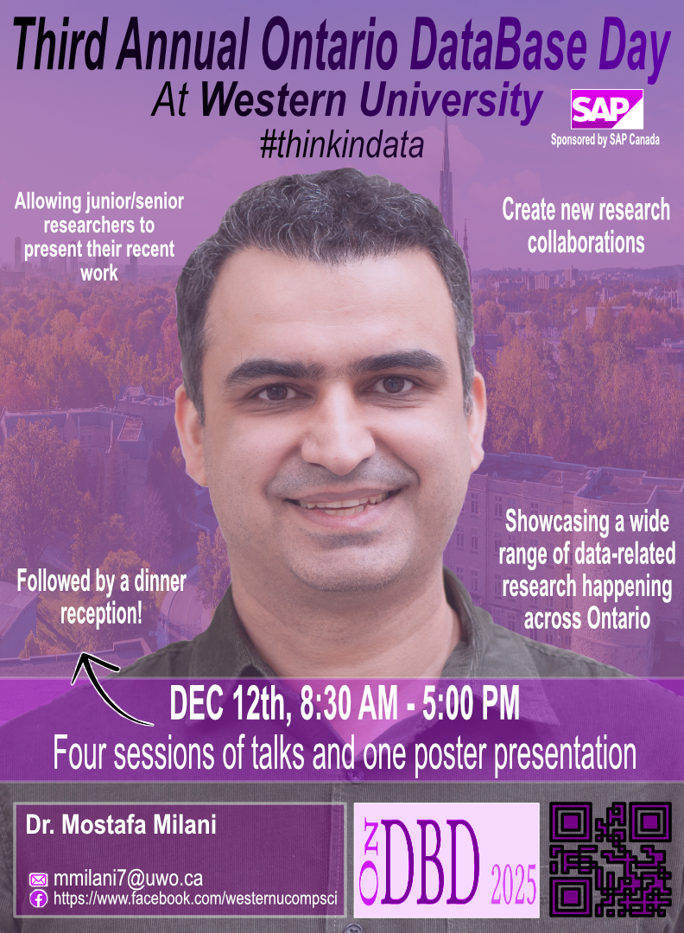
Slide 69 of 160
Notes:
https://cs1033.gaul.csd.uwo.ca/~apuley2/posterassign/apuley2_poster.jpg

Slide 71

Slide 70 of 160
Notes:
https://cs1033.gaul.csd.uwo.ca/~arana83/posterassign/arana83_poster.jpg

Slide 72
Slide 71 of 160
Notes:
https://cs1033.gaul.csd.uwo.ca/~arapp3/posterassign/arapp3_poster.jpg

Slide 73
Slide 72 of 160
Notes:
https://cs1033.gaul.csd.uwo.ca/~arazafin/posterassign/arazafin_poster.jpg

Slide 74

Slide 73 of 160
Notes:
https://cs1033.gaul.csd.uwo.ca/~aroger72/posterassign/aroger72_poster.jpg

Slide 75
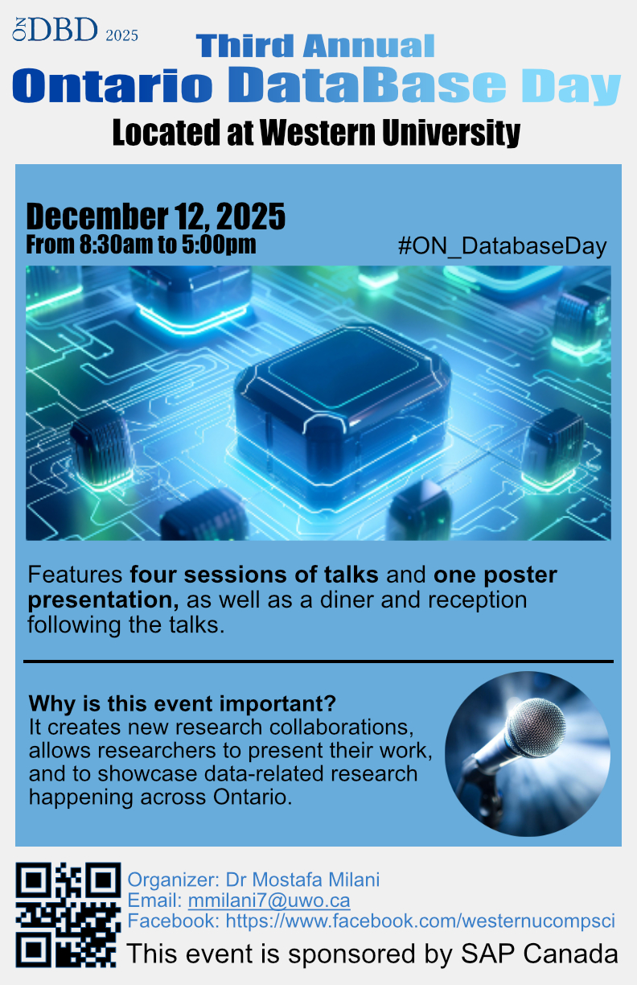
Slide 74 of 160
Notes:
https://cs1033.gaul.csd.uwo.ca/~aroger82/posterassign/aroger82_poster.jpg

Slide 76

Slide 75 of 160
Notes:
https://cs1033.gaul.csd.uwo.ca/~aroufaie/posterassign/aroufaie_poster.jpg

Slide 77

Slide 76 of 160
Notes:
https://cs1033.gaul.csd.uwo.ca/~asabapa/posterassign/asabapa_poster.jpg

Slide 78

Slide 77 of 160
Notes:
https://cs1033.gaul.csd.uwo.ca/~asadoh/posterassign/asadoh_poster.jpg

Slide 79

Slide 78 of 160
Notes:
https://cs1033.gaul.csd.uwo.ca/~aspagno4/posterassign/aspagno4_poster.jpg

Slide 80

Slide 79 of 160
Notes:
https://cs1033.gaul.csd.uwo.ca/~astorm/posterassign/astorm_poster.jpg

Slide 81

Slide 80 of 160
Notes:
https://cs1033.gaul.csd.uwo.ca/~asumeiya/posterassign/asumeiya_poster.jpg

Slide 82

Slide 81 of 160
Notes:
https://cs1033.gaul.csd.uwo.ca/~atang328/posterassign/atang328_poster.jpg

Slide 83
Slide 82 of 160
Notes:
https://cs1033.gaul.csd.uwo.ca/~athom429/posterassign/athom429_poster.jpg

Slide 84

Slide 83 of 160
Notes:
https://cs1033.gaul.csd.uwo.ca/~aumoru/posterassign/aumoru_poster.jpg

Slide 85

Slide 84 of 160
Notes:
https://cs1033.gaul.csd.uwo.ca/~avaithe2/posterassign/avaithe2_poster.jpg

Slide 86

Slide 85 of 160
Notes:
https://cs1033.gaul.csd.uwo.ca/~avlitas/posterassign/avlitas_poster.jpg

Slide 87

Slide 86 of 160
Notes:
https://cs1033.gaul.csd.uwo.ca/~awats55/posterassign/awats55_poster.jpg

Slide 88
Slide 87 of 160
Notes:
https://cs1033.gaul.csd.uwo.ca/~awilki68/posterassign/awilki68_poster.jpg

Slide 89

Slide 88 of 160
Notes:
https://cs1033.gaul.csd.uwo.ca/~azahid44/posterassign/azahid44_poster.jpg

Slide 90

Slide 89 of 160
Notes:
https://cs1033.gaul.csd.uwo.ca/~azhan444/posterassign/azhan444_poster.jpg

Slide 91
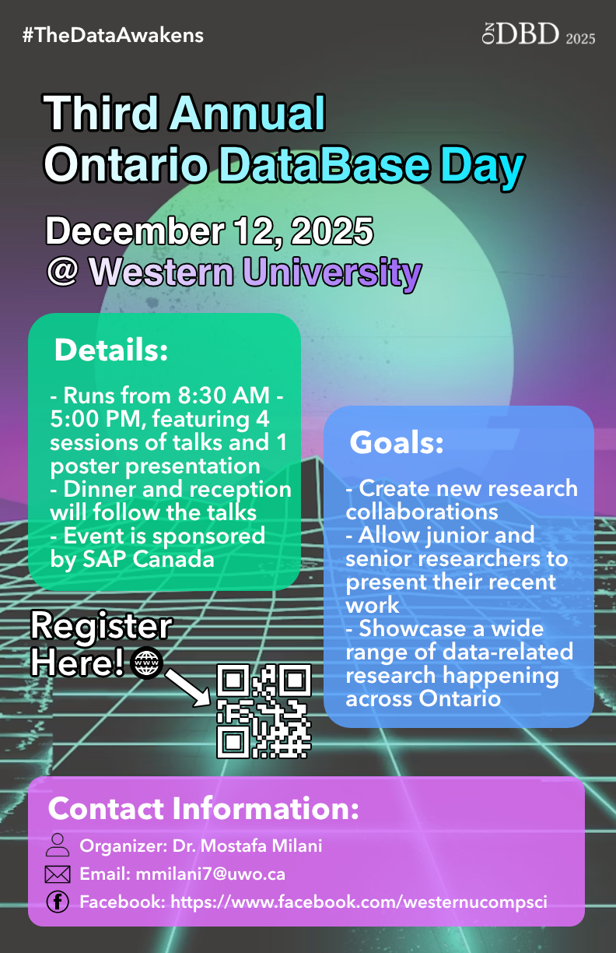
Slide 90 of 160
Notes:
https://cs1033.gaul.csd.uwo.ca/~azhan449/posterassign/azhan449_poster.jpg

Slide 92

Slide 91 of 160
Notes:
https://cs1033.gaul.csd.uwo.ca/~barndt3/posterassign/barndt3_poster.jpg

Slide 93

Slide 92 of 160
Notes:
https://cs1033.gaul.csd.uwo.ca/~bball24/posterassign/bball24_poster.jpg

Slide 94
Slide 93 of 160
Notes:
https://cs1033.gaul.csd.uwo.ca/~bbrisset/posterassign/bbrisset_poster.jpg

Slide 95

Slide 94 of 160
Notes:
https://cs1033.gaul.csd.uwo.ca/~bbylaard/posterassign/bbylaard_poster.jpg

Slide 96

Slide 95 of 160
Notes:
https://cs1033.gaul.csd.uwo.ca/~bchiang5/posterassign/bchiang5_poster.jpg

Slide 97

Slide 96 of 160
Notes:
https://cs1033.gaul.csd.uwo.ca/~bcostel2/posterassign/bcostel2_poster.jpg

Slide 98

Slide 97 of 160
Notes:
https://cs1033.gaul.csd.uwo.ca/~bdai26/posterassign/bdai26_poster.jpg

Slide 99
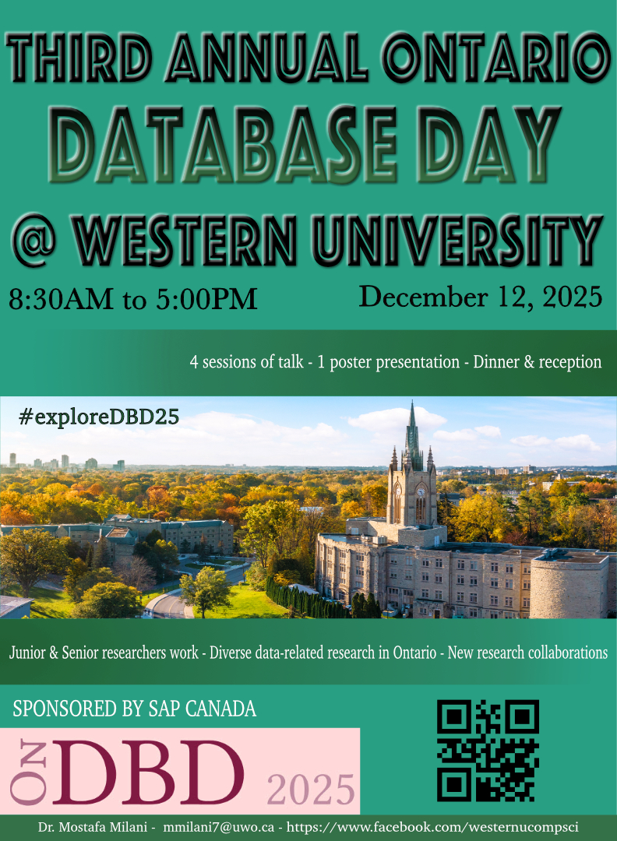
Slide 98 of 160
Notes:
https://cs1033.gaul.csd.uwo.ca/~bgacusan/posterassign/bgacusan_poster.jpg

Slide 100
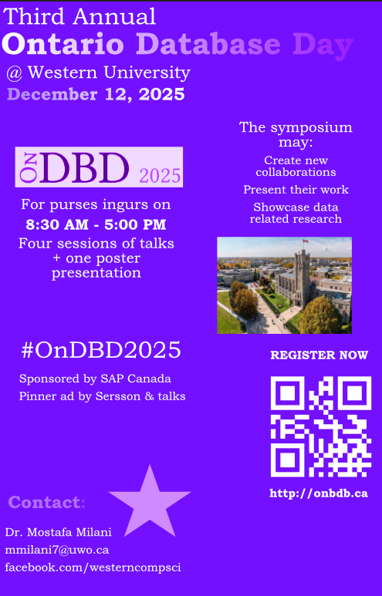
Slide 99 of 160
Notes:
https://cs1033.gaul.csd.uwo.ca/~bgagnon6/posterassign/bgagnon6_poster.jpg

Slide 101
Slide 100 of 160
Notes:
https://cs1033.gaul.csd.uwo.ca/~bgelman/posterassign/bgelman_poster.jpg

Slide 102

Slide 101 of 160
Notes:
https://cs1033.gaul.csd.uwo.ca/~bharri72/posterassign/bharri72_poster.jpg

Slide 103
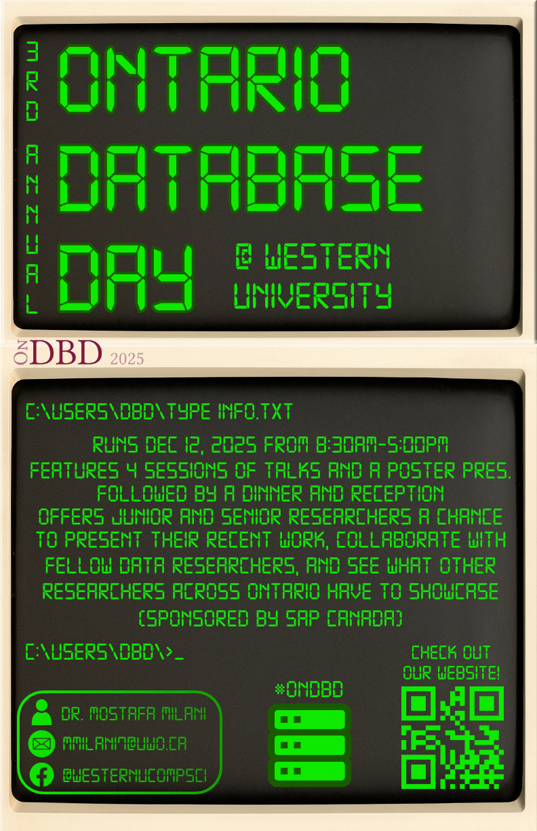
Slide 102 of 160
Notes:
https://cs1033.gaul.csd.uwo.ca/~bhebb2/posterassign/bhebb2_poster.jpg

Slide 104

Slide 103 of 160
Notes:
https://cs1033.gaul.csd.uwo.ca/~bhicks27/posterassign/bhicks27_poster.jpg

Slide 105

Slide 104 of 160
Notes:
https://cs1033.gaul.csd.uwo.ca/~bhudson9/posterassign/bhudson9_poster.jpg

Slide 106

Slide 105 of 160
Notes:
https://cs1033.gaul.csd.uwo.ca/~bjone45/posterassign/bjone45_poster.jpg

Slide 107
Slide 106 of 160
Notes:
https://cs1033.gaul.csd.uwo.ca/~bkalra4/posterassign/bkalra4_poster.jpg

Slide 108
Slide 107 of 160
Notes:
https://cs1033.gaul.csd.uwo.ca/~bmecklin/posterassign/bmecklin_poster.jpg

Slide 109

Slide 108 of 160
Notes:
https://cs1033.gaul.csd.uwo.ca/~bmorto2/posterassign/bmorto2_poster.jpg

Slide 110

Slide 109 of 160
Notes:
https://cs1033.gaul.csd.uwo.ca/~bncube/posterassign/bncube_poster.jpg

Slide 111
Slide 110 of 160
Notes:
https://cs1033.gaul.csd.uwo.ca/~bnemec/posterassign/bnemec_poster.jpg

Slide 112

Slide 111 of 160
Notes:
https://cs1033.gaul.csd.uwo.ca/~bpan27/posterassign/bpan27_poster.jpg

Slide 113

Slide 112 of 160
Notes:
https://cs1033.gaul.csd.uwo.ca/~bpuncha/posterassign/bpuncha_poster.jpg

Slide 114
Slide 113 of 160
Notes:
https://cs1033.gaul.csd.uwo.ca/~bramjatt/posterassign/bramjatt_poster.jpg

Slide 115
Slide 114 of 160
Notes:
https://cs1033.gaul.csd.uwo.ca/~bschried/posterassign/bschried_poster.jpg

Slide 116
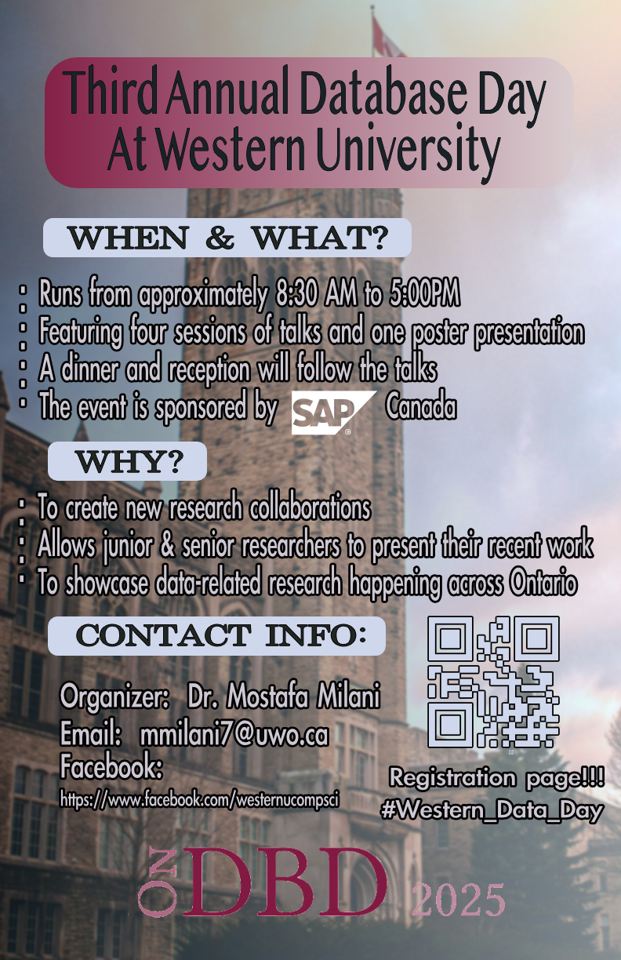
Slide 115 of 160
Notes:
https://cs1033.gaul.csd.uwo.ca/~bstock5/posterassign/bstock5_poster.jpg

Slide 117

Slide 116 of 160
Notes:
https://cs1033.gaul.csd.uwo.ca/~bstotlan/posterassign/bstotlan_poster.jpg

Slide 118

Slide 117 of 160
Notes:
https://cs1033.gaul.csd.uwo.ca/~bsu33/posterassign/bsu33_poster.jpg

Slide 119

Slide 118 of 160
Notes:
https://cs1033.gaul.csd.uwo.ca/~bswitze5/posterassign/bswitze5_poster.jpg

Slide 120

Slide 119 of 160
Notes:
https://cs1033.gaul.csd.uwo.ca/~bszyc/posterassign/bszyc_poster.jpg

Slide 121

Slide 120 of 160
Notes:
https://cs1033.gaul.csd.uwo.ca/~bwils72/posterassign/bwils72_poster.jpg

Slide 122

Slide 121 of 160
Notes:
https://cs1033.gaul.csd.uwo.ca/~bzarcon/posterassign/bzarcon_poster.jpg

Slide 123
Slide 122 of 160
Notes:
https://cs1033.gaul.csd.uwo.ca/~bzhao282/posterassign/bzhao282_poster.jpg

Slide 124

Slide 123 of 160
Notes:
https://cs1033.gaul.csd.uwo.ca/~bzhong25/posterassign/bzhong25_poster.jpg

Slide 125

Slide 124 of 160
Notes:
https://cs1033.gaul.csd.uwo.ca/~cadaytsa/posterassign/cadaytsa_poster.jpg

Slide 126

Slide 125 of 160
Notes:
https://cs1033.gaul.csd.uwo.ca/~calmei22/posterassign/calmei22_poster.jpg

Slide 127
Slide 126 of 160
Notes:
https://cs1033.gaul.csd.uwo.ca/~capolina/posterassign/capolina_poster.jpg

Slide 128
Slide 127 of 160
Notes:
https://cs1033.gaul.csd.uwo.ca/~cboudr6/posterassign/cboudr6_poster.jpg

Slide 129

Slide 128 of 160
Notes:
https://cs1033.gaul.csd.uwo.ca/~cboulos4/posterassign/cboulos4_poster.jpg

Slide 130

Slide 129 of 160
Notes:
https://cs1033.gaul.csd.uwo.ca/~cbrot/posterassign/cbrot_poster.jpg

Slide 131

Slide 130 of 160
Notes:
https://cs1033.gaul.csd.uwo.ca/~ccha92/posterassign/ccha92_poster.jpg

Slide 132

Slide 131 of 160
Notes:
https://cs1033.gaul.csd.uwo.ca/~cchataw/posterassign/cchataw_poster.jpg

Slide 133

Slide 132 of 160
Notes:
https://cs1033.gaul.csd.uwo.ca/~cche323/posterassign/cche323_poster.jpg

Slide 134
Slide 133 of 160
Notes:
https://cs1033.gaul.csd.uwo.ca/~ccomrie2/posterassign/ccomrie2_poster.jpg

Slide 135

Slide 134 of 160
Notes:
https://cs1033.gaul.csd.uwo.ca/~cdeligna/posterassign/cdeligna_poster.jpg

Slide 136

Slide 135 of 160
Notes:
https://cs1033.gaul.csd.uwo.ca/~cedgar8/posterassign/cedgar8_poster.jpg

Slide 137

Slide 136 of 160
Notes:
https://cs1033.gaul.csd.uwo.ca/~cezeoch/posterassign/cezeoch_poster.jpg

Slide 138

Slide 137 of 160
Notes:
https://cs1033.gaul.csd.uwo.ca/~cfoste56/posterassign/cfoste56_poster.jpg

Slide 139

Slide 138 of 160
Notes:
https://cs1033.gaul.csd.uwo.ca/~cgowing/posterassign/cgowing_poster.jpg

Slide 140

Slide 139 of 160
Notes:
https://cs1033.gaul.csd.uwo.ca/~cguo264/posterassign/cguo264_poster.jpg

Slide 141

Slide 140 of 160
Notes:
https://cs1033.gaul.csd.uwo.ca/~cguo282/posterassign/cguo282_poster.jpg

Slide 142

Slide 141 of 160
Notes:
https://cs1033.gaul.csd.uwo.ca/~chebel/posterassign/chebel_poster.jpg

Slide 143

Slide 142 of 160
Notes:
https://cs1033.gaul.csd.uwo.ca/~cjafree/posterassign/cjafree_poster.jpg

Slide 144
Slide 143 of 160
Notes:
https://cs1033.gaul.csd.uwo.ca/~clee2374/posterassign/clee2374_poster.jpg

Slide 145

Slide 144 of 160
Notes:
https://cs1033.gaul.csd.uwo.ca/~clo284/posterassign/clo284_poster.jpg

Slide 146

Slide 145 of 160
Notes:
https://cs1033.gaul.csd.uwo.ca/~cloewen7/posterassign/cloewen7_poster.jpg

Slide 147
Slide 146 of 160
Notes:
https://cs1033.gaul.csd.uwo.ca/~cmaglina/posterassign/cmaglina_poster.jpg

Slide 148

Slide 147 of 160
Notes:
https://cs1033.gaul.csd.uwo.ca/~cmanley4/posterassign/cmanley4_poster.jpg

Slide 149

Slide 148 of 160
Notes:
https://cs1033.gaul.csd.uwo.ca/~cmcfar29/posterassign/cmcfar29_poster.jpg

Slide 150

Slide 149 of 160
Notes:
https://cs1033.gaul.csd.uwo.ca/~cmcgow3/posterassign/cmcgow3_poster.jpg

Slide 151

Slide 150 of 160
Notes:
https://cs1033.gaul.csd.uwo.ca/~cmctagg2/posterassign/cmctagg2_poster.jpg

Slide 152
Slide 151 of 160
Notes:
https://cs1033.gaul.csd.uwo.ca/~cmgbiri/posterassign/cmgbiri_poster.jpg

Slide 153

Slide 152 of 160
Notes:
https://cs1033.gaul.csd.uwo.ca/~cmitc43/posterassign/cmitc43_poster.jpg

Slide 154

Slide 153 of 160
Notes:
https://cs1033.gaul.csd.uwo.ca/~cmombour/posterassign/cmombour_poster.jpg

Slide 155

Slide 154 of 160
Notes:
https://cs1033.gaul.csd.uwo.ca/~cpaine2/posterassign/cpaine2_poster.jpg

Slide 156
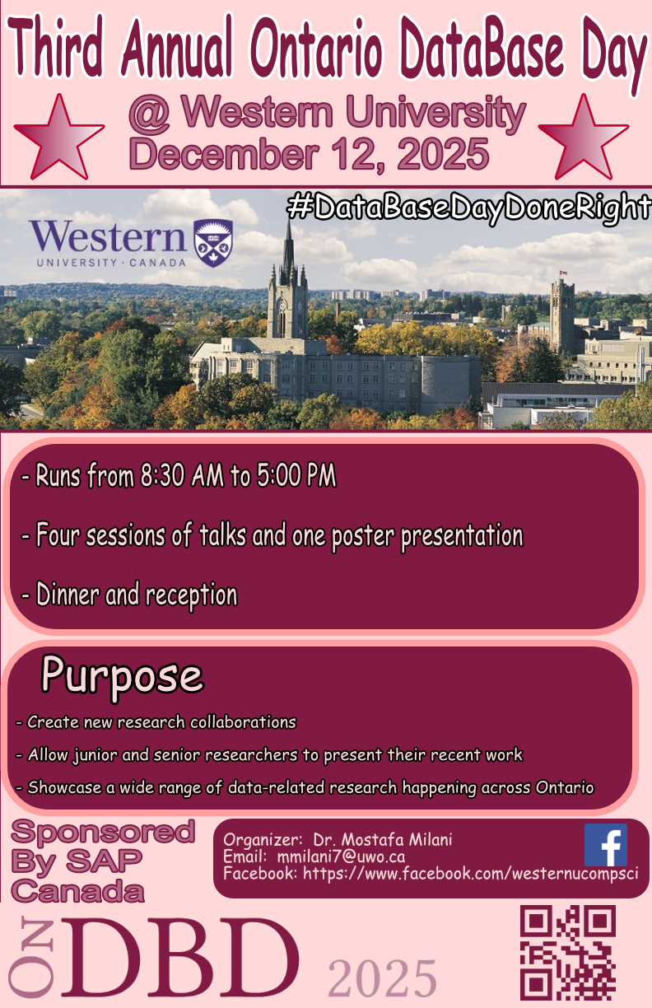
Slide 155 of 160
Notes:
https://cs1033.gaul.csd.uwo.ca/~cpatte52/posterassign/cpatte52_poster.jpg

Slide 157

Slide 156 of 160
Notes:
https://cs1033.gaul.csd.uwo.ca/~cpoptsis/posterassign/cpoptsis_poster.jpg

Slide 158

Slide 157 of 160
Notes:
https://cs1033.gaul.csd.uwo.ca/~csanto44/posterassign/csanto44_poster.jpg

Slide 159

Slide 158 of 160
Notes:
https://cs1033.gaul.csd.uwo.ca/~csedgwic/posterassign/csedgwic_poster.jpg

Slide 160

Slide 159 of 160
Notes:
https://cs1033.gaul.csd.uwo.ca/~cshih33/posterassign/cshih33_poster.jpg

Slide 161

Slide 160 of 160
Notes:
https://cs1033.gaul.csd.uwo.ca/~cspenc67/posterassign/cspenc67_poster.jpg

