Slide 1
POSTER SHOW Group 5

Slide 2

Slide 1 of 160
Notes:
https://cs1033.gaul.csd.uwo.ca/~swan2452/posterassign/swan2452_poster.jpg

Slide 3

Slide 2 of 160
Notes:
https://cs1033.gaul.csd.uwo.ca/~sweingus/posterassign/sweingus_poster.jpg

Slide 4
Slide 3 of 160
Notes:
https://cs1033.gaul.csd.uwo.ca/~swestwal/posterassign/swestwal_poster.jpg

Slide 5

Slide 4 of 160
Notes:
https://cs1033.gaul.csd.uwo.ca/~swilco/posterassign/swilco_poster.jpg

Slide 6

Slide 5 of 160
Notes:
https://cs1033.gaul.csd.uwo.ca/~switty2/posterassign/switty2_poster.jpg

Slide 7

Slide 6 of 160
Notes:
https://cs1033.gaul.csd.uwo.ca/~swoo65/posterassign/swoo65_poster.jpg

Slide 8

Slide 7 of 160
Notes:
https://cs1033.gaul.csd.uwo.ca/~swu832/posterassign/swu832_poster.jpg

Slide 9
Slide 8 of 160
Notes:
https://cs1033.gaul.csd.uwo.ca/~swu842/posterassign/swu842_poster.jpg

Slide 10
Slide 9 of 160
Notes:
https://cs1033.gaul.csd.uwo.ca/~sxu585/posterassign/sxu585_poster.jpg

Slide 11

Slide 10 of 160
Notes:
https://cs1033.gaul.csd.uwo.ca/~syang923/posterassign/syang923_poster.jpg

Slide 12

Slide 11 of 160
Notes:
https://cs1033.gaul.csd.uwo.ca/~syang944/posterassign/syang944_poster.jpg

Slide 13

Slide 12 of 160
Notes:
https://cs1033.gaul.csd.uwo.ca/~szha552/posterassign/szha552_poster.jpg

Slide 14
Slide 13 of 160
Notes:
https://cs1033.gaul.csd.uwo.ca/~szhu366/posterassign/szhu366_poster.jpg

Slide 15
Slide 14 of 160
Notes:
https://cs1033.gaul.csd.uwo.ca/~tballent/posterassign/tballent_poster.jpg

Slide 16

Slide 15 of 160
Notes:
https://cs1033.gaul.csd.uwo.ca/~tbanwait/posterassign/tbanwait_poster.jpg

Slide 17

Slide 16 of 160
Notes:
https://cs1033.gaul.csd.uwo.ca/~tbao27/posterassign/tbao27_poster.jpg

Slide 18
Slide 17 of 160
Notes:
https://cs1033.gaul.csd.uwo.ca/~tbarre24/posterassign/tbarre24_poster.jpg

Slide 19

Slide 18 of 160
Notes:
https://cs1033.gaul.csd.uwo.ca/~tbiderma/posterassign/tbiderma_poster.jpg

Slide 20

Slide 19 of 160
Notes:
https://cs1033.gaul.csd.uwo.ca/~tbussier/posterassign/tbussier_poster.jpg

Slide 21

Slide 20 of 160
Notes:
https://cs1033.gaul.csd.uwo.ca/~tdantas/posterassign/tdantas_poster.jpg

Slide 22

Slide 21 of 160
Notes:
https://cs1033.gaul.csd.uwo.ca/~telmiyeh/posterassign/telmiyeh_poster.jpg

Slide 23

Slide 22 of 160
Notes:
https://cs1033.gaul.csd.uwo.ca/~tfurkhan/posterassign/tfurkhan_poster.jpg

Slide 24

Slide 23 of 160
Notes:
https://cs1033.gaul.csd.uwo.ca/~tgriff24/posterassign/tgriff24_poster.jpg

Slide 25
Slide 24 of 160
Notes:
https://cs1033.gaul.csd.uwo.ca/~tgundlin/posterassign/tgundlin_poster.jpg

Slide 26

Slide 25 of 160
Notes:
https://cs1033.gaul.csd.uwo.ca/~tkaruna8/posterassign/tkaruna8_poster.jpg

Slide 27
Slide 26 of 160
Notes:
https://cs1033.gaul.csd.uwo.ca/~tkediler/posterassign/tkediler_poster.jpg

Slide 28

Slide 27 of 160
Notes:
https://cs1033.gaul.csd.uwo.ca/~tle255/posterassign/tle255_poster.jpg

Slide 29

Slide 28 of 160
Notes:
https://cs1033.gaul.csd.uwo.ca/~tliang64/posterassign/tliang64_poster.jpg

Slide 30

Slide 29 of 160
Notes:
https://cs1033.gaul.csd.uwo.ca/~tliu552/posterassign/tliu552_poster.jpg

Slide 31

Slide 30 of 160
Notes:
https://cs1033.gaul.csd.uwo.ca/~tluo82/posterassign/tluo82_poster.jpg

Slide 32

Slide 31 of 160
Notes:
https://cs1033.gaul.csd.uwo.ca/~tmccoubr/posterassign/tmccoubr_poster.jpg

Slide 33

Slide 32 of 160
Notes:
https://cs1033.gaul.csd.uwo.ca/~tmujahed/posterassign/tmujahed_poster.jpg

Slide 34

Slide 33 of 160
Notes:
https://cs1033.gaul.csd.uwo.ca/~tnorieg/posterassign/tnorieg_poster.jpg

Slide 35
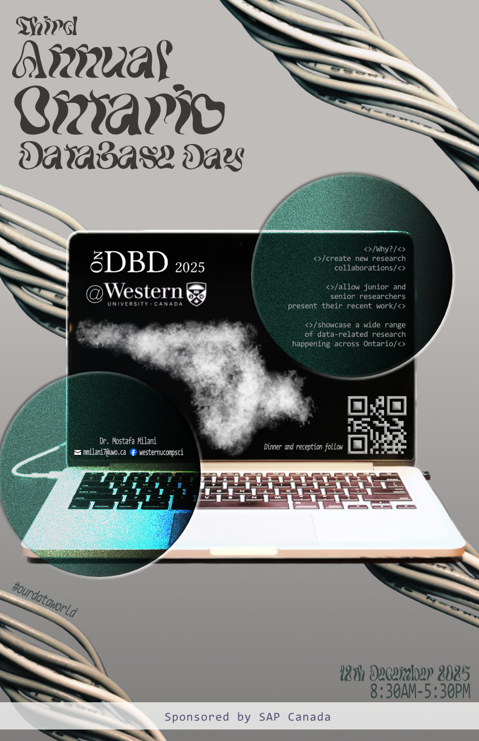
Slide 34 of 160
Notes:
https://cs1033.gaul.csd.uwo.ca/~toni2/posterassign/toni2_poster.jpg

Slide 36

Slide 35 of 160
Notes:
https://cs1033.gaul.csd.uwo.ca/~tpinzari/posterassign/tpinzari_poster.jpg

Slide 37

Slide 36 of 160
Notes:
https://cs1033.gaul.csd.uwo.ca/~tqwasmi/posterassign/tqwasmi_poster.jpg

Slide 38

Slide 37 of 160
Notes:
https://cs1033.gaul.csd.uwo.ca/~tstaple4/posterassign/tstaple4_poster.jpg

Slide 39

Slide 38 of 160
Notes:
https://cs1033.gaul.csd.uwo.ca/~tsu48/posterassign/tsu48_poster.jpg

Slide 40

Slide 39 of 160
Notes:
https://cs1033.gaul.csd.uwo.ca/~tvesey/posterassign/tvesey_poster.jpg

Slide 41

Slide 40 of 160
Notes:
https://cs1033.gaul.csd.uwo.ca/~twang944/posterassign/twang944_poster.jpg

Slide 42

Slide 41 of 160
Notes:
https://cs1033.gaul.csd.uwo.ca/~tweeras/posterassign/tweeras_poster.jpg

Slide 43

Slide 42 of 160
Notes:
https://cs1033.gaul.csd.uwo.ca/~tzhao337/posterassign/tzhao337_poster.jpg

Slide 44

Slide 43 of 160
Notes:
https://cs1033.gaul.csd.uwo.ca/~uschwerd/posterassign/uschwerd_poster.jpg

Slide 45

Slide 44 of 160
Notes:
https://cs1033.gaul.csd.uwo.ca/~vbhardw7/posterassign/vbhardw7_poster.jpg

Slide 46
Slide 45 of 160
Notes:
https://cs1033.gaul.csd.uwo.ca/~vderakh/posterassign/vderakh_poster.jpg

Slide 47
Slide 46 of 160
Notes:
https://cs1033.gaul.csd.uwo.ca/~vdurair/posterassign/vdurair_poster.jpg

Slide 48

Slide 47 of 160
Notes:
https://cs1033.gaul.csd.uwo.ca/~vgupta92/posterassign/vgupta92_poster.jpg

Slide 49

Slide 48 of 160
Notes:
https://cs1033.gaul.csd.uwo.ca/~vho95/posterassign/vho95_poster.jpg

Slide 50

Slide 49 of 160
Notes:
https://cs1033.gaul.csd.uwo.ca/~vkarunar/posterassign/vkarunar_poster.jpg

Slide 51

Slide 50 of 160
Notes:
https://cs1033.gaul.csd.uwo.ca/~vkruzel/posterassign/vkruzel_poster.jpg

Slide 52

Slide 51 of 160
Notes:
https://cs1033.gaul.csd.uwo.ca/~vmachtin/posterassign/vmachtin_poster.jpg

Slide 53

Slide 52 of 160
Notes:
https://cs1033.gaul.csd.uwo.ca/~vshao/posterassign/vshao_poster.jpg

Slide 54
Slide 53 of 160
Notes:
https://cs1033.gaul.csd.uwo.ca/~vtan29/posterassign/vtan29_poster.jpg

Slide 55

Slide 54 of 160
Notes:
https://cs1033.gaul.csd.uwo.ca/~vtran223/posterassign/vtran223_poster.jpg

Slide 56
Slide 55 of 160
Notes:
https://cs1033.gaul.csd.uwo.ca/~vwalia2/posterassign/vwalia2_poster.jpg

Slide 57

Slide 56 of 160
Notes:
https://cs1033.gaul.csd.uwo.ca/~vwalia3/posterassign/vwalia3_poster.jpg

Slide 58

Slide 57 of 160
Notes:
https://cs1033.gaul.csd.uwo.ca/~vwangwu/posterassign/vwangwu_poster.jpg

Slide 59

Slide 58 of 160
Notes:
https://cs1033.gaul.csd.uwo.ca/~wkaafara/posterassign/wkaafara_poster.jpg

Slide 60

Slide 59 of 160
Notes:
https://cs1033.gaul.csd.uwo.ca/~wlin297/posterassign/wlin297_poster.jpg

Slide 61

Slide 60 of 160
Notes:
https://cs1033.gaul.csd.uwo.ca/~wlu287/posterassign/wlu287_poster.jpg

Slide 62

Slide 61 of 160
Notes:
https://cs1033.gaul.csd.uwo.ca/~wmccabe/posterassign/wmccabe_poster.jpg

Slide 63

Slide 62 of 160
Notes:
https://cs1033.gaul.csd.uwo.ca/~wvo/posterassign/wvo_poster.jpg

Slide 64

Slide 63 of 160
Notes:
https://cs1033.gaul.csd.uwo.ca/~xche453/posterassign/xche453_poster.jpg

Slide 65
Slide 64 of 160
Notes:
https://cs1033.gaul.csd.uwo.ca/~xche743/posterassign/xche743_poster.jpg

Slide 66

Slide 65 of 160
Notes:
https://cs1033.gaul.csd.uwo.ca/~xhuan529/posterassign/xhuan529_poster.jpg

Slide 67
Slide 66 of 160
Notes:
https://cs1033.gaul.csd.uwo.ca/~xli3655/posterassign/xli3655_poster.jpg

Slide 68

Slide 67 of 160
Notes:
https://cs1033.gaul.csd.uwo.ca/~xli3693/posterassign/xli3693_poster.jpg

Slide 69

Slide 68 of 160
Notes:
https://cs1033.gaul.csd.uwo.ca/~xlin526/posterassign/xlin526_poster.jpg

Slide 70
Slide 69 of 160
Notes:
https://cs1033.gaul.csd.uwo.ca/~xliu2855/posterassign/xliu2855_poster.jpg

Slide 71

Slide 70 of 160
Notes:
https://cs1033.gaul.csd.uwo.ca/~xwei268/posterassign/xwei268_poster.jpg

Slide 72

Slide 71 of 160
Notes:
https://cs1033.gaul.csd.uwo.ca/~xwei283/posterassign/xwei283_poster.jpg

Slide 73

Slide 72 of 160
Notes:
https://cs1033.gaul.csd.uwo.ca/~xyang862/posterassign/xyang862_poster.jpg

Slide 74

Slide 73 of 160
Notes:
https://cs1033.gaul.csd.uwo.ca/~xzha2489/posterassign/xzha2489_poster.jpg

Slide 75
Slide 74 of 160
Notes:
https://cs1033.gaul.csd.uwo.ca/~xzha2525/posterassign/xzha2525_poster.jpg

Slide 76

Slide 75 of 160
Notes:
https://cs1033.gaul.csd.uwo.ca/~xzhu542/posterassign/xzhu542_poster.jpg

Slide 77

Slide 76 of 160
Notes:
https://cs1033.gaul.csd.uwo.ca/~xzhu547/posterassign/xzhu547_poster.jpg

Slide 78

Slide 77 of 160
Notes:
https://cs1033.gaul.csd.uwo.ca/~ybakir3/posterassign/ybakir3_poster.jpg

Slide 79
Slide 78 of 160
Notes:
https://cs1033.gaul.csd.uwo.ca/~yche4325/posterassign/yche4325_poster.jpg

Slide 80

Slide 79 of 160
Notes:
https://cs1033.gaul.csd.uwo.ca/~yche4334/posterassign/yche4334_poster.jpg

Slide 81

Slide 80 of 160
Notes:
https://cs1033.gaul.csd.uwo.ca/~yche4443/posterassign/yche4443_poster.jpg

Slide 82

Slide 81 of 160
Notes:
https://cs1033.gaul.csd.uwo.ca/~ykim977/posterassign/ykim977_poster.jpg

Slide 83

Slide 82 of 160
Notes:
https://cs1033.gaul.csd.uwo.ca/~ykishant/posterassign/ykishant_poster.jpg

Slide 84
Slide 83 of 160
Notes:
https://cs1033.gaul.csd.uwo.ca/~ylee948/posterassign/ylee948_poster.jpg

Slide 85

Slide 84 of 160
Notes:
https://cs1033.gaul.csd.uwo.ca/~yliu4566/posterassign/yliu4566_poster.jpg

Slide 86

Slide 85 of 160
Notes:
https://cs1033.gaul.csd.uwo.ca/~yliu4873/posterassign/yliu4873_poster.jpg

Slide 87
Slide 86 of 160
Notes:
https://cs1033.gaul.csd.uwo.ca/~yliu5288/posterassign/yliu5288_poster.jpg

Slide 88

Slide 87 of 160
Notes:
https://cs1033.gaul.csd.uwo.ca/~ylu967/posterassign/ylu967_poster.jpg

Slide 89

Slide 88 of 160
Notes:
https://cs1033.gaul.csd.uwo.ca/~yma842/posterassign/yma842_poster.jpg

Slide 90

Slide 89 of 160
Notes:
https://cs1033.gaul.csd.uwo.ca/~ymeng259/posterassign/ymeng259_poster.jpg

Slide 91

Slide 90 of 160
Notes:
https://cs1033.gaul.csd.uwo.ca/~ymichail/posterassign/ymichail_poster.jpg

Slide 92

Slide 91 of 160
Notes:
https://cs1033.gaul.csd.uwo.ca/~yshi692/posterassign/yshi692_poster.jpg

Slide 93
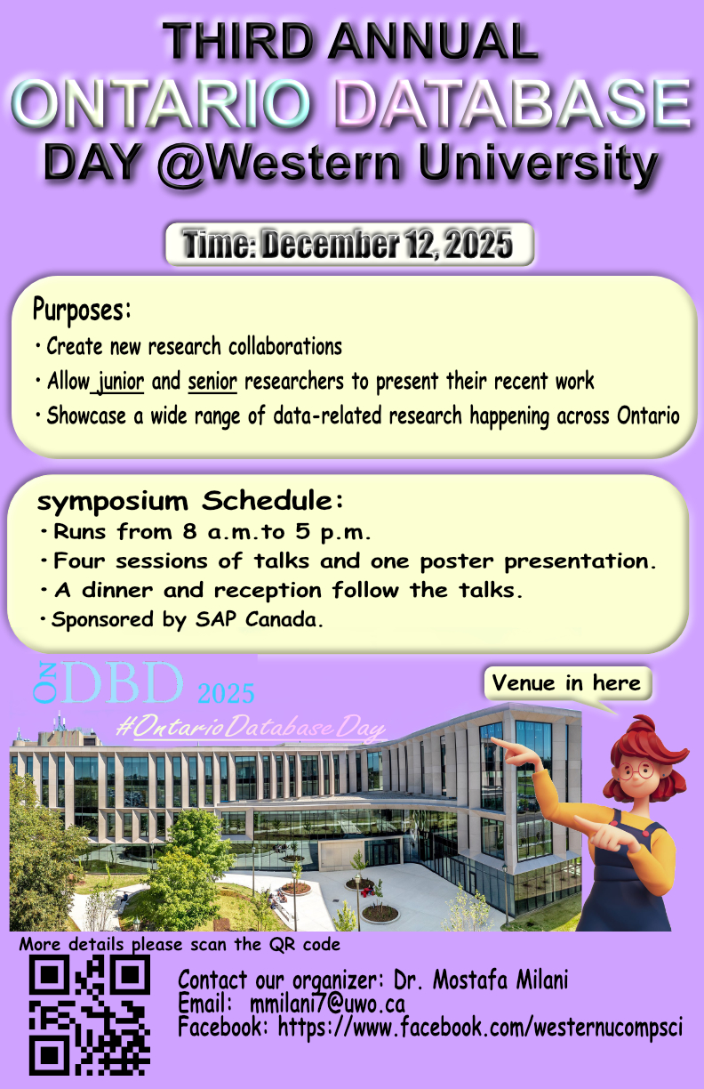
Slide 92 of 160
Notes:
https://cs1033.gaul.csd.uwo.ca/~ysong653/posterassign/ysong653_poster.jpg

Slide 94
Slide 93 of 160
Notes:
https://cs1033.gaul.csd.uwo.ca/~ysun2532/posterassign/ysun2532_poster.jpg

Slide 95

Slide 94 of 160
Notes:
https://cs1033.gaul.csd.uwo.ca/~ysun2534/posterassign/ysun2534_poster.jpg

Slide 96

Slide 95 of 160
Notes:
https://cs1033.gaul.csd.uwo.ca/~ywan6337/posterassign/ywan6337_poster.jpg

Slide 97

Slide 96 of 160
Notes:
https://cs1033.gaul.csd.uwo.ca/~ywan6586/posterassign/ywan6586_poster.jpg

Slide 98
Slide 97 of 160
Notes:
https://cs1033.gaul.csd.uwo.ca/~yyao465/posterassign/yyao465_poster.jpg

Slide 99
Slide 98 of 160
Notes:
https://cs1033.gaul.csd.uwo.ca/~yyou54/posterassign/yyou54_poster.jpg

Slide 100

Slide 99 of 160
Notes:
https://cs1033.gaul.csd.uwo.ca/~yzha6526/posterassign/yzha6526_poster.jpg

Slide 101

Slide 100 of 160
Notes:
https://cs1033.gaul.csd.uwo.ca/~yzhen593/posterassign/yzhen593_poster.jpg

Slide 102

Slide 101 of 160
Notes:
https://cs1033.gaul.csd.uwo.ca/~yzho429/posterassign/yzho429_poster.jpg

Slide 103

Slide 102 of 160
Notes:
https://cs1033.gaul.csd.uwo.ca/~zclark5/posterassign/zclark5_poster.jpg

Slide 104

Slide 103 of 160
Notes:
https://cs1033.gaul.csd.uwo.ca/~zcui94/posterassign/zcui94_poster.jpg

Slide 105

Slide 104 of 160
Notes:
https://cs1033.gaul.csd.uwo.ca/~zhao49/posterassign/zhao49_poster.jpg

Slide 106

Slide 105 of 160
Notes:
https://cs1033.gaul.csd.uwo.ca/~zhaq6/posterassign/zhaq6_poster.jpg

Slide 107
Slide 106 of 160
Notes:
https://cs1033.gaul.csd.uwo.ca/~zhausman/posterassign/zhausman_poster.jpg

Slide 108
Slide 107 of 160
Notes:
https://cs1033.gaul.csd.uwo.ca/~zhe444/posterassign/zhe444_poster.jpg

Slide 109

Slide 108 of 160
Notes:
https://cs1033.gaul.csd.uwo.ca/~zhe446/posterassign/zhe446_poster.jpg

Slide 110

Slide 109 of 160
Notes:
https://cs1033.gaul.csd.uwo.ca/~zhuan673/posterassign/zhuan673_poster.jpg

Slide 111

Slide 110 of 160
Notes:
https://cs1033.gaul.csd.uwo.ca/~zkhan338/posterassign/zkhan338_poster.jpg

Slide 112

Slide 111 of 160
Notes:
https://cs1033.gaul.csd.uwo.ca/~zli3573/posterassign/zli3573_poster.jpg

Slide 113

Slide 112 of 160
Notes:
https://cs1033.gaul.csd.uwo.ca/~zliu2864/posterassign/zliu2864_poster.jpg

Slide 114

Slide 113 of 160
Notes:
https://cs1033.gaul.csd.uwo.ca/~zloader/posterassign/zloader_poster.jpg

Slide 115

Slide 114 of 160
Notes:
https://cs1033.gaul.csd.uwo.ca/~znikolov/posterassign/znikolov_poster.jpg

Slide 116
Slide 115 of 160
Notes:
https://cs1033.gaul.csd.uwo.ca/~zniu43/posterassign/zniu43_poster.jpg

Slide 117

Slide 116 of 160
Notes:
https://cs1033.gaul.csd.uwo.ca/~zshen289/posterassign/zshen289_poster.jpg

Slide 118

Slide 117 of 160
Notes:
https://cs1033.gaul.csd.uwo.ca/~zsun444/posterassign/zsun444_poster.jpg

Slide 119

Slide 118 of 160
Notes:
https://cs1033.gaul.csd.uwo.ca/~zsun467/posterassign/zsun467_poster.jpg

Slide 120
Slide 119 of 160
Notes:
https://cs1033.gaul.csd.uwo.ca/~zsweitze/posterassign/zsweitze_poster.jpg

Slide 121

Slide 120 of 160
Notes:
https://cs1033.gaul.csd.uwo.ca/~ztheria/posterassign/ztheria_poster.jpg

Slide 122

Slide 121 of 160
Notes:
https://cs1033.gaul.csd.uwo.ca/~ztian252/posterassign/ztian252_poster.jpg

Slide 123

Slide 122 of 160
Notes:
https://cs1033.gaul.csd.uwo.ca/~zwan3445/posterassign/zwan3445_poster.jpg

Slide 124

Slide 123 of 160
Notes:
https://cs1033.gaul.csd.uwo.ca/~zwan3449/posterassign/zwan3449_poster.jpg

Slide 125

Slide 124 of 160
Notes:
https://cs1033.gaul.csd.uwo.ca/~zwu648/posterassign/zwu648_poster.jpg

Slide 126
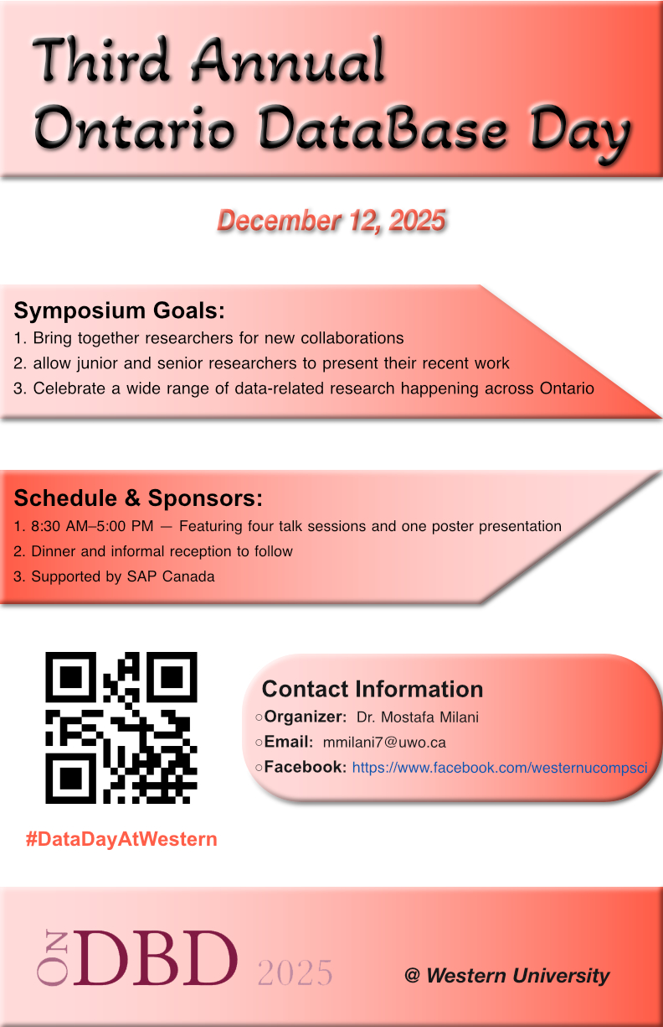
Slide 125 of 160
Notes:
https://cs1033.gaul.csd.uwo.ca/~zxue67/posterassign/zxue67_poster.jpg

Slide 127
Slide 126 of 160
Notes:
https://cs1033.gaul.csd.uwo.ca/~zyu542/posterassign/zyu542_poster.jpg

Slide 128

Slide 127 of 160
Notes:
https://cs1033.gaul.csd.uwo.ca/~zzha2365/posterassign/zzha2365_poster.jpg

Slide 129

Slide 128 of 160
Notes:
https://cs1033.gaul.csd.uwo.ca/~zzha825/posterassign/zzha825_poster.jpg

Slide 130
Slide 129 of 160
Notes:
https://cs1033.gaul.csd.uwo.ca/~zzhu534/posterassign/zzhu534_poster.jpg

