Slide 1
Top 10 Posters as Selected by TypeDiabeatIt
CS1033b – Spring 2023

Slide 2
22/111
Notes:
smehrabn_poster.jpg

Slide 3
27/111
Notes:
rluo57_poster.jpg

Slide 4
36/111
Notes:
mmoren3_poster.jpg

Slide 5
39/111
Notes:
lpuley_poster.jpg

Slide 6
53/112
Notes:
ltaha4_poster.jpg

Slide 7
15/73
Notes:
vzhao7_poster.jpg

Slide 8
30/73
Notes:
mzhan733_poster.jpg

Slide 9
Third Place – Alexa D.
113/113
Notes:
adecassa_poster.jpg THIRD

Slide 10
Second Place – Lukas B.
50/110
Notes:
lbozinov_poster.jpg SECOND PLAC

Slide 11
First Place – Arman D.
114/113
Notes:
adanesh3_poster.jpg FIRST

Slide 12
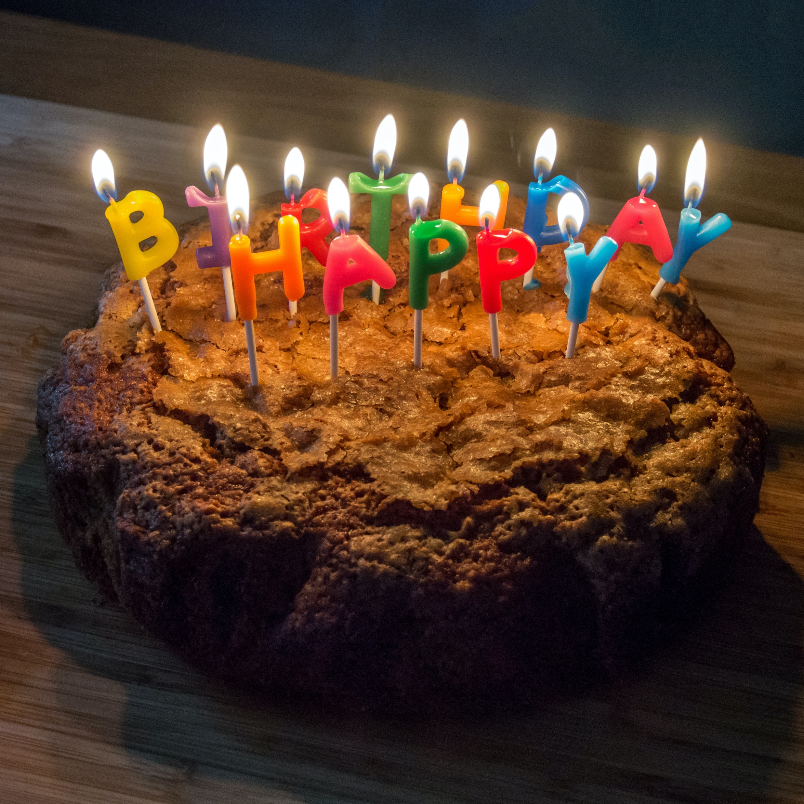
Happy Birthday Bryan!

