Slide 1
Top 10 Pics From
The CFUW Milton and District Organization

Slide 2
Hyunchong C.
Laura’s Section
Slide 127 of 160
Notes:
https://cs1033.gaul.csd.uwo.ca/~hcho249/posterassign/hcho249_poster.jpg

Slide 3
Avery W.
Laura’s Section
Notes:
https://cs1033.gaul.csd.uwo.ca/~aweinb2/posterassign/aweinb2_poster.jpg

Slide 4
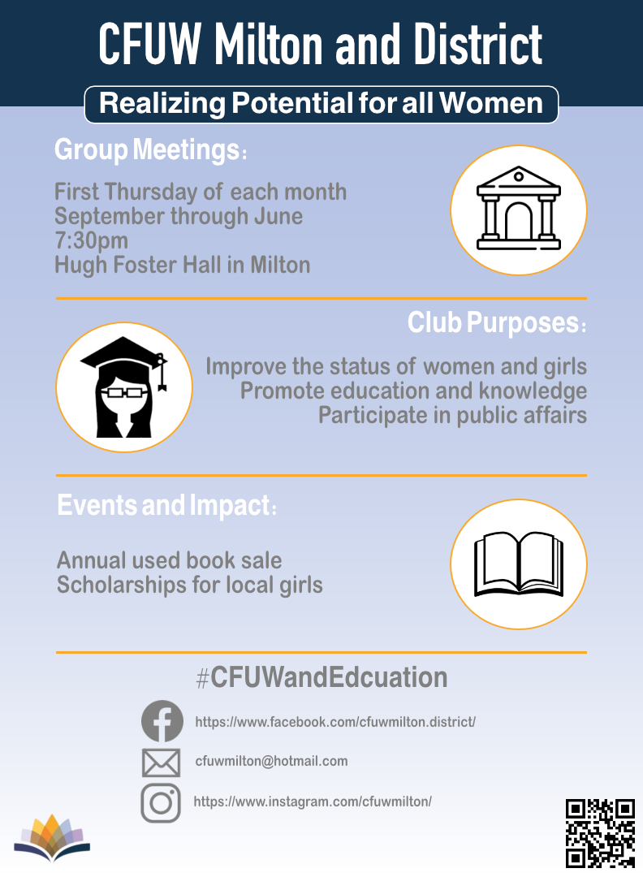
Ryan L.
Laura’s Section
Slide 139 of 160
Notes:
https://cs1033.gaul.csd.uwo.ca/~rlapedus/posterassign/rlapedus_poster.jpg

Slide 5
William G.
Laura’s Section
Slide 96 of 160
Notes:
https://cs1033.gaul.csd.uwo.ca/~wgao226/posterassign/wgao226_poster.jpg

Slide 6
Briana Z.
Laura’s Section
Slide 116 of 160
Notes:
https://cs1033.gaul.csd.uwo.ca/~bzhong22/posterassign/bzhong22_poster.jpg

Slide 7
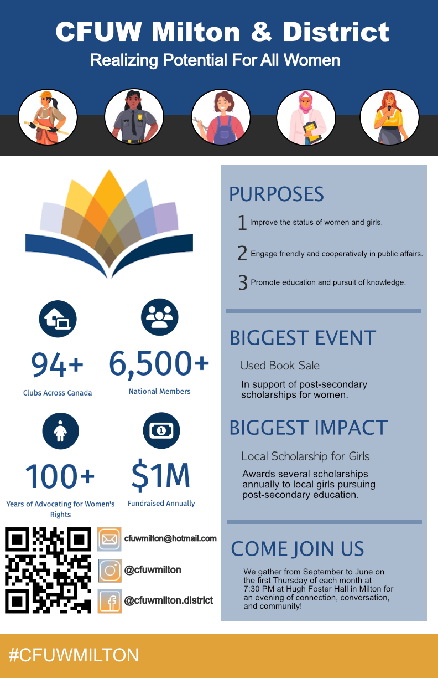
Brooke S.
Bryan’s Section
Slide 124 of 160
Notes:
https://cs1033.gaul.csd.uwo.ca/~bsonnen2/posterassign/bsonnen2_poster.jpg

Slide 8
Berenika M.
Laura’s Section
Slide 110 of 160
Notes:
https://cs1033.gaul.csd.uwo.ca/~bmatouse/posterassign/bmatouse_poster.jpg

Slide 9
Jacob F.
Bryan’s Section
Third Place
Slide 143 of 160
Notes:
https://cs1033.gaul.csd.uwo.ca/~jfenster/posterassign/jfenster_poster.jpg

Slide 10
Saibya K.
Laura’s Section
Second Place
Slide 146 of 160
Notes:
https://cs1033.gaul.csd.uwo.ca/~skatagi/posterassign/skatagi_poster.jpg

Slide 11
Adrian D.
Laura’s Section
First Place
Slide 13 of 160
Notes:
https://cs1033.gaul.csd.uwo.ca/~adaigle7/posterassign/adaigle7_poster.jpg

