Slide 1

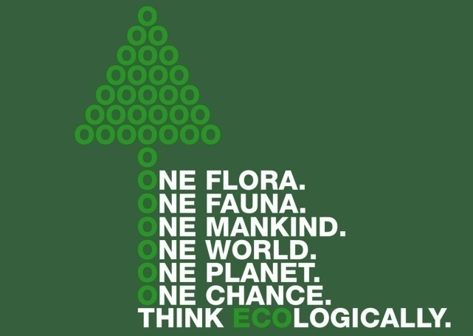
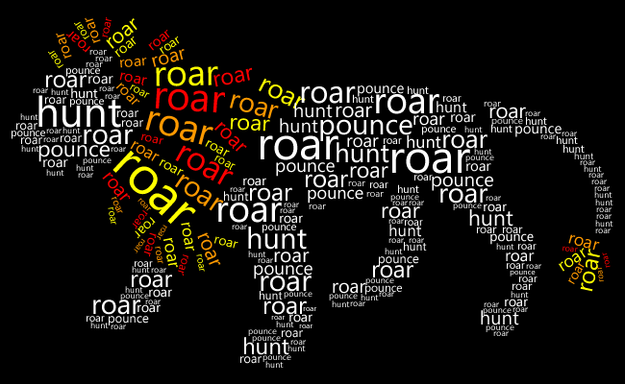
-What is Multimedia
-Multimedia History
-Design Tips
-FONT/TEXT Tips
Computer Science 1033 – Week 1
Fonts
“If the Force of Yoda's is so strong, construct a sentence with words in the proper order then why can't he? → Unix Fortune
Notes:
Lynda.com the single space practice Graphi Design Tips and Tricks Weekly.

Slide 2
Overview of Today’s Topics
A bit of a mishmash ☺
Overview of multimedia in general
A bit of the history of multimedia
A little bit about monitors and display
Design tips
Usage of text on a website

Slide 3
Textbook Readings
Introduction
  All of it (it’s not very long!)
Graphics
  What are Graphics?
  Basics of Graphics
  Design Principles and Considerations

Slide 4
Big Ideas for Today
Big Idea 1: First Impressions Matter!
  Using senses to communicate
  How do we spread ideas
  Why use the Internet?
Big Idea 2: What makes one design look better than another?
  CRAP
Big Idea 3: Monitors and Needlepoint!
Big Idea 4: Fonts
  Are you a font savant?

Slide 5
What is Multimedia? (term coined around 1962)
Some definitions:
  Wikipedia → “Multimedia is media and content that uses a combination of different content forms.”
  Merriam Webster → Their definition is actually a multimedia definition ☺ http://www.merriam-webster.com/dictionary/multimedia
  Cambridge Dictionary → “using a combination of moving and still pictures, sound, music and words, especially in computers or entertainment”

Slide 6
All the definitions encompass different ways (more than one) of expressing something.
How do we express ourselves?

Slide 7

Exercise
Find one or two other people in the room and take 2 minutes to introduce yourself
Find out:
  Their favourite movie(s)
  Where they went to high school
  Farthest country from London, Ontario that one of their grandparents is from
  What one thing do they hope to learn in this class

Slide 8
Making an Impression
How long do you think you have before someone makes a judgement about you?
  In her book The Four-Minute Sell, Janet Elsea says you have just 7 to 15 seconds to make a good first impression.
  You have about four minutes total for someone to decide if he or she wants to go beyond that first four minutes (therein lies the four-minute sell).

Slide 9
Now consider after you first arrive at a website…
How long does it take you to decide if you want to stay or if you want to leave this site?
QUESTION: What makes you want to leave a website rather than investing more time in it?
  http://vandelaydesign.com/blog/design-process/why-visitors-leave/

Slide 10
How can we communicate?
Via the five senses:
  Sight
  Smell
  Sound
  Touch
  Taste
QUESTION: Which ones can we utilize for communication on the web?
Multimedia application → an application that can be used to present text, sound, video, images and animation (technical definition)... http://www.simworx.co.uk/dimensions-4d5d-effects-theatres/

Slide 11
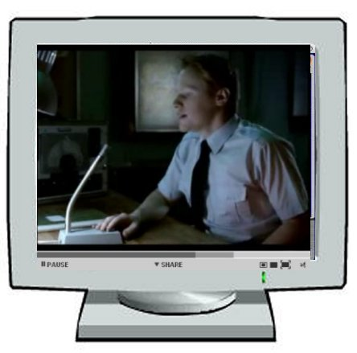
Multimedia Uses
To Inform:
  http://www.cbc.ca/radio/
To Educate:
  How to parallel park
To Sell and Run Businesses:
  http://www.chapters.ca
  http://www.monster.ca
  http://www.eharmony.ca
To Entertain:

Slide 12
Why communicate via the web?
QUESTION: What are the ways we can communicate or “spread a message” to other people? Can you name some ways? How did/does propaganda work? What did people used to do to spread a message?
  Other people
  Telephone
  Radio
  TV
  Newspaper/Magazines
  World Wide Web (Question: What are some of the benefits of the World Wide Web over the other methods mentioned above?)
    Tweeting (think Egypt or Hong Kong!)
The World Wide Web is:
  Fast
  Cheap (sometimes free!)
  Usually Current
  Accessible by millions

Slide 13
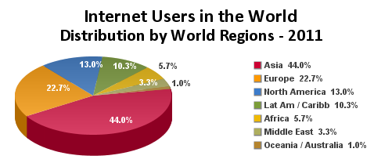
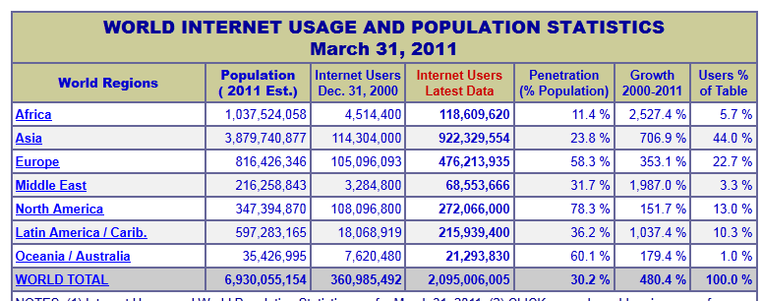
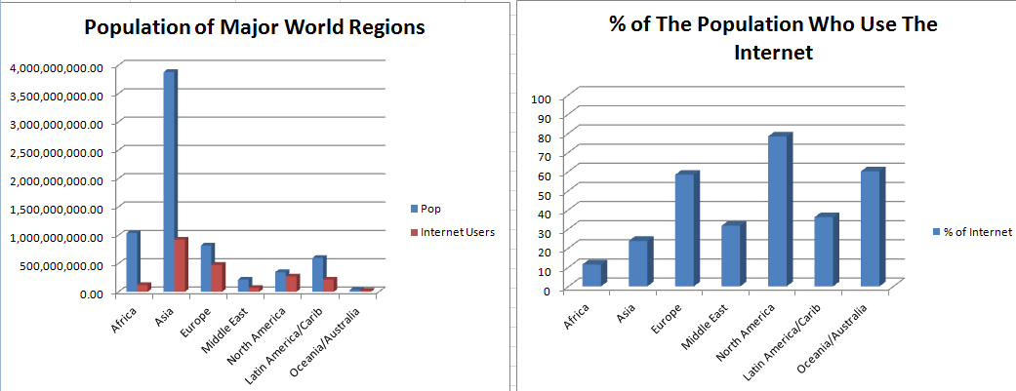
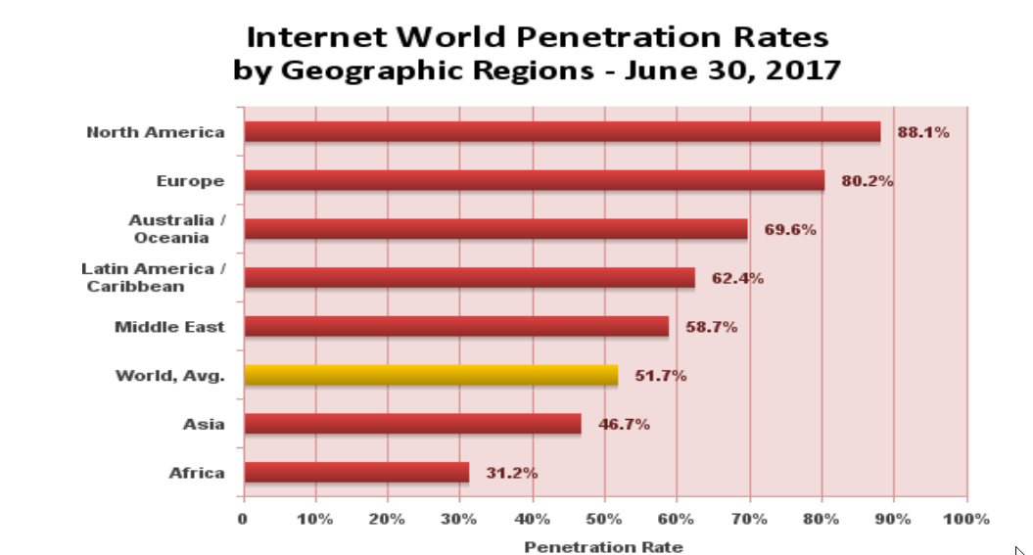
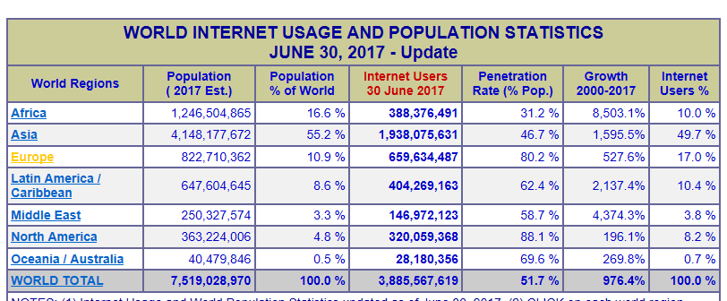
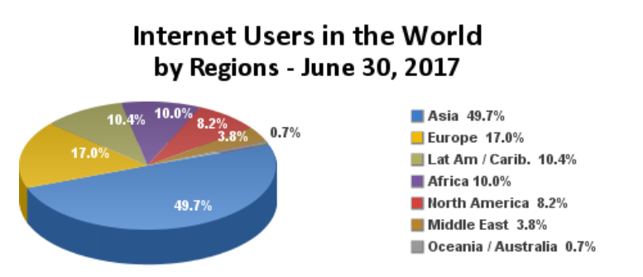
The World Wide Web is the: Voice of Power!
Which area do you think has the most people?
  Africa,
  Asia
  Europe,
  Latin American/Caribbean
  Middle East,
  North America
  Oceania/Australia
Which area do you think has the most Internet users?
Which area is the smallest, has the least users?
Info from: http://www.internetworldstats.com/stats.htm

Slide 14
The Future→ Are you ready?
https://www.youtube.com/watch?v=Y9FOyoS3Fag
QUESTION: What is the difference between the World Wide Web and the Internet?

Slide 15
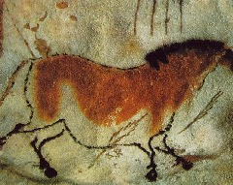
Great Moments in Multimedia History Before the 1800s
Also…
1041AD → Bi Sheng invents movable type in China using clay letters.
1450 → Johann Gutenburg introduces movable type (with steel letters), to Europe allowing mass production of books.
1702 → England’s first daily newspaper starts publishing
15,000 -13,000 BC → Prehistoric humans paint images on the walls of their caves Grotte de Lascaux, France

Slide 16
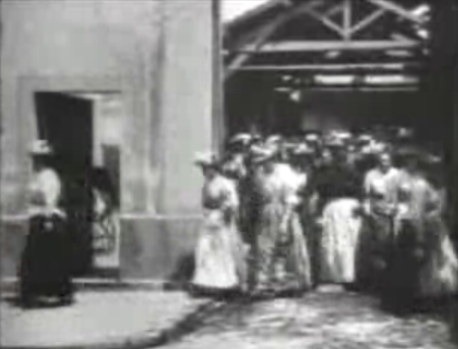
Great Moments in Multimedia History between 1800 and 1900
Also…
1814 →Joseph Nicéphore Niépce achieves the first photographic image.
1837 → Louis Daguerre invents the first practical form of photographic reproduction.
1858 → Europe and North America are linked via a transatlantic telegraph cable. By 1866, news that had once taken months to travel, now took seconds
1877 → Thomas Edison invents the phonograph
1877 → Eadweard Muybridge invents high speed photography - creating first moving pictures that captured motion.
1895 → Louis and Auguste Lumiere make La Sortie ouviers de l’usine Lumiere, considered the first motion picture

Slide 17

Great Moments in Multimedia History between 1900 and 1940
Also…
1914 →Animation created by tracing live action films (rotoscoping)
1926 → First practical television system demonstrated
1927 → The Jazz Singer is the first film to feature spoken dialogue in sync with the movie.
1928 → Walt Disney debuts Steamboat Willie, first cartoon to use synchronized sound.
1939 → The Wizard of Oz memorably shows the difference between the colour and black and white cinematography.
1940 → Dorothy Kunhardt’s Pat The Bunny is published. First book to have multimedia and interactivity: We pat the soft fur of the bunny, play peek-a-boo, look in the mirror, and then do it all over again.

Slide 18
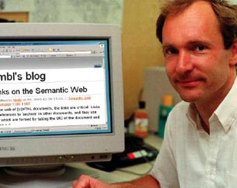
Great Moments in Multimedia History between 1940 and 1993
Also…
1962 →Telstar, first communications satellite is launched into orbit.
1969 → ARPANET (eventually the Internet) is established by the U.S. Department of Defence (more on this later)
1971 → First email sent, @ picked as symbol to indicate address
1983 → Internet is created when TCP/IP is adopted by all ARPANET users
1991 → Tim Berners Lee has finished developing the World Wide Web(http) and html and URL. World Wide Web makes its debut
1993 → Mosaic, first graphical web browser is released
1991 → Tim Berners Lee invents the World Wide Web.

Slide 19
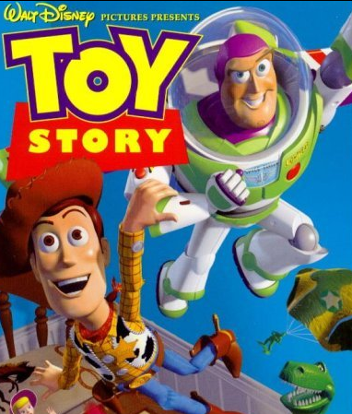
Great Moments in Multimedia History between 1994 and 2001
Also…
1994→The Rolling Stones become first major band to broadcast live over the internet.
1996→ Affordable digital cameras become widely available
1999 → Napster debuts
2001 → Apple introduces iTunes and the iPod
2005 → youTube.com launches
2006 → First twitter message sent
2007 → Search engine giant Google surpasses Microsoft as "the most valuable global brand," and also is the most visited Web site
1995 → Disney releases Toy Story, first feature length computer generated movie.: 77 minutes, 4 years to make, 800,000 machine hours to render.
Information and dates from:
http://www.webopedia.com/quick_ref/timeline.asp
http://writing.atomicmartinis.com/moments.htm

Slide 20
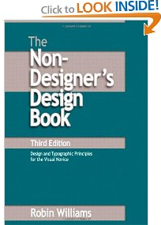
Good Design Principles
https://cheezburger.com/635909/funny-memes-images-that-prove-design-isnt-for-everybody
What can we do to make our websites (or any marketing material) look a bit more professional?
Remember design is all about CRAP!
Most of this information and some of the examples are taken from an
EXCELLENT book called: E
  The Non-Designer’s Design Book
  by Robin Williams

Slide 21
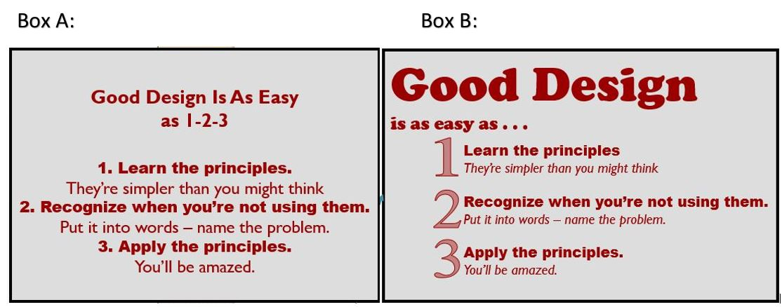
Box A Box B
Good Design Is As Easy
as 1-2-3
1. Learn the principles.
They’re simpler than you might think
2. Recognize when you’re not using them.
Put it into words – name the problem.
3. Apply the principles.
You’ll be amazed.
Good Design
is as easy as …
    Learn the principles.
    They’re simpler than you might think
    Recognize when you’re not using them.
    Put it into words – name the problem.
    Apply the principles.
    You’ll be amazed.
1
2
3
Both boxes above say the same thing.
QUESTION: Which design do you like better: A or B?
QUESTION: Can you put your finger on what makes one “Better” than the other.

Slide 22
When designing a webpage think about CRAP!
Element
Overview
Contrast
Repetition
Alignment
Proximity
Avoid making 2 elements just similar, either make them the same (same font, colour, etc…) or make them VERY different.
Repeat some aspect of the design throughout the entire design i.e. Bold font, thick rule, bullet, colors, font types
Items are aligned - creates stronger cohesive unit
Group related items together

Slide 23
Contrast
Cool Quotes
See everything, overlook a great deal, improve a little.
Between two evil, choose neither; between two good, choose both.
Give with no strings attached, and you will receive in the same manner
Cool Quotes
See everything, overlook a great deal, improve a little.
Between two evil, choose neither; between two good, choose both.
Give with no strings attached, and you will receive in the same manner

Slide 24
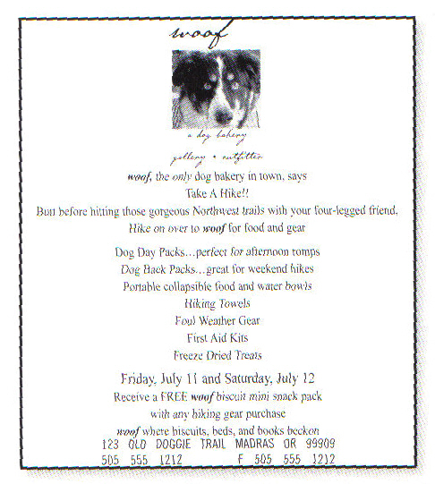
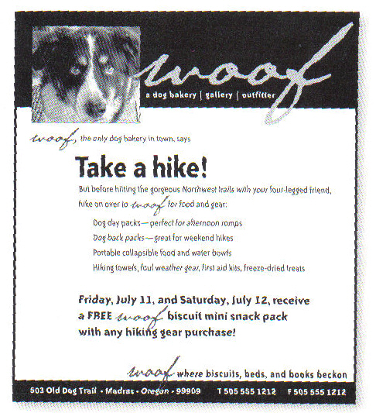
Contrast: Another Example
General Rule: Don’t be wimpy, go bold or go home!
Examples from: “The Non-Designer’s Design Book by Robin Williams

Slide 25

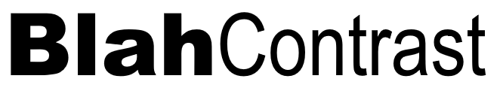
This:
Is better than this:

Slide 26
Repetition
Brad Pitt
Movies
  Thelma and Louise
  Legends of the Fall
  Oceans Eleven
Relationships
  Gwyneth Paltrow
  Jennifer Aniston
  Angelina Jolie
Childhood
  Birthday: December 18, 1963
  Born: Shawnee, Oklahoma
References available upon request
Repetition of
  Bullet type
  Spacing
  Light text
  Heavy text
  Alignment
  Indentation

Slide 27
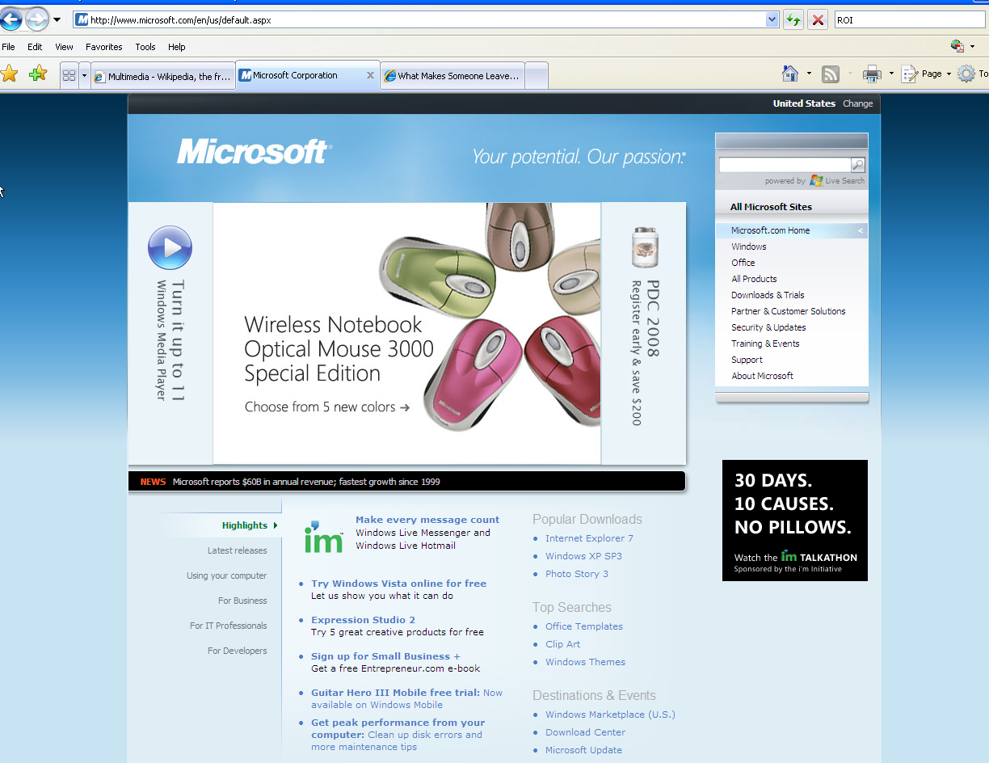
Repetition: Another Example
QUESTION: What repeated elements can you find in this webpage?

Slide 28
Alignment
Fun Things for a Professor to do the First Day of Classes:
Ask students to call you "Tinkerbelle" or "Surfin' Bird".
Growl constantly and address students as "matey".
Show a video on medieval torture implements to your calculus class. Giggle throughout it.
Sneeze on students in the front row and wipe your nose on your tie.
by Alan Meiss
Fun Things for a Professor to do the First Day of Classes:
Ask students to call you "Tinkerbelle" or "Surfin' Bird".
Growl constantly and address students as "matey".
Show a video on medieval torture implements to your calculus class. Giggle throughout it.
Sneeze on students in the front row and wipe your nose on your tie.
by Alan Meiss
This is okay 😐
But this looks better! ☺

Slide 29
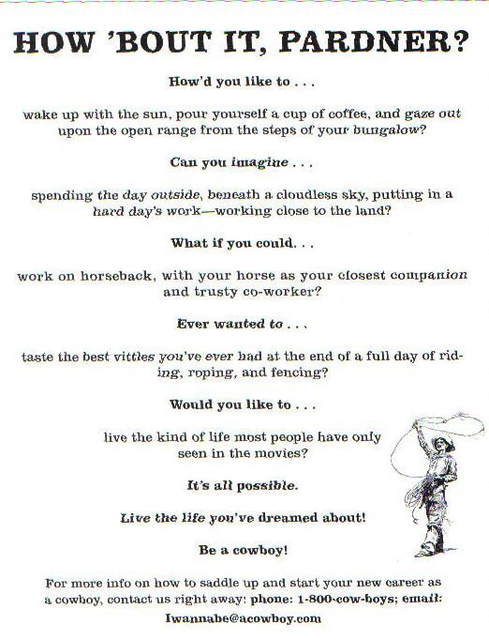
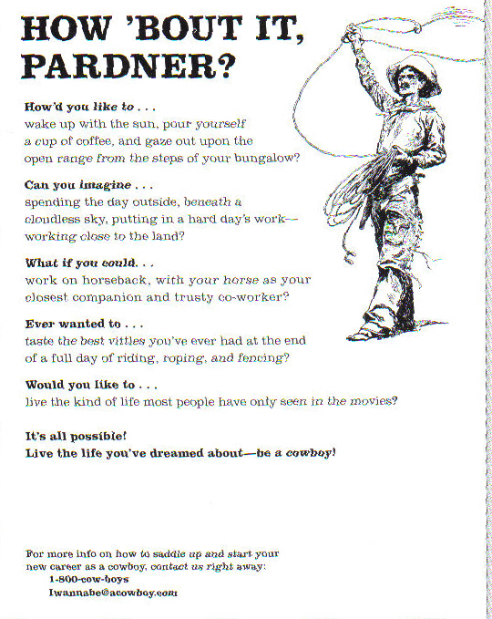
Alignment: Another Example
Examples from: “The Non-Designer’s Design Book by Robin Williams

Slide 30
Proximity
The Menu
Eggs Benedict
Pecan Crusted Trout
Steak and Kidney Pie
Apple Crisp
Cheese Fondue
Macaroni and Cheese
Strawberry Cheesecake
Lemon Mousse
Caesar Salad
Roast Chicken
The Menu
Eggs Benedict
Pecan Crusted Trout
Steak and Kidney Pie
Apple Crisp
Cheese Fondue
Macaroni and Cheese
Strawberry Cheesecake
Lemon Mousse
Caesar Salad
Roast Chicken
QUESTION: What do you think when you look at the second box compared to the first box?
Remember→ Physically grouping things together implies a relationship

Slide 31
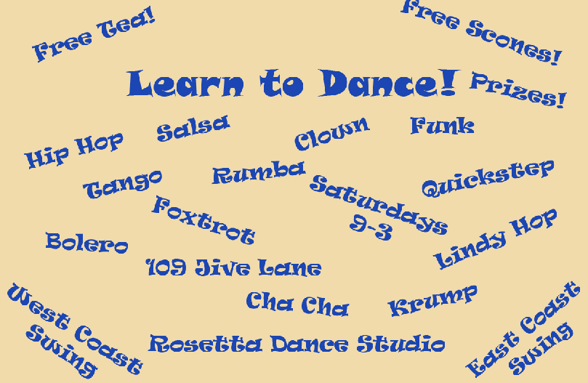
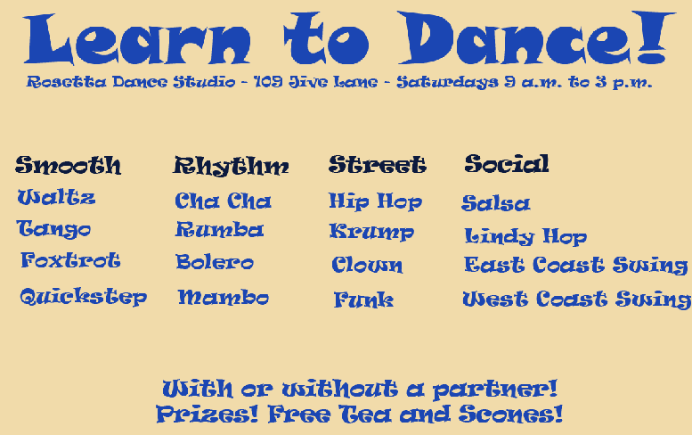
Proximity: Another Example
Examples from: “The Non-Designer’s Design Book by Robin Williams

Slide 32
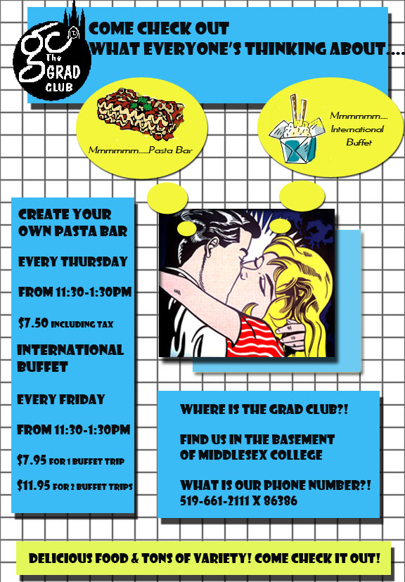
Poster Finalist From 2007
QUESTION: Can you see examples of the four principles that worked well in this poster and what didn’t work well?
Notes:
Kahoot → lreid2@uwo.ca

Slide 33


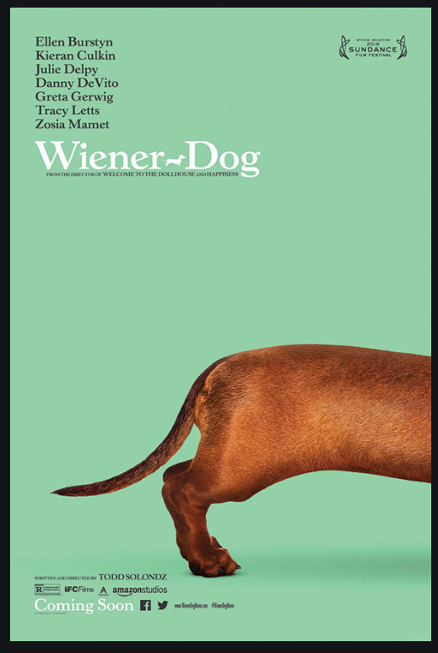

Which poster design do you think achieves the most CRAP principles?
A | B
C | D

Slide 34
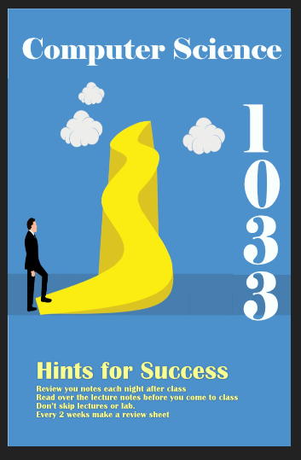
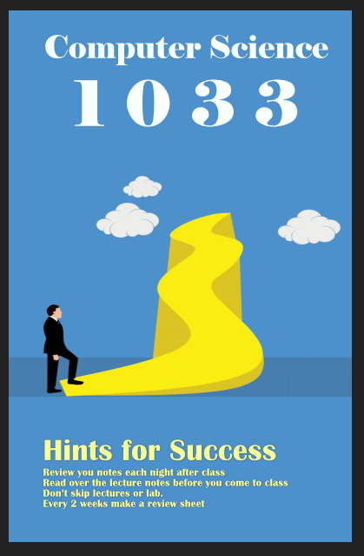
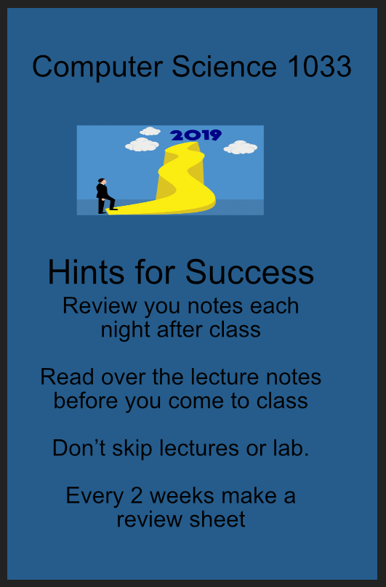
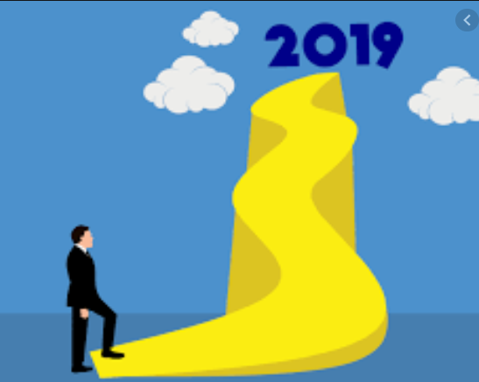
Take a few minutes to think about how you would put these pieces onto a poster.
Hints for Success
Review you notes each night after class
Read over the lecture notes before you come to class
Don’t skip lectures or lab.
Every 2 weeks make a review sheet
Computer Science 1033

Slide 35
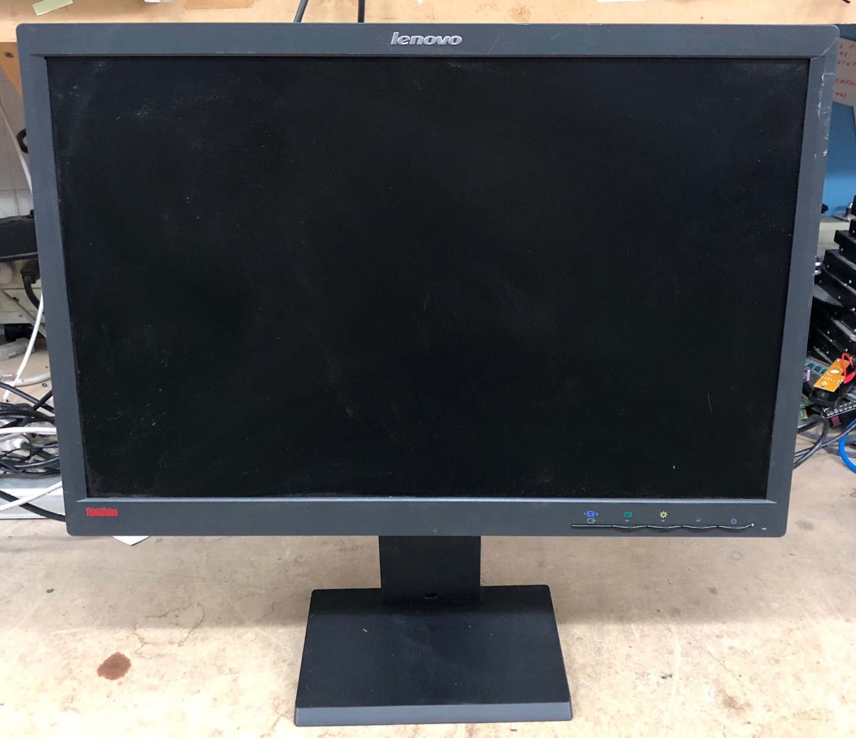
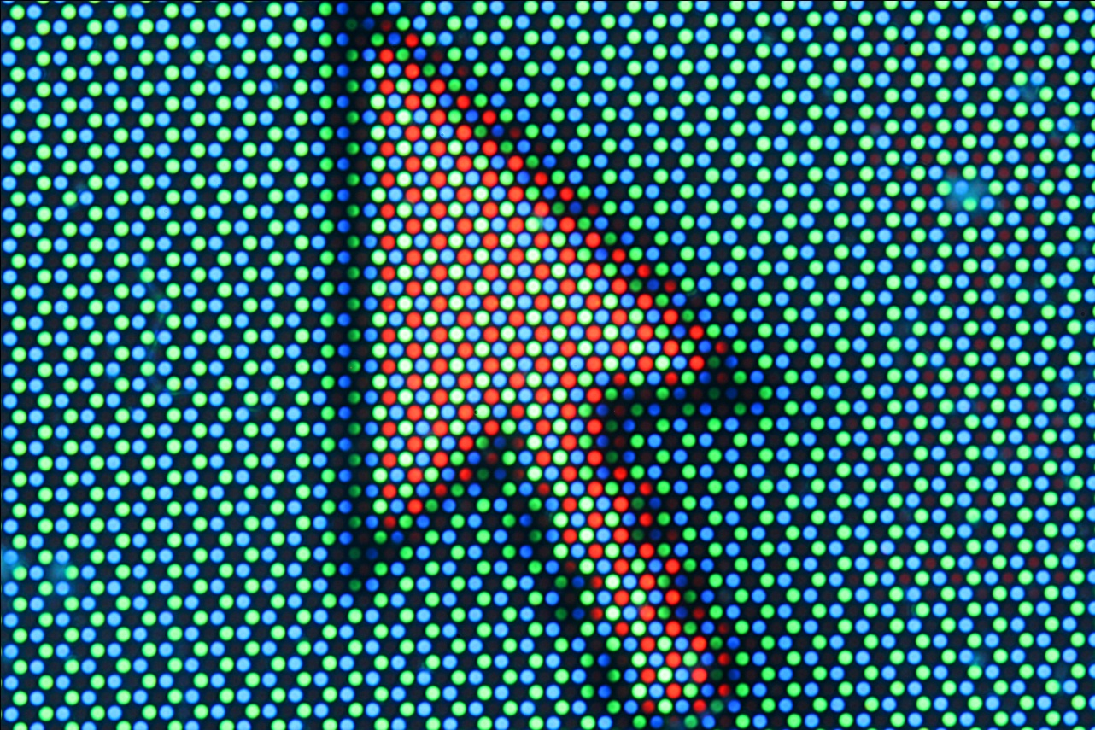
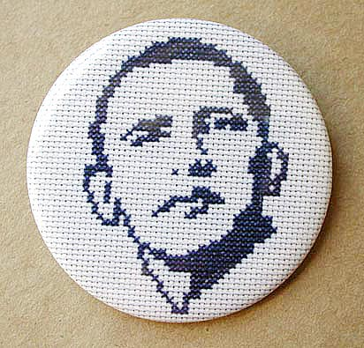

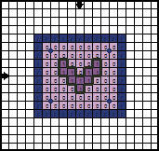
Before we begin, let’s see how a monitor displays things visually!
A monitor is just a rectangular area (the screen) broken down into very small pieces or dots where each piece/dot can take on a particular colour.
Very similar to graph paper or cross-stitching, Obama and Owl are cross-stitched.

Slide 36
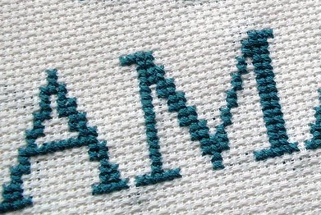
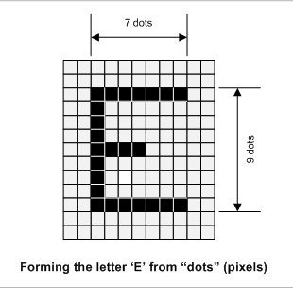
More on monitors
Question: What are the dots/pieces on a monitor/screen called?
We can use pixels (dots, thread) to represent ANYTHING (images, text, drawing) that we want to display visually on the screen (paper, fabric).
This “E” has a size of 9 (9 pixels)

Slide 37
More on monitors
QUESTION: On a 17 inch monitor, we could have 800 pixels (width) by 600 pixels (height) OR 1024 pixels by 768 pixels. Think about the size of the dots/pixels for a minute in BOTH cases.
  What is the terminology for the number of pixels across by the number of pixels down?
  Which resolution will have the bigger pixels?
  If we displayed this “E”, on which screen
  would it look bigger: the 800by600 resolution or the 1024by768 resolution?
800 pixels
1024 pixels
17 inches
600 pixels
768 pixels
Notes:
Resolution
800 by 600
800 by 600

Slide 38
More on monitors (and printers)
A pixel is displayed using light on a monitor to create images or text.
When printing text or images, we use ink to create the pixel but in printing, the pixels are called dots.
Dots (in printing), are just like pixels in that:
  They can take on different colours
  They can be big, creating big images, or small, creating smaller images.

Slide 39
More on monitors and printers
QUESTION: Which one will have bigger dots → 72dpi or 300dpi (where dpi means dots per inch)? Think about 2 dpi vs. 4 dpi.
|--- 1 inch ---|
|--- 1 inch ---|
Notes:
72dpi
Quality isnt as good

Slide 40
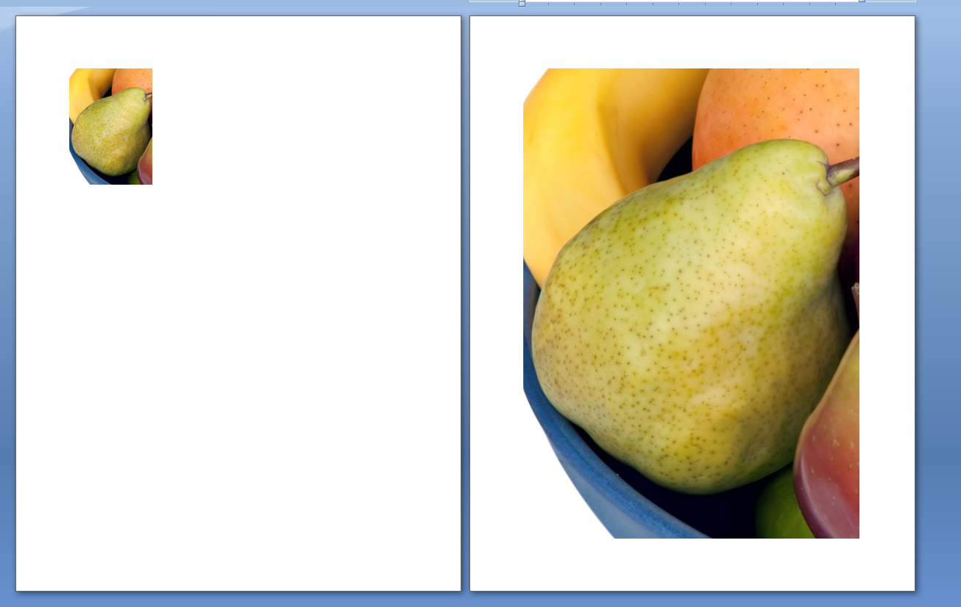
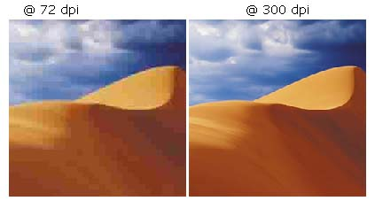
300 PPI 72PPI
QUESTION: Can any one guess the problem with bigger dots/pixels?

Slide 41
Let’s see how to represent text
Now that we have a basic understanding of ANYTHING is drawn on a monitor or on a piece of paper by a printer (just broken down into dots) ….

Slide 42
The Use of Text on a Website
What do you need to know? Remember:
  Text can be used to serve two purposes:
    It conveys information
    It can be used as a graphical element of the page (i.e. it doesn’t have to be ugly or boring! ☺)
You may have a cool font on your machine, but the person viewing your website might not have that font! Here are some “Websafe Fonts”
QUESTION: What can you do if you really want to use an unusual font on your website? Choice 1 or Choice 2

Slide 43
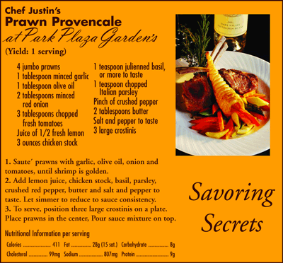
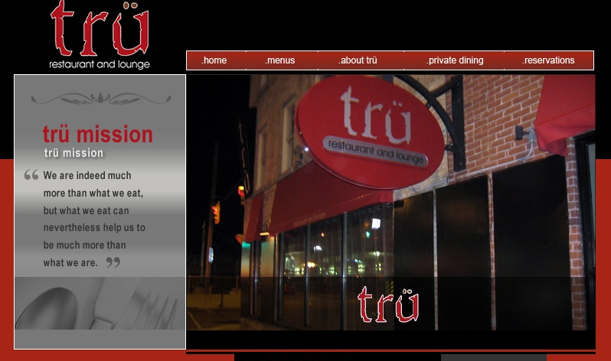
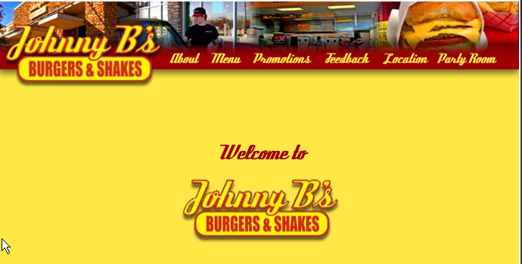
Text can set a mood
QUESTION: What type of restaurants are these?

Slide 44
Make your style of text choices based on:
Your audience:
  QUESTION: What do you need to think about for each of the following groups?
    Children (what age group?)
    Teens
    Young Adults
    Older People
The type of application:
  Educational?
  Entertainment?
  Business?

Slide 45
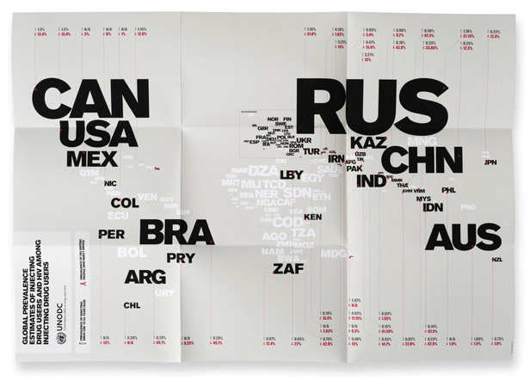
Text can set a mood
United Nations Poster showing the power of text!
You can completely change the look of your page by varying the:
  Text Attributes
  Text Placement
Here is some text with different attributes
Here is some text with different:
Placement
Layout
Design
The End

Slide 46
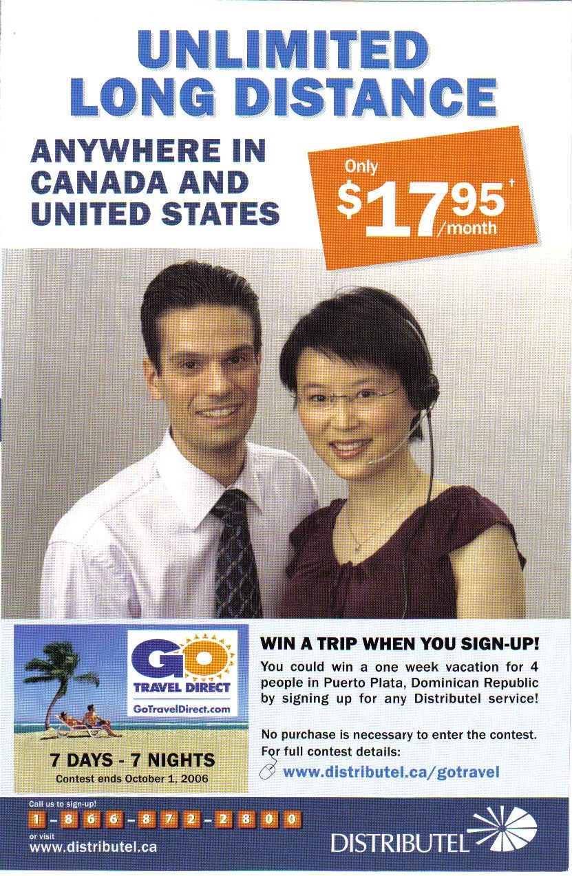
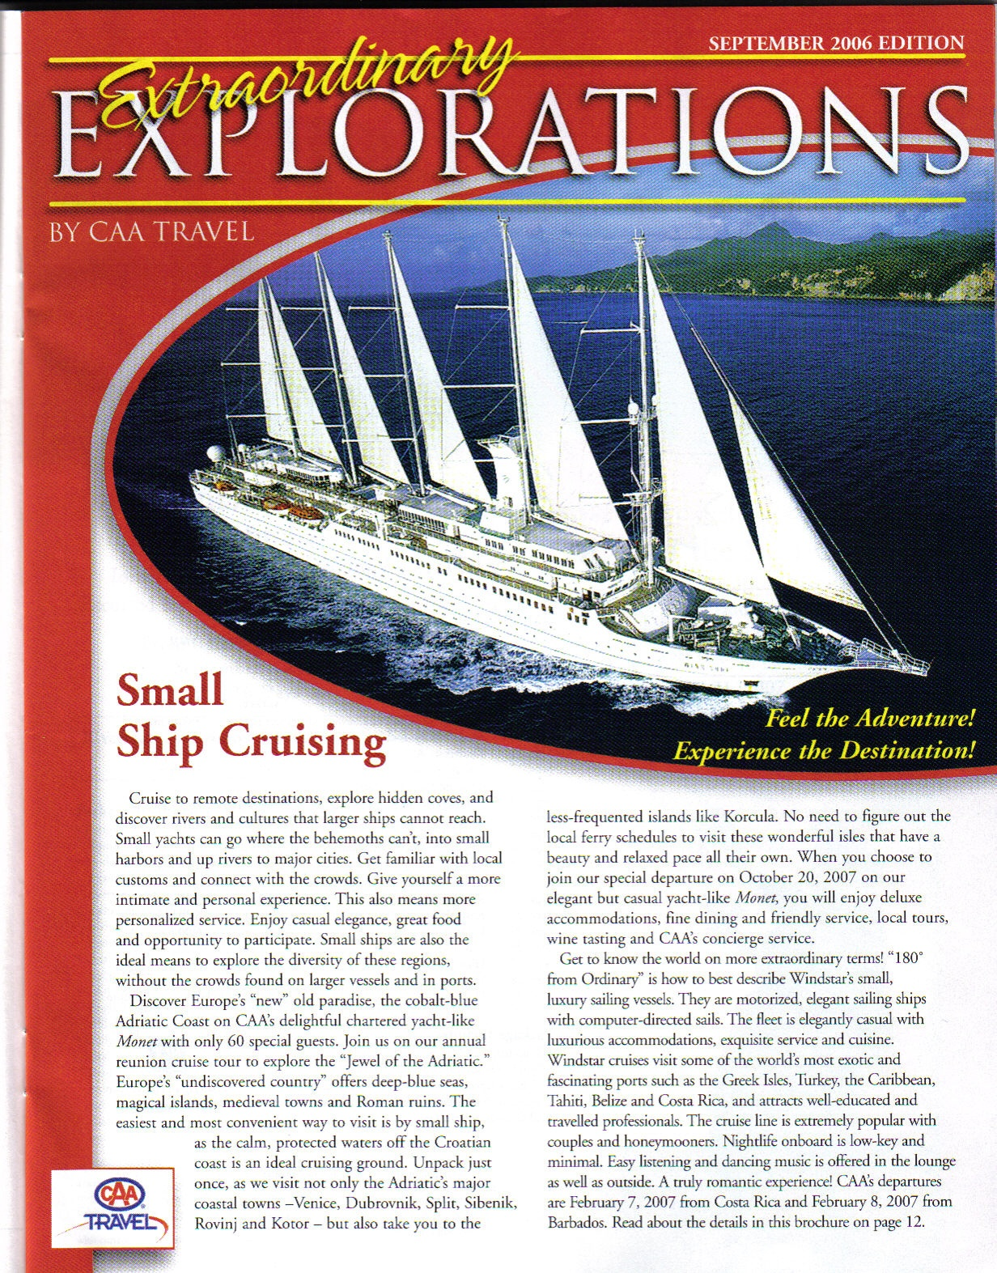
Some Examples From Print

Slide 47
Some Terminology
Font Type (or Typeface or sometimes just Font)
  Characters that have a common design are grouped into families called Font Types
  QUESTION: Can you name two Font types?
    Arial
    Arial Black
    Chiller
    Times New Roman
    Comic Sans MS

Slide 48
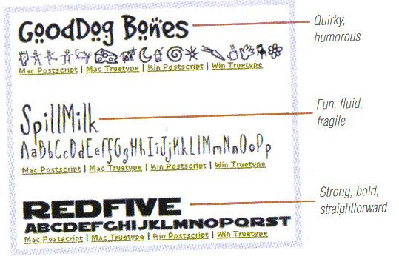
Some Funky Fonts
Examples from: “The Non-Designer’s Design Book by Robin Williams
Try out these websites → http://www.flamingtext.com/Font-Baby-Kruffy
Free fonts from Google → http://www.google.com/webfonts (remind me to show you how you can use all these cool fonts!)

Slide 49

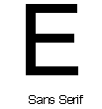
Most typefaces or fonts are divided into one of two categories: Serif or Sans Serif
  Serif: has a fine line added to finish a letter stroke
    Always use serif fonts for large paragraphs of text. The human eye finds them easier to read!
    Examples: Times New Roman, Courier
  Sans Serif: no line added
    Best for headlines and headings
    Examples: Comic, Arial
https://www.youtube.com/watch?v=Y50Dmh3SWys
(NOTE: the above video is just to get you thinking about fonts! Because Arial and Times Roman are standard on both Macs and Windows...it is FINE to use them ☺)

Slide 50
Style
  Variations in the appearance that allows the writer to emphasis parts of the text.
  Some examples
    Bold Times New Roman
    Italics Times New Roman
    Underline Times New Roman
    Bold Comic
    Italics Comic
    Underline Comic

Slide 51
Case
Why does case matter?
QUESTION: What does this say?
  I LOVE YOU
  I love you
  CATS AND DOGS
  cats and dogs

Slide 52
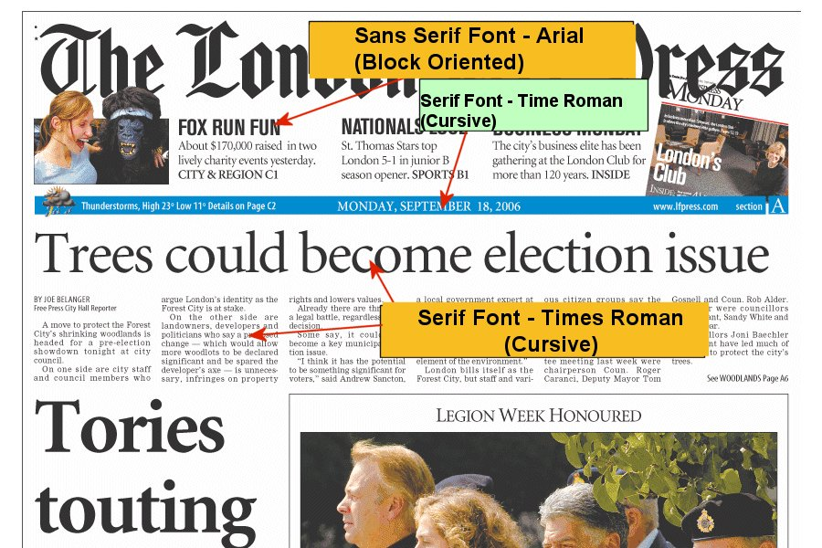
Case
  In general it is much easier to read mixed case than all uppercase. Save uppercase for headlines.

Slide 53
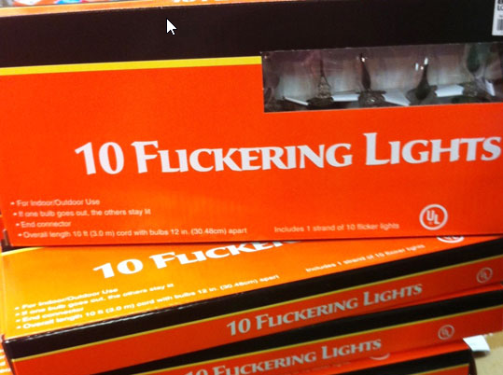
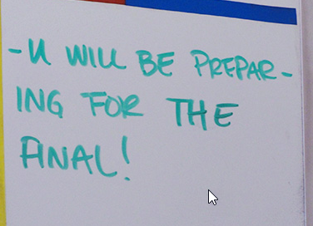
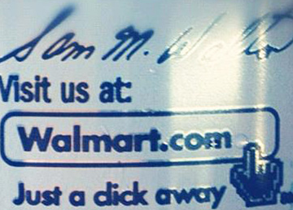
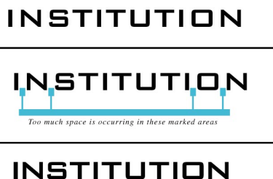
Kerning
  What is wrong here?
  Adjusting the distance between pairs of letters
  In standard spacing distance between uppercase A and W seems farther than say H and N
    AW vs. HN
    We can use kerning to fix this
    OR to fix situations like I just showed ☺
    QUESTION: Are you good at kerning? Take the test!
Tracking
  Adjusting the distance between ALL the letters
  Measured in ems

Slide 54


Examples from: “The Non-Designer’s Design Book by Robin Williams

Slide 55
Leading (pronounced Ledding)
  Amount of vertical space between lines of text
  As the length of a line increases, it is harder for the reader to jump to the next line, thus wide columns require greater leading.
  Tracking and leading are also related, see the next example:

Slide 56
Leading Examples
Okay, that might be a bit subjective but lots of Western students, including computer science students say that one of the factors that made them decide to come to Western to study was seeing the campus.
Loose Track More Leading
Okay, that might be a bit subjective but lots of Western students, including computer science students say that one of the factors that made them decide to come to Western to study was seeing the campus.

Slide 57
Leading Examples
Okay, that might be a bit subjective but lots of Western students, including computer science students say that one of the factors that made them decide to come to Western to study was seeing the campus.
Loose Track Less Leading
Okay, that might be a bit subjective but lots of Western students, including computer science students say that one of the factors that made them decide to come to Western to study was seeing the campus.

Slide 58
Leading Examples
Okay, that might be a bit subjective but lots of Western students, including computer science students say that one of the factors that made them decide to come to Western to study was seeing the campus.
Tight Track More Leading
Okay, that might be a bit subjective but lots of Western students, including computer science students say that one of the factors that made them decide to come to Western to study was seeing the campus.

Slide 59
Leading Examples
Okay, that might be a bit subjective but lots of Western students, including computer science students say that one of the factors that made them decide to come to Western to study was seeing the campus.
Tight Track Less Leading
Okay, that might be a bit subjective but lots of Western students, including computer science students say that one of the factors that made them decide to come to Western to study was seeing the campus.

Slide 60
Monospaced Fonts vs. Proportional Fonts
  QUESTION: Courier is Monospaced and Times New Roman is Proportional, can you see the difference?
    WWWMMM
    IIIIII
← Courier
    WWWMMM
    IIIIII
← Times New Roman

Slide 61
Review
Typography

Slide 62

Font Size
Font size can be measured in several different units:
  points, picas (as in MS Word, absolute length)
  pixels (relative to the screens resolution)
  percentage, ems (relative to the default browser font)
  inches, centimetres (absolute length)

Slide 63


Points (Absolute length)
Points are a print unit
Text that is 72 points is 1 inch tall
QUESTION: then why is the word now in this image not 1 inch???

Slide 64

Points (Absolute length)
Commonly text is 12 points, this is 1/6 of an inch.
NOTE: A point size of 72, will always give you a font that is one inch high when printed.
If you sent this MS Word Document to a printer and measured between the lines, it would be one inch. For print it doesn’t matter if you print from a Windows machine or a Mac, a 72 point font size on paper is always one inch high.

Slide 65

Pixels, ems, % (Relative length)
When text is displayed in pixels, ems, %, it is relative to the default font size for the browser and to the screen resolution.
1 em is equal to the width
of an M in the default font
type and size of the browser
  E.g. Firefox → Times New
  Roman, Fontsize 16 pixels

Slide 66
Experiment with Font Size
If you are on your laptop go to: http://www.csd.uwo.ca/~lreid/cs033/FontTest1.html
Then try the following:
  Set the resolution to be the lowest: 800 pixels by 600 pixels
  Set the resolution to be the highest.
  View the page in IE and then pick View>Text Size and pick some of the different sizes. Notice the absolute fonts don’t change, the relative ones do.
  View the page in Mozilla Firefox, then pick Tools>Options then the Content Tab and change the Font Size.
  Hold down the CTRL key and use the scroll button on your mouse

Slide 67
Which Unit of Measurement to Use
In general, don’t use points, it is for printing.
If you are worried about:
  Accessibility → use ems or % since they are relative to the browsers default font and the user can make the text more readable
  Control → if you want the layout to be precise, use pixels.

Slide 68
Font Colour
Colour
  If you look at the underlying html on a webpage you will see the colour for text is encoded in a strange way:
    http://www.csd.uwo.ca/~lreid/cs1033/fontcolours.html
  Hexadecimal representation
    Hex Digits are: 0,1,2,3,4,5,6,7,8,9,A,B,C,D,E,F
      With TWO space holders 99 in decimal is big, 19 is small
      With TWO space holders FF in hex is big, 1F is small
    Colours must start with #
    Then you need 2 hex digits for Red, 2 hex digits for Green and 2 hex digits for Blue →
    #
    Thus really bright red would be:
F
F
0
0
0
0

Slide 69
QUESTION
  How would you represent yellow?
  What colour do you think this is #222222?
  What colour do you think this is #CCCCCC?
Answers:
  Yellow → #FFFF00
  Dark Gray → #222222
  Light Gray → #CCCCCC
Fun Game: http://yizzle.com/whatthehex/

Slide 70
Things to remember when using text:
Is text the best choice?
  Use text when it is the best way to convey information
Make sure it is readable
  Use a dark background with light text or a light background with dark text
  Don’t make the font too small
  Make sure the font is readable (be careful with weird fonts)
  Don’t use too many fonts (2 or 3 different styles is enough)
  Don’t crowd your text, have some white space
  Paragraphs are easier to read in serif, san serif for headings

Slide 71
More tips…
Use text sparingly
  Remember it is sometimes hard to read on a computer screen
  Use bullets
  Break text up into sections
  Don’t be too wordy
Be consistent
  Pick a colour, size, and style of font you like and stick with it on all the pages
Spell check → there is NO excuse for spelling mistakes!

Slide 72
More tips…
Avoid offending
  Don’t use swear words or disrespectful language
Set a mood
  Try to pick a font that goes with the tone of your site (for example comic font is great for kids)
  Make sure it coordinates/complements your images/graphics
NEVER EVER EVER use underlining on a webpage → WHY?

Slide 73
A Great Design Review in 50 Seconds!
http://mattgreenwood.tv/ELEMENTS-OF-DESIGN

