Slide 1
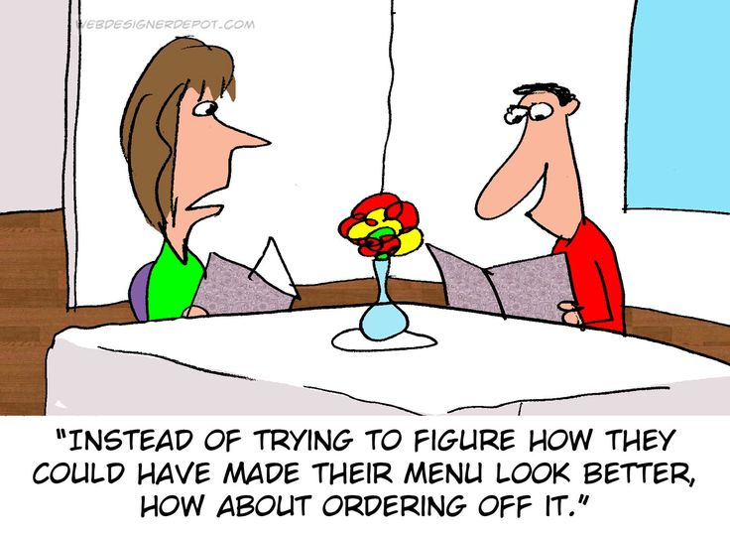
WeB SITE Design & Setup
Computer Science 1033 – Week 6
“What separates design from art is that design is meant to be… functional.” ― Cameron Moll

Slide 2
Overview of This Week’s Topics
Good and bad websites
Websites and Webpage organization
index.html → importance of
HTML

Slide 3
Textbook Readings for this Week
Websites
  Websites
  Website Development
  Design Principles

Slide 4
Big Ideas for this Week
Big Idea 1:
  Consistency is what transforms average into excellent.
Big Idea 2: The beauty of HTML is its simplicity
  Simplicity boils down to two steps:
    Identify the essential
    Eliminate the rest

Slide 5
What do you think of these sites?
http://www.brescia.uwo.ca
https://www.margarethevanderpas.com
http://www.mariasemple.com/
https://wrightwoodfurniture.com/
www.distancetomars.com
https://etch.co/ (hmmm???)
https://www.newyorker.com

Slide 6
How about these sites?
https://history.aip.org/climate/index.htm
http://www.lingscars.com
http://www.jamilin.com/
http://www.gatesnfences.com/

Slide 7
Good Website Design Tips
Have something valuable to offer → provide something useful or interesting
Don’t distract with blinking, animated GIFs, autoloading sound, too much scrolling
No popups!
Don’t use images on the background unless you know what your doing
Put a lot of thought into the organization of your page
Minimize clicking (no more than 3 clicks to get to a page)

Slide 8
More Tips
Have a way to get to the home page on every page
Include a menu on every page (in the same location on every page)
Compress your images
Don’t let multimedia files bog down your website
No line of text should be more than 600 pixels wide
Don’t make your page too wide (around 900 to 1000 pixels), user should NEVER have to do horizontal scrolling. Vertical scrolling should be kept to a minimum

Slide 9
More Tips
Use contrasting colors or simple backgrounds to make text easy to read
Make text large enough to read
Use ALL CAPITAL LETTERS sparingly,
Never use more than one exclamation point
Spell Check
Never underline words that are not links
Put contact info or a link to it on every page

Slide 10
More Tips
Test your links
Remove dead links
Avoid confusing navigation and having menus in different spots on different pages
Avoid ugly design: no color continuity
Don’t have text that hard to read
Include a “Last Modified” date
  Keep up to date, update your “What’s New” section frequently
Don’t steal content (I stole this content is from: http://websitehelpers.com/design ☺ )

Slide 11
More Tips
Think about how the user will navigate through your website and remember the 3-click rule.
Have a consistency throughout your pages
  Colours
  Menu placement
  Layout
  Fonts
  Buttons
Think about the layout, have white space, clean alignment and balance on your pages

Slide 12
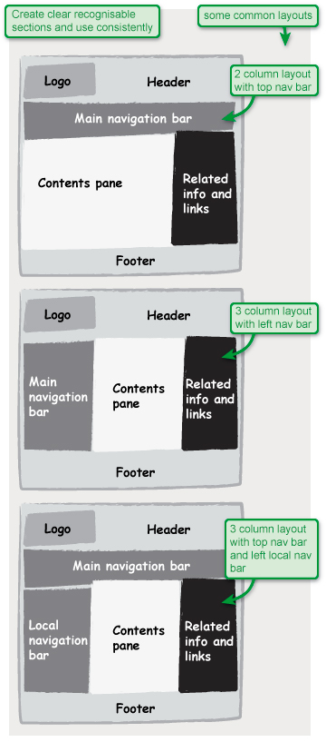
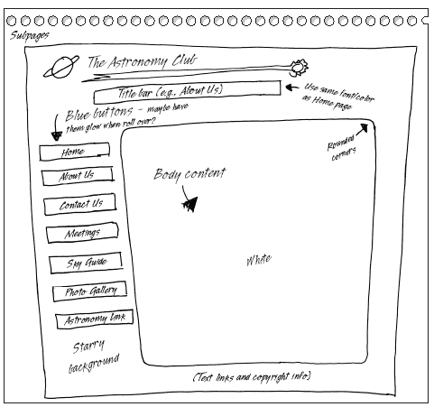
https://www.microsoft.com/mspress/books/sampchap/6403/0-7356-18607-04.gif
http://usability.coi.gov.uk/themes/page-layout/assets/images/1a-1.jpg

Slide 13
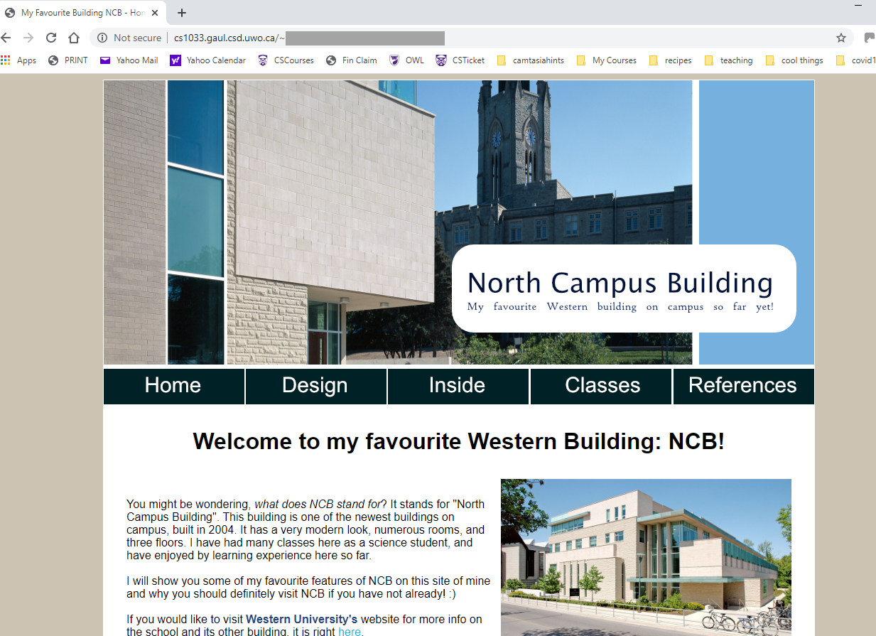
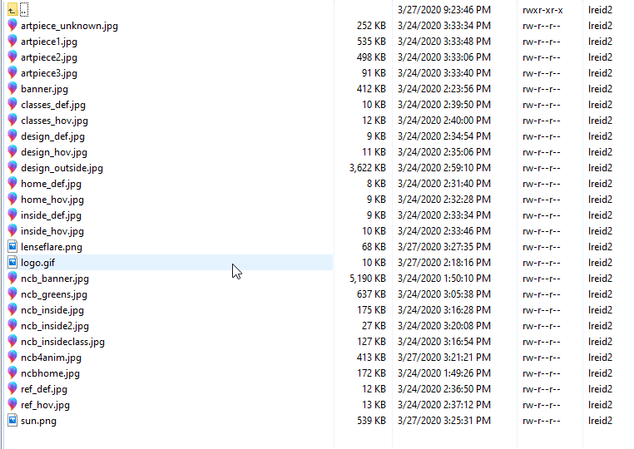
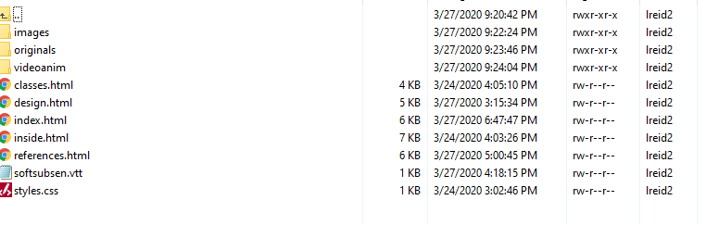
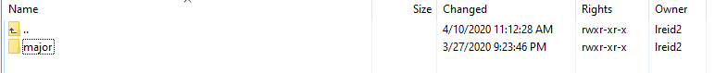
Webpages and Websites
A website is a collection of related webpages stored in a folder. The folder may or may not contain sub folders.
The website folder should contain a sub folder called images which holds the image files (.jpg, .gif, etc) that will be displayed on the page.

Slide 14
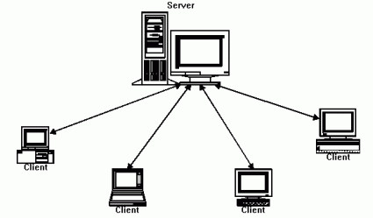
Decide on what webpages you will need.
Each webpage is normally an html file, a file that has the extension .html or .htm
  .html .htm
    Very basic page, just has clickable links, images, sometimes forms
    The .html file is just a file with html codes that is displayed in a browser to make it look pretty for the client (Chrome, IE, Safari, Firefox)
    CS1033 just covers .html & .htm pages
  Other extensions for webpages include:
    .php → extra stuff that is brought in also from the server, allows for use of data in a database on the server, more complex form manipulation
  Store each .html file in the folder (the Website)
  The home page for the website, the “starting page” should have the file name index.html

Slide 15
Webpages and Websites
Question: On panther.uwo.ca, what is the main folder for your: http://publish.uwo.ca/~lreid2
Question: Does that folder contain a file called index.html?
http://wts.uwo.ca/services/web/activate_my_personal_web_space.html
CHECK IT OUT USING SECURE FTP (WINSCP, FUGU, FILEZILLA)

Slide 16
Folder Structure for a Simple Site
Decide on the pages you will need
Create a top level folder. Use lowercase letters
Give the home page the name index.html
  Must be all lowercase!
  Index.html is invalid
Give the other pages appropriate lowercase names (no spaces in the file names) with the .html extension
Create a subfolder called images (lowercase) and put all your images in that folder

Slide 17
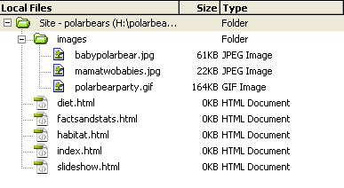
Example of a simple website
Assume we are making a website about Polar Bears. The folder structure (folder is called H:\polarbears) might look like this:

Slide 18
Links for the simple structure
Assume the domain name for this site is: ArcticAnimals.org
Thus the website would be:
  http://www.ArcticAnimals.org
To get to the polar bear website, you could type:
  http://www.ArcticAnimals.org/polarbears OR
  http://www.ArcticAnimals.org/polarbears/index.html
To get to the habitat page you would type:
  http://www.ArcticAnimals.org/polarbears/habitat.html

Slide 19
Something to try
Go to your panther page and type each of the following:
  http://publish.uwo.ca/~lreid2
  http://publish.uwo.ca/~lreid2/index.html
  http://publish.uwo.ca/~lreid2/posterassign
  Question: Why don’t we see a webpage when we type the last choice?
Now go to UWO Computer Science page and type each of the following:
  http://www.csd.uwo.ca
  http://www.csd.uwo.ca/index.html

Slide 20
More complicated site
Sometimes websites have many submenus and have lots of webpages.
In this case we need a more complicated folder structure
  BUT it is NOT really that much more complicated, just one main folder with subfolders that contain “sub websites”
  Each sub website is a sub folder that contains it’s own index.html and images subfolder

Slide 21
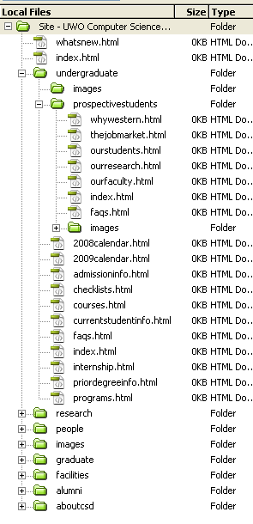
Example of a more complicated site:
Westerns Computer Science Site might be set up like this →

Slide 22
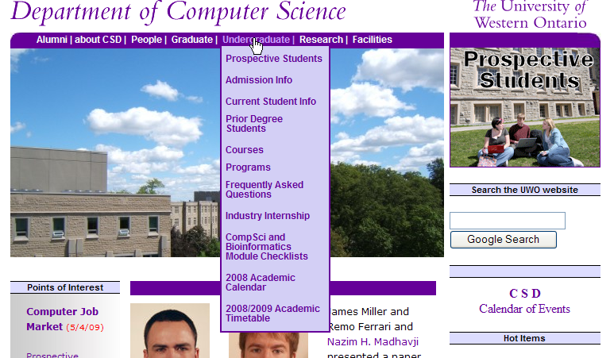

Slide 23
Web Server
You will likely build your site on your own machine. When the website is completed you will need to move it to a Web Server
Web Server → the computer that runs software which holds the webpages and serves up (delivers) webpage to the client. This computer must be connected to the Internet. The software delivering the webpages is also called a web server
Question: What is the software we use to move the webpages we have built on to the web server?
Question: What is the name of the web server machine at Western?

Slide 24
Web Browser
Once you have moved your website onto the web server you MUST test your website by opening it in a Web Browser
Web Browser → software/program that displays formatted webpages to the client.
Question: What is the input we give a web browser?
Question: What is the output from the web browser program?
Question: Can you name 3 web browser programs?
Question: Does anyone know how you look at the html that was used to create the page currently displayed in the browser?

Slide 25
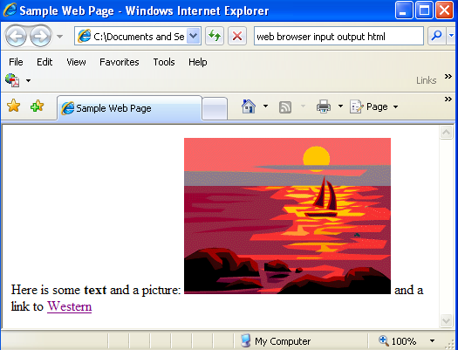

HTML and Web Browsers
Stored on the webserver (the SERVER)
<html>
<title>Sample webpage</title>
<body>
Here is some <b>text</b> and a picture: <img src="sunset.gif">
and a link to <a href="http://www.uwo.ca">Western</a>
</body>
</html>
Viewed on the CLIENT
Above is input to
A Web Browser
Lovely website to the right is output from a Web Browser

Slide 26
What is HTML?
History:
  In the late 1980s, Tim Berners Lee proposed a way of sharing research papers using the Internet and hypertext (immediate links to other documents)
  In 1990 Berners Lee set the specifications for the HTML language and wrote a browser to read HTML files and output linkable papers
  He proposed html tags
    Example of some tags → <html>, </html>, <b>, </b>,<ol>, </ol>
    Tag always start with “<“ and end with “>”
    Most tags come in pairs: opening tag and a closing tag, for example:
    <title>This is the title of the webpage</title>
  Used to have to make html files (webpages) with simple text editors like Notepad

Slide 27

History…
Tim Berners Lee:
  Created the first web browser
  Created URL layout
  Came up with the World Wide Web and the concept of hyperlinks among pages
  Created HTML tags (they have changed a bit over time but he came up with the initial ones)
  Watch starting at 2 minutes

Slide 28
Introduction to HTML
Question: Can you guess some of the tags you think we would need to create a useful and readable webpage?

Slide 29
Types of HTML tags
Section tags
  <html>, <body>, <head>, …
Formatting tags
  <b>, <ul>, <i>,<p>,<h2>,</b>,</h2>, …
Link tags
  <a href=“http://www.msn.com”>, </a>, …
Placeholder tags (standalone or unpaired tags)
  <img src=“mydog.jpg”>, <hr>

Slide 30
Let’s make a webpage the Old Fashioned Way!
Open Notepad
Save your file as myfirstpage.html
Type in some tags
Save the file again
Close the file
Double click on it, it should now open in Chrome
In Chrome, from the menu select View>Source
Edit the tags some more and save the file
Go back to Chrome and hit the refresh button

Slide 31
It is way to hard to remember all the tags, so…
WYSIWYG programs to the rescue!
  Eg. Adobe Dreamweaver or html5-editor.net
They creates the tags for us so that we don’t have to remember the syntax for each tag!
Question: Can you still see the tags in https://editor.csd.uwo.ca/ ? If so, how?

Slide 32
Some Tips
Webpages will NOT format as precisely as something like a MS Word document to be printed because everyone’s resolution is different and screen size is different.
Design a template/layout and then save it and make copies for each page in your site and add the content to the copies
Don’t forget to make an images folder! Put your images in the folder BEFORE you start adding them to your page. ALWAYS ADD THE IMAGE TO THE IMAGES FOLDER BEFORE YOU PUT IT IN YOUR PAGE!
Try previewing your page in more than one browser
Always use lower case names with no spaces for all folder and all file names

Slide 33
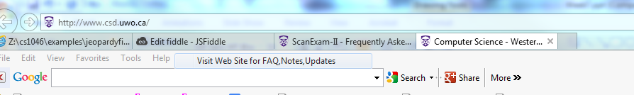
Page Title
Shows up now at the top of the tab
Page title is very important, when you print a webpage, the title appears at the top of printed paper
Search engines look at page title
Title is displayed in the list returned by Google
Always set the page title on all your pages
Start with the current page, then the pipe | then the site name
  Examples:
  Work Experience | Laura K. Reid Online Resume
  Natural Sciences | Western Buildings

Slide 34
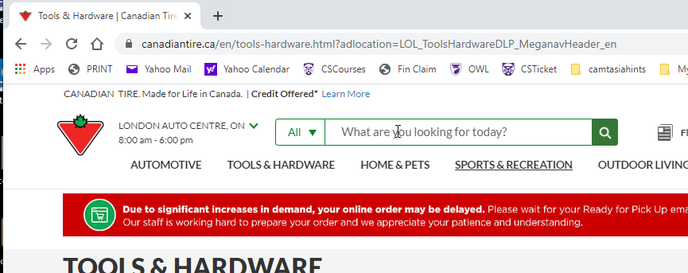
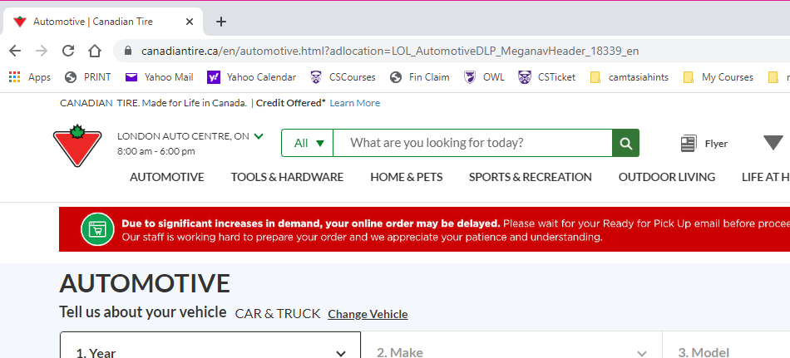
Canadian Tire Does It Right!

Slide 35
Setting the Page Property/Title
Must set this in Notepad
Webpage Name | Website
e.g.
Sample Work | Laura’s Stained Glass

Slide 36
HTML vs. CSS vs. JavaScript
Real World Example → writing a book
STEPS:
  Author writes the book – CREATES THE CONTENT OF BOOK
  Author sends book to publisher to make it look nice – SET THE LOOK AND FEEL OF BOOK
  Publisher decides to create an audio or an online book and then they need to allow readers to jump to chapters – SET UP THE BEHAVIOUR

Slide 37
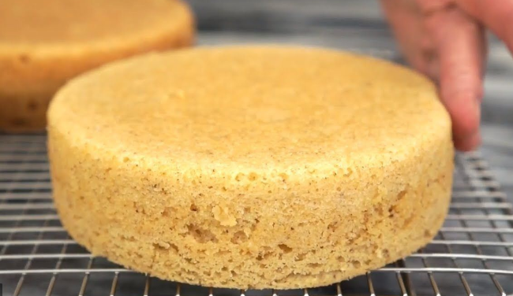


Another Real World Example
Birthday cake:
  Bake/create cake
  Decorate cake
  Add trick candles
Always do 3 things:
Create content
Set look
Set behaviour

Slide 38
Building a Web Page
Content → create an HTML file (.html)
Looks → create a CSS file (.css) (or sometimes add CSS to the .html file)
Behaviour → create a JavaScript file (.js)
In CS1033, we are just doing .html and .css.
We are just doing minimal .css, if you take CS2033, you will learn even more css and a touch of .js

Slide 39
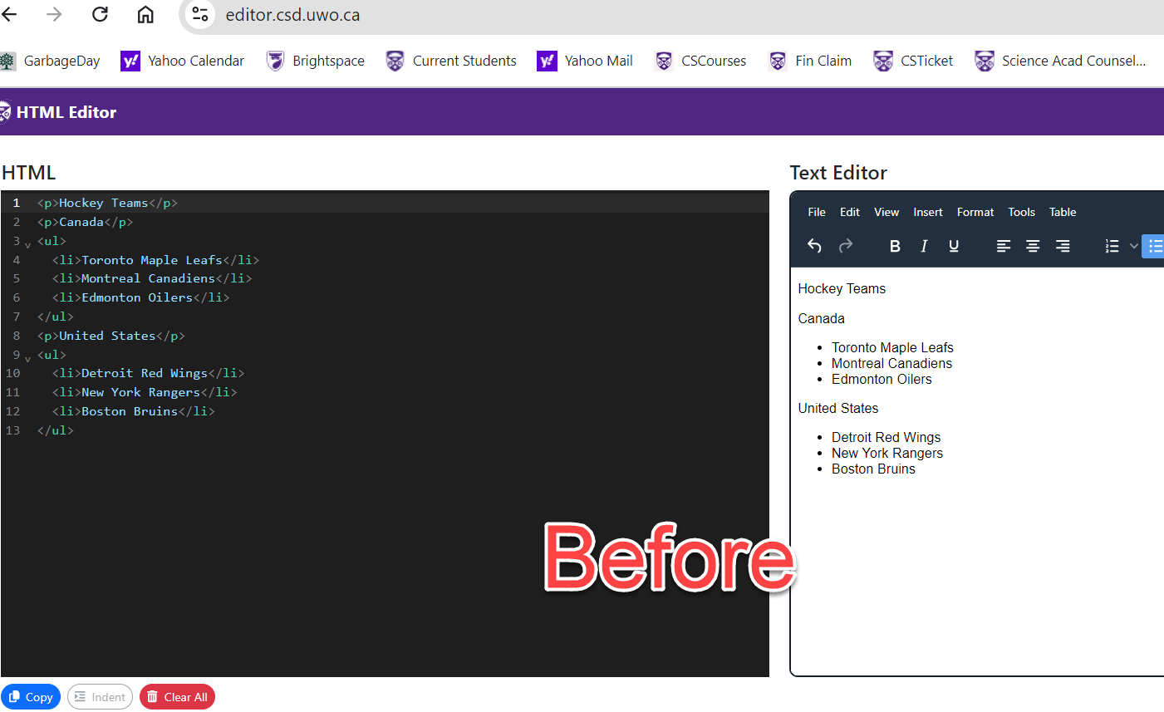
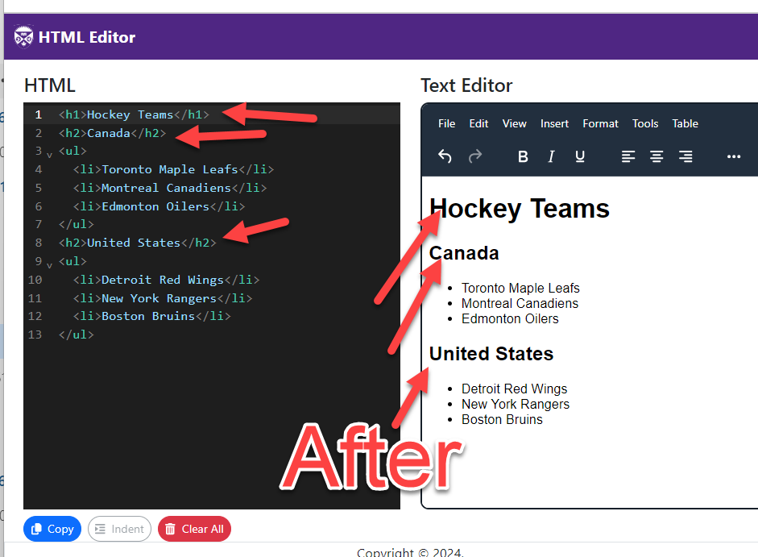
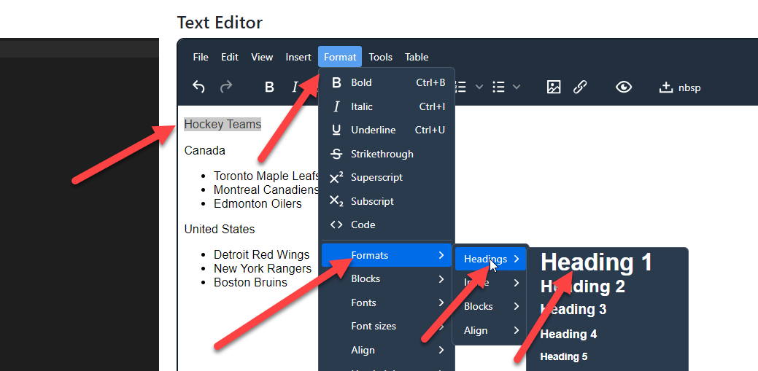
Formatting Text
Headers → H1, H2, H3, H4, H5, H6
  H1 is the largest
  All are bolded
  All force a blank line after them

Slide 40
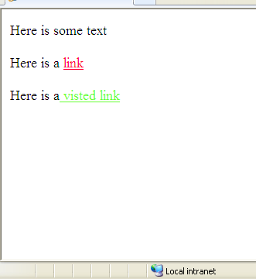
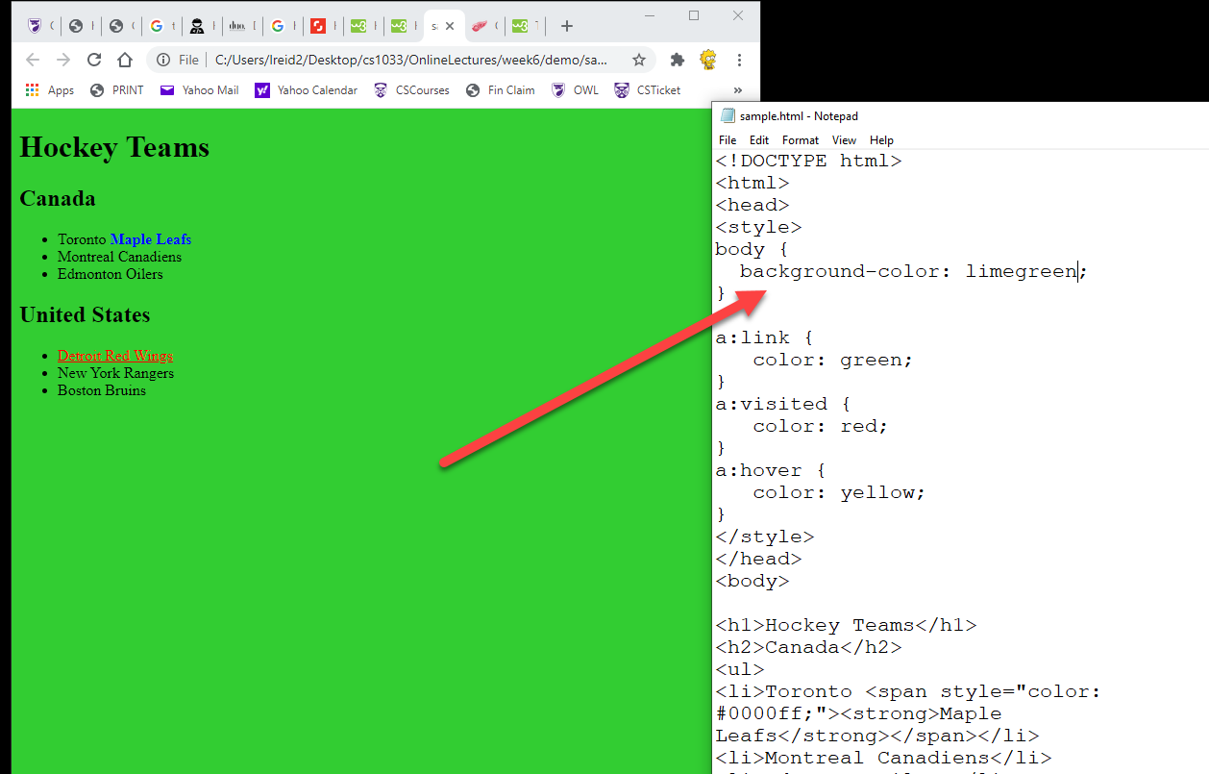
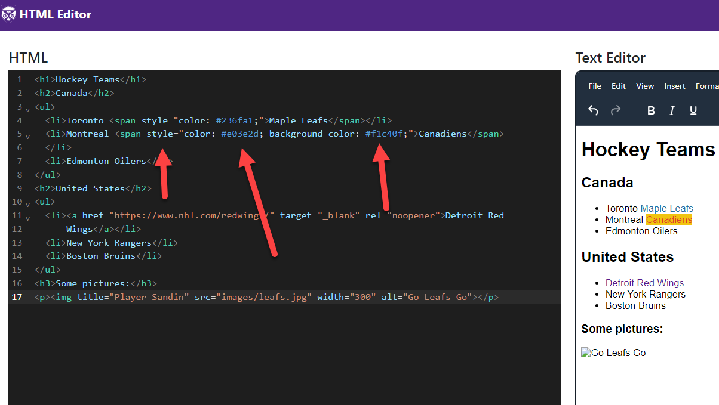
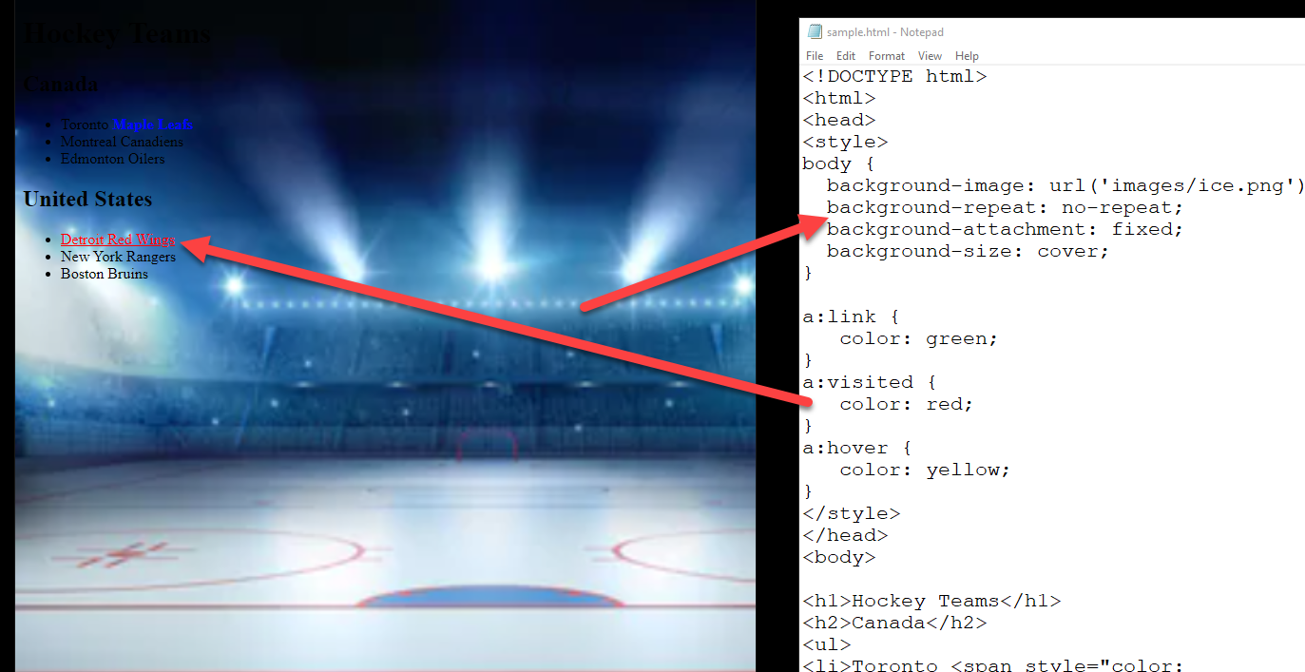
Changing Background and Link Colours
If you decide to use a background image, make sure it is not too busy and the image file size is small.
  https://affinity.pt/en/
Don’t forget about your links colours either! Try to pick colours that work with your site palette: http://duomgmt.com/
Remember to use GOOGLE!

Slide 41
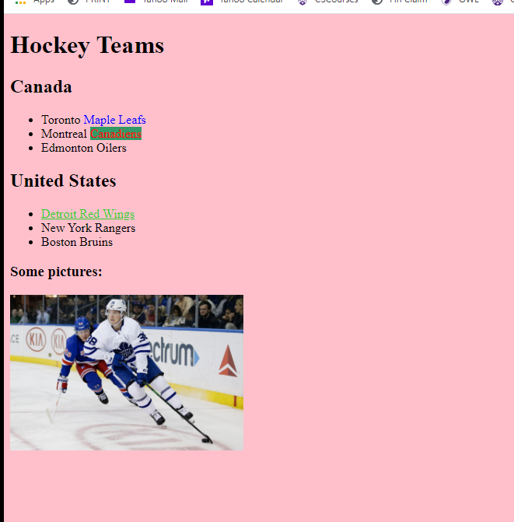
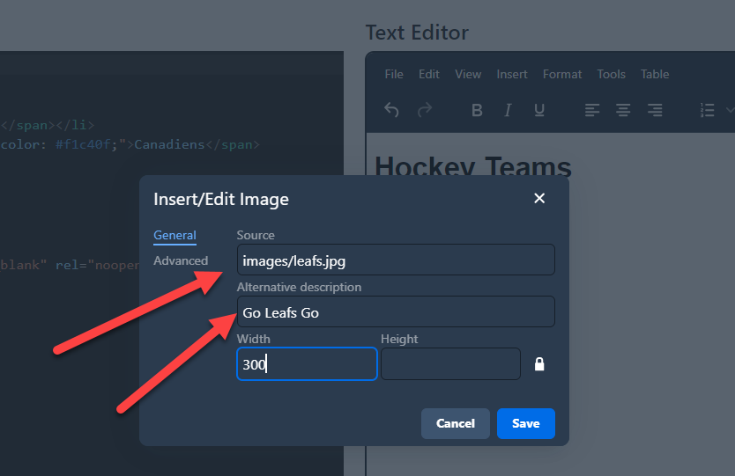
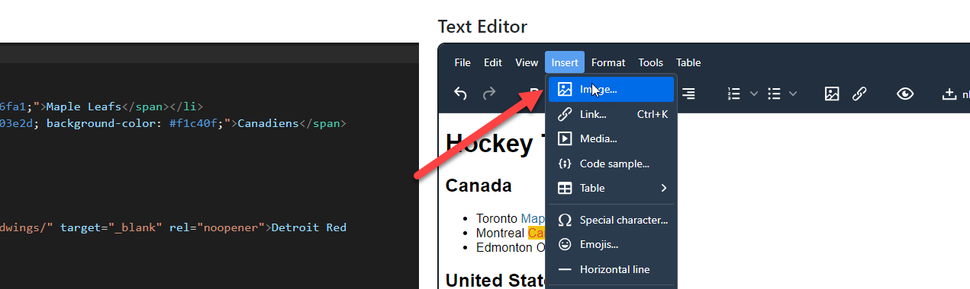
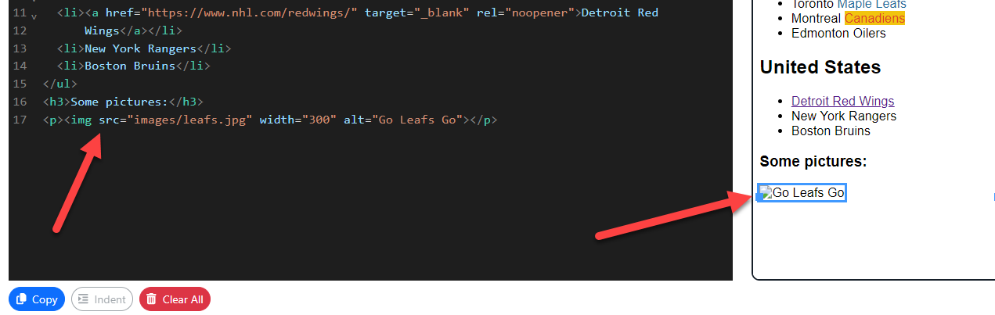
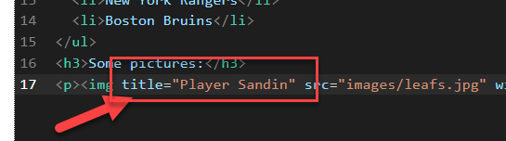
Graphics
Add your images via html5-editor
ALWAYS set the alternative text:
  Meet Barriers Free Access Requirements
  Shows when page is loading
  Shows up when using a text browser
  Might be used as keywords in searches
Set the Title attribute
  Shows when mouse hovers over
Player Sandin

Slide 42
Graphics Continued
Use common universal formats such as jpg, gif and png files that will work in any browser
Resize and compress the image as much as possible in Affinity (or other graphics package like Photoshop) BEFORE putting the image file into your images folder.
Any resizing you do within html5-editor OR with css will not affect the download speed

Slide 43
Types of Links
5 Basic Ones

Slide 44
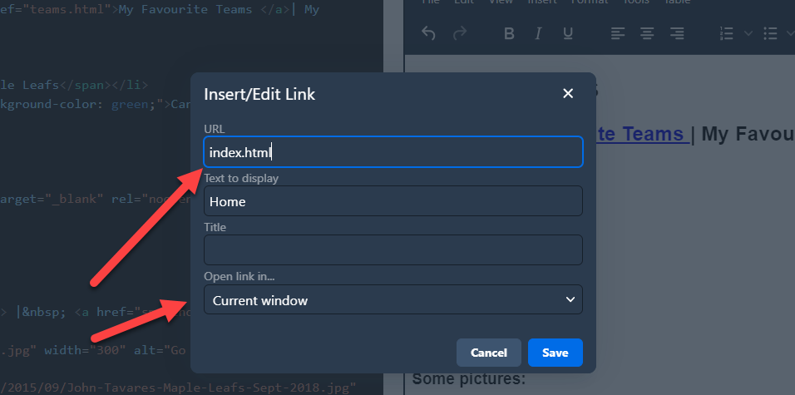
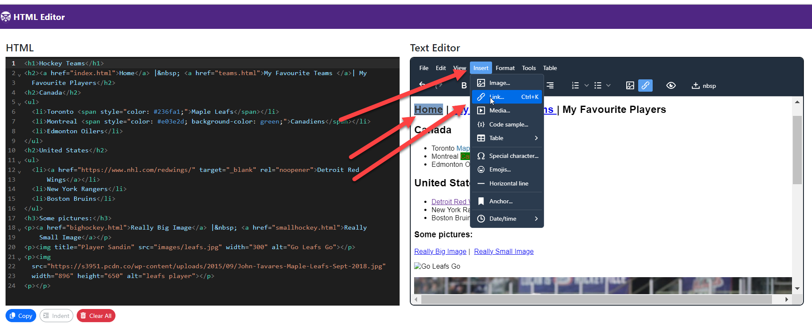
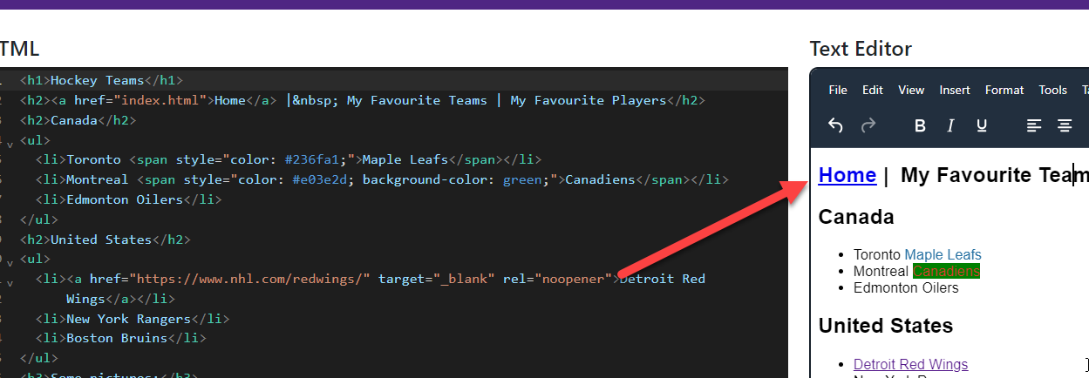

Links – Type 1
TYPE 1: Links to other pages within your site:
  For Example:
    Link from index.html to contactinfo.html
    Link from contactinfo.html back to index.html
http://cs1033.gaul.csd.uwo.ca/~lreid2/examplesforta/assign3/student1/

Slide 45
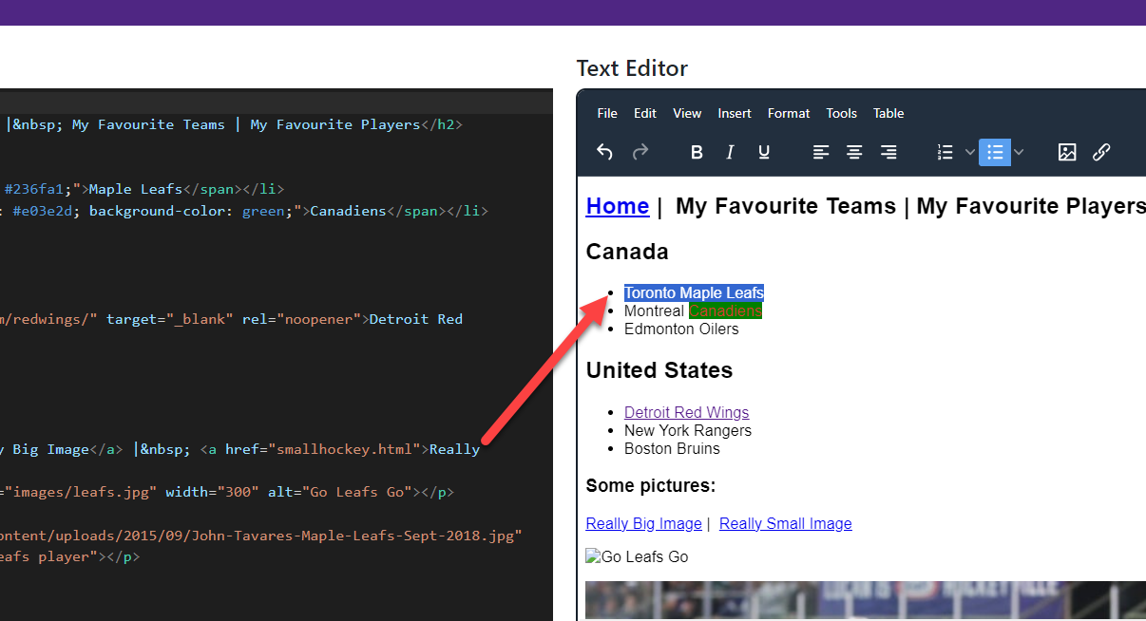
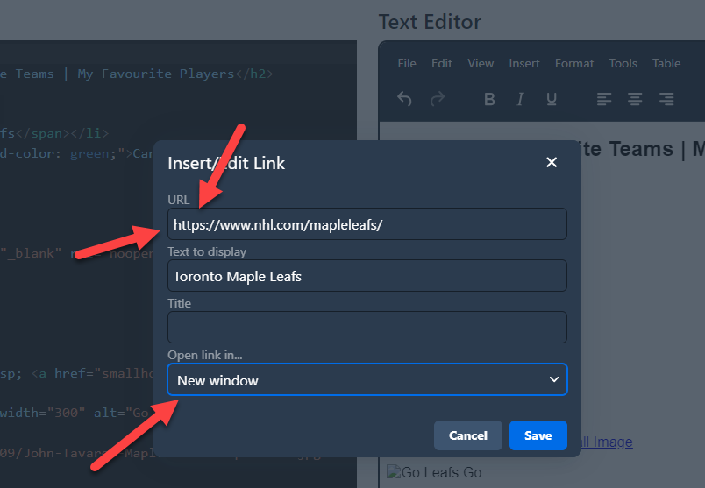
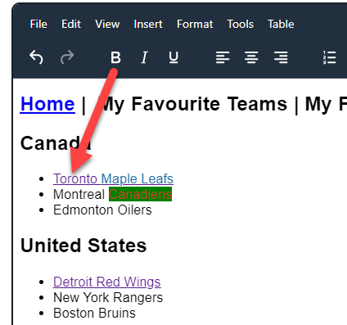
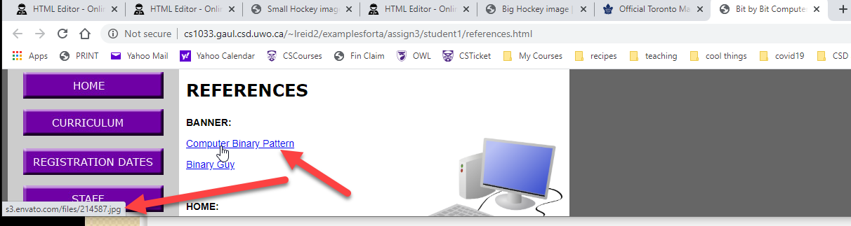
Links – Type 2
TYPE 2: Link to a different website
  For example
    Link from index.html to http://www.utoronto.ca
    Should open in new window or tab
    Make sure you have http:// in front!
http://cs1033.gaul.csd.uwo.ca/~lreid2/examplesforta/assign3/student1/references.html

Slide 46
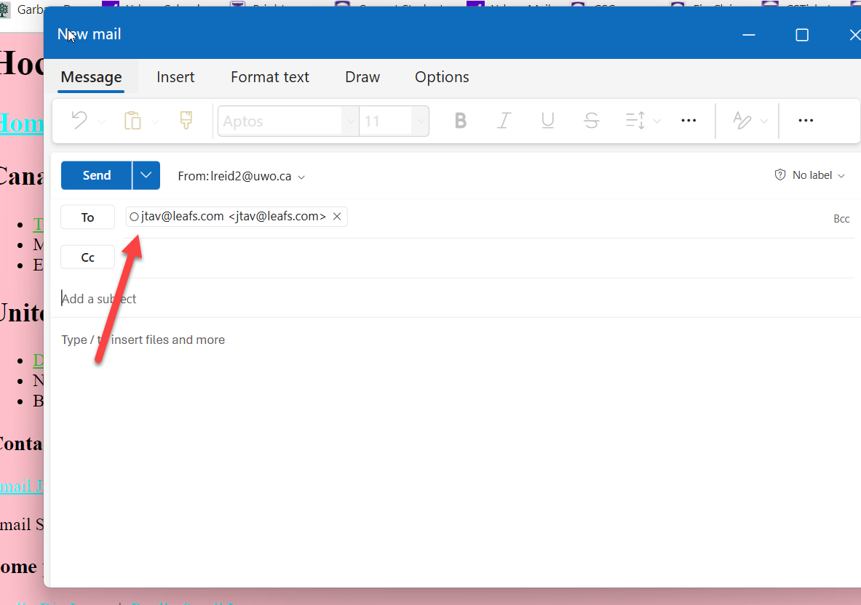
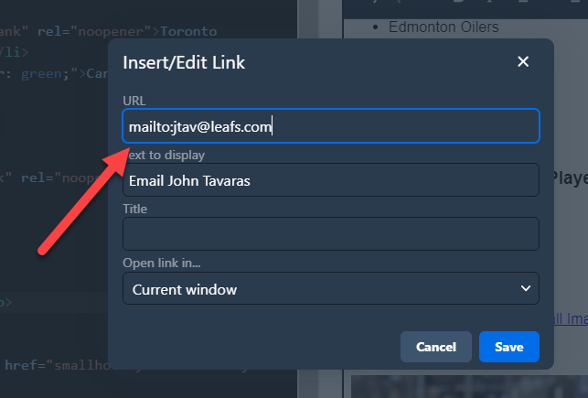
Links – Type 3
TYPE 3: Link to an email address
  For example:
    Link to homerjsimpson@yahoo.com
    Type mailto:homerjsimpson@yahoo.com into box
    Clicking on the link brings up default emailer like Outlook
http://cs1033.gaul.csd.uwo.ca/~lreid2/examplesforta/assign3/student1/contactinfo.html

Slide 47
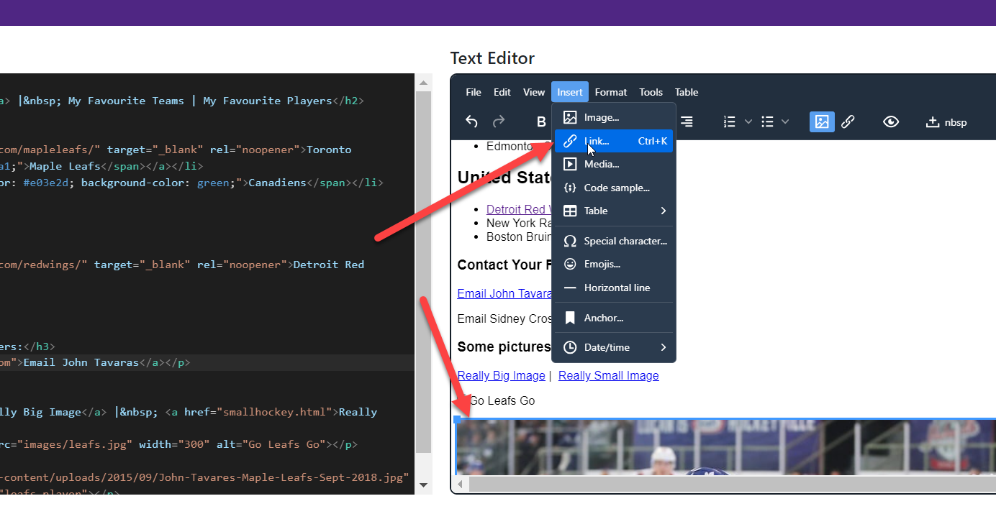
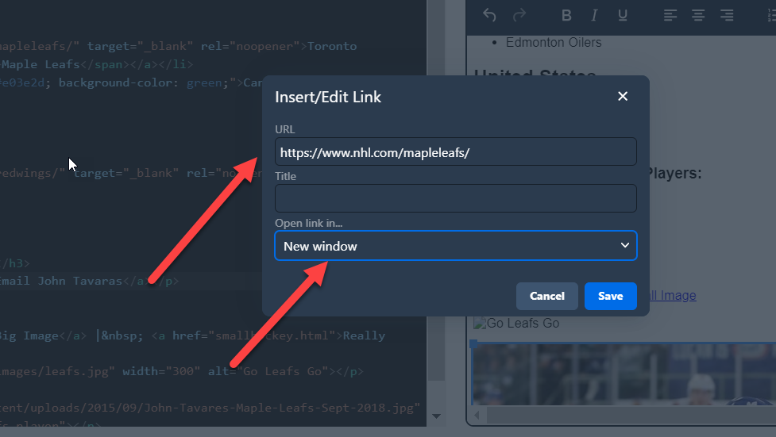
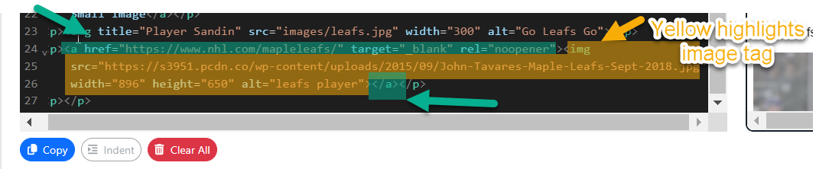
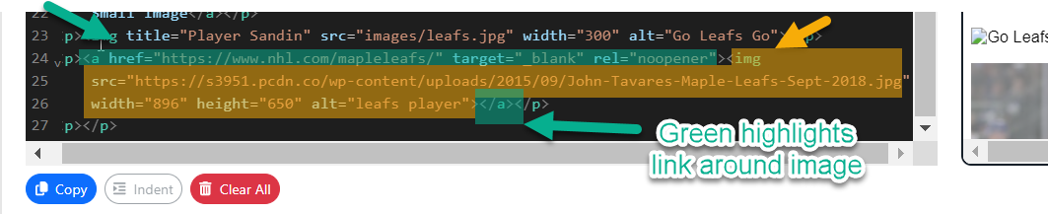
Links – Type 4
TYPE 4a: Link on a image
  On the whole image:
    Link to http://www.canada.gc.ca
    http://cs1033.gaul.csd.uwo.ca/~lreid2/examplesforta/assign3/student1/contactinfo.html (click on banner)

Slide 48
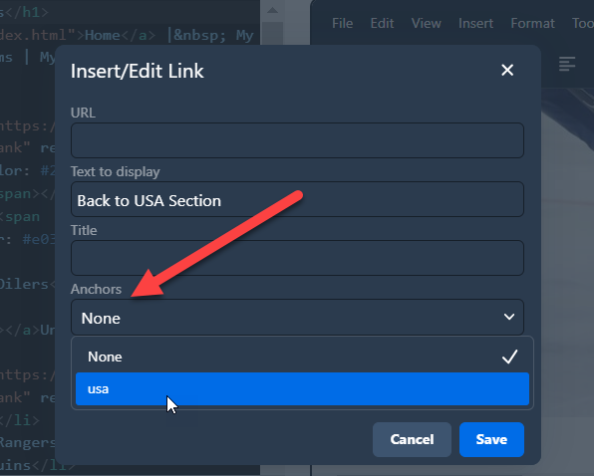
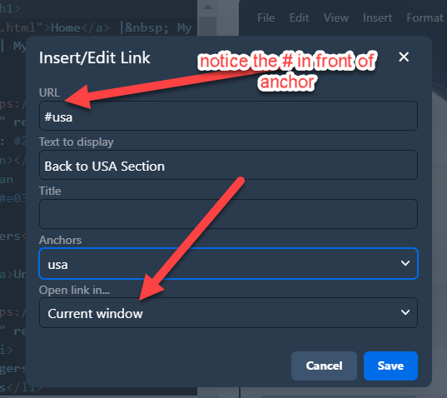
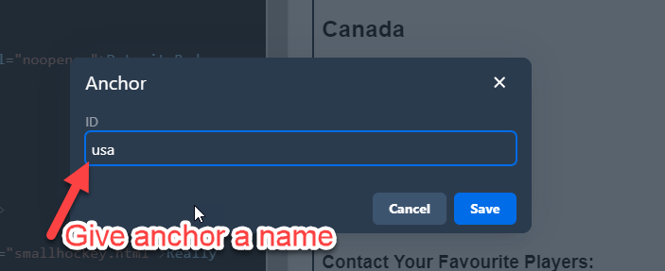
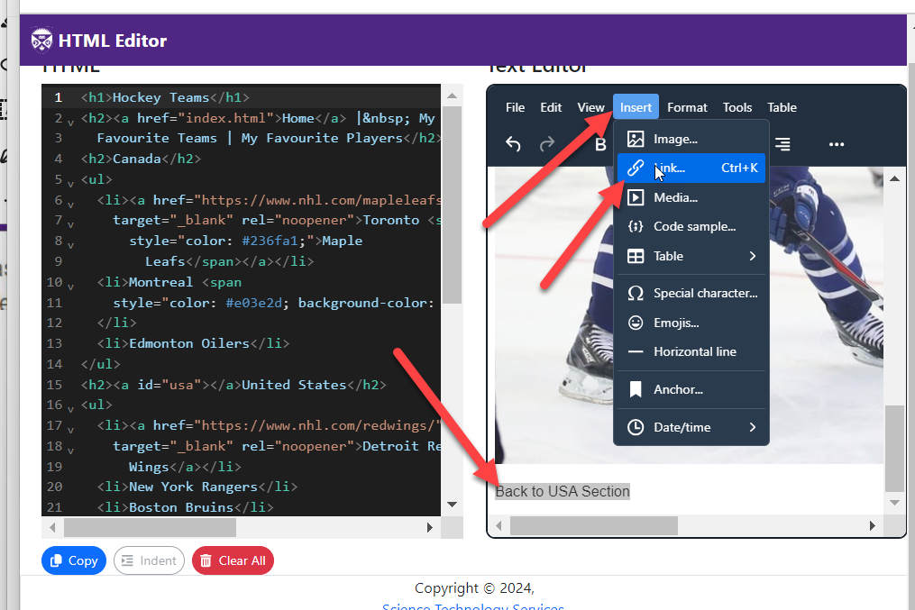
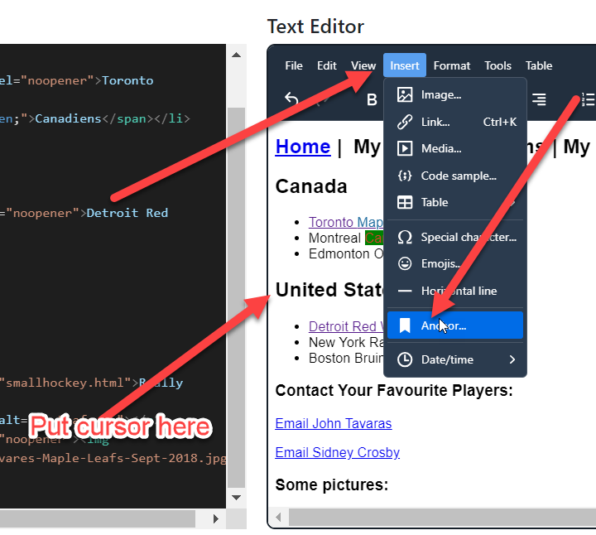
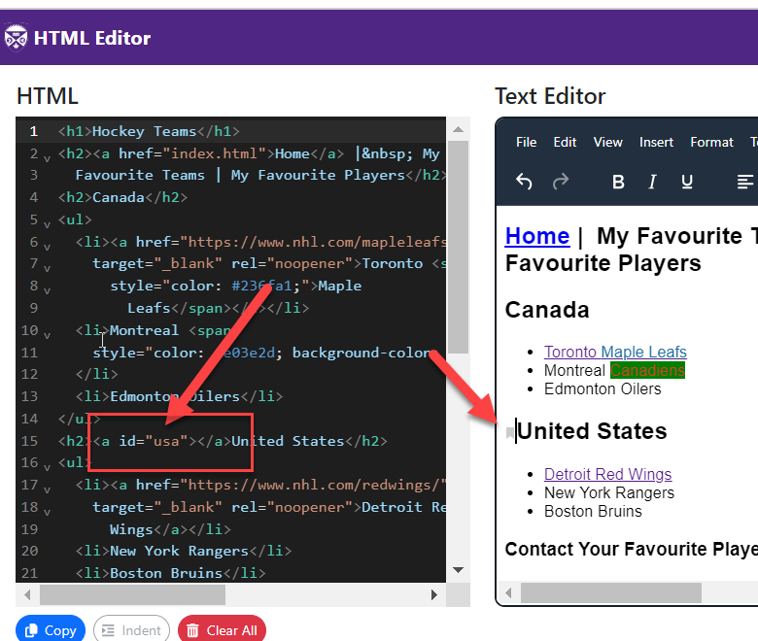
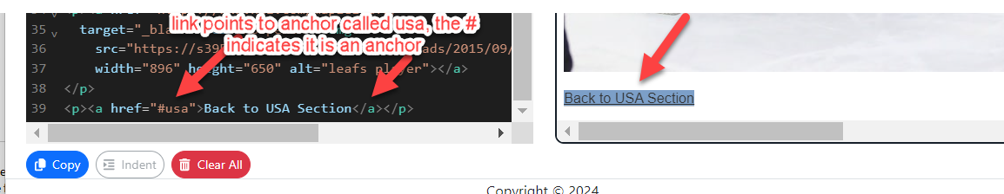
Links – Type 5
TYPE 5: Link to particular spot within a page
  The spot is called the bookmark or the named anchor
  Find the spot you want to jump to, put your cursor there and then select Insert> Anchor
  Give the spot a name you make up, for example: middleofpage
  Note: the anchor name cannot have spaces
  or special characters in it.
  Go to where you want the link and add a link with # in front of it and the name of the anchor:
http://cs1033.gaul.csd.uwo.ca/~lreid2/examplesforta/assign3/student1/staff.html

Slide 49
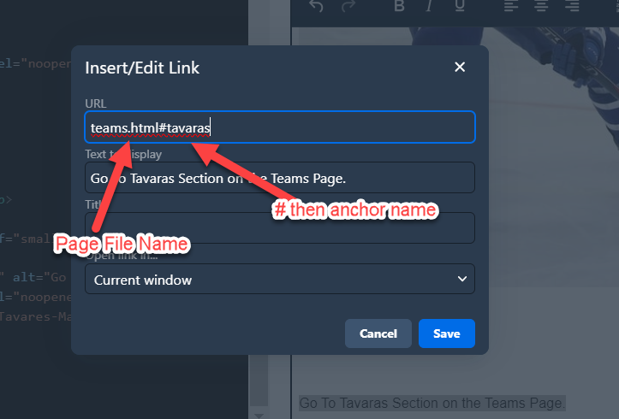
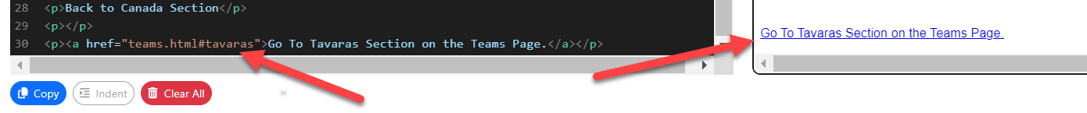
Links – Type 5
Named anchors can link to any spot within the current page OR you can link to the middle of another page, for example:
  http://en.wikipedia.org/wiki/Jpg#Sample_photographs
Use named anchors to make Back to Top buttons or jump from a list to another area of the page
You can do this also to jump to an anchor on a DIFFERENT one of your pages

Slide 50

Named Anchors used on this page

Slide 51

HTML Tables
Tables are made up of rows and columns
Place where a row meets a column is called a cell. A cell can hold any kind of data: links, text, images, etc…
Can have a table inside another table (called a nested table)
For CS1033, we will use tables to make a simple clean layout for each of our pages!
Tables can be expressed in terms of one of:
  Percentage %
  Pixels

Slide 52
Tables expressed in terms of Percentage
Here is an example: http://www.csd.uwo.ca/~lreid/outreach/iveysurveyTables.htm
% of the browser, not the entire screen
Another example: http://www.csd.uwo.ca/~lreid/cs1033/ExamplesForLectures/tablesexamples.html

Slide 53
Table expressed in terms of Pixels
Resolution affects the way a page is displayed.
In general, most people do NOT have their resolution below 1024 by 768. Thus if we make our table 1000 pixels wide EVERYONE should be able to view it. If we make our table 1200 pixels wide, some people (the ones whose resolution is still 1024 by 768) will have to scroll horizontally.

Slide 54

Resolution 1280 by 1024:

Slide 55

Resolution 800 by 600:

Slide 56

Some hints for using tables to organize your overall appearance:
Have the border set to 0
Make sure you give some cell padding, so the text doesn’t go flush to the end of the cell
Use the alignment buttons to make everything look clean. Do NOT centre paragraphs of text.
Use pixels to set up your table initially, don’t go wider than 1000 pixels
Merge/join and split cells to help you define your areas

Slide 57


Google Fonts
Want some cool fonts for your page? Use Google Fonts! http://www.google.com/fonts
Click on
  The Font you like/choose
  Then + Select this style button
  Then Embed tab
  Then select and copy the <link> NOTE: the <link> will look like similar to this:
  <link href="https://fonts.googleapis.com/css2?family=Modak&display=swap" rel="stylesheet">
  Then paste the code you just copied into Notepad below the <head> tag but above the </head> tag.
  Save your file
  Should look like this:
Notes:
HOW TO VIDEO in dreamweaver

Slide 58



Google Fonts Continued…
Next…
  Go back to Google Fonts → http://www.google.com/fonts
  Copy the CSS Rule
  Near the top of Notepad, create a <style> rule for the text that you want to have the Google Font, e.g. all your list items:
  Save your file and test it:
Notes:
HOW TO VIDEO in dreamweaver

Slide 59



CSS – External CSS File vs. Internal CSS Style Rules
Internal CSS Style Rules:
  Either look like this:
  Or this:
  Problem is that you have to remember to add CSS style rules to EVERY file (.html)

Slide 60


External CSS to the Rescue!
We can put all our rules in a separate .css file
We link each page (.html file) to that .css file
Then we just change the rule in .css file and it will take affect on ALL the pages!
And we can easily swap for a different .css page to get a different look!

