Slide 1

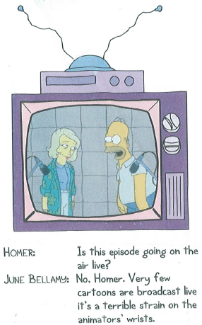
Animation
Computer Science 1033 – Week 8
“Live action writers will give you a structure, but who the hell is talking about structure? Animation is closer to jazz than some kind of classical stage structure.” → Ralph Bakshi

Slide 2
Textbook Readings for this Week
Animation

Slide 3
Make sure you get a copy of all your work!
Your assignment 2 and 3 websites will only be posted for the next month (till about ONE month after our final exam) so make sure you take a copy of everything you want to save and put it on a memory stick or in the cloud.
ONE MONTH AFTER THE COURSE ENDS YOU WILL NOT BE ABLE TO GET ANYTHING YOU POSTED ON cs1033.gaul.csd.uwo.ca BACK. KEEP COPIES!

Slide 4
Good Review for Searching!
https://www.youtube.com/watch?v=LVV_93mBfSU Lean[

Slide 5
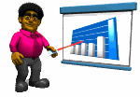
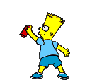
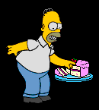


What is animation
A sequence of images that create the illusion of movement when played in succession.
QUESTION: How does the illusion work, what is each still image called?
Here are some simple examples:
A FRAME

Slide 6
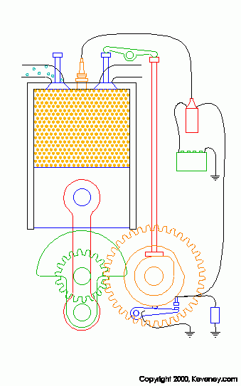


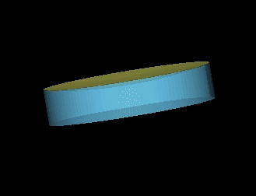
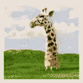
Why use animation?
Easier to show somebody how something works then to try and explain it.
Also animation:
  Indicate movement
  Illustrate change over time
  Visualize three-dimensional objects
  Attracts attention
Four Stroke Engine

Slide 7
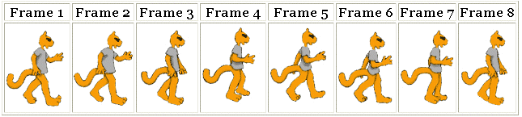

How does animation work?
Simulation of movement through a series of pictures that have objects in slightly different positions
Each drawing is called a frame (a snapshot of what’s happening at a particular moment)
Required Frames Per Second FPS:
  Movies on film → 24 fps
  TV →30 fps
    9000 frames for five minute cartoon
  Computer animation → 12 to15 fps
Jerky if anything less

Slide 8
Sampling and Quantizing of Motion
Since each frame is just an image →
  Each frame is sampled into a discrete samples and each sample becomes a pixel → Sampling process
    Remember:
      More samples means better quality (same image represented in10 pixels by 10 pixels or in 200 pixels by 200 pixels)
      More samples means bigger file sizes (10 pixels by 10 pixels vs 200 pixels by 200 pixels)
  Each pixel gets assigned a colour, maybe just 2 colours(black and white→1bit colour) or maybe 16 million colour (24 bit colour) → Quantization process
Question: What else can we “Sample” with MOTION?
Notes:
Sample the temporal dimensions of the video, sampling= frames
Higher frame rate means more accurate motion is sampled. Also means larger file size!

Slide 9
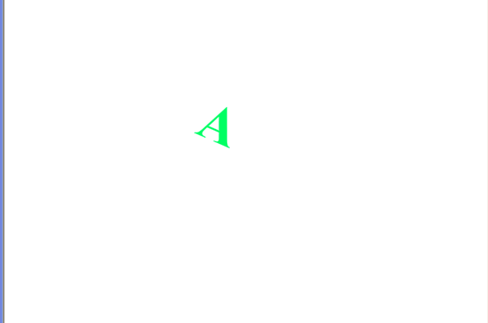
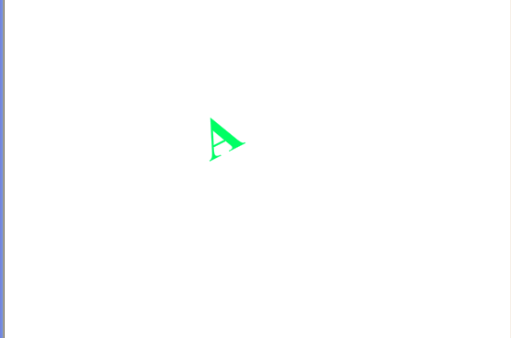
Frame Rate (Frames Per Second FPS)
Frame Rate: indicates the playback speed of the animation in frames per second
  Low frame rate appears choppy
  Question: BUT high frame rate can also appear choppy, WHY?
    Answer: if the computer playing the animation is not fast enough to process and display the frames.

Slide 10
2-D Animation
two types of 2-D animation:
  Cel Animation (also called traditional animation, classical animation, hand-drawn animation, frame by frame animation)
  Path Based Animation
Both types still are made of frames:
  The more frames per second, the more believable the movement will be.
  The more frames per second, the bigger the final version of the movie file will be (more bytes)

Slide 11
5 Types of Animation
https://www.youtube.com/watch?v=NZbrdCAsYqU (start at 30 seconds)
  Traditional Animation (Cel Animation)
    Rotoscoping is one type
  2D Animation (Path Based Animation)
  Computer Animation
  Motion Graphics (this is what we will be doing, it uses Path Based Animation behind the scenes)
  Stop Motion

Slide 12
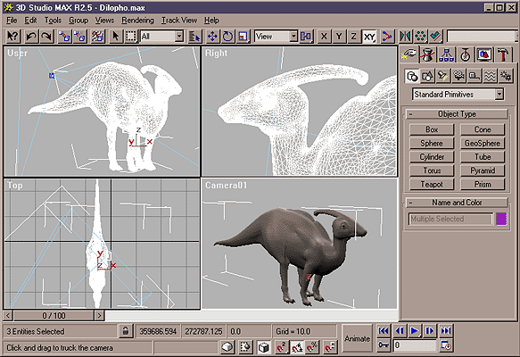
3-D Animation (Type of Computer Animation)
3-Dimension animation involves 3 steps:
  Modelling
  Rendering
  Animating
Demo

Slide 13
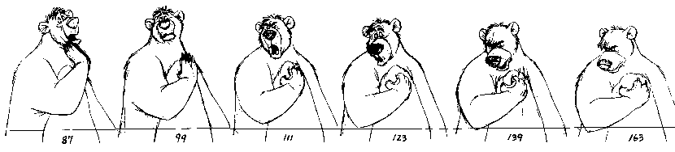
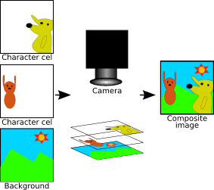
Cel Animation
An animator must HAND draw every single frame!
To simplify, one background is drawn and then the item that will move is drawn on a clear sheet of plastic (a cel), one drawing for each frame.
When moving to the next scene, just change the background
Traditional Animation
(start at second 55)

Slide 14
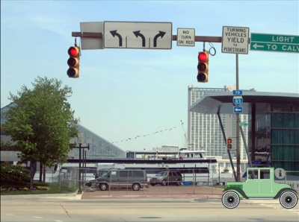
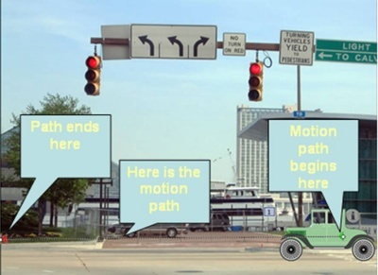
Path Based Animation
Pick:
  a starting point for an object, (start frame)
  an ending point for an object (end frame)
  a path for the object to follow
And then the computer generated all the frames in between (called TWEENING), so that the artist doesn’t have to draw the intermediate frames (like the artist did in cel based animation)

Slide 15
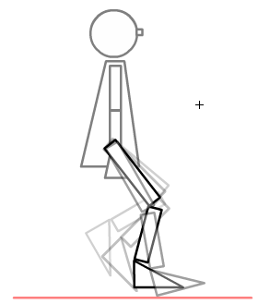


2-D Animation Terminology
Question: What do these terms mean?
  Keyframe
  Tweening
  Onion Skinning
Some Inspiration → An amazing animator: http://j-scott.com/work/

Slide 16
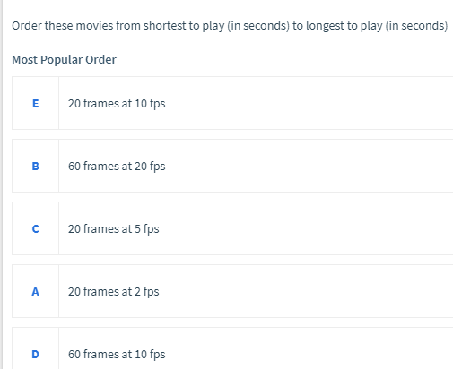
Path Based Animation
Question If I have a 40 frame movie playing at 5 frames per second, how long will the movie be? ___ seconds
Question :
Question: The path the object follows have to be a straight line, TRUE or FALSE?
Question: What software allows us to do path based animation?
A – 10 sec
B – 3 sec
C – 4 sec
D – 6 sec
E – 2 sec
ORDER: EBCDA

Slide 17
Path Based Animation Software
The software that generates the frames has features such as:
  Looping
  Transition (Fade in and Fade out)
  Repetitions → allows the user to pick how many times the animation repeats
  Setting the Frames Per Second
    Question: What does a bigger FPS imply?
      Larger file size
      More realistic motion

Slide 18
What can we do to change the motion?
If the animation appears too slow, we can speed up the motion by:
  Reduce the number of frames (say pull out every other frame)
  OR
  Increase the frame rate (go from 10fps to 20fps)
Assume we have an animation is the 40 frames and our frame rate is 10 frames per second.
  QUESTION: how long will the animation be?
  QUESTION: what happens to the movie if we pull out every other frame?
  QUESTION: what happens if we go from 10fps to 20fps?
4 seconds
2 seconds – 20 frames now and file size will be ~ ½
2 seconds – no change to original file size because same number of frames

Slide 19
Slowing down the motion by adding more frames
Assume now that the motion is a bit too fast, 2 ways to slow it down:
  Way 1: Add more frames:
    Keep the frame rate the same
    Increase the number of frames between the keyframes to stretch out the animation
  Way 2: Lower the frame rate (go from 20fps to 5fps)
    Keep the same number of frames as original but stretches out movie
  Original Clip has 5 frames, at 20 fps, so finishes playing at 0.2 seconds, too fast!
    Way 1: still have 20 fps, but add in extra frames between, now have 20 frames
    Way 2: holds frame on screen for 0.2 seconds, then moves to frame 2, on screen for 0.2 second, etc….

Slide 20
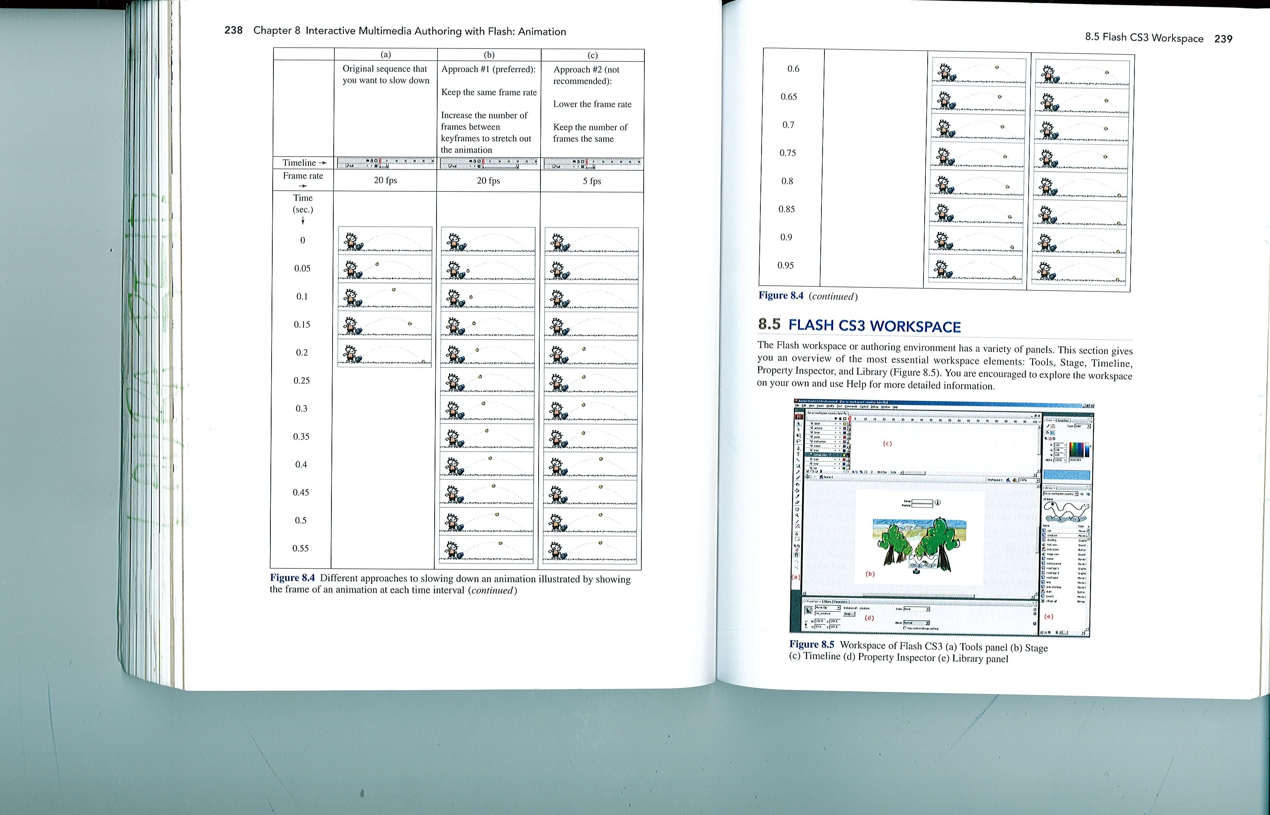
Question: What is wrong with Way (c)?
https://frames-per-second.appspot.com/
From the text book: Digital Media Primer by Yue-Ling Wong

Slide 21
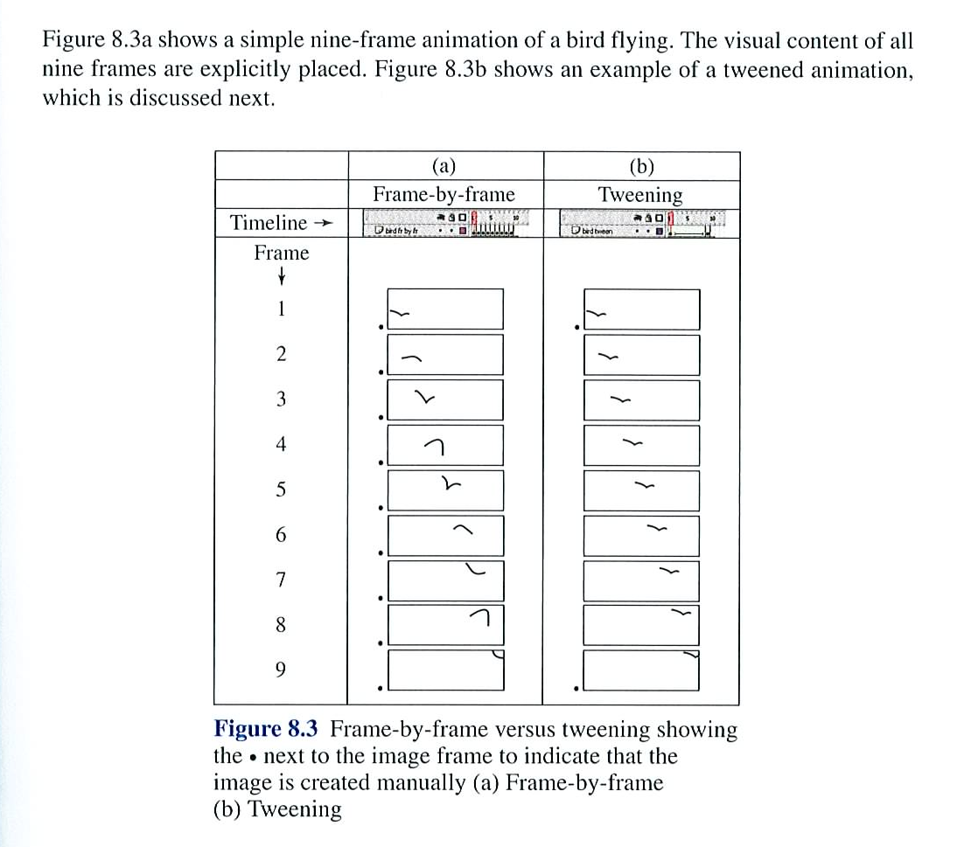
Cel Animation vs. Path Based Animation
From the text book: Digital Media Primer by Yue-Ling Wong

Slide 22
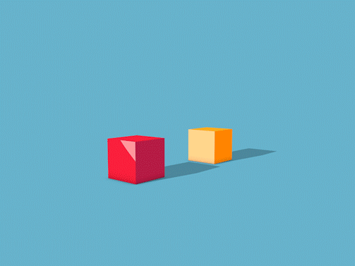
5 Tips to Create Realistic Motion
Question: which object is heavier? How do you know this? How did the artist achieve this?
Timing
Consider the timing and spacing of your key frames

Slide 23


Question: How does the artist show the speed with the poker chips? What is Ease?
Consider playing with Ease (Slow In and Slow Out) in your animation software → hEaseqbKhY

Slide 24
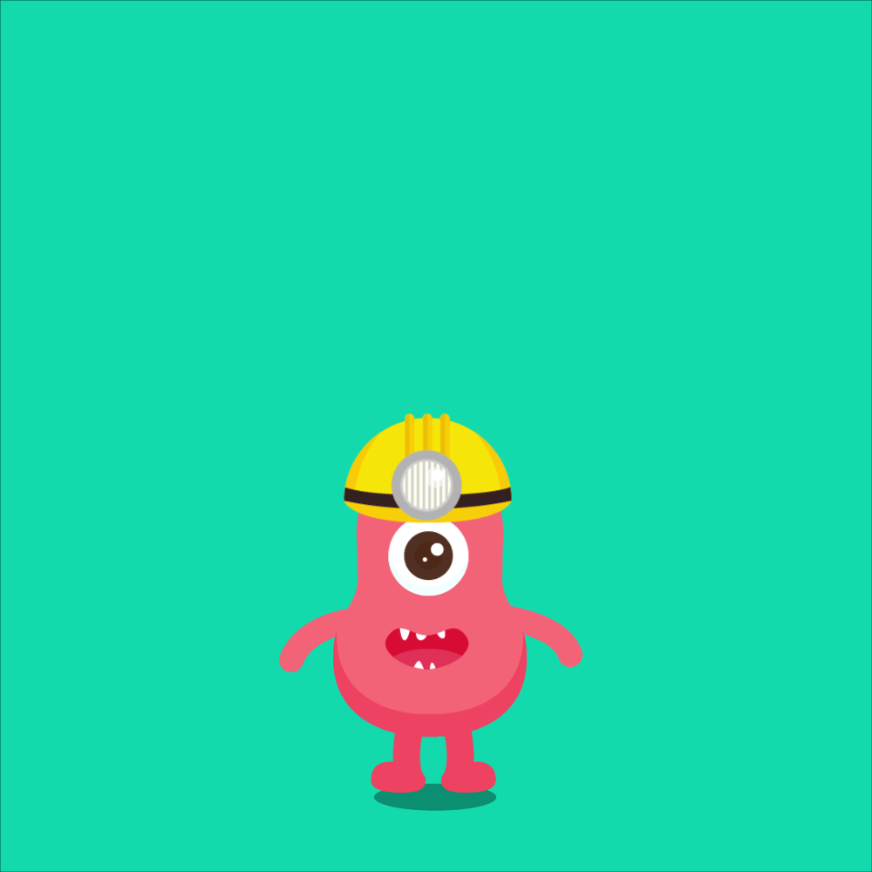
Question: What do you notice about the movement of the helmet compared to the body in this image?
When the something continues to move after the thing it is joined to stops → Follow Through

Slide 25
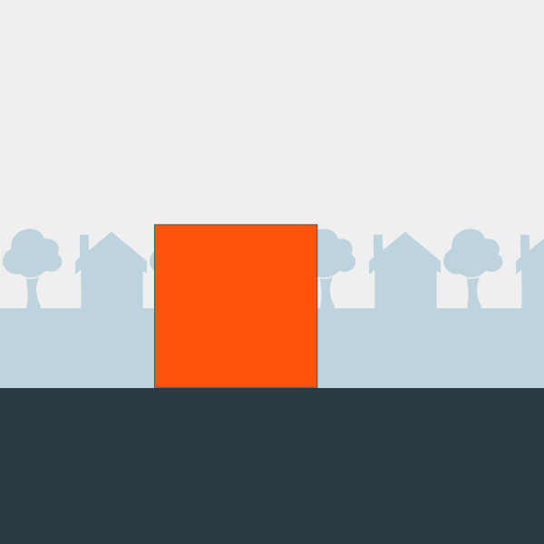
Question: What do you think the box is about to do? What term do we use when we think something is about to happen?
When the something prepares for an action to communicate to the viewer that something is about to happen → Anticipation

Slide 26
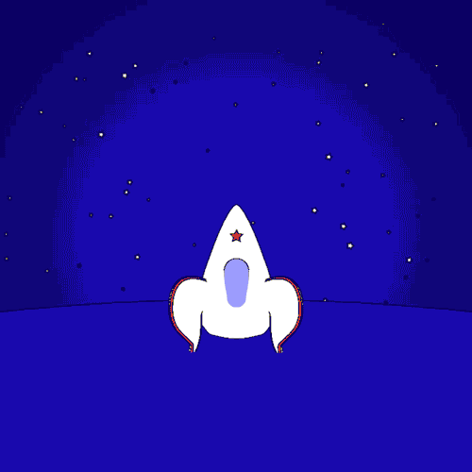
Question: What is interesting about the shape of this rocket as it starts and stops? What terms would you use to describe this? What other common object do we often use to display this phenomena?
Animated objects can get longer or flatter to emphasis their speed, momentum, weight and mass→ Squash and Stretch

Slide 27
Where can you get animation?
Purchase CDs or buy off the Internet or get free clipart on the Internet, for example:
  https://classroomclipart.com/clipart/Animations.htm
OR, you can create your own:
  Animated Gifs can be create in Photoshop or in other software tools
  Using Flash
We will look at different file types of animation:
  Animated gifs (.gif)
  Flash Animations (.swf)
  PowerPoint Animations (.mp4)

Slide 28
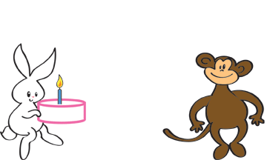
Animated GIFS
Question: What do you think the file size of an animated gif is affected by:
  Size of the gif (frame dimensions)
  Number of colors
  Number of frames
Question: What do you think is the maximum number of colours you can have in an animated gif?
No Plug-ins Required: Animated GIFs require no plug-ins, and the authoring tools to create them are often free and easy to learn.
No Sound: If you need sound in addition to motion, you cannot use an animated GIF by itself. Instead, you may want to consider other animation alternatives, such as Flash, or even video
Plug-in: A program that permits web browser to access and execute files that the browser would not normally recognize. Flash uses Shockwave

Slide 29
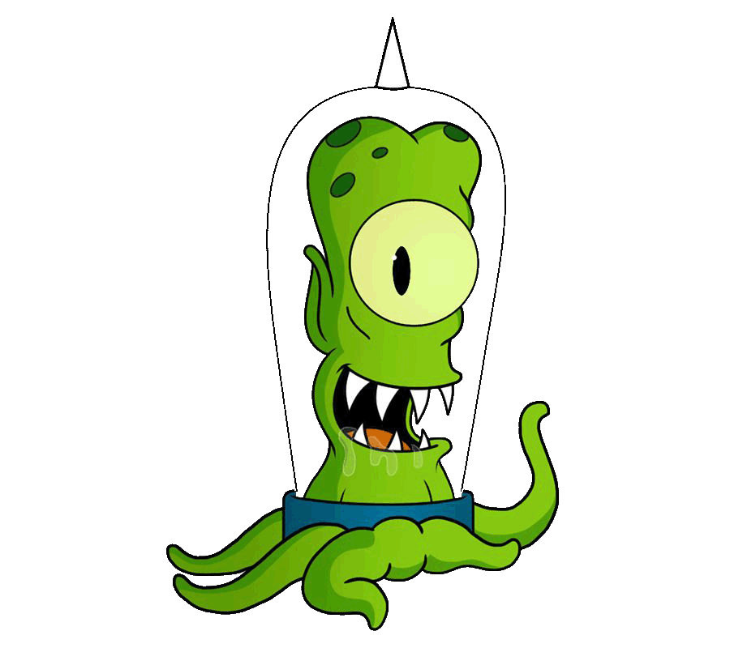

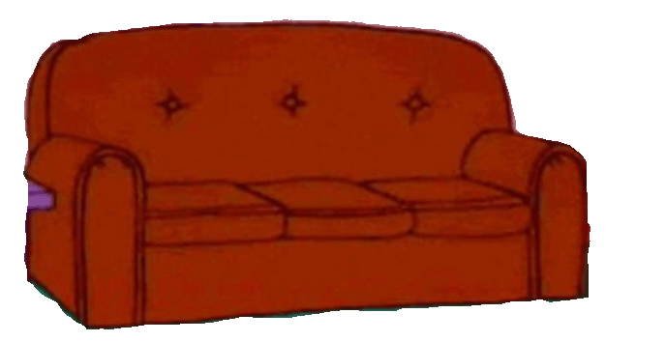
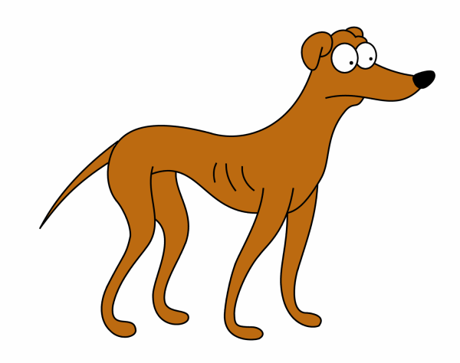
As of fall 2019, we are using PowerPoint to do our animations:
First decide on how to create the animation:
  To make an object arrives
  To emphasis an object while it is still there
  To make an object leave
  To make an object follow a path

Slide 30
Ease in/Ease Out (Smooth Start/End) and Bounce End
Smooth Start – slow at the beginning, gets quicker at that end
Smooth End – starts quickly but slows down at the end
Smooth Start – makes it start slowly (ease in)
Smooth End – makes it end slowly (ease out)
Smooth Start + Smooth End <= Duration
How to make a ball bounce in PowerPoint
0 for Smooth Start and 0 for smooth end
2 for Smooth Start and 0 for smooth end
4 for Smooth Start and 0 for smooth end
0 for Smooth Start and 2 for smooth end
0 for Smooth Start and 4 for smooth end
0 for Smooth Start/End 1 for bounce
2 Smooth Start, 0 smooth end, 1 bounce end
Default Start 2 sec smooth start and 2 sec smooth end

Slide 31

Regular Smooth Start Smooth End Bounce

Slide 32

Control your Timing and Duration
Go Canada!
When motion path (ghosted shape) has a green circle (start) or red circle (end), motion is selected. When motion path has a green triangle (start) or red triangle (end), motion is NOT selected.

Slide 33
Tweening in Action
QUESTION: Suppose we had the following starting picture and the given ending picture, what THREE things do you think you would have to consider in order to make it appear animated but it should have a smooth animation, not jerky?
QUESTION: What colour will the tween frames be?
Start picture
End picture

Slide 34
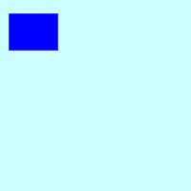
3 Things All Happening At Once:
Tweening: Creating the intermediate frames based on the starting keyframe and ending keyframe. In the above case, the tweening operation needs to create frames that are doing 3 things all at once:
  Going from a square to a circle
  Going from the top left corner to the bottom right corner (following a path)
  Going from blue to red (so it MUST go through purple in order for the transition to look smooth)
Notes:
shape

Slide 35
Try it yourself in PowerPoint
Both of these shapes start at blue but the left one morphs to red and the right one morphs to green. Before pushing play, try to figure out which colours each oval must go through to get to its ending colour. Then try it out in PowerPoint
Starts at blue, morphs to red
Starts at blue, morphs to yellow

Slide 36
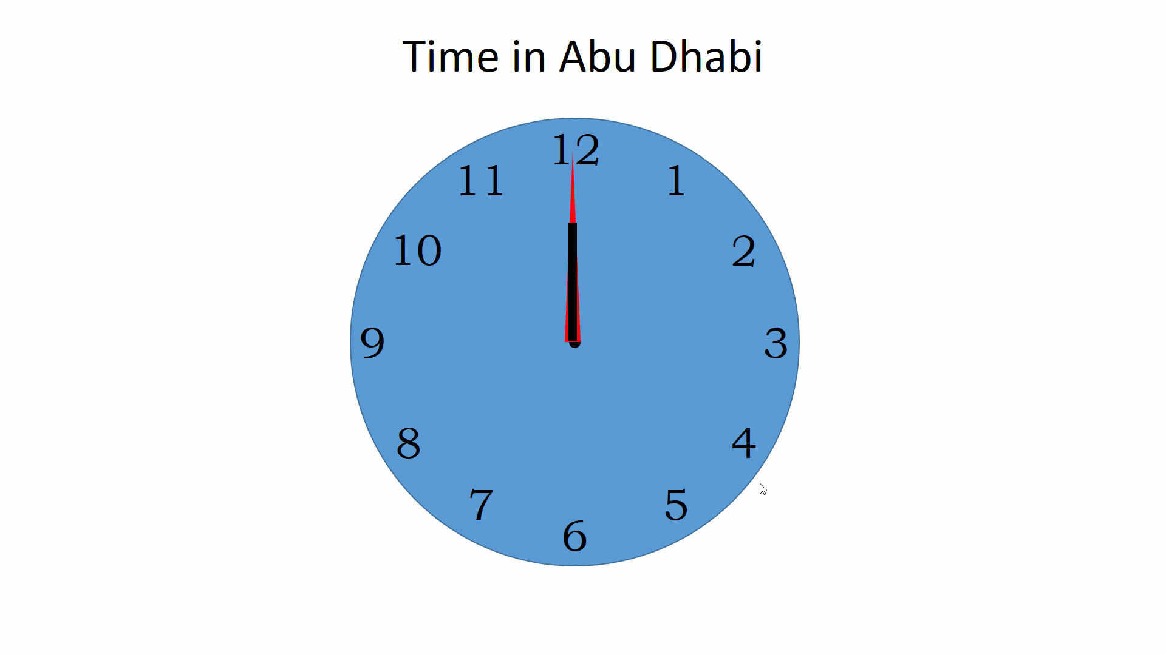
Laura’s first venture into the world of PowerPoint Animation ☺
First time I tried PowerPoint and this happened ☹ (can you see the problem?)

Slide 37
Comparing File Types:
 | Animated GIF | Flash | Photoshop | PowerPoint
Created by | Depends | Adobe | Adobe | Microsoft
Extension | Source depends .gif (movie) | .fla (source) .swf (movie) .gif (Flash can make gifs too!) | .psd (source) .mp4 OR .gif | .ppt (source) .mp4 (final version)
File Size | Larger than normal gif | Vector images take up less space than GIF bitmapped images | Fairly large (.mp4 files are compressed but still large) | Fairly large (.mp4 files are compressed but still large)
Need to play it | Nothing | Flash Player (Free – used to work with most browsers but now it is not supported in Chrome and Safari) | No plugin for .gif and most browsers can now play .mp4 | No plug in required for .mp4 anymore

Slide 38
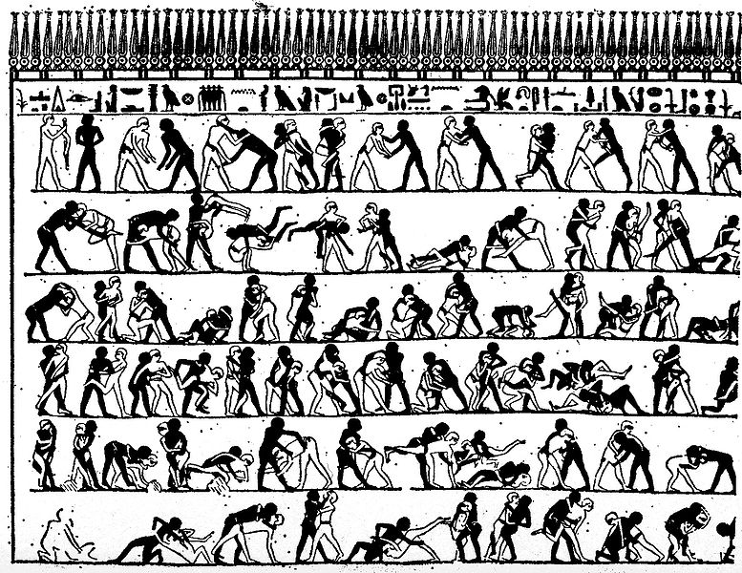
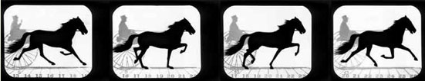

History of Animation:
→ early cave drawings show animals with 8 legs (trying to show animal moving)
→ 1868 – Flip book patented
→ 1877 - Praxinoscope Cylinder containing slits that when spun gave the illusion of movement
→ 1892 - Reynaud showed how he could use 12 pictures and loop the pictures. He had 500 frames using something similar to the modern film projector
→ 1898 – Stop motion animation introduced
Ancient Egypt Mural attempting to depict movement (4000 years old)

Slide 39
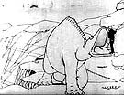
1906 → Blacktons makes “The Humorous Phases of Funny Faces” using a blackboard and frame by frame shots
1914 → McCay makes “Gertie the Dinosaur”, the first successful character animation
1928 → Walt Disney uses sound and animation in Steamboat Willie
1937 → first full length feature animation movie: Snow White
Gertie The Dinosaur

Slide 40
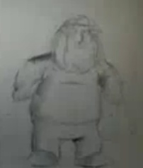
1960 → first prime time animation TV Show debuted Question: What was it?
Question: What is the longest running animation prime time show
1982 → Star Trek, The Wrath of Khan includes computer generated effects. TRON, a Disney animation includes 15 minutes of computer generated scenes
1986 → Take On Me by aha, creates much hyped video that uses rotoscoping (pencil-sketch animation/live-action combination )
1995 → Question: What was the first full length completely computer generated animation movie released?
Question: What is the highest grossing animated film of all time?
2011 → Cinemagraphs are invented…
Chris Griffin

Slide 41


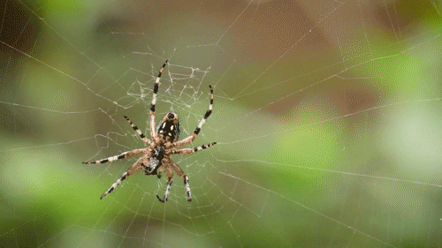
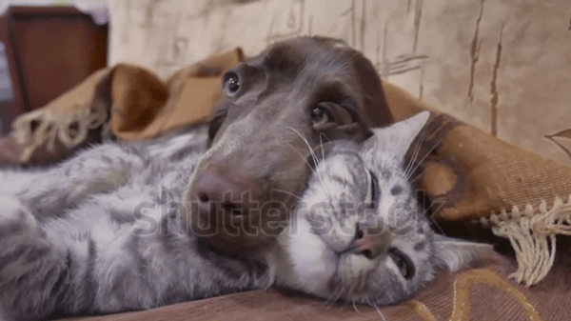
Cinemagraphs
Introduced in 2011
Sample One
Usually stored as animated .gif
To create one you will need BOTH a still picture and a video
Sample Two
Laura’s first tries at Cinemagraphs

Slide 42
Finally, for the major assignment, you must create an animation. Here is a previous one to inspire you!
  Cute major from a former year:

