Slide 1
Welcome to Multimedia & communications
Please look at the course syllabus in OWL (owl.uwo.ca).
Computer Science 1033
“Education: Being able to differentiate between what you do know and what you don't. It's knowing where to go to find out what you need to know; and it's knowing how to use the information once you get it.” → William Feather

Slide 2
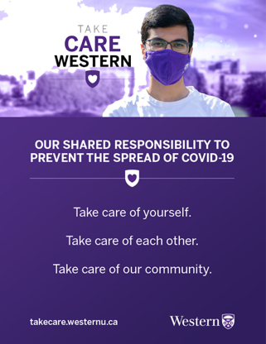
Western has both a vaccine and a mask mandate.
Students must complete the symptom checklist every day.
  Students who are found to be on campus who have not completed the symptom checklist or have failed the daily symptom check will be referred for investigation under the Student Code of Conduct.
Students are expected to carry their student cards to campus each day in anticipation of spot checks by Building Ambassadors.
Students not wearing masks will be asked to leave the classroom.
  Students with accommodations approved by Accessible Education must make arrangements with the instructor before coming to class, lab, practicum or clinical site.
  Eating and drinking are prohibited in the classroom to facilitate proper mask wearing.
Individuals found to have attended class without appropriate vaccination, or who are found to have engaged in fraud related to the vaccination policy, will face academic sanctions up to and including expulsion.
Students who are not fully vaccinated by October 12th 2021 and who are not granted an exemption under the policy will be issued a trespass order. Enforcement of this trespass order will be carried out by campus police, and will be accompanied by academic sanctions, up to and including expulsion.

Slide 3
Overview of Today’s Topics
Introduction to the lecturers and let’s find out about you!
Introduction to the course
What will you need to purchase
Go over course outline
Visit the course website:
  http://owl.uwo.ca
Closing Remarks
LOTS OF VALUABLE INFORMATION

Slide 4
Introduction to the Lecturer
Monday Night Class
  Instructor: Laura K. Reid
  Email: lreid@csd.uwo.ca
  Office: Middlesex College Room 416 (hard to find, you need to use the south stairs or the south elevator)
  Office Hours (both in person and on zoom):
    Mondays 1:00pm – 2:00pm
    Wednesdays 10:00am – 11:00am
    Other available by email appointment
The best way to contact me is via email:
  Make sure you put CS1033 in the subject line.
  Email me with your @uwo.ca account.
  I may email the entire class sometimes, check your UWO email at least every 72 hours.
  NOTE: I don’t always check email on Saturday and Sunday.

Slide 5
Introduction to YOU
How many of you are:
  In first year?
  In MIT?
  In BMOS?
  In Computer Science?
  In second, third or fourth year?
How did you hear about this course?
  From a friend or relative
  From a counsellor
  Read about it in the calendar or on the web

Slide 6
Introduction to YOU
How many of you have used:
  Affinity Photo/Photoshop?
  Web building software?
  FTP?
  Animation building software?
  Sound editing software (like Audacity)?
  Movie making software (like iMovie)?
DON’T WORRY! REMEMBER: I am assuming you don’t know any of the above software!

Slide 7
Introduction to the Course
What is this course all about?
  Communication on the world wide web!
    What to communicate → up to you
    How to communicate → up to you but with some guidance from me

Slide 8

Communication on the Web
Communications
Multimedia
Convey thoughts
Exchange Ideas
  Make sure you are:
    Articulate
    Clear
    Easy to understand
How to do I put those thoughts on the Internet?
  Text
  Images
  Video
  Sound
  Animation

Slide 9
Learning Outcomes
Upon completion of this course, you should be able to:
  Apply the 4 basic design principles in order to create an effective and eye pleasing design
  Sample and quantize different forms of analog data to convert it to digital data
  Understand how compression affects different forms of data and how to helps us decide how we represent the data
  Explain how the internet is represented, how data travels across it and how websites are represented on it
  Describe the algorithm Google uses when searching and the other considerations it takes into account when performing a search.
  Describe how animation, video and audio are represented on a computer
  Create and manipulate images and animation using PowerPoint
  Create and edit video clips and audio clips
  Create webpages that include text, images, video, animations and audio WITHOUT using template based web building software

Slide 10
What will I learn?
LECTURES → Multimedia Components
  Text
  Graphics
  Animation
  Video
  Sound
LABS (10 labs) →
  File Transfer (1)
  Affinity (2)
  HTML5Editor(3)
  PowerPoint Animation(2)
  Audacity (1)
  Shotcut and integration (1)

Slide 11

What do you need to purchase?
Digital Textbook written specifically for this course!
  Costs just around $30 CAD
  It contains more in-depth explanations of the topics taught in class, more examples, and lots of review questions after each chapter.
  Purchase book here: https://he.kendallhunt.com/product/multimedia-and-communication

Slide 12
What do I need to purchase?
Lecture notes are available on the website
Software is available in MC230 and NCB105 (perhaps MC235 also....SORT OF!)
Following software is free:
  Shotcut
  Audacity
  SFTP Software (WinSCP is available from ITS, Mac users can use Fugu or Filezilla)
  HTML5-Editor

Slide 13
What will I need to purchase?
Affinity Photo Software (70 dollars):
MAKE SURE YOU GET AFFINITY PHOTO (NOT Designer or Publisher) https://affinity.serif.com/en-gb/photo/#buy
  I have emailed them to ask about a student rate (student rate is 42 dollars) More info here: http://www.csd.uwo.ca/~lreid/cs1033/affinity/studentpurchaseswesternu.pdf AND in Owl under the FAQ section.
MC230 and NCB105 have Affinity Photo
Free 7 day trial version
Middlesex College labs are open 24/7 as long as there is no lab being conducted in them. You need your student card to get into the building and into the lab rooms. (North entrance of the building)

Slide 14
Peer Marking Subscription
We are doing Peer Marking for the assignments (more info in a minute)
Kritik.io
20 dollars
You MUST purchase a subscription to this in order to take this course. You cannot complete the course without making this purchase.

Slide 15
Let’s go over the Course Outline
READ THE COURSE OUTLINE, it is a contract between you and me!
Lectures → New this year FLIPPED CLASSROOMS!
Quizzes → worth 8% of final grade
Labs → worth 9% of final grade
Assignments:
  Poster Assignment → 8 %
  Web Assignment→15 %
  Major Assignment → 20 %
Exam → worth 40%

Slide 16
Consulting
Both professors have office hours
Each of our teaching assistants must consult 2 hours a week during assignments.
Consulting by teaching assistants will likely be done via Zoom – please check Owl for the zoom room and remember that the t.a. will only let you in one at a time.
Consulting hours are posted in Owl.

Slide 17
Lectures
This crazy Covid year we are going blended!
Lectures will be videos that you watch every week on your own time
Come to class every OTHER week and we will do activities that will help you do better on the quizzes and the assignments → FLIPPED CLASSROOMS!
The dates for the flipped classrooms (i.e. the dates you come to class) are:
  Jan 24 (Zoom)
  Feb 7 (Zoom)
  Feb 28 (Hopefully in person)
  March 14 (In person)
  March 28 (In person)
We will do activities mostly during these sessions to reinforce material, we will not be teaching you new material.

Slide 18
Lectures continued
On the opposite weeks, you will have a quiz during lecture time to make sure you are watching the videos. The quizzes will be:
  Jan 31
  Feb 14
  March 7
  March 21
  April 4
Quizzes Info:
  40 minutes long
  Always on the previous 2 weeks worth of lecture videos (not lab material unless they overlap)
  Given via Owl and open book (only open during lecture time)
  We drop your lowest quiz.

Slide 19
Labs BEFORE READING WEEK
You do NOT need to do anything during your lab time, all labs will be done online and all will be due Monday nights at 11:45pm
Your t.a. will be available via zoom during your lab time if you need help but you do not have to attend this lab session. You only need to go if you need help
Labs are worth 1 mark each but we drop your lowest. Lab marks add up to 10, you will get either 9% or the total of all your lab marks, which ever is lower.
Due to add/drop date, BOTH lab 1 and lab 2 will be due on Monday, Jan 24.
Lab 3 will be due Monday, Jan 31
Lab 4 will be due Monday, Feb 7
Lab 5 will be due Monday, Feb 14
Hopefully we will be back in person after Feb 27th and then you go to your regularly scheduled lab!
Hand in Labs 1-5 in Owl>Assignments

Slide 20
Labs AFTER READING WEEK
Always bring a memory stick to your lab! Labs 8, 9 and 10 bring headphones.
Need your student card to open the door to the labs in Middlesex College
Lab attendance is mandatory
You MUST attend the lab you registered for, you may NOT switch labs during the term.
Labs 1-10 are worth 1% each
Lab marks add up to 10, you will get either 9% or the total of all your lab marks, which ever is lower.
Your lab mark will be updated every week in Owl by your teaching assistant.
You can not make up a lab, that is why we mark it out of 9 rather than 10, so you have a bit of wiggle room in case you are sick/busy/sleep in one week!

Slide 21
Labs continued…
Remember to ALWAYS sign the TA’s attendance sheets! It is up to you to make sure that your attendance was recorded so you get the mark.
You MUST do the lab during the 2 hour lab period. DON'T come to the lab with it already completed.
If you are trying/working hard, you will get the 1%, if you are playing on your phone the whole lab, you will NOT get the 1% even if you show up.
If you attended and completed a lab but your mark isn't updated within a week, contact the TA to ask about the missing mark. Don't wait until the end of term to ask about missing marks.
Once the lab marks are posted, you have 2 weeks to complain if it is incorrect.

Slide 22
Labs continued…
A strike out in the gradebook in owl is just to show that we drop your lowest mark
I only teach this course, I have nothing to do with enrollment so I can NOT switch your lab for you.
SELF – REPORTING: NOTE: you still have to do the lab on your own time if you self report or get accommodations from your counsellor. If you Self Report, you MUST email me within 48 hours.
NOTE ABOUT LABS (WEIRD SITUATIONS):
  Lab 10 will likely be online if you want, so you can get ahead for last assignment.

Slide 23
Assignments
Poster Assignment → Design a poster for a given scenario (Affinity) (8%)
Web Assignment→ Design a website for a given scenario (HTML5-Editor & Affinity ) (15%)
Major Assignment → Design a website about Sports (HTML5-Editor,Affinity, PowerPoint, Shotcut/iMovie) (20%)
Here are some examples from previous years…

Slide 24


Previous Poster Assignments
Create a poster for The Grad Club Pub at Western

Slide 25



Previous Poster Assignments
Create a poster for the Computer Science Department

Slide 26


Previous Poster Assignments
Community Engaged Learning → http://www.success.uwo.ca/experience/curricular/index.html

Slide 27

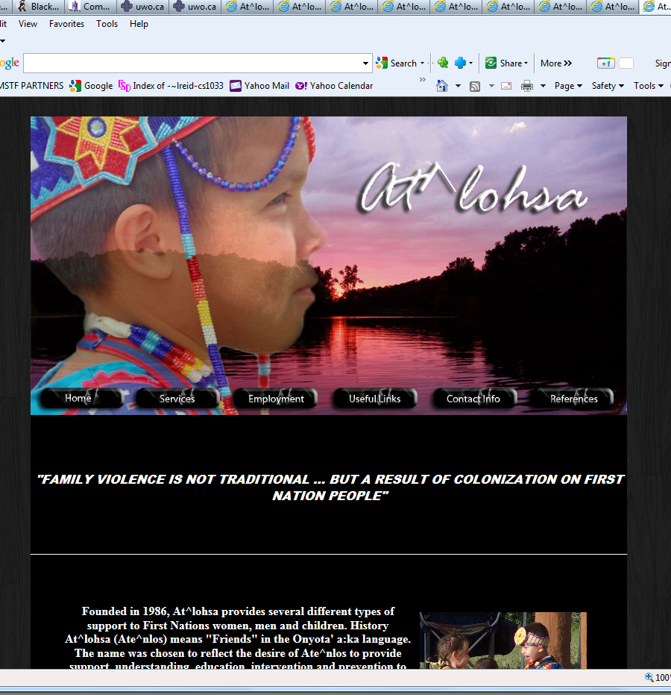


Previous Web Assignments
Create a website for a given scenario → Remembrance Day, Theatre Company, Native Family Healing Centre (Community Service Project)

Slide 28
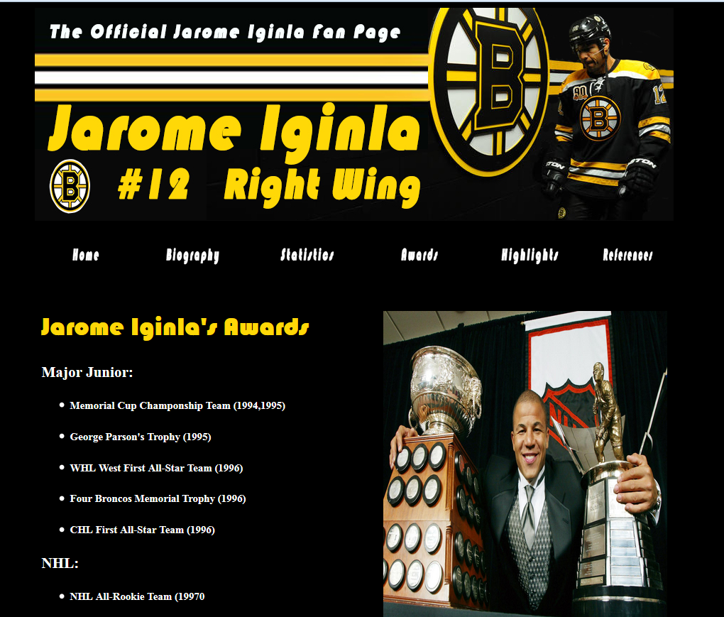

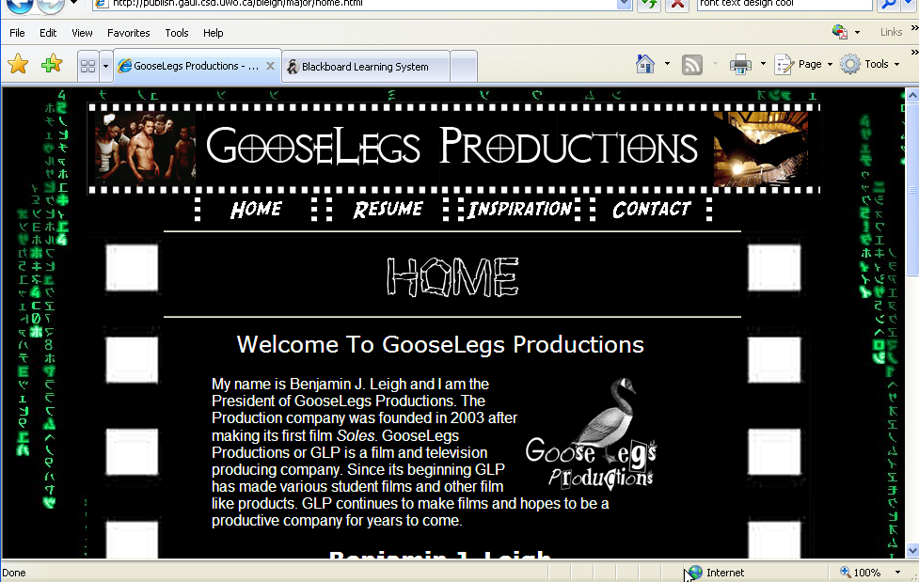

Previous Major Assignments
Design a website about Sports:
http://cs1033.gaul.csd.uwo.ca/~lreid2/other/student23/major/
Favorite Building - Home (uwo.ca)

Slide 29

Major Assignment Continued…
Had to contain video and animation, here are some samples from previous years:
Brescia Move-in Day
Simon The Dog Video
http://www.csd.uwo.ca/~lreid/AnimationExamples/flashbasketball.swf
http://www.csd.uwo.ca/~lreid/AnimationExamples/welcome.swf
http://www.csd.uwo.ca/~lreid/AnimationExamples/freighttrain.swf
http://www.csd.uwo.ca/~lreid/AnimationExamples/puggie2.swf
http://www.csd.uwo.ca/~lreid/AnimationExamples
http://www.csd.uwo.ca/~lreid/cs1033/samplemajor
This year: Student Major

Slide 30
Assignments
Students will lose 15% off the assignments grade for each day it is late. Thus an assignment that is 2 days late and was marked at 85% would receive 55%
No assignments more than 3 days late will be accepted
NO EXTENSIONS WILL BE GIVEN FOR ASSIGNMENTS unless instructed by the student’s academic counsellor or you SELF REPORT.
  If you Self Report you get a 48 hour extension from the original due date.
  If you Self Report, you MUST email me within 48 hours!

Slide 31
Handing in/Marking Assignments
You will be submitting a link to your assignment via kritik.io
After the late period is over, you will be assigned 5-6 other students to mark according to our rubric that we have set up in kritik
You will get 2 or 3 days to complete the marking (it should not take more than 1.5 hours in total).
After all the marking is done, you will get 24 hours to review how you were marked and evaluate the people who marked you. (this part should take no more than 5 minutes).

Slide 32
Marking of Assignments
80% of your grade is based on the marks your peers gave you.
10% of your grade is based on how well you mark your peers.
5% of your grade is based on what your peers think of your written comments about your marking.
5% of your mark is based on you checking how you were marked. (EASY marks for this part!)

Slide 33
Marking Assignments
If you think your assignment was marked incorrectly, you can submit a dispute and we will check to see if one of the markers made a mistake.
You cannot dispute subjective rubric items, you can only dispute the non subjective items. (Must dispute within 4 days)
You get a better mark if you give the correct mark, not the highest easy mark, nor the hard low mark but the deserved mark, so mark carefully
This process helps you do better in the course because it helps you do better on the next assignment

Slide 34
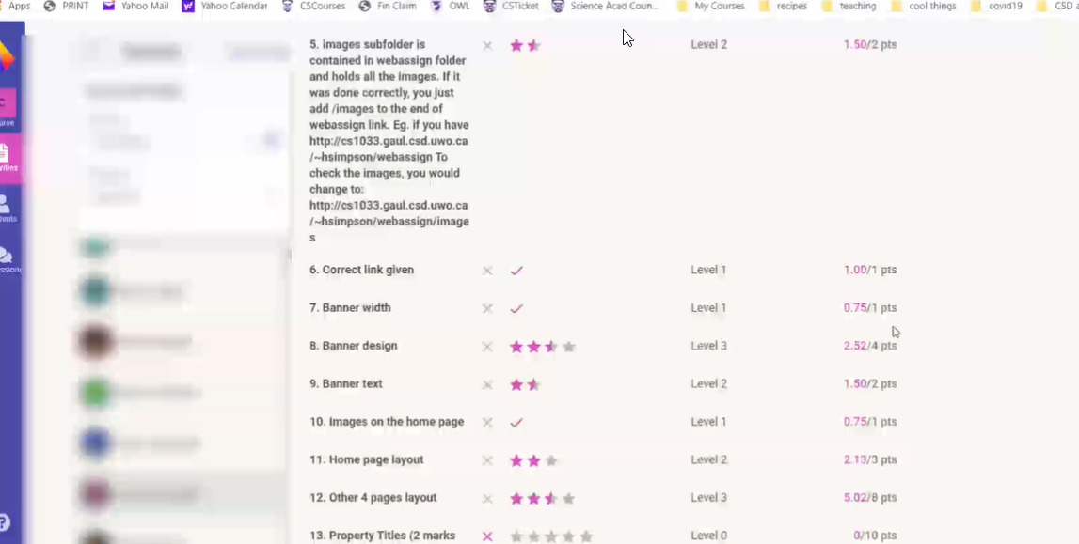
Example

Slide 35
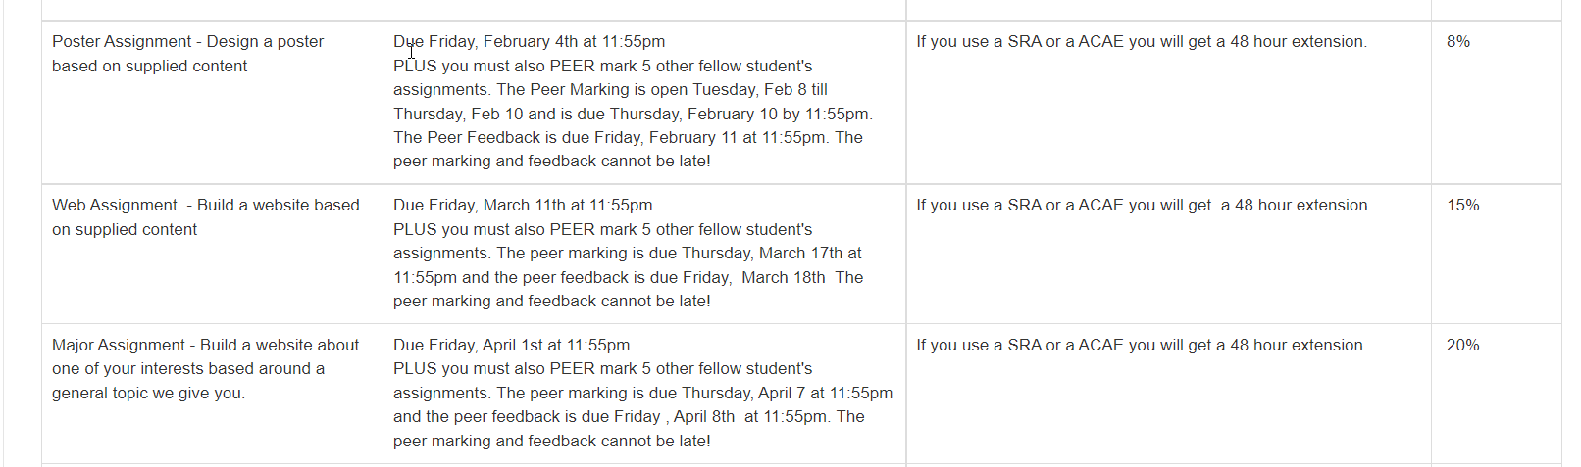
Assignment Dates

Slide 36
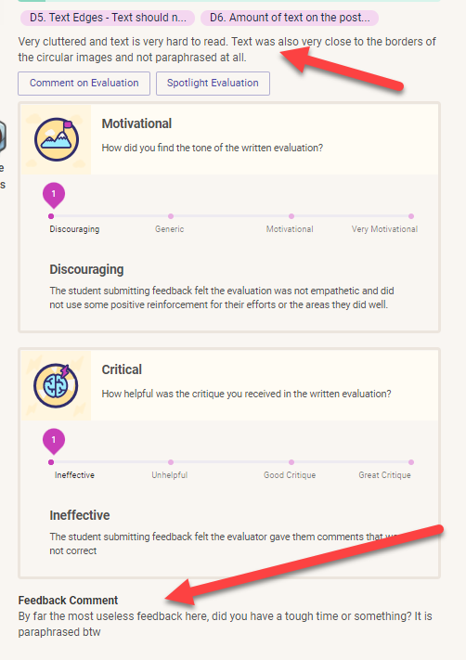
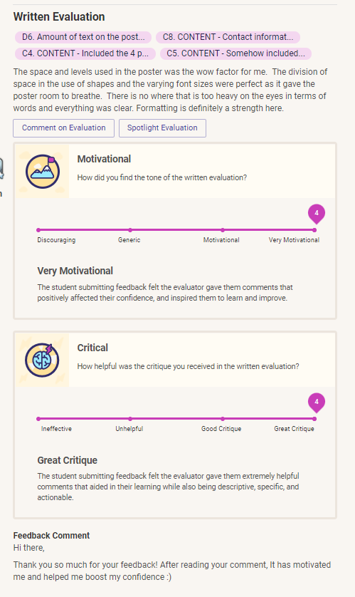

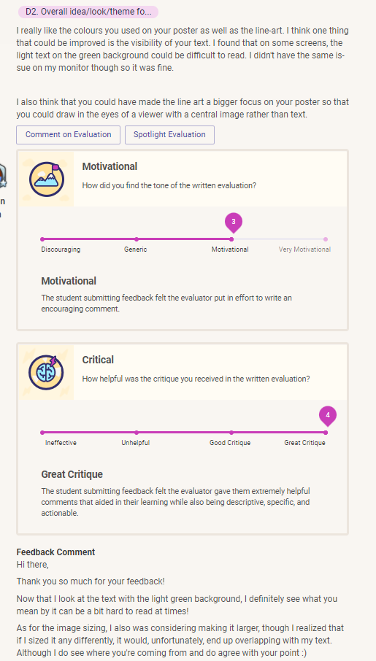

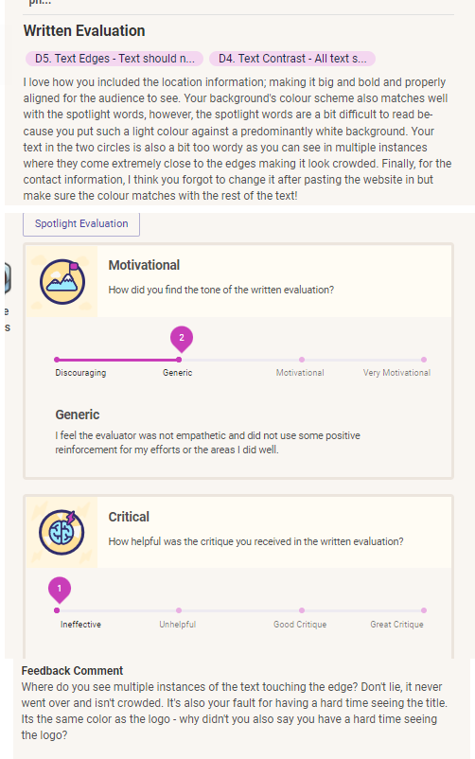
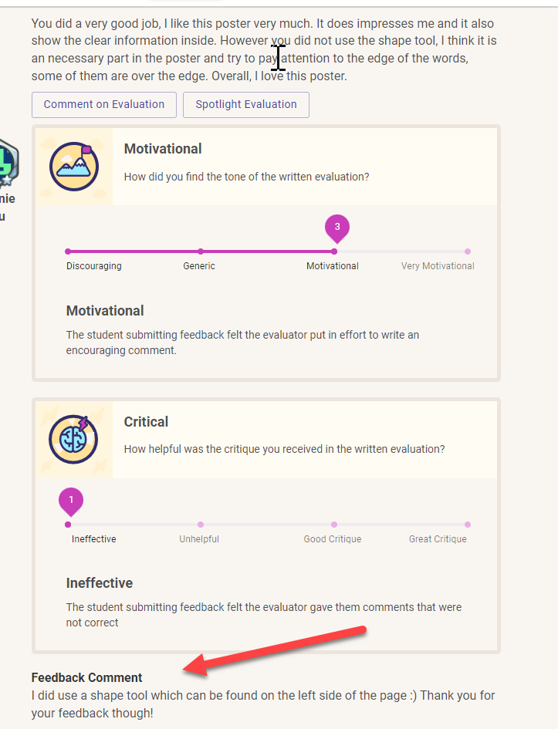
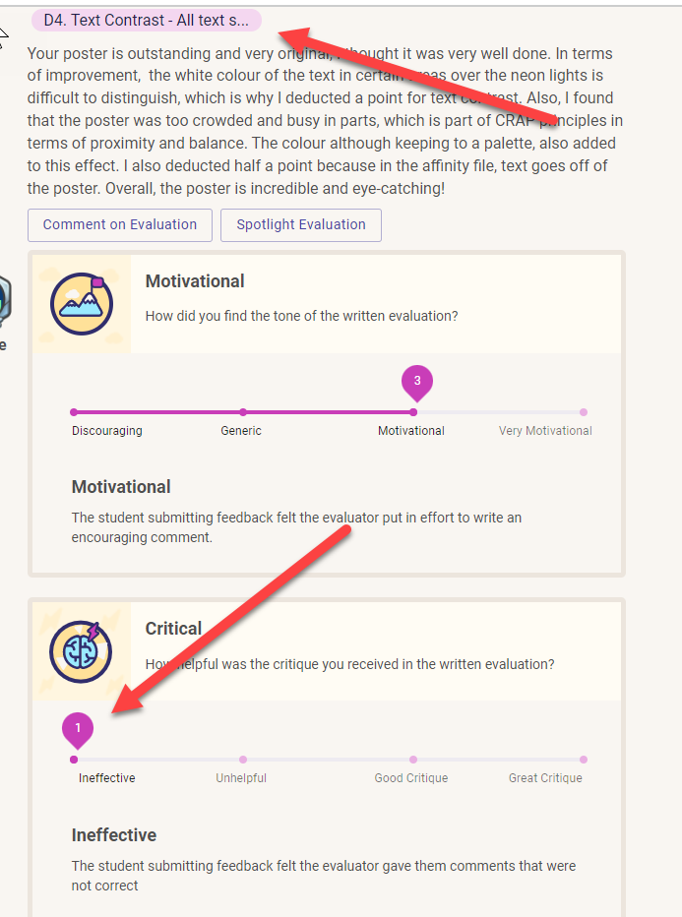
Some last comments about Peer Marking
Peer marking is process, not an exact science. Do not expect to get perfect on the peer marking, expect to learn from the process of doing it. (softskills like giving feedback, accepting feedback, etc..)
Being respectful in the feedback process is expected. Someone listing flaws of your assignment is not an insult to you and you shouldn’t give low feedback scores.
Every career you have, I promise you (unless you literally are a self-employed team of one - and even then you still have to interact with customers), you're always going to be getting feedback from people. You're never going to be able to just produce work and walk away from it. And so this is a great introduction to getting used to that.

Slide 37
If you can follow instructions, you should be able to get at least 70% on all the assignments. The assignments have subjective parts, do not expect to get 100%. If you are expecting to get 100% on every assignment in order to get into med school, this isn’t the course for you.
Test what you hand in to Kritik on a DIFFERENT computer/your phone. It might work fine on your computer but not work for anyone else.
Cheating à we have seen lots of students cheat last term. The course material is not super hard but it does require effort (if you want a bird course – this ain’t it!)
  Bryan and Laura are VERY available to help you if you get stuck so there is NO Reason to cheat, it is not worth the risk!

Slide 38
Exam
There is only a final exam in this course, no midterm
Final Exam is about 150 multiple choice and true or false questions…LOTS OF MEMORIZATION REQUIRED (IT WILL NOT BE OPEN BOOK!)
Worth 40% of final mark
Final exam mark combined with the major assignment mark must be over 45% to pass the course.
Must get over 45% on the final exam to get over a 59% in the course and over 35% to pass the course.
See your Academic Counsellor in your Dean’s office if you can not attend the exam, DO NOT SEE ME, I can’t do anything about final exams!
Exam is automatically checked for cheating, DON’T CHEAT!

Slide 39
Integrity/Organizational Quiz
Based on everything I said today and the course outline and academic integrity
  Sample questions:
    If I miss my lab, I can just go to another lab to make it up.
      True
      False
    The professor can switch my lab for me.
      True
      False
You get unlimited tries; you must get perfect on it in order to open up the rest of the course material.
If you get stuck on a question, and can’t get it after 3 or 4 tries, email me and I will give you a hint.
You have till the end of THIS month to do the quiz. Don’t forget to complete it.

Slide 40
Let’s Look At The Website
Course Website (announcements, lab information) → http://owl.uwo.ca

Slide 41


Slide 42



Open Monday-Friday, 10:30-3:30

Slide 43


Can you see any difference between these 2 images?

Slide 44
Some advice to do well in this course:
Prepare for (read over before the lab) and attend all your labs
Attend the flipped classroom sessions.
Do all your assignments, especially the last one
The final exam is mostly memorization, review your notes every week.
Then you have an excellent chance of doing very well in this course ☺

Slide 45
Last Slide!
You can’t register for Kritik until the add/drop is over! Don’t email us about this!
For next week:
  READ THE COURSE OUTLINE CAREFULLY
    Do the quiz in OWL! – remember you can’t see anything for the course without getting 100% on it!
  Once you are done the Integrity Quiz, start watching the Week 1 videos.
  Remember the first 2 labs are due January 24.
Using PowerPoint to do our animations, here are some inspirations:
ANY QUESTIONS?

