Slide 1

CS 1033A
MULTIMEDIA & COMMUNICATIONS

Slide 2
Overview of today's class
INTRODUCING ME, YOU, AND THE COURSE ITSELF
LEARNING OUTCOMES AND REQUIREMENTS
Course schedule and IMPORTANT DATES

Slide 3


Introducing us (the instructors)
Laura Reid Section 200 Office: MC 416 Email: lreid2@uwo.ca
Bryan Sarlo Section 201 Office: MC 349 Email: bsarlo@uwo.ca

Slide 4
Contacting us
Both Laura and Bryan have weekly office hours (see syllabus for days/times).
Our TAs will have consulting hours only on the weeks when assignments are due.
The best way to communicate is by email. Please include CS 1033 in the subject line and use your Western email address.

Slide 5

Introducing you (the students)
How many of you are:
In 1st year?
Not in 1st year?
In MIT?
In BMOS?
In CS?
Excited for this course?

Slide 6

Introducing you (the students)
How many of you have used:
Photo editing software (i.e. Photoshop)?
Web building software?
FTP / SFTP?
Animation building software?
Audio editing software (i.e. Audacity)?
Video editing software (i.e. iMovie)?

Slide 7
What is this course about?
Multimedia
Combining media (text, images, audio, video, etc.)
Communications
How do computers work and communicate with each other?
How do we reach our intended audience?

Slide 8

Lecture topics
Text and graphics
How computers work
Website design
Animation
Video
Audio

Slide 9

Lab topics – 10 Labs
SFTP (1)
Affinity Photo (2)
HTML5 Editor (3)
PowerPoint animation (2)
Shotcut video editing (1)
Audacity audio editing (1)

Slide 10
Learning outcomes (part 1)
Apply the 4 basic design principles in order to create an effective and eye pleasing design.
Sample and quantize different forms of analog data to convert it to digital data.
Understand how compression affects different forms of data and how to helps us decide how we represent the data.
Explain how the internet is represented, how data travels across it and how websites are represented on it.

Slide 11
Learning outcomes (part 2)
Describe the algorithm Google uses when searching and the other considerations it takes into account when performing a search.
Describe how animation, video and audio are represented on a computer.
Create and manipulate images and animation using PowerPoint.
Create and edit video clips and audio clips.
Create webpages that include text, images, video, animations and audio without using template based web building software.

Slide 12

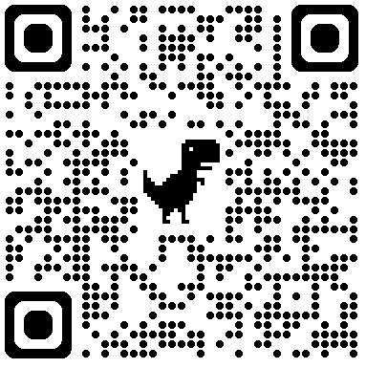
Textbook
This is a recommended textbook.
It was written specifically for this course!
Lots of review questions and helpful examples and diagrams.
Cost is about $40 CAD.
Digital book only.
https://he.kendallhunt.com/product/multimedia-and-communication

Slide 13

Course structure
Lectures
Pre-recorded videos you can watch whenever and wherever.
10 weeks worth of videos
In-person (blended) classes
Roughly every 2 weeks.
We'll go through demonstrations, exercises, and review questions.

Slide 14
Course structure – blended classes
Class | Section 200 | Section 201
Blended 1 (Reviews weeks 1&2) | Wednesday Sept 16 | Friday Sept 18
Blended 2 (Reviews weeks 3&4) | Wednesday Oct 7 | Friday Oct 9
Blended 3 (Reviews weeks 5&6) | Wednesday Oct 28 | Friday Oct 30
Blended 4 (Reviews weeks 7&8) | Wednesday Nov 11 | Friday Nov 13
Blended 5 (Reviews weeks 9&10) | Wednesday Nov 25 | Friday Nov 27
 | 7pm-9pm in MC-110 | 11:30am-1:30pm in SSC-2050

Slide 15
Evaluation
Assessment Type | Weight | Notes
Integrity/Organizational Quiz | 1% | Unlocks content
Quizzes (5) | 8% | Best 4 of 5 (2% each)
Labs (10) | 8% | Best 8 of 10 (1% each)
Assignments (3) | 43% | Weights are 8%, 15%, and 20%
Final Exam | 40% | Covering topics from whole course

Slide 16
Evaluation – Integrity/organizational quiz
Open now and must be completed in January.
About the course outline and academic integrity policies.
In Brightspace > Assessments > Quizzes.
Open-book and unlimited attempts.
Must get at least 90% on the quiz.
The weekly content will be locked until you complete this quiz.

Slide 17
Evaluation – Quizzes
Roughly every 2 weeks on the weeks we don't have class.
Can do it from anywhere but only during the class time.
30 minutes from when you start or until the class time ends.
Covers topics from previous 2 weeks' lecture videos.
Multiple choice, fill in the blanks, matching questions.

Slide 18
Evaluation – Quizzes
Quiz | Section 200 | Section 201
Quiz 1 | Wednesday Sept 23 | Friday Sept 25
Quiz 2 | Wednesday Oct 21 | Friday Oct 23
Quiz 3 | Wednesday Nov 4 | Friday Nov 6
Quiz 4 | Wednesday Nov 18 | Friday Nov 20
Quiz 5 | Wednesday Dec 2 | Friday Dec 4
 | Open 7pm-9pm | Open 11:30am-1:30pm

Slide 19
Evaluation – Labs
Weekly in-person hands-on work in a computer lab.
Start the week of Sept 21-25
You MUST attend the section in which you are registered – NO EXCEPTIONS!
Do not do the lab work before your scheduled session.
You must show up, do the work in the lab, and show the TA.

Slide 20
Evaluation – 3 Assignments
Poster Assignment: create a poster with given information.
Web Assignment: create a website with given information.
Major Assignment: create a website with an animation and video about anything that relates to: Western Campus.

Slide 21
Evaluation – Assignments
Assignments will be peer marked.
You will need to subscribe to Kritik.io (about $22) but wait 1-2 weeks until we send you an email invitation to register.
You will have to mark 5-6 other students for each assignment.
Part of your assignment grade will come from the peer marking.

Slide 22
Evaluation – Assignments
Peer marking is not perfect but there are systems in place to help make it as fair as possible.
It helps you learn the material better and prepare for other assignments, quizzes, and the final exam.
It teaches you to give and receive feedback.
Rubrics are clear and available early.

Slide 23
Evaluation – Assignments
Assignment | Creation Due* | Peer Marking Due | Feedback Due
Poster | Friday, Oct 22 | Oct 27-29 | Oct 30
Web | Friday, Nov 13 | Nov 17-19 | Nov 20
Major | Thursday, Dec 3 | Dec 7-9 | Dec 10
* Assignment creations can be submitted up to 3 days late and then will NOT be accepted anymore. Once peer marking begins, assignments cannot be submitted or modified.

Slide 24
Evaluation – Assignments
Late assignment penalties are normally 15% per day late.
You are given 3 late coupons for this course.
Each late coupon waives the penalty for 1 late day.
You can decide how many to use on each assignment but once they run out, they do not replenish, and late penalties will be applied to any late submissions.

Slide 25
Evaluation – Assignments
You still must submit by 3 days after the assignment's due date. This is a FIRM cutoff and assignments submitted or modified after this point will be given a mark of zero (0%).
We will post a Qualtrics form during the assignment's due period. You MUST indicate your desired number of late coupons to use in that form. They will NOT be automatically applied.
In Brightspace, go to the Useful Stuff section for more info.

Slide 26


Evaluation – Assignments (First Assignment)
Examples of a previous poster assignment:

Slide 27
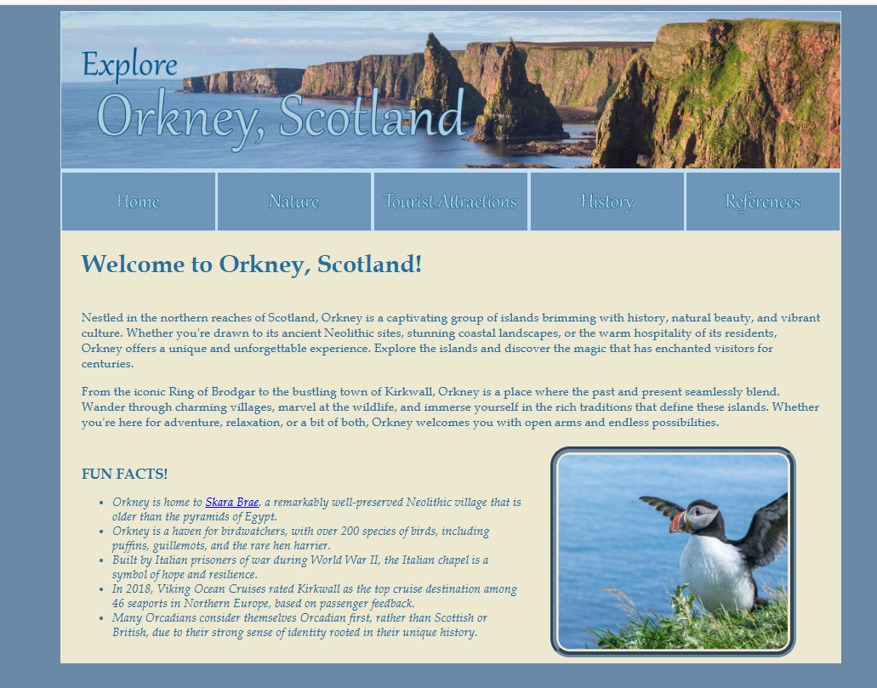
Evaluation – Assignments (Second Assignment)
Example of a previous web assignment:

Slide 28
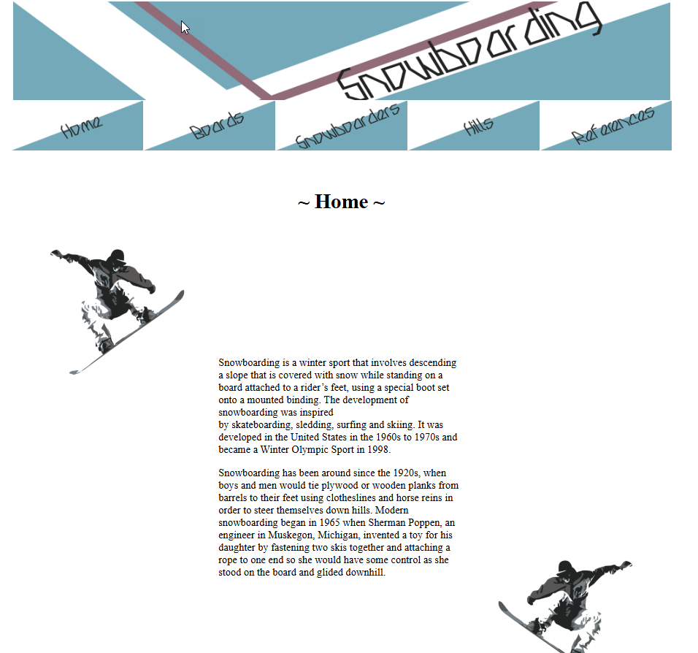
Evaluation – Assignments (Third Assignment)
Example of a previous major assignment:
https://cs1033.gaul.csd.uwo.ca/~lreid2/other/student33/major/index.html

Slide 29
Evaluation – Final exam
The final exam contains about 150 questions.
They are multiple choice and true/false.
Covers material from lecture videos, labs, and assignments.
The university will schedule the exam; it will be in the exam period April 12-30. Details should be available in 1-2 months.

Slide 30
Evaluation – Grade requirements
Weighted average between final exam and major assignment must be at least 45% to pass the course.
Final exam mark must be at least 35% to pass the course.
Final exam mark must be at least 45% to get over 59% in the course.
Your mark may be reduced if you do not meet the requirements.

Slide 31
What do I need?
In Owl>Useful Stuff>Useful Links &FAQs>Useful Links to get:
WinSCP (Windows) / Filezilla (Macs – Client Version) – free to download
Brackets
Affinity By Canva– free
HTML5 Editor – free in-browser app
Shotcut / iMovie – free to download
Kritik – $22 subscription
ALL software is available in MC230 & MC240 to work on campus

Slide 32
Next steps
Read the course outline.
Complete the integrity/organizational quiz.
Watch the Week 1 and Week 2 videos ASAP.
Mark your calendars with the important dates we discussed.
Don't worry about Kritik yet!

Slide 33
Any Questions?
Some final thoughts on using AI in this course:
The real value of this course comes from doing the work yourself. Every assignment is a chance to build skills, prepare for the final exam, and make your investment in education pay off. Shortcuts won’t grow your knowledge—effort will.
If you let a robot do all the work, guess who’s ready for the exam? The robot. Don’t let that happen—be smarter than the bot!
See you all NEXT week in this class, watch the Week 1 and Week 2 lecture videos BEFORE next week’s class!

