Slide 1
Welcome to Multimedia & communications
Please look at the course syllabus in OWL (owl.uwo.ca).
Computer Science 1033
“Education: Being able to differentiate between what you do know and what you don't. It's knowing where to go to find out what you need to know; and it's knowing how to use the information once you get it.” → William Feather

Slide 2
Overview of Today’s Topics
Introduction to the lecturers and let’s find out about you!
Introduction to the course
What will you need to purchase
Go over course outline
Visit the course website:
  http://owl.uwo.ca
Closing Remarks
LOTS OF VALUABLE INFORMATION

Slide 3
Introduction to the Lecturer
Monday Night Class
  Head Instructor: Laura K. Reid (but Bryan Sarlo and I co-teach the course)
  Email: lreid@csd.uwo.ca
  Office: Middlesex College Room 416 (hard to find, you need to use the south stairs or the south elevator)
  Office Hours (both in person and on zoom):
    Mondays 1:00pm – 2:00pm
    Wednesdays 10:00am – 11:00am
    Other available by email appointment
The best way to contact me is via email:
  Make sure you put CS1033 in the subject line.
  Email me with your @uwo.ca account.
  I may email the entire class sometimes, check your UWO email at least every 72 hours.
  NOTE: I don’t always check email on Saturday and Sunday.

Slide 4
Introduction to YOU
How many of you are:
  In first year?
  In MIT?
  In BMOS?
  In Computer Science?
  In second, third or fourth year?
How did you hear about this course?
  From a friend or relative
  From a counsellor
  Read about it in the calendar or on the web

Slide 5
Introduction to YOU
How many of you have used:
  Affinity Photo/Photoshop?
  Web building software?
  FTP?
  Animation building software?
  Sound editing software (like Audacity)?
  Movie making software (like iMovie)?
DON’T WORRY! REMEMBER: I am assuming you don’t know any of the above software!

Slide 6
Introduction to the Course
What is this course all about?
  Communication on the world wide web!
    What to communicate → up to you
    How to communicate → up to you but with some guidance from me

Slide 7

Communication on the Web
Communications
Multimedia
Convey thoughts
Exchange Ideas
  Make sure you are:
    Articulate
    Clear
    Easy to understand
How to do I put those thoughts on the Internet?
  Text
  Images
  Video
  Sound
  Animation

Slide 8
Learning Outcomes
Upon completion of this course, you should be able to:
  Apply the 4 basic design principles in order to create an effective and eye pleasing design
  Sample and quantize different forms of analog data to convert it to digital data
  Understand how compression affects different forms of data and how to helps us decide how we represent the data
  Explain how the internet is represented, how data travels across it and how websites are represented on it
  Describe the algorithm Google uses when searching and the other considerations it takes into account when performing a search.
  Describe how animation, video and audio are represented on a computer
  Create and manipulate images and animation using PowerPoint
  Create and edit video clips and audio clips
  Create webpages that include text, images, video, animations and audio WITHOUT using template based web building software

Slide 9
What will I learn?
LECTURES → Multimedia Components
  Text
  Graphics
  Animation
  Video
  Sound
LABS (10 labs) →
  File Transfer (1)
  Affinity (2)
  HTML5Editor(3)
  PowerPoint Animation(2)
  Audacity (1)
  Shotcut and integration (1)

Slide 10

What do you need to purchase?
Digital Textbook written specifically for this course!
  Costs just around $30 CAD
  It contains more in-depth explanations of the topics taught in class, more examples, and lots of review questions after each chapter.
  Purchase book here: https://he.kendallhunt.com/product/multimedia-and-communication

Slide 11
What do I need to purchase?
Lecture notes are available on the website
Software is available in MC230 and NCB105 (perhaps MC235 also....SORT OF!)
Following software is free:
  Shotcut
  Audacity
  SFTP Software (WinSCP is available from ITS, Mac users can use Fugu or Filezilla)
  HTML5-Editor

Slide 12
What will I need to purchase?
Affinity Photo Software (72 dollars):
MAKE SURE YOU GET AFFINITY PHOTO (NOT Designer or Publisher) https://affinity.serif.com/en-gb/photo/#buy (NOT the iPad Version)
Note: Western students gets a discount. It will cost 45 dollars but you MUST order before Friday, January 27 or you will NOT get the discount. Then you will receive your license key the following week (week of January 30th) (we have to do a bulk purchase).
  The place you pay is here: https://csd.purplepay.uwo.ca/ 45 dollars
  You need to indicate the operating system of your laptop
  Do NOT click on the CONTACT US Link - they can’t help, just be patience, it is a mass order so it takes time.
MC230 and NCB105 have Affinity Photo
Free 7 day trial version
Middlesex College labs are open 24/7 as long as there is no lab being conducted in them. You need your student card to get into the building and into the lab rooms.

Slide 13
Peer Marking Subscription
We are doing Peer Marking for the assignments (more info in a minute)
Kritik.io
20 dollars
You MUST purchase a subscription to this in order to take this course. You cannot complete the course without making this purchase.

Slide 14
Let’s go over the Course Outline
READ THE COURSE OUTLINE, it is a contract between you and me!
Lectures → We are doing FLIPPED/BLENDED CLASSES!
Quizzes → worth 8% of final grade
Integrity Quiz → worth 1% of final grade
Labs → worth 8% of final grade
Assignments:
  Poster Assignment → 8 %
  Web Assignment→15 %
  Major Assignment → 20 %
Exam → worth 40%

Slide 15
Consulting
Both professors have office hours
Each of our teaching assistants must consult 2 hours a week during assignments.
Consulting by teaching assistants will likely be done via Zoom – please check Owl for the zoom room and remember that the t.a. will only let you in one at a time.
Consulting hours are posted in Owl.

Slide 16
Lectures
This is our second year trying out blended classes.
Lectures will be videos that you watch every week on your own time.
Come to class every OTHER week and we will do activities that will help you do better on the quizzes and the assignments → FLIPPED/BLENDED CLASSROOMS!
The dates for the flipped classrooms (i.e. the dates you come to class) are:
  Monday, Jan 16 (watch videos week 1 & 2)
  Monday, Jan 30 (watch videos week 3 & 4)
  Monday, Feb 13 (watch videos week 5 & 6)
  Monday, March 6 (watch videos week 7 & 8)
  Monday, March 20 (watch video week 9 & 10)
We will do activities mostly during these sessions to reinforce material, we will not be teaching you new material.

Slide 17
Lectures/Quizzes continued
On the opposite weeks, you will have a quiz during YOUR lecture time to make sure you are watching the videos. The quizzes will be:
  Monday, Jan 23 (watch videos week 1 & 2)
  Monday, Feb 6 (watch videos week 3 & 4)
  Monday, Feb 27 (watch videos week 5 & 6)
  Monday, March 13 (watch videos week 7 & 8)
  Monday, March 27 (watch video week 9 & 10)
Quizzes Info:
  40 minutes long
  Always on the previous 2 weeks worth of lecture videos (not lab material unless they overlap)
  Given via Owl and open book (only open during lecture time)
  We drop your lowest quiz.

Slide 18
Labs
Always bring a memory stick to your lab! Labs 8, 9 and 10 bring headphones.
Labs are worth 1 mark each but we drop your lowest two labs. Lab marks add up to 10, you will get either 8% or the total of all your lab marks, which ever is lower.
Need your student card to open the door to the labs in Middlesex College
Lab attendance is mandatory
You MUST attend the lab you registered for, you may NOT switch labs during the term.
Labs 1-10 are worth 1% each
Your lab mark will be updated every week in Owl by your teaching assistant.
You can not make up a lab, that is why we mark it out of 8 rather than 10, so you have a bit of wiggle room in case you are sick/busy/sleep in two weeks!
If you miss more than 2 labs, the weight of the missed lab will move to the final exam. Keep in mind:
  it is easier to get 100% on the lab than on the final exam so it is NOT a good option to skip a lab
  There will be questions about the labs on the final exam, so it is NOT a good option to skip a lab
  The assignments are based on your understanding of the labs, so it is NOT a good option to skip a lab
  Some labs build on knowledge from previous labs, so it is NOT a good option to skip a lab.

Slide 19
Labs continued…
Remember to ALWAYS sign the TA’s attendance sheets! It is up to you to make sure that your attendance was recorded so you get the mark.
You MUST do the lab during the 2 hour lab period. DON'T come to the lab with it already completed.
If you are trying/working hard, you will get the 1%, if you are playing on your phone the whole lab, you will NOT get the 1% even if you show up.
If you attended and completed a lab but your mark isn't updated within a week, contact the TA to ask about the missing mark. Don't wait until the end of term to ask about missing marks.
Once the lab marks are posted, you have 2 weeks to complain if it is incorrect.

Slide 20
Labs continued…
A strike out in the gradebook in owl is just to show that we drop your 2 lowest marks
I only teach this course, I have nothing to do with enrollment so I can NOT switch your lab for you.
We do NOT allow you to switch labs, so please do not waste our time by emailing us during the term to see if you can do it just for one week.

Slide 21
Assignments
Poster Assignment → Design a poster for a given scenario (Affinity) (8%)
Web Assignment→ Design a website for a given scenario (HTML5-Editor & Affinity ) (15%)
Major Assignment → Design a website about Summer (HTML5-Editor,Affinity, PowerPoint, Shotcut/iMovie) (20%)
Here are some examples from previous years…

Slide 22


Previous Poster Assignments
Create a poster for The Grad Club Pub at Western

Slide 23


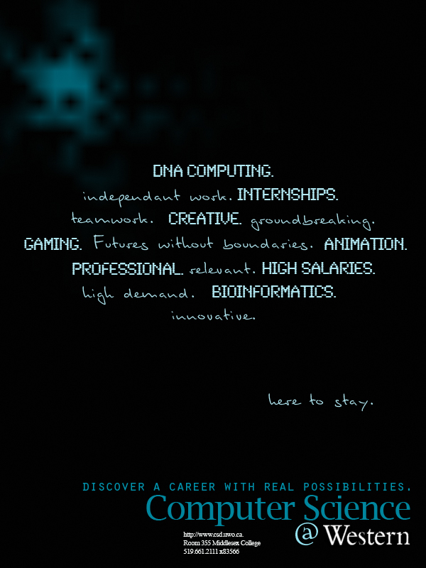
Previous Poster Assignments
Create a poster for the Computer Science Department

Slide 24


Previous Poster Assignments
Community Engaged Learning → http://www.success.uwo.ca/experience/curricular/index.html

Slide 25
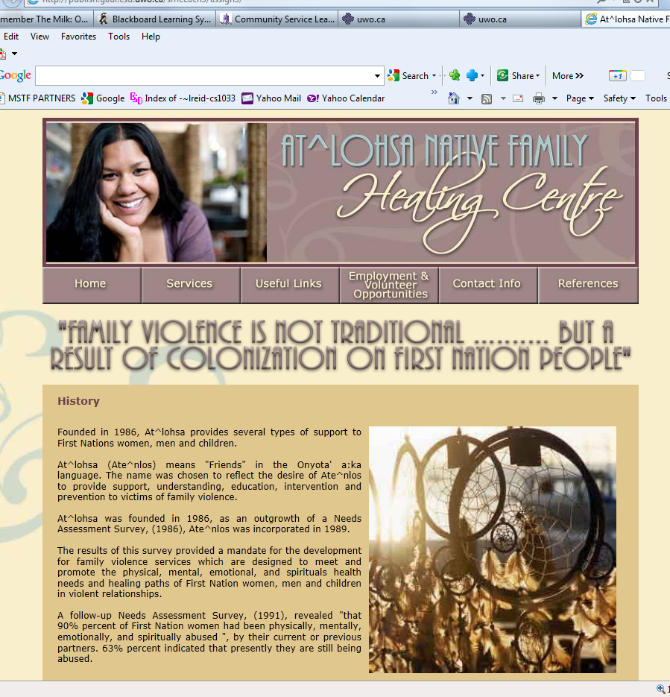
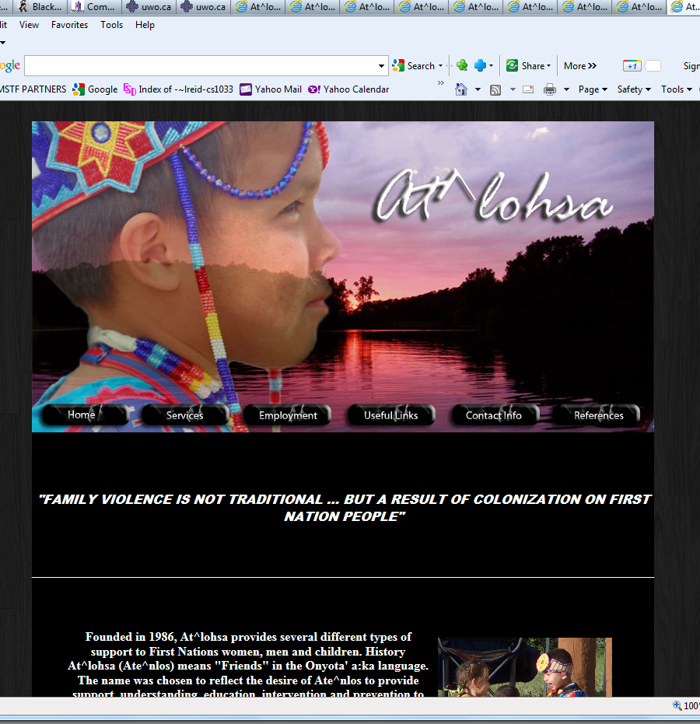

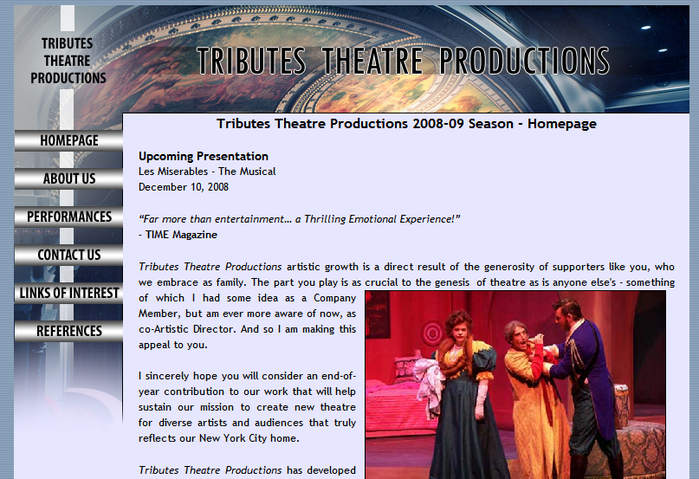
Previous Web Assignments
Create a website for a given scenario → Remembrance Day, Theatre Company, Native Family Healing Centre (Community Service Project)

Slide 26
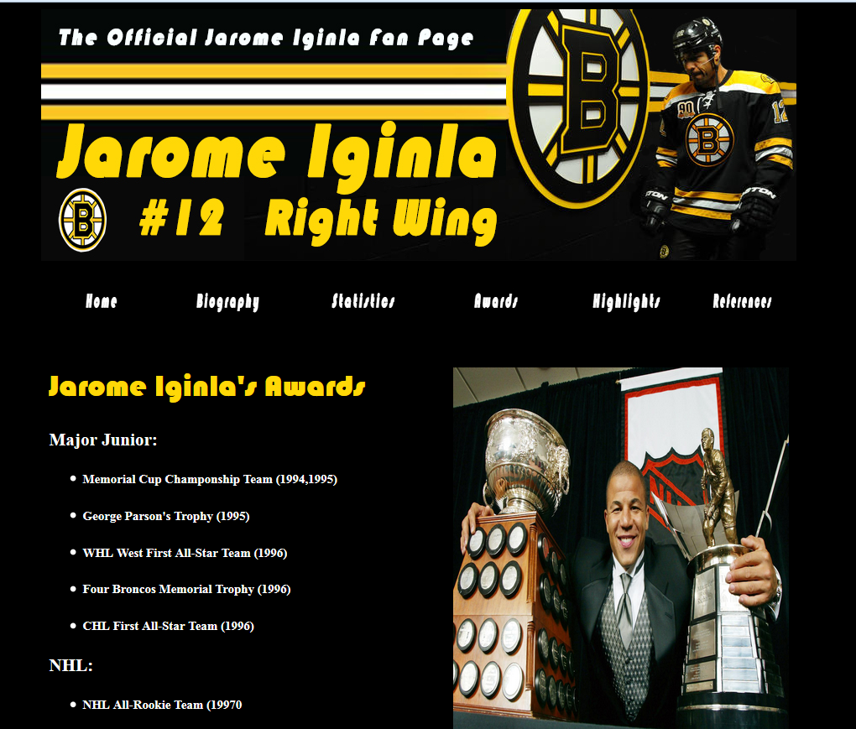

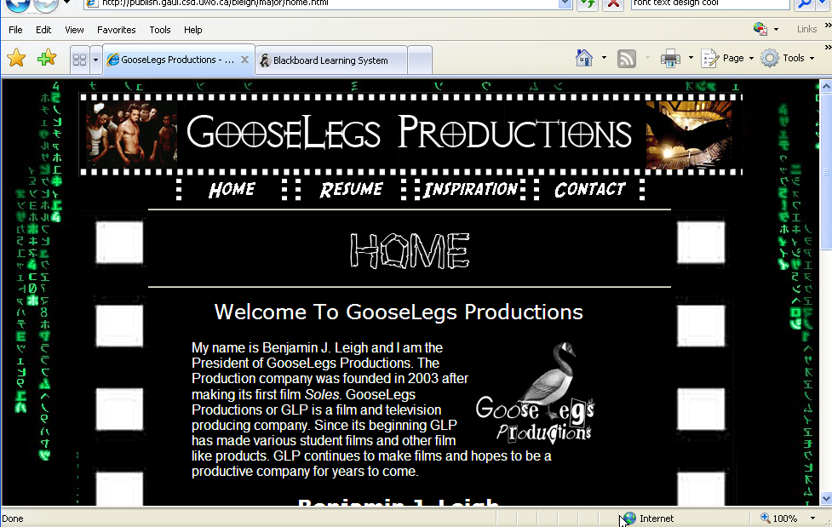

Previous Major Assignments
Design a website about Sports:
http://cs1033.gaul.csd.uwo.ca/~lreid2/other/student23/major/
Favorite Building - Home (uwo.ca)

Slide 27

Major Assignment Continued…
Had to contain video and animation, here are some samples from previous years:
Brescia Move-in Day
Simon The Dog Video
http://www.csd.uwo.ca/~lreid/AnimationExamples/flashbasketball.swf
http://www.csd.uwo.ca/~lreid/AnimationExamples/welcome.swf
http://www.csd.uwo.ca/~lreid/AnimationExamples/freighttrain.swf
http://www.csd.uwo.ca/~lreid/AnimationExamples/puggie2.swf
http://www.csd.uwo.ca/~lreid/AnimationExamples
https://cs1033.gaul.csd.uwo.ca/~lreid2/other/student33/major/index.html
https://cs1033.gaul.csd.uwo.ca/~lreid2/other/student34/major/ https://cs1033.gaul.csd.uwo.ca/~lreid2/other/student31/major/

Slide 28
Assignments
Students will lose 15% off the assignments grade for each day it is late. Thus an assignment that is 2 days late and was marked at 85% would receive 55%
No assignments more than 3 days late will be accepted
NO EXTENSIONS WILL BE GIVEN FOR ASSIGNMENTS unless instructed by the student’s academic counsellor.
For assignments only, we give you 3 late coupons for the term.

Slide 29
Handing in/Marking Assignments
You will be submitting a link to your assignment via kritik.io
After the late period is over, you will be assigned 5-6 other students to mark according to our rubric that we have set up in kritik
You will get 2 or 3 days to complete the marking (it should not take more than 1.5 hours in total).
After all the marking is done, you will get 24 hours to review how you were marked and evaluate the people who marked you. (this part should take no more than 5 minutes).

Slide 30
Marking of Assignments
80% of your grade is based on the marks your peers gave you.
10% of your grade is based on how well you mark your peers.
5% of your grade is based on what your peers think of your written comments about your marking.
5% of your mark is based on you checking how you were marked. (EASY marks for this part!)

Slide 31
Marking Assignments
If you think your assignment was marked incorrectly, you can submit a dispute and we will check to see if one of the markers made a mistake.
You cannot dispute subjective rubric items, you can only dispute the non subjective items. (Must dispute within 4 days)
You get a better mark if you give the correct mark, not the highest easy mark, nor the hard low mark but the deserved mark, so mark carefully
This process helps you do better in the course because it helps you do better on the next assignment

Slide 32
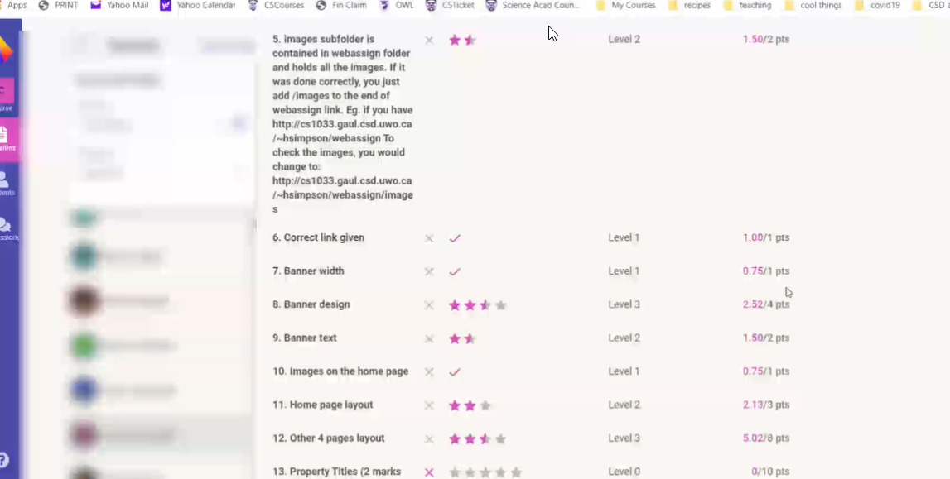
Example

Slide 33
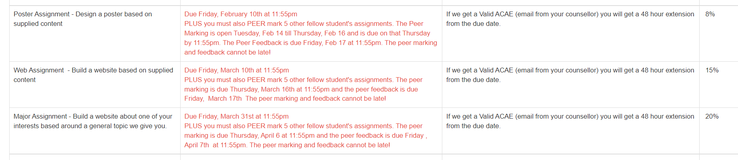
Assignment Dates

Slide 34
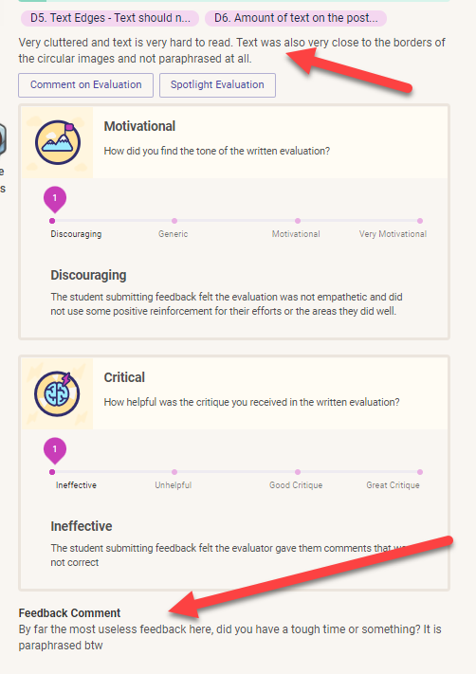
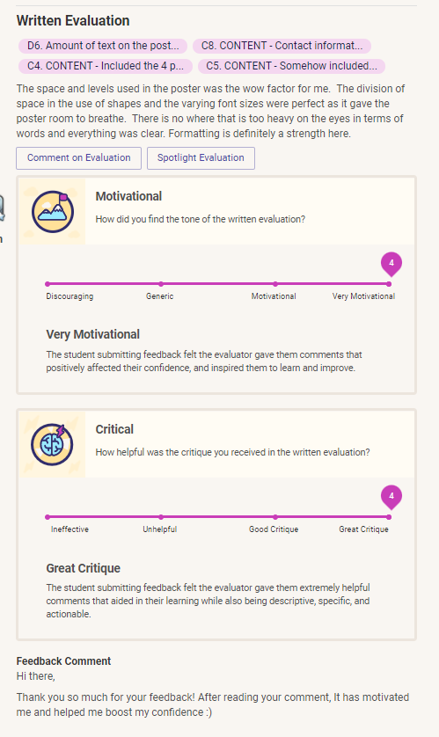

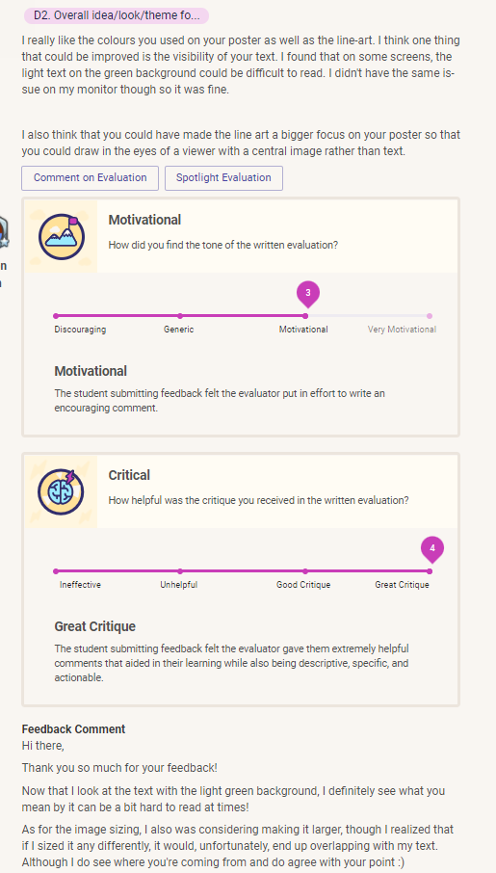

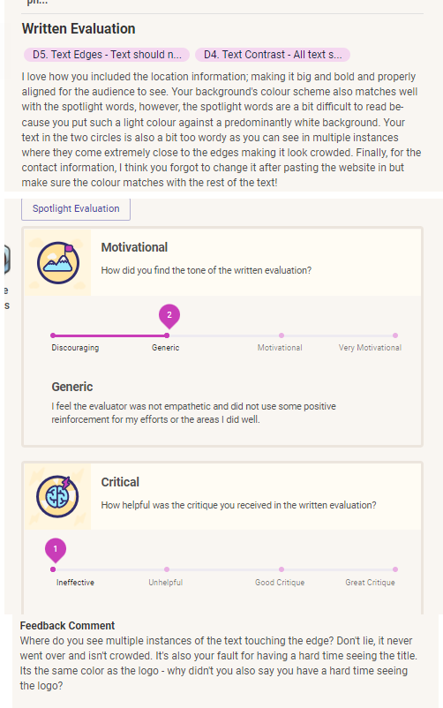
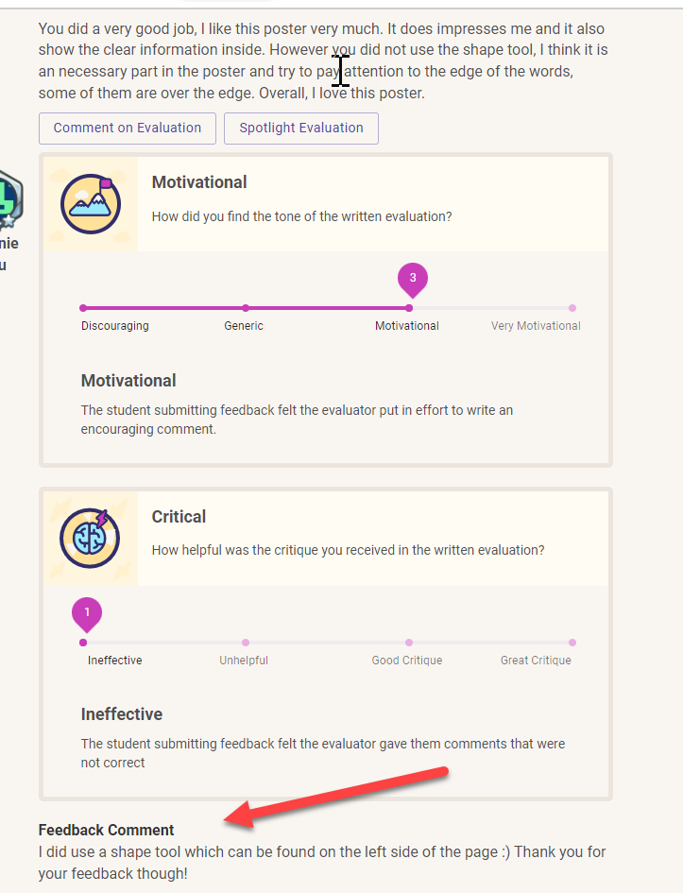
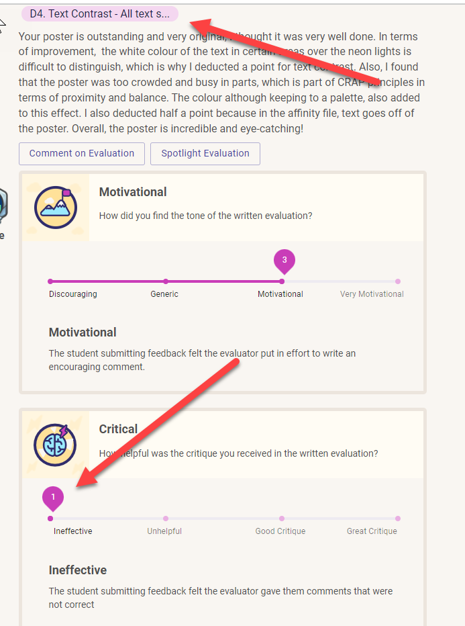
Some last comments about Peer Marking
Peer marking is process, not an exact science. Do not expect to get perfect on the peer marking, expect to learn from the process of doing it. (softskills like giving feedback, accepting feedback, etc..)
Being respectful in the feedback process is expected. Someone listing flaws of your assignment is not an insult to you and you shouldn’t give low feedback scores.
Every career you have, I promise you (unless you literally are a self-employed team of one - and even then you still have to interact with customers), you're always going to be getting feedback from people. You're never going to be able to just produce work and walk away from it. And so this is a great introduction to getting used to that.

Slide 35
If you can read and follow instructions, you should be able to get at least 70% on all the assignments. The assignments have subjective parts, do not expect to get 100%. If you are expecting to get 100% on every assignment in order to get into med school, this isn’t the course for you.
Test what you hand in to Kritik on a DIFFERENT computer/your phone. It might work fine on your computer but not work for anyone else.
Cheating à we have seen lots of students cheat last term. The course material is not super hard but it does require effort (if you want a bird course – this ain’t it!)
  Bryan and Laura are VERY available to help you if you get stuck so there is NO Reason to cheat, it is not worth the risk!

Slide 36
Peer Marking Benefits
Timely Feedback
Exposure to multiple points of view
Learning to accept and deliver feedback
Engaging with the material at a deeper level (especially between assignment 2 and 3)
Rubrics are clear and fair to every student in the course
Students are rewarded not just for creating the assignment but also for being a careful and thoughtful marker (more than one way to use your talents on assignments).

Slide 37
Late Coupons for Assignments
New this year
Can only use them ONLY on assignments
You get 3 late coupons for the WHOLE term
Cannot use them to push you past the last possible date to hand in.
Each coupon removes one day’s late penalty.
Gradebook will contain # of coupons you have left (give me time to update this ☺)

Slide 38
Late Coupons Continued
You can use all 3 coupons on one assignment but then you have none left for later assignments.
To use one, go to Owl>Tests&Quizzes during the 3 days that you can hand in late
You do not need to use them, try to hand in on time, this is only if you are really crammed for time
You may only use them on the creation phase of the assignment NOT on marking or feedback phase.

Slide 39
Late Coupons Continued…
Example: assume an assignment is due on Friday, Oct 18, 2030 at 11:59pm. Then:
  You may not hand in more than 3 days late (so no matter what, if you hand in after Monday, Oct 21 at 11:59pm, we will not accept your assignment, even if you used all 3 late coupons!)
  If you hand in to Kritik.io before 11:59pm, Oct 18, no need to use a coupon!
  If you hand in to Kritik.io on Saturday, Oct 19, then you can (you don’t have to use it but you can) submit 1 coupon (if you still have coupons left) to remove the -15% penalty.
  Go to OWL>Tests&Quizzes AFTER 11:59pm on Oct 18 to say how many coupons you want to use if you do decide to use a late coupon(s).

Slide 40
Exam
There is only a final exam in this course, no midterm
Final Exam is about 150 multiple choice and true or false questions…LOTS OF MEMORIZATION REQUIRED (IT WILL NOT BE OPEN BOOK!)
Worth 40% of final mark
Final exam mark combined with the major assignment mark must be over 45% to pass the course.
Must get over 45% on the final exam to get over a 59% in the course and over 35% to pass the course.
See your Academic Counsellor in your Dean’s office if you can not attend the exam, DO NOT SEE ME, I can’t do anything about final exams!
Exam is automatically checked for cheating, DON’T CHEAT!

Slide 41
Integrity/Organizational Quiz
Based on everything I said today and the course syllabus and academic integrity
  Sample questions:
    If I miss my lab, I can just go to another lab to make it up.
      True
      False
    The professor can switch my lab for me.
      True
      False
You get unlimited tries; you must get at least 90% on it in order to open up the rest of the course material.
You must complete it during January AND get over 90% on it to get the 1% towards your final grade.
If you get stuck on a question, and can’t get it after 3 or 4 tries, email me and I will give you a hint.
Don’t forget to complete it.

Slide 42
Let’s Look At The Website
Course Website (announcements, lab information) → http://owl.uwo.ca

Slide 43


Slide 44



Open Monday-Friday, 10:30-3:30

Slide 45


Can you see any difference between these 2 images?

Slide 46
Some advice to do well in this course:
Prepare for (read over before the lab) and attend all your labs
Attend the flipped classroom sessions.
Do all your assignments, especially the last one
The final exam is mostly memorization, review your notes every week.
Then you have an excellent chance of doing very well in this course ☺

Slide 47
Last Slide!
You can’t register for Kritik until the add/drop is over! Don’t email us about this!
For next week:
  READ THE COURSE OUTLINE CAREFULLY
    Do the quiz in OWL! – remember you can’t see anything for the course without getting 90% on it!
  Once you are done the Integrity Quiz, start watching the Week 1 and 2 videos for next class
ANY QUESTIONS?

