Slide 1
Welcome to Multimedia & communications
Please look at the course syllabus in OWL (owl.uwo.ca).
Computer Science 1033
A vision of students today
“Education: Being able to differentiate between what you do know and what you don't. It's knowing where to go to find out what you need to know; and it's knowing how to use the information once you get it.” → William Feather

Slide 2
Overview of Today’s Topics
Introduction to the lecturer and let’s find out about you!
Introduction to the course
What will you need to purchase
Go over course outline
Visit the course website:
  http://owl.uwo.ca
Closing Remarks
LOTS OF VALUABLE INFORMATION

Slide 3
Introduction to the Lecturer
Monday Night Class
  Instructor: Laura K. Reid
  Email: lreid@csd.uwo.ca
  Office: Middlesex College Room 416 (hard to find, you need to use the south stairs or the south elevator)
  Office Hours:
    Mondays 2:00pm – 3:00pm
    Tuesdays 1:30pm – 2:30pm
    Other available by email appointment
The best way to contact me is via email:
  Make sure you put CS1033 in the subject line.
  Email me with your @uwo.ca account.
  I may email the entire class sometimes, check your UWO email at least every 72 hours.
  NOTE: I don’t always check email on Saturday and Sunday.

Slide 4
Introduction to YOU
How many of you are:
  In first year?
  In MIT?
  In BMOS?
  In Computer Science?
  In second, third or fourth year?
How did you hear about this course?
  From a friend or relative
  From a counsellor
  Read about it in the calendar or on the web

Slide 5
Introduction to YOU
How many of you have used:
  Affinity?
  Web building software?
  FTP?
  Animation building software?
  Sound editing software (like Audacity)?
  Movie making software (like iMovie)?
DON’T WORRY! REMEMBER: I am assuming you don’t know any of the above software!

Slide 6
Introduction to the Course
What is this course all about?
  Communication on the world wide web!
    What to communicate → up to you
    How to communicate → up to you but with some guidance from me

Slide 7

Communication on the Web
Communications
Multimedia
Convey thoughts
Exchange Ideas
  Make sure you are:
    Articulate
    Clear
    Easy to understand
How to do I put those thoughts on the Internet?
  Text
  Images
  Video
  Sound
  Animation

Slide 8
Learning Outcomes
Upon completion of this course, you should be able to:
  Apply the 4 basic design principles in order to create an effective and eye pleasing design
  Sample and quantize different forms of analog data to convert it to digital data
  Understand how compression affects different forms of data and how to helps us decide how we represent the data
  Explain how the internet is represented, how data travels across it and how websites are represented on it
  Describe the algorithm Google uses when searching and the other considerations it takes into account when performing a search.
  Describe how animation, video and audio are represented on a computer
  Create and manipulate images and animation using PowerPoint
  Create and edit video clips and audio clips
  Create webpages that include text, images, video, animations and audio WITHOUT using template based web building software

Slide 9
What will I learn?
LECTURES → Multimedia Components
  Text
  Graphics
  Animation
  Video
  Sound
LABS (10 labs) →
  File Transfer (1)
  Affinity (2)
  BlueGriffon(3)
  PowerPoint Animation(2)
  Audacity (1)
  Shotcut and integration (1)

Slide 10

What do you need to purchase?
Digital Textbook written specifically for this course!
  Costs just around $30 CAD
  It contains more in-depth explanations of the topics taught in class, more examples, and lots of review questions after each chapter.
  Purchase book here: https://he.kendallhunt.com/product/multimedia-and-communication

Slide 11
What do you need to purchase?
Lecture notes are available on the website
Software is available in MC230 and NCB105 (perhaps MC235 also....SORT OF!)
Following software is free:
  Shotcut
  Audacity
  SFTP Software (WinSCP is available from ITS, Mac users can use Fugu or Filezilla)
  BlueGriffin

Slide 12
What will I need?
Affinity Photo Software (70 dollars):
MAKE SURE YOU GET AFFINITY PHOTO (NOT designer or publisher) https://affinity.serif.com/en-gb/photo/#buy
  I have emailed them to ask about a student rate (student rate is 42 dollars) More info here: http://www.csd.uwo.ca/~lreid/cs1033/affinity/studentpurchaseswesternu.pdf
MC230 and NCB105 have Affinity Photo
Free 7 day trial version
Middlesex College labs are open 24/7 as long as there is no lab being conducted in them. You need your student card to get into the building and into the lab rooms. (North entrance of the building)

Slide 13
Let’s go over the Course Outline
READ THE COURSE OUTLINE, it is a contract between you and me!
Lectures
Quiz → worth 1% of final grade (based on syllabus and your understanding of when to email me ☺ )
Labs → worth 9% of final grade
Assignments:
  Poster Assignment →10 %
  Web Assignment→18 %
  Major Assignment → 22 %
Exam → worth 40%

Slide 14
Consulting
Both professors have office hours
Each of our 7 teaching assistants must consult 1 hour a week during assignments, thus, there are over 7 hours a week of extra help if you need it (only the week the assignments are due)
Consulting by teaching assistants is done in MC16A, check announcements, then please notify me if the t.a. is missing!
Consulting hours are posted on the door of the room and on the cs1033 website.

Slide 15
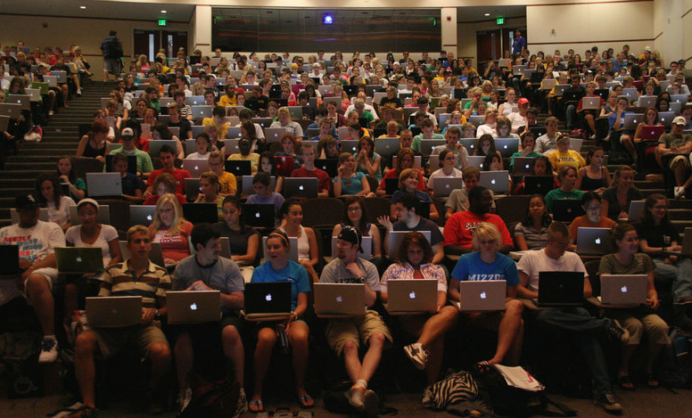
Lectures
Make sure you come to classes, notes may be incomplete ON PURPOSE
We (both you and I) expect “civility” in the use of/with respect to:
  Laptops
  Cell Phones
  Punctuality
  Class Discussion/Noise Levels
  Emails
    Checking
    Subject heading
  “Helping” on assignments is fine and ENCOURAGED, “Copy/Paste” is not fine!
  Asking/hiring others to do your assignment OR being paid to do someone else‘s work are forms of plagiarism and will be reported to your Dean.

Slide 16
Labs
Always bring a memory stick to your lab! Labs 8, 9 and 10 bring headphones.
Need your student card to open the door to the labs in Middlesex College
Lab attendance is mandatory
You MUST attend the lab you registered for, you may NOT switch labs during the term.
Labs 1-10 are worth 1% each
Lab marks add up to 10, you will get either 9% or the total of all your lab marks, which ever is lower.
Your lab mark will be updated every week in Owl by your teaching assistant.
You can not make up a lab, that is why we mark it out of 9 rather than 10, so you have a bit of wiggle room in case you are sick one week!

Slide 17
Labs continued…
Remember to ALWAYS sign the TA’s attendance sheets! It is up to you to make sure that your attendance was recorded so you get the mark.
You MUST do the lab during the 2 hour lab period. DON'T come to the lab with it already completed.
If you are trying/working hard, you will get the 1%, if you are playing on your phone the whole lab, you will NOT get the 1% even if you show up.
If you attended and completed a lab but your mark isn't updated within a week, contact the TA to ask about the missing mark. Don't wait until the end of term to ask about missing marks.

Slide 18
Labs continued…
A strike out in the gradebook in owl is just to show that we drop your lowest mark
I only teach this course, I have nothing to do with enrollment so I can NOT switch your lab for you.
SELF – REPORTING: NOTE: you still have to do the lab on your own time if you self report or get accommodations from your counsellor.

Slide 19
Assignments
Poster Assignment → Design a poster for a given scenario (Affinity) (10%)
Web Assignment→ Design a website for a given scenario (BlueGriffon & Affinity ) (18%)
Major Assignment → Design a website about Western (BlueGriffon, Affinity, PowerPoint, Shotcut) (22%)
Here are some examples from previous years…

Slide 20


Previous Poster Assignments
Create a poster for The Grad Club Pub at Western

Slide 21



Previous Poster Assignments
Create a poster for the Computer Science Department

Slide 22


Previous Poster Assignments
Community Engaged Learning → http://www.success.uwo.ca/experience/curricular/index.html

Slide 23

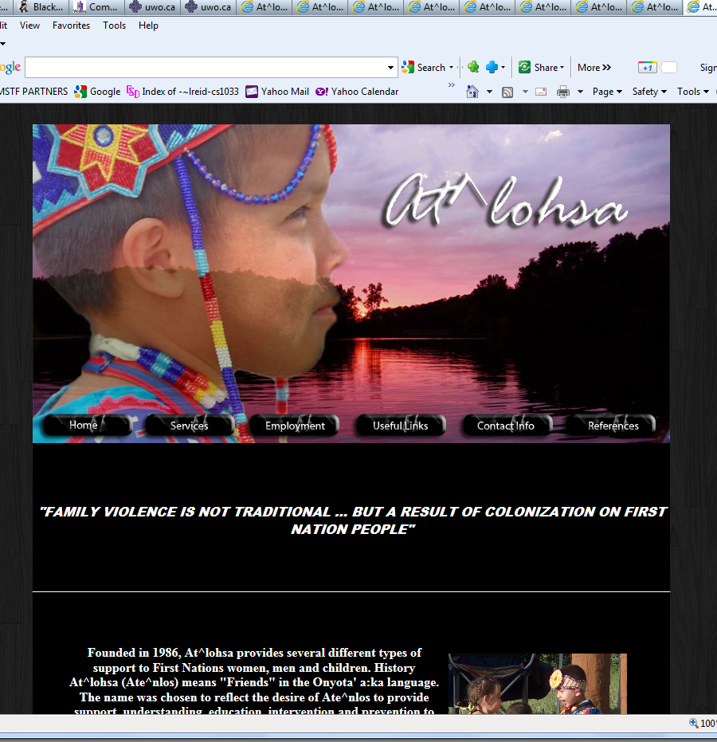

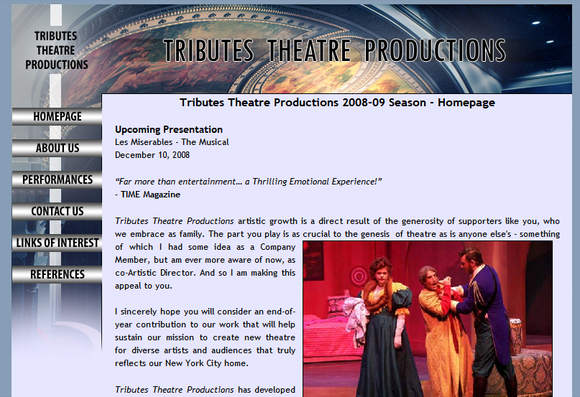
Previous Web Assignments
Create a website for a given scenario → Remembrance Day, Theatre Company, Native Family Healing Centre (Community Service Project)

Slide 24
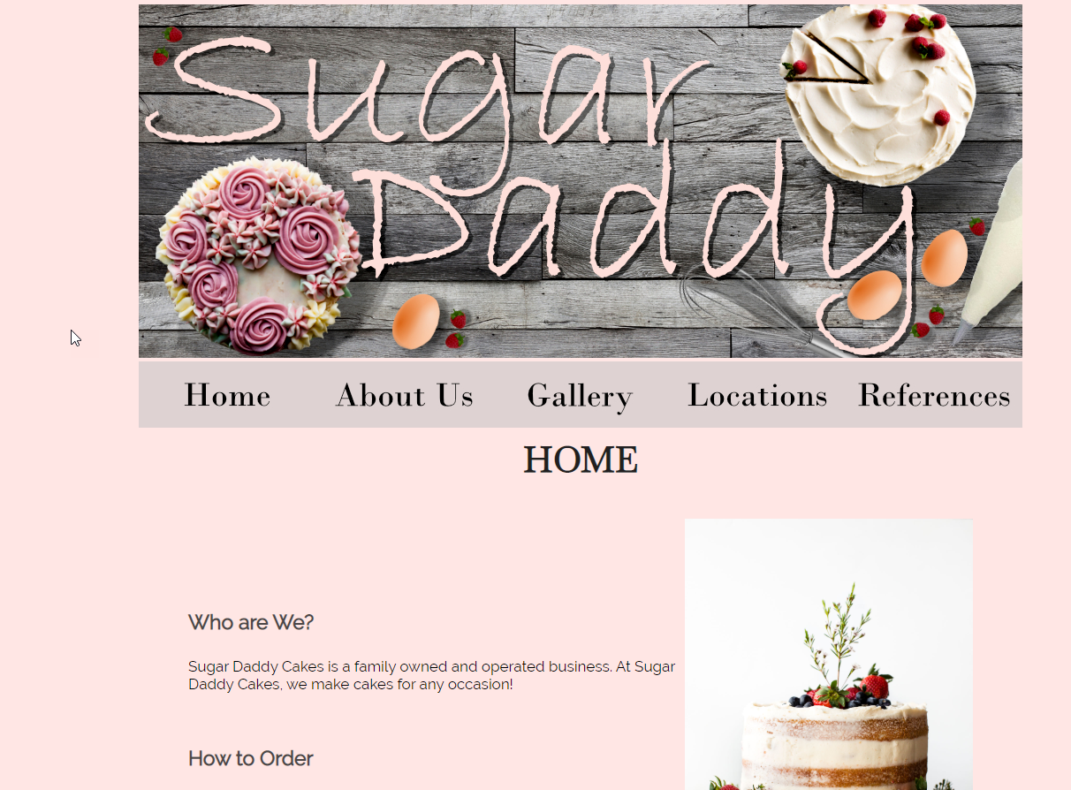
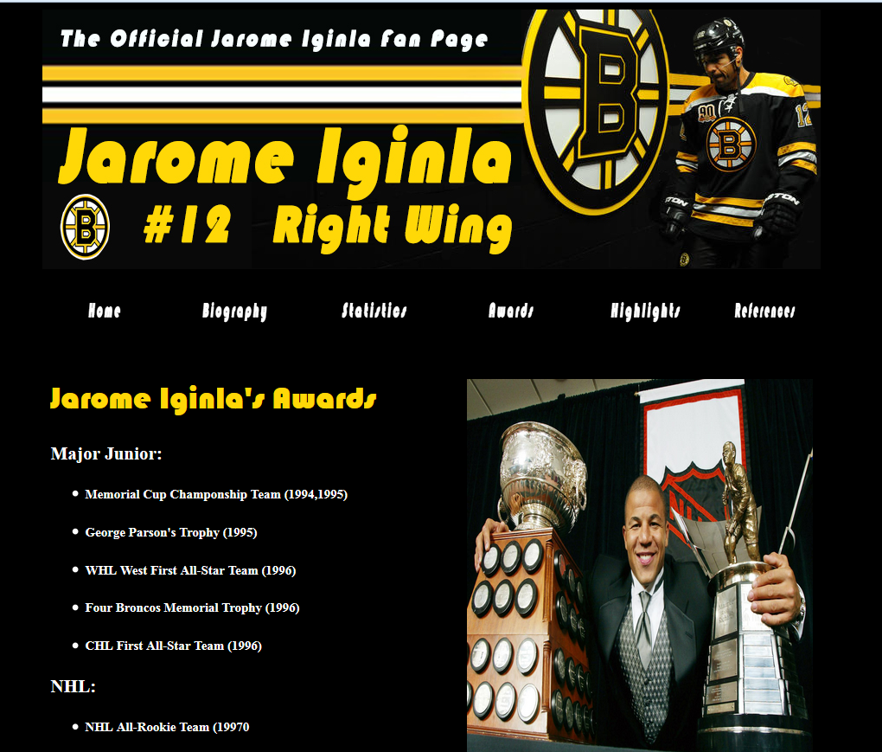
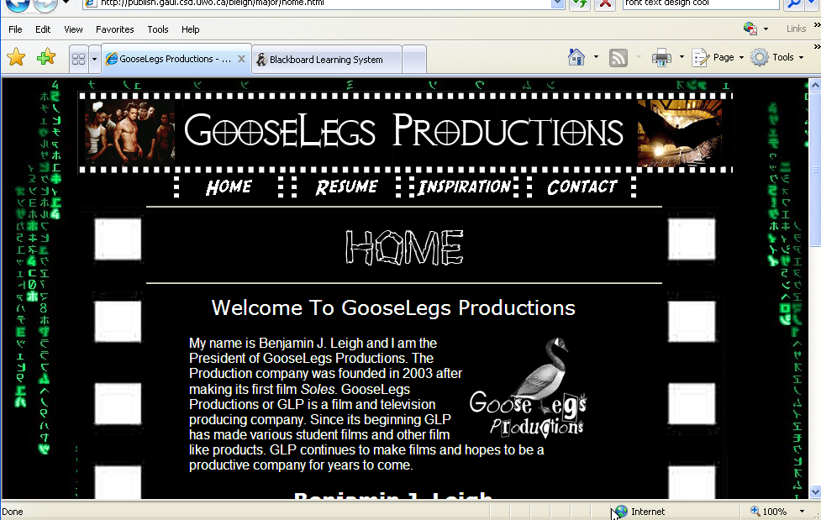

Previous Major Assignments
Design an online resume website, or a website about Western:
http://cs1033.gaul.csd.uwo.ca/~lreid2/other/student23/major/

Slide 25

Major Assignment Continued…
Had to contain video and animation, here are some samples from previous years:
Brescia Move-in Day
Simon The Dog Video
http://www.csd.uwo.ca/~lreid/AnimationExamples/flashbasketball.swf
http://www.csd.uwo.ca/~lreid/AnimationExamples/welcome.swf
http://www.csd.uwo.ca/~lreid/AnimationExamples/freighttrain.swf
http://www.csd.uwo.ca/~lreid/AnimationExamples/puggie2.swf
http://www.csd.uwo.ca/~lreid/AnimationExamples
http://www.csd.uwo.ca/~lreid/cs1033/samplemajor

Slide 26
Assignments
Students will lose 15% off the assignments grade for each day it is late. Thus an assignment that is 2 days late and was marked at 85% would receive 55%
No assignments more than 3 days late will be accepted
Saturday and Sunday count as 1 day
NO EXTENSIONS WILL BE GIVEN FOR ASSIGNMENTS unless instructed by the student’s academic counsellor or you SELF REPORT.
  If you Self Report you get a 48 hour extension from the original due date.

Slide 27
Handing in Your Assignments
You will be using OWL to submit your assignment online
OWL records the date and time you hand in the assignment. Even 1 minute late is LATE ☹
You will get an email from OWL when your assignment has been received. SAVE THIS EMAIL!
The teaching assistant will return your assignment mark breakdown sheet to you via OWL (it will be an .xls document) after he/she has marked your assignment. READ YOUR MARK BREAKDOWN SHEET

Slide 28
Handing in Your Assignments
The T.A.s will try to get assignment back to you 1 week from the last possible day to hand in the assignment to mark it.
Remarks are for the ENTIRE assignment, not just the section you request.
  I do ALL remarks.
  You have 2 weeks to read over the mark breakdown and get back to me if you feel the t.a. made a mistake (NOTE: Some marks in this course are subjective!)
  NOTE: I often mark harder than the t.a.s, think wisely about asking for a remark ☺
THERE IS NO PAPER USED IN THIS COURSE!

Slide 29
Exam
There is only a final exam in this course, no midterm
Final Exam is about 150 multiple choice and true or false questions…LOTS OF MEMORIZATION REQUIRED
Worth 40% of final mark
Final exam mark combined with the major assignment mark must be over 45% to pass the course.
Must get over 45% on the final exam to get over a 59% in the course and over 30% to pass the course.
See your Academic Counsellor in your Dean’s office if you can not attend the exam, DO NOT SEE ME, I can’t do anything about final exams!
Exam is automatically checked for cheating, DON’T CHEAT!

Slide 30
Quiz (worth 1%)
Based on everything I said tonight and the course outline (available tomorrow!).
  Sample questions:
    If I miss my lab, I can just go to another lab to make it up.
      True
      False
    The professor can switch my lab for me.
      True
      False
You get 3 tries only, you must get over 90% to get the 1%. (14 questions → need to get 13 or 14 correct)
You have till the end of THIS month to do the quiz. Don’t forget to complete it.

Slide 31
Let’s Look At The Website
Course Website (announcements, lab information) → http://owl.uwo.ca

Slide 32


Slide 33



Open Monday-Friday, 10:30-3:30

Slide 34


Be a Volunteer Note Taker for this class!
Help a fellow student with a disability
Receive a certificate of acknowledgement from Student Accessibility Services (formerly SSD)
Qualify for an addition to your Western Co-Curricular record
Interested?
Email peernotes@uwo.ca for more info
Want to sign up?
Complete the form at this link: https://tinyurl.com/y93yqhet
OR use the above QR code to access the form

Slide 35


Can you see any difference between these 2 images?

Slide 36
To Prepare for Lab 1
Click on this link TODAY (this will make sure a folder gets created NOW that you need for Lab 1)
  https://wts.uwo.ca/services/web/activate_my_personal_web_space.html (Activate My Personal Web Space)

Slide 37

Please…
Put all your garbage in the bins, this isn’t a movie theatre, so don’t just drop it at your seat!

Slide 38
Just 2 more slides!
ANY QUESTIONS?
For next week:
  READ THE COURSE OUTLINE CAREFULLY
    Do the quiz in OWL! – remember you get 3 tries!
  Print off/read over the lecture notes and bring them to class (Do it on the Monday Afternoon)
  Remember labs are cancelled for this week, the first lab starts NEXT WEEK.
Using PowerPoint this year for our animations, here are some inspirations:

Slide 39
Some advice to do well in this course:
Prepare for (read over before the lab) and attend all your labs
Attend lectures
Do all your assignments, especially the last one
The final exam is mostly memorization, review your notes every week.
Then you have an excellent chance of doing very well in this course ☺

