Slide 1
Warmup Review Questions
What is the frame rate you need on computers for an animation?
What is rotoscoping?
What are the 3 stages in 3D animation?
Notes:
12-15
Sketching around live video to make it look animated
Modelling, Rendering and Animating

Slide 2
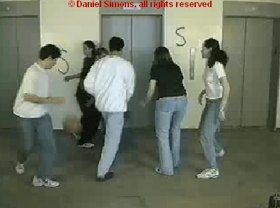
Video
Computer Science 1033 – Week 10
Your goal is to count how many times the ball is passed by those wearing white shirts
“A good film is when the price of the dinner, the theatre admission and the babysitter were worth it.” → Alfred Hitchcock

Slide 3
Today
Announcements
Intro to video, TVs, resolution
Colour Sampling
Compression
Download vs Streaming
Other things to consider

Slide 4
Make sure you get a copy of all your work!
Your websites will only be posted for the next month (till about June 1, 2020) so copy of everything you want onto a stick. YOU WILL NOT BE ABLE TO GET IT BACK AFTER THAT DATE!

Slide 5
Announcements
Readings: Video

Slide 6
Announcements
Feedback page is open:
  Please fill in the Feedback form: https://feedback.uwo.ca

Slide 7
Web Assignment
Reasons for lost marks on website assignments:
  Forgot proper titles
  Forgot images folder or called it Images
  Called file Index.html instead of index.html
  Called index.html something like home.html
  Called aboutus.html something like About Us.html
  Forgot to check links or images ☹
  Didn’t make the references working links
  Filepaths should be relative and case-sensitive!

Slide 8
Hints for Major Assignment
Remember:
  Rules for Titles
  Headers
  File names, spaces, lowercase
  Images
    Alt, Hover/tooltips on home page
    Size within page
    On each page
  Banner
  No Scrolling horizontal/vertically to see buttons
  Consistency
  Buttons → look, ease of use
  links that go OFF your site open in a new window/tab
  Back to top
  References page layout
  Text colours, contrast
  Broken links
    Check from a different computer!
  Underlining
  Colours
    Link Colours
  Paragraphs
  Padding
  Followed the instructions (make the anchor links, etc..)
  Have an images subfolder
  Have an originals subfolder
    NEED LINK TO animation .pptx and banner .afphoto

Slide 9
Inspiration from previous years
Bit By Bit website
Bollywood Blitz website/
Lego Batman Movie website
Travels

Slide 10
For Major Assignment life will be much easier if you set up a site in build your folders first (major, then major/images, then major/originals)
Then move your images into images folder
Move your banner .afphoto and your animation .pptx into originals folder
Put your animation .mp4 and video .mp4 in a folder called videoanim

Slide 11
Major Assignment
How to make a link on your references to your animation .pptx file and your banner .afphoto file:
  Make a folder inside of major called originals, so you should have this:
  Move your banner.afphoto into the originals folder, so you should now have this:
  On your references page, type the text like: My Banner and My Animation
  Make link to each of those files, like this

Slide 12
Major Assignment
Animation should relate to your theme
Video should relate to your theme:
  Can just be images that transition with some captions
  Keep it under 30 seconds
  Fade out the sound
  Need to have soft captions this year!

Slide 13
Assignment 2
Student 1 – BEAUTIFUL – Amazing colour scheme!
Student 2 – lovely banner but it is a bit tall – references a problem ☹ (and the property titles)
Student 3 – lovely layout on all pages, only issue is the image is skews on home page
Student 4 – love the buttons but can you spot the mistake?
Student 5 – great layout on the pages but forgot headings
Student 6 – did a great job with layout but 2 problems with references

Slide 14
What is Video?
A sequence of still images (photographs) that create the illusion of movement when played in succession.
Question: What is each still image called?
Frames Per Second (fps)
  Movies on film → 24-30 fps
  TV was originally 29.97 fps (59.94 fields per second)
  Computer Displayed Video → AT LEAST12-15 fps
    Humans can distinguish as single images at less than 10 fps
  https://frames-per-second.appspot.com/
    Set Motion Blur to None and Frame Per Second to 5 fps
Digital Video → each frame is a bitmapped graphic, stored as 0s and 1s
Does this sound familiar?
Notes:
Frame

Slide 15
Sampling and Quantizing of Motion
Since each frame is just an image →
  Each frame is sampled into a discrete samples and each sample becomes a pixel → Sampling process
    Remember:
      More samples means better quality (10 pixels by 10 pixels vs 200 pixels by 200 pixels)
      More samples means bigger file sizes (10 pixels by 10 pixels vs 200 pixels by 200 pixels)
  Each pixel gets assigned a colour, maybe just 2 colours(black and white→1bit colour) or maybe 16 million colour (24 bit colour) → Quantization process
What else can we “sample” with MOTION?
  Timing of the motion
  Sampling = frames
  Higher FPS = more accurate motion, but larger file size

Slide 16
Quantizing →Colour Compression In The Video
For still images RGB is commonly used
For video the model is YUV (YIQ) or YCbCr (for MPEG compression)
Y → luminance (brightness)
UV →(CbCr) chrominance (color/hue)
Question: Black and White TV only used the ____ signal (fill in the blank with Y, U, or V)
Question: Which one will the human eye detect changes in more easily? How does this help us with compression? Where have we seen this used before?

Slide 17
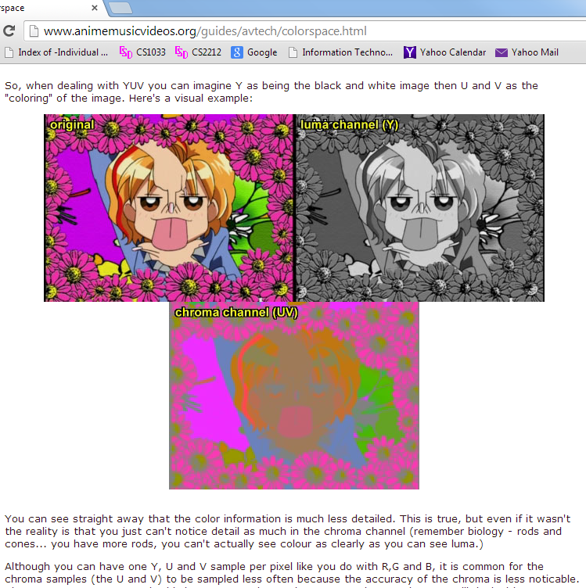

Slide 18

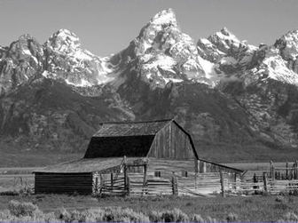


YUV / YCbCr Components
Original Picture
Y Component
Cb Component
Cr Component

Slide 19
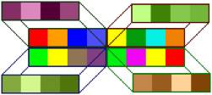
You may see that the compression used 4:1:1 Color Sampling Method what does this mean?
Assume we have 16 pixels that
we are looking at in blocks of 4→
http://dvxuser.com/articles/colorspace/
Color Sampling Method | Amount of Y (luminance) | Amount of U (color or hue) | Amount of V (color or hue) | Amount of Compression | Used in
4:4:4 | 4 samples (i.e. 4 pixels) | 4 samples | 4 samples | None 12 samples for each group of 4 pixels
4:2:2 | 4 samples | 2 samples | 2 samples | Reduced from 12 samples to 8, 33% reduction in storage | Digital Betacam format
4:2:0 | 4 samples | 2 samples of either U or V, one scan line of U, then one scan line of V |  | 12 to 6, 50% reduction in storage | HDV, MPEG-1, DVD, MPEG-2, PAL DV
4:1:1 | 4 samples | 1 sample | 1 sample | 12 to 6, 50% reduction in storage | NTSC DV, miniDV digital camcorder

Slide 20

If we look at a grid of 4x4 pixels, the ratio tells us how many values from the YCbCr or YUV layers are showing.
                In this example there are 4 of each layer (Y, U, and V) so this is a 4:4:4 image.
                Watch this starting at 2:45
http://blogs.adobe.com/VideoRoad/2010/06/color_subsampling_or_what_is_4.html

Slide 21


Here we have Y in every pixel but the U and V are only in every 2nd column.
This is 4:2:2.
The U and V only appear once in four columns.
This is 4:1:1.
http://blogs.adobe.com/VideoRoad/2010/06/color_subsampling_or_what_is_4.html

Slide 22
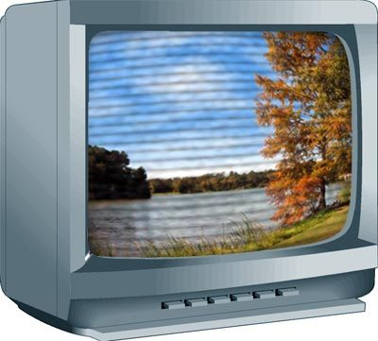
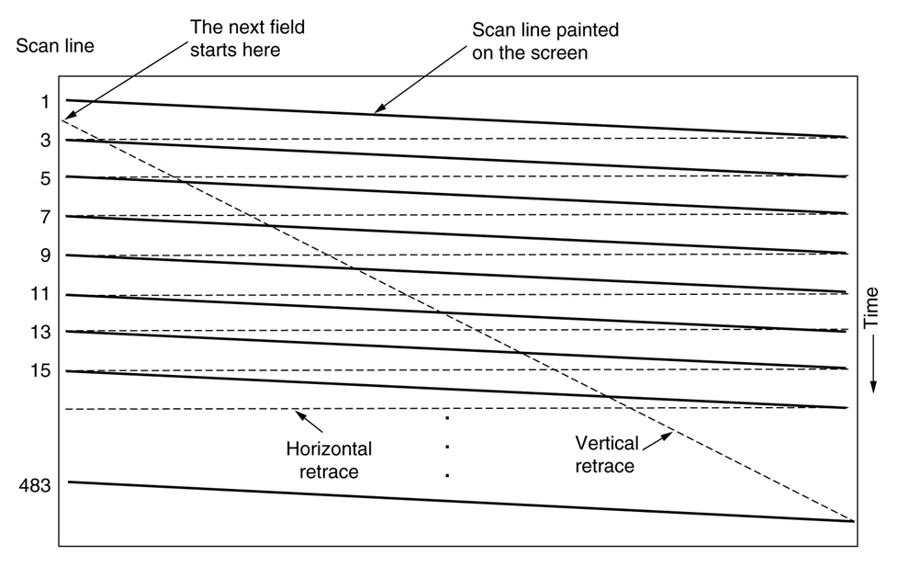
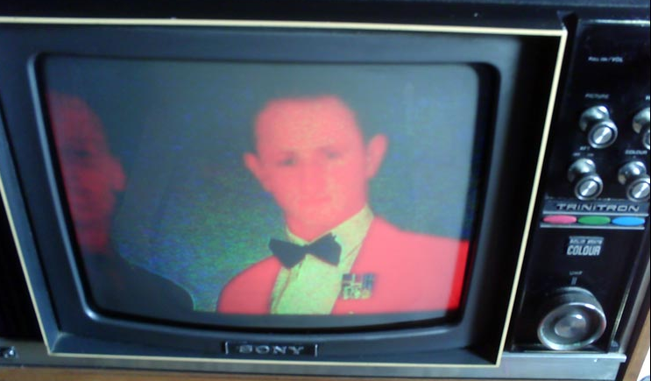
How did the original TV display work?
Our eyes see phosphor dots on the screen.
An electron beam (gun) activates the dots. The gun scans through the dots horizontally
A complete scan is when the gun starts at the top left and scans several times horizontally till it gets to the bottom right
480

Slide 23
The scan only draws every OTHER line (1,3, 5, …479) then starts back at the top and draws the even lines (2,4,…480).
  Thus two passes
  Each pass is called a field
  The process is called interlaced display
This way it can cheat the eye, while the phosphor dots are disappearing, it is drawing the line underneath.
Interlacing should be avoided now, instead use progressive (interlacing is for old TVs) for video that will be displayed on the web.
http://www.crutchfield.com/Learn/learningcenter/home/understanding-resolution.html

Slide 24
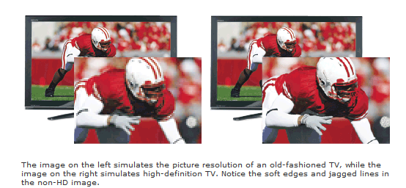
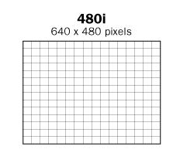
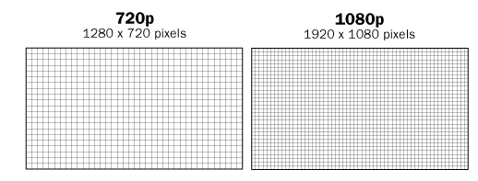
i means interlaced
p means progressive

Slide 25

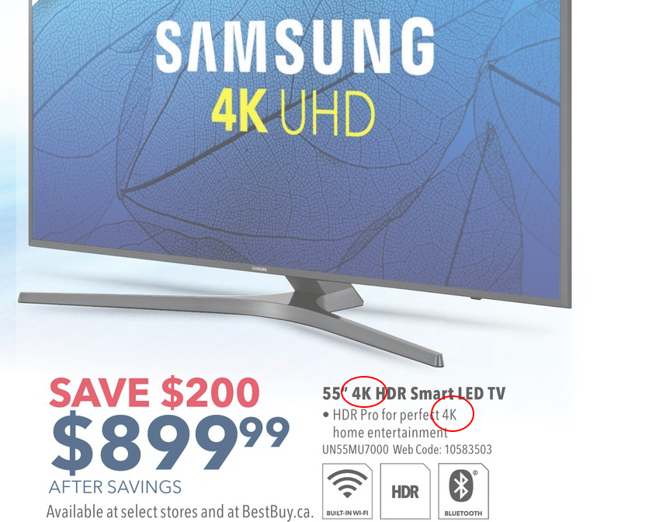
2000’s TVs
Question: On a HD TV, what does the circled area mean?
Notes:
UPDATE AD

Slide 26
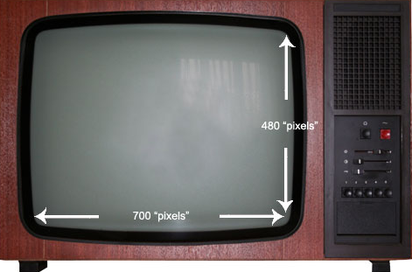
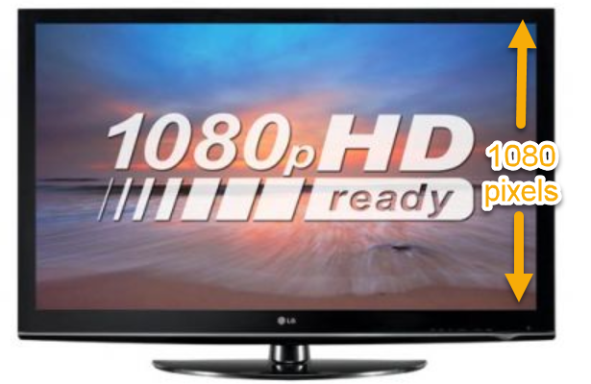
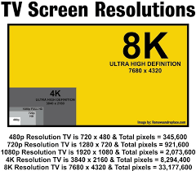
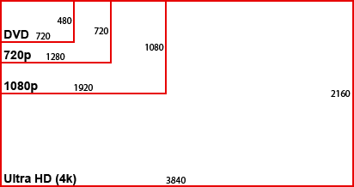
Do you notice anything odd here?
480i TV

Slide 27
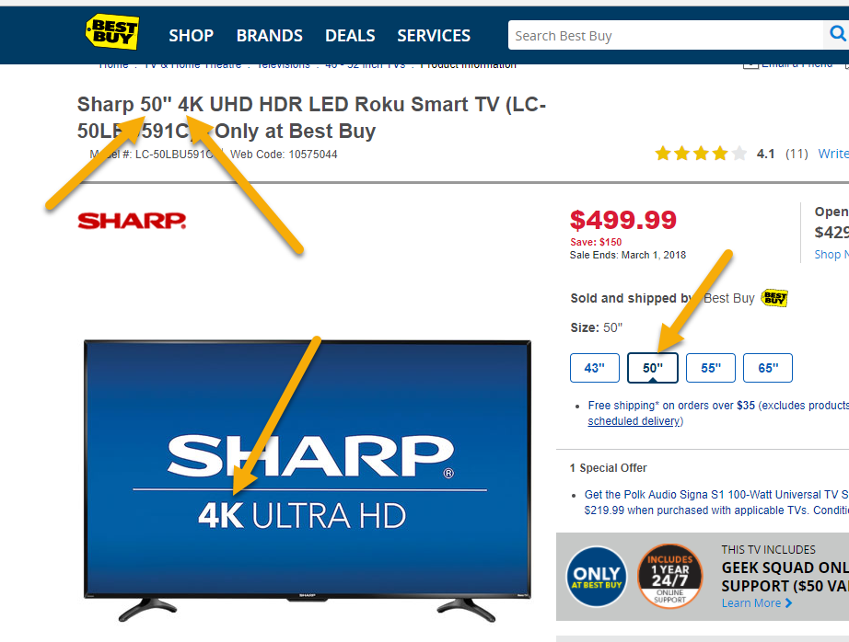
What do TV specs mean?
The 50” means 50 diagonal inches (not sure why it is not metric ☺ )
The 4K or 1080 or 720 means number of pixels
  Originally TVs before 1980s had 480 horizontal scan lines
  Then HD → TVs had either 1080 or 720 horizontal scan lines
  NOW 4K or 8K → TVs have ~4000 or 8000 VERTICAL scan lines
You may see i or p – interlaced or progressive

Slide 28
2010’s TVs
Most TVs sold now are 4K → 4K resolution (4096 x 2160 → 4K refers to WIDTH now???) https://www.youtube.com/watch?v=RodCjVf-5AE
  Initially they were very expensive and there was very little content available for them
  Now the prices have come down a lot, and there are a lot more shows and movies shot in 4K now
  Newer phones have 4K video cameras
  4K video games are being made for the PS4 Pro and Xbox One S and Xbox One X
Notes:
UPDATE to 8K

Slide 29
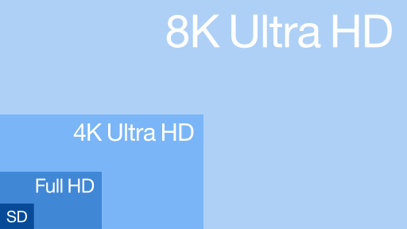
Comparison of Resolutions
Standard Definition resolution was 480 or 576
High Definition resolutions started at 720, then up to 1080, 1440, and then to 4K. Now companies are beginning to make 8K TVs but they are very expensive (and not much content)

Slide 30
2010’s Small Devices Matter Too!
Apple suggests that small devices (iPads, etc) should be held at 10-12 inches away from your face, and that the screen resolution should be at least 300ppi to look crisp. Apple uses the term "high retina display" for this.
  http://www.makeuseof.com/tag/how-does-the-retina-display-work/ (watch Steve Jobs video)
  https://www.youtube.com/watch?v=Zl5cN8Z7LnM (just watch the first two minutes)

Slide 31
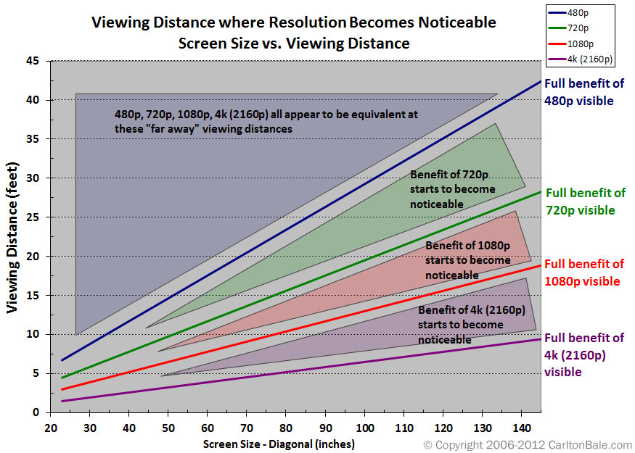
For Retina Display:
Retina Displays – have a pixel density high enough so that your eyes cant detect pixels at a normal viewing distance. You need to consider:
  Pixel density
  Viewing distance
  Display size
https://www.designcompaniesranked.com/resources/is-this-retina/

Slide 32
Editing of Video
Before Digital Video:
  Had to copy from one tape to another tape
  Had to load up tapes on a machine to copy
  Loss of quality after each copy made
Now:
  Can easily move clips around
  No loss of quality
  Slight compression occurs in the camcorder when the video is captured
  https://www.youtube.com/watch?v=Wa_VZISu6fc
Notes:
DV25

Slide 33
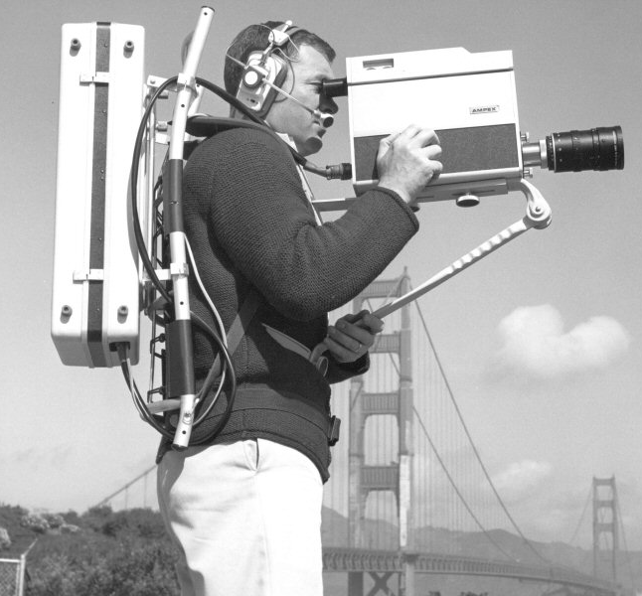
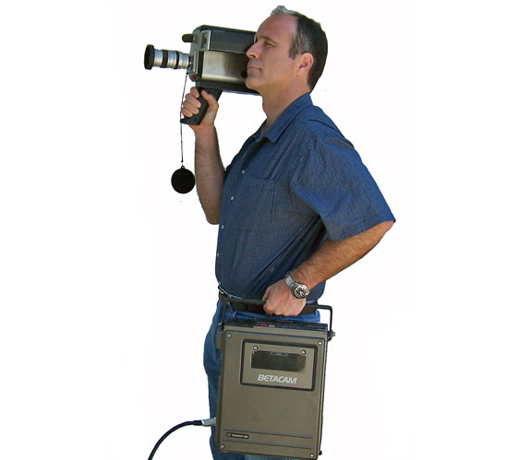
A Little History of Camcorders
Before 1967 NOTHING was portable (had to use tripods)
1967 → Sony came up with first portable black and white camcorder (needed BIG shoulders)
1971 → first cassettes (didn’t need to load reels)
1982 → combine video, sound recording and playback (camera recorder)
2001→ Most camcorders record at 5fps
2019 → iPhoneX records 4K at 60fps
Betacam

Slide 34
Break
Take a 10 minute break
Check out some Poster Assignments during break

Slide 35
Things to think about before exporting video:
Where will I be putting my video?
  On the web:
    Bandwidth is an issue, need good compress
    Standard file format is now mp4
  On CD-Rom (playback speed is an issue)
  DVD video (must be in mpeg2 format)
Who is my audience?
  Will they be on different platforms
  How old will their computer be, how old will their CD or DVD player be?
Will I still need to edit it later on? Should I compress it at all?

Slide 36
Why Compress? An Example
Assume we have video that is:
  1440 X 1080 pixels → 1,555,200 pixels per frame
  24-bit colour
  30 fps
  1 second long
  Audio is stereo so 2 channels
  Audio is 48,000Hz and 16 bit = 48,000*1sec*16bits/sample*2=1,536,000bits
Video
  1,555,200 X 24 bits per pixel (for color) = 37,324,800 bits per frame
  37,324,800 * 30 frames per second * 1 second= 1,119,744,000 bits/8 = 139,968,000 bytes =133MB
Audio
  1,536,000bits/8 → 188 KB
Total
  133MB + 188KB =~ 133MB → LOTS OF STORAGE FOR JUST 1 SECOND
  OR 1,067 Mb
  OR 1.04 Gb
  THUS a DVD could hold 35 seconds of uncompressed video… Not a very long movie ☹
https://www.youtube.com/watch?v=r6Rp-uo6HmI

Slide 37
Data Rate or Bit Rate
Amount of video processed per second
Average bit rate = file size/length in seconds of video
Our example from previous slide → 133MB per second
Consider a 48X Speed CD Rom
  Average playback (bit/data rate) rate is 7MB/s
  Our video would be VERY CHOPPY
Consider a video that is 100MB and 10 Seconds long:
  Question: what would its data rate be?
  it would be choppy on our CD Player
Consider a video that is 100MB and 33 second long, it would play back at 3MB per second and be fine on our CD Player
NOTE: problems occur not just because of file size but also because of data rate!
Bit rate is normally measured in bits NOT bytes (Mb is mega bits, MB is mega bytes)

Slide 38

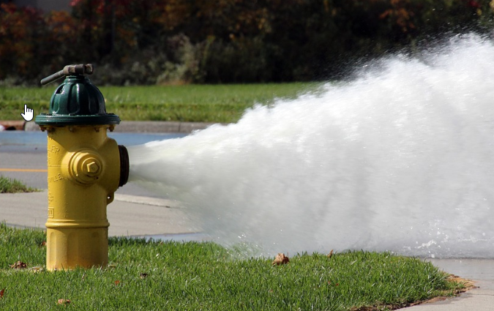
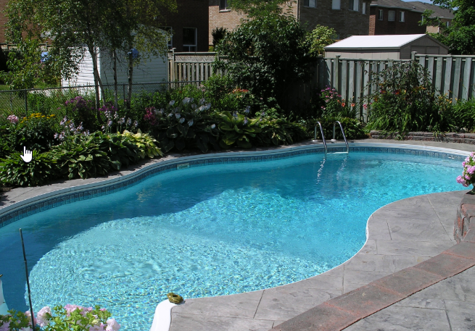


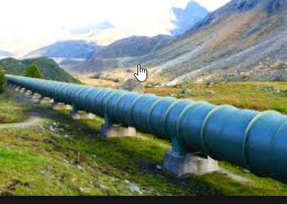
Analogy
Don’t just consider the file size of the video, also how many bits you have to get across in a given time.
Think of getting water from one swimming pool to another pool via a pipe:
  Amount of water in the pool is the file size
  Diameter of the pipe is the bandwidth (you can’t really control this for your viewer)
  Amount of pressure/flow you want is the bitrate (if your trying to push so much through that it gets clogged occasionally, the pressure is too high – your hose might sprout little leaks where you lose water (i.e.quality!))

Slide 39
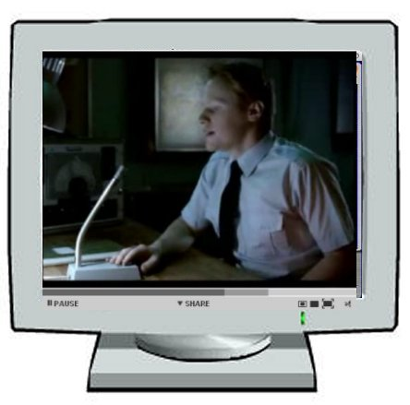

Compression
Question: What things do you think we should think about optimizing to decrease video file size?
  One thing to think about: what we did to an image to make it smaller
  Another idea: think about what you could do with the frames on Ellen Degeneres doing an interview vs. a tennis match

Slide 40
General Compression Strategies
Lower the frame size of the video
  If it was 640 by 480, change it to 320 by 240, less pixels!
Lower the frame rate of the video
  Changing the frame rate by ½ (say 20 fps to 10fps) will generally ½ the file size (remove ½ of the frames). Common fps are 24, 30, 60
  Question: What type of video would you NOT want to do this on?
Pick a codec that does higher compression
  Question: What is a codec?
Notes:
Sports, high action (it is okay for shows like larry king with talking heads)

Slide 41
Codec
A codec is a piece of code that compresses video or audio as it is created (exported from the editing software) and then when displaying it to the user decompresses the video or audio (also stands for coder/decoder)
There are LOTS of codecs. You have to use the same one to decompress that was used to compress a video. https://www.youtube.com/watch?v=GhWki9a7s18
Most common codecs are:
  H.264 – the one YouTube uses
  DivX
Can sometimes get a piece of video on your machine and then not be able to play it, this is because you are missing the appropriate codec! (just watch till 2:30)

Slide 42
Codec Continued
For example …if you take your friend’s camera and plug it into your computer and the jpgs will display but the videos won’t play then likely: You are missing the codec!
Codecs sometimes depend on the file format.
What are the file formats available for video?

Slide 43
Video File Formats
File Type | Also known as: | Originally created by | More Info | Platforms
.mov | QuickTime movie | Apple | Also for audio Supports MIDI Streaming with QuickTime Streaming Server Can watch video as it is downloaded Codecs→ Animation, Sorenson Video, H.264, PlanarRGB, Cinepak | Apple QuickTime player available for Mac and Windows
.avi | Audio Video Interleave | Intel | Codecs→ Microsoft RLE, Intel Indeo Video, Cinepak | Mostly Windows but Apple QuickTime player can play avi files
.rm | Real Video | Real Systems | High compression Pick compression based on connection speed Can stream with Real Server Need for speed often compromises quality | Cross platform Need Real Player
.wmv | Windows Media | Microsoft | Good compression | Used with Windows Media Player
.mpg .mpeg .mp4 (container) | MPEG | Motion Picture Experts Group | mpeg-1→ VCD, mpeg-2→ DVD MUST USE THIS! mpeg-4→ often use hand held devices (heavily compressed) and good for HDTV | Cross Platform
.flv | Flash Video, f4v | Adobe | Progressive download from webserver Can be streamed with Adobe Flash Media Server Codecs→ Sorenson Spark, On2 VP6 (can have transparent video), H.264 | Cross Platform Need Flash Player to play a SWF file that holds the flv file
.mp4 is by far the most common now. Used by YouTube
Flash video is becoming obsolete
Notes:
UPDATE or HIDE

Slide 44
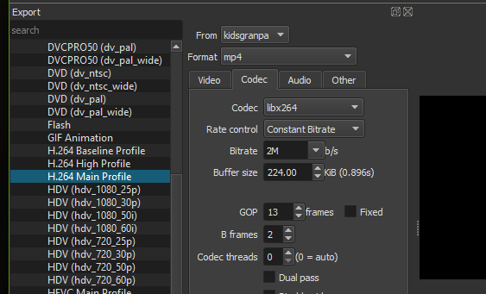
Compression Strategies Continued
Pick a codec that does higher compression
  QuickTime and AVI use different codecs so you can pick one that gives better compression.
  Watch this.
Lower the picture quality of the video
  Sorenson codec lets you set a limit on the data rate
  H.264 is currently the most widely used
  Some let you set the quality:

Slide 45
Compression Strategies Continued
Lower the color depth
  Not popular because video looks best at 24bit color (unless it is a cartoon)
  Some compressors won’t compress color
Play with the audio
  Unfortunately the audio is usually not the problem so compressing it more won’t usually help much!

Slide 46
Compression Concepts
Temporal Compression vs. Spatial Compression:
  Spatial
    Compress each frame individually
    Uses the same techniques as JPG compression
    Codecs that do spatial compression are: Animation, PlanarRGB
  Temporal
    Just save info on selected frames (called keyframes)
    All other frames just save the differences from the previous keyframe
    Good when the difference between current frame and keyframe is small
    Codecs using temporal compression are: Sorenson Video, H.264
  Question: What kinds of video would not do well with temporal compression?
  Watch this starting at 3:50 (just till 5min)
Notes:
Temporal Compression explained: http://www.youtube.com/watch?v=_14imL2S2II&feature=related

Slide 47
Compression Concepts
Lossy vs. Lossless Compression
  Depends on the codec
  Lossless
    looks for large blocks of pixels that are the same to do RLE (run length encoding)
    QuickTime Animation and PlanarRGB are lossless
  Lossy
    Lowers video quality but get better file size and better data rate (bit rate).
How this relates to bit rate (just watch first 2 minutes and 40 seconds)

Slide 48
HTML5
A new standard (well not that new…first beta released in 2008) for the html in webpages. It includes a way to watch video on a website that does NOT require the browser to have a plug in (all new browsers can display the video using HTML5)

Slide 49
Before HTML5, to insert video, the code looked like this ☹:
<object classid="clsid:D27CDB6E-AE6D-11cf-96B8-444553540000" width="475" height="269" id="FLVPlayer">
<param name="movie" value="FLVPlayer_Progressive.swf" />
<param name="quality" value="high" /> <param name="wmode" value="opaque" />
<param name="scale" value="noscale" /> <param name="salign" value="lt" />
<param name="FlashVars" value="&amp;MM_ComponentVersion=1&amp;skinName=Clear_Skin_1&amp;streamName=pictures_1&amp;autoPlay=false&amp;autoRewind=false" />
<param name="swfversion" value="8,0,0,0" />
<!-- This param tag prompts users with Flash Player 6.0 r65 and higher to download the latest version of Flash Player. Delete it if you don’t want users to see the prompt. -->
<param name="expressinstall" value="Scripts/expressInstall.swf" /> <!-- Next object tag is for non-IE browsers. So hide it from IE using IECC. --> <!--[if !IE]>-->
<object type="application/x-shockwave-flash" data="FLVPlayer_Progressive.swf" width="475" height="269">
<!--<![endif]--> <param name="quality" value="high" /> <param name="wmode" value="opaque" />
<param name="scale" value="noscale" /> <param name="salign" value="lt" />
<param name="FlashVars" value="&amp;MM_ComponentVersion=1&amp;skinName=Clear_Skin_1&amp;streamName=pictures_1&amp;autoPlay=false&amp;autoRewind=false" />
<param name="swfversion" value="8,0,0,0" /> <param name="expressinstall" value="Scripts/expressInstall.swf" />
<!-- The browser displays the following alternative content for users with Flash Player 6.0 and older. --> <div>
<h4>Content on this page requires a newer version of Adobe Flash Player.</h4> <p><a href="http://www.adobe.com/go/getflashplayer">
<img src="http://www.adobe.com/images/shared/download_buttons/get_flash_player.gif" alt="Get Adobe Flash player" /></a>
</p> </div> <!--[if !IE]>--> </object> <!--<![endif]--> </object>
Now it looks like this:
<video src="myvideos/movie.mp4" controls>
if this text shows instead, your browser is really old!
</video>

Slide 50
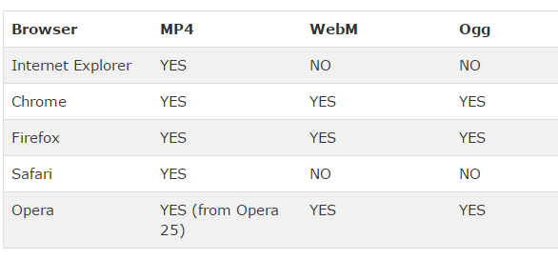
Inserting Video into your webpage using…HTML5
Currently HTML5 supports 3 video formats:
  MP4
  WebM
  Ogg
Have to worry about what browser your viewer is going to use:

Slide 51
HTML5 Video Formats
Apple is trying to get away from Flash so it won’t support .flv,
HTML5 does NOT support .flv
HTML5 Standards group wanted:
  Good compression, good image quality
  Royalty free
  Should handle hardware issues as well as software issues
Works on handheld devices too ☺

Slide 52
HTML5 supports →ogg, webm and mp4
Originally only wanted to use codec: Theora or Vorbis (.ogg containers) because they were open source but Apple wasn’t sure if they were open source
WebM another file format, royalty free, open source, backed by Google
  YouTube uses WebM
Apple and Microsoft only support the codec: H.264 which creates .mp4 files
  Used in blu-ray discs, vimeo, YouTube and iTunes
  H.264 is lossy but can do lossless

Slide 53
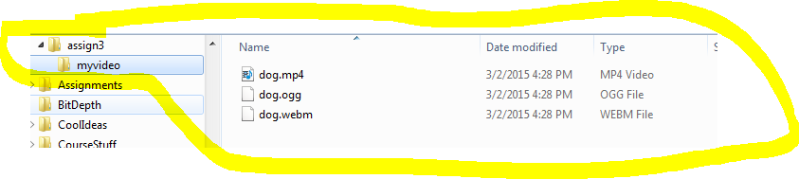
How to add video in HTML5
Make sure you encode your video as a mp4, ogg or WebM file using Adobe Encoder
Put your video somewhere inside the folder containing your website (perhaps a subfolder). E.g. if you folder is assign3, maybe put video in assign3/myvideo folder:
Make sure the first line of your webpage is:
  <!DOCTYPE html> (this indicates it is html5)

Slide 54
HTML5 <video> tag
Edit the html code in the assign3 folder (e.g. the index.html file) and put the following <video> tag where you want the video as follows:
Might need this →
QUESTION: What do you think each of these parameters do?
QUESTION: What do you think this does:
<video width="320" height="240">
<source src=“myvideo/dog.mp4" type=“video/mp4“>
</video>
<video width="320" height="240">
<source src=“myvideo/dog.mp4" type=“video/mp4">
<source src=“myvideo/dog.ogg" type="video/ogg">
<source src=“myvideo/dog.webm" type="video/webm">
Your browser does not support the video tag.
</video>
<video width="320" height="240" controls autoplay loop muted poster=“doggy.jpg”>
<source src=“myvideo/dog.mp4" type=“video/mp4">
</video>
…
<source src=“myvideo/dog.mp4#t=10,22" type=“video/mp4">
Notes:
CLEAN UP

Slide 55
Other Terms You Need To Know
Container File Format
  A file format that stores both the data (the frames) AND how to play the data (which codec to use)
  Some common containers are:
    .avi → sometimes has uncompressed video, just depends, no streaming
    .flv (doesn’t allow subtitle)
    .ogg (free open source container format)
    .mp4
Newer container formats support subtitles, chapters, etc…
Question: Why can your computer sometimes play one .avi file but then not play another .avi file?

Slide 56
Something else cool you can do with HTML5 and container file formats:
Pick a subtitle or closed captioning file
<video controls width="640" height="360“>
<source src="devstories.mp4" type='video/mp4>
<track src="devstories-en.vtt"
label="English subtitles" kind="subtitles" srclang="en" default></track>
</video>
http://www.html5rocks.com/en/tutorials/video/basics/
Notes:
LOOK INTO SUBTITLES

Slide 57
Subtitles
Subtitles help the viewer understand dialogue
  Especially important for hearing impaired
Two main types: hard and soft
  Hard (hardsubs): embedded into the video file so they can not be turned off or removed
  Soft (softsubs): usually stored in a separate file telling what text to appear at what time in the video. These can be turned off/on as needed.
  Both types have pros and cons, but we will just work with softsubs here.

Slide 58
Subtitles
You must specify the start time, end time, and the text to be displayed for each subtitle panel on the video
This format is also often used if you want to set up Karaoke.
For videos embedded in a website, the format has to be a .vtt (Web Video Text Tracks) file.

Slide 59
Subtitles
In the webpage, add the following HTML:
<video width="1280" height="720" controls>
<source src="cat.mp4" type="video/mp4">
<track label="English" kind="subtitles" srclang="en" src="cat.vtt" default>
Your browser does not support the video tag.
</video>
The width, height, video source file, and subtitles file may need to be updated.

Slide 60
Subtitles
Here is a SOFT subtitled video demo:
http://www.csd.uwo.ca/~bsarlo/cs1033a/samples/video.html
Here is a HARD subtitle video demo:
  http://www.csd.uwo.ca/~lreid/cs033/moviedemo/RachelB%20project_final.wmv
Have a look at the WebVTT subtitle file here:
http://www.csd.uwo.ca/~bsarlo/cs1033a/samples/cat.vtt

Slide 61
Vote Now:
Which video would YOU rather have (no right or wrong answer)
  This one:
  http://www.csd.uwo.ca/~lreid/cs1033/ExamplesForLectures/videoslag/144example.mp4
  OR
  This one:
  http://www.csd.uwo.ca/~lreid/cs1033/ExamplesForLectures/videoslag/8kexample.mp4

Slide 62
Video on the Web
Getting video/audio (media) from a website to your computer so you can view it:
  Downloading
    Make a copy of the file/video on your machine
  Streaming
    Like listening to the radio – you can listen but can’t save it (without difficulties)

Slide 63
Download
Used to be the ONLY option!
When you visit a website containing video, the entire video must be downloaded to your computer before you can play it.
  Progressive downloads allow you to start watching as soon as it has downloaded enough bits to stay ahead of the download
For the web, usually stored on a HTTP protocol
Data that is sent is permanently stored on the end machine.
Disadvantages:
  Question: What do you think is a disadvantage?
Advantages:
  Question: What do you think is an advantage?
Notes:
Long wait times
Have file permanently, can play over and over again without wait time, best for small clips, higher quality video because we don’t have to compress to improve streaming, Can go through video step by step

Slide 64
Streaming
In true streaming the file is never permanently saved to the user’s hard drive, media begins to play as soon as it gets enough packets to stay ahead of the viewer
Disadvantages:
  Question: What do you think is a disadvantage?
Advantages:
  Question: What do you think is an advantage?
Notes:
Fastest but requires the server be a streaming server,
Reduces waiting time for user
Drawback: needs lots of compression, congestions may cause the media to stall if the download process cant keep up with the playback, doesn’t take up disk storage, live playback, great for long videos

Slide 65
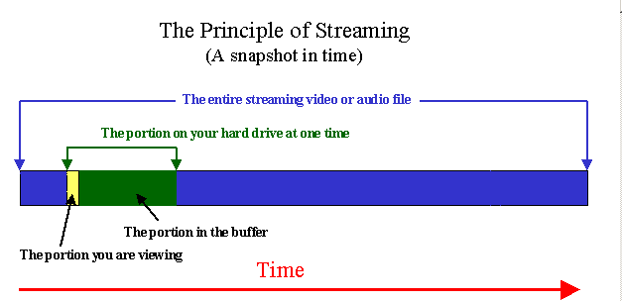
Streaming
When streaming video (like on youtube), the video must be delivered fast enough so there appears to be no delay
Uses buffering:
  small buffer space is created on the user's computer
  data starts downloading into it.
  as soon as the buffer is full (usually just a matter of seconds), the file starts to play
  As soon as the video finishes playing, buffer is purged
  Kinda like a rabbit in front of grey hounds

Slide 66
Streaming…
Sometime requires special streaming server (RTSP)
Video starts almost immediately
If the data rate (bit rate) of the encoded video file is bigger than the amount of bandwidth available, the video will frequently STOP PLAYING ☹
Unicast vs. Multicast -http://www.bolermountain.com/
  Unicast → each user gets his/her own stream of video, the server has to send out A LOT of data if several users are watching at once
  Multicast → send the same stream to a bunch of users but then they lose the ability to pause, rewind, etc.

Slide 67
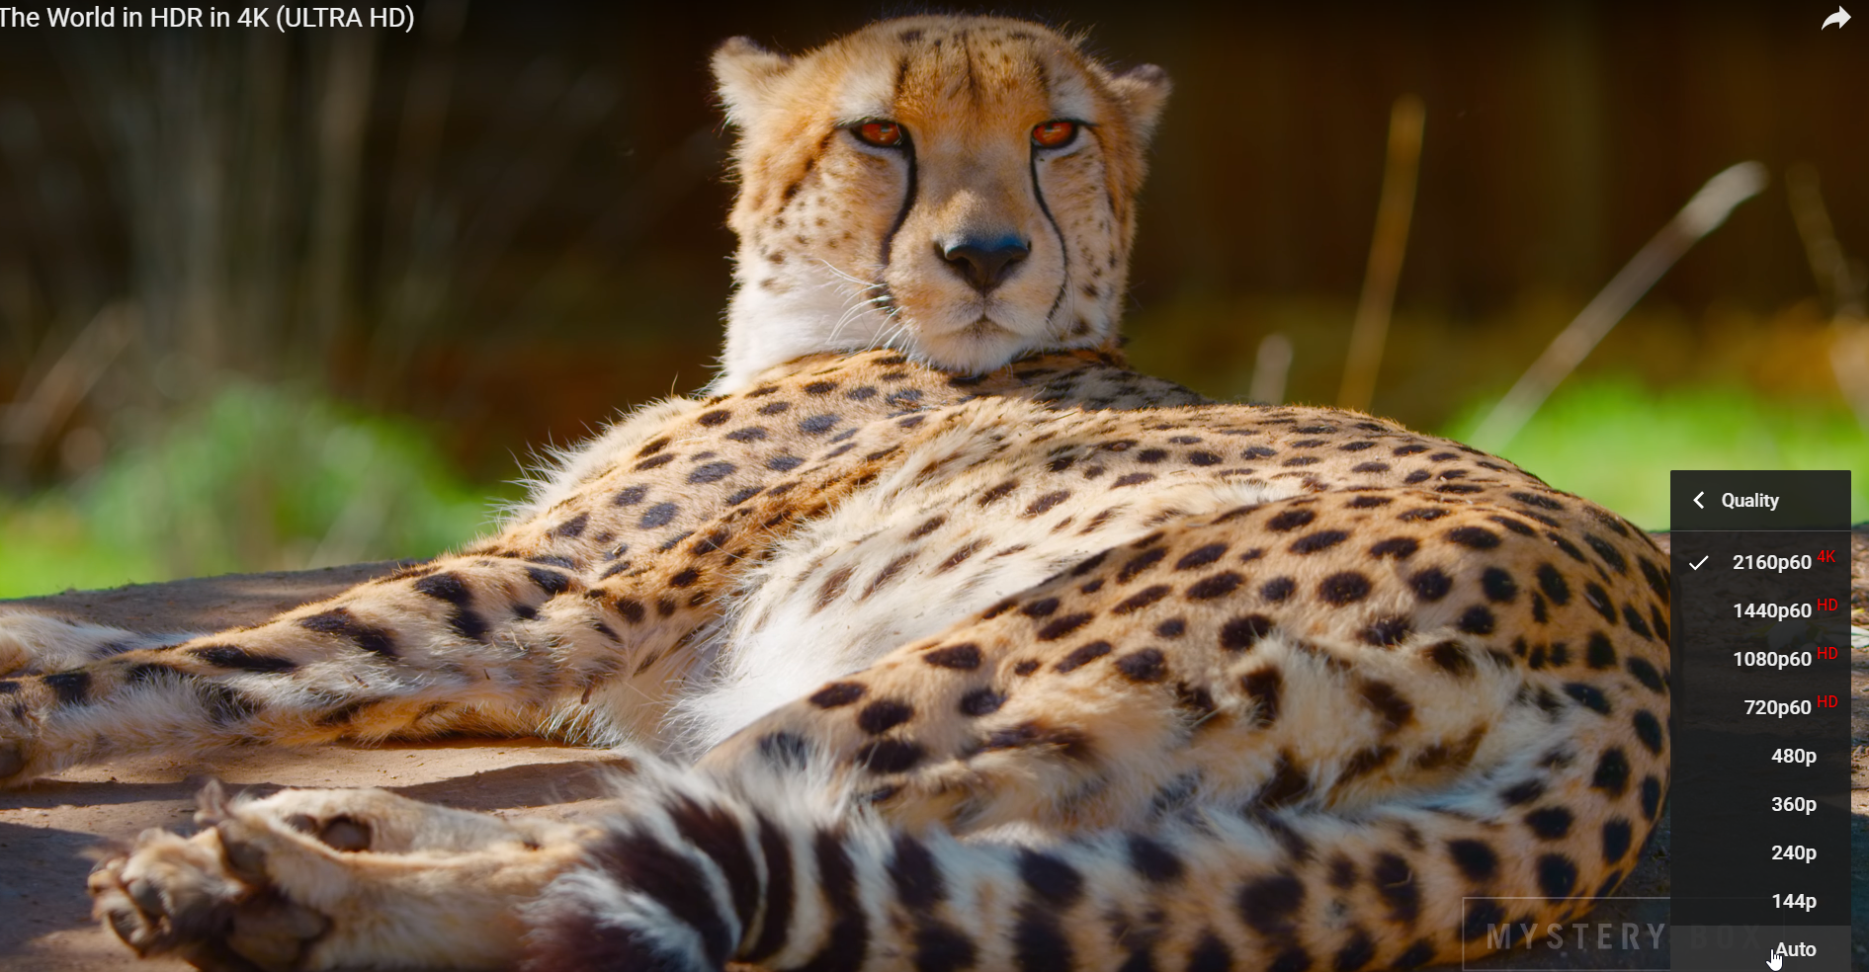
Adaptive Streaming
YouTube is now (because of 4K content) doing Adaptive Streaming
When you upload a 4K video, it makes several versions of it (1440 version, 1080 version, etc):

Slide 68
When you upload your 4K video, give youtube a few hours to make the different versions THEN TEST THE QUALITY.
Vimeo also does this.
If the viewer picks Auto, it will serve up the BEST quality video it can to avoid buffering depending on the current bandwidth
People find buffering MUCH more annoying than low quality, so youtube ADAPTS (adaptive streaming) depending on bandwidth

Slide 69
YouTube
YouTube accepts video in several formats including: .WMV, .AVI, .MOV, MPEG and .MP4
Uses many codecs but the most common is H.264
YouTube used to output everything in as either .flv or .f4v (Flash video) as every computer had Flash BUT NOW IT CONVERTS UPLOADED VIDEO TO .mp4
YouTube ALWAYS re-encodes your video, so don’t upload something that you have already highly compressed, it will get compressed again, instead upload high quality video
  QUESTION: what is the downside of uploading high quality uncompressed video?
Notes:
It takes a long time to wait while it uploads

Slide 70
Consider
Going from 1080p HD video to 4K video will NOT always improve video quality on the internet because of compression
  If you encode at the same bit rate and the bitrate is low, the 1080p video will be clearer than the 4K video because it had less compression done to it.
  Comparison: which video looks better?
    A
    B
    One of the videos is 4K and one is 1080p but both were given a bitrate of 1Mbps.

Slide 71
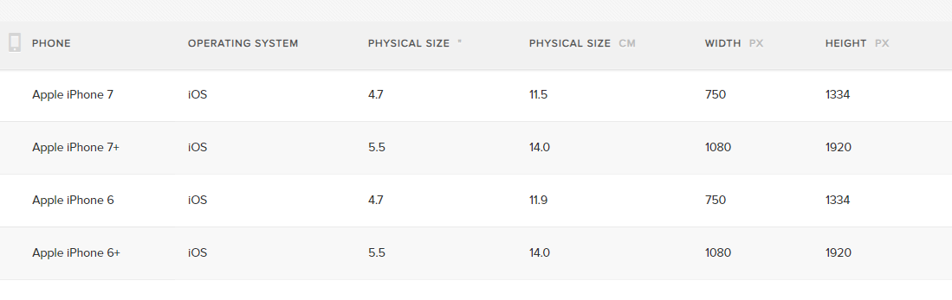
Also consider:
Over 75% of all videos are viewed on mobile devices now
VERY Confusing:
  How can a smart phone record 4K but not have 4K display?
  Smartphones that are capable of recording 4K video do NOT necessary have a 4K display (they have at least an 8.8 Megapixel sensor for recording)

Slide 72
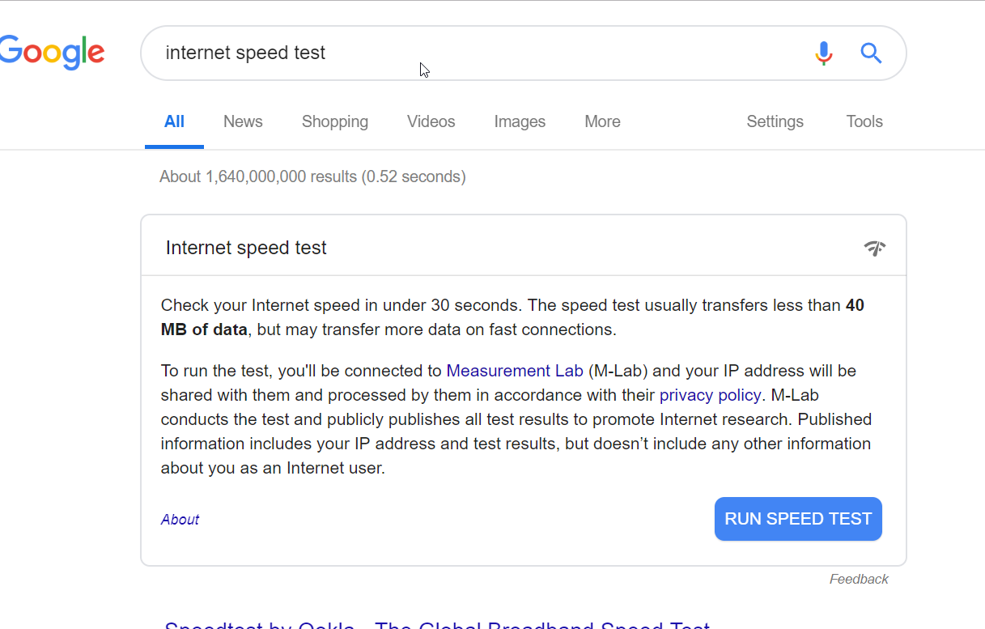
Check your connection right now!
http://google.com

Slide 73
Review Questions
How many lines of HORIZONTAL resolution did TVs from the 1970s have?
Every avi file was encoded using the same codec → TRUE or FALSE?
It is not possible to add tracks to HTML5 videos → TRUE or FALSE?
How is bitrate measured?

