Slide 1
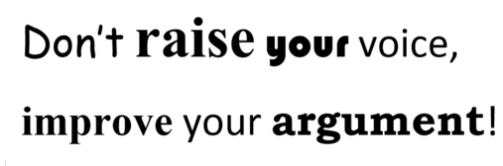
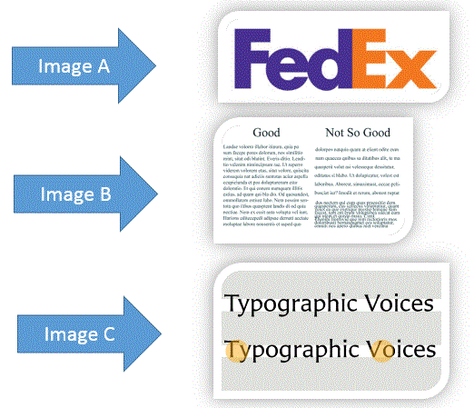
Warm up Questions:
Identify which words
are serif font:
Match the image to the
typography term:
  Kerning
  Tracking
  Leading

Slide 2
Review:
Colour codes are of the format
# __ __ __ __ __ __
Red Red Green Green Blue Blue
Each of the slots will take the value of:
0,1,2,3,4,5,6,7,8,9,A,B,C,D,E,F
00 means no amount of that colour
FF max amount of that colour

Slide 3
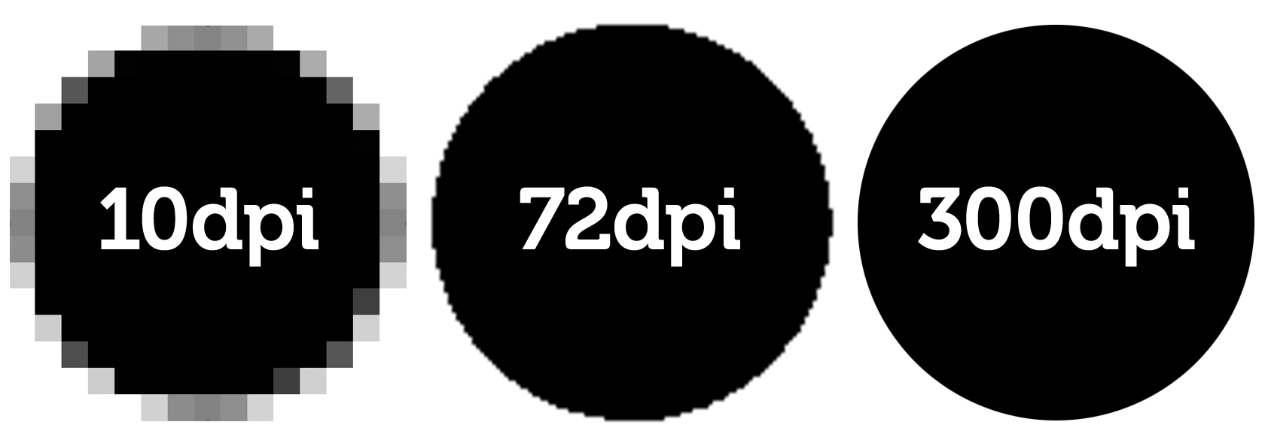
Review:
Image resolution is a measure of pixels per inch. Low DPI results in blurring/pixelation.

Slide 4
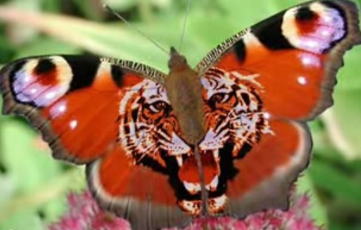
Introduction to Graphics
Computer Science 1033 – Week 3
How to design a poster
“Think honk if you're a telepath.”→ Unix Fortune

Slide 5
Overview of Today’s Topics
Announcements
Representing/Encoding our World
Binary System
Converting Analog Data to Digital Data
Sampling Images
Quantizing Images
Black and White, Colour Images

Slide 6
Textbook Readings
Understanding Computers
  Fundamentals of Computers
  Binary, Hexadecimal, and Other Number Systems
  Digital Language
Graphics
  Pixel Measurements and Resolution
  Digitized Images

Slide 7
Announcements
DON’T FORGET TO DO THE QUIZ IN OWL BEFORE JANUARY 31st !
Assignment 1 is now posted.
  http://owl.uwo.ca

Slide 8
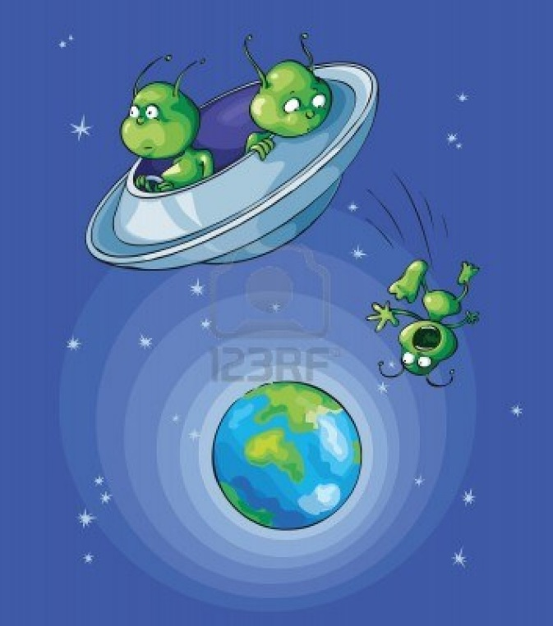
Consider this:
An alien has dropped into your backyard and it is up to you to explain how humans communicate…
THINK ABOUT IT, how do humans communicate/represent “Stuff”?

Slide 9
Before computers how did we encode data (i.e. store information about our world)?
How did we represent the world around us before ~1880?
How did we represent the world around us after 1900?
How do we represent our thoughts?
How do we represent our language?
How did we SAVE representation of our thoughts before 1980ish?
How about now?
Drawings, language, paintings, books
Above plus … photographs, movies, TV, record albums
English words, pictures
Letters, words
Books, diaries, journals
Blogs, Facebook, Twitter
Notes:
Drawings, paintings

Slide 10
How did we represent NUMBERS in history?
How do humans represent cost and quantities?
How did “the average person” calculate costs before home computers (Still used today)?
How did we calculate costs before 1950s?
How did we calculate costs before 1600s?
Why is our number system base 10? OR how did we calculate costs before 2700BC?
Decimal Numbers
Calculators
Slide Ruler
Abacus
Count on our fingers!

Slide 11
Remember
_ is a digit place holder
987 is a 3 digit number
BUT it could also be a 8 digit number as follows:
000000987
If you had to represent the numbers with digit holders, you pad the front with zeros 0:
0
0
0
0
0
9
8
7

Slide 12
How does a computer represent numbers and words and images and sound?
How does a computer represent numbers?
How does a computer represent words?
How does a computer represent images?
How does a computer represent sound?
What is DNA and why is Laura mentioning it here? → http://en.wikipedia.org/wiki/Quaternary_numeral_system
https://www.youtube.com/watch?v=dNtVWPaOzho

Slide 13
Important…
Basically everything we talk about from now in this course is how a computer encodes/represents stuff!
Remember computers only understand/speak “Binary” → O or 1
Programmers have figured out how to convert our world to something a computer can understand, thus they convert:
  Words to binary
  Images to binary
  Sound to binary
  Movies to binary
Something from a former student

Slide 14
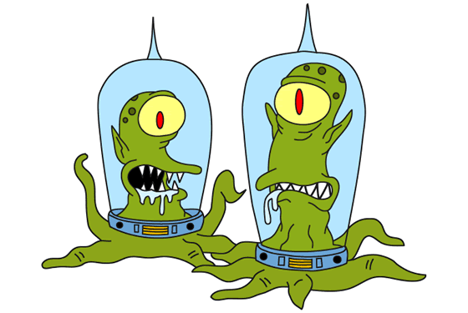
Let’s try an experiment:
How could we possibly represent anything with just 0’s and 1’s? Seems impossible but everyone in this class can do it (if we start small)!
THE ALIENS ARE COMING, they only speak binary!!! OH NO…Using binary let’s represent:
Notes:
Kang and Kodos

Slide 15
Let’s trying using Binary to represent our world!
Use only 1’s and 0’s to represent:
  Over 6 feet tall.
  People who went to high school the longest in:
    London
    Ontario (but not London)
    Canada (but not Ontario)
    Outside of Canada
  People who were born on a Su, M, Tu, W, Th, F, Sa
  People who were born in Jan, Feb, Mar, Apr, May, Jun, Jul, Aug, Sep, Oct, Nov, Dec
  People who were born in 1913, 1914, 1915, … 2013
  Bonus Question:
    What are the alien’s names on The Simpsons ☺ ?
Notes:
Kang an kodos

Slide 16
How many items can we represent with Binary Bits? (how many patterns can we make)
If we have 1 bit →
If we have 2 bits →
If we have 3 bits →
0
Could represent:
-Black and White OR
-True and False
1
00
Could represent:
-Black, Light Gray, Dark Gray, White OR
-DNA Bases OR
-Red, Blue, Yellow and Black
01
10
11
000
100
Could represent:
-days of the week but not the months of the year, WHY?
-8 shades of GRAY
001
101
010
110
011
111

Slide 17
Representing Decimal Numbers in Binary
Decimal | Number of Digits | Binary | Number of Bits
0 | 1 | 0 | 1
1 | 1 | 1 | 1
2 | 1 | 10 | 2
3 | 1 | 11 | 2
4 | 1 | 100 | 3
5 | 1 | 101 | 3
6 | 1 | 110 | 3
7 | 1 | 111 | 3
8 | 1 | 1000 | 4
9 | 1 | 1001 | 4
10 | 2 | 1010 | 4
11 | 2 | 1011 | 4
What do you notice every time we need to increase the number of bits?

Slide 18
How many things can we represent with Binary Digits (Bits)
QUESTION : if I have a one bit number, how many items can I represent?
QUESTION : How about 2 bit number?
QUESTION : How about 3 bit number?
QUESTION: How about an 8 bit number (8 bits is called a BYTE)

Slide 19
Stuff (number of dogs let’s say) | Binary Representation of Stuff | Decimal Representation of Stuff
 | 0 or 00000000 | 0 or 00000000
 | 1 or 00000001 | 1 or 00000001
 | 10 or 00000010 | 2 or 00000002
 | 11 or 00000011 | 3 or 00000003
 | 100 or 00000100 | 4 or 00000004
 | 10110 or 00010110 | 22 or 00000022
  http://www.youtube.com/watch?v=b6vHZ95XDwU&feature=related

Slide 20
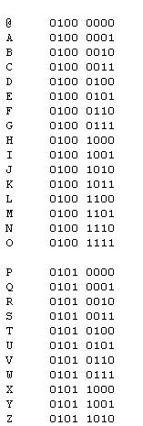
Representing Characters in Binary
Use 1 byte for each letter →
Called the ASCII code
Thus DOG would be encoded as:
With 8 bits, (or 1 byte), we can encode 2⁸ → 256 different characters
01000100 | 01001111 | 01000111
D | O | G

Slide 21
How many numbering systems are there?
Infinite! Some of the common ones are:
Binary → (2 Binary Digits/ BITS) 0,1,10,11,100,101, 110, 111,1000, 1001, …
Octal → (8 Digits) 0,1,2,3,4,5,6,7,10,11, 12,13,14,15,16,17,20
Decimal → (10 Digits) 0,1,2,3,4,5,6,7,8,9,10,11,12,13, 14,15,16,17,18,19,20, … , 99, 100, 101, 102… 999
Hexadecimal→ (16 Digits) 0,1,2,3,4,5,6,7,8,9,A,B,C,D,E,F,10,11,12, 13,14,15,16,17,18,19,1A,1B,1C,1D,1E,1F,20… FA, FB, FC, FD, FE, FF, 100, 101, 102,…. FFE, FFF, 1000, 1001, 1002
NOTE: as soon as you run out of patterns, you need an extra place holder (just like you learned in grade 2, that in decimal, when you have the numbers from 000 to 999, you only need 3 place holders but after 999, you will need another (4) place holder → 1000)
Select: Start>Programs>Accessories>Calculator>View>Scientific
  Or use this online one: http://calc.50x.eu/

Slide 22
Decimal Representation
Binary Representation
0
1
0
0
0
0
1
1
1
1
0
0
0
1
2
3
1
1
0
1
4
5
6
7
0
0
0
1
1
1
0
1

Slide 23
Binary to Decimal Conversion
Each digit must be converted individually and then the digits are added together
How is a digit converted?
  If the digit is a 0, ignore it!
  If the digit is a 1, get the place value of the digit and calculate 2 to the power of that place value
  Note that the place values always begin with the right-most digit at place 0

Slide 24
Binary to Decimal Conversion
Suppose we want to convert 1001 to decimal
The small, red numbers below represent each digit’s place value
Now we raise 2 to the power of the place value for each of the 1’s
The first 1 has place value 3, so take 2³ = 8
The next 1 has place value 0, so take 2⁰ = 1
Now add them together. 8+1 = 9
1 | 0 | 0 | 1
3 | 2 | 1 | 0

Slide 25
Binary to Decimal Conversion
Another example: Convert 0111 to decimal
The three 1s are at place values 2, 1, and 0
  2² = 4
  2¹ = 2
  2⁰ = 1
Add them together. 4+2+1 = 7
0 | 1 | 1 | 1
3 | 2 | 1 | 0

Slide 26
Binary to Decimal Conversion
Another example: Convert 100 to decimal
The only 1 is at place value 2
  2² = 4
The solution is 4.
The formula is the same for any number of digits. In this course you only need to do conversions on up to 4 bits (4 digits)
1 | 0 | 0
2 | 1 | 0

Slide 27


Binary example:
Think of lights in your home. If a light is on, it has a value of 1, if it’s off then it’s 0.
➔ 0000
➔ 1111
➔ 1000
➔ 0101

Slide 28
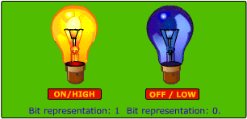
Why do Computers like Binary?
A computer uses electricity and can distinguish between getting a high volt or a low volt. A high volt is a 1, a low volt is a 0

Slide 29
Some basic concepts
Everything we want to show/hear on a computer MUST be encoded.
A lot of our world that was once measured in an analog manner can now be represented in a digital manner:
 | Analog | Digital
Time
Temperature
Sound
Weight

Slide 30
Break ☺
Something to amuse you during the break: Painting the Mona Lisa by using MS Paint (not even Photoshop…WOW)
  Mona Lisa with MS Paint

Slide 31
Converting Analog to Digital
Conversion is a 2 step process:
  Step 1: Sampling → how often do I take a sample (measurement) to represent parts of the “thing” (how many parts will I break the thing up into)
  Step 2: Quantizing → how many discrete values will I use to represent the parts the “thing”
  *** where “thing” means image, sound, video, animation, text ***

Slide 32
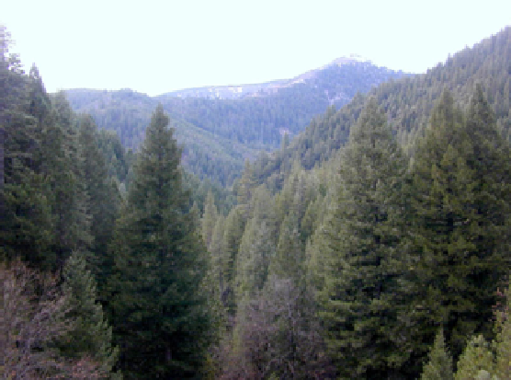


Sampling for Images
← Original Image
Am I going to try to represent this image with 4 samples? What will it look like?

Slide 33

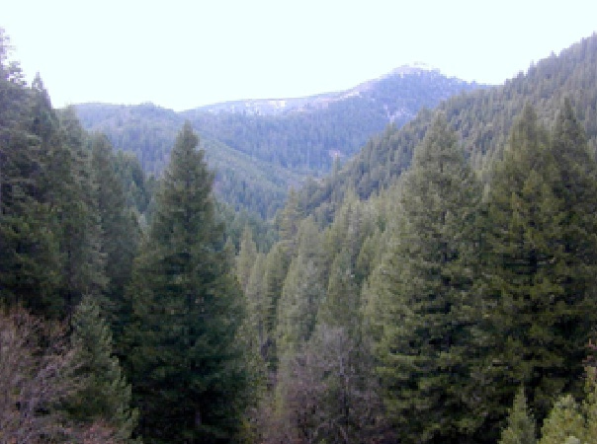

Sampling
Am I going to try to represent this image with around 64 samples?
Am I going to try to represent this image 7500 samples?

Slide 34
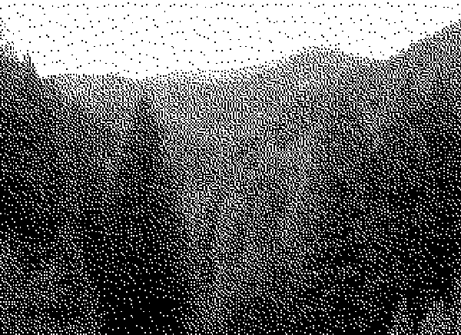
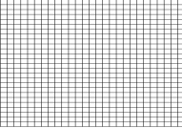
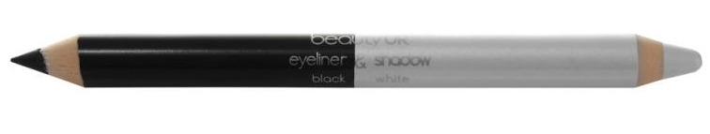
Quantizing Images
Assume I have this image and I have broken it into samples but I can only use ONE 0 or ONE 1 to represent each sample, what will it look like?
0
1

Slide 35

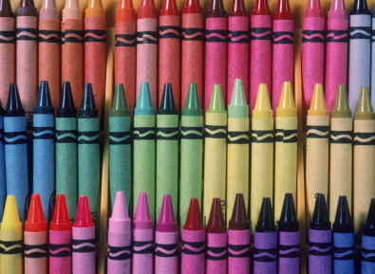
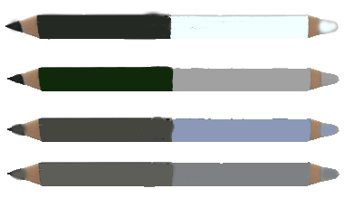
Quantizing Images
Do I have 1 bit to represent the colour of each square (only have 2 colours)
Do I have 4 bits to represent the colour of each square (have 16 colours)
Do I have 24 bits to represent the colour of each square (have about 16 million colours)
NOTE: all these images have the exact same number of samples

Slide 36
Sampling and Quantizing
We will learn how to sample and quantize sound and video as well
Right now let’s figure out how to sample and quantize a picture

Slide 37
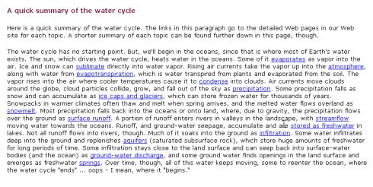
Introduction to Graphics
What can you learn from this:

Slide 38
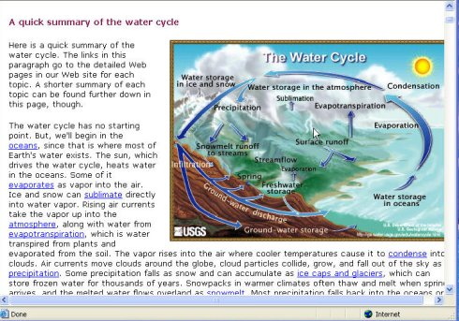
How about this?

Slide 39
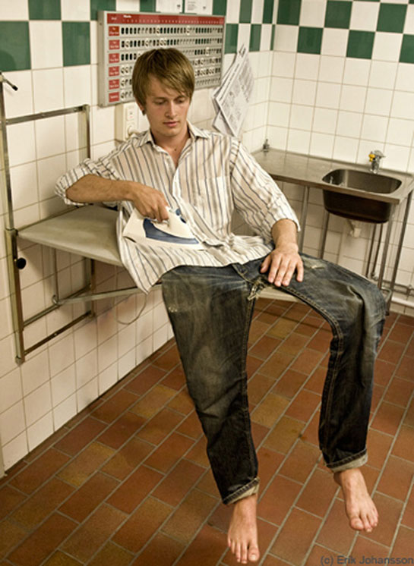
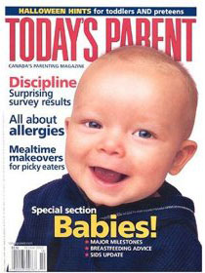
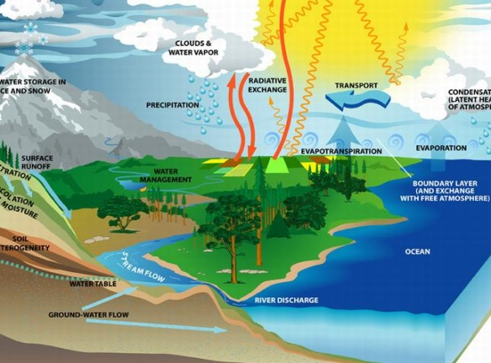
Images are great for
Information
Explanation
Entertainment

Slide 40
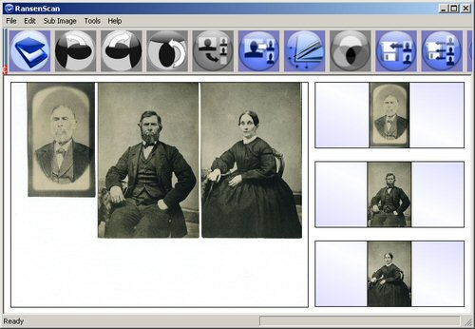
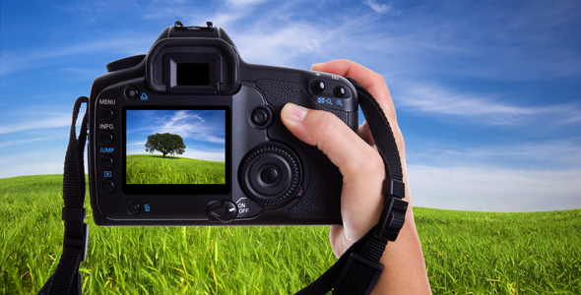

Where do we get our images to use on our computer?
By scanning existing images (a drawing or an old photograph or a painting)
By taking a picture with our digital camera
By creating something original using MS Paint or Photoshop or some graphics program

Slide 41
Some Terminology: Dots Per Inch (dpi)
When scanning or getting an image from our digital camera, the scanner or the camera can determine how many samples to take (how finely to break down the images)
The more samples that are taken, the higher the resolution will be.
Samples on scanners/printers are measured as dots per inch (DPI)
Samples on a monitor are measured as pixels per inch (PPI)

Slide 42
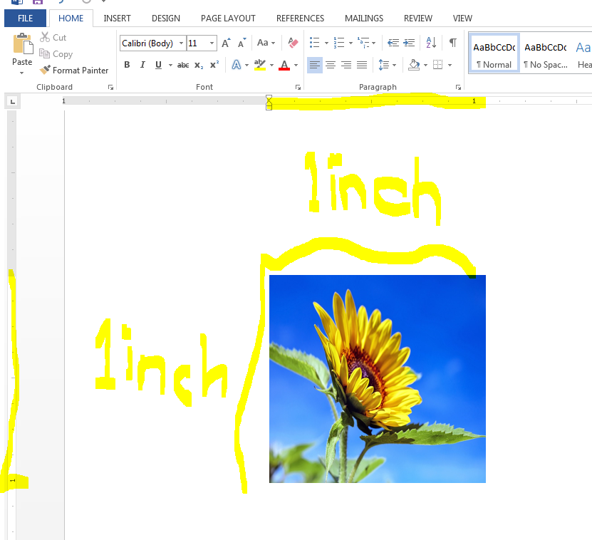
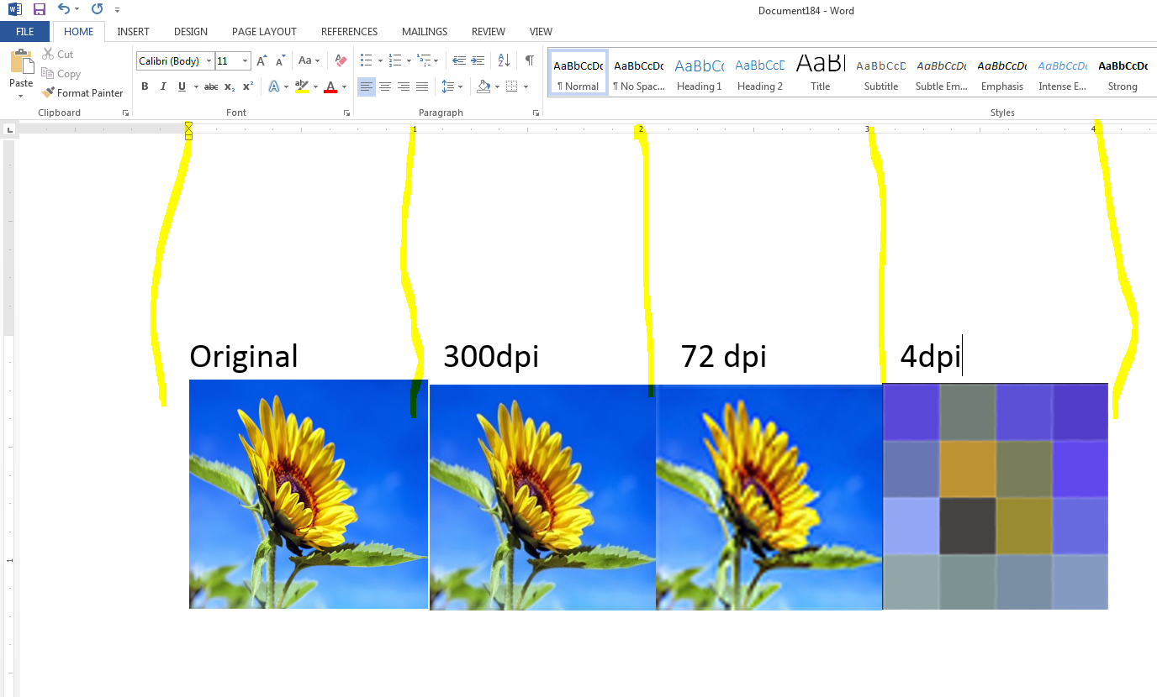
Here is an image in MS Word that is 1 inch by 1 inch, if I scan it in at 4DPI, it will look like this:
4 pixels by 4 pixels so 16 pixels in total at 4DPI

Slide 43
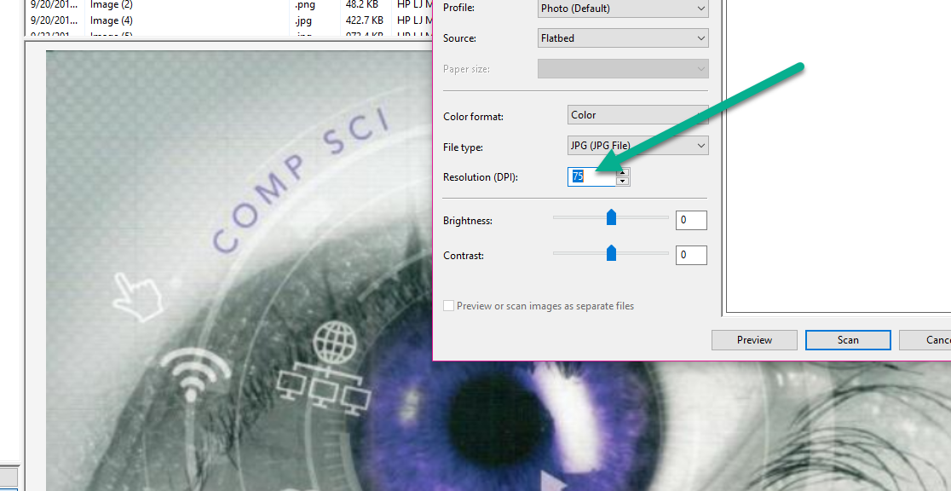
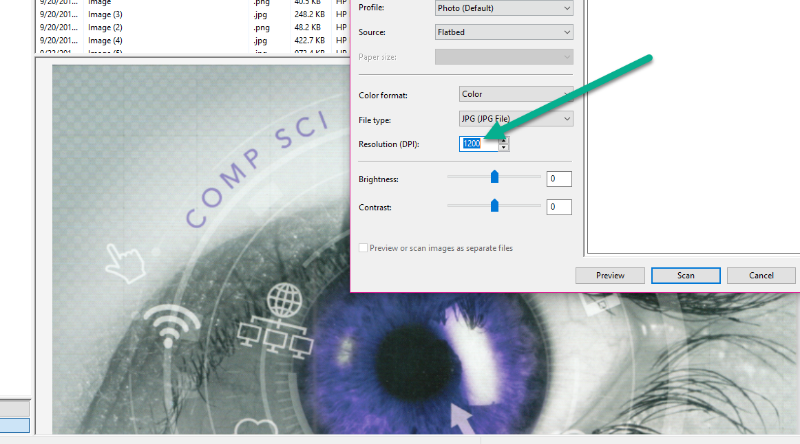
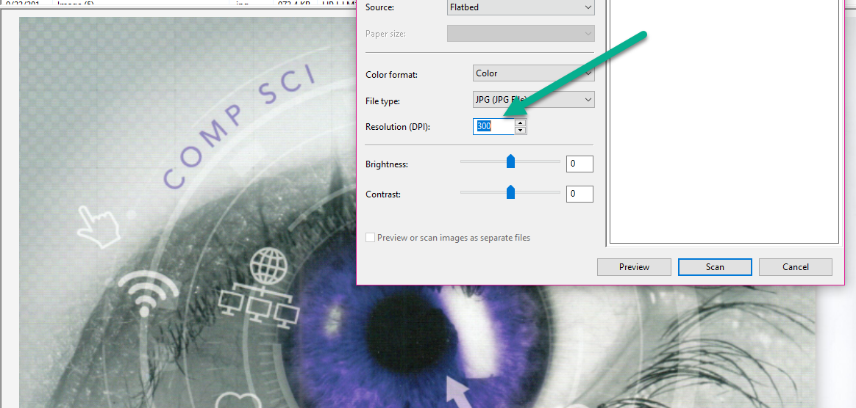

Slide 44
Example
If we scan an 8 inch by 10 inch image at 100dpi, the image will be (8*100) * (10*100) = 800*1000 = 800,000 samples (almost 1 million samples).
QUESTION: What do we call a sample in an image?
Thus the above image would have 800,000 pixels.

Slide 45
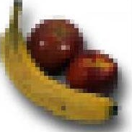

Pixel
An image is represented by a grid (array, matrix) of squared Picture elements called pixels
A pixel is the smallest image component and thus shows the smallest detail
Arranged in column and rows

Slide 46
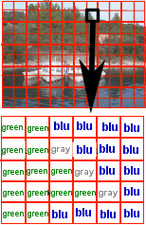
Pixels
Each pixel is given a numerical value that represents the corresponding colour:
  Green might be 1000
  Gray might be 1010
  Blue might be 1110

Slide 47
Now that we understand that …
An image is broken into samples (called pixels → sampling the image) and each pixel is assigned a colour (represented by 0s and 1s → quantizing the image)
Next question is … HOW DO WE PUT THE IMAGE ON A PIECE OF PAPER OR ON TO A MONITOR?

Slide 48
If we scan that same 8 inch by 10 inch picture in and we set the resolution to 300dpi, after scanning, we will get (8 * 300) * (10 * 300) = 7,200,000 pixels (about 7 million pixels)
NOTE: when printing an image, you should print with a dpi of at least 300.

Slide 49
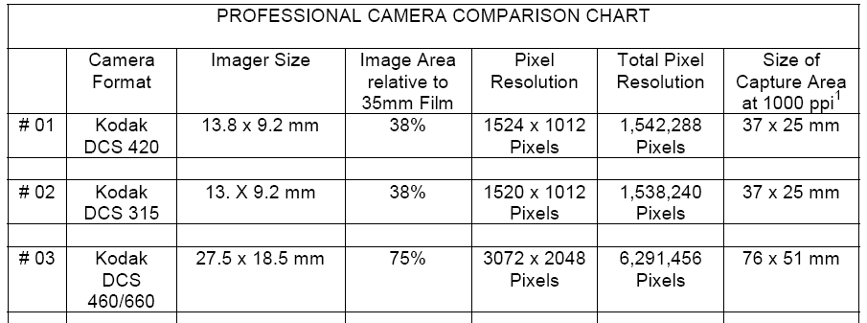
Digital Cameras
Megapixel→ how many millions of pixels you can capture in a photograph on your digital camera (how many “samples” it will break the image into)
Example:
  Kodak DCS 460/660 captures 3072 by 2048 pixels for one photograph → about 6 million pixels or about 6 megapixels
  iPhone 8 Plus features a 12-megapixel wide-angle and telephoto lens and a 7-megapixel FaceTime camera.

Slide 50
Digital Camera Stats
Megabytes | Size of image (pixels WxH) | Total # of Pixels | Printing at 300dpi, biggest suggested print
1 Megapixel | 1280 X 960 | 1,228,800 | 4.2” by 3.2 “
2 Megapixels | 1600 X 1200 | 1,920,000 | 5.3” by 4 “
3 Megapixels | 2048 X 1536 | 3,145,728 | 6.8” by 5.1”
4 Megapixels | 2272 X 1704 | 3,871,488 | 7.5 by 5.6 “
5 Megapixels | 2560 X 1920 | 4,915,200 | 8.5” by 6.4”
Thus, a camera with more megapixels can print a larger image without the human eye detecting a loss of quality.
If you just want to print 4” by 6” images, you don’t need much more than 3 megapixels

Slide 51
Printing Images on Paper
When printing an image, the image must be printed at a size that has a minimum of 300 pixels per inch.
QUESTION: Thus, if you had an image that was 3000 pixels by 1500 pixels, for the print quality to be good enough to the human eye, what size should you print it at?
Answer: 3000/300 → 10 inches by 1500/300 → 5 inches. DON’T PRINT IT ANY LARGER THAN 10” by 5”

Slide 52
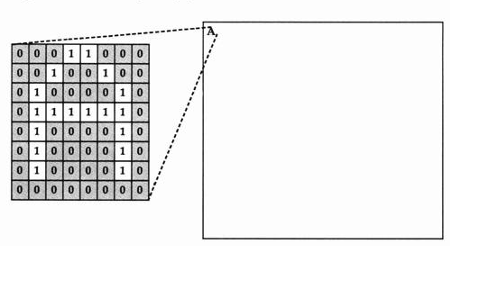
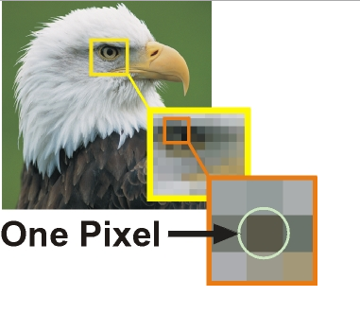
Remember that we take an image and…
Break it into samples (called pixels). But how does the pixel in the image go onto the screen (or paper)?

Slide 53
Displaying Images on the Screen
Remember →The monitor/screen is made up of rows of screen pixels. Each screen pixel gets a colour. Thus we map the image pixels on to the screen pixels IN A ONE TO ONE MAPPING and see our image.
The Screen Resolution is the number of pixels across by the number of pixels down that a screen is currently displaying
  Common Screen Resolutions:
    640 by 480
    800 by 600
    1024 by 768
    1280 by 1024

Slide 54
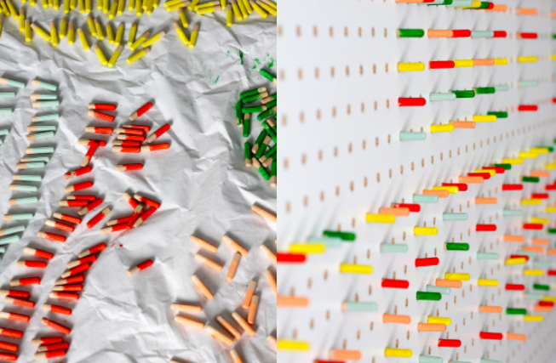
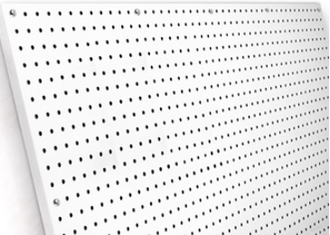
Screen is like a peg board (holes are the monitor pixels)
Image is like pegs (pegs are the image pixels)
One to One mapping

Slide 55
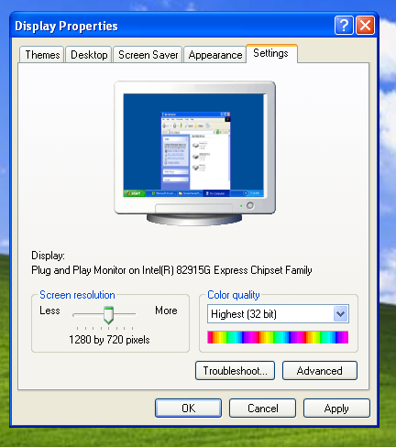
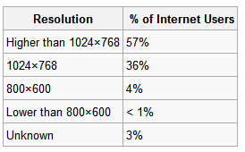
Changing the Screen Resolution
On a Windows machine:
  Right click on the Desktop
  Select Properties
  Select Settings
  Change the Screen resolution→

Slide 56
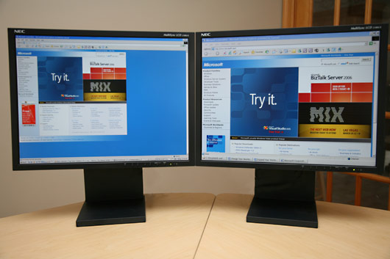
1600 px
1024 px
 | Size of fonts, icons, images | Amount of data you can fit on the screen at one time
640 by 480 | Appear large, text larger, easier to read | Not as much
1280 by 1024 | Appear smaller, text small, harder to read | A lot !

Slide 57
Displaying images on a screen
Amount of space the image takes up on the screen is dependent on:
  Size of the image
  The current resolution of the screen
  NOT THE DPI
Example:
  Image that is 400 pixels by 300 pixels will take up ¼ of the screen on a monitor with resolution 800 by 600
  Same image will take up about 1/16 on a screen that is set at 1280 by 1024
All these images are 412 by 324 pixels but all are different DPI → http://www.csd.uwo.ca/~lreid/cs1033/resolution/

Slide 58
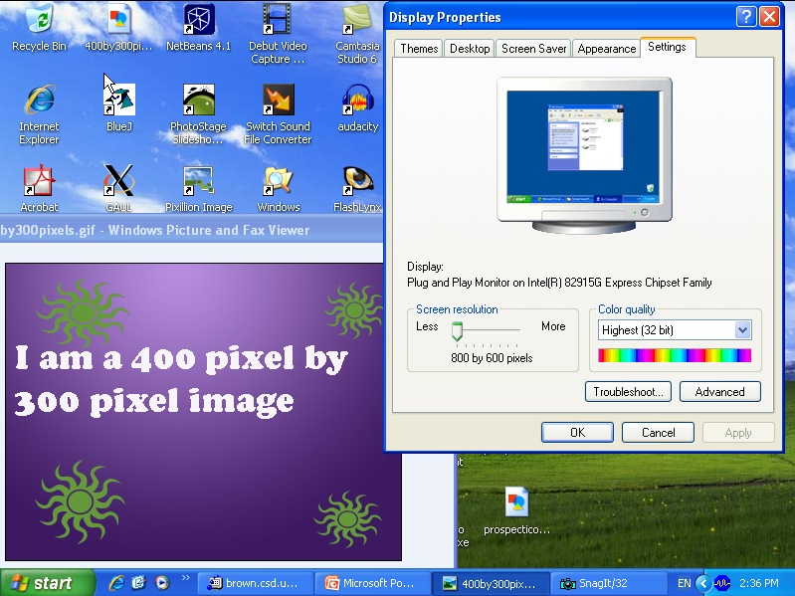
800 by 600 Monitor Resolution
600 pixels
300 pixels
400 pixels
800 pixels
Image takes up ¼ of the screen

Slide 59
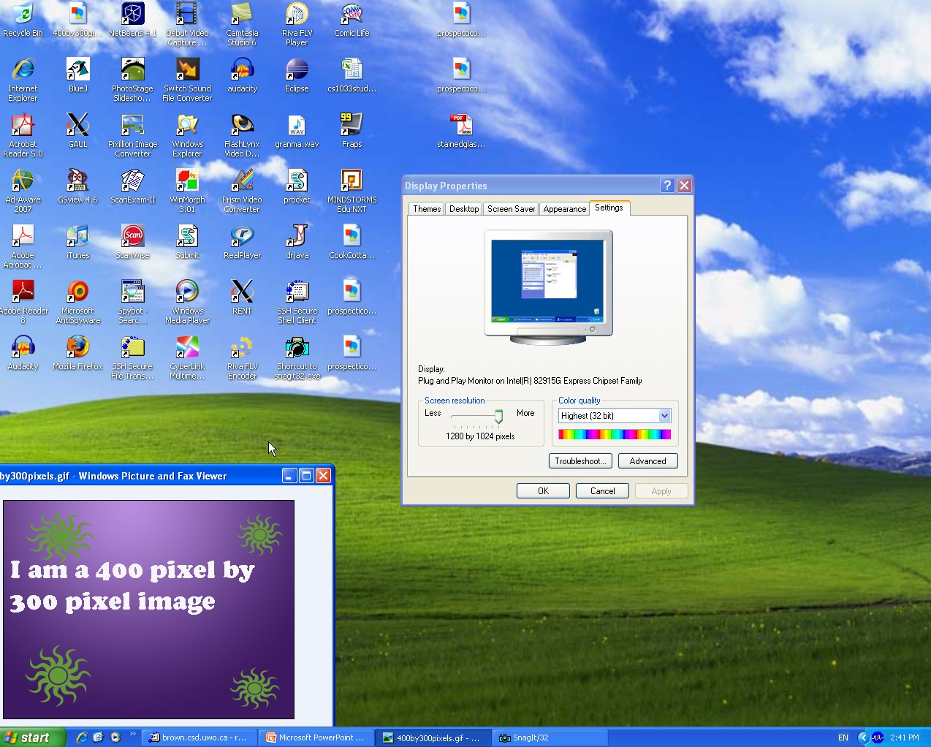
1280 by 1024 Monitor Resolution
1024 pixels
300 pixels
400 pixels
1280 pixels

Slide 60
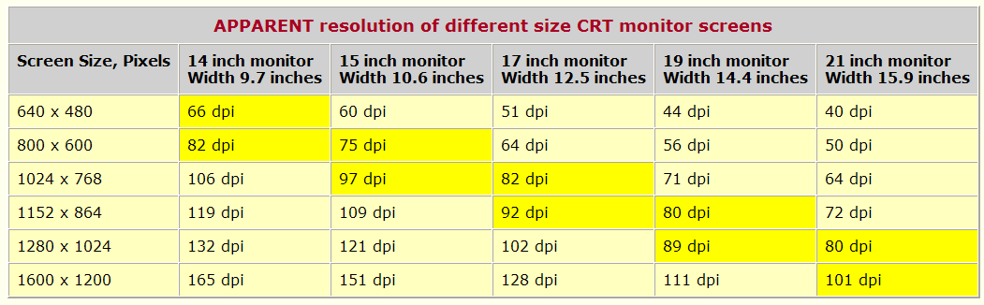
Average Pixels Per Inch for Monitors
Depends on:
  Size of the monitor in inches
  Current resolution
but average pixels (dots) per inch is usually around 72ppi

Slide 61
Why does 72PPI matter?
If we always create an image at 72 ppi, we are guaranteed that what we see with the zoom level at 100% will be about the same size as on a typical screen as it would if we decided to print it.
Again look at this example: http://www.csd.uwo.ca/~lreid/cs1033/resolution/
  The 72ppi will print about the size that it would be displayed on a monitor
BUT… remember if you ever will want to print the image, it should be created at least at 300ppi

Slide 62
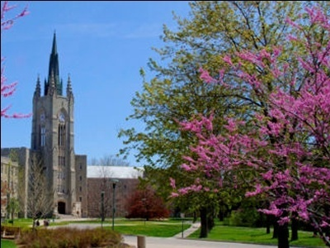

Resizing an Image → Resampling
Assume we have an image that is 400 pixels by 300 pixels.
Making it smaller (200 by 150) →
  Removes pixels
  Makes it crisper
  Gives it a smaller file size

Slide 63
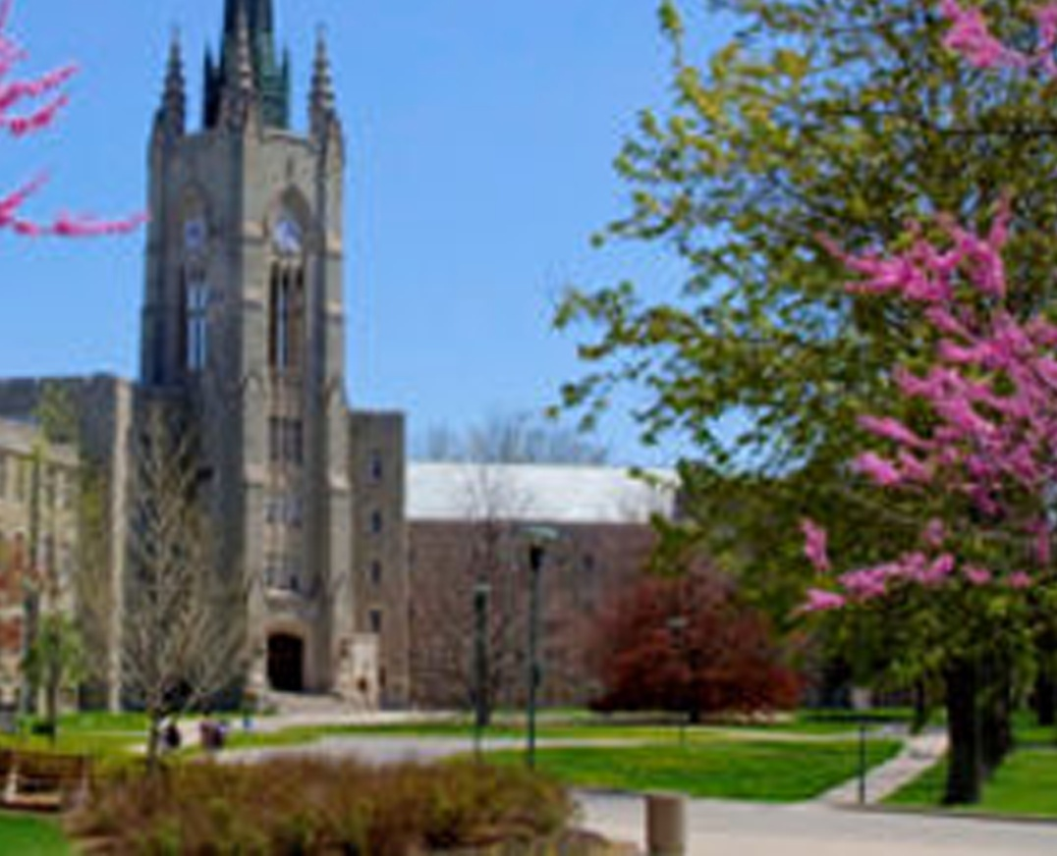
Resampling
Making it bigger (1600 by 1200)→
  More pixels
  Makes it pixelated, jagged
  Adds pixels (guesses where to put them, like a digital zoom on a digital camera)
  Makes the file size bigger

Slide 64
File Size for Images
The file size for an image is determined by the number of pixels
  More pixels → greater file size
  Less pixels → smaller file size
  DPI/PPI does not make a difference in the file size → http://www.csd.uwo.ca/~lreid/cs1033/resolution/
On the web you want the SMALLEST FILE SIZE possible BUT you still want to display your image at a size appropriate for your page!

Slide 65
Review
QUESTION: How many pixels will a 4 inch by 6 inch image be if we scan it in at 100 dpi?
QUESTION: Assume we have 3 images, all 3 images are 100 pixels by 100 pixels but they were each scan in with different dpi. (One was 10dpi, one was 50 dpi, one was 100dpi)
  Which of the following statements are true?
    All 3 images will have the same file size
    The image that was scanned in at 100dpi will print smaller than the one scanned in at 10dpi
Notes:
A1: 400 * 600 → 240,000
A2: statement 1 is true
Statement 2 → 10 inch by 10 inches (10dpi), 2 inches by 2 inches (50dpi), 1 inch by inch (100dpi) TRUE

Slide 66
Review Questions
QUESTION: How many pixels is an image that is 800 pixels by 800 pixels?
QUESTION : How many megapixels is that image?
QUESTION : How big would this picture be if you printed it out at 200 dpi?
QUESTION : How big would this picture be if you printed it out at 100 dpi?
QUESTION : How many colours can you represent with 4 bit colour?
Notes:
A1: 640,000
A2: about ½ megapixel
A3: 800/200 → 4inch by 800/200 → 4inches
A4: 8 inches by 8 inches
A5: 16 colours

Slide 67
Review Questions
QUESTION: How many things can you represent with a 5 bit depth (5 bits)?
QUESTION : What is the smallest value that you should set the dpi for an image that you plan to print?
QUESTION : When converting analog to digital what two things to you have to do to analog data?
QUESTION : How big will the following image be when printed? 600 pixels by 900 pixels, printed at 300 dpi?
QUESTION : What bit depth do you need to represent a black and white image?

Slide 68
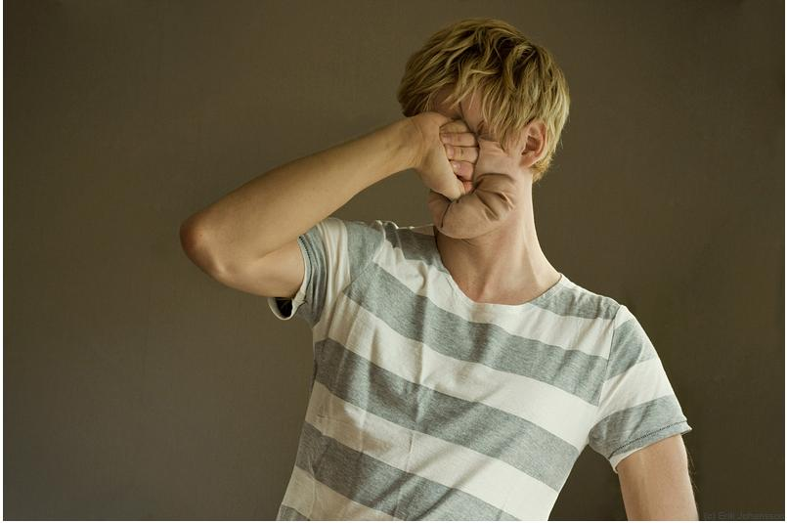
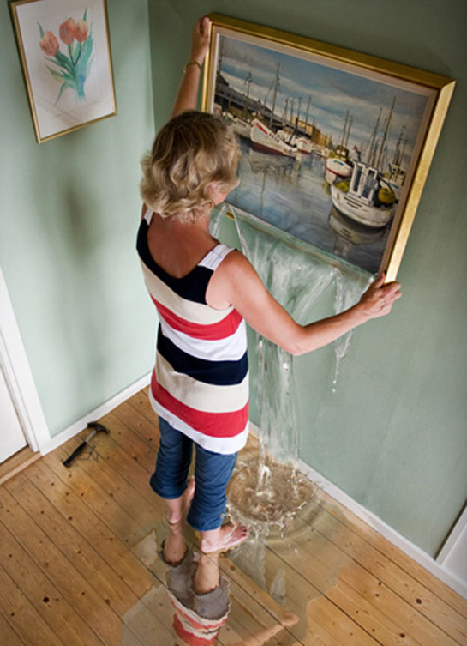
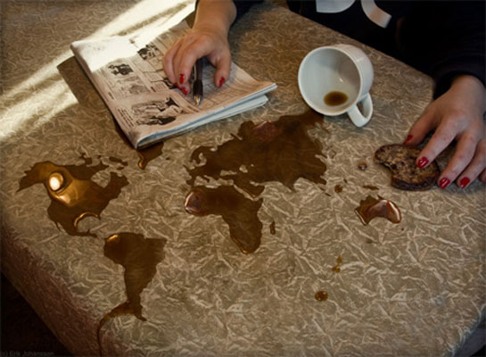
Next Week
More on graphics ☺ → compression!
I will bring a review sheet for all the concepts tonight next week

