Slide 1



Warm up Question:
Question: Match the following images to the correct file format:
GIF
PNG
JPG
Notes:
http://www.intermindful.com/images/jpg-SunsetInAllen600x450.jpg
www.axdn.com/redist/axpssp_logo.png

Slide 2

HOW THE WEB WORKS
Computer Science 1033 – Week 6
https://www.youtube.com/watch?v=uQpaFN93UyU
“The Internet: where men are men, women are men, and children are FBI agents.”→ Anonymous

Slide 3


Slide 4
Overview of Today’s Topics
Announcements
The Internet
IP addresses and Domain Names
Preparing to build a website
Good Website Design
What is a webpage → Introduction to html
How to organize you files within your website, file extensions, types of web pages
Review

Slide 5
Announcements
Final Exam TENTATIVELY is Thursday, April 23 at 2pm
Poster Assignments will be marked by Feb 18th.
  You will lose 15% if you did not submit correctly in OWL. MAKE SURE YOU SAVE THE EMAIL TO PROVE YOU SUBMITTED, we will NOT give you this mark back without the email even if your assignment was up on Panther BEFORE the due date.
Please leave the labs when your lab finishes. We only have a enough seats for the people taking the course. If you want to work on your assignments:
  MC 230 Lab is open from 8:30pm-8:30am from M – Thu
  MC 230 Lab is open from 4:30pm till 8:30am from F - M morning
Notes:
http://www.csd.uwo.ca/~lreid/cs1033/assignment1/spring2013/uc2011-poster-a3.jpg

Slide 6
Announcements
Web assignment due Friday, March 13th
  PLEASE BACK YOUR FILES UP TO THE CLOUD OR ON A STICK AND YOUR COMPUTER – you don’t get extra time because of technical issues
  It is posted now, you could start working on the banner or the buttons if you want to get a bit ahead.

Slide 7
Textbook Readings for this Week
Understanding Computers
  Communications on the Internet
Websites
  Putting the Website Online

Slide 8
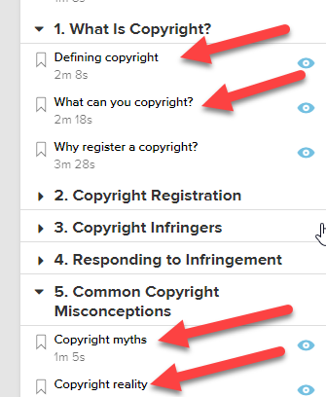
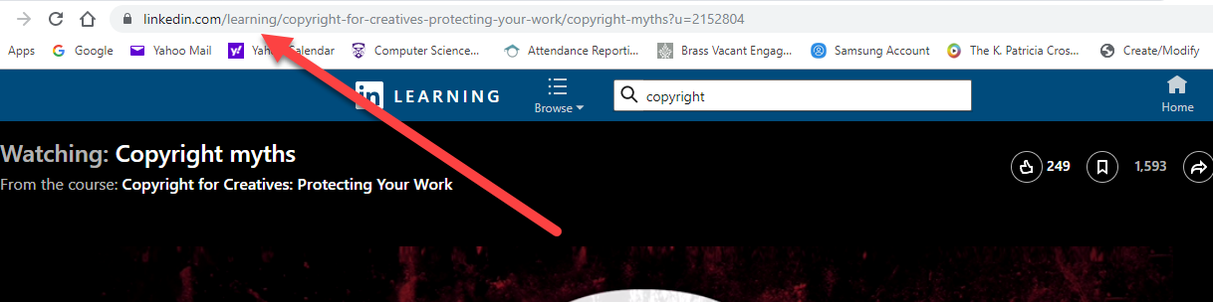
REQUIRED Homework
You MUST watch these 4 videos about Copyright Rules and Creative Commons on your OWN time:
  Creative Common Vimeo:
    https://creativecommons.org/about/videos/creative-commons-kiwi/
    Go to linkedin.com/learning and log in with your Western credentials
    In linkedin.com/learning search for this course: Copyright for Creatives: Protecting Your Work.
    Then watch the following videos:
      Defining copyright
      What can you copyright
      Copyright myths
      Copyright reality

Slide 9
Computer Network
Network: a group of interconnected computers (could be connected with wires, wirelessly, satellites)
Let’s look at some ways to configure a network and think about the pros and cons of each configuration.
Assume we have the following map of the United States:

Slide 10
What is good and bad about this layout?
Washington, DC

Slide 11
How about this layout?
Washington, DC

Slide 12
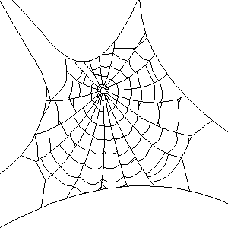
How about this layout?
Washington, DC

Slide 13
The Internet
Internet: a global system of interconnected computer networks that use the standardized Internet Protocol Suite (TCP/IP) to serve billions of users worldwide.
A network of networks
The Internet is hardware, not software! The World Wide Web is software that runs on the Internet!

Slide 14
How does the Internet work?
Uses TCP/IP
A standard protocol (way of communicating),
The ideas behind this protocol were funded by the Advanced Research Projects Agency (ARPA) of the US Department of Defence (DoD) (around 1969). Thus the Internet was originally call the ARPANET
Opposite of your home telephone where you get a direct line that only you and the person you are talking to can use.
TCP/IP has no direct line at the outset of the message! If a communication line is broken, another line is tried.

Slide 15
How does the Internet work?
Image that I had a written a manuscript, printed it but I had NOT stapled it together. I have to get it from our classroom to my publisher in Toronto at Bloor and Yonge. I could:
  Idea 1: Give the whole manuscript to one of you and tell you at the beginning to take the whole manuscript, drive down Western Road South, till it meets the 401, go east till you get to the cut off for Yonge Street, go south and stop at Bloor. AND I WILL STOP ALL TRAFFIC ON THESE ROADS WHILE YOU DO THIS. This is how a phone line work! (Like when Barak comes to town ☺)
  Called Circuit Switching

Slide 16
How does the Internet work?
Idea 2: How else could I do it?

Slide 17
How does the Internet work
Each page in the manuscript is similar to a packet
Packet: a small group of bytes consisting of a header (tells where it is going: destination and where it came from: source) and the body. (Often 64 bytes for header and 512 bytes for body)
Protocol: rules for the format and transmission of data

Slide 18
TCP
Does a few things:
  At the sending end:
    Take a large chunk of data (such as a webpage, email message, etc) and breaks it into small packets
    Sends the packets out on to the Internet
  At the receiving end:
    Detects lost packets, packets with errors because of network congestion, traffic load balancing, or other unpredictable network behaviour, and requests the packet to be resent from the source
    Rearranges and reassembles the packets back into the webpage, email message, etc on the receivers machine

Slide 19
IP
Like a GPS
Picks a route for a packet, stopping at routers which pick the next best machine/network to send the package to.
If a communication line is down or broken, sends the package back to TCP and TCP sends it again to try a different route.
Needs to be able to identify all the machines on the Internet, thus each machine has it’s own unique address
Uses IP Addresses

Slide 20
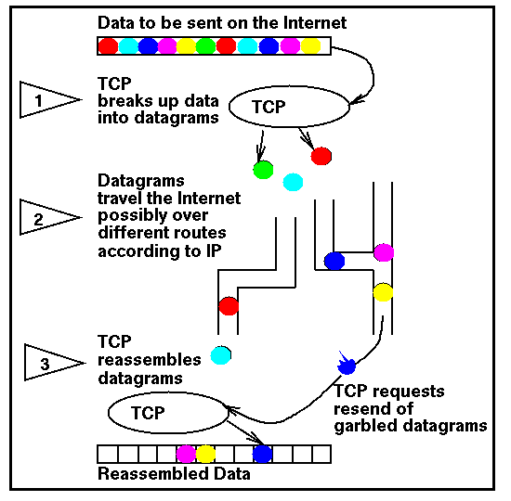
Datagram in this example is another word for packet:

Slide 21
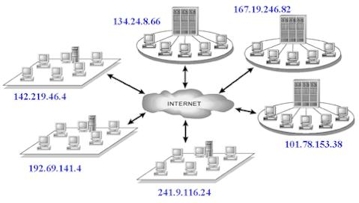
IP Address
Just like your home address
Each machine has its own address, called an IP Address
Consists of 4 numbers with dots between them.
Each number ranges from 0 to 255
Sample IP Address: 129.100.23.247

Slide 22
IP Addresses
Home Address
Phone Number
IP Address
1151 Richmond Street, London, Ontario, Canada
Canada
Ontario
London
1151 Richmond Street
1 (519) 679-2117
1
519
679
2117
129.100.23.247
129
100
23
247
EXCEPT → IP addresses are NOT geographical so just think of this as an analogy not exactly done like this!

Slide 23
IP Address → Ways to Represent It
Is always 32 bits
IP address can be expressed as:
Newer ones are 128 bits (2¹²⁸ different possible addresses) → IPv6. We wont be looking at them!
Type | Example
Dotted Quad | 129.100.23.247 (most common)
Binary | 10000001 01100100 00010111 11110111
Hexadecimal | 81 64 17 F7
Decimal | 2,170,820,599

Slide 24
How to send the message, for example a webpage.
TCP breaks webpage into packets of bytes
TCP figures out IP address of where it wants to send the packets (destination)
TCP figures out IP address of where the packet is coming from (source)
Sends off each packet to first machine (IP Address) on the route (DOES NOT PREPLAN ROUTE!)
Packet stops at first machine, likely a router, then the router sends it to the next machine on the journey (IP Address) and so on until it gets to the final IP Address (destination)
Called Packet Switching

Slide 25
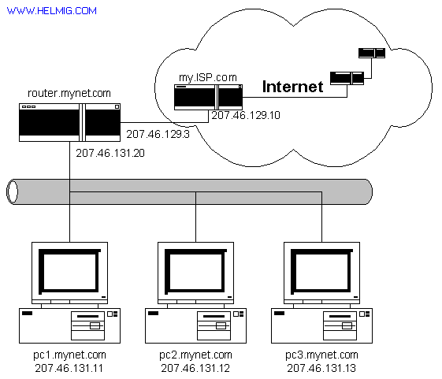

Let’s see an actual route: at the Command Prompt, type:
tracert 74.125.95.99
http://www.youtube.com/watch?v=tAv_eLm7DMk

Slide 26

Some Experiments with IP Addresses
If you have a laptop, type the following IP address into the address bar of your web browser: 98.158.91.201 and hit enter:
Give me 4 random numbers between 0 and 255 and I will try them on my machine ☺

Slide 27
Another experiment
In Windows, go to Start>All Programs>Accessories>Command Prompt
Type the command: ping gate.csd.uwo.ca
then type
ping 123.123.123.123
then type
ping 129.100.22.120
Go to: http://www.hcidata.info/host2ip.htm
Go to: http://www.whatismyip.com/
Watch this movie: http://www.youtube.com/watch?v=RbY8Hb6abbg

Slide 28
Why is this the first time you are hearing about IP Addresses?
Question: How come you don’t just use IP addresses in your web browser? What do you use in your web browser?

Slide 29
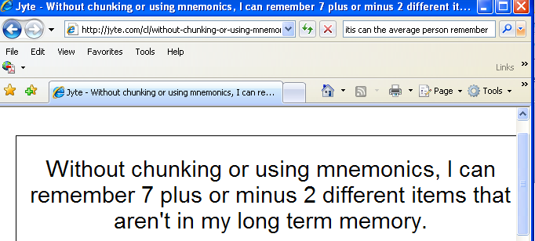
IP Addresses and Domain Names
Numbers are hard for us to remember!
Phone numbers are 7 digits for a reason!

Slide 30
Domain Names to the Rescue
In 1973, IP Address became the standardized way to identify machines on the Internet.
In 1984, University of Wisconsin came up with a name server, that maps a name to an IP address.
In 1985, Domain Name System is established and the initial top level domain names are introduced.
Notes:
.com, .net, .org

Slide 31
Domain Name History
In 1990, the Internet moves beyond of the world of the government and universities and into the commercial society.
Up until 1995, you didn’t have to pay for your domain name, 1995 to 1998 you paid the NSF (National Science Foundation) $100 US dollars for a 2 year registration for a domain name.
In 1998 the assignment of domain name is opened up to private companies to encourage competition.

Slide 32
Break
https://twitter.com/i/status/1096556250240876544
https://twitter.com/i/status/1184252317174030338
Posters

Slide 33

Break
Slideshows of last terms poster assignment:
  http://www.csd.uwo.ca/~lreid/cs1033/assignment1
Laura loved this one ☺ →

Slide 34
How does a Domain Name work?
Every machine on the internet gets an IP Address
A DNS (Domain Name System) maps the domain name to the correct IP address.
In most cases there is a one to one mapping between an IP Address and a Domain Name:
  129.100.23.247 maps to www.csd.uwo.ca
Sometimes one IP Address might maps to more than one domain name:
  155.12.12.12 might map to www.chapters.ca and www.indigo.ca
Sometimes one domain name might map to more than one IP Address:
  155.12.12.1 and 155.12.12.2 and … 155.12.12.77 might all be web server machines for www.msn.com
http://www.hcidata.info/host2ip.htm

Slide 35
Domain Names
Domain Names identify machines on the Internet, for example a web server machine.
A Web server contains all the web pages for a company or individual.
Web pages are stored on the web server machine (sometimes the machine is called a host) in folders or directories(web site)
A web site is really a folder
Web pages are just files, usually with the extension .html, for example: myhomepage.html or prices.htm

Slide 36
Question
Machine/Host (usually called www)
File
Folder/directory
Web Page
Web Site
Web Server

Slide 37
URL
A URL (established by Tim Berners Lee in 1990) points at a web page on the internet.
For example:
http://www.uwo.ca/its/courses/spring.html
File
spring.html is a webpage file
Hypertext Transfer Protocol (http)
Rules on data is exchanged between servers and browsers
Other examples:
ftp://, news://
Domain Name
The name of the site, points to the web server machine
Folder
its is a folder on the web server machine
Folder
courses is a folder inside the its folder
World Wide Web
Indicates we are referring to the world wide web

Slide 38

Domain Names Systems (DNS)
A Domain Name System/Server (DNS) maps the domain name to the IP Address.
Like a big phone book of Domain Names and IP Addresses →
http://www.youtube.com/watch?v=dE4rsNuG0aw

Slide 39
Let’s break down the Domain Name!
http://www.csd.uwo.ca
World Wide Web
Not a part of the domain name, usually it is just the machine/host name that is the webserver
Third Level Domain
Also a Sub domain
csd is a subdomain of the domain uwo.ca
Top Level Domain (TLD)
Rules exist for what you can pick, only certain combinations of letters have been established as allowable top level domains
Second Level Domain
Things to note:
the domain is uwo.ca
csd is a sub domain of uwo.ca
www is not part of the actual domain name but it will be stored in the DNS

Slide 40
Sub Domains
Used to organize your web server (just like folders and directories organize your computer)
Example:
  http://www.uwo.ca
  http://www.csd.uwo.ca
  http://www.brescia.uwo.ca
csd is a sub domain of uwo.ca
brescia is also a sub domain of uwo.ca

Slide 41
Rules for Domain Names
Each item between a dot is called a level.
You can have a maximum of 127 levels (thus the top level domain is 1 level and the second level is 1 level, that leaves room for 125 sub domains).
Each level can be up to 63 characters long
The entire domain name (including sub domains) can not be more than 255 characters.
http://www.abc.def.hij.com
Question: What is the above domain name?
Question: How many sub domains does the above domain name have?
Notes:
4
2

Slide 42
Rules for Domain Names
Must use one of the approved TLDs.
Each level must consist of letters, digits and hyphens.
Each level cannot start with a hyphen or end with a hyphen.
Each level must not contain a space.
Domain names are case insensitive. Can cause confusion!
Question: Do these domain names represent the same domain?
→ dogsrus.com
→ DogsRUs.com
Question: Fill in the following table:
 | Domain Name | Valid or Invalid
A | we are the world.org
B | We-Are-The-World.org
C | We_Are_The_World.org
D | WeAre99%OfTheWorld.org
E | We.Are.The.World.org
F | -weare.theworld-.org
G | Wearetheworld.werock
Notes:
No (spaces)
Yes
Yes – same domain
No (underscores)
No (%)
Yes
No (starts with hyphen)
No (invalid top level domain)

Slide 43
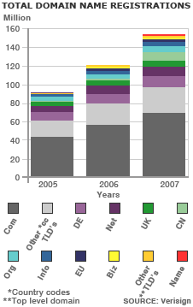
Top Level Domain Names
An International Internet committee has established the allowable top level domains:
Question: Can you name at least 5 other top level domains? (E.G. .realty)
  http://data.iana.org/TLD/tlds-alpha-by-domain.txt
  https://www.apple.com/ca/legal/intellectual-property/tld/registration-policy/
Question: after .com what do you think is the most popular TLD was in 2007? Not what you might think ☺ .

Slide 44
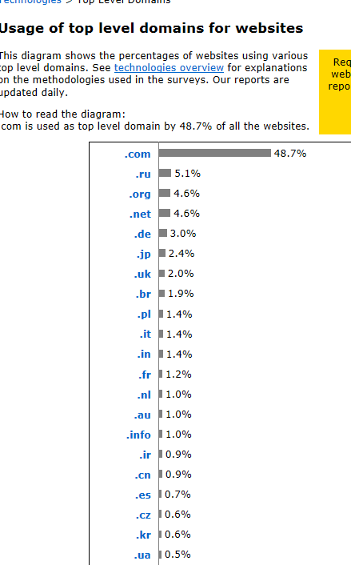
Usage as of 2016
Why do you think .ru is popular?
Answer
Notes:
Russian sites used for hacking

Slide 45
Top Level Domain names
Original ones were:
  .com, .org, .net, .int, .edu, .gov, .mil
Then country ones appeared (all 2 letters)
  .ca, .ae, .uk, .de
Then geographical ones:
  .asia, .berlin, .vegas
And now…Brand ones:
  .Bloomberg, .Barclays, .youtube
ICANN has now approved ones like:
  .adult, .apartments, .flowers, …
List of most expensive domain names

Slide 46
Tracing Routes Using Domain Names
Review: https://www.youtube.com/watch?v=5o8CwafCxnU

Slide 47
Why should you care about Domain Names?
Let’s assume you are about to start a new business:
Do you need a website?
  YES, YES, YES
Essential for competition!
Nowadays your customers don’t just want a website from you, THEY EXPECT A WEBSITE!

Slide 48
Successful businesses take full advantage of the Internet:
Google → Fact: as of 2007, Google passes Microsoft as the most visited website in the world.
  Question: Name some other sites that have now passed Microsoft → https://en.wikipedia.org/wiki/List_of_most_popular_websites
Notes:
Facebook, myspace, youtube

Slide 49

Starting to think about your business
Perhaps you will need flyers/advertisements
You may need business cards
You might design a logo in Photoshop
You SHOULD have a website
You will legally need a company name.
Question: Why is the company name important in terms of your website?

Slide 50
Picking a domain name: SOME SUGGESTIONS:
1. Keywords, Keywords, Keywords- Since our goal is to drive highly targeted traffic to our site; we need to pick a domain name with our keywords in it. Search engines give a lot of weight to domain names. If your domain name matches a keyword phrase that has traffic, you will get higher rankings. For example, if your site is called www.marketingcompany.com, this phrase gets tons of searches a day, so we will get free traffic coming to our site.
2. Be Memorable- Your domain name should be descriptive, memorable, and easy to spell and pronounce. For example, www.myspace.com
3. Avoid Hyphens- Most people won’t remember the hyphen. However if you want to get www.joshfuller.com and it is taken, only then should you try www.josh-fuller.com.
4. .Com First- Buy a .com extension because it’s the default extension in most people’s mind. Many times a .com extension is going to be taken so you will need to try .net, .biz, .org, etc. Always try to get .com first.

Slide 51
More Suggestions
5. Keep it Short- Keep in mind that people need to be able to remember it, and type it. Focus on the shortest name that your customers and visitors will associate with your website. For example, www.pcworld.com, is much more effective than www.powercomputingworld.com
6. Kill Procrastination- Don’t wait to register your domain name. If you are thinking about registering a domain name and it’s available, what are you waiting for? Just like offline real estate, online real estate is being bought up fast. Register before you loose the opportunity to get the name you really want.
7. Get Creative- If your first choice is already taken. Add “e” or “i” or a number in front of a name, for example www.isurfing.com. Another secret is adding “web” or “net” in front or at the end of a name. Combine short, meaningful, catchy phrases or words that describe your business or site. For example if www.cheaptrips.com is taken, try www.webcheaptrips.com or www.cheaptrips4u.com

Slide 52
More Suggestions
8. Know the Rules- Remember that domain names can only use letters, numbers, and dashes. Spaces and symbols are not allowed. Also, domain names are not case sensitive.
9. Testing, Testing, 123- Before you purchase your domain name, spend a couple minutes testing them. See what your friends and family think of your choices. You may have a name you think is perfect, however it may be difficult for people to remember and/or hard to spell.
10. Learn from Monopoly- In the board game Monopoly, the person who usually wins, is the person who buys up the most real estate. Online real estate is no different. Purchase domain names similar in spelling to yours. The truth is, most people can’t spell. Every day millions of people misspell domain names. Inevitably, they will still land on someone’s web page. I have typed in www.utube.com, instead of www.youtube, a couple times and landed on some sort of tube manufacturing website. Utube is getting thousands of free hits to their site, just because they are similar in spelling to Youtube. If your website is www.cheaptrips.com, consider buying www.cheeptrips.com and www.cheeptrip.com.
11. Which Online Realtor to Use?- Go to www.GoDaddy.com. Start with The Domain Search Box and search for a name that is available. Once you find a name that works, go ahead and start the check out process. Your new domain name will only cost you $8 - $10. Skip all of the extra services they will try and sell you. No need for them. You only have to register domains for 1 year at a time to keep costs down. They will automatically renew each year or GoDaddy will notify you to do so.
From: http://billionairebythirty.com/2009/05/how-to-pick-a-domain-name-to-drive-traffic/comment-page-1/

Slide 53
How do you find out if the Domain Name you want is available?
Find out from a website that lets you purchase domain names such as:
  www.godaddy.com
  www.mydomain.com
  https://www.101domain.com/
  www.register.com
Pay per year, must reregister every year or every few years

Slide 54
To Host or Not To Host → That is the Question!
You have:
  Picked a domain name
  Registered it and paid for it
Now you want to find a company that will hold/host your website (keep the files that make up your website) OR perhaps you can set up your own webserver in at your company or home?

Slide 55
Don’t Host→ That is the answer!
4 Reasons NOT to Host Your Own Website:
Expensive: Server and server software (web server, mail server, firewall, virus protection etc.) can be expensive.
Continual Connection: The server needs a 24/7 high speed connection to the internet, which is relatively costly.
Technical: Setting up all the configurations including mail server, FTP server and DNS server can be complicated.
Support: Server maintenance requires 24 hour support, special skills and knowledge.

Slide 56
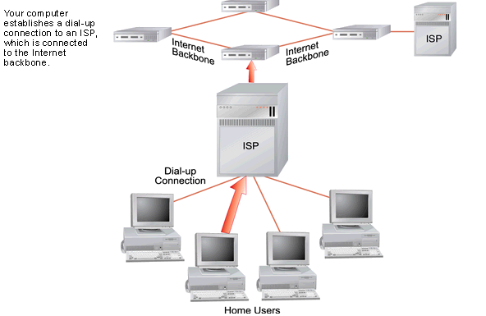
Find an ISP → Internet Service Provider
ISP → A company that provides access to the Internet
Maintains one or more machines that are permanently connected to the Internet
Offers connections via telephone lines, cable, satellite dishes.

Slide 57
ISP
Provide user with:
  User account for accessing the Internet
  Email access
  Web Space to host/hold your website
Some ISPs are:
  Rogers
  Bell
  Execulink
  Western (at least while you are a student here ☺)

Slide 58
What to look for in an ISP
Top 10 Reasons to pick an ISP
Disk Space → Always get more, Standard 5 GB – 10 GB
Bandwidth → bandwidth is the amount of traffic that is allowed to occur between your web site and the rest of the internet in a given time period (static pages go with low; need for downloads go with high)
Web Site Speed → Web site speed is a given… slow.. Poor service (ask for some websites and try it out yourself)
Database/Programming Language Support → Needs for dynamic website – interact with customers. Perl, Java, PHP etc…
Technical Support → Test by sending them an e-mail and see response time, Contact names, e-mails, phone numbers, hotlines
UpTime → Look for 99% plus guaranteed
FTP Access → Unlimited and unrestricted FTP access for easy maintenance
Web Statistics Summary: → Traffic on your website- Easy access to your information… control
Scripts availability → counters, forms support.
Web Provider → Reliability? How long? Popular?

Slide 59
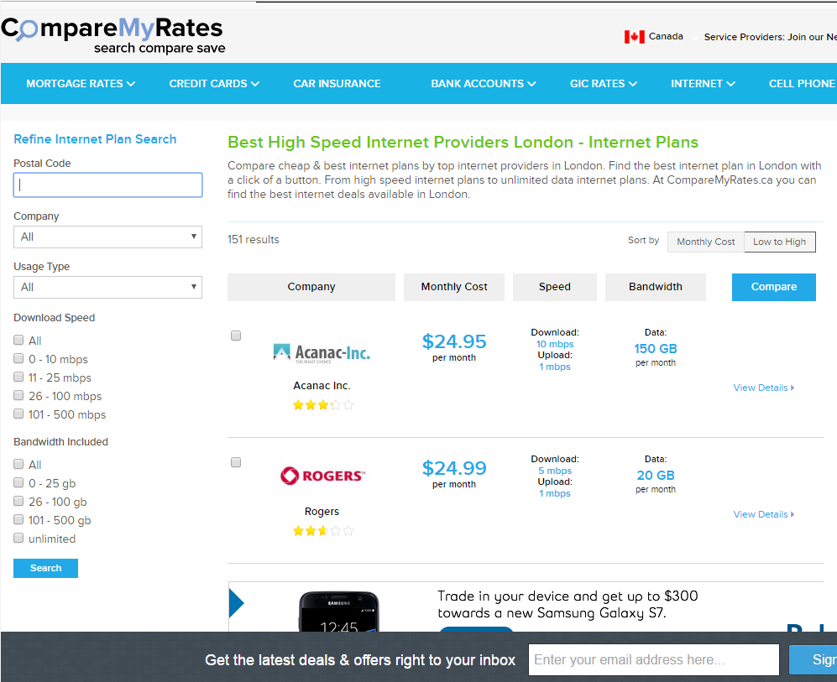
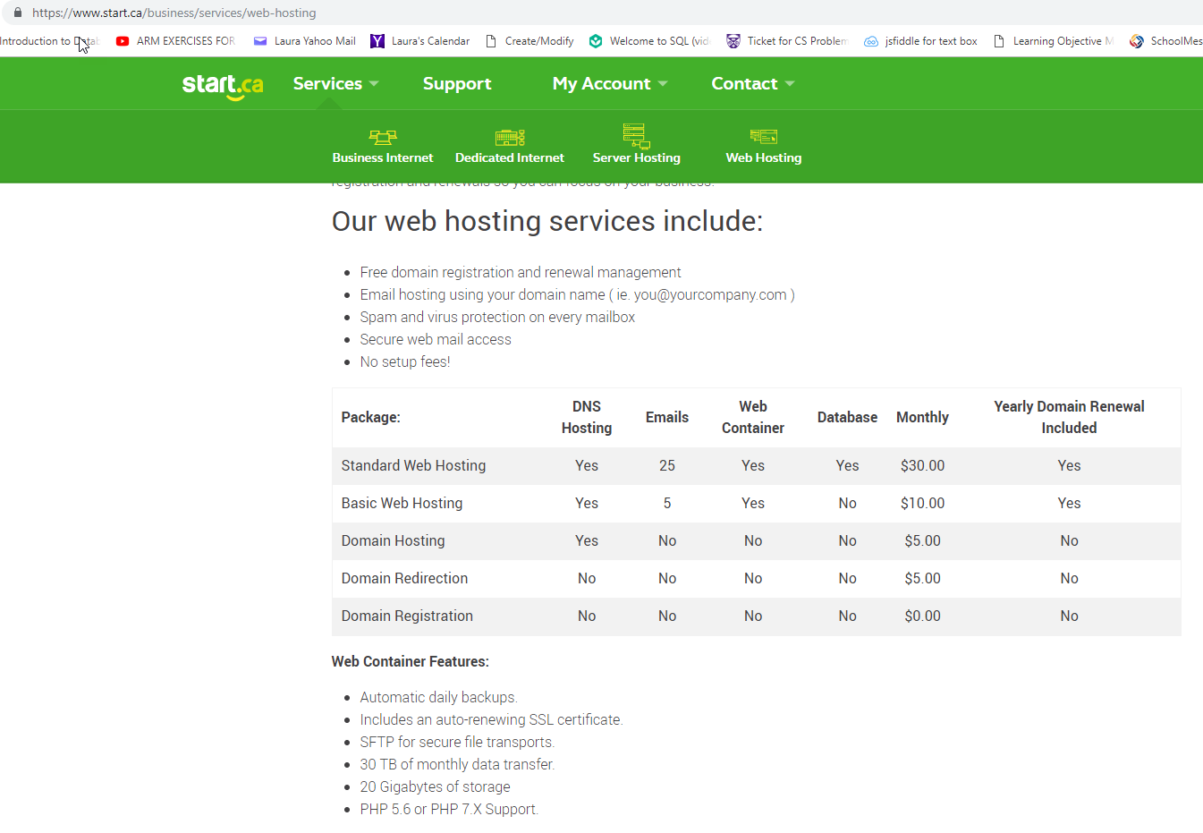
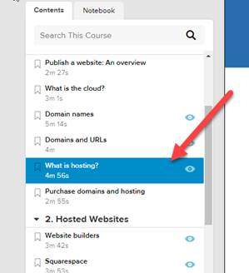
Newer Data → http://www.comparemyrates.ca/internet-plans/

Slide 60

Okay, I have the Domain Name, what is next? Stage 1: Planning and Design
Define the Business Requirements
  Meet with the client:
    Be prepared
    Ask questions → LISTEN TO THE ANSWERS
    Learn as much as you can about their business
    Ask for all the reports they generate, the forms they fill in, their printed brochures, etc…

Slide 61
What questions should you ask your clients?
Who will their primary audience be?
What is the company’s image?
Do they have a company logo (this will help you with colours and a theme)? How about some other graphics/images?
Will the company’s focus change over the next year or so?
What content will be on the page? This might help you figure out how to organize the material!

Slide 62
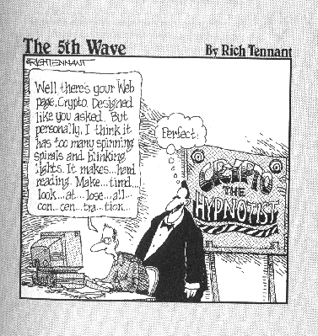
Questions:
Think of some of your favourite websites, what is it about those websites that you like?
Think of some websites you avoid, why do you avoid them?

Slide 63
What is the best thing you can do when designing a new website?
Look at other websites!
  Look at the competitors websites
    What are some of the great ideas they have?
  Look at websites that you think are:
    Beautiful
    Easy to Use
    Effective in getting the message across
    Using a great colour scheme
    Hideous
    Hard to Use
    Annoying

Slide 64
Review
https://www.youtube.com/watch?v=AYdF7b3nMto

Slide 65
Next Week
A bit of BlueGriffon
Tables to layout out your pages
How to upload your web site
How to attract search engines
How Google works
A little bit more Internet History

Slide 66
Review
Question: True or false: www.csd.uwo.ca/courses is a domain name?
Question: Give 3 valid TLDs
Question: www.homer.simpson.com is a valid domain name. TRUE or FALSE
Question: Zack&Cody.Love.You.2.com is a valid domain name. TRUE or FALSE
Question: What is a message (a webpage or an email message or a file) on the Internet broken down into before it is sent over the net?
Question: Are the following valid IP addresses?
  1.1.1.1
  126.265.13.10
  129.129.129

