Slide 1
Warm up Questions:
Question: What are the chunks of data that are sent over the internet called?
Question: What protocal is in charge of dividing the data that goes over the internet into chunks?
Question: Give an example of a valid IP address.

Slide 2
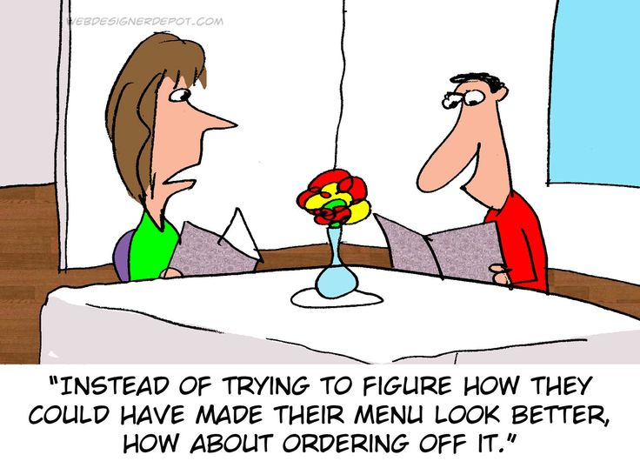
WeB SITE Design & Setup
Computer Science 1033 – Week 7
https://www.youtube.com/watch?v=j2G1IUpRiPY
Tip 1:0:15 Tip 2 2:45: Tip 3: 4:15 Tip 4: 5:25 Tip 5: 7:20
“What separates design from art is that design is meant to be… functional.” ― Cameron Moll

Slide 3
Overview of Today’s Topics
Announcements
Overview of Assignment 2
Good and bad websites
Websites and Webpage organization
index.html → importance of
HTML
Break
BlueGriffon review

Slide 4
Textbook Readings for this Week
Websites
  Websites
  Website Development
  Design Principles

Slide 5
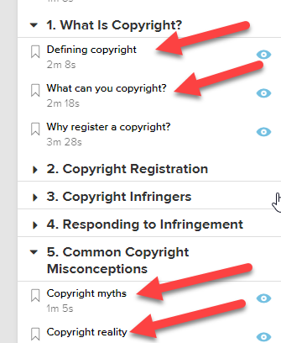
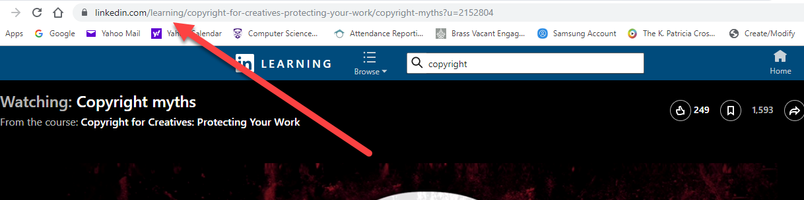
REQUIRED Homework
You MUST watch these 4 videos about Copyright Rules and Creative Commons on your OWN time:
  Creative Common Vimeo:
    https://creativecommons.org/about/videos/creative-commons-kiwi/
    Go to linkedin.com/learning and log in with your Western credentials
    In linkedin.com/learning search for this course: Copyright for Creatives: Protecting Your Work.
    Then watch the following videos:
      Defining copyright
      What can you copyright
      Copyright myths
      Copyright reality

Slide 6
Announcements
Exam Schedule → our exam is scheduled for 2PM on Thursday, April 23rd
Poster Assignment are marked
You can ask for a remark but I remark the whole assignment and your mark could go lower.
Assignment 2 is due Friday, March 13th
  I will do a demo for assignment 2 next week.
  PLEASE try to hand it in on Wed or Thur to make your life easier!

Slide 7
Assignment 2
Two nice examples from previous years to get you thinking!
http://cs1033.gaul.csd.uwo.ca/~lreid2/other/student25/major/references.html
http://cs1033.gaul.csd.uwo.ca/~lreid2/other/student15/

Slide 8
Announcements
Web Assignment
  IT will take you longer than you think, give yourself LOTS of time to finish it and to hand it in (Hand it in on before Wednesday, the labs will be VERY busy on Thursday and Friday).
  Hints:
    Remember your titles
    Think about layout, consistency, ease of use!
    Follow the specs
    Use a table for a clean layout (put the banner in the top row and content in the bottom row)
    Common Mistakes → http://www.csd.uwo.ca/~lreid/cs1033/assignment3/SamplesOfCommonMistakes/

Slide 9
Announcements
Web Assignment Hints
  THINGS THAT CAN GO HORRIBLY WRONG ☹
    http://cs1033.gaul.csd.uwo.ca/~lreid2/other/student1/
    http://cs1033.gaul.csd.uwo.ca/~lreid2/other/student2
    http://cs1033.gaul.csd.uwo.ca/~lreid2/other/student3/assign3/howtohelp.html (need to scroll for buttons, bullets, banner)
    http://cs1033.gaul.csd.uwo.ca/~lreid2/other/student9/major/ (consistency)
    http://cs1033.gaul.csd.uwo.ca/~lreid2/other/student19/
    http://cs1033.gaul.csd.uwo.ca/~lreid2/other/student20 (edges)
    http://cs1033.gaul.csd.uwo.ca/~lreid2/other/student14 (scrolling and banner on next page)
    http://cs1033.gaul.csd.uwo.ca/~lreid2/other/student22
    http://cs1033.gaul.csd.uwo.ca/~lreid2/other/student18/Contact%20Us.html (file names and button movement)
  THINGS THAT CAN GO RIGHT ☺
    http://cs1033.gaul.csd.uwo.ca/~lreid2/other/student8/assign3/registration.html
    http://cs1033.gaul.csd.uwo.ca/~lreid2/other/student22/assign3/
    http://cs1033.gaul.csd.uwo.ca/~lreid2/other/student15/index.html

Slide 10
Paragraphs → Centering → DON’T
Hyphens on lists
Emails links
Back to top, anchors
Think about link colours
Link lengths
  http://www.csd.uwo.ca/images/CSD_long_photo_16.jpg vs.
  Middlesex
Common Mistake: renaming files/folder…this will TOTALLY SCREW up your website if you do not do it correctly!

Slide 11
Things to remember, especially for Web Assignment and Major Assignment
Keep the menu in the same place on every page. (either the top or the left, it is up to you)
Should not have to scroll horizontally
Should not have to scroll vertically to see navigation buttons
Keep the colours consistent on every page
Keep the layout fairly consistent on every page
Should always have a way to get home
Long pages should have a “Back to Top” button

Slide 12
Hints for Web Assignment
Remember:
  Titles
  Headers
  File names, spaces, lowercase
  Images
    Alt, Title
    Size within page
    On each page
  Banner
  No Scrolling horizontal/vertically to see buttons
  Consistency
  Buttons → look, ease of use
  Back to top
  References page layout
  Text colours, contrast
  Broken links
    Check from a different computer!
  Underlining
  Colours
    Link Colours
  Paragraphs
  Padding
  Followed the instructions (make the anchor links, etc..)

Slide 13
How to do Web Assignment
Colours → look at: http://kuler.adobe.com/
https://www.design-seeds.com/
Marks for:
  Nice Banner
  Good Colour Scheme
  Alt/title tag on banner/images
  No scrolling horizontally EVER at 1000 pixels
  Consistency in the layout of the pages and the buttons/NICE LAYOUT ON EVERY PAGE
  NO Underlining

Slide 14
Roll over buttons get 1 or 2 marks more
PROPERTY TITLES! Website – Web Page
  Antonio’s Restaurant – Home
  Antonio’s Restaurant – References
Must use table to lay things out
Headings on pages
Use an image for each page/good size
Layout paragraphs well (don’t squish on edge)
Bold/highlight headings

Slide 15
Let’s try it out
Watch me start Web Assignment!

Slide 16
What do you think of these sites?
http://www.brescia.uwo.ca
http://www.margarethe-vanderpas.com/
http://www.mariasemple.com/
https://wrightwoodfurniture.com/
www.distancetomars.com
https://etch.co/ (hmmm???)
https://www.newyorker.com

Slide 17
How about these sites?
https://history.aip.org/climate/index.htm
http://www.lingscars.com
http://www.jamilin.com/
http://www.gatesnfences.com/

Slide 18
Good Website Design Tips
http://www.youtube.com/watch?v=JQwTqt8gkjM
Have something valuable to offer → provide something useful or interesting
Don’t distract with blinking, animated GIFs, autoloading sound, too much scrolling
No popups!
Don’t use images on the background unless you know what your doing
Put a lot of thought into the organization of your page
Minimize clicking (no more than 3 clicks to get to a page)

Slide 19
More Tips
Have a way to get to the home page on every page
Include a menu on every page (in the same location on every page)
Compress your images
Don’t let multimedia files bog down your website
No line of text should be more than 600 pixels wide
Don’t make your page too wide (around 900 to 1000 pixels), user should NEVER have to do horizontal scrolling. Vertical scrolling should be kept to a minimum

Slide 20
More Tips
Use contrasting colors or simple backgrounds to make text easy to read
Make text large enough to read
Use ALL CAPITAL LETTERS sparingly,
Never use more than one exclamation point
Spell Check
Never underline words that are not links
Put contact info or a link to it on every page

Slide 21
More Tips
Test your links
Remove dead links
Avoid confusing navigation and having menus in different spots on different pages
Avoid ugly design: no color continuity
Don’t have text that hard to read
Include a “Last Modified” date
  Keep up to date, update your “What’s New” section frequently
Don’t steal content (I stole this content is from: http://websitehelpers.com/design ☺ )

Slide 22
More Tips
Think about how the user will navigate through your website and remember the 3-click rule.
Have a consistency throughout your pages
  Colours
  Menu placement
  Layout
  Fonts
  Buttons
Think about the layout, have white space, clean alignment and balance on your pages

Slide 23
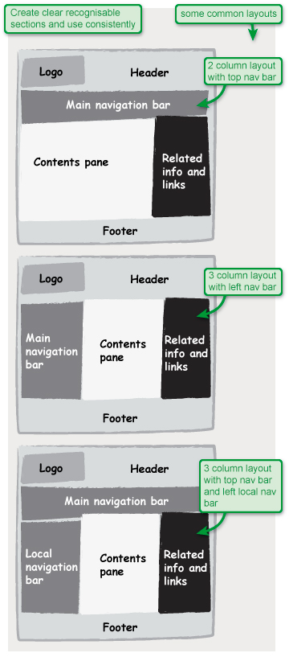
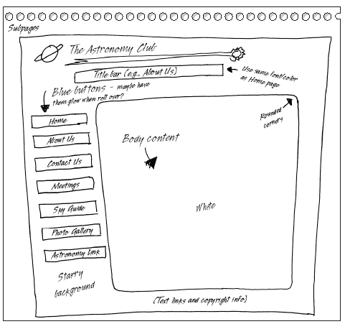
https://www.microsoft.com/mspress/books/sampchap/6403/0-7356-18607-04.gif
http://usability.coi.gov.uk/themes/page-layout/assets/images/1a-1.jpg

Slide 24
Webpages and Websites
A website is a collection of related webpages stored in a folder. The folder may or may not contain sub folders.
The website folder should contain a sub folder called images which holds the image files (.jpg, .gif, etc) that will be displayed on the page.

Slide 25
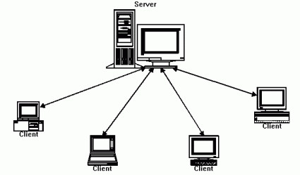
Decide on what webpages you will need.
Each webpage is normally an html file, a file that has the extension .html or .htm
  .html .htm
    Very basic page, just has clickable links, images, sometimes forms
    The .html file is just a file with html codes that is displayed in a browser to make it look pretty for the client (Chrome, IE, Safari, Firefox)
    CS1033 just covers .html & .htm pages
  Other extensions for webpages include:
    .php → extra stuff that is brought in also from the server, allows for use of data in a database on the server, more complex form manipulation
  Store each .html file in the folder (the Website)
  The home page for the website, the “starting page” should have the file name index.html

Slide 26
Webpages and Websites
Question: On panther.uwo.ca, what is the main folder for your: http://publish.uwo.ca/~lreid2
Question: Does that folder contain a file called index.html?
http://wts.uwo.ca/services/web/activate_my_personal_web_space.html
CHECK IT OUT USING SECURE FTP (WINSCP, FUGU, FILEZILLA)

Slide 27
Folder Structure for a Simple Site
Decide on the pages you will need
Create a top level folder. Use lowercase letters
Give the home page the name index.html
  Must be all lowercase!
  Index.html is invalid
Give the other pages appropriate lowercase names (no spaces in the file names) with the .html extension
Create a subfolder called images (lowercase) and put all your images in that folder

Slide 28
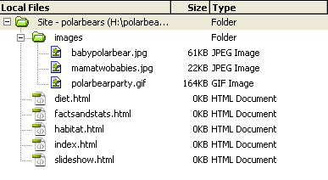
Example of a simple website
Assume we are making a website about Polar Bears. The folder structure (folder is called H:\polarbears) might look like this:

Slide 29
Links for the simple structure
Assume the domain name for this site is: ArcticAnimals.org
Thus the website would be:
  http://www.ArcticAnimals.org
To get to the polar bear website, you could type:
  http://www.ArcticAnimals.org/polarbears OR
  http://www.ArcticAnimals.org/polarbears/index.html
To get to the habitat page you would type:
  http://www.ArcticAnimals.org/polarbears/habitat.html

Slide 30
Something to try
Go to your panther page and type each of the following:
  http://publish.uwo.ca/~lreid2
  http://publish.uwo.ca/~lreid2/index.html
  http://publish.uwo.ca/~lreid2/posterassign
  Question: Why don’t we see a webpage when we type the last choice?
Now go to UWO Computer Science page and type each of the following:
  http://www.csd.uwo.ca
  http://www.csd.uwo.ca/index.html

Slide 31
More complicated site
Sometimes websites have many submenus and have lots of webpages.
In this case we need a more complicated folder structure
  BUT it is NOT really that much more complicated, just one main folder with subfolders that contain “sub websites”
  Each sub website is a sub folder that contains it’s own index.html and images subfolder

Slide 32
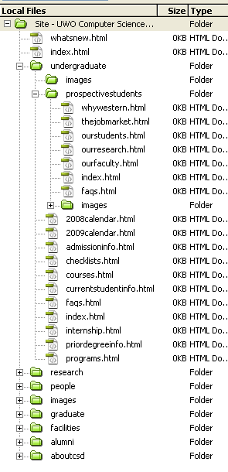
Example of a more complicated site:
Westerns Computer Science Site might be set up like this →

Slide 33
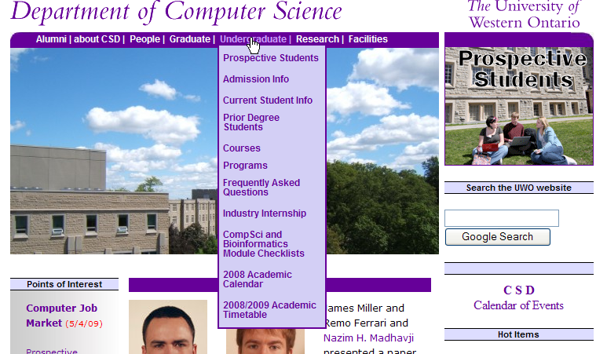

Slide 34
Web Server
You will likely build your site on your own machine. When the website is completed you will need to move it to a Web Server
Web Server → the computer that runs software which holds the webpages and serves up (delivers) webpage to the client. This computer must be connected to the Internet. The software delivering the webpages is also called a web server
Question: What is the software we use to move the webpages we have built on to the web server?
Question: What is the name of the web server machine at Western?

Slide 35
Web Browser
Once you have moved your website onto the web server you MUST test your website by opening it in a Web Browser
Web Browser → software/program that displays formatted webpages to the client.
Question: What is the input we give a web browser?
Question: What is the output from the web browser program?
Question: Can you name 3 web browser programs?
Question: Does anyone know how you look at the html that was used to create the page currently displayed in the browser?

Slide 36
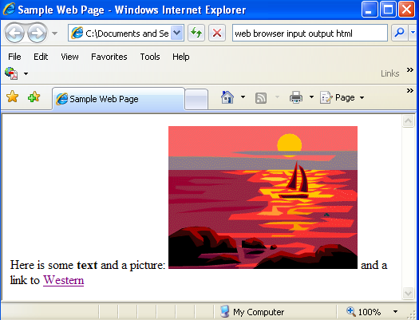

HTML and Web Browsers
Stored on the webserver (the SERVER)
<html>
<title>Sample webpage</title>
<body>
Here is some <b>text</b> and a picture: <img src="sunset.gif">
and a link to <a href="http://www.uwo.ca">Western</a>
</body>
</html>
Viewed on the CLIENT
Above is input to
A Web Browser
Lovely website to the right is output from a Web Browser

Slide 37
What is HTML?
History:
  In the late 1980s, Tim Berners Lee proposed a way of sharing research papers using the Internet and hypertext (immediate links to other documents)
  In 1990 Berners Lee set the specifications for the HTML language and wrote a browser to read HTML files and output linkable papers
  He proposed html tags
    Example of some tags → <html>, </html>, <b>, </b>,<ol>, </ol>
    Tag always start with “<“ and end with “>”
    Most tags come in pairs: opening tag and a closing tag, for example:
    <title>This is the title of the webpage</title>
  Used to have to make html files (webpages) with simple text editors like Notepad

Slide 38

History…
Tim Berners Lee:
  Created the first web browser
  Created URL layout
  Came up with the World Wide Web and the concept of hyperlinks among pages
  Created HTML tags (they have changed a bit over time but he came up with the initial ones)
  Watch starting at 2 minutes

Slide 39
Break
Slideshow of Poster Assignments

Slide 40
History of HTML
Question: Can you guess some of the tags you think we would need to create a useful and readable webpage?

Slide 41
Types of HTML tags
Section tags
  <html>, <body>, <head>, …
Formatting tags
  <b>, <ul>, <i>,<p>,<h2>,</b>,</h2>, …
Link tags
  <a href=“http://www.msn.com”>, </a>, …
Placeholder tags (standalone or unpaired tags)
  <img src=“mydog.jpg”>, <hr>

Slide 42
Let’s make a webpage the Old Fashioned Way!
Open Notepad
Save your file as myfirstpage.html
Type in some tags
Save the file again
Close the file
Double click on it, it should now open in IE
In IE, from the menu select View>Source
Edit the tags some more and save the file
Go back to IE and hit the refresh button

Slide 43
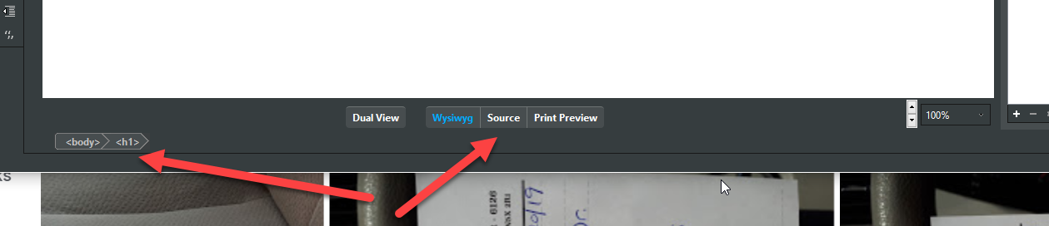
It is way to hard to remember all the tags, so…
WYSIWYG programs to the rescue!
  Eg. Adobe Dreamweaver or BlueGriffon
They creates the tags for us so that we don’t have to remember the syntax for each tag!
Question: Can you still see the tags in BlueGriffon? If so, how?

Slide 44
BlueGriffon Tips
Webpages will NOT format as precisely as something like a MS Word document to be printed because everyone’s resolution is different and screen size is different.
Design a template/layout and then save it and make copies for each page in your site and add the content to the copies
Don’t forget to make an images folder! Put your images in the folder BEFORE you start adding them to your page. ALWAYS ADD THE IMAGE TO THE IMAGES FOLDER BEFORE YOU PUT IT IN YOUR PAGE!
Try previewing your page in more than one browser
It is easier to create the top level folder and subfolders first and then point BlueGriffon to that folder
Always use lower case names with no spaces for all folder and all file names

Slide 45
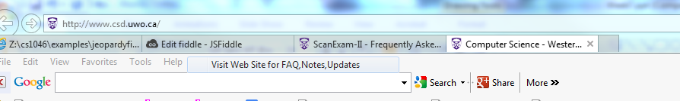
Page Title
Shows up now at the top of the tab
Page title is very important, when you print a webpage, the title appears at the top of printed paper
Search engines look at page title
Title is displayed in the list returned by Google
Always set the page title on all your pages
Start with the site name, then hyphen and the page description
  Examples:
  The Department of Computer Science – Undergraduate Information
  Laura K. Reid Online Resume – Work Experience

Slide 46
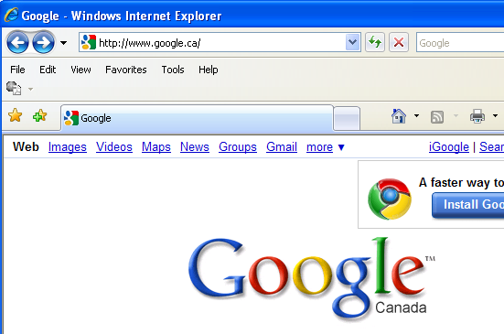
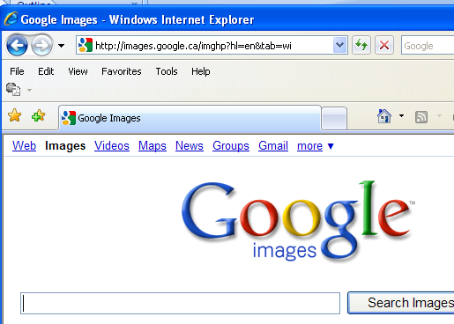
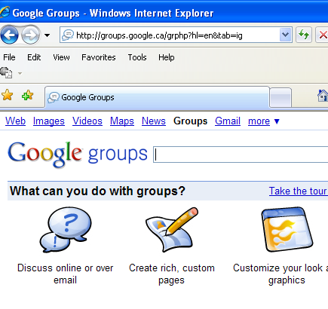
Google Does It Right!

Slide 47
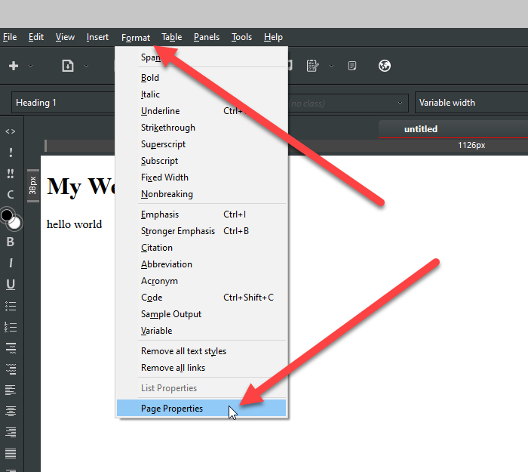
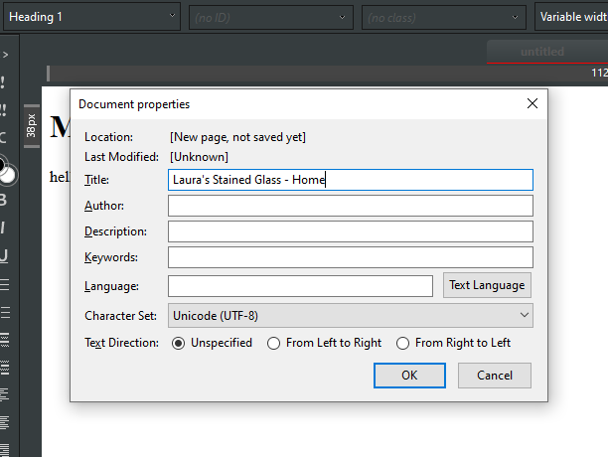
In BlueGriffon
In menu bar:
Format>Page Properties
Type in Site Name HYPHEN Page Name, e.g.
Laura’s Stained Glass – Home

Slide 48
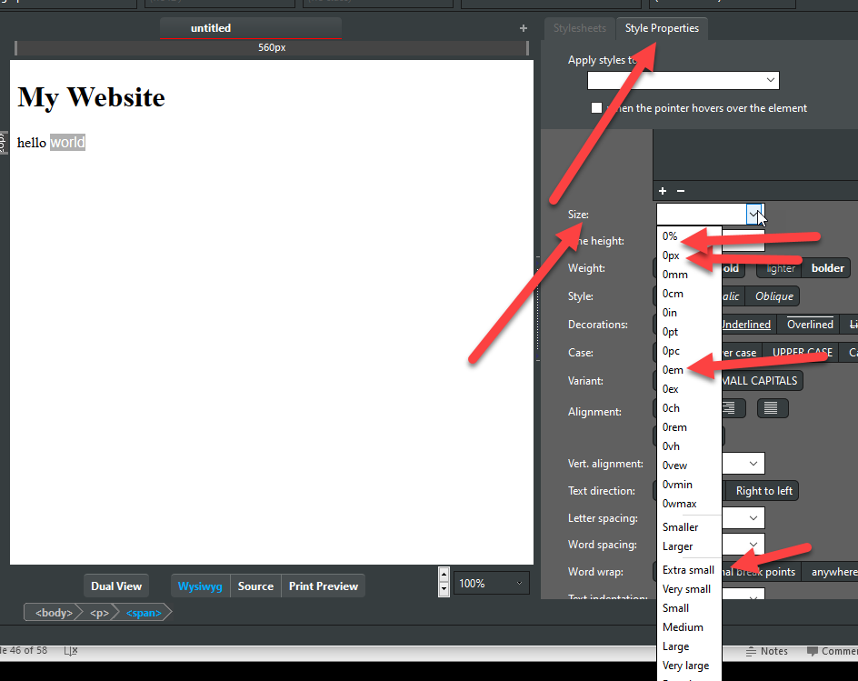
Formatting Text
Headers → H1, H2, H3, H4, H5, H6
  H1 is the largest
  All are bolded
Should use pixels rather than points for text size. Use ems or % when the audience might need to enlarge the text

Slide 49
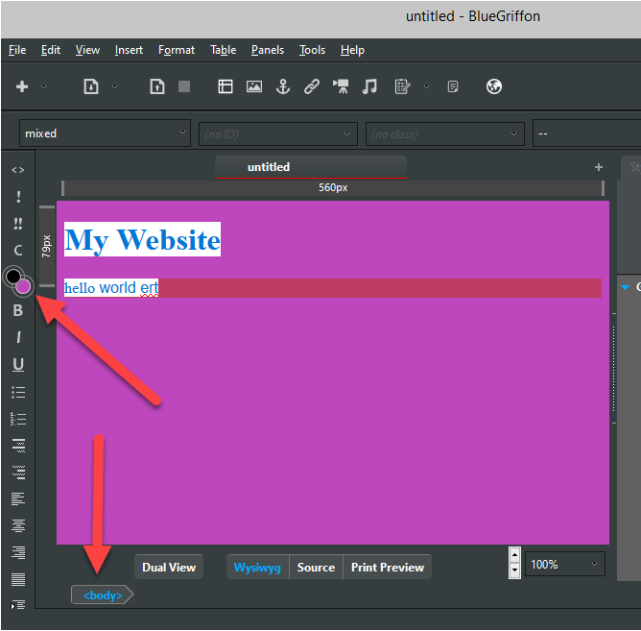
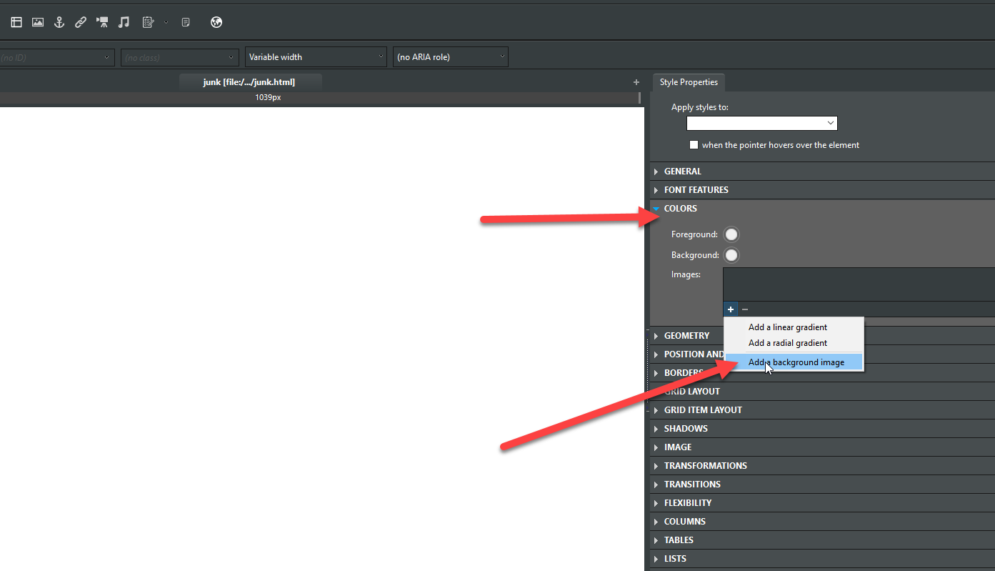
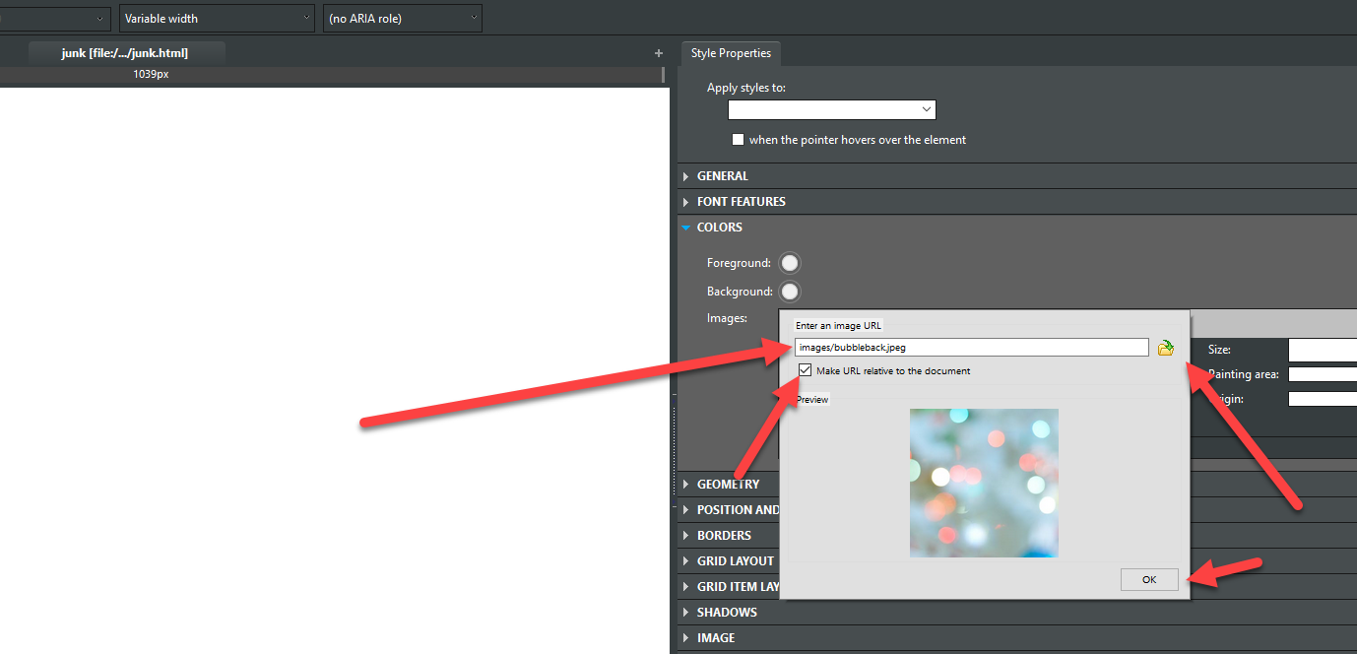
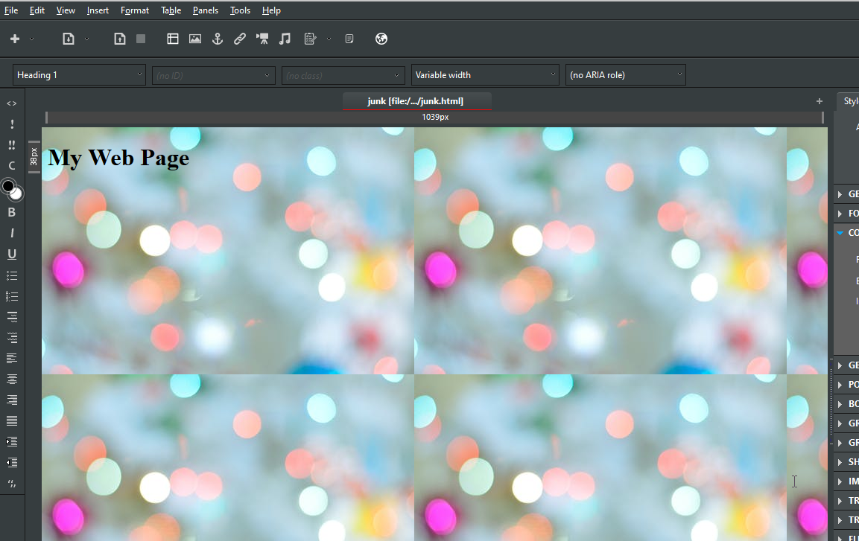
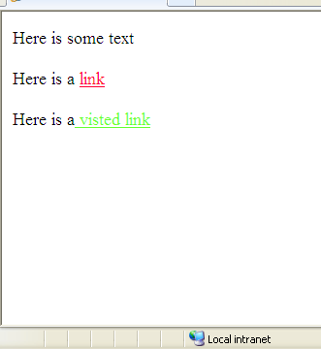
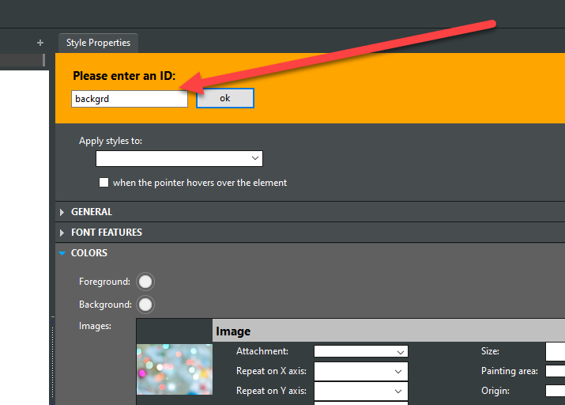
Changing Background and Link Colours
If you decide to use a background image, make sure it is not too busy and the image file size is small.
  https://affinity.pt/en/
Don’t forget about your links colours either! Try to pick colours that work with your site palette: http://duomgmt.com/
Remember to use GOOGLE!

Slide 50
Graphics
Use common universal formats such as jpg, gif and png files that will work in any browser
Resize and compress the image as much as possible in Photoshop (or other graphics package) BEFORE putting it in with BlueGriffon.
Any resizing you do within BlueGriffon will not affect the download speed

Slide 51
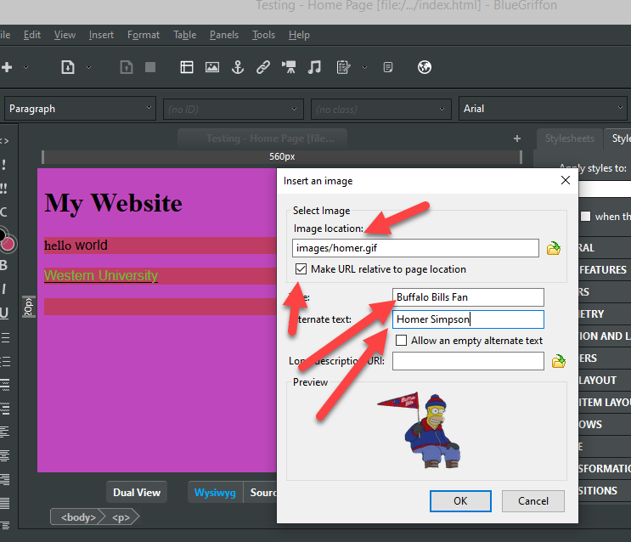
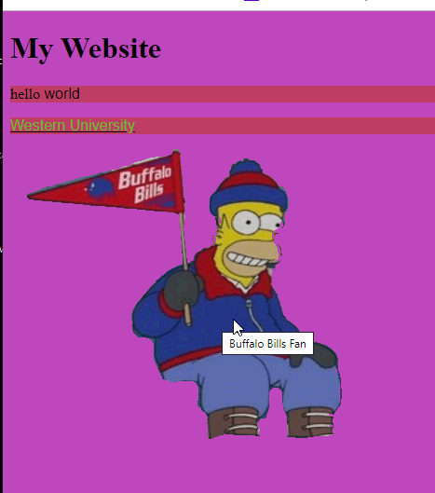
Graphics continued
ALWAYS set the alternative text:
  Meet Barriers Free Access Requirements
  Shows when page is loading
  Shows up when using a text browser
Set the Title attribute
  Shows when mouse hovers over

Slide 52
Types of Links
5 Basic Ones

Slide 53
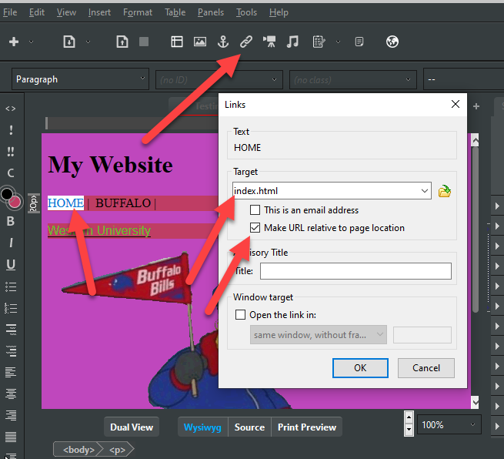

Links – Type 1
TYPE 1: Links to other pages within your site:
  For Example:
    Link from index.html to contactinfo.html
    Link from contactinfo.html back to index.html
http://cs1033.gaul.csd.uwo.ca/~lreid2/examplesforta/assign3/student1/

Slide 54
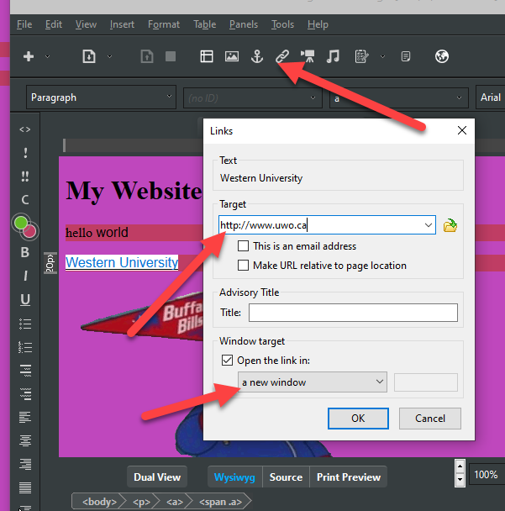
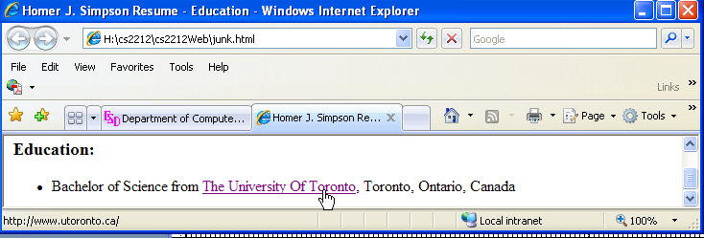
Links – Type 2
TYPE 2: Link to a different website
  For example
    Link from index.html to http://www.utoronto.ca
    Should open in new window or tab
    Make sure you have http:// in front!
http://cs1033.gaul.csd.uwo.ca/~lreid2/examplesforta/assign3/student1/references.html

Slide 55
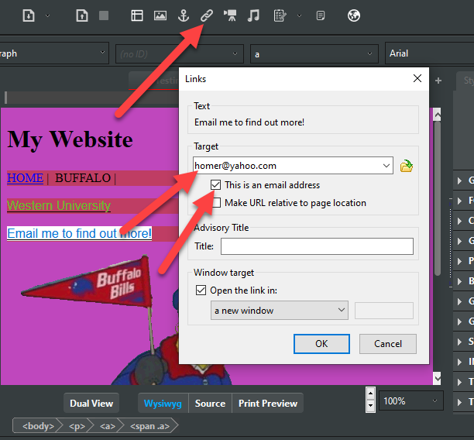
Links – Type 3
TYPE 3: Link to an email address
  For example:
    Link to homerjsimpson@yahoo.com
    Clicking on the link brings up default emailer like Outlook
http://cs1033.gaul.csd.uwo.ca/~lreid2/examplesforta/assign3/student1/contactinfo.html

Slide 56
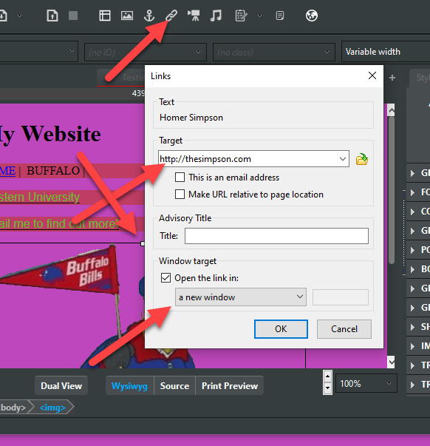
Links – Type 4
TYPE 4a: Link on a image
  On the whole image:
    Link to http://www.canada.gc.ca
    http://cs1033.gaul.csd.uwo.ca/~lreid2/examplesforta/assign3/student1/contactinfo.html (click on banner)

Slide 57
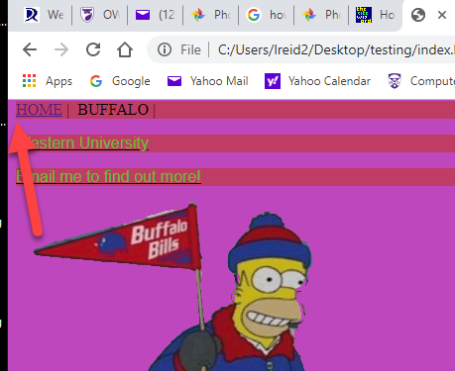
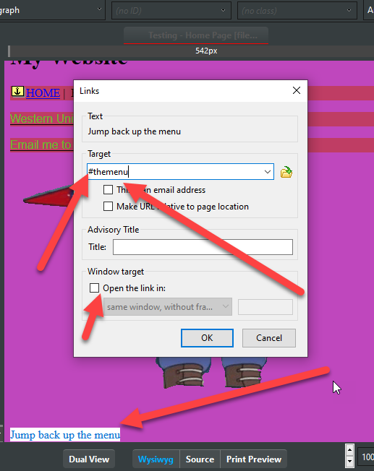
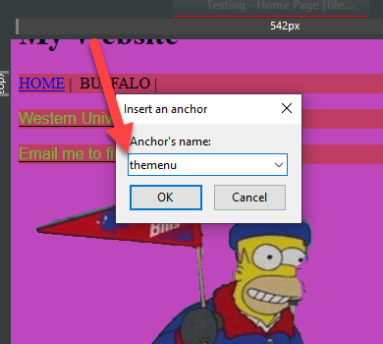
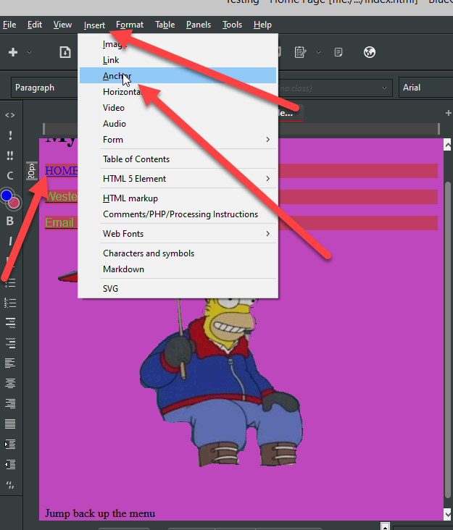
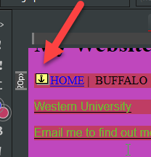
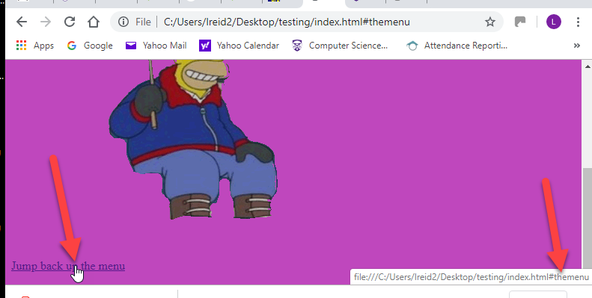
Links – Type 5
TYPE 5: Link to particular spot within a page
  The spot is called the bookmark or the named anchor
  Find the spot you want to jump to, put your cursor there and then select Insert>Named Anchor
  Give the spot a name you make up, for example: middleofpage
  Go to where you want the link and add a link with # in front of it and the name of the anchor:
http://cs1033.gaul.csd.uwo.ca/~lreid2/examplesforta/assign3/student1/staff.html

Slide 58
Links – Type 5
Named anchors can link to any spot within the current page OR you can link to the middle of another page, for example:
  http://en.wikipedia.org/wiki/Jpg#Sample_photographs
Use named anchors to make Back to Top buttons or jump from a list to another area of the page

Slide 59
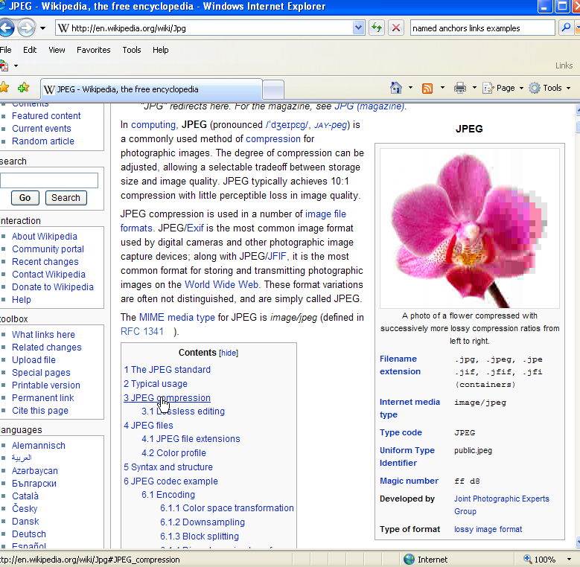
Named Anchors used on this page

Slide 60
When using BlueGriffon …
Make backups!
  Don’t just use one stick, every so often save your folder for assignment 2 to the cloud or your laptop – JUST IN CASE!

Slide 61
Next week
Searching
FINAL REVIEW QUESTION: If you are creating a webpage for the Contact Info about your Scuba Diving Business, which would be the best title for the page:
  Contact Info
  Untitled
  Laura’s Scubalious Diving Co
  Laura’s Scubalious Diving Co – Contact Us

