Slide 1

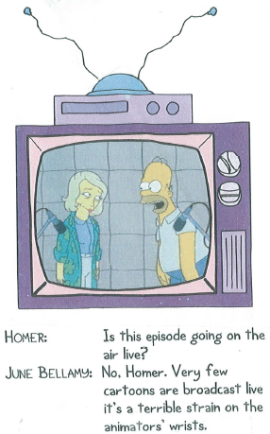
Animation
Computer Science 1033 – Week 8
“Live action writers will give you a structure, but who the hell is talking about structure? Animation is closer to jazz than some kind of classical stage structure.” → Ralph Bakshi

Slide 2
Overview of Today’s Topics
Announcements
Hints about Web Assignment
Finish Page Rank/Google
Animation

Slide 3
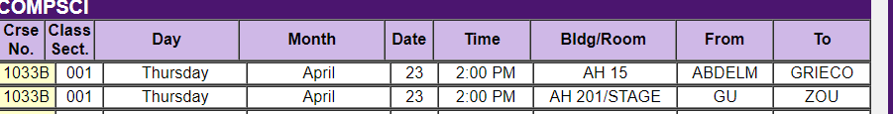
Announcements
Web Assignment due Friday (March 13th)
Final Exam
  Thursday, April 23rd at 2:00 pm
  All multiple choice – 2 hour time period
  Bring:
    Pencil (soft) and eraser
    Student card
  Do NOT bring: calculator, iPod, hat, etc..
OUR WHOLE CLASS HAS THEIR EXAM IN ALUMNI HALL:

Slide 4
Textbook Readings for this Week
Animation

Slide 5
Hints for Web Assignment
Remember:
  Titles
  Headers
  File names, spaces, lowercase
  Images
    Alt, Title
    Size within page
    On each page
  Banner
  No Scrolling horizontal/vertically to see buttons
  Consistency
  Buttons → look, ease of use
  Back to top
  References page layout
  Text colours, contrast
  Broken links
    Check from a different computer!
  Underlining
  Colours
    Link Colours
  Paragraphs
  Padding
  Followed the instructions (make the anchor links, etc..)

Slide 6
How to do Web Assignment
Colours → look at: http://kuler.adobe.com/
https://www.design-seeds.com/
Marks for:
  Nice Banner
  Good Colour Scheme
  Alt/title tag on banner/images
  No scrolling horizontally EVER at 1000 pixels
  Consistency in the layout of the pages and the buttons/NICE LAYOUT ON EVERY PAGE
  NO Underlining

Slide 7
Roll over buttons get 1 or 2 marks more
PROPERTY TITLES! Website – Web Page
  Grade 8 Designs – Home
  Grade 8 Designs – References
Must use table to lay things out
Headings on pages
Use an image for each page/good size
Layout paragraphs well (don’t squish on edge)
Bold/highlight headings

Slide 8
Announcements
Web Assignment
  IT will take you longer than you think, give yourself LOTS of time to finish it and to hand it in (Hand it in on before Wednesday, the labs will be VERY busy on Thursday and Friday).
  Hints:
    Remember your titles
    Think about layout, consistency, ease of use!
    Follow the specs
    Use a table for a clean layout (put the banner in the top row and content in the bottom row)
    Common Mistakes → http://www.csd.uwo.ca/~lreid/cs1033/assignment3/SamplesOfCommonMistakes/

Slide 9
Announcements
Web Assignment Hints
  THINGS THAT CAN GO HORRIBLY WRONG ☹
    http://cs1033.gaul.csd.uwo.ca/~lreid2/other/student1/
    http://cs1033.gaul.csd.uwo.ca/~lreid2/other/student2
    http://cs1033.gaul.csd.uwo.ca/~lreid2/other/student3/assign3/howtohelp.html (need to scroll for buttons, bullets, banner)
    http://cs1033.gaul.csd.uwo.ca/~lreid2/other/student9/major/ (consistency)
    http://cs1033.gaul.csd.uwo.ca/~lreid2/other/student19/ (not named index.html in main folder) – click on webpages
    http://cs1033.gaul.csd.uwo.ca/~lreid2/other/student20 (edges)
    http://cs1033.gaul.csd.uwo.ca/~lreid2/other/student14 (scrolling and banner on next page) http://cs1033.gaul.csd.uwo.ca/~lreid2/other/student22
    http://cs1033.gaul.csd.uwo.ca/~lreid2/other/student18/Contact%20Us.html (file names and button movement)
  THINGS THAT CAN GO RIGHT ☺
    http://cs1033.gaul.csd.uwo.ca/~lreid2/other/student8/assign3/registration.html
    http://cs1033.gaul.csd.uwo.ca/~lreid2/other/student22/assign3/
    http://cs1033.gaul.csd.uwo.ca/~lreid2/other/student15/index.html

Slide 10
Paragraphs → Centering → DON’T
Hyphens on lists
Emails links
Back to top, anchors
Think about link colours
Link lengths
  http://www.csd.uwo.ca/images/CSD_long_photo_16.jpg vs.
  Middlesex
Common Mistake: renaming files/folder…this will TOTALLY SCREW up your website if you do not do it correctly!

Slide 11
Web Assignment
Reasons for lost marks on website assignments:
  Forgot proper titles
  Forgot images folder or called it Images
  Called file Index.html instead of index.html
  Called index.html something like home.html
  Called aboutus.html something like About Us.html
  Forgot to check links or images ☹
  Didn’t make the references working links
  Filepaths should be relative and case-sensitive!
  Save your work frequently.

Slide 12
Make sure you get a copy of all your work!
Your websites will only be posted for the next month (till about June 1, 2020) so copy of everything you want onto a stick. YOU WILL NOT BE ABLE TO GET IT BACK AFTER THAT DATE!

Slide 13
Good Review for Searching!
https://www.youtube.com/watch?v=LVV_93mBfSU

Slide 14
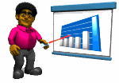




What is animation
A sequence of images that create the illusion of movement when played in succession.
How does the illusion work, what is each still image called?
Here are some simple examples:

Slide 15
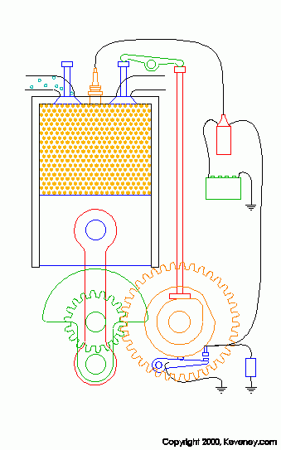


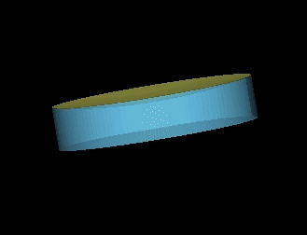

Why use animation?
Easier to show somebody how something works then to try and explain it.
Also animation:
  Indicate movement
  Illustrate change over time
  Visualize three-dimensional objects
  Attracts attention
Four Stroke Engine

Slide 16
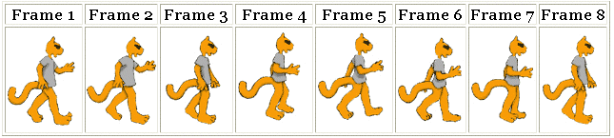

How does animation work?
Simulation of movement through a series of pictures that have objects in slightly different positions
Each drawing is called a frame (a snapshot of what’s happening at a particular moment)
Required Frames Per Second FPS:
  Movies on film → 24 fps
  TV →30 fps
    9000 frames for five minute cartoon
  Computer animation → 12 to15 fps
Jerky if anything less

Slide 17
Sampling and Quantizing of Motion
Since each frame is just an image →
  Each frame is sampled into a discrete samples and each sample becomes a pixel → Sampling process
    Remember:
      More samples means better quality (same image represented in10 pixels by 10 pixels or in 200 pixels by 200 pixels)
      More samples means bigger file sizes (10 pixels by 10 pixels vs 200 pixels by 200 pixels)
  Each pixel gets assigned a colour, maybe just 2 colours(black and white→1bit colour) or maybe 16 million colour (24 bit colour) → Quantization process
Question: What else can we “Sample” with MOTION?
Notes:
Sample the temporal dimensions of the video, sampling= frames
Higher frame rate means more accurate motion is sampled. Also means larger file size!

Slide 18
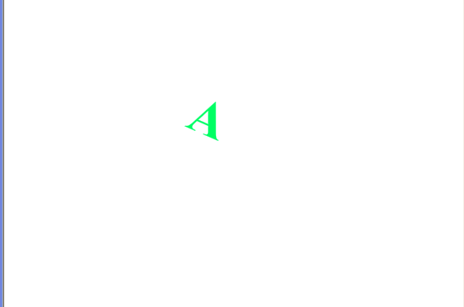
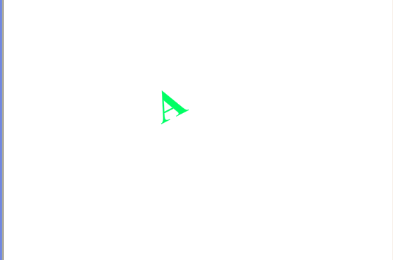
Frame Rate (Frames Per Second FPS)
Frame Rate: indicates the playback speed of the animation in frames per second
  Low frame rate appears choppy
  Question: BUT high frame rate can also appear choppy, WHY?
    Answer: if the computer playing the animation is not fast enough to process and display the frames.

Slide 19
2-D Animation
two types of 2-D animation:
  Cel Animation (also called traditional animation, classical animation, hand-drawn animation, frame by frame animation)
  Path Based Animation
Both types still are made of frames:
  The more frames per second, the more believable the movement will be.
  The more frames per second, the bigger the final version of the movie file will be (more bytes)

Slide 20
5 Types of Animation
https://www.youtube.com/watch?v=NZbrdCAsYqU (start at 30 seconds)
  Traditional Animation (Cel Animation)
    Rotoscoping is one type
  2D Animation (Path Based Animation) *** this is what we will be doing
  Computer Animation
  Motion Graphics
  Stop Motion (5:30)

Slide 21
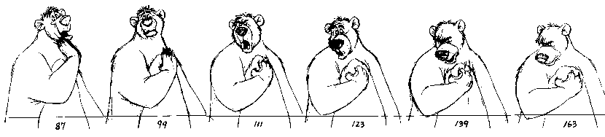
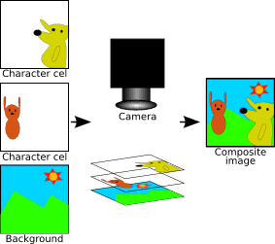
Cel Animation
An animator must HAND draw every single frame!
To simplify, one background is drawn and then the item that will move is drawn on a clear sheet of plastic (a cel), one drawing for each frame.
When moving to the next scene, just change the background
http://www.youtube.com/watch?v=jbhCUPwSrp0&feature=player_embedded (start at 55)
For example: Charlie Brown

Slide 22
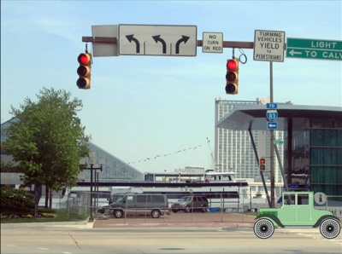
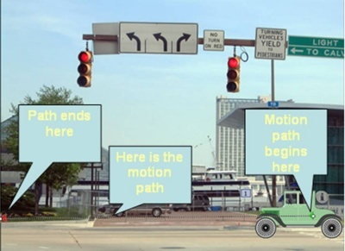
Path Based Animation
Pick:
  a starting point for an object, (start frame)
  an ending point for an object (end frame)
  a path for the object to follow
And then the computer generated all the frames in between (called TWEENING), so that the artist doesn’t have to draw the intermediate frames (like the artist did in cel based animation)

Slide 23
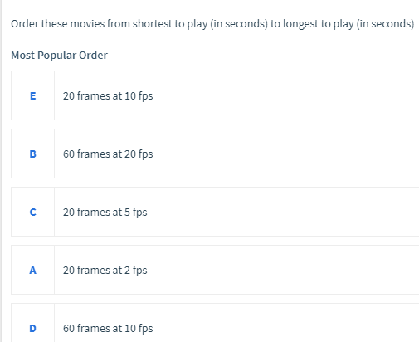
Path Based Animation
Question If I have a 40 frame movie playing at 5 frames per second, how long will the movie be? ___ seconds
Question :
Question: The path the object follows have to be a straight line, TRUE or FALSE?
Question: What software allows us to do path based animation?
A – 10 sec
B – 3 sec
C – 4 sec
D – 6 sec
E – 2 sec
ORDER: EBCDA

Slide 24
Path Based Animation Software
The software that generates the frames has features such as:
  Looping
  Transition (Fade in and Fade out)
  Repetitions → allows the user to pick how many times the animation repeats
  Setting the Frames Per Second
    Question: What does a bigger FPS imply?
      Larger file size
      More realistic motion

Slide 25
What can we do to change the motion?
If the animation appears too slow, we can speed up the motion by:
  Reduce the number of frames (say pull out every other frame)
  OR
  Increase the frame rate (go from 10fps to 20fps)

Slide 26
Slowing down the motion by adding more frames
Assume now that the motion is a bit too fast, 2 ways to slow it down:
  Way 1: Add more frames:
    Keep the frame rate the same
    Increase the number of frames between the keyframes to stretch out the animation
  Way 2: Lower the frame rate (go from 20fps to 5fps)
    Keep the same number of frames as original but stretches out movie
  Original Clip has 5 frames, at 20 fps, so finishes playing at 0.2 seconds, too fast!
    Way 1: still have 20 fps, but add in extra frames between, now have 20 frames
    Way 2: holds frame on screen for 0.2 seconds, then moves to frame 2, on screen for 0.2 second, etc….

Slide 27
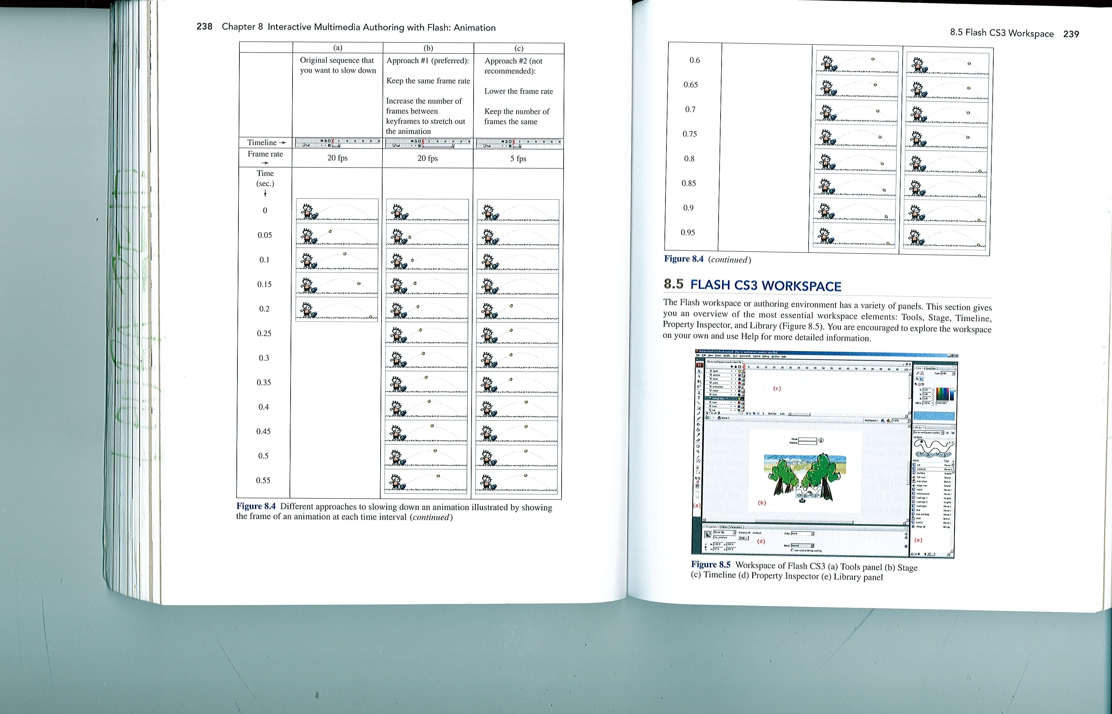
Question: What is wrong with Way (c)?
From the text book: Digital Media Primer by Yue-Ling Wong

Slide 28
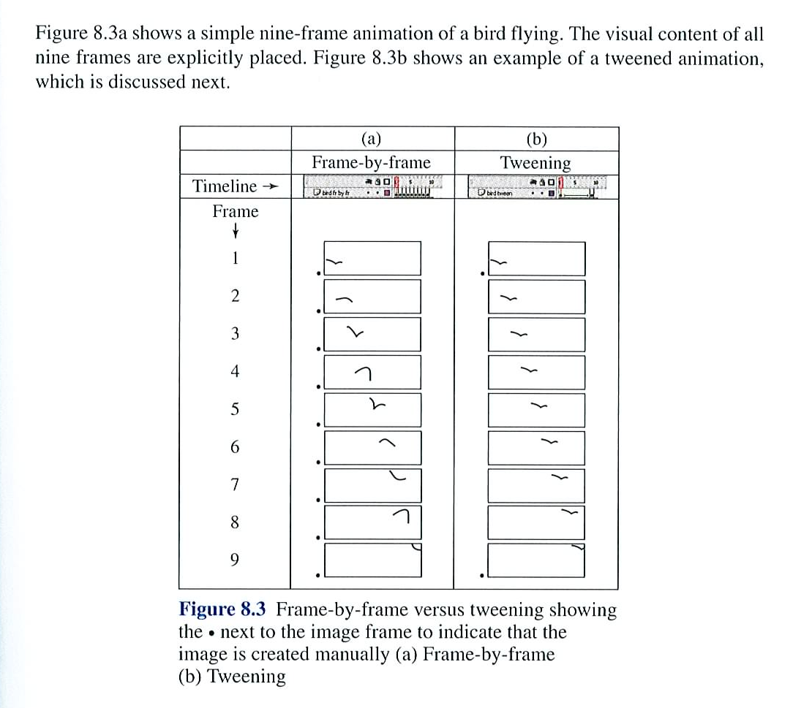
Cel Animation vs. Path Based Animation
From the text book: Digital Media Primer by Yue-Ling Wong

Slide 29


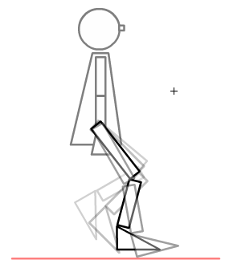
2-D Animation Terminology
Question: What do these terms mean?
  Keyframe
  Tweening
  Onion Skinning
Some Inspiration → An amazing animator: http://j-scott.com/work/

Slide 30
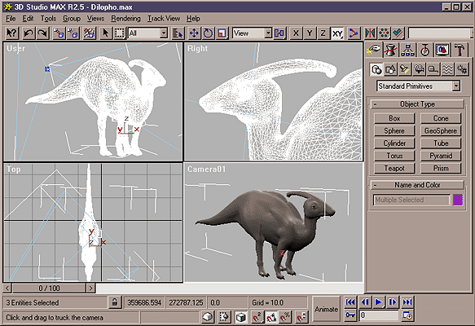
3-D Animation
3-Dimension animation involves 3 steps:
  Modelling
  Rendering
  Animating
Demo

Slide 31
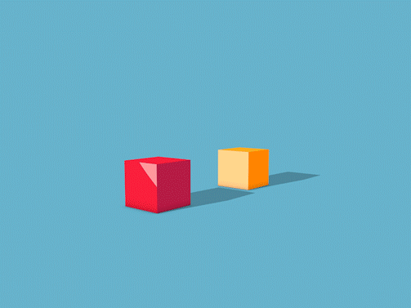
5 Tips to Create Realistic Motion
Question: which object is heavier? How do you know this? How did the artist achieve this?
https://www.youtube.com/watch?v=KRVhtMxQWRs (start at 2:10)
Consider the timing and spacing of your key frames

Slide 32


Question: How does the artist show the speed with the poker chips? What is Ease?
Consider playing with Ease in your animation software → https://www.youtube.com/watch?v=fQBFsTqbKhY

Slide 33
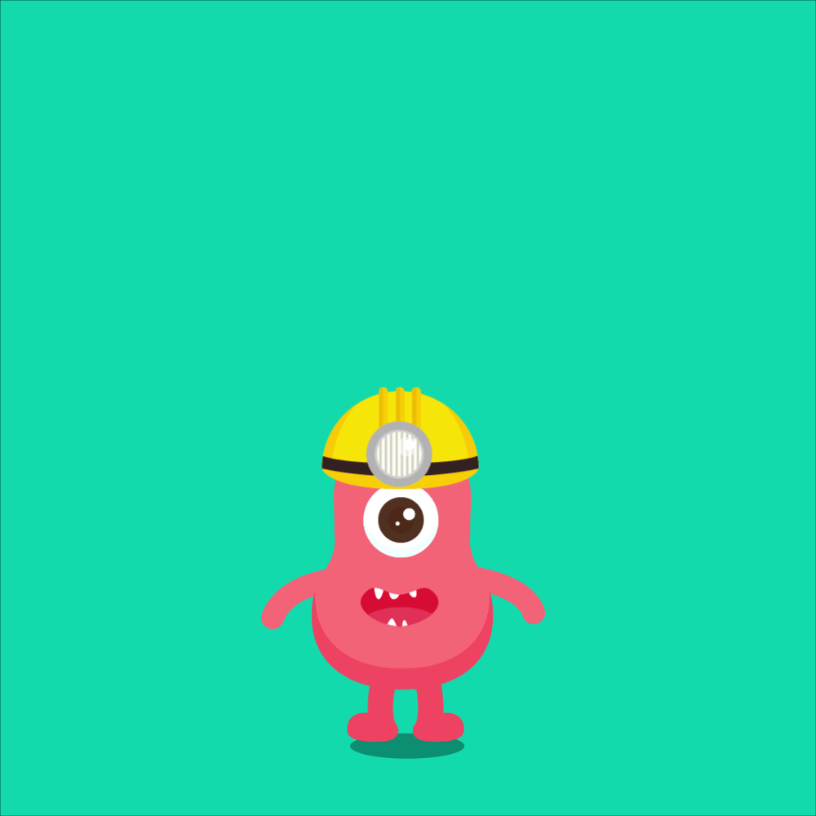
Question: What do you notice about the movement of the helmet compared to the body in this image?
When the something continues to move after the thing it is joined to stops → Follow Through

Slide 34
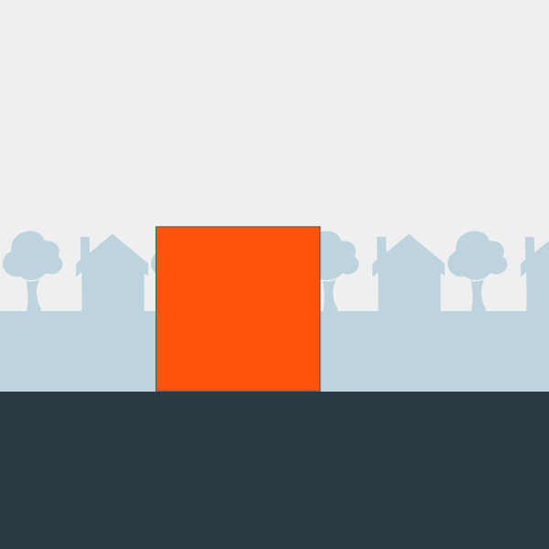
Question: What do you think the box is about to do? What term do we use when we think something is about to happen?
When the something prepares for an action to communicate to the viewer that something is about to happen → Anticipation

Slide 35
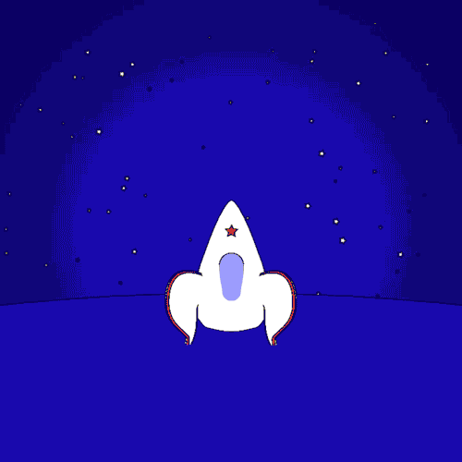
Question: What is interesting about the shape of this rocket as it starts and stops? What terms would you use to describe this? What other common object do we often use to display this phenomena?
Animated objects can get longer or flatter to emphasis their speed, momentum, weight and mass→ Squash and Stretch

Slide 36
Break
After you grab your coffee, watch this video and see how at the very end of it, it does MORPHING very effectively ☺
  http://www.youtube.com/watch?v=nUDIoN-_Hxs

Slide 37
Where can you get animation?
Purchase CDs or buy off the internet or get free clipart on the internet, for example:
  https://classroomclipart.com/clipart/Animations.htm
OR, you can create your own:
  Animated Gifs can be create in Photoshop or in other software tools
  Using Flash
We will look at two different file types of animation:
  Animated gifs
  Flash animation

Slide 38
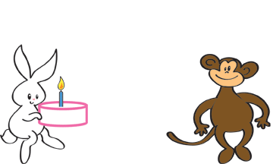
Animated GIFS
Question: What do you think the file size of an animated gif is affected by:
  Size of the gif (frame dimensions)
  Number of colors
  Number of frames
Question: What do you think is the maximum number of colours you can have in an animated gif?
No Plug-ins Required: Animated GIFs require no plug-ins, and the authoring tools to create them are often free and easy to learn.
No Sound: If you need sound in addition to motion, you cannot use an animated GIF by itself. Instead, you may want to consider other animation alternatives, such as Flash, or even video
Plug-in: A program that permits web browser to access and execute files that the browser would not normally recognize. Flash uses Shockwave

Slide 39
EVERYONE used to use Flash
A multimedia authoring and playback system
Launched in 1996 by Macromedia
Adobe bought it in 2005
Flash became popular for its animated graphics
Responsible for much of the animations, advertisements and video components found on today's Web sites
Flash is the industry's most advanced authoring environment for creating interactive websites, digital experiences and mobile content.

Slide 40
Why was Flash so popular?
Interactive content rich with video, graphics, animation
Import multimedia elements from other applications
Support vector graphics:
  much more space efficient over bitmapped frames
  scale up with accurate detail no matter how large the window is resized by the user.
Flash Player is a free client application that works with popular Web browsers to play the animation
Adobe worked out a deal to have the Flash player preinstalled on machines between the critical time period of 1998-2000 (before most people had broadband). This helped Flash over take Director in terms of popularity (users didn’t have to wait to install the player while surfing)
APPLE sort of KILLED Flash because they didn’t allow Flash to be used on Apple Devices
Flash is now becoming obsolete.

Slide 41
Flash in action
QUESTION:Suppose we had the following starting picture and the given ending picture, what THREE things do you think you would have to consider in order to make it appear animated but it should have a smooth animation, not jerky?
Question: What colour will the tween frames be?
Start picture
End picture

Slide 42

Essential Flash Terminology
Notes:
shape

Slide 43
Essential Flash Terminology
Tweening: Creating the intermediate frames based on the starting keyframe and ending keyframe. There are 3 types of tweens:
Motion Guide: lets you animation an object along a path that you draw yourself. Only works with symbols
Motion Tween | Shape Tween | Classic Tween (from cs3)
Animates symbols only. Create the tween initially and then go to a frame and move the object and that frame becomes a keyframe | Works with non symbol shapes and vector graphics only | Animates symbols only. Need to manually create all keyframes and connect then with a tween
Can’t morph (only position and rotation) | Can morph shapes | Can’t morph (only position and rotation)

Slide 44
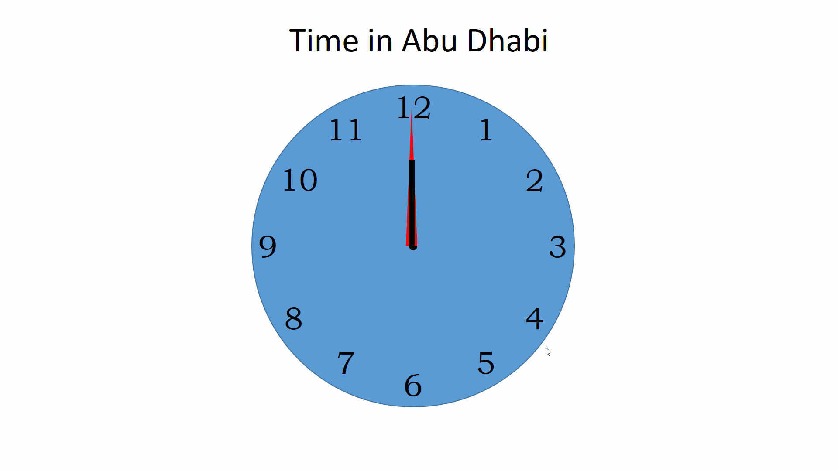
Laura’s venture into the world of Flash and Powerpoint Animation ☺
Open in IE
  KatieK – first flash project didn’t take long
  Then I tried to make a walking man:
    walking
    walking2
Then I saw this
So I tried to recreate it myself - hatchet ☹
Then I Tried Powerpoint and this happened:

Slide 45


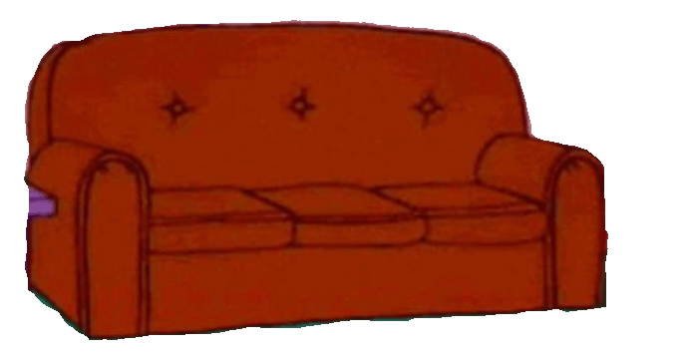
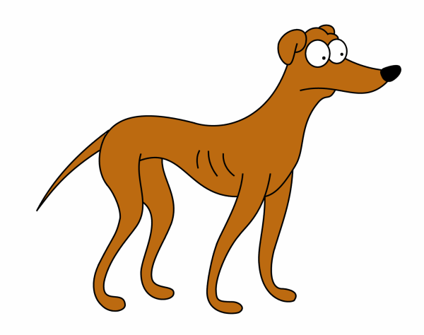
We will be using PowerPoint as of Fall 2019 for animation
First decide on how to create the animation:
  To make an object arrives
  To emphasis an object while it is still there
  To make an object leave
  To make an object follow a path

Slide 46
Ease in/Ease Out (Smooth Start/End) and Bounce End
Smooth Start – slow at the beginning, gets quicker at that end
Smooth End – starts quickly but slows down at the end
Smooth Start – makes it start slowly (ease in)
Smooth End – makes it end slowly (ease out)
Smooth Start + Smooth End <= Duration
How to make a ball bounce in PowerPoint
0 for Smooth Start and 0 for smooth end
2 for Smooth Start and 0 for smooth end
4 for Smooth Start and 0 for smooth end
0 for Smooth Start and 2 for smooth end
0 for Smooth Start and 4 for smooth end
0 for Smooth Start/End 1 for bounce
2 Smooth Start, 0 smooth end, 1 bounce end
Default Start 2 sec smooth start and 2 sec smooth end

Slide 47

Regular Smooth Start Smooth End Bounce

Slide 48
Control your Timing and Duration
Go Canada!
When motion path (ghosted shape) has a green circle (start) or red circle (end), motion is selected. When motion path has a green triangle (start) or red triangle (end), motion is NOT selected.

Slide 49
Comparing File Types:
 | Animated GIF | Flash | Photoshop | PowerPoint
Created by | Depends | Adobe | Adobe | Microsoft
Extension | Source depends .gif (movie) | .fla (source) .swf (movie) .gif (Flash can make gifs too!) | .psd (source) .mp4 OR .gif | .ppt (source) .mp4 (final version)
File Size | Larger than normal gif | Vector images take up less space than GIF bitmapped images | Fairly large (.mp4 files are compressed but still large) | Fairly large (.mp4 files are compressed but still large)
Need to play it | Nothing | Flash Player (Free and works with most browsers) | No plugin for .gif and most browsers can now play .mp4 | No plug in required for .mp4 anymore

Slide 50
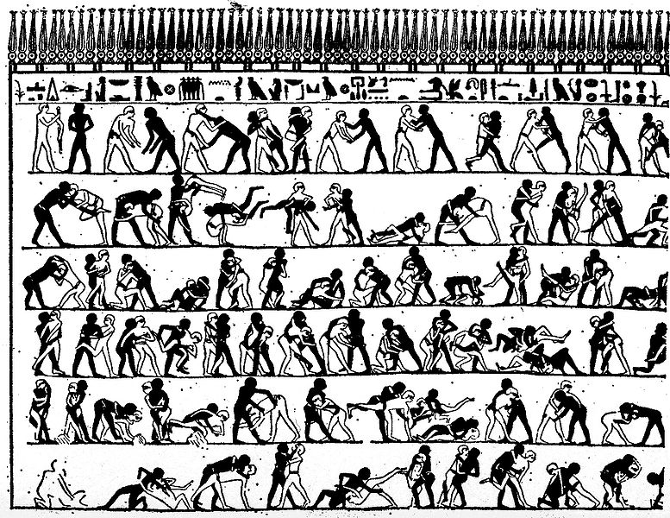
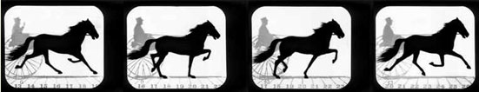

History of Animation:
→ early cave drawings show animals with 8 legs (trying to show animal moving)
→ 1868 – Flip book patented
→ 1877 - Praxinoscope Cylinder containing slits that when spun gave the illusion of movement
→ 1892 - Reynaud showed how he could use 12 pictures and loop the pictures. He had 500 frames using something similar to the modern film projector
→ 1898 – Stop motion animation introduced
Ancient Egypt Mural attempting to depict movement (4000 years old)

Slide 51
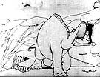
1906 → Blacktons makes “The Humorous Phases of Funny Faces” using a blackboard and frame by frame shots
1914 → McCay makes “Gertie the Dinosaur”, the first successful character animation
1928 → Walt Disney uses sound and animation in Steamboat Willie
1937 → first full length feature animation movie: Snow White
Gertie The Dinosaur

Slide 52
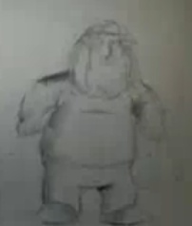
1960 → first prime time animation TV Show debuted Question: What was it?
Question: What is the longest running animation prime time show
1982 → Star Trek, The Wrath of Khan includes computer generated effects. TRON, a Disney animation includes 15 minutes of computer generated scenes
1986 → Take On Me by aha, creates much hyped video that uses rotoscoping (pencil-sketch animation/live-action combination )
1995 → Question: What was the first full length completely computer generated animation movie released?
Question: What is the highest grossing animated film of all time?
Chris Griffin

Slide 53

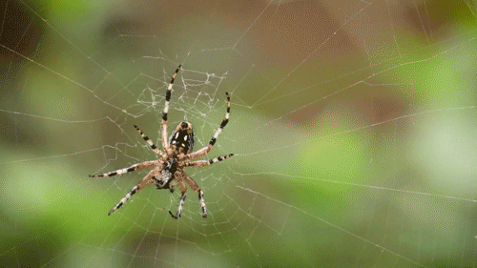
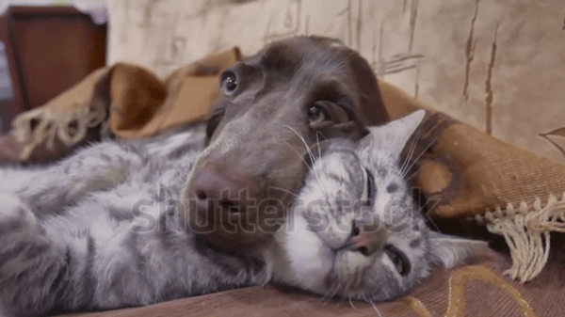
Cinemagraphs
Introduced in 2011
https://www.youtube.com/watch?v=ydyGiq7hnOg
Usually stored as animated .gif
Need BOTH a still picture and a video
https://flixel.com/cinemagraph/mr605d3hcragjswdy8ci/
Laura’s first tries at Cinemagraphs ☹

Slide 54
Let’s Review
http://www.youtube.com/watch?v=SaJxnTf44eg&feature=related
Finally: For the major assignment, you must create an animation.
  Cute major from last term:

Slide 55
Warm up Questions:
Question: What is the minimum number of frames per second should we have when building an animation for display on a computer?
Question: Which type of animation uses frames:
  Cel Based
  Path Based
  Both
  Neither
Question: If an animation is 40 frames long and the fps is 5, how long will the animation take to play?

