Slide 1
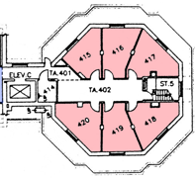

Mahmoud El-Sakka
Computer Science Department
Office: MC-419
Email: elsakka@csd.uwo.ca
Phone: 519-661-2111 x86996

Slide 2

Current Research Interest
Image denoising
Image compression

Slide 3
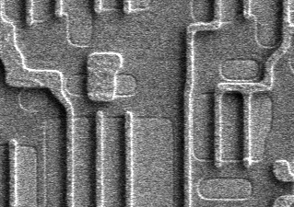

Image denoising
Attempts to automatically reduce existing noise in digital Images.
Denoised image
Original Noisy Image

Slide 4
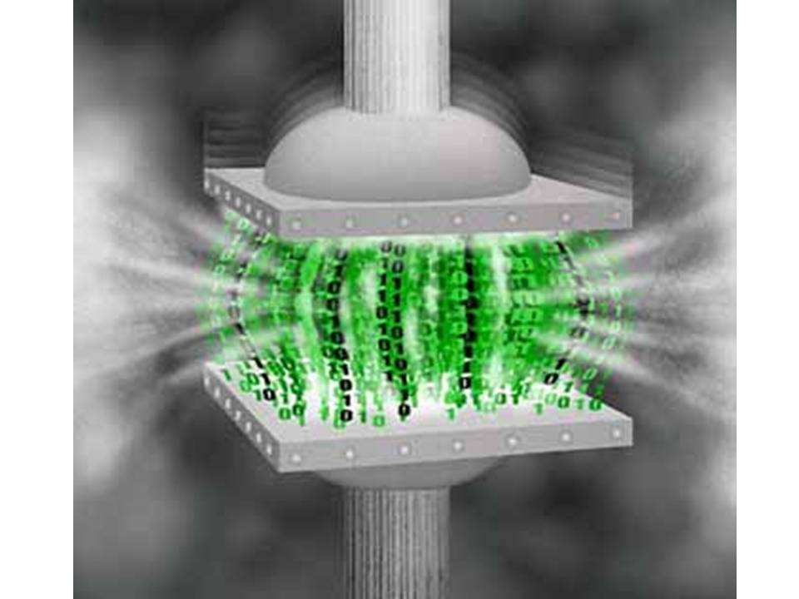
Image compression
Compression: is a bit-rate reduction which involves
  encoding information using fewer bits

Slide 5
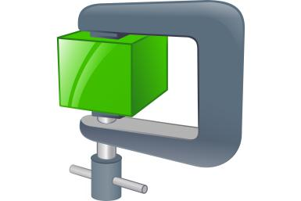
Prediction methods
Similarity methods
Statistical methods

Slide 6

Teaching
NO final EXAM!!
CS4481b/CS9628b
Image compression
To provide students with a solid understanding of the fundamentals and principles of various digital Image Compression Schemes
All required
image-related background will be built during the course
Second term on Wednesdays
from 10:30 pm to 1:30 pm

Slide 7

☺
☺
☺
☺
☺
☺
For Listening ☺

Slide 8




