Slide 1
CS3350B Computer Architecture Winter 2015 Lecture 3.1: Memory Hierarchy: What and Why?
Marc Moreno Maza
www.csd.uwo.ca/Courses/CS3350b
[Adapted from lectures on
Computer Organization and Design,
Patterson & Hennessy, 5th edition, 2014]

Slide 2
Components of a Computer
Processor
Devices
Control
Memory
Input
Datapath
Output
Fast and Small
Cache
Slow and Large
Main Memory
Secondary Memory
(Disk)

Slide 3
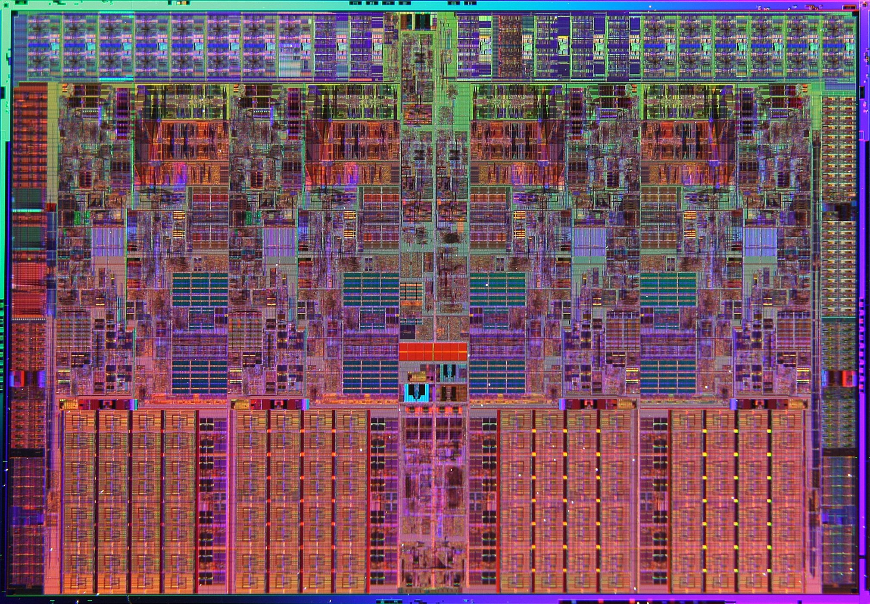
Nehalem Die Photo
Memory Controller
Misc IO
Misc IO
13.6 mm (0.54 inch)
Core
Core
Core
Core
Memory
Queue
QPI
QPI
Shared L3 Cache
18.9 mm (0.75 inch)

Slide 4
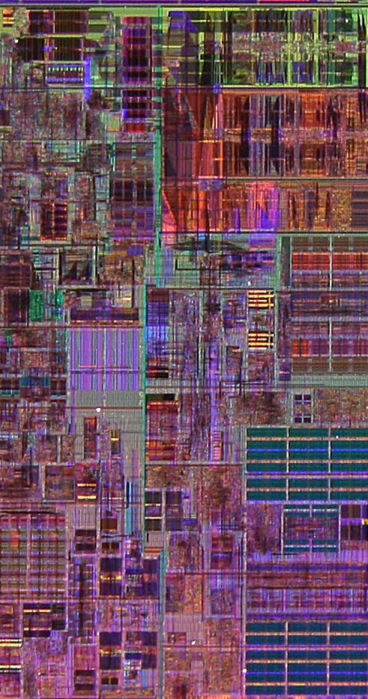
Core Area Breakdown
Memory Controller
Execution Units
32KB I$ per core
32KB D$ per core
512KB L2$ per core
Share one 8-MB L3$
L1 Data cache
L2 Cache & Interrupt Servicing
L1 Inst cache & Inst Fetch
L3 Cache
Load Store Queue
Notes:
Good memory hierarchy (cache) design is increasingly important to overall performance

Slide 5
Two Machines’ Cache Parameters
 | Intel P4 | AMD Opteron
L1 organization | Split I$ and D$ | Split I$ and D$
L1 cache size | 8KB for D$, 96KB for trace cache (~I$) | 64KB for each of I$ and D$
L1 block size | 64 bytes | 64 bytes
L1 associativity | 4-way set assoc. | 2-way set assoc.
L1 replacement | ~ LRU | LRU
L1 write policy | write-through | write-back
L2 organization | Unified | Unified
L2 cache size | 512KB | 1024KB (1MB)
L2 block size | 128 bytes | 64 bytes
L2 associativity | 8-way set assoc. | 16-way set assoc.
L2 replacement | ~LRU | ~LRU
L2 write policy | write-back | write-back
Notes:
This is from the old slide set – pre 2008.
A trace cache finds a dynamic sequence of instructions including taken branches to load into a cache block. Thus, the cache blocks contain dynamic traces of the executed instructions as determined by the CPU rather than static sequences of instructions as determined by memory layout. It folds branch prediction into the cache.

Slide 6
Two Machines’ Cache Parameters
 | Intel Nehalem | AMD Barcelona
L1 cache organization & size | Split I$ and D$; 32KB for each per core; 64B blocks | Split I$ and D$; 64KB for each per core; 64B blocks
L1 associativity | 4-way (I), 8-way (D) set assoc.; ~LRU replacement | 2-way set assoc.; LRU replacement
L1 write policy | write-back, write-allocate | write-back, write-allocate
L2 cache organization & size | Unified; 256MB (0.25MB) per core; 64B blocks | Unified; 512KB (0.5MB) per core; 64B blocks
L2 associativity | 8-way set assoc.; ~LRU | 16-way set assoc.; ~LRU
L2 write policy | write-back | write-back
L2 write policy | write-back, write-allocate | write-back, write-allocate
L3 cache organization & size | Unified; 8192KB (8MB) shared by cores; 64B blocks | Unified; 2048KB (2MB) shared by cores; 64B blocks
L3 associativity | 16-way set assoc. | 32-way set assoc.; evict block shared by fewest cores
L3 write policy | write-back, write-allocate | write-back; write-allocate
Notes:
The sophisticated memory hierarchies of these chips and the large fraction of
the dies dedicated to caches and TLBs show the significant design effort expended
to try to close the gap between processor cycle times and memory latency.
Why do we have to put so much effort on memory hierarchy?

Slide 7
Processor-Memory Performance Gap
µProc
55%/year
(2X/1.5yr)
“Moore’s Law”
Processor-Memory
Performance Gap (grows 50%/year)
DRAM
7%/year
(2X/10yrs)
Notes:
HIDDEN SLIDE – KEEP?
Memory baseline is a 64KB DRAM in 1980, with three years to the next generation until 1996 and then two years thereafter with a 7% per year performance improvement in latency.
Processor assumes a 35% improvement per year until 1986, then a 55% until 2003, then 5%
Need to supply an instruction and a data every clock cycle
In 1980 there were no caches (and no need for them), by 1995 most systems had 2 level caches (e.g., 60% of the transistors on the Alpha 21164 were in the cache)

Slide 8
The “Memory Wall”
Processor vs DRAM speed disparity continues to grow
Clocks per instruction
Clocks per DRAM access

Slide 9
The Principle of Locality
Program likely to access a relatively small portion of the address space at any instant of time
Temporal Locality (locality in time): If a memory location is referenced then it will tend to be referenced again soon
Spatial Locality (locality in space): If a memory location is referenced, the locations with nearby addresses will tend to be referenced soon
What program structures lead to temporal and spatial locality in code? In data?
Locality Example:
Data
Reference array elements in succession (stride-1 reference pattern):
Reference sum each iteration:
Instructions
Reference instructions in sequence:
Cycle through loop repeatedly:
sum = 0;
for (i=0; i<n; i++)
sum += a[i];
return sum;
Spatial locality
Temporal locality
Spatial locality
Temporal locality
Notes:
How does the memory hierarchy work? Well it is rather simple, at least in principle.
In order to take advantage of the temporal locality, that is the locality in time, the memory hierarchy will keep those more recently accessed data items closer to the processor because chances are (points to the principle), the processor will access them again soon.
In order to take advantage of the spatial locality, not ONLY do we move the item that has just been accessed to the upper level, but we ALSO move the data items that are adjacent to it.
+1 = 15 min. (X:55)

Slide 10
Locality Exercise 1
Question: Does this function in C have good locality?
int sumarrayrows(int a[M][N])
{
int i, j, sum = 0;
for (i = 0; i < M; i++)
for (j = 0; j < N; j++)
sum += a[i][j];
return sum;
}

Slide 11
Locality Exercise 2
Question: Does this function in C have good locality?
int sumarraycols(int a[M][N])
{
int i, j, sum = 0;
for (j = 0; j < N; j++)
for (i = 0; i < M; i++)
sum += a[i][j];
return sum;
}

Slide 12
Locality Exercise 3
Question: Can you permute the loops so that the function scans the 3D array a[] with a stride-1 reference pattern (and thus has good spatial locality)?
int sumarray3d(int a[M][N][N])
{
int i, j, k, sum = 0;
for (i = 0; i < N; i++)
for (j = 0; j < N; j++)
for (k = 0; k < M; k++)
sum += a[k][i][j];
return sum;
}

Slide 13
Why Memory Hierarchies?
Some fundamental and enduring properties of hardware and software:
Fast storage technologies (SRAM) cost more per byte and have less capacity
Gap between CPU and main memory (DRAM) speed is widening
Well-written programs tend to exhibit good locality
These fundamental properties complement each other beautifully
They suggest an approach for organizing memory and storage systems known as a memory hierarchy, to obtain the effect of a large, cheap, fast memory

Slide 14
Characteristics of the Memory Hierarchy
Processor
Inclusive – what is in L1$ is a subset of what is in L2$ is a subset of what is in MM is a subset of what is in SM
4-8 bytes (word)
Increasing distance from the processor in access time
L1$
8-32 bytes (block)
L2$
1 to 4 blocks
Main Memory
1,024+ bytes (disk sector = page)
Secondary Memory
(Relative) size of the memory at each level
CPU looks first for data in L1, then in L2, …, then in main memory.
Notes:
Because the upper level is smaller and built using faster memory parts, its hit time will be much smaller than the time to access the next level in the hierarchy (which is the major component of the miss penalty).
This structure, with the appropriate operating mechanisms, allows the processor to have an access time that is determined primarily by level 1 of the hierarchy and yet a memory as large as level n. Maintaining this illusion is the subject of this chapter.
Giving users the illusion of fast memory access and large memory size, by taking advantage of locality.
If level closer to Processor, it is:
Smaller
Faster
More expensive
Retains a subset of the data from the lower levels (e.g., contains most recently used data)
Processor accesses data out of highest levels
Lowest Level (usually disk) contains all available data (does it go beyond the disk?)

Slide 15
Caches
Cache: Smaller, faster storage device that acts as staging area for subset of data in a larger, slower device
Fundamental idea of a memory hierarchy:
For each k, the faster, smaller device at level k serves as cache for larger, slower device at level k+1
Why do memory hierarchies work?
Programs tend to access data at level k more often than they access data at level k+1
Thus, storage at level k+1 can be slower, and thus larger and cheaper per bit
Net effect: Large pool of memory that costs as little as the cheap storage near the bottom, but that serves data to programs at ≈ rate of the fast storage near the top.
Notes:
How does the memory hierarchy work? Well it is rather simple, at least in principle.
In order to take advantage of the temporal locality, that is the locality in time, the memory hierarchy will keep those more recently accessed data items closer to the processor because chances are (points to the principle), the processor will access them again soon.
In order to take advantage of the spatial locality, not ONLY do we move the item that has just been accessed to the upper level, but we ALSO move the data items that are adjacent to it.

Slide 16
Caching in a Memory Hierarchy
Smaller, faster, more expensive
device at level k caches a
subset of the blocks from level k+1
Level k:
8
4
9
14
3
10
Data is copied between
levels in block-sized transfer units
10
4
0
1
2
3
Level k+1:
Larger, slower, cheaper storage
device at level k+1 is partitioned
into blocks.
4
4
5
6
7
8
9
10
10
11
12
13
14
15

Slide 17
General Caching Concepts
Program needs object d, which is stored in some block b
Cache hit
Program finds b in the cache at level k. e.g., block 14
Cache miss
b is not at level k, so level k cache must fetch it from level k+1. e.g., block 12
If level k cache is full, then some current block must be replaced (evicted). Which one is the “victim”?
Placement (mapping) policy: where can the new block go? e.g., b mod 4
Replacement policy: which block should be evicted? e.g., LRU
Request
12
14
Request
14
12
0
1
2
3
Level
k:
4*
9
14
12
14
3
4*
12
Request
12
4*
0
1
2
3
Level
k+1:
4
5
6
7
4*
8
9
10
11
12
13
14
15
12

Slide 18
General Caching Concepts
Types of cache misses:
Cold (compulsory) miss
Cold misses occur because the cache is empty
Conflict miss
Most caches limit blocks at level k to a small subset (sometimes a singleton) of the block positions at level k+1
e.g. block i at level k+1 must be placed in block (i mod 4) at level k
Conflict misses occur when the level k cache is large enough, but multiple data objects all map to the same level k block
e.g. Referencing blocks 0, 8, 0, 8, 0, 8, ... would miss every time
Capacity miss
Occurs when the set of active cache blocks (working set) is larger than the cache

Slide 19
More Caching Concepts
Hit Rate: the fraction of memory accesses found in a level of the memory hierarchy
Hit Time: Time to access that level which consists of
Time to access the block + Time to determine hit/miss
Miss Rate: the fraction of memory accesses not found in a level of the memory hierarchy ⇒ 1 - (Hit Rate)
Miss Penalty: Time to replace a block in that level with the corresponding block from a lower level which consists of
Time to access the block in the lower level + Time to transmit that block to the level that experienced the miss + Time to insert the block in that level + Time to pass the block to the requestor
Hit Time << Miss Penalty
Notes:
A HIT is when the data the processor wants to access is found in the upper level (Blk X).
The fraction of the memory access that are HIT is defined as HIT rate.
HIT Time is the time to access the Upper Level where the data is found (X). It consists of:
(a) Time to access this level.
(b) AND the time to determine if this is a Hit or Miss.
If the data the processor wants cannot be found in the Upper level. Then we have a miss and we need to retrieve the data (Blk Y) from the lower level.
By definition (definition of Hit: Fraction), the miss rate is just 1 minus the hit rate.
This miss penalty also consists of two parts:
(a) The time it takes to replace a block (Blk Y to BlkX) in the upper level.
(b) And then the time it takes to deliver this new block to the processor.
It is very important that your Hit Time to be much much smaller than your miss penalty. Otherwise, there will be no reason to build a memory hierarchy.

Slide 20
Examples of Caching in the Hierarchy
Cache Type
What Cached
Where Cached
Latency (cycles)
Managed By
Registers
4-byte word
CPU registers
0.5
Compiler
TLB
Address translations
On-Chip TLB
0.5
Hardware
L1 cache
32-byte block
On-Chip L1
Hardware
L2 cache
32-byte block
On/Off-Chip L2
10
Hardware
Virtual Memory
4-KB page
Main memory
100
Hardware+OS
Buffer cache
Parts of files
Main memory
100
OS
Network buffer cache
Parts of files
Local disk
10,000,000
AFS/NFS client
Browser cache
Web pages
Local disk
10,000,000
Web browser
Web cache
Web pages
Remote server disks
1,000,000,000
Web proxy server

Slide 21
Claim
Being able to look at code and get qualitative sense of its locality is key skill for professional programmer
Examples:
BLAS (Basic Linear Algebra Subprograms)
SPIRAL, Software/Hardware Generation for DSP Algorithms
FFTW, by Matteo Frigo and Steven G, Johnson
Cache-Oblivious Algorithms, by Matteo Frigo, Charles E. Leiserson, Harald Prokop, and Sridhar Ramachandran, 1999
…
Notes:
http://www.netlib.org/blas/
http://www.spiral.net/
http://www.fftw.org/
Mattew’s cache oblivious paper
http://supertech.csail.mit.edu/papers/FrigoLePr99.pdf
The performance challenge for algorithms is that the memory hierarchy
varies between different implementations of the same architecture in cache size,
associativity,
block size, and number of caches. To cope with such variability, some
recent numerical
libraries parameterize their algorithms and then search the parameter
space at runtime to find the best combination for a particular computer. This approach
is called autotuning.

Slide 22
Memory Performance
Cache Miss Rate: number of cache misses/total number of cache references (accesses)
Miss rate + hit rate = 1.0 (100%)
Miss Penalty: the difference between lower level access time and cache access time
Average Memory Access Time (AMAT) is the average time to access memory considering both hits and misses
AMAT = Time for a Hit + Miss Rate * Miss Penalty
What is the AMAT for a processor with a 200 ps clock, a miss penalty of 50 clock cycles, a miss rate of 0.02 misses per instruction and a cache access time of 1 clock cycle?
1 + 0.02 * 50 = 2 clock cycles, or 2 * 200 = 400 ps
Notes:
AMAT = 1 + 0.02x50 = 2

Slide 23
Measuring Cache Performance – Effect on CPI
Assuming cache hit costs are included as part of the normal CPU execution cycle, then
CPU time = IC × CPI × CC
= IC × (CPI_{ideal} + Average memory-stall cycles) × CC
CPI_{stall}
A simple model for Memory-stall cycles:
Memory-stall cycles = #accesses/instruction × miss rate × miss penalty
This ignores extra costs of write misses.
Notes:
Reasonable write buffer depth (e.g., four or more words) and a memory capable of accepting writes at a rate that significantly exceeds the average write frequency means write buffer stalls are small

Slide 24
Impacts of Cache Performance
Relative cache miss penalty increases as processor performance improves (faster clock rate and/or lower CPI)
Memory speed unlikely to improve as fast as processor cycle time. When calculating CPI_{stall}, cache miss penalty is measured in processor clock cycles needed to handle a miss
Lower the CPI_{ideal}, more pronounced impact of stalls
Processor with a CPI_{ideal} of 2, a 100 cycle miss penalty, 36% load/store instr’s, and 2% instruction cache and 4% data cache miss rates
Memory-stall cycles = 2% × 100 + 36% × 4% × 100 = 3.44
So CPI_{stalls} = 2 + 3.44 = 5.44
More than twice the CPI_{ideal} !
What if the CPI_{ideal} is reduced to 1?
What if the data cache miss rate went up by 1%?
Notes:
For ideal CPI = 1, then CPIstall = 4.44 and the amount of execution time spent on memory stalls would have risen from 3.44/5.44 = 63% to 3.44/4.44 = 77%
For miss penalty of 200, memory stall cycles = 2% 200 + 36% x 4% x 200 = 6.88 so that CPIstall = 8.88
This assumes that hit time (so hit time is 1 cycle) is not a factor in determining cache performance. A larger cache would have a longer access time (if a lower miss rate), meaning either a slower clock cycle or more stages in the pipeline for memory access.

Slide 25
Multiple Cache Levels
Main Memory
L2$
L1$
CPU
Mem
Access
.
.
.
Miss
Hit
Miss
Hit
Path of Data Back to CPU

Slide 26
Multiple Cache Levels
With advancing technology, have more room on die for bigger L1 caches and for second level cache – normally a unified L2 cache (i.e., it holds both instructions and data,) and in some cases even a unified L3 cache
New AMAT Calculation: AMAT = L1 Hit Time + L1 Miss Rate * L1 Miss Penalty, L1 Miss Penalty = L2 Hit Time + L2 Miss Rate * L2 Miss Penalty and so forth (final miss penalty is Main Memory access time)
Notes:
Also reduces cache miss penalty

Slide 27
New AMAT Example
1 cycle L1 hit time, 2% L1 miss rate,
5 cycle L2 hit time, 5% L2 miss rate.
100 cycle main memory access time
Without L2 cache: AMAT = 1 + .02*100 = 3
With L2 cache: AMAT = 1 + .02*(5 + .05*100) = 1.2

Slide 28
Summary
Wanted: effect of a large, cheap, fast memory
Approach: Memory Hierarchy
Successively lower levels contain “most used” data from next higher level
Exploits temporal & spatial locality of programs
Do the common case fast, worry less about the exceptions (RISC design principle)
Challenges to programmer:
Develop cache friendly (efficient) programs

Slide 29
Layout of C Arrays in Memory (hints for the exercises)
C arrays allocated in row-major order
Each row in contiguous memory locations
Stepping through columns in one row:
for (i = 0; i < N; i++)
sum += a[0][i];
Accesses successive elements of size k bytes
If block size (B) > k bytes, exploit spatial locality
compulsory miss rate = k bytes / B
Stepping through rows in one column:
for (i = 0; i < n; i++)
sum += a[i][0];
Accesses distant elements
No spatial locality!
Compulsory miss rate = 1 (i.e. 100%)

