Slide 1
CS3350B
Computer Architecture
Winter 2015
Lecture 6.3: Instructional Level Parallelism:
Advanced Techniques
Marc Moreno Maza
www.csd.uwo.ca/Courses/CS3350b
[Adapted from lectures on Computer Organization and Design,
Patterson & Hennessy, 5th edition, 2011]

Slide 2
Greater Instruction-Level Parallelism
Deeper pipeline (more #stages: 5 => 10 => 15 stages)
  Less work per stage ⇒ shorter clock cycle
Multiple issue “superscalar”
  Replicate pipeline stages ⇒ multiple pipelines
    e.g., have two ALUs or a register file with 4 read ports and 2 write ports
    have logic to issue several instructions concurrently
  Execute more than one instruction at a clock cycle, producing an effective CPI < 1, so use Instructions Per Cycle (IPC)
  e.g., 4GHz 4-way multiple-issue
    16 BIPS, peak CPI = 0.25, peak IPC = 4
  If a datapath has a 5-stage pipeline, how many instructions are active in the pipeline at any given time?
  But dependencies reduce this in practice
Notes:
Answer to the last question is, obviously, twenty!
Superpipelined processors have longer instruction latency than multiple issue processors which can degrade performance in the presence of true dependencies
Multiple issue processors are more susceptible to resource conflicts – but we can fix this with hardware and/or software !
Increase the depth (number of stages) of the pipeline to increase the clock rate – superpipelining
The more stages in the pipeline, the more forwarding/hazard hardware needed and the more pipeline latch overhead (i.e., the pipeline latch accounts for a larger and larger percentage of the clock cycle time)

Slide 3
Pipeline Depth and Issue Width
Intel Processors over Time
Microprocessor | Year | Clock Rate | Pipeline Stages | Issue width | Cores | Power
i486 | 1989 | 25 MHz | 5 | 1 | 1 | 5W
Pentium | 1993 | 66 MHz | 5 | 2 | 1 | 10W
Pentium Pro | 1997 | 200 MHz | 10 | 3 | 1 | 29W
P4 Willamette | 2001 | 2000 MHz | 22 | 3 | 1 | 75W
P4 Prescott | 2004 | 3600 MHz | 31 | 3 | 1 | 103W
Core 2 Conroe | 2006 | 2930 MHz | 14 | 4 | 2 | 75W
Core 2 Yorkfield | 2008 | 2930 MHz | 16 | 4 | 4 | 95W
Core i7 Gulftown | 2010 | 3460 MHz | 16 | 4 | 6 | 130W

Slide 4
Multiple-Issue Processor Styles
Static multiple-issue processors, aka VLIW (very-long instruction word)
  Decisions on which instructions to execute simultaneously are being made statically (at compile time by the compiler)
  e.g. Intel Itanium and Itanium 2
    128-bit “bundles” containing three instructions
    Five functional units (IntALU, Mmedia, Dmem, FPALU, Branch)
    Extensive support for speculation and predication
Dynamic multiple-issue processors (aka SuperScalar)
  Decisions on which instructions to execute simultaneously (in the range of 2 to 8) are being made dynamically (at run time by the hardware)
    e.g., IBM power series, Pentium 4, MIPS R10K, AMD Barcelona

Slide 5
Multiple-Issue Datapath Responsibilities
Must handle, with a combination of hardware and software fixes, the fundamental limitations of
  How many instructions to issue in one clock cycle – issue slots
  Storage (data) dependencies – aka data hazards
    Limitation more severe in a SS/VLIW processor due to (usually) low ILP
  Procedural dependencies – aka control hazards
    Ditto, but even more severe
    Use dynamic branch prediction to help resolve the ILP issue
  Resource conflicts – aka structural hazards
    A SS/VLIW processor has a much larger number of potential resource conflicts
    Functional units may have to arbitrate for result buses and register-file write ports
    Resource conflicts can be eliminated by duplicating the resource or by pipelining the resource
Notes:
Pipelining is much less expensive than duplicating

Slide 6
Static Multiple Issue Machines (VLIW)
Static multiple-issue processors (aka VLIW) use the compiler (at compile-time) to statically decide which instructions to issue and execute simultaneously
  Issue packet – the set of instructions that are bundled together and issued in one clock cycle – think of it as one large instruction with multiple operations
  The mix of instructions in the packet (bundle) is usually restricted – a single “instruction” with several predefined fields
  The compiler does static branch prediction and code scheduling to reduce (control) or eliminate (data) hazards
VLIW’s have
  Multiple functional units
  Multi-ported register files
  Wide program bus

Slide 7
An Example: A VLIW MIPS
Consider a 2-issue MIPS with a 2 instr bundle
64 bits
ALU Op (R format)
or
Branch (I format)
Load or Store (I format)
Instructions are always fetched, decoded, and issued in pairs
  If one instr of the pair can not be used, it is replaced with a nop
Need 4 read ports and 2 write ports and a separate memory address adder

Slide 8
Code Scheduling Example
Consider the following loop code
lp: lw $t0,0($s1) # $t0=array element
addu $t0,$t0,$s2 # add scalar in $s2
sw $t0,0($s1) # store result
addi $s1,$s1,-4 # decrement pointer
bne $s1,$0,lp # branch if $s1 != 0
/* increment each element (unsigned integer) in array A by n */
for (i=m; i>=0; --i) /* m is the initial value of $s1 */
A[i] += n; /* n is the value in register $s2 */
Must “schedule” the instructions to avoid pipeline stalls
  Instructions in one bundle must be independent
  Must separate load/use instructions from their loads by one cycle
  Notice that the first two instructions have a load/use dependency, the next two and last two have data dependencies
  Assume branches are perfectly predicted by the hardware

Slide 9
The Scheduled Code (Not Unrolled)
 | ALU or branch | Data transfer | CC
lp: | nop | lw $t0,0($s1) | 1
 | addi $s1,$s1,-4 | nop | 2
 | addu $t0,$t0,$s2 | nop | 3
 | bne $s1,$0,lp | sw $t0,4($s1) | 4
lp: lw $t0,0($s1) # $t0=array element
addu $t0,$t0,$s2 # add scalar in $s2
sw $t0,0($s1) # store result
addi $s1,$s1,-4 # decrement pointer
bne $s1,$0,lp # branch if $s1 != 0
Four clock cycles to execute 5 instructions for a
  CPI of 0.8 (versus the best case of 0.5?)
  IPC of 1.25 (versus the best case of 2.0?)
  noops don’t count towards performance !!
Notes:
For lecture
Note that displacement value for the sw has to be adjusted because the addi has been scheduled before it rather than after it as in the original code.
Note load-use resolutions since addu is two cycles after its corresponding load

Slide 10
Loop Unrolling
Loop unrolling – multiple copies of the loop body are made and instructions from different iterations are scheduled together as a way to increase ILP
Apply loop unrolling (4 times for our example) and then schedule the resulting code
  Eliminate unnecessary loop overhead instructions
  Schedule so as to avoid load use hazards
During unrolling the compiler applies register renaming to eliminate all data dependencies that are not true data dependencies
Notes:
An important compiler technique to get more performance from loops is loop
unrolling, where multiple copies of the loop body are made. After unrolling, there
is more ILP available by overlapping instructions from different iterations.

Slide 11
Loop Unrolling in C
for (i=m; i>=0; --i)
A[i] += n;
/* unrolled 4 times */
for (i=m; i>=0; i-=4){
A[i] += n;
A[i-1] += n;
A[i-2] += n;
A[i-3] += n; }
Assume size of A is 8, i.e. m=7.
Execute not-unrolled code:
Iteration # i Instruction
1 7 A[7] += n
2 6 A[6] += n
3 5 A[5] += n
4 4 A[4] += n
5 3 A[3] += n
6 2 A[2] += n
7 1 A[1] += n
8 0 A[0] += n
Execute unrolled code:
Iteration #1, i=7:
{ A[7] += n;
A[6] += n;
A[5] += n;
A[4] += n; }
Iteration #2, i=3:
{ A[3] += n;
A[2] += n;
A[1] += n;
A[0] += n; }

Slide 12
Apply Loop Unrolling for 4 times
lp: lw $t0,0($s1) # $t0=array element
lw $t1,-4($s1) # $t1=array element
lw $t2,-8($s1) # $t2=array element
lw $t3,-12($s1)# $t3=array element
addu $t0,$t0,$s2 # add scalar in $s2
addu $t1,$t1,$s2 # add scalar in $s2
addu $t2,$t2,$s2 # add scalar in $s2
addu $t3,$t3,$s2 # add scalar in $s2
sw $t0,0($s1) # store result
sw $t1,-4($s1) # store result
sw $t2,-8($s1) # store result
sw $t3,-12($s1)# store result
addi $s1,$s1,-16 # decrement pointer
bne $s1,$0,lp # branch if $s1 != 0
/* code in c */
for(i=m;i>=0;i-=4)
{
A[i] += n;
A[i-1] += n;
A[i-2] += n;
A[i-3] += n;
}
Why not reuse $t0 but use $t1, $t2, $t3?
Why -4,-8,-12 and $s1=$s1-16?
How many times can a loop be unrolled?
lp: lw $t0,0($s1) # $t0=array element
addu $t0,$t0,$s2# add scalar in $s2
sw $t0,0($s1) # store result
addi $s1,$s1,-4 # decrement pointer
bne $s1,$0,lp # branch if $s1!=0
Notes:
During the unrolling process, the compiler introduced additional registers
($t1, $t2, $t3). The goal of this process, called register renaming, is to eliminate
dependences that are not true data dependences, but could either lead to
potential hazards or prevent the compiler from flexibly scheduling the code.
Consider how the unrolled code would look using only $t0. There would be
repeated instances of lw $t0,0($$s1), addu $t0,$t0,$s2 followed by sw
t0,4($s1), but these sequences, despite using $t0, are actually completely
independent—no data values flow between one pair of these instructions and
the next pair. This is what is called an antidependence or name dependence,
which is an ordering forced purely by the reuse of a name, rather than a real
data dependence which is also called a true dependence.
Renaming the registers during the unrolling process allows the compiler to
move these independent instructions subsequently so as to better schedule the
code. The renaming process eliminates the name dependences, while preserving
the true dependences.
Notice now that 12 of the 14 instructions in the loop execute as pairs. It
takes 8 clocks for 4 loop iterations, or 2 clocks per iteration, which yields a
CPI of 8/14 = 0.57. Loop unrolling and scheduling with dual issue gave us
an improvement factor of almost 2, partly from reducing the loop control
instructions and partly from dual issue execution. The cost of this performance
improvement
is using four temporary registers rather than one, as well as a
significant increase in code size

Slide 13
The Scheduled Code (Unrolled)
 | ALU or branch | Data transfer | CC
lp: | addi $s1,$s1,-16 | lw $t0,0($s1) | 1
 | nop | lw $t1,12($s1) #-4 | 2
 | addu $t0,$t0,$s2 | lw $t2,8($s1) #-8 | 3
 | addu $t1,$t1,$s2 | lw $t3,4($s1) #-12 | 4
 | addu $t2,$t2,$s2 | sw $t0,16($s1) #0 | 5
 | addu $t3,$t3,$s2 | sw $t1,12($s1) #-4 | 6
 | nop | sw $t2,8($s1) #-8 | 7
 | bne $s1,$0,lp | sw $t3,4($s1) #-12 | 8
/* code in c */
for(i=m;i>=0;i-=4)
{
A[i] += n;
A[i-1] += n;
A[i-2] += n;
A[i-3] += n;
}
Eight clock cycles to execute 14 instructions for a
  CPI of 0.57
  (versus the best case of 0.5)
  IPC of 1.8
  (versus the best case of 2.0)

Slide 14
Predication
Predication can be used to eliminate branches by making the execution of an instruction dependent on a “predicate”, e.g.,
  if (p) {statement 1} else {statement 2}
would normally compile using two branches. With predication it would compile as
  (p) statement 1
  (~p) statement 2
The use of (condition) indicates that the instruction is committed only if condition is true
Predication can be used to speculate as well as to eliminate branches
Notes:
LEAVE THIS SLIDE IN HIDE MODE – NO LONGER COVERED IN BOOK AND A BIT MUCH DETAIL FOR THIS COURSE.
One conditional branch to the else portion of the code and one after code block 1 to skip the else code block

Slide 15
Summary of Compiler Support for VLIW Processors
The compiler packs groups of independent instructions into the bundle
  Done by code re-ordering (trace scheduling)
The compiler uses loop unrolling to expose more ILP
The compiler uses register renaming to solve name dependencies and ensures no load use hazards occur
While superscalars use dynamic prediction, VLIW’s primarily depend on the compiler for branch prediction
  Loop unrolling reduces the number of conditional branches
  Predication eliminates if-then-else branch structures by replacing them with predicated instructions
The compiler predicts memory bank references to help minimize memory bank conflicts

Slide 16
VLIW Advantages & Disadvantages
Advantages
  Simpler hardware (potentially less power hungry)
  Potentially more scalable
    Allow more instr’s per VLIW bundle and add more FUs
Disadvantages
  Programmer/compiler complexity and longer compilation times
    Deep pipelines and long latencies can be confusing (making peak performance elusive)
  Lock step operation, i.e., on hazard all future issues stall until hazard is resolved (hence need for predication)
  Object (binary) code incompatibility
  Needs lots of program memory bandwidth
  Code bloat
    Noops are a waste of program memory space
    Loop unrolling to expose more ILP uses more program memory space
Notes:
Also need bigger RegFile since renaming uses programmer visible registers (not an RUU as with SS)

Slide 17
Dynamic Multiple Issue Machines (SS)
Dynamic multiple-issue processors (aka SuperScalar) use hardware at run-time to dynamically decide which instructions to issue and execute simultaneously
Instruction-fetch and issue – fetch instructions, decode them, and issue them to a FU to await execution
Instruction-execution – as soon as the source operands and the FU are ready, the result can be calculated
Instruction-commit – when it is safe to, write back results to the RegFile or D$ (i.e., change the machine state)

Slide 18
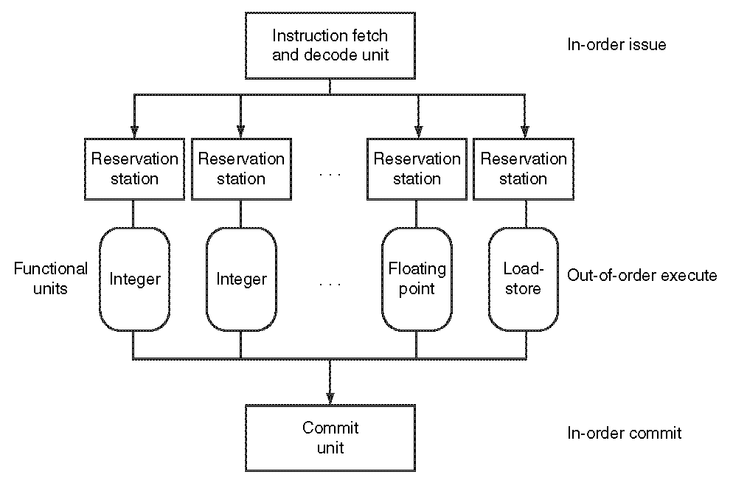
Dynamic Multiple Issue Machines (SS)

Slide 19
Dynamic Pipeline Scheduling
Allow the CPU to execute instructions out of order to avoid stalls
  But commit result to registers in order
Example
  lw $t0, 20($s2)
  addu $t1, $t0, $t2
  subu $s4, $s4, $t3
  slti $t5, $s4, 20
  Can start subu while addu is waiting for lw

Slide 20
Why Do Dynamic Scheduling?
Why not just let the compiler schedule code?
  Disadvantages of complier scheduling code
Not all stalls are predicable
  e.g., cache misses
Can’t always schedule around branches
  Branch outcome is dynamically determined
Different implementations of an ISA have different latencies and hazards

Slide 21
Speculation
“Guess” what to do with an instruction
  Start operation as soon as possible
  Check whether guess was right
    If so, complete the operation
    If not, roll-back and do the right thing
Common to static and dynamic multiple issue
Examples
  Speculate on branch outcome (Branch Prediction)
    Roll back if path taken is different
  Speculate on load
    Roll back if location is updated

Slide 22
Out Of Order Intel
All use OOO since 2001
Microprocessor | Year | Clock Rate | Pipeline Stages | Issue width | Out-of-order/ Speculation | Cores | Power
i486 | 1989 | 25MHz | 5 | 1 | No | 1 | 5W
Pentium | 1993 | 66MHz | 5 | 2 | No | 1 | 10W
Pentium Pro | 1997 | 200MHz | 10 | 3 | Yes | 1 | 29W
P4 Willamette | 2001 | 2000MHz | 22 | 3 | Yes | 1 | 75W
P4 Prescott | 2004 | 3600MHz | 31 | 3 | Yes | 1 | 103W
Core | 2006 | 2930MHz | 14 | 4 | Yes | 2 | 75W
Core 2 Yorkfield | 2008 | 2930MHz | 16 | 4 | Yes | 4 | 95W
Core i7 Gulftown | 2010 | 3460MHz | 16 | 4 | Yes | 6 | 130W

Slide 23
Streaming SIMD Extensions (SSE)
SIMD: Single Instruction Multiple Data
A data parallel architecture
Both current AMD and Intel’s x86 processors have ISA and micro-architecture support SIMD operations
  MMX, 3DNow!, SSE, SSE2, SSE3, SSE4, AVX
  Many functional units
  8 128‐bit vector registers: XMM0, XMM1, …, XMM7
  See the flag field in /proc/cpuinfo
SSE (Streaming SIMD extensions): a SIMD instruction set extension to the x86 architecture
  Instructions for operating on multiple data simultaneously (vector operations): for (i=0; i<n; ++i) Z[i]=X[i]+Y[i];
Programming SSE in C++: intrinsics

Slide 24
Does Multiple Issue Work?
Yes, but not as much as we’d like
Programs have real dependencies that limit ILP
Some dependencies are hard to eliminate
  e.g., pointer aliasing
Some parallelism is hard to expose
  Limited window size during instruction issue
Memory delays and limited bandwidth
  Hard to keep pipelines full
Speculation can help if done well

Slide 25
Takeaway
Pipelining is an important form of ILP
Challenge is hazards
  Forwarding helps with many data hazards
  Delayed branch helps with control hazard in 5 stage pipeline
  Load delay slot / interlock necessary
More aggressive performance:
  Longer pipelines
  VLIW
  Superscalar
  Out-of-order execution
  Speculation
  SSE?

