Slide 1
CS3350B
Computer Architecture
Winter 2015
Lecture 7.2: Multicore TLP (1)
Marc Moreno Maza
www.csd.uwo.ca/Courses/CS3350b
[Adapted from lectures on
Computer Organization and Design,
Patterson & Hennessy, 4th or 5th edition, 2011]

Slide 2
Review: Multiprocessor Systems (MIMD)
Multiprocessor (Multiple Instruction Multiple Data):
a computer system with at least 2 processors
  Deliver high throughput for independent jobs via job-level parallelism on top of ILP
  Improve the run time of a single program that has been specially crafted to run on a multiprocessor - a parallel processing program
    Now Use term core for processor (“Multicore”)
    because “Multiprocessor Microprocessor” too redundant
Processor
Processor
Processor
Cache
Cache
Cache
Interconnection Network
Memory
I/O
Notes:
Power has become the overriding issue for both data centers and microprocessors. Power efficiency has joined scalable performance making the case for multiprocessors. Multiprocessors also improve availability.

Slide 3
Review
Sequential software is slow software
  SIMD and MIMD only path to higher performance
Multiprocessor (Multicore) uses Shared Memory (single address space) (SMP)
Cache coherency implements shared memory even with multiple copies in multiple caches
  False sharing a concern
MESI Protocol ensures cache consistency and has optimizations for common cases.

Slide 4
Multiprocessors and You
Only path to performance is parallelism
  Clock rates flat or declining
  SIMD: 2X width every 3-4 years
    128b wide now, 256b 2011, 512b in 2014?, 1024b in 2018?
    Advanced Vector Extensions are 256-bits wide!
  MIMD: Add 2 cores every 2 years: 2, 4, 6, 8, 10, …
A key challenge is to craft parallel programs that have high performance on multiprocessors as the number of processors increase – i.e., that scale
  Scheduling, load balancing, time for synchronization, overhead for communication

Slide 5
Example: Sum Reduction
Sum 100,000 numbers on 100 processor SMP
  Each processor has ID: 0 ≤ Pn ≤ 99
  Phase I:
  Partition 1000 numbers per processor;
  Initial summation on each processor
  sum[Pn] = 0; // 0 ≤ Pn ≤ 99
  for (i = 1000*Pn;
  i < 1000*(Pn+1); i = i + 1)
  sum[Pn] = sum[Pn] + A[i];
Phase II: Add these partial sums
  Reduction: divide and conquer
  Half the processors add pairs, then quarter, …
  Need to synchronize between reduction steps

Slide 6
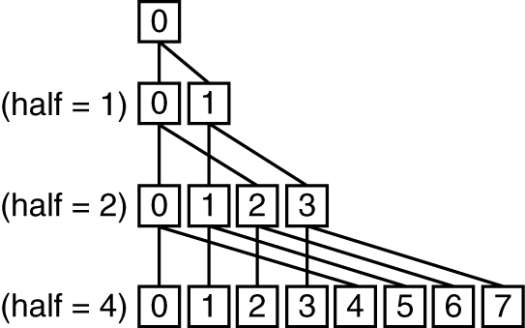
Example: Sum Reduction
Second Phase:
After each processor has computed its “local” sum
This code runs simultaneously on each core
half = 100;
repeat
synch();
/*Proc 0 sums extra element if there is one */
if (half%2 != 0 && Pn == 0)
sum[0] = sum[0] + sum[half-1];
half = half/2; /* dividing line on who sums */
if (Pn < half)
sum[Pn] = sum[Pn] + sum[Pn+half];
until (half == 1);

Slide 7
An Example with 10 Processors
sum[P0]
sum[P1]
sum[P2]
sum[P3]
sum[P4]
sum[P5]
sum[P6]
sum[P7]
sum[P8]
sum[P9]
P0
P1
P2
P3
P4
P5
P6
P7
P8
P9
half = 10
P0
P1
P2
P3
P4
half = 5
P0
P1
half = 2
P0
half = 1
Notes:
For lecture
So load balancing issue at second reduction (when half = 2)

Slide 8
Threads
thread of execution: smallest unit of processing scheduled by operating system
Threads have their own state or context:
  Program counter, Register file, Stack pointer,
Threads share a memory address space
Note: A “process” is a heavier-weight construct, which has its own address space. A process typically contains one or more threads.
  Not to be confused with a processor, which is a physical device (i.e., a core)

Slide 9
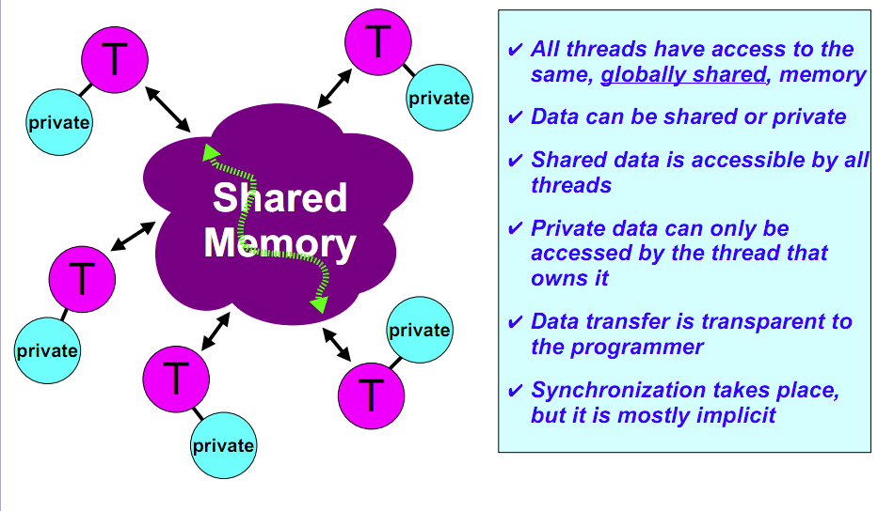
Memory Model for Multi-threading
Process
CAN BE SPECIFIED IN A LANGUAGE WITH MIMD SUPPORT –
such as OpenMP and CilkPlus

Slide 10
Multithreading
On a single processor, multithreading occurs by time-division multiplexing:
  Processor switched between different threads
    may be “pre-emptive” or “non pre-emptive”
  Context switching happens frequently enough that user perceives threads as running at the same time
On a multiprocessor, threads run at the same time, with each processor running a thread

Slide 11
Multithreading vs. Multicore
Basic idea: Processor resources are expensive and should not be left idle
For example: Long latency to memory on cache miss?
  Hardware switches threads to bring in other useful work while waiting for cache miss
  Cost of thread context switch must be much less than cache miss latency
Put in redundant hardware so don’t have to save context on every thread switch:
  PC, Registers, …
Attractive for applications with abundant TLP

Slide 12
Data Races and Synchronization
Two memory accesses form a data race if from different threads, to same location, and at least one is a write, and they occur one after another
If there is a data race, result of program can vary depending on chance (which thread ran first?)
Avoid data races by synchronizing writing and reading to get deterministic behavior
Synchronization done by user-level routines that rely on hardware synchronization instructions

Slide 13
Question: Consider the following code when executed concurrently by two threads.
What possible values can result in *($s0)?
# *($s0) = 100
lw $t0,0($s0)
addi $t0,$t0,1
sw $t0,0($s0)
☐
101 or 102
☐
100, 101, or 102
☐
100 or 101
☐
102
Notes:
- 102 if one thread starts executing after the other completely finishes.
- 101 if both threads execute the lw before either thread executes the sw. One thread will see “stale data”.

Slide 14
Lock and Unlock Synchronization
Lock used to create region (critical section) where only one thread can operate
Given shared memory, use memory location as synchronization point: lock, semaphore or mutex
Thread reads lock to see if it must wait, or OK to go into critical section (and set to locked)
  0 => lock is free / open / unlocked / lock off
  1 => lock is set / closed / locked / lock on
Set the lock
Critical section (only one thread gets to execute this section of code at a time)
e.g., change shared variables
Unset the lock

Slide 15
Possible Lock Implementation
Lock (a.k.a. busy wait)
  Get_lock: # $s0 -> addr of lock
  addiu $t1,$zero,1 # t1 = Locked value
  Loop: lw $t0,0($s0) # load lock
  bne $t0,$zero,Loop # loop if locked
  Lock: sw $t1,0($s0) # Unlocked, so lock
Unlock
  Unlock:
sw $zero,0($s0)
Any problems with this?

Slide 16
Possible Lock Problem
Thread 1
addiu $t1,$zero,1
Loop: lw $t0,0($s0)
bne $t0,$zero,Loop
Lock: sw $t1,0($s0)
Thread 2
addiu $t1,$zero,1
Loop: lw $t0,0($s0)
bne $t0,$zero,Loop
Lock: sw $t1,0($s0)
Time
Both threads think they have set the lock!
Exclusive access not guaranteed!

Slide 17
Hardware-supported Synchronization
Hardware support required to prevent interloper (either thread on other core or thread on same core) from changing the value
  Atomic read/write memory operation
  No other access to the location allowed between the read and write
Could be a single instruction
  e.g., atomic swap of register ↔ memory
  or an atomic pair of instructions

Slide 18
Synchronization in MIPS
Load linked: ll rt, off(rs)
Load rt with the contents at Mem(off+rs) and reserves the memory address off+rs by storing it in a special link register (R_{link})
Store conditional: sc rt, off(rs)
Check if the reservation of the memory address is valid in the link register. If so, the contents of rt is written to Mem(off+rs) and rt is set to 1; otherwise no memory store is performed and 0 is written into rt.
  Returns 1 (success) if location has not changed since the ll
  Returns 0 (failure) if location has changed
Note that sc clobbers the register value being stored (rt) !
  Need to have a copy elsewhere if you plan on repeating on failure or using value later
Notes:
Here using the Green Sheet convention of rs and rt for source register and target register.

Slide 19
Synchronization in MIPS Example
Atomic swap (to test/set lock variable)
Exchange contents of register and memory:
$s4 ↔ Mem($s1)
  try: add $t0,$zero,$s4 #copy value
  ll $t1,0($s1) #load linked
  sc $t0,0($s1) #store conditional
  beq $t0,$zero,try #loop if sc fails
  add $s4,$zero,$t1 #load value in $s4
sc would fail if another thread executes sc here

Slide 20
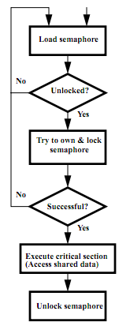
Test-and-Set
In a single atomic operation:
  Test to see if a memory location is set (contains a 1)
  Set it (to 1) if it isn’t (it contained a zero when tested)
  Otherwise indicate that the Set failed, so the program can try again
  While accessing, no other instruction can modify the memory location, including other Test-and-Set instructions
Useful for implementing lock operations

Slide 21
Test-and-Set in MIPS
Single atomic operation
Example: MIPS sequence for implementing a T&S at ($s1)
  Try: addiu $t0,$zero,1
  ll $t1,0($s1)
  bne $t1,$zero,Try
  sc $t0,0($s1)
  beq $t0,$zero,Try
  Locked:
  critical section
  sw $zero,0($s1)

Slide 22
Summary
Sequential software is slow software
  SIMD and MIMD only path to higher performance
Multiprocessor (Multicore) uses Shared Memory (single address space)
Cache coherency implements shared memory even with multiple copies in multiple caches
  False sharing a concern
Synchronization via hardware primitives:
  MIPS does it with Load Linked + Store Conditional

