Slide 1
<number>
CS3350B
Computer Architecture
Winter 2015
Lecture 7.3: Multicore TLP (2)
Marc Moreno Maza
www.csd.uwo.ca/Courses/CS3350b
[Adapted from lectures on
Computer Organization and Design,
Patterson & Hennessy, 4th or 5th edition, 2011]

Slide 2
<number>
Plan
Hardware multithreading
CilkPlus and OpenMP: simple parallel extensions to C/C++ for high-level parallel programming on multicores
Parallel performance metrics and profiling tool cilkview

Slide 3
<number>
Multithreading on A Chip
Find a way to “hide” true data dependency stalls, cache miss stalls, and branch stalls by finding instructions (from other process threads) that are independent of those stalling instructions
Hardware multithreading – increase the utilization of resources on a chip by allowing multiple processes (threads) to share the functional units of a single processor
  Processor must duplicate the state hardware for each thread – a separate register file, PC, instruction buffer, and store buffer for each thread
  The caches, TLBs, BHT, BTB, RUU can be shared (although the miss rates may increase if they are not sized accordingly)
  The memory can be shared through virtual memory mechanisms
  Hardware must support efficient thread context switching

Slide 4
<number>
Types of Hardware Multithreading
Fine-grain – switch threads on every instruction issue
  Round-robin thread interleaving (skipping stalled threads)
  Processor must be able to switch threads on every clock cycle
  Advantage – can hide throughput losses that come from both short and long stalls
  Disadvantage – slows down the execution of an individual thread since a thread that is ready to execute without stalls is delayed by instructions from other threads
Coarse-grain – switches threads only on costly stalls (e.g., L2 cache misses)
  Advantage – thread switching doesn’t have to be essentially free and much less likely to slow down the execution of an individual thread
  Disadvantage – limited, due to pipeline start-up costs, in its ability to overcome throughput loss
  Pipeline must be flushed and refilled on thread switches

Slide 5
<number>
Multithreaded Example: Sun’s Niagara (UltraSparc T2)
Eight fine grain multithreaded single-issue, in-order cores (no speculation, no dynamic branch prediction)
 | Niagara 2
Data width | 64-b
Clock rate | 1.4 GHz
Cache (I/D/L2) | 16K/8K/4M
Issue rate | 1 issue
Pipe stages | 6 stages
BHT entries | None
TLB entries | 64I/64D
Memory BW | 60+ GB/s
Transistors | ??? million
Power (max) | <95 W
8-way MT SPARC pipe
I/O
shared
funct’s
8-way MT SPARC pipe
8-way MT SPARC pipe
8-way MT SPARC pipe
8-way MT SPARC pipe
8-way MT SPARC pipe
8-way MT SPARC pipe
Crossbar
8-way MT SPARC pipe
8-way banked L2$
Memory controllers
Notes:
L1 caches support only two coherent states: valid and invalid lines. The L1 data cache is write-through, so there is no invalid state. The L2 cache keeps a directory of all eight L1 caches and can invalidate lines that are modified (using the MESI protocol).

Slide 6
<number>
Niagara Integer Pipeline
Cores are simple (single-issue, 6 stages, no branch prediction), small, and power-efficient
Fetch
Thrd Sel
Decode
Execute
Memory
WB
RegFilex8
Thrd Sel Mux
ALU Mul Shft Div
D$
DTLB Stbufx8
Inst bufx8
Crossbar Interface
I$
ITLB
Decode
Thread Select Logic
Instr type
Cache misses
Traps & interrupts
Resource conflicts
Thrd Sel Mux
PC logicx8
Notes:
No speculative execution. Since the pipeline is short and there are multiple threads per core, branch prediction is unnecessary. The core can hide the time required to fetch the new instruction stream on a taken branch by switching to another thread during the clock delay.
Register has eight register windows with three read ports and two write ports.
Threads are issued round-robin, but stalled threads will get priority when they are ready to resume.

Slide 7
<number>
Simultaneous Multithreading (SMT)
A variation on multithreading that uses the resources of a multiple-issue, dynamically scheduled processor (superscalar) to exploit both ILP and TLP
  Most SS processors have more functional unit parallelism than a single thread can effectively use
  With register renaming and dynamic scheduling, multiple instructions from independent threads can be issued without regard to dependencies among them
  Need separate rename tables (RUUs) for each thread or need to be able to indicate which thread the entry belongs to
  Need the capability to commit from multiple threads in one cycle
Intel’s Pentium 4 SMT is called hyperthreading
  Supports just two threads (doubles the architecture state)

Slide 8
<number>
Threading on a 4-way SS Processor Example

Slide 9
Microprocessor Comparison
Processor | SUN T1 | Opteron | Pentium D | IBM Power 5
Cores | 8 | 2 | 2 | 2
Instruction issues / clock / core | 1 | 3 | 3 | 4
Peak instr. issues / chip | 8 | 6 | 6 | 8
Multithreading | Fine-grained | No | SMT | SMT
L1 I/D in KB per core | 16/8 | 64/64 | 12K uops/16 | 64/32
L2 per core/shared | 3 MB shared | 1MB / core | 1MB/ core | 1.9 MB shared
Clock rate (GHz) | 1.2 | 2.4 | 3.2 | 1.9
Transistor count (M) | 300 | 233 | 230 | 276
Die size (mm2) | 379 | 199 | 206 | 389
Power (W) | 79 | 110 | 130 | 125
<number>

Slide 10
<number>
Summary of Hardware Multithreading
Benefit:
  All multithreading techniques improve the utilisation of processor resources and, hence, the performance
  If the different threads are accessing the same input data they may be using the same regions of memory
  Cache efficiency improves in these cases
Disadvantage:
  The perceived performance may be degraded when comparing with a single-thread CPU
  Multiple threads interfering with each other
  The cache has to be shared among several threads so effectively they would use a smaller cache
  Thread scheduling at hardware level adds high complexity to processor design
  Thread state, managing priorities, OS-level information, …

Slide 11
<number>
Shared Memory Model with Explicit Thread-based Parallelism
Shared memory process consists of multiple threads, explicit programming model with full programmer control over parallelization
Pros:
  Takes advantage of shared memory, programmer need not worry (that much) about data placement
  Programming model is “serial-like” and thus conceptually simpler than alternatives
  Compiler directives are generally simple and easy to use
  Legacy serial code does not need to be rewritten
Cons:
  Codes can only be run in shared memory environments!
  Compiler must support
  (e.g., CilkPlus and OpenMP in gcc 4.xx)
  (both are available on the machines in MC10)

Slide 12
<number>
Introduction to CilkPlus

Slide 13
<number>
Introduction to OpenMP
API used for multi-threaded, shared memory parallelism
  Compiler Directives
  Runtime Library Routines
  Environment Variables
Portable
Standardized
See
http://www.openmp.org/mp documents/OpenMP4.0.0.pdf
http://computing.llnl.gov/tutorials/openMP/

Slide 14
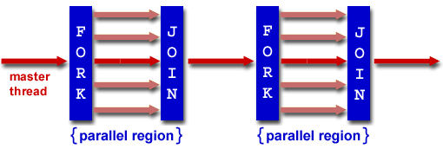
<number>
OpenMP Programming Model
Fork - Join Model:
OpenMP programs begin as single process: master thread; Executes sequentially until the first parallel region construct is encountered
  FORK: the master thread then creates a team of parallel threads
  Statements in program that are enclosed by the parallel region construct are executed in parallel among the various team threads
  JOIN: When the team threads complete the statements in the parallel region construct, they synchronize and terminate, leaving only the master thread

Slide 15
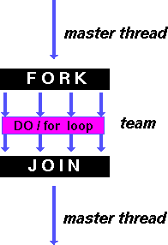
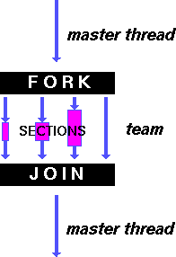
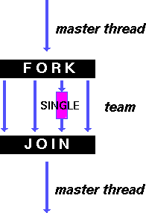
<number>
OpenMP Directives
shares iterations of a
loop across the team
each section executed
by a separate thread
serializes the execution
of a thread

Slide 16
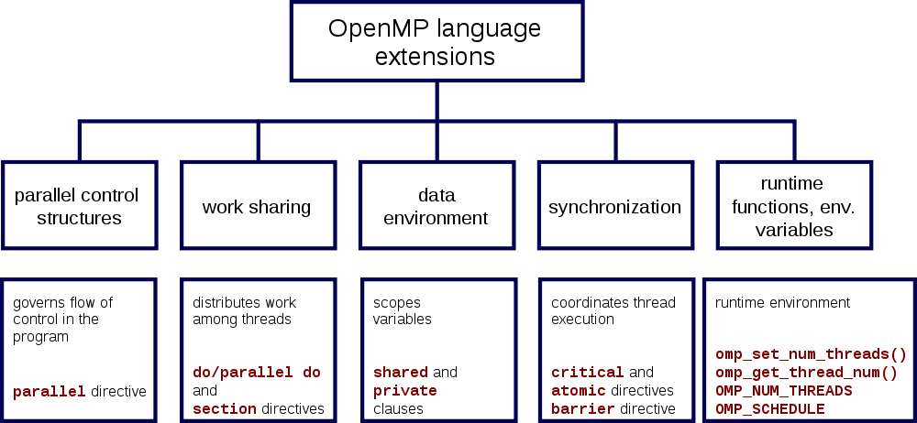
<number>
OpenMP Specification

Slide 17
<number>
OpenMP Extends C with Pragmas
Pragmas are a mechanism C provides for language extensions
Commonly implemented pragmas: structure packing, symbol aliasing, floating point exception modes
Good mechanism for OpenMP because compilers that don't recognize a pragma are supposed to ignore them
  Runs on sequential computer even with embedded pragmas

Slide 18
<number>
Matrix Multiply in OpenMP
#pragma omp parallel for private(tmp, i, j, k)
for(i=0; i<Ndim; i++){
for(j=0; j<Mdim; j++){
tmp = 0.0;
for( k=0; k<Pdim; k++){
tmp += A[i*Ndim+k] * B[k*Pdim+j];
}
C[i*Ndim+j] = tmp;
}
}
Note: Outer loop spread across N threads; inner loops inside a thread
Notes:
<number>

Slide 19
<number>
Amdahl’s Law: theoretically how much speed up you can get by parallelization
Speed up = | S + P
S + (P/N)
S = Fraction of the code which is serial
P = Fraction of the code which can be parallel
S + P = 1
N = Number of processor
Notes:
<number>

Slide 20
<number>
Amdahl’s Law
P values
Notes:
<number>

Slide 21
<number>
Exercise: Parallelize Sum of Squares
S = 0;
for (i=0; i<100; ++i)
s += X[i]**2; //two instructions per loop
Each iteration depends on the result of the iteration before.
As written, unparalleizable
  P = 0
How would you create parallelism here?

