Slide 2
CS2209 Tutorial 2
Sep. 21st , 2020
Xindi Wang
xwang842@uwo.ca
Department of Computer Science

Slide 3
Reminder
Assignment 1 is due on Sep 23rd in zyBook (which means that you are required to buy zyBook to finish the assignment)
Presentation Title Here

Slide 4
Today’s Agenda
Review of Logical Operations
Logical Laws
Rules of Inference
Agenda

Slide 5
Review of Logical Operations
Review of Logical Operations

Slide 6
Logical Operations
Basics:
 | Notation | False when
p AND q | $$p∧q$$ | Either p or q must be false
p OR q | $$p∨q$$ | Both p and q must be false
NOT p | $$¬p$$ | p is true
p XOR q | $$p⨁q$$ | p and q have the same truth value
IF p, THEN q | $$p→q$$ | If p is true, then b is false
p if and only if q | $$p↔q$$ | p and q have the different truth value
Logical Operations

Slide 7
Logical Operation
Compound Propositions:
Tautology: a compound proposition is a tautology if the proposition is always true (i.e. all rows in the true table are true) (e.g. $p→$ $p$ $∨q$)
Contradiction: a compound proposition is a contradiction if the proposition is always false (i.e. all rows end with false) (e.g. $p∧¬p$)
Satisfaction: some rows in the truth table end with true (e.g. $p→q$)
Logical Operations

Slide 8
Logical Laws
Logical Laws

Slide 9
Logical Laws
Double Negation | $$¬¬p≡p$$
De Morgan’s Laws | $$¬(p∧q)≡(¬p∨¬q)$$ | $$¬(p∨q)≡(¬p∧¬q)$$
Commutative Laws | $$p∧q≡q∧p$$ | $$p∨q≡q∨p$$
Associative Laws | $$p∧(q∧r)≡(p∧q)∧r$$ | $$p∨(q∨r)≡(p∨q)∨r$$
Distributive Laws | $p∧(q∨r)≡(p∧q)∨(q∧r$) | $p∨ (q∧r)≡(p∨q)∧(q∨r$)
Identity Laws | $$p∧T≡p$$ | $$p∨F≡p$$
Domination Laws | $$p∧F≡F$$ | $$p∨T≡T$$
Idempotent Laws | $$p∧p≡p$$ | $$p∨p≡p$$
Absorption Laws | $$p∧(p∨q)≡p$$ | $p∨ (p∧q)$ $≡p$
Conditional Identities | $$p↔q≡(p→q)∧(q→p)$$ | $$p→q≡¬p∨q$$
Propositions

Slide 10
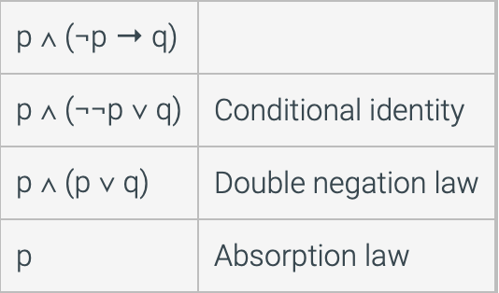
Logical Laws
To show the logical equivalence of compound proposition
$¬ ((s∧t)∨(t∨r)$) $≡¬\left(s∧t\right)∧¬(t∨r)$
$p∧(¬p→q)≡p$
Logical Laws

Slide 11
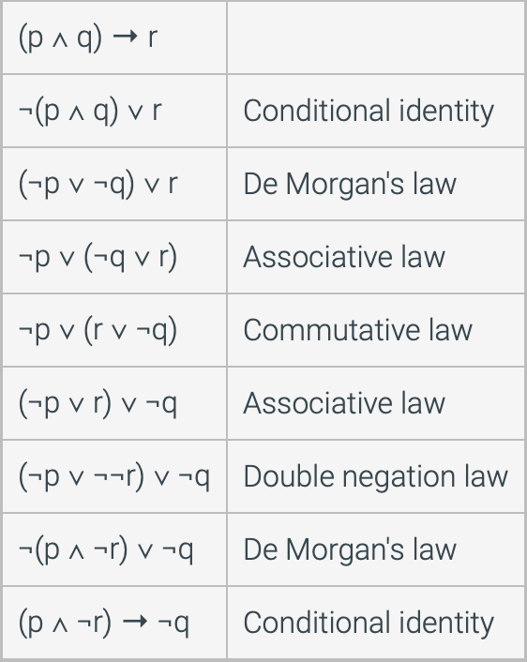
Logical Laws
To show the logical equivalence of compound proposition
$(p∧q)→r≡(p∧¬r)→¬q$
Logical Laws
Notes:
$$¬ ((s∧t)∨(t∨r$$

Slide 12
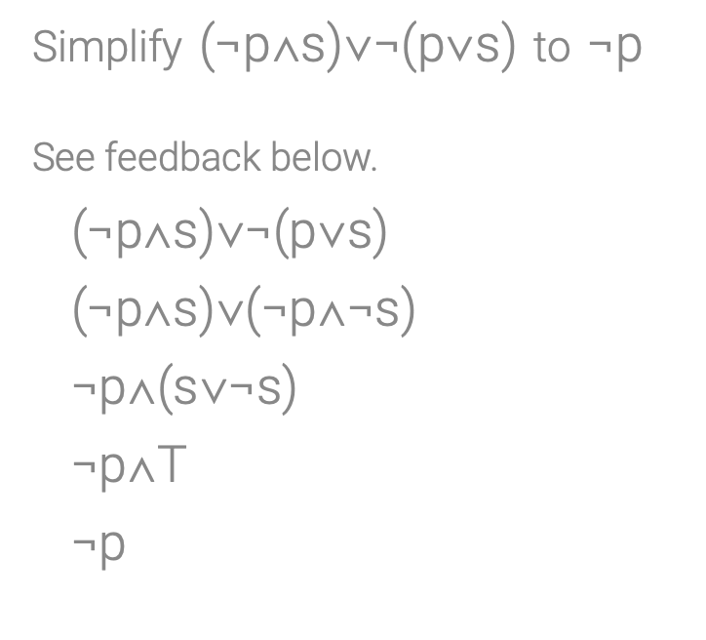
Logical Laws
Simplify the compound proposition using logical laws
Logical Laws
Notes:
$$¬ ((s∧t)∨(t∨r$$

Slide 13
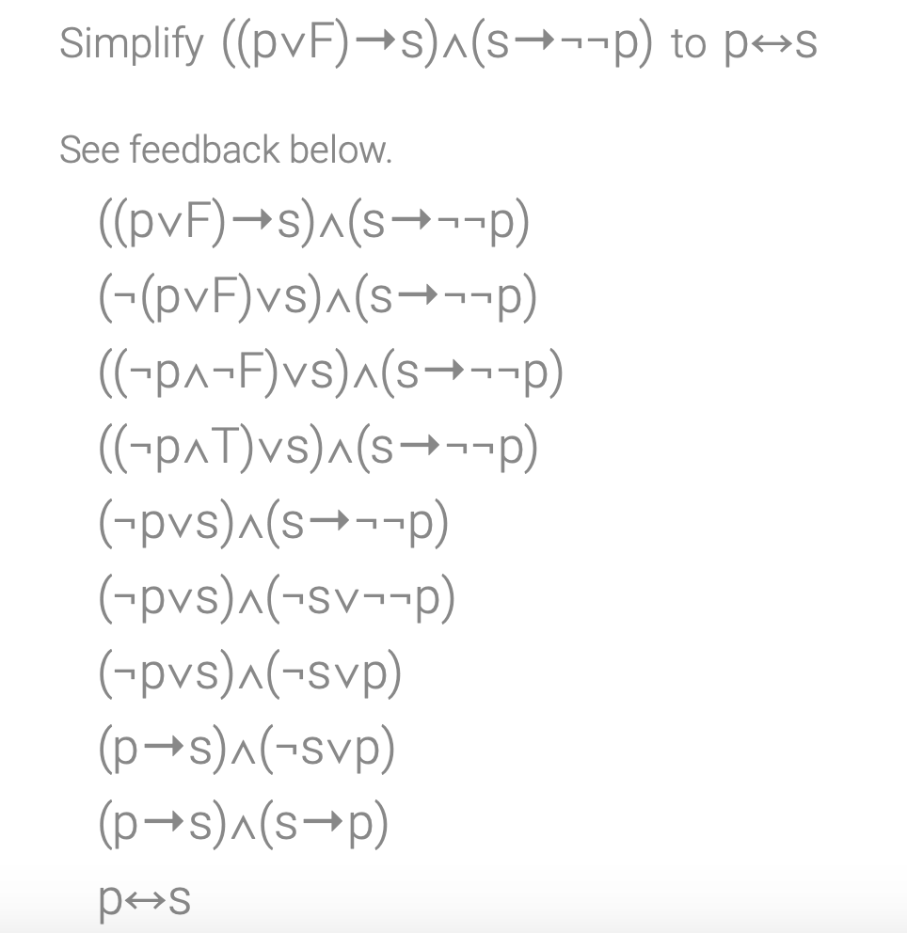
Logical Laws
Logical Laws
Notes:
$$¬ ((s∧t)∨(t∨r$$

Slide 14
Rules of Inference
Rules of Inference

Slide 15
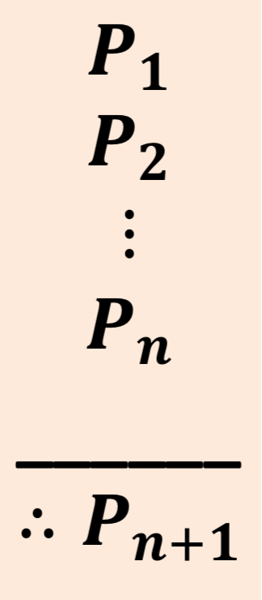
Arguments and Validity
Definitions: an argument, in logic, is a sequence of propositional statements. The last statement in the sequence is call conclusion. All the rest are premises
An argument is valid if whenever all premises are true, the conclusion is also true.
If premises are P1, …, Pn, and conclusion is Pn+1, then the argument is valid if and only if $P1∧P2∧…∧Pn→Pn+1$
Rules of Inference

Slide 16
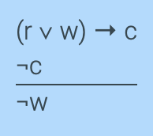
Arguments and Validity
Here is an argument expressed in English
Assign variable names to each proposition
w: It is windy, r: It is raining, c: The game will be cancelled
Write into arguments form:
p: It is raining, q: It is windy, c: the game will be cancelled
Rules of Inference

Slide 17
Rules of Inference
Just like we use equivalences to simplify compound propositions instead using truth tables. We could also apply tautology of the form $F→G$(where F is a sequence of premises connected with AND operations, and G is the conclusion), to prove that the arguments is valid.
Rules of Inference

Slide 18
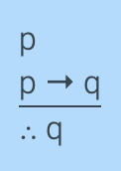
Rules of Inference
Modus ponens (main rule of inference)
Given by tautology $p∧(p→q)→q$
p | q | p$→$q | (p$→$q)$⋀$p | (p$→$q)$⋀$p$→$q
T | T | T | T | T
T | F | F | F | T
F | T | T | F | T
F | F | T | F | T
Rules of Inference

Slide 19
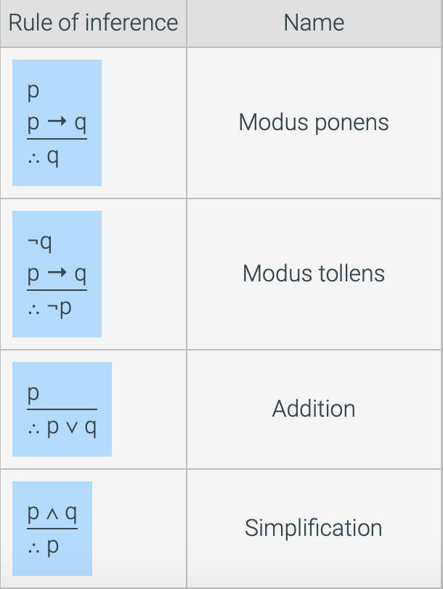
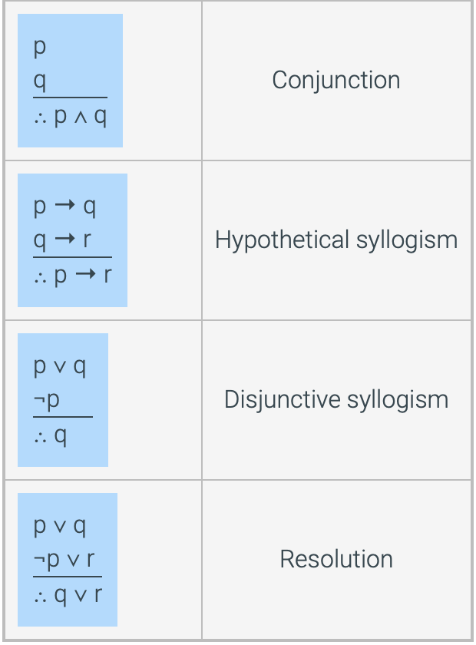
Rules of Inference
Rules of Inference

Slide 20
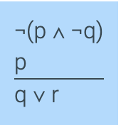
Rules of Inference
Prove arguments are valid using rules of inference
$¬\left(p∧¬q\right)$ and $p$ Hypothesis
$¬p∨¬¬q$ De Morgan’s Law
$¬p∨q$ Double negation
$¬¬ p$ Double negation
$(¬p∨q)$ $∧(¬¬ p$) $→q$ Disjunctive syllogism
$q$ $→$ $q$ $∨r$ Addition
Rules of Inference

