Slide 2
CS2209 Tutorial 3
Sep. 28th , 2020
Xindi Wang
xwang842@uwo.ca
Department of Computer Science

Slide 3
Reminder
Assignment 2 is due on Oct 5th in zyBook (which means that you are required to buy zyBook to finish the assignment)
Presentation Title Here

Slide 4
Today’s Agenda
Review of Propositional Logic
Predicates and Quantifiers
Agenda

Slide 5
Review of Propositional Logic
Review of Propositional Logic

Slide 6
Logical Operations
Basics:
p | q | $$p∧q$$ | $$p∨q$$ | $$¬p$$ | $$p⨁q$$ | $$p→q$$ | $$p↔q$$
T | T | T | T | F | F | T | T
T | F | F | T | F | T | F | F
F | T | F | T | T | T | T | F
F | F | F | F | T | F | T | T
Logical Operations

Slide 7
Logical Operations
Compound Propositions:
Tautology: a compound proposition is a tautology if the proposition is always true (i.e. all rows in the true table are true) (e.g. $p→$ $p$ $∨q$)
Contradiction: a compound proposition is a contradiction if the proposition is always false (i.e. all rows end with false) (e.g. $p∧¬p$)
Satisfaction: some rows in the truth table end with true (e.g. $p→q$)
Logical Operations

Slide 8
Logical Laws
Double Negation | $$¬¬p≡p$$
De Morgan’s Laws | $$¬(p∧q)≡(¬p∨¬q)$$ | $$¬(p∨q)≡(¬p∧¬q)$$
Commutative Laws | $$p∧q≡q∧p$$ | $$p∨q≡q∨p$$
Associative Laws | $$p∧(q∧r)≡(p∧q)∧r$$ | $$p∨(q∨r)≡(p∨q)∨r$$
Distributive Laws | $p∧(q∨r)≡(p∧q)∨(q∧r$) | $p∨ (q∧r)≡(p∨q)∧(q∨r$)
Identity Laws | $$p∧T≡p$$ | $$p∨F≡p$$
Domination Laws | $$p∧F≡F$$ | $$p∨T≡T$$
Idempotent Laws | $$p∧p≡p$$ | $$p∨p≡p$$
Absorption Laws | $$p∧(p∨q)≡p$$ | $p∨ (p∧q)$ $≡p$
Conditional Identities | $$p↔q≡(p→q)∧(q→p)$$ | $$p→q≡¬p∨q$$
Logical Laws

Slide 9
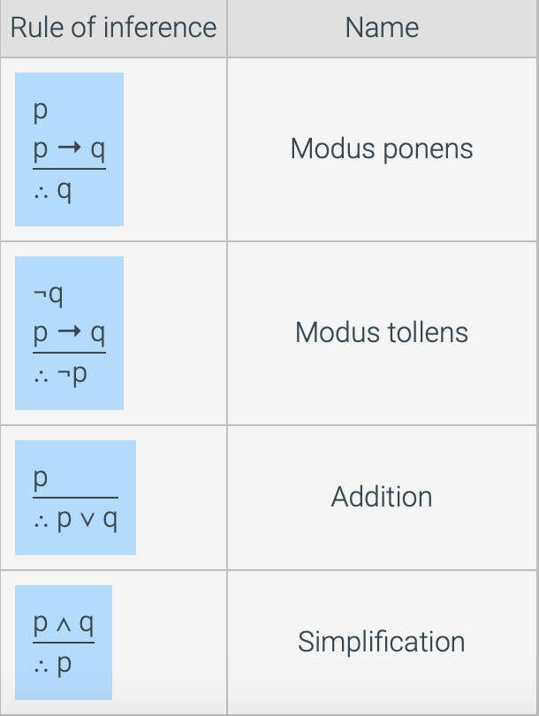
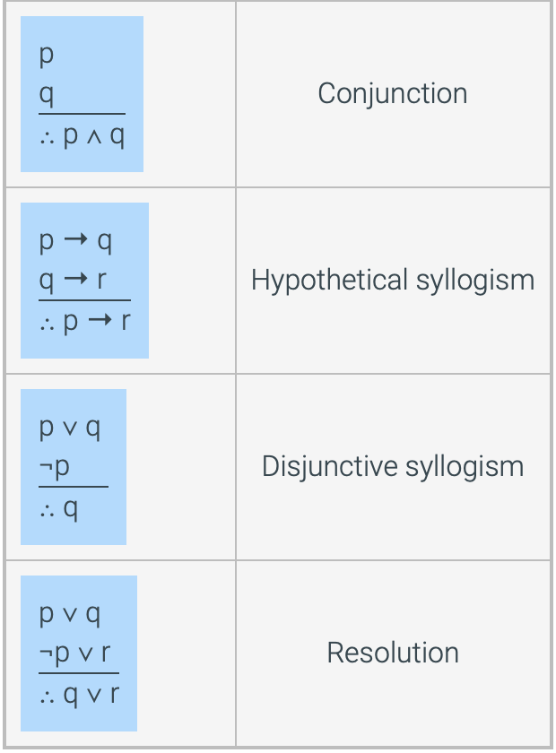
Rules of Inference
Rules of Inference

Slide 10
Exercises
Filling out the truth table for a compound proposition (use basic logical connectives)
$¬(p∧¬\left(q∧s\right))$
p | q | s | $$q∧s$$ | $¬$($q∧s)$ | $p∧¬$($q∧s)$ | $¬(p∧¬$($q∧s)$)
T | T | T | T | F | F | T
T | T | F | F | T | T | F
T | F | T | F | T | T | F
T | F | F | F | T | T | F
F | T | T | T | F | F | T
F | T | F | F | T | F | T
F | F | T | F | T | F | T
F | F | F | F | T | F | T
Exercises

Slide 11
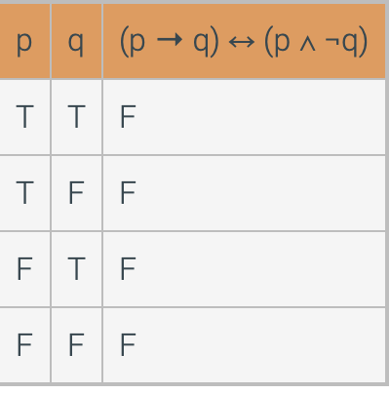
Exercises
Proving tautologies or contradictions using truth table
$(p→q)↔(p∧¬q)$
Exercises

Slide 12
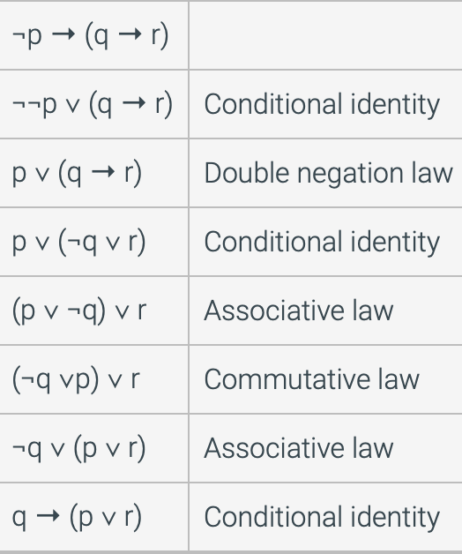
Exercises
Using laws of logic to prove logical equivalence
$¬p→(q→r)≡q→(p∨r)$
Exercises

Slide 13
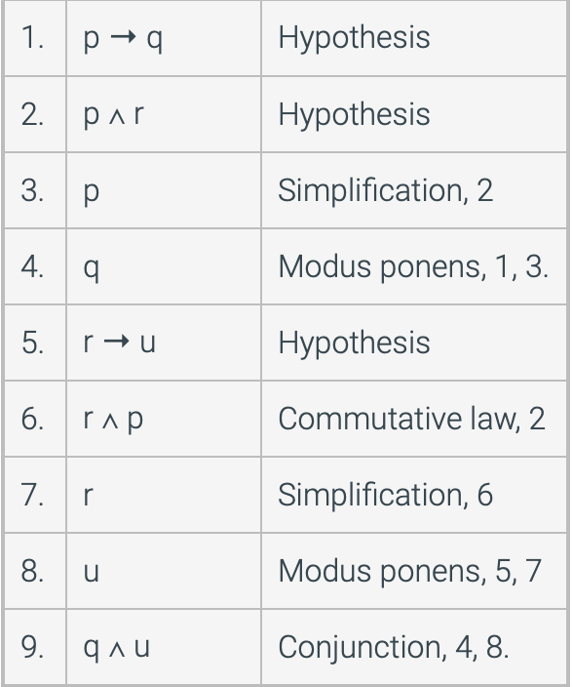
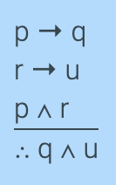
Exercises
Proving arguments are valid using rules of inference
Exercises

Slide 14
Predicates and Quantifiers
Predicates and Quantifiers

Slide 15
Predicates
Definition: A logical statement whose truth value is a function of one or more variables is called a predicate. (propositions with parameters)
P(x) is a predicate that P(x) is true for some values of $x∈S$, and false for the rest
Example: $x<y$ is a predicate, when $x=1, y=2$ is true and $x=3, y=2$ is false
Predicates

Slide 16
Qualifiers: universal
Universal qualifier: $∀$, for all
The statement $∀x∈S, P(x)$ (for every x in domain S, P(x)) is called a universally quantified statement
$∀x∈S, P(x)$ is true if and only if $P(x)$ is true for every $x∈S$
If $x1, x2, …, xn$ is a list of elements in S, then $∀x∈S, P(x)$ is true if and only if $P\left(x1\right)∧P\left(x2\right)∧…∧P(xn)$ is true
Qualifiers

Slide 17
Qualifiers: existential
Existential qualifier: $∃$, there exists
The statement $∃x∈S, P(x)$ (there exist some x in domain S, P(x)) is called a existentially quantified statement
$∃x∈S, P(x)$ is true if and only if there exist some true $x∈S$ such that $P(x)$ is true
If $x1, x2, …, xn$ is a list of elements in S, then $∀x∈S, P(x)$ is true if and only if $P\left(x1\right)∨P\left(x2\right)∨…∨P(xn)$ is true
Qualifiers

