Slide 1

Tutorial on Medical Image Segmentation: Beyond Level-Sets
MICCAI, 2014
Western University
Canada
www.csd.uwo.ca/faculty/yuri/miccai14_MIS
1: Basics of optimization-based segmentation
- continuous and discrete approaches
2 : Exact and approximate techniques
- non-submodular and high-order problems
3: Multi-region segmentation (Milan)
- high-dimensional applications

Slide 2
Introduction to Image Segmentation
implicit/explicit representation of boundaries
  active contours, level-sets, graph cut, etc.
Basic low-order objective functions (energies)
  physics, geometry, statistics, information theory
Set functions, submodularity
  Exact methods
Approximation methods
  Higher-order and non-submodular objectives
  Comparison to gradient descent (level-sets)
Part 1
Part 2

Slide 3
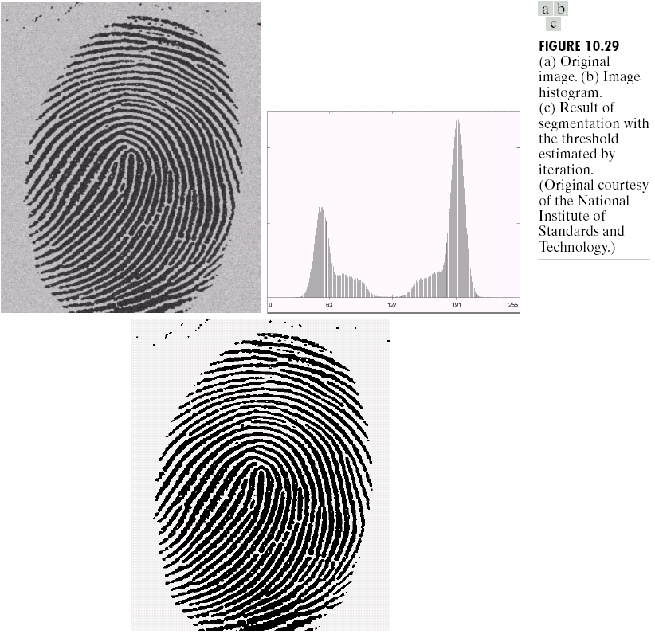
Thresholding
T

Slide 4
Thresholding
T
S={ p : I_{p} < T }

Slide 5





Thresholding
Background
Subtraction
?
I= I_{obj} - I_{bkg}
-
=
Threshold intensities above T
better segmentation?

Slide 6
Good segmentation S ?
Objective function must be specified
  Quality function
  Cost function
  Loss function E(S) : 2^{P} → ℜ
  “Energy”
  Regularization functional
Segmentation becomes an optimization problem: S = arg min E(S)

Slide 7
Good segmentation S ?
Objective function must be specified
  Quality function
  Cost function
  Loss function E(S) = E₁(S)+…+ E_{n}(S)
  “Energy”
  Regularization functional
  combining different constraints
  e.g. on region and boundary
Segmentation becomes an optimization problem: S = arg min E(S)

Slide 8
Beyond linear combination of terms
Ratios are also used
  Normalized cuts [Shi, Malik, 2000]
  Minimum Ratio cycles [Jarmin Ishkawa, 2001]
  Ratio regions [Cox et al, 1996]
  Parametric max-flow applications [Kolmogorov et al 2007]
Not in this tutorial

Slide 9
Segmentation principles
interactive vs. unsupervised
Boundary seeds
  Livewire (intelligent scissors)
Region seeds
  Graph cuts (intelligent paint)
  Distance (Voronoi-like cells)
Bounding box
  Grabcut [Rother et al]
Center seeds
  Star shape [Veksler]
Many other options…
Normalized cuts [Shi Malik]
Mean-shift [Comaniciu]
MDL [Zhu&Yuille]
Entropy of appearance
Add enough constraints:
  Saliency
  Shape
  Known appearance
  Texture

Slide 10
1. We won’t cover everything…
2. We will not emphasize the differences between interactive and unsupervised
(too easy to convert one into the other)
interactive vs. unsupervised
Boundary seeds
  Livewire (intelligent scissors)
Region seeds
  Graph cuts (intelligent paint)
  Distance (Voronoi-like cells)
Bounding box
  Grabcut [Rother et al]
Center seeds
  Star shape [Veksler]
Many other options…
Normalized cuts [Shi Malik]
Mean-shift [Comaniciu]
MDL [Zhu&Yuille]
Entropy of appearance
Add enough constraints:
  Saliency
  Shape
  Known appearance
  Texture

Slide 11
Common segmentation techniques
boundary-based region-based both region & boundary
region-growing
intelligent scissors
(live-wire)
active contours
(snakes)
watersheds
thresholding
geodesic
active contours
(e.g. level-sets)
MRF
(e.g. graph-cuts)
random walker
optimization-based

Slide 12
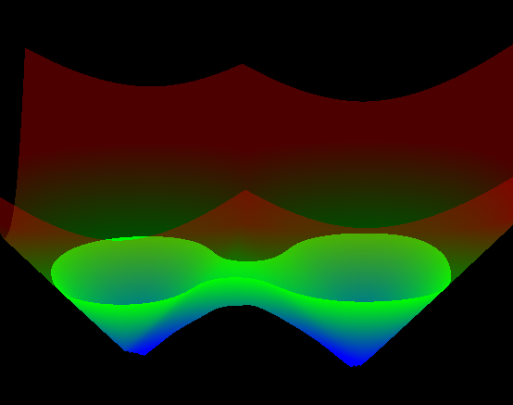
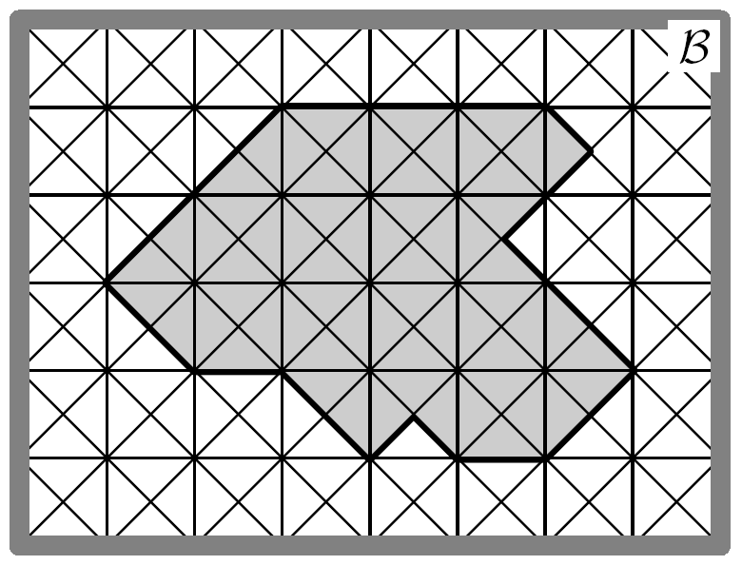
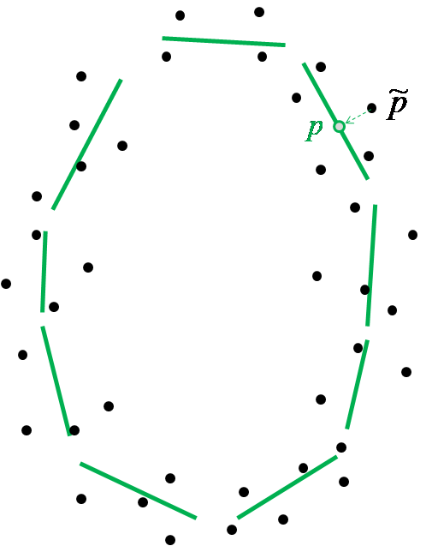
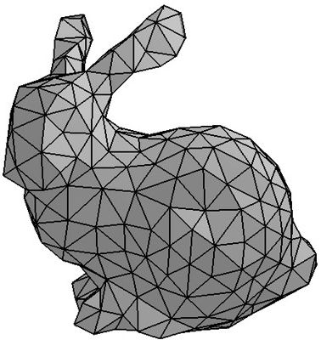
Common surface representations
continuous
optimization
combinatorial
optimization
mixed
optimization
graph labeling
point cloud
labeling
mesh
level-sets
on complex
on grid

Slide 13
Active contours (e.g. snakes)
  [Kass, Witkin, Terzopoulos 1987]
Given: initial contour (model) near desirable object
Goal: evolve the contour to fit exact object boundary

Slide 14
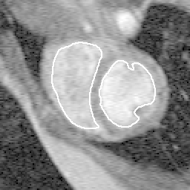
Tracking via active contours
Tracking Heart Ventricles

Slide 15
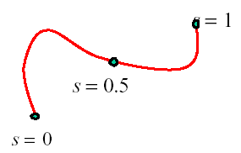
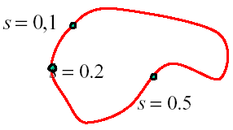
Active contours - snakes
Parametric Curve Representation (continuous case)
A curve can be represented by 2 functions
parameter
open curve
closed curve

Slide 16
Snake Energy
internal energy encourages smoothness or any particular shape
external energy encourages curve onto image structures (e.g. image edges)

Slide 17
Active contours - snakes
(continuous case)
internal energy (physics of elastic band)
external energy (from image)
elasticity / stretching
stiffness / bending
proximity to image edges

Slide 18
Active contours – snakes
(discrete case)
elastic energy
(elasticity)
bending energy
(stiffness)

Slide 19
Basic Elastic Snake
continuous case
discrete case
elastic smoothness term
(interior energy)
image data term
(exterior energy)

Slide 20
Snakes - gradient descent
C
simple elastic snake energy
here, energy is a function of 2n variables
update equation for the whole snake
C

Slide 21
Snakes - gradient descent
C
simple elastic snake energy
here, energy is a function of 2n variables
update equation for each node
C

Slide 22
Snakes - gradient descent
E(C)
energy function E(C) for contours C
local minima
for E(C)
gradient descent steps
step size
could be tricky
second derivative of image intensities

Slide 23
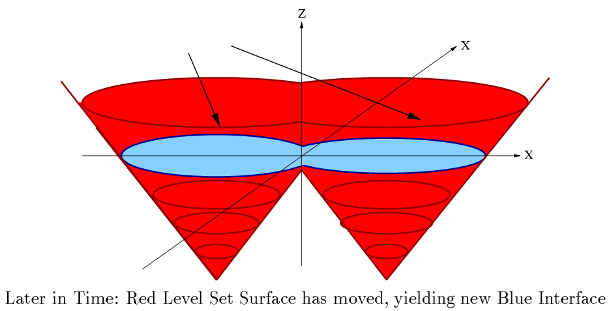
Implicit (region-based) surface representation via level-sets
(implicit contour representation)
[Dervieux, Thomasset, 79, 81] [Osher, Sethian, 89]

Slide 24
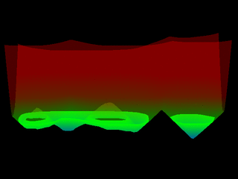

Implicit (region-based) surface representation via level-sets
Normal contour motion can be represented by evolution of level-set function u
[Dervieux, Thomasset, 79, 81] [Osher, Sethian, 89]
The scaling by is easily verified in one dimension
Note 1: - commonly used for gradient descent evolution
Note 2: - level sets can not represent tangential motion of contour points ???

Slide 25
Tangential vs. normal motion of contour points
- normal motion of a contour point visibly changes shape (geometry)
- tangential motion generates no “visible” shape change
A simple example of
tangential motion
of contour points
(rotation)
A simple example of
normal motion
of contour points
(expansion)
Comments: - geometric “energy” of a contour measures “visible” shape properties
(length, curvature, area, e.t.c.). Thus, gradient descent w.r.t. geometric objective generates only ”visible” (normal) motion.
level sets can represent contour gradient descent evolution
only for geometric “energies” E(C) (s.t. ∇E is collinear with contour normal )
Level sets
(implicit contour representation)
Geodesic active contours

Slide 26
Tangential vs. normal motion of contour points
- normal motion of a contour point visibly changes shape (geometry)
- tangential motion generates no “visible” shape change
Q: in what medical applications
tangential motion of
segment boundary matters?
Comments: - gradient descent for physics-based “energy” of a contour (e.g. elasticity)
may produce geometrically “invisible” tangential motion of contour points
physics-based energy of a contour depends on its parameterization,
while geometrically it could be the same contour (compare two shapes above)
Parametric contours
(explicit contour representation)
Physics-based active contours

Slide 27
Physics vs. Geometry
continuous optimization
mesh
level-sets
snakes, balloons, active contours
explicit or parametric contour representation
physics-based objectives (typically)
gradient descent
could use dynamic programming in 2D
geodesic active contours
implicit or non-parametric representation
geometry-based objectives
gradient descent
can use convex formulations (TV-based)
[Amini, Weymouth, Jain, 1990]
[Chan, Esidoglu, Nikolova 2006]

Slide 28
Most common geometric functionals
for segmentation with level-sets
Functional E( C )
or
weighted length
(boundary alignment to intensity edges)
weighted area
(region alignment to appearance model)
flux
(oriented boundary alignment)

Slide 29
Most common geometric functionals
for segmentation with level-sets
Functional E( C )
or
weighted length
(boundary alignment to intensity edges)
weighted area
(region alignment to appearance model)
flux
(oriented boundary alignment)

Slide 30
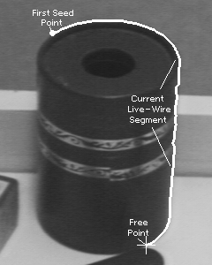

Towards discrete geometry: weighted boundary length on a graph
[Barrett and Mortensen 1996]
“Live wire” or “intelligent scissors”
pixels
image-based edge weights
|∇ I|
B
A
shortest path algorithm (Dijkstra)

Slide 31


shortest path on a 2D graph graph cut
Example:
find the shortest
closed contour in a given domain of a graph
Shortest paths
approach
Graph Cuts
approach
p
Compute the shortest path p ->p for a point p.
Compute the minimum cut that separates red region from blue region
Repeat for all points on the gray line. Then choose the optimal contour.

Slide 32
graph cuts vs. shortest paths
On 2D grids graph cuts and shortest paths give optimal 1D contours.
B
A
A Path connects points
A Cut separates regions
Shortest paths still give optimal 1-D contours on N-D grids
Min-cuts give optimal hyper-surfaces on N-D grids

Slide 33
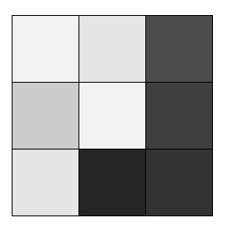
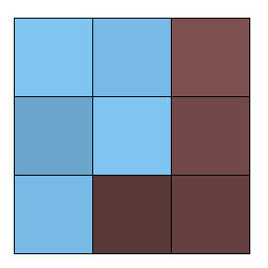
Graph cut
[Boykov and Jolly 2001]
t
n-links
a cut
hard
constraint
hard
constraint
s
Minimum cost cut can be computed in polynomial time
(max-flow/min-cut algorithms)

Slide 34
Minimum s-t cuts algorithms
Augmenting paths [Ford & Fulkerson, 1962]
  - heuristically tuned to grids [Boykov&Kolmogorov 2003]
Push-relabel [Goldberg-Tarjan, 1986]
- good choice for denser grids, e.g. in 3D
Preflow [Hochbaum, 2003]
  - also competitive

Slide 35
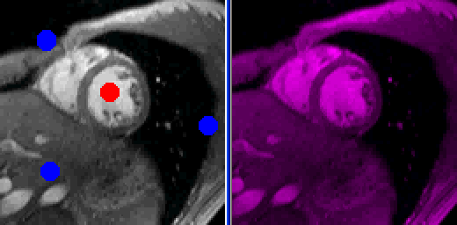
Optimal boundary in 2D
“max-flow = min-cut”

Slide 36
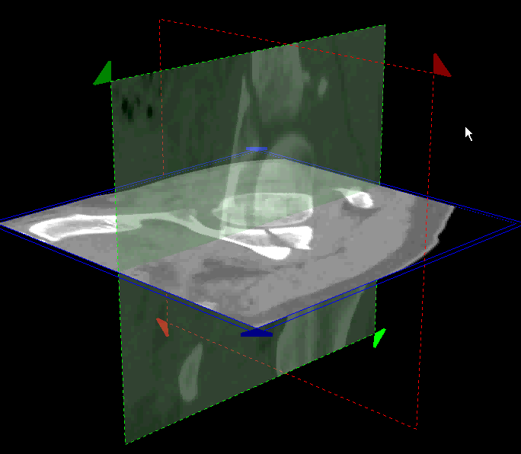
Optimal boundary in 3D
3D bone segmentation (real time screen capture, year 2000)

Slide 37
‘Smoothness’ of segmentation boundary
- snakes (physics-based contours)
- geodesic contours (geometry)
- graph cuts
(discrete geometry)
NOTE: many distance-to-seed methods optimize segmentation boundary only indirectly,
they compute some analogue of optimum Voronoi cells
[fuzzy connectivity, random walker, geodesic Voronoi cells, etc.]

Slide 38
Discrete vs. continuous boundary cost
Geodesic contours
Graph cuts
C
[Caselles, Kimmel, Sapiro, 1997] (level-sets)
[Chan, Esidoglu, Nikolova, 2006] (convex)
[Boykov and Jolly 2001]
[Boykov and Kolmogorov 2003]
Both incorporate
segmentation boundary smoothness and
alignment to image edges

Slide 39
Graph cuts on a grid and boundary of S
Severed n-links can approximate geometric length of contour C [Boykov&Kolmogorov, ICCV 2003]
This result fundamentally relies on ideas of Integral Geometry (also known as Probabilistic Geometry) originally developed in 1930’s.
  e.g. Blaschke, Santalo, Gelfand

Slide 40
Integral geometry approach to length
a subset of lines L
intersecting contour C
C
a set of all
lines L
probability that a “randomly drown” line intersects C
Euclidean length of C :
Cauchy-Crofton formula
the number of times
line L intersects C

Slide 41
Graph cuts and integral geometry
Graph nodes are imbedded
in R2 in a grid-like fashion
C
Edges of any regular neighborhood system generate families of lines
{ , , , }
Euclidean
length
graph cut cost
for edge weights:
the number of edges of family k intersecting C
Length can be estimated without computing any derivatives

Slide 42
Metrication errors
Euclidean
metric
“standard”
4-neighborhoods
(Manhattan metric)
8-neighborhoods
larger-neighborhoods
Riemannian
metric

Slide 43


Metrication errors
4-neighborhood
8-neighborhood

Slide 44
Differential vs. integral approach to geometric boundary length
Parametric
(explicit)
contour
representation
Differential
geometry
Level-set
function
representation
Integral
geometry
Cauchy-Crofton formula
implicit (region-based) representation of contours

Slide 45
Implicit (region-based) surface representation via level-sets
Level set function u(p) is normally stored on image pixels
Values of u(p) can be interpreted as distances or heights of image pixels
-1.7
-0.8
-0.8
0.2
A contour may be approximated from u(x,y) with sub-pixel accuracy
-0.6
-0.4
-0.5
0.5
C
-0.2
0.6
0.3
0.7

Slide 46
Implicit (region-based) surface representation via graph-cuts
Graph cuts represent surfaces via binary labeling S_{p} of each graph node
Binary values of S_{p} indicate interior or exterior points (e.g. pixel centers)
0
0
0
1
There are many contours satisfying interior/exterior labeling of points
0
0
0
1
Question: Is this a contour to be reconstructed from binary labeling S_{p} ?
C
Answer: NO
0
1
1
1

Slide 47
Contour/surface representations
(summary)
Implicit (area-based)
Explicit (boundary-based)
Level sets
(geodesic active contours)
Snakes
(physics-based band model)
Live-wire
(shortest paths on graphs)
Graph cuts
(minimum cost cuts)
What else besides
boundary length |∂S| ?

Slide 48
From seeds to more general region constraints
[Boykov and Jolly 2001]
t
n-links
a cut
t-link
S
t-link
segmentation
s
assume are known
“expected” intensities
of object and background
cost of severed t-links
E(S) = +
cost of severed n-links

Slide 49
From seeds to more general region constraints
[Boykov and Jolly 2001]
t
n-links
a cut
t-link
S
t-link
segmentation
re-estimate
s
could be
unknown intensities
of object and background
Block-Coord.Descent
cost of severed t-links
E(S, I^{s},I^{t}) = +
Chan-Vese model
cost of severed n-links

Slide 50
Block-coordinate descent for
Minimize over labeling S for fixed I ⁰, I ¹
Minimize over I ⁰, I ¹ for fixed labeling S
optimal L can be computed using graph cuts
fixed for S=const
optimal I ¹, I ⁰ can be computed by minimizing
squared errors inside object and background segments

Slide 51

Chan-Vese segmentation
(binary case )

Slide 52


Chan-Vese segmentation
(could be used for more than 2 labels )
can be used for segmentation, to reduce color-depth,
or to create a cartoon

Slide 53
Chan-Vese segmentation
(could be used for more than 2 labels )
can be used for segmentation, to reduce color-depth,
or to create a cartoon
joint optimization over S and I⁰, I¹,… is NP-hard
without the smoothing term, this is like
“K-means” clustering in the color space

Slide 54
From fixed intensity segments to general intensity distributions
[Boykov and Jolly 2001]
t
n-links
a cut
t-link
S
t-link
segmentation
s
Appearance models can be
given by intensity distributions
of object and background
cost of severed t-links
E(S) = +
cost of severed n-links

Slide 55
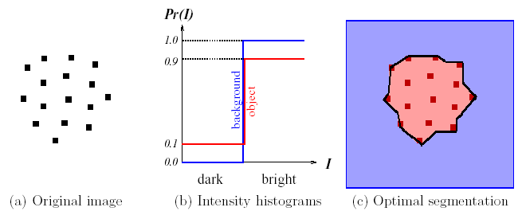
Graph cut (region + boundary)

Slide 56
Graph cut as energy optimization for S
[Boykov and Jolly 2001]
t
n-links
a cut
t-link
S
t-link
segmentation ⇔ cut
s
E(S)
cost(cut) = +
cost of severed t-links
cost of severed n-links
unary terms
pair-wise terms
regional properties of S
boundary smoothness for S

Slide 57
Unary potentials as linear term wrt.
unary terms
=
Linear region term analogous to
geodesic active contours

Slide 58
Unary potentials as linear term wrt.
unary terms
(linear)
Examples of potential functions f
  Log-likelihoods
  Chan-Vese
  Volume Ballooning
  Attention

Slide 59
In general,…
k-arity potentials are k-th order polynomial
pair-wise terms
quadratic polynomial wrt.
Quadratic term analogous to boundary length in
geodesic active contours

Slide 60

Basic (quadratic) boundary regularization
second-order terms
(quadratic)
Examples of discontinuity penalties w
  Euclidean
  boundary length
  [Boykov&Kolmogorov, 2003], via integral geometry
  contrast-weighted
  boundary length
  [Boykov&Jolly, 2001]

Slide 61
Basic second-order segmentation energy
includes linear and quadratic terms

Slide 62
Basic second-order segmentation energy
includes linear and quadratic terms
MAIN ADVANTAGE: guaranteed global optimum
(t.e. best segmentation w.r.t. objective)
(discrete case) via graph cuts
[Boykov&Jolly’01; Boykov&Kolmogorov’03]
public code [BK’2004], fast on CPU
(continuous case) via convex TV formulations
[Chen,Esidoglu,Nikolova’06; Chambolle,Pock,Cremers’08]
public code [C. Nieuwenhuis’2014], comparably fast on GPU
NOTE: this formulation is different from basic level-sets [Osher&Sethian’89]

Slide 63

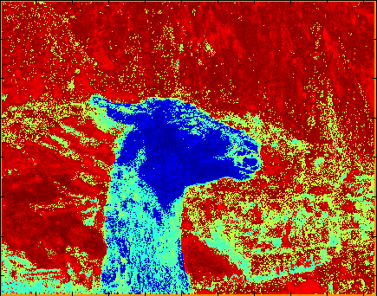

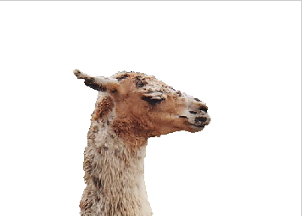
Optimization vs Thresholding
S
thresholding
e.g. graph cut [BJ, 2001]

Slide 64
Other examples of useful globally optimizable segmentation objectives
Flux [Boykov&Kolmogorov 2005]
Color consistency [“One Cut”, Tang et al. 2014]
Distance ||S-S₀|| from template shape
  Hamming, L₂,… [e.g. Boykov,Cremers,Kolmogorov, 2006]
Star-shape prior [Veksler 2008]
NOT ALLOWED

Slide 65
Many more example of useful hard-to-optimize segmentation objectives
Typical Problems:
Typical Solutions:
Continuous case
  Non-convexity
Discrete case
  Non-submodularity (more later)
  High-order
  Density (too many terms)
gradient descent
(linearization)
+ level sets
to be discussed

Slide 66
Examples of useful higher-order energies
Cardinality potentials (constraints on segment size)
can not be represented as a sum of simpler (unary or quadratic) terms
high-order
potential

Slide 67
Examples of useful higher-order energies
Cardinality potentials (constraints on segment size)
can be represented as a sum of
unary and quadratic terms
NOTE: 2nd-order
potential
still difficult to optimize
(completely connected graph)

Slide 68
Examples of useful higher-order energies
Cardinality potentials (constraints on segment size)
can not be represented as a sum of simpler (unary or quadratic) terms
high-order
potential

Slide 69
Examples of useful higher-order energies
Cardinality potentials (constraints on segment size)
Curvature of the boundary
Shape convexity
Segment connectivity
Appearance entropy, color consistency
Distribution consistency
High-order shape moments
…

Slide 70
Summary
Covered basics of:
Not-Covered:
Thresholding, region growing
Snakes, active contours
Geodesic contours
Graph cuts (binary labeling, MRF)
Ratio functionals
Normalized cuts
Watersheds
Random walker
Many others…
Implicit surface representation
Global optimization is possible
To be covered later:
High-order models

