Slide 1

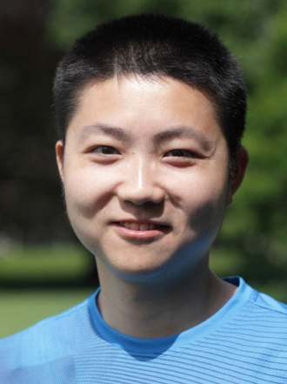

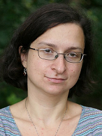

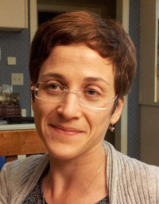


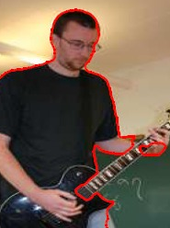

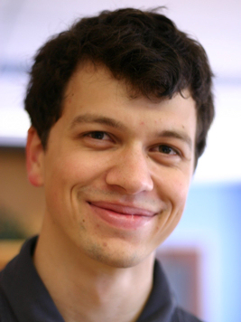
Higher-order and/or non-submodular optimization:
Tutorial on Medical Image Segmentation: Beyond Level-Sets
MICCAI, 2014
Western University
Canada
Yuri Boykov jointly with
Andrew
Delong
M. Tang
I. Ben Ayed
O. Veksler
H. Isack
L. Gorelick
C. Nieuwenhuis
E. Toppe
C. Olsson
A. Osokin
A. Delong

Slide 2
Basic segmentation energy E(S)
segment appearance
(linear / unary)
boundary smoothness
(quadratic / pairwise)
a cut
t
n-links
- such second-order functions
  can be minimized exactly via graph cuts
    [Greig et al.’91, Sullivan’94, Boykov-Jolly’01]
t-link
t-link
s

Slide 3
Basic segmentation energy E(S)
segment appearance
(linear / unary)
boundary smoothness
(quadratic / pairwise)
a cut
t
n-links
- submodular second-order functions
  can be minimized exactly via graph cuts
    [Greig et al.’91, Sullivan’94, Boykov-Jolly’01]
t-link
t-link
s
[Hammer 1968, Pickard&Ratliff 1973]

Slide 4
Submodular set functions
any (binary) segmentation functional E(S)
is a set function E:
Ω
S

Slide 5
Submodular set functions
Edmonds 1970 (for arbitrary lattices)
Set function is submodular if for any
Ω
S
T
Significance: any submodular set function can be
globally optimized in polynomial time
[Grotschel et al.1981,88, Schrijver 2000]

Slide 6
Submodular set functions
equivalent intuitive interpretation via “diminishing returns”
Set function is submodular if for any
Ω
S
T
v
Easily follows from the previous definition:
Significance: any submodular set function can be
globally optimized in polynomial time
[Grotschel et al.1981,88, Schrijver 2000]

Slide 7
Submodular set functions
Assume set Ω and 2nd-order (quadratic) function
Indicator variables
Function E(S) is submodular if for any
Significance: submodular 2nd-order boolean (set) function
can be globally optimized in polynomial time by graph cuts
[Hammer 1968, Pickard&Ratliff 1973]
[Boros&Hammer 2000, Kolmogorov&Zabih2003]

Slide 8
Global Optimization
?
submodularity
convexity
Combinatorial
optimization
Continuous
optimization

Slide 9
Global Optimization
?
submodularity
convexity
f (x,y) = α∙xy
EXAMPLE:
for α < 0
A
C
x
A
C
x
B
1
B
1
0
0
1
1
y
D
y
D
submodular binary energy
convex continuous extension
f (0,0) + f (1,1) ≤ f (0,1) + f (1,0)

Slide 10
Global Optimization
submodularity
convexity
f (x,y) = α∙xy
EXAMPLE:
for α < 0
A
C
x
A
C
x
B
1
B
1
0
0
1
1
y
D
y
D
submodular binary energy
concave continuous extension
f (0,0) + f (1,1) ≤ f (0,1) + f (1,0)

Slide 11
posterior optimization
(in Markov Random Fields)
Assume Gibbs distribution over binary random variables
for
Theorem [Boykov, Delong, Kolmogorov, Veksler in unpublished book 2014?]
All random variables s_{p} are positively correlated iff set function E(S) is submodular
That is,… submodularity implies MRF with “smoothness” prior

Slide 12
second-order submodular energy
segment region/appearance
boundary smoothness
w_{pq}< 0 would imply
non-submodularity

Slide 13
Now - more difficult energies
Non-submodular energies
High-order energies

Slide 14




Beyond submodularity: even second-order is challenging
Example: deconvolution
image I blurred with mean kernel
QPBO
TRWS
non-submodular
quadratic term
submodular
quadratic term
“partial enumeration”

Slide 15
Beyond submodularity: even second-order is challenging
Example: quadratic volumetric prior
e.g.
NOTE: any convex cardinality potentials are supermodular [Lovasz’83]
(not submodular)

Slide 16
Many useful higher-order energies
Cardinality potentials
Curvature of the boundary
Shape convexity
Segment connectivity
Appearance entropy, color consistency
Distribution consistency
High-order shape moments
…

Slide 17
Non-submodular and/or
high-order functions E(S)
Optimization is a very active area of research…
QPBO [survey Kolmogorov&Rother, 2007]
LP relaxations [e.g. Schlezinger, Komodakis, Kolmogorov, Savchinsky,…]
Message passing, e.g. TRWS [Kolmogorov]
Partial Enumeration [Olsson&Boykov, 2013]
Trust Region [e.g. Gorelick et al., 2013]
Bound Optimization [Bilmes et al.’2006, Ben Ayed et al.’2013, Tang et al.’2014]
Submodularization [e.g. Gorelick et al., 2014]

Slide 18
Our recent methods: local submodular approximations (submodularization)
Prior approximation techniques
based on linearization
gradient descent + level sets (in continuous case)
LP relaxations (QPBO, TRWS, etc)
local linear approximations (parallel ICM)
Fast Trust Region [CVPR 13]
Auxiliary Cuts [CVPR 13]
LSA [CVPR 14]
Pseudo-bounds [ECCV 14]
, [Bilmes et al.2009]

Slide 19
Trust Region
Approximation
Linear approx.
at S₀
non-submodular term
submodular terms
|S|
0
S₀
appearance log-likelihoods
boundary length
volume constraint
trust
region
S₀
L₂ distance to S₀
submodular
approx.

Slide 20
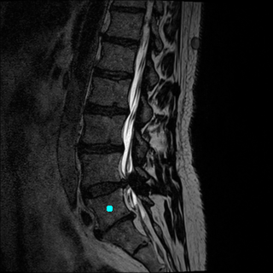
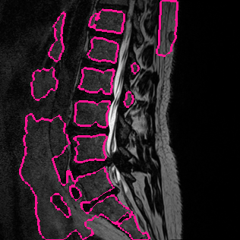
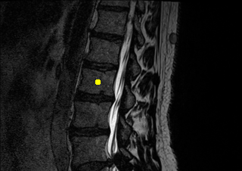
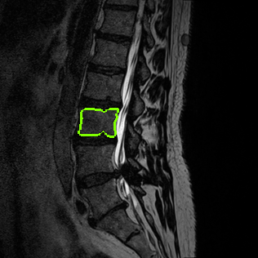
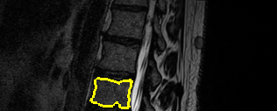
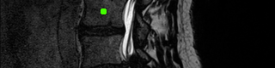
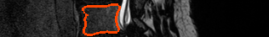
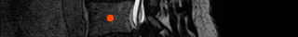
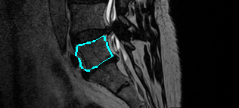
Volume Constraint for Vertebrae segmentation
Log-Lik. + length

Slide 21
Fast iterative
techniques
Gradient descent
and Level sets
Trust region Vs. bound optimization
Vs.
Sub-problem solutions
Vs.
Convex
continuous
formulation
Graph Cuts
(submodular discrete formulation)
Notes:
Add another bound here

Slide 22


Trust Region vs. Gradient Descent
Gorelick et al.,
CVPR 2013
trust region
||S – S₀|| ≤ d
iso-surfaces of
approximation
iso-surfaces of
∂ E
∂ S
-
gradient
Notes:
Some high-level conceptual differences between the level sets and trust region optimization frameworks are summarized in this Figure. Standard level sets methods
Use fixed dt to make steps (-dt derivative) in the gradient descent direction. Trust region algorithms moves to solution S* minimizing an approximating functional within a ball of given size d. The size of the trust region is adjusted in each iteration based on the quality of the current approximation. The blue line illustrates the spectrum of trust region moves for all
values of d. Solution S_tilde is the global minimum of approximation E_tilde. For example, if we choose E_tilde to be is a 2nd-order Taylor approximation of E(S) at point S0 Then S_tilde would correspond to a Newton's step.

Slide 23
Trust Region vs. Gradient Descent
e.g., Gorelick et al.,
CVPR 2013
trust region
||S – S₀|| ≤ d
iso-surfaces of
approximation
∂ E
∂ S
Can be solved globally with graph cuts
or convex relaxation
iso-surfaces of
-
gradient
Notes:
The size of the trust region is adjusted in each iteration based on the quality of the current approximation.

Slide 24
Bound Optimization
e.g., Ben Ayed et al.,
CVPR 2013
(Majorize-Minimize, Auxiliary Function, Surrogate Function)
A_{t}(S)
E(S)
E(S_{t})
E(S_{t+1})
solution space
S_{t}
S_{t+1}
S

Slide 25
Bound Optimization
e.g., Ben Ayed et al.,
CVPR 2013
(Majorize-Minimize, Auxiliary Function, Surrogate Function)
A_{t+1}(S)
E(S)
E(S_{t})
E(S_{t+1})
E(S_{t+2})
solution space
S_{t}
S_{t+1}
S_{t+2}
S
local minimum

Slide 26
Bound Optimization
e.g., Ben Ayed et al.,
CVPR 2013
(Majorize-Minimize, Auxiliary Function, Surrogate Function)
A_{t+1}(S)
Can be solved
globally with
graph cuts
or
Convex relaxation
E(S)
E(S_{t})
E(S_{t+1})
E(S_{t+2})
solution space
S_{t}
S_{t+1}
S_{t+2}
S

Slide 27
Pseudo-Bound Optimization
Tang et al.,
ECCV 2014
(Majorize-Minimize, Auxiliary Function, Surrogate Function)
(a)
E(S)
(b)
E(S_{t})
(c)
E(S_{t+1})
Make larger move!
solution space
S_{t}
S
S_{t+1}

Slide 28
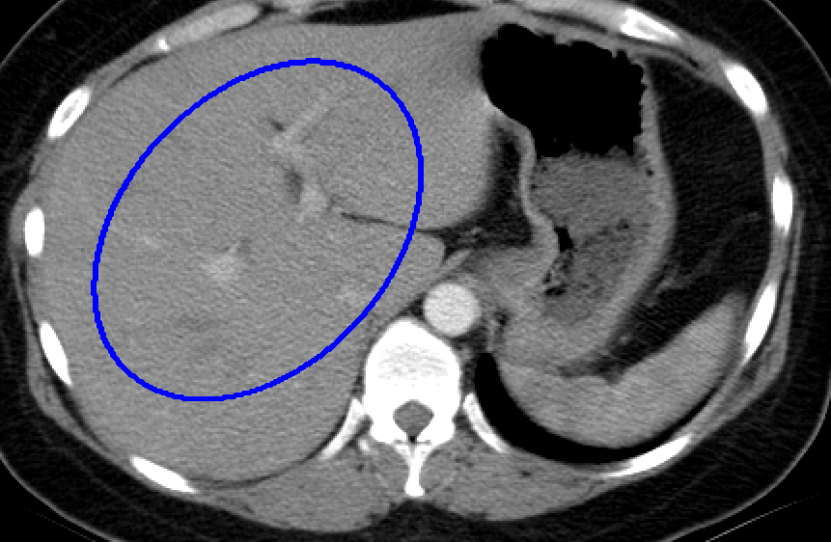
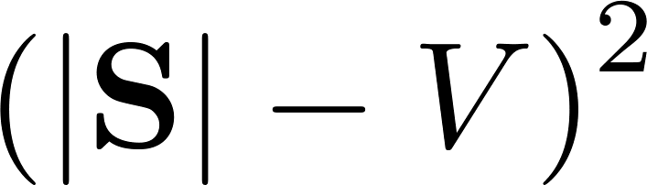
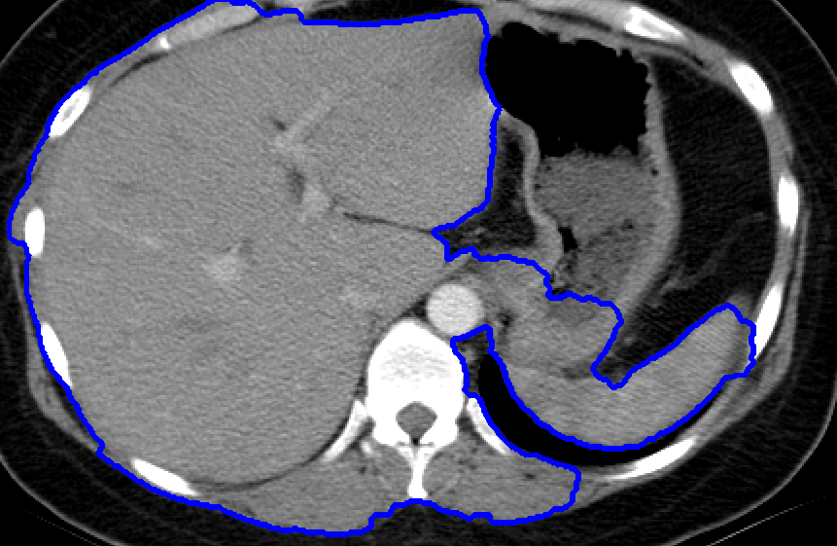
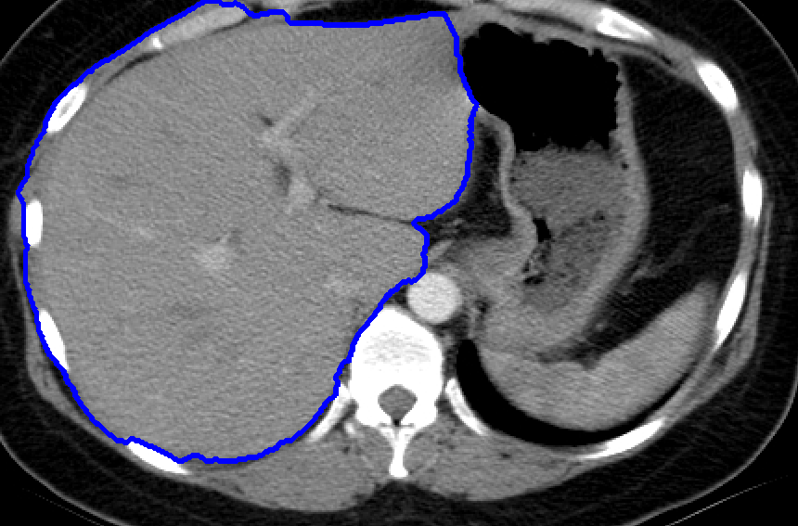




An example illustrating the difference
between the three frameworks
Gradient Descent
Initialization
Log-likelihood
Adding volume
Notes:
Switch the order of high-order and first-order – mention it is an active research area in the vision community – very useful – optimization

Slide 29


An example illustrating the difference
between the three frameworks
Trust Region
Initialization
Log-likelihood
Adding volume
Notes:
Switch the order of high-order and first-order – mention it is an active research area in the vision community – very useful – optimization

Slide 30


An example illustrating the difference
between the three frameworks
Bound
Optimization
Initialization
Log-likelihood
Adding volume
Notes:
Switch the order of high-order and first-order – mention it is an active research area in the vision community – very useful – optimization

Slide 31
An example illustrating the difference
between the three frameworks
Pseudo-Bound
Optimization
Initialization
Log-likelihood
Adding volume
Notes:
Switch the order of high-order and first-order – mention it is an active research area in the vision community – very useful – optimization

Slide 32
Summary of main differences/similarities
Framework | Properties | Applicability
Gradient Descent (e.g. level-sets) | - Fixed small moves - Linear approximation | Any differentiable functional
Trust region | - Adaptive large moves - Submodular or convex approximation | Any differentiable functional
Bound optimization | - Unlimited large moves - Submodular or convex bounds | Need a bound (not always easy)
Notes:
Switch the order of high-order and first-order – mention it is an active research area in the vision community – very useful – optimization

Slide 33

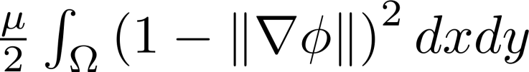
Trust Region Vs. Level sets:
Experimental comparisons
Level set evolution without re initialization
C. Li et al.,
CVPR 2005
No ad hoc initialization procedures
Keep a distance function by adding:
Allows relatively large values of dt
Frequently used by the community (>1500 citations)
Notes:
Switch the order of high-order and first-order – mention it is an active research area in the vision community – very useful – optimization

Slide 34
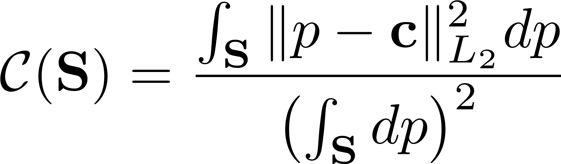



Trust region Vs. Level sets: Example 1
Compactness (Circularity) prior
Ben Ayed et al.,
MICCAI 14
Low
Min for a circle
High

Slide 35
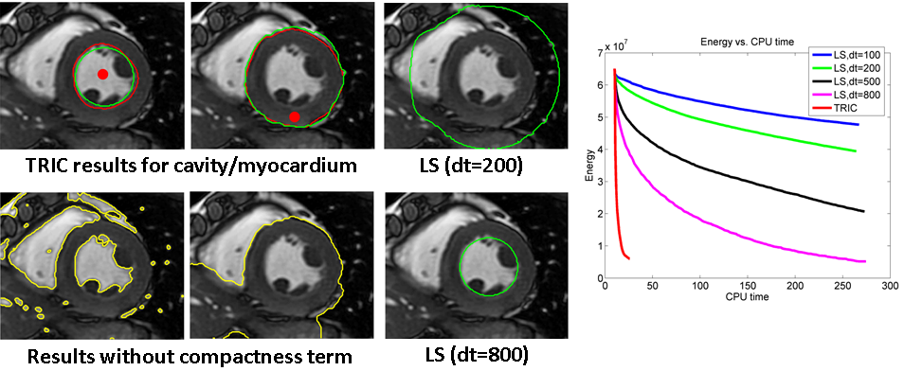
Trust region Vs. Level sets: Example 1
Compactness (Circularity prior)
Trust region
Without
compactness

Slide 36
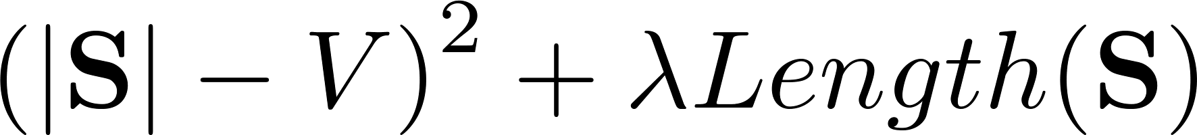
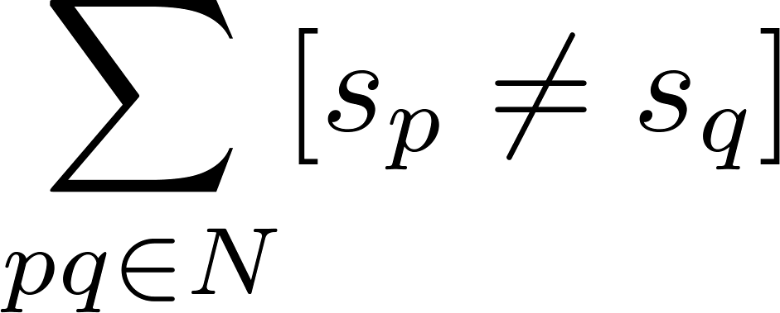
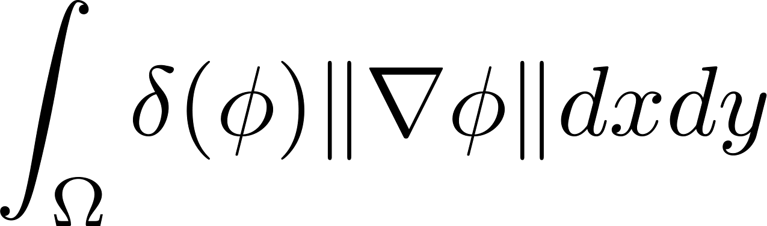
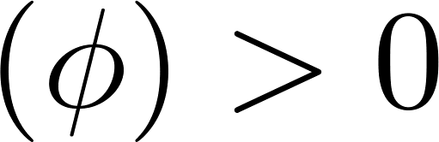
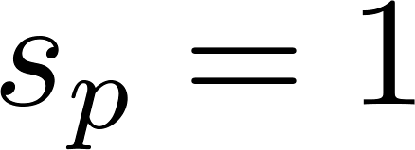
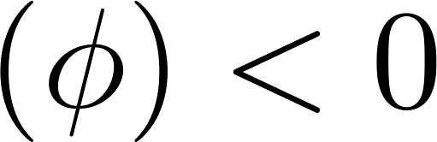
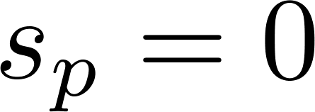
Trust region Vs. Level sets: Example 2
Volume constraint + Length
Discrete
Continuous

Slide 37
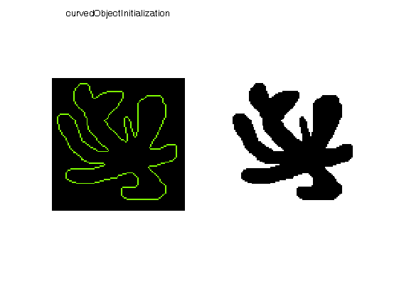
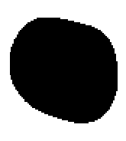
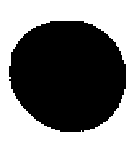
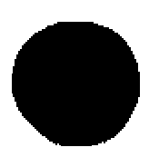
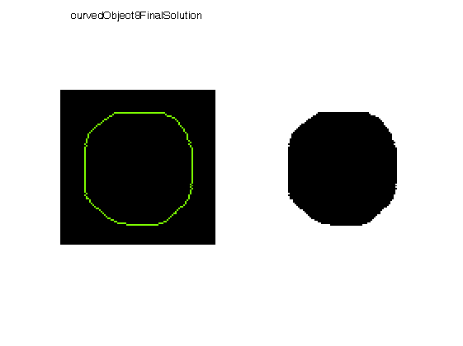
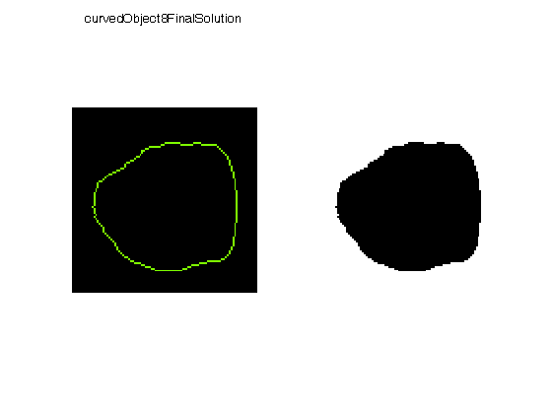
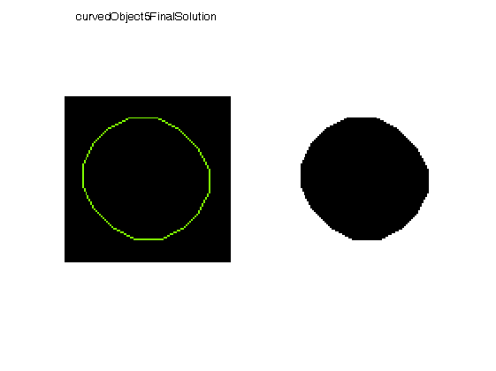

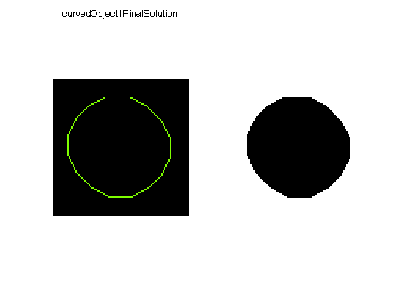
Trust Region Vs. Level Sets: Example 2
Volume Constraint + Length
Init
LS, t=1
LS, t=5
LS, t=10
LS, t=50
LS, t=1000
FTR, α=2
FTR, α=5
FTR, α=10

Slide 38
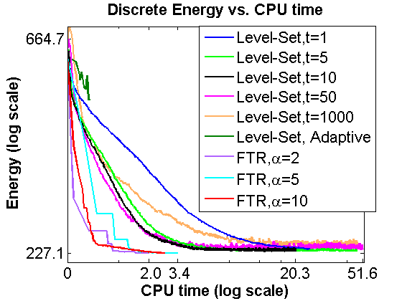
Trust Region Vs. Level Sets: Example 2
Volume Constraint + Length

Slide 39
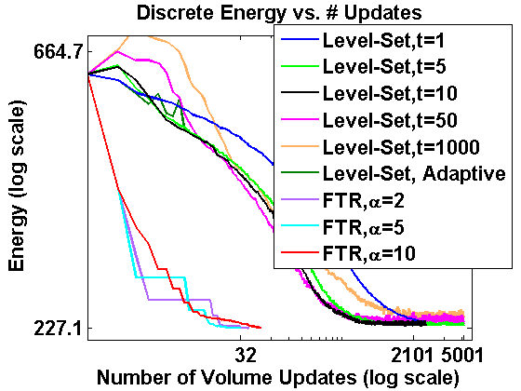
Trust Region Vs. Level Sets: Example 2
Volume Constraint + Length

Slide 40
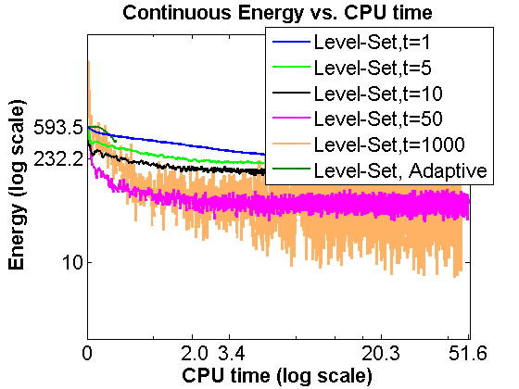
Trust Region Vs. Level Sets: Example 2
Volume Constraint + Length

Slide 41
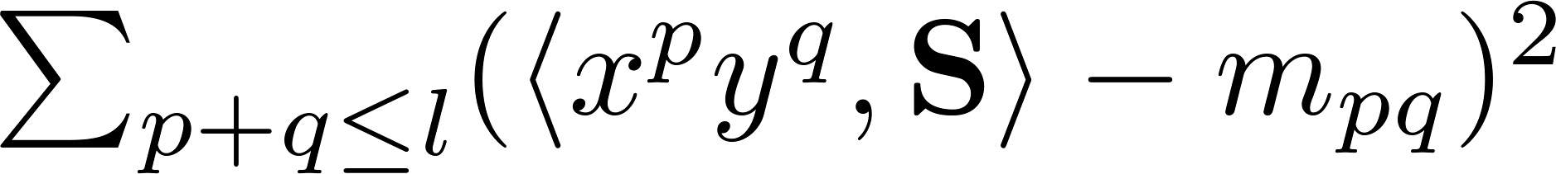
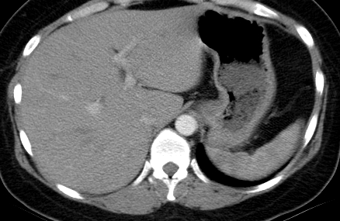
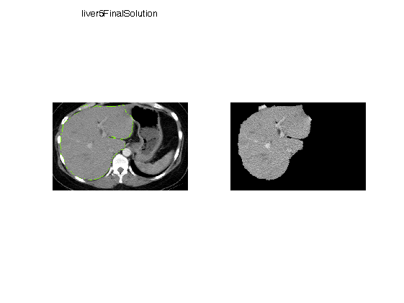
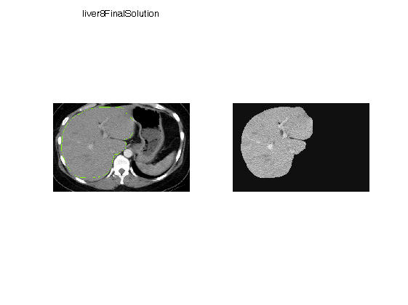

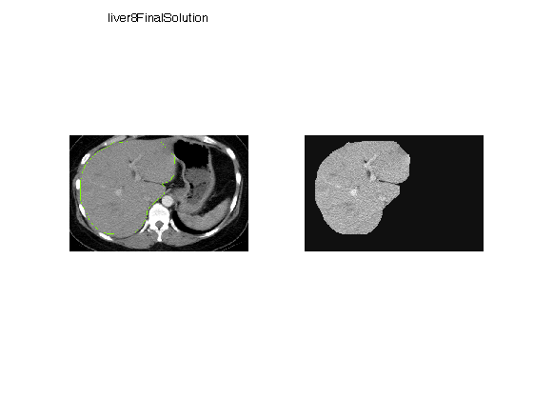
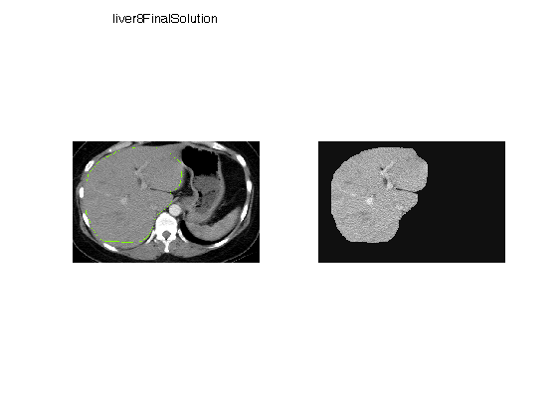

Trust Region Vs. Level Sets: Example 3
Shape moment Constraint + Length
Up to order-2
moments learned
from user-provided
ellipse
Init
FTR, α=2
FTR, α=5
FTR, α=10
Level-Set, t=1
Level-Set, t=5
Level-Set, t=10
Level-Set, t=50
Level-Set, t=1000

Slide 42
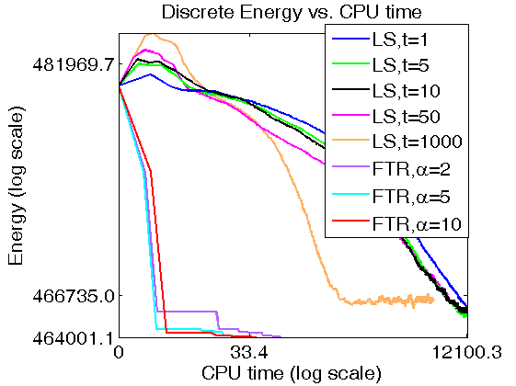
Trust Region Vs. Level Sets: Example 3
Shape moment Constraint + Length
Level-Set, t=1
Level-Set, t=5
Level-Set, t=10
Level-Set, t=50
Level-Set, t=1000

Slide 43
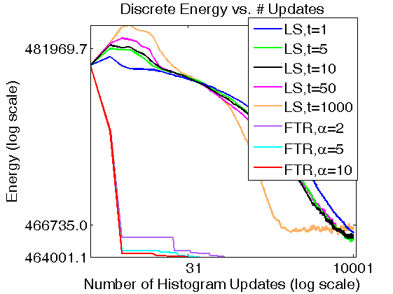
Trust Region Vs. Level Sets: Example 3
Shape moment Constraint + Length
Level-Set, t=1
Level-Set, t=5
Level-Set, t=10
Level-Set, t=50
Level-Set, t=1000

Slide 44
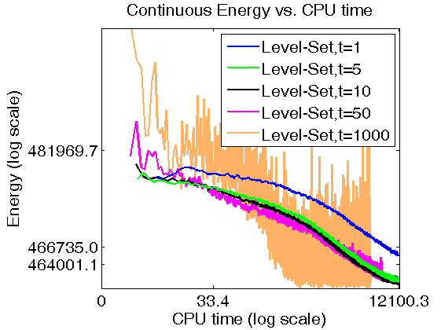
Trust Region Vs. Level Sets: Example 3
Shape moment Constraint + Length
Level-Set, t=1
Level-Set, t=1000

Slide 45


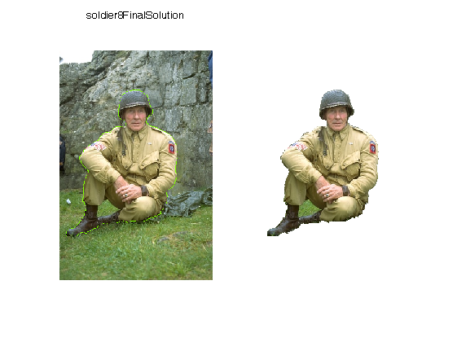
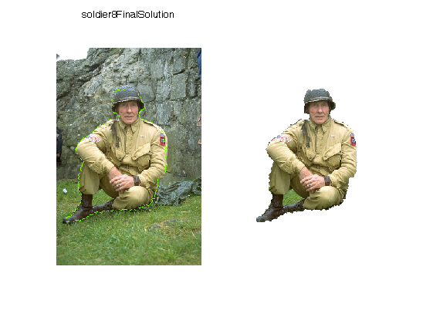

Bound Optimization Vs. Level Sets
L2 bin count Constraint
Init
Surrogate
Level-Set, dt=1
Level-Set, dt=50
Level-Set, dt=1000
Notes:
Fix the dt here

Slide 46

Bound Optimization Vs. Level Sets
L2 bin count Constraint
Notes:
Fix the dt here

Slide 47

Bound Optimization Vs. Level Sets
L2 bin count Constraint
Notes:
Fix the dt here

Slide 48

Entropy-based segmentation
Interactive segmentation with box
non-submodular term
submodular terms
volume
balancing
color consistency
boundary smoothness
+
+
|S|
|S_{i}|
0
|Ω|/2
|Ω|
0
|Ω_{i}|/2
|Ω_{i}|

Slide 49

Pseudo-Bound optimization [ECCV 2014]
Entropy-based segmentation
GrabCut
(block-coordinate descent)
Dual Decomposition
576 sec
1.8 sec
One-Cut [ICCV 2013]
1.3 sec
11.9 sec

Slide 50
Curvature optimization
instead of boundary length
(pairwise submodular term)
(3-rd order non-submodular potential, see next slide)

Slide 51
Nieuwenhuis et al., CVPR 2014
general intuition example
3-cliques
with configurations
(0,1,0) and (1,0,1)
S
p-Δ
p
p+Δ
S
more responses where curvature is higher

Slide 52
Need to penalize
3-clique configurations
(010) and (101)
Nieuwenhuis et al., CVPR 2014
uses submodular approximation
and Trust Region [CVPR13, CVPR14]

Slide 53


Segmentation
Examples
length-based regularization

Slide 54

Segmentation
Examples
elastica [Heber,Ranftl,Pock, 2012]

Slide 55

Segmentation
Examples
90-degree curvature [El-Zehiry&Grady, 2010]

Slide 56

Segmentation
Examples
our squared curvature

Slide 57
Take-home messages
submodular or convex approximations are a good alternative to linearization methods (Level-Sets, QPBO, TRWS, etc.,)
(Trust Region, Auxiliary Functions, Pseudo-bounds, etc.)
[CVPR 2013, CVPR 2014, ECCV 2014]
- code available

